Slide 1
Report on Ongoing Actions for MQXFB
New test and measurement techniques
S. Russenschuck, F. Mangiarotti, G. Willering with the contribution of (at least) 32 staff from TM, MSC, TE

Slide 2
Overview
MQXFS/P test history and lessons learnt (limitation versus degradation versus defect, homogenous or local)
Software for QA, safety, database, and reporting (Carpenter)
New quench antenna systems to enable longitudinal and transveral quench localization in coils without local voltage taps
Upgraded trim powering for the assessment of coil performance with a short lead time
V-I measurements (pole turn versus full coil)
Safety issues have been addressed (but not here). Presentation TE-TM 2.05.2022

Slide 3
MQXF test history
2020 |  |  |  |  |  |  |  |  |  |  |  | 2021
J | F | M | A | M | J | J | A | S | O | N | D | J | F | M | A | M | J | J | A | S | O | N | D
 |  | COVID shutdown | COVID shutdown | A1 bench commissioning | MQXFBP1 preparation | MQXFBP1 CD 1 | MQXFBP1 CD 2 |  |  |  | End of year shutdown | MQXFBP2 preparation | MQXFBP2 CD 1 (electrical NC) | MQXFBP2 CD 2 | MQXFBP2 CD 2 | MQXFBP2 CD 2 | Flood shutdown | Flood shutdown | MQXFS7b trim powering | MQXFS7b trim powering | MQXFBP2 CD 3 (+ trim powering) | MQXFBP2 CD 3 (+ trim powering) | End of year shutdown
Timeline of activities
for MQXFBP1 and BP2
10 months of cold testing for the MQXFB(S&P) in 2020-2021

Slide 4
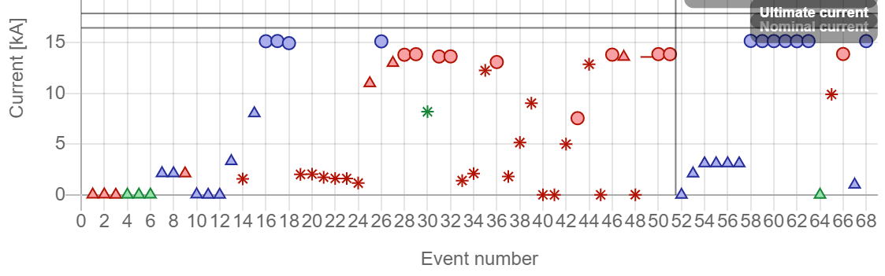
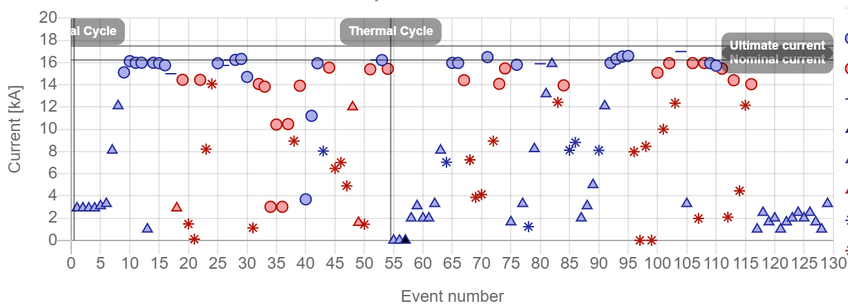
MQXFP Event history
No quench
Natural quench
Provoked quench
Trip
MQXFBP1
T = 1.9 K
1.9< T <4.5 K
T = 4.5 K
Almost 200 quenches in total
MQXFBP2

Slide 5
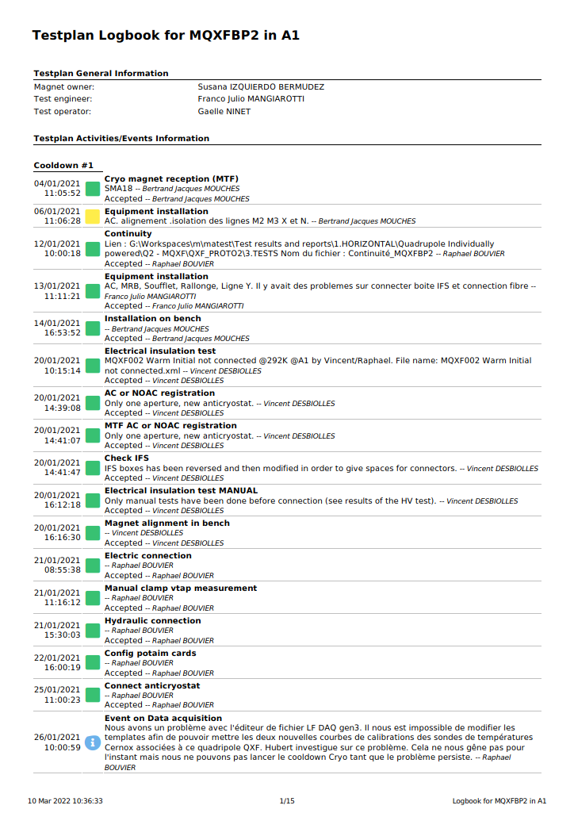
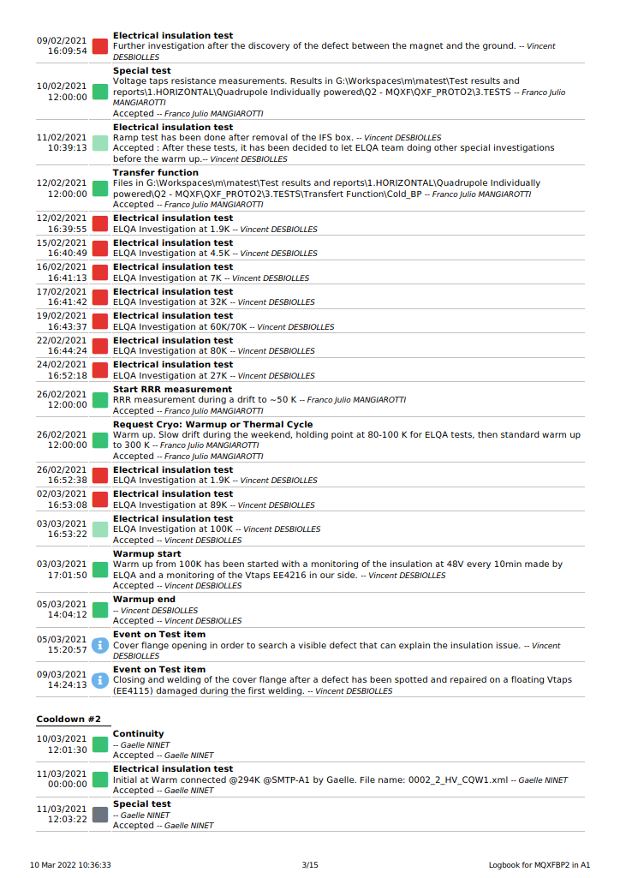
Carpenter as a QA and safety tool
All tests done are stored in the database, including status and comments
Test order imposed by the approved test procedure
Levels imposed by the test plan
Easy to follow up the test chronology
Sign off at the control points

Slide 6
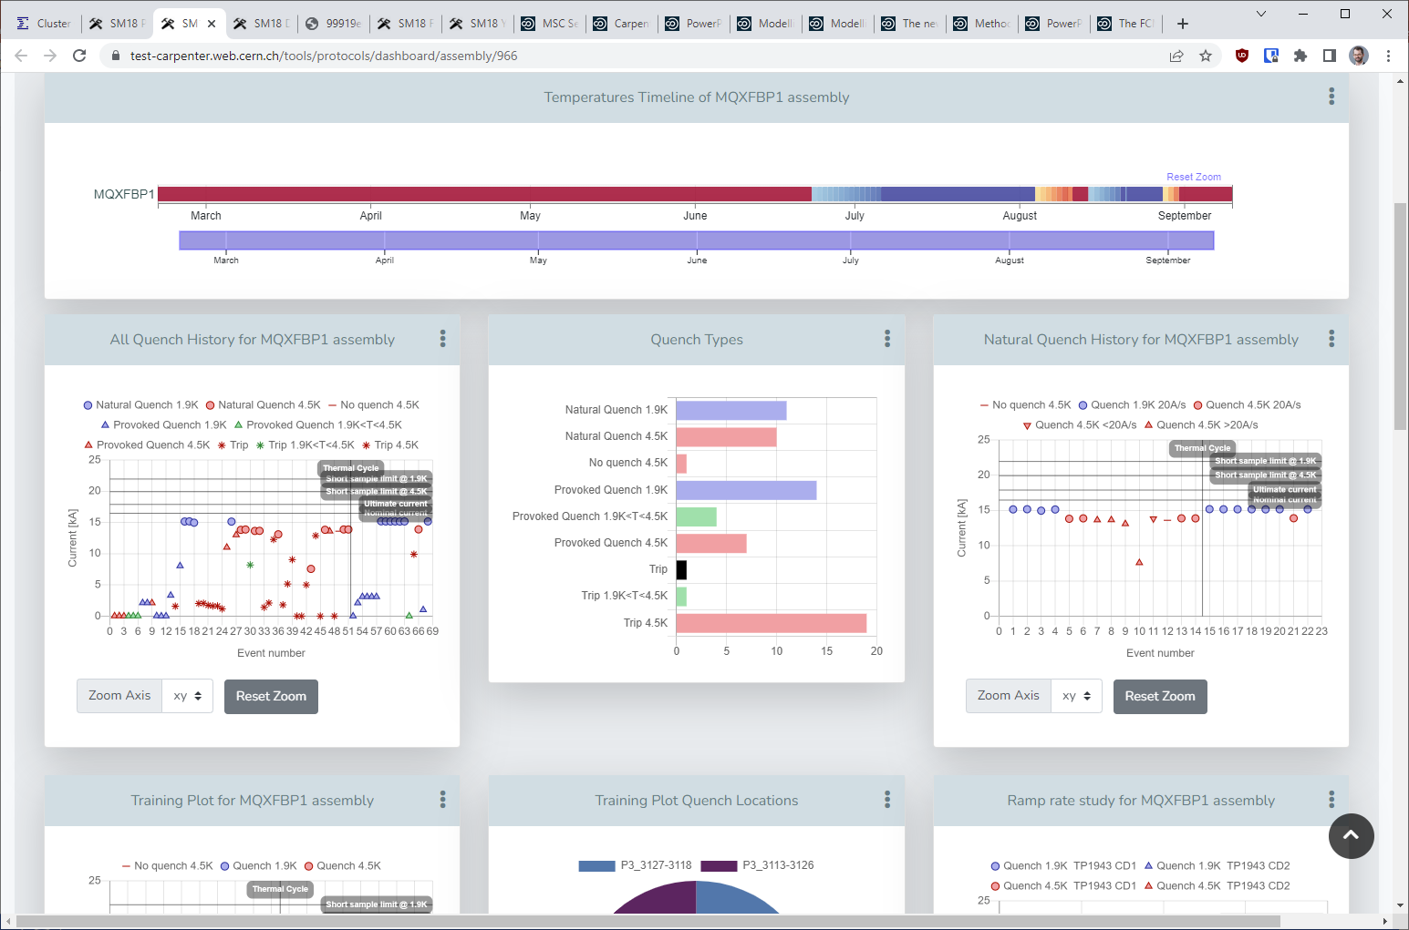
Carpenter for data visualization
Main test data uploaded to the database, which allows to automatically generate standard plots (Protocols)

Slide 7
Take home messages – MQXF testing overview
7 years experience with testing of MQXF magnets. Highest priority during all this time, short of the 11 T, which adds to the experience
At least 23 TM staff and FSU directly involved in the MQXF prototype tests; more for the short model campaign (bench and instrumentation preparation, calibration and commissioning, testing new procedures)
Synergies identified between former TF and MM section already before (grand) unification: quench antennas, DAQ, and instrumentation. And now, of course, the upgrade for WP3
10 months of MQXF cold testing in 2020-2021

Slide 8
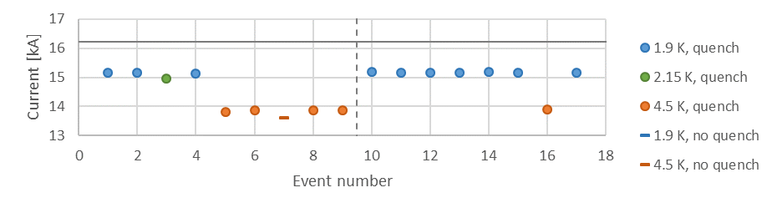
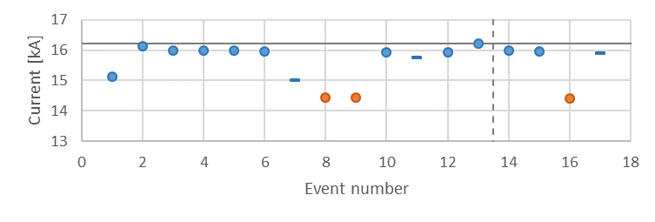
Quench performance limitation (MQXFB prototypes)
MQXFBP1
Nominal current
Thermal
cycle
MQXFBP2
Nominal current
Thermal
cycle
Thermal
cycle
The magnets reach a quench limit in the first or second quench: same current, voltage signature and quench antenna signals.

Slide 9
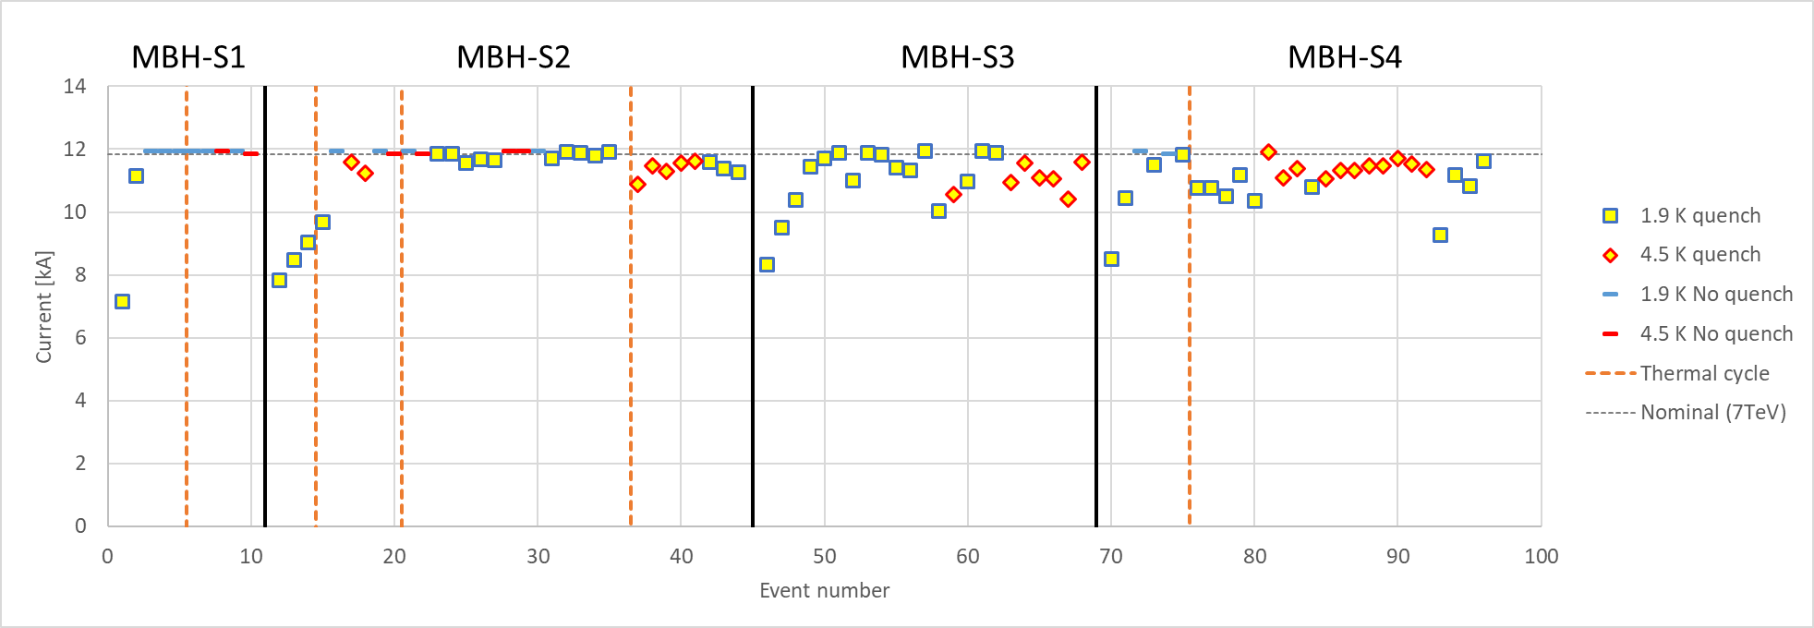
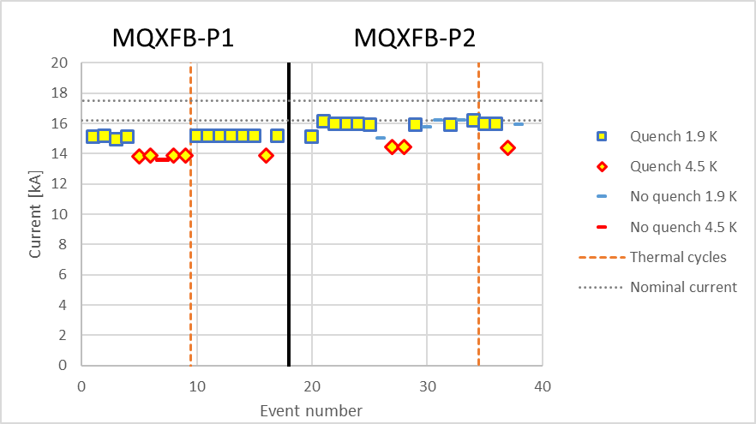
Quench performance limitations versus degradation (11 T series)
In these plots: tests at nominal ramp rate
The type of degradation in the 11 T (gets worse after each thermal cycle) is different from that of the MQXF (no further degradation so far)

Slide 10
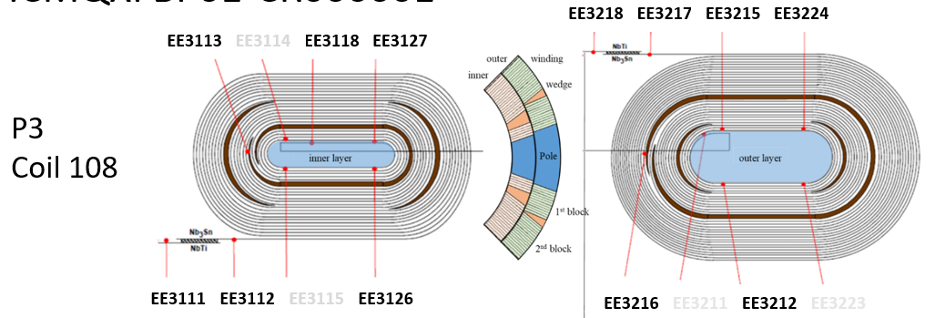
Quench location 1.A – Voltage signals
Quench starts between 3127-3118 (pole turn center)
After ~13 ms it propagates transversally to 3113-3126
Quench does not reach longitudinally neighboring segments (3126-3127 and 3118-3212)
QPV: ~15 m/s at 15 kA, 1.9 K
U₁
U₁
U₂
U₂
1.9 K, 20 A/s VI, 15.16 kA. File: a011, CD2.

Slide 11
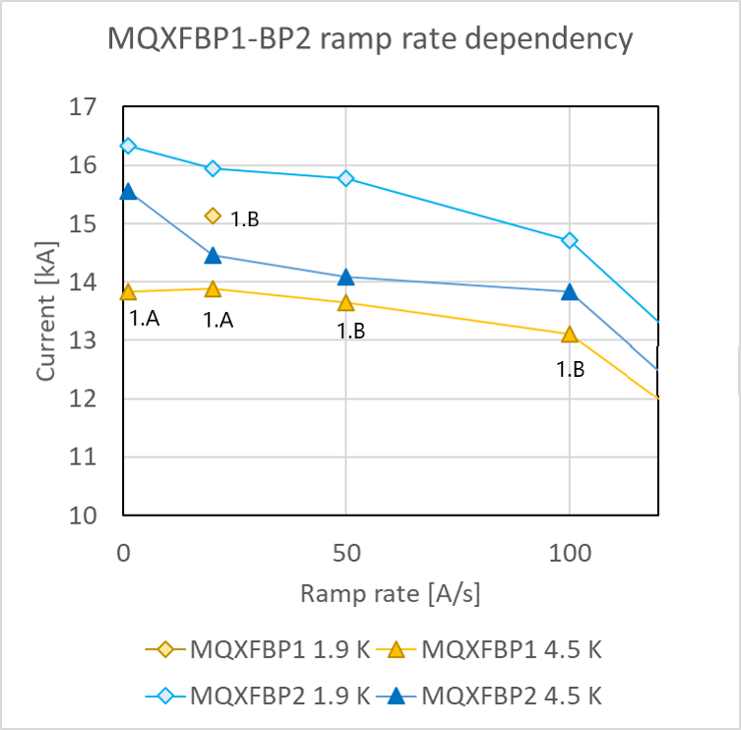
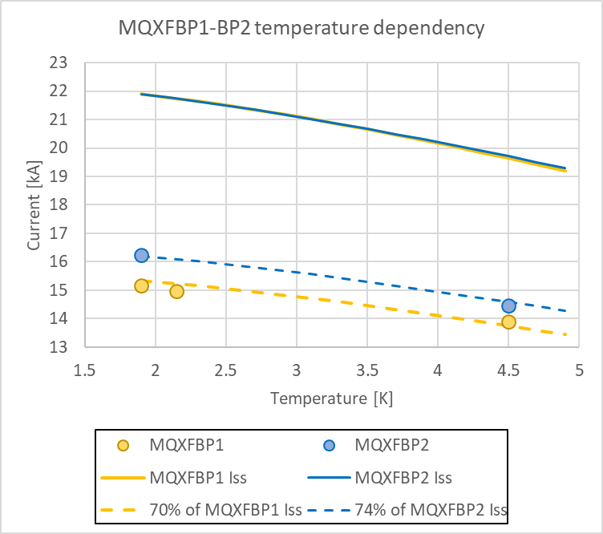
Ramp rate and temperature dependence
2.A
2.A
2.A
2.A
2.A
2.A
2.A
Normal temperature dependence in both magnets, -> not mechanically limited. Ramp rate dependence for BP1: insufficient data. For BP2, low RR at 4.5 K may hint at non-homogeneous defect. Ongoing R&D: Special test foreseen on a SMC with artificially degraded conductor

Slide 12
Take home message – performance characterization (ramp rates, quench propagation)
The magnets show almost no training; they reach a current limit at the first or second quench
The current limit did not change after one thermal cycle (as opposed to the 11 T where it got worse after successive thermal cycles (degradation versus limitation)
Temperature dependence is normal – conductor limitation, no mechanical limitation
Quench propagation velocity: similar to other (not limited) short models – indicates local conductor degradation
More information on these techniques here: https://indico.cern.ch/event/820811/

Slide 13
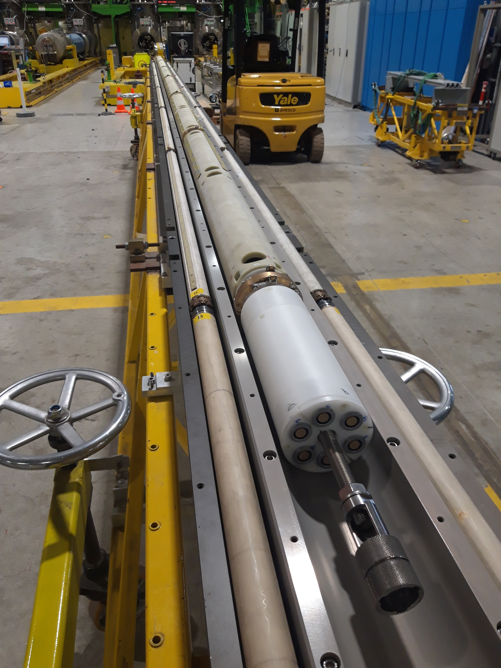
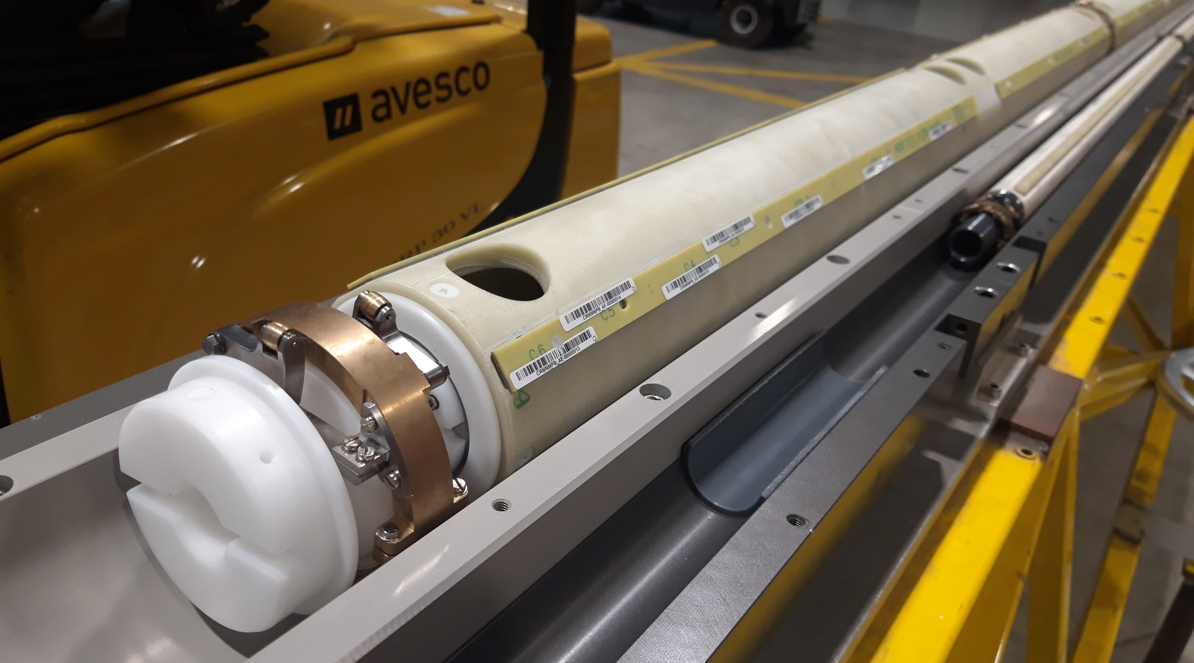
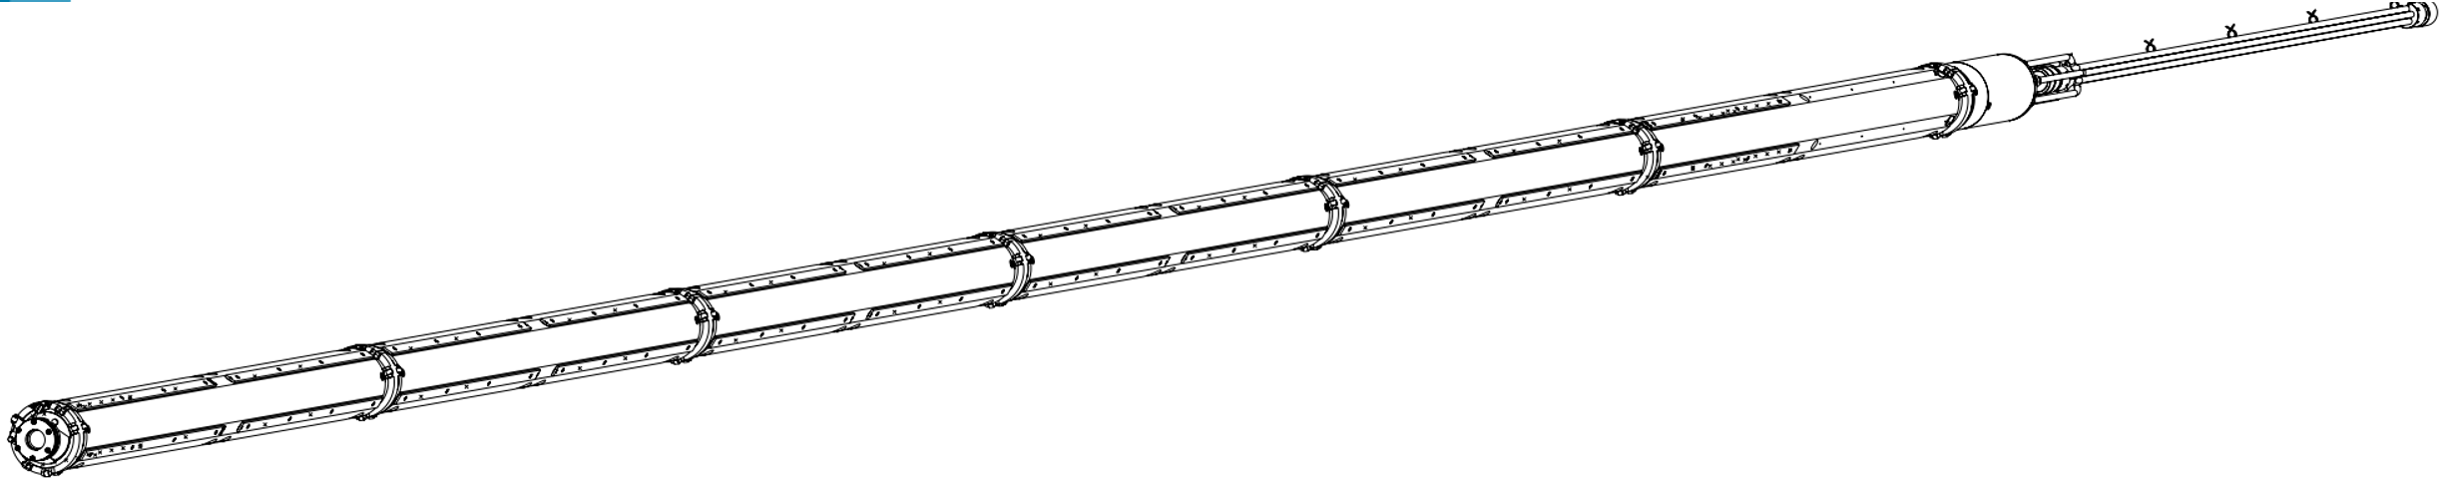
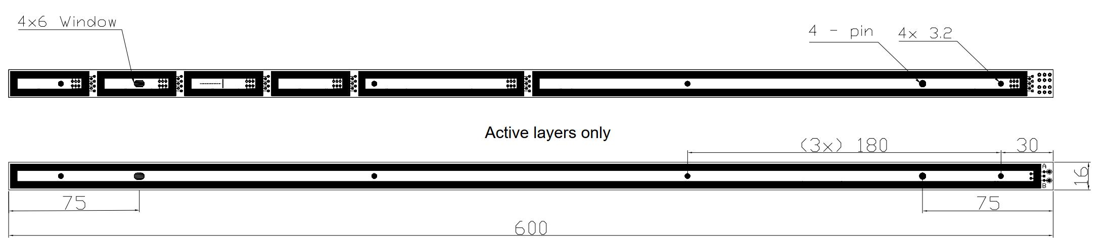
Quench Antenna (B2 sensitive)
6 support tubes of 1.27 meter
4 times 11 PCB’s of 0.6 meter

Slide 14

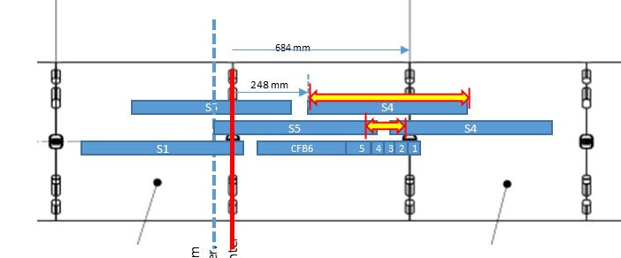
Quench location 1.B – QA signal
Six quenches with different QA position. In each, we observe where the quench starts.
Example top: starts in QA 5
Example bottom: starts in CF 4
After ~13 ms we see the transverse quench propagation
QA 5
QA 6
CF4
CF3

Slide 15
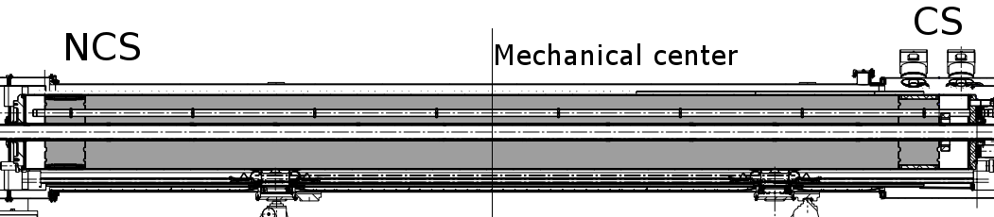
Quench localization
The recurring quench locations are in the inner layer, pole turn, straight segment, near the mechanical center. In MQXFBP1 in coil P3, in MQXFBP2 in coil P1.
Longitudinal localization within ±50 mm from quench antenna data.
MQXFBP1:
1.A
1.B
MQXFBP2:
2.A
2.B
2.C
CS
NCS
Mechanical center
Tomographic and metallographic inspections

Slide 16
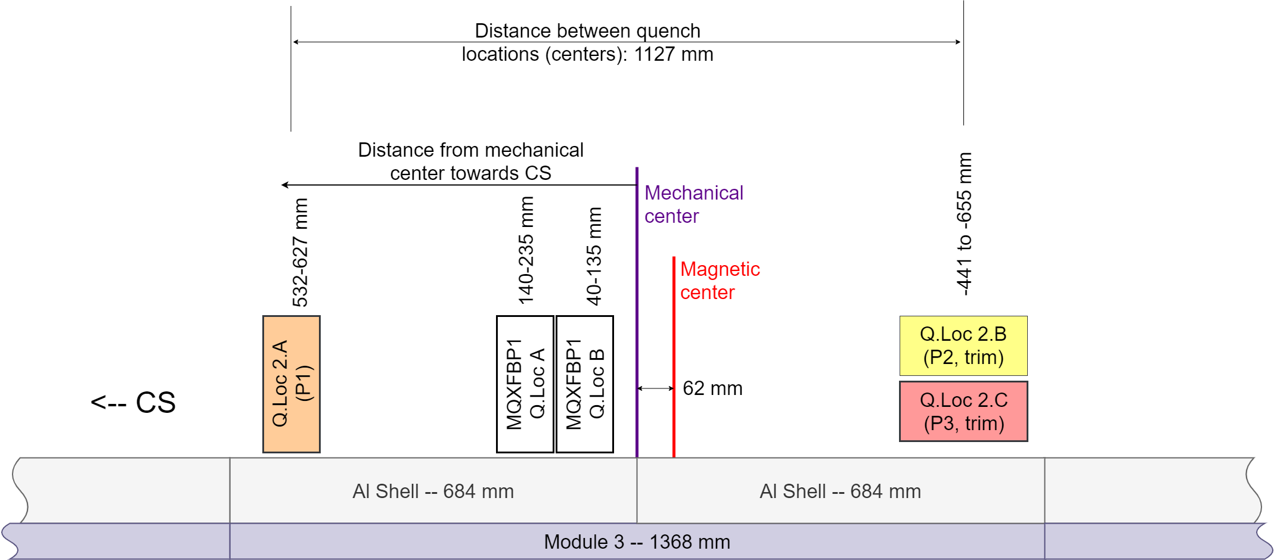
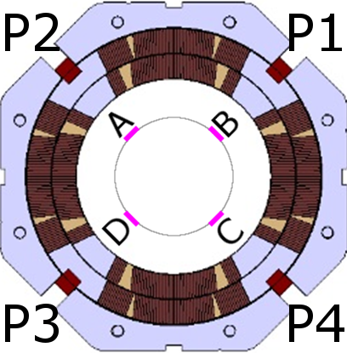
Quench localization
MQXFBP2:
2.A
2.B
2.C
MQXFBP1:
1.A
1.B
Layer jump side
Trim powering
Tomographic and metallographic inspections

Slide 17
Vibration analysis for Fresca2
Investigation of all vibrations picked up by the MM shaft used as a quench antenna).
Training effect: less vibrations after consecutive ramps.
Vibration analysis fully trained magnet
Highest activity seen by QA 5, consistent with quench locations in the magnet.
Signals for QA5
# vibrations per kA²
1
7
2
6
3
5
QA segment
4
4
5
3
6
2
7
1
This type of analysis was not needed in the MQXFBPx because they were not limited mechanically. However, we have this tool at our disposal if needed

Slide 18
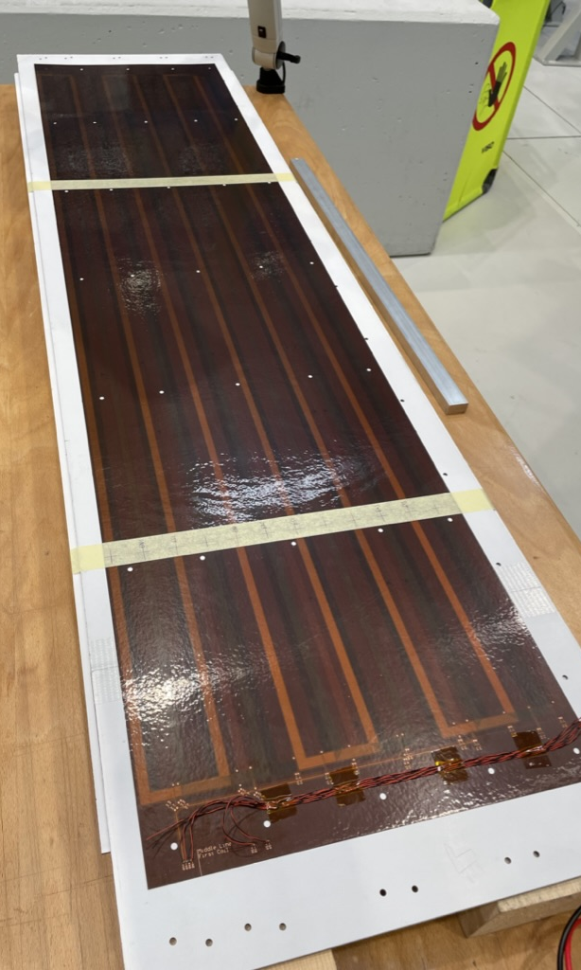
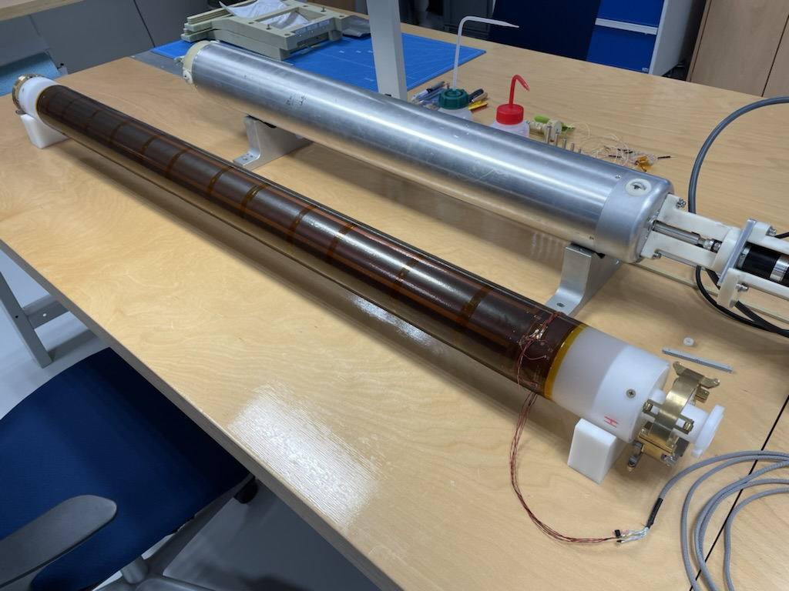
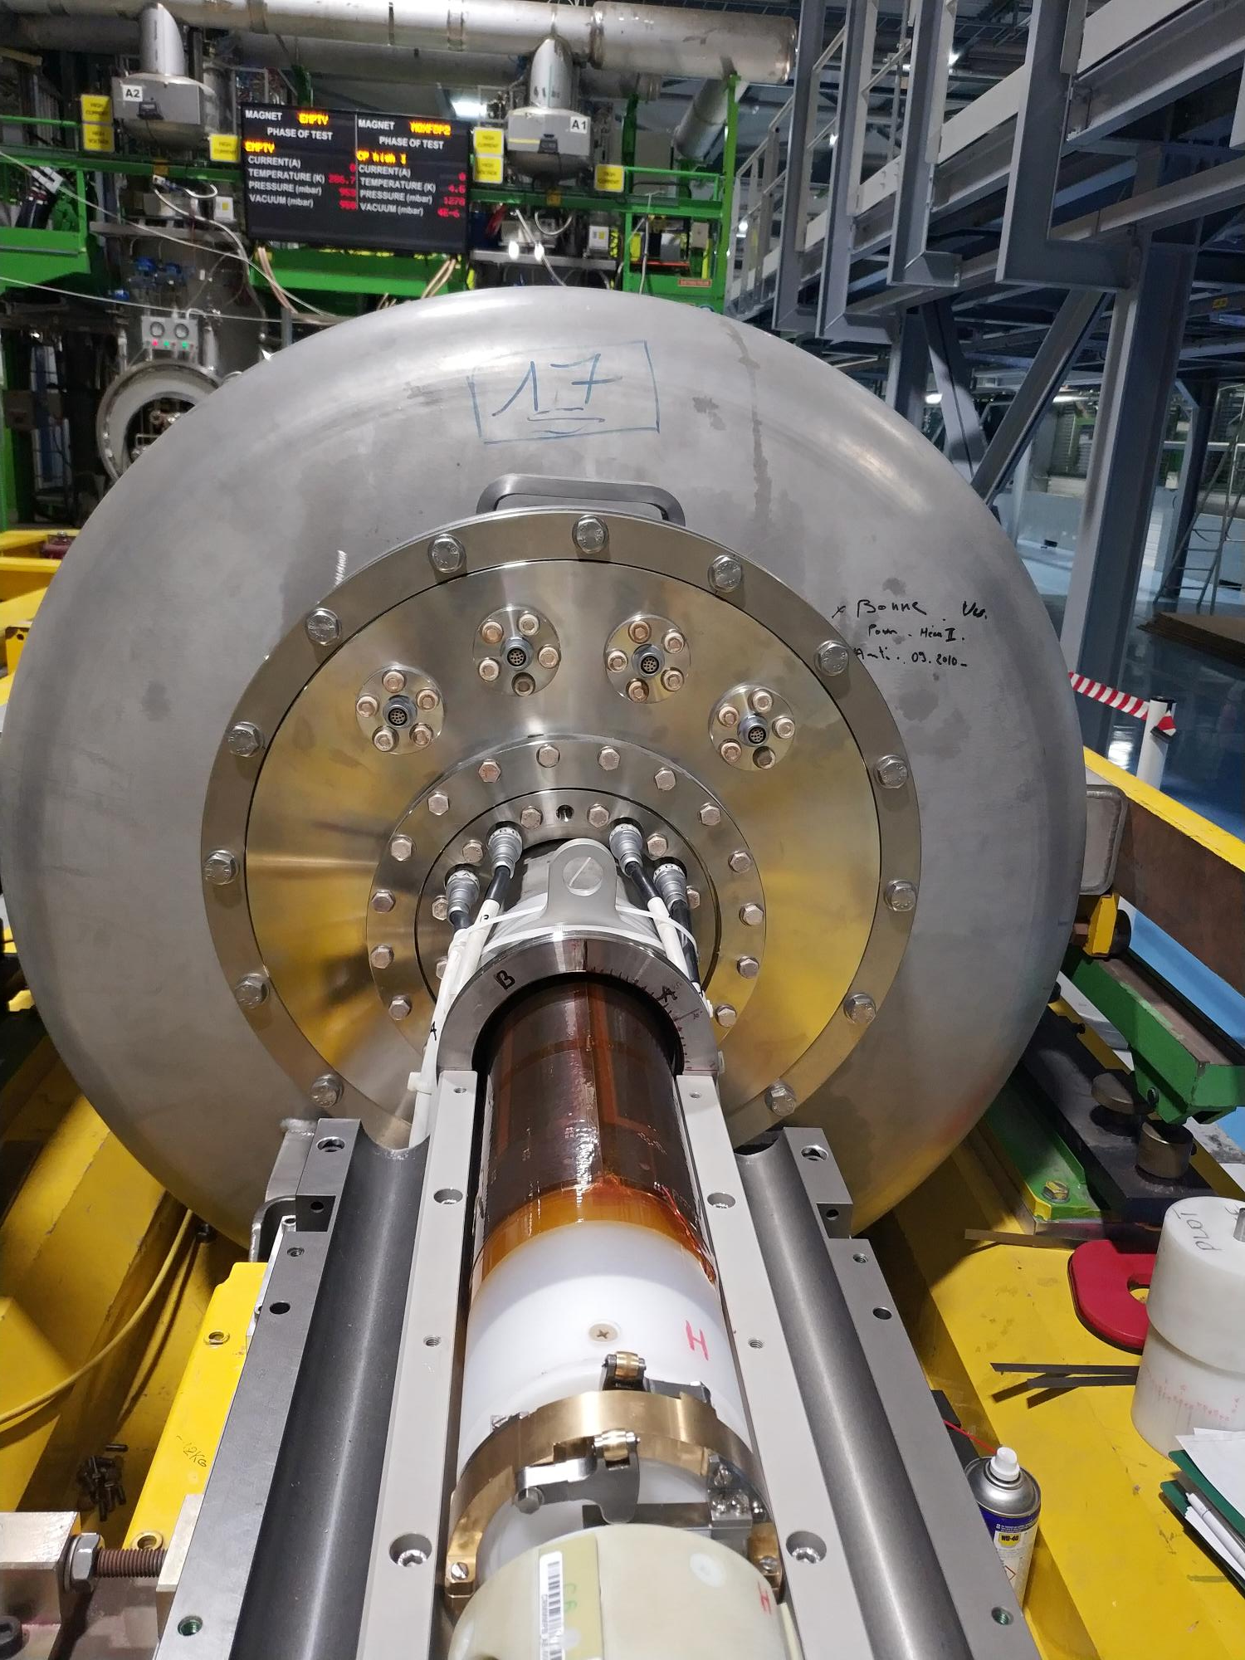
Multipole Sensitive Quench-Antenna
(prototype segment)
Clean B3,A3,B4,A4 sensitive through coil design (analogue bucking -> Flex PCB design)
Compromise between noise (PC, vibrations etc), resolution in radial direction, and signal strength.
Leroy et al. 1993, Ogitsu et al. 1996, Bossert et al. 2011

Slide 19
Data from quench
@ 4.5 K, 1 A/s, I_{quench} = 15455 A, trim circuit disconnected

Slide 20
Take home message – Quench antenna
Standard 4-coil (B2 sensitive – 64 channels) quench antenna effective to localize the longitudinal quench location within +/- 45 mm for reproducible quench positions. Also, most probably, effective for recording field changes due to vibrations (in case of structural limitations)
Multipole quench antenna (with 12 x 600-mm segments = 48 channels) will allow us to localize the quench in the cross section, in particular for magnets with fewer voltage taps. If needed shorter flex PCB can be retrofitted.

Slide 21
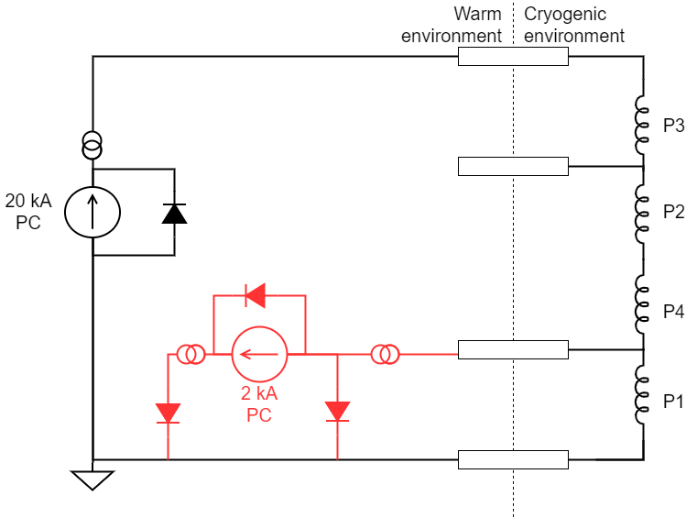
Circuit diagram, trim powering
Main current leads (20 kA)
Auxiliary current leads (600 A) used for CLIQ in the temporary cold mass configuration
Superconducting CLIQ leads
Coil to trim down
~0.3 V
10x 300 A
Next step: Double the leads to allow up to 2 kA trim powering
~0.6 V, 13 kA
Trim PC protection diode
Notes:
600 A leads can accommodate up to 1.6 kA peak (quench or control cryogenics) and 1.5 kA steady state.

Slide 22
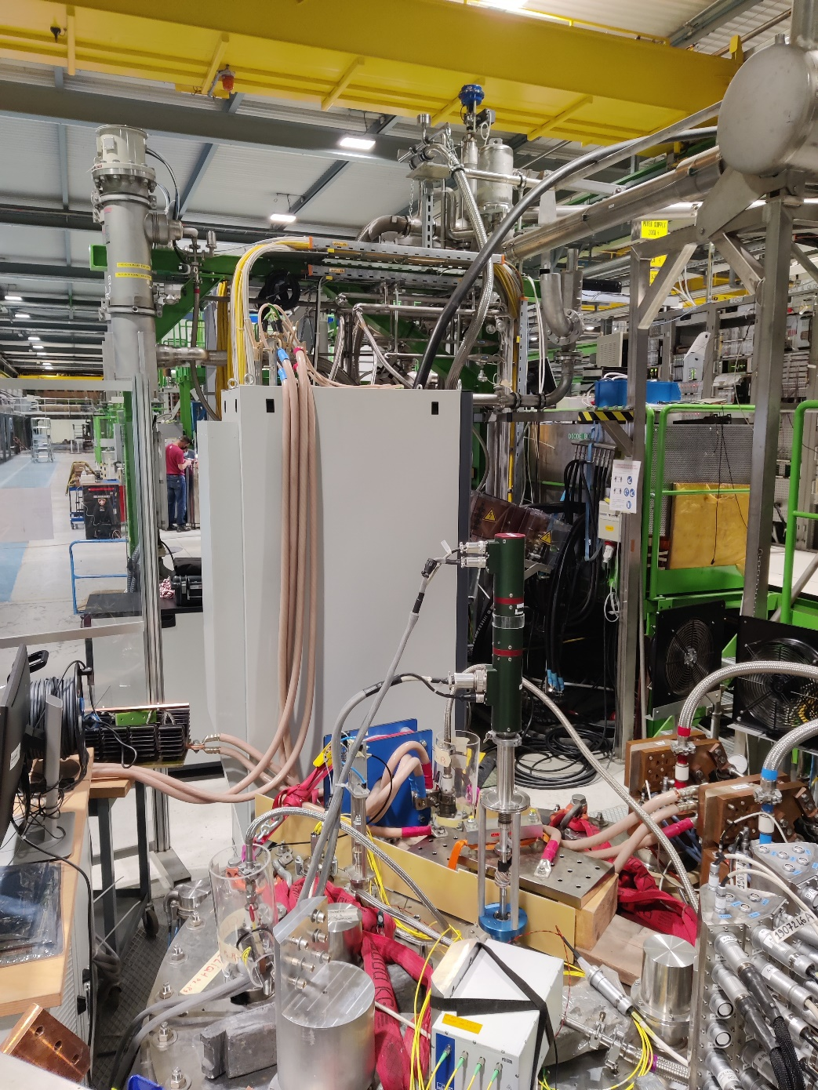
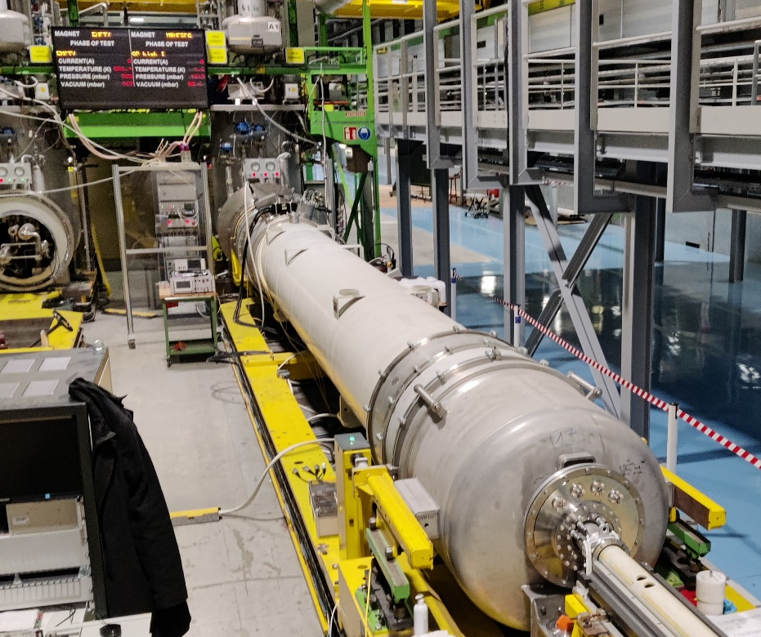
Initial tests on MQXFS7
Test of MQXFBP2
2 kA cables going to the mezzanine
2 kA Trim PC
2 kA Trim PC
Additional DCCT (to measure trim current)
Protection diode
Notes:
Non-standard test but with EPC present, test plan approved and simulations (validated with measurements).

Slide 23
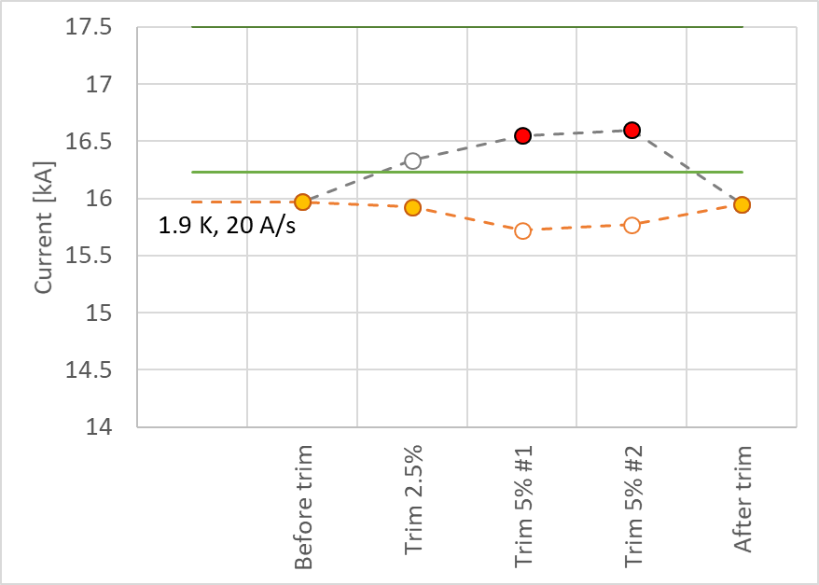
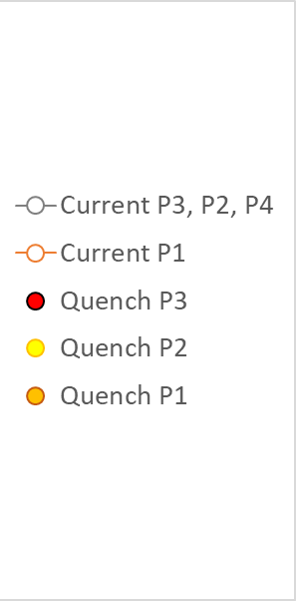
Trim powering results
Ultimate current
Nominal current

Slide 24
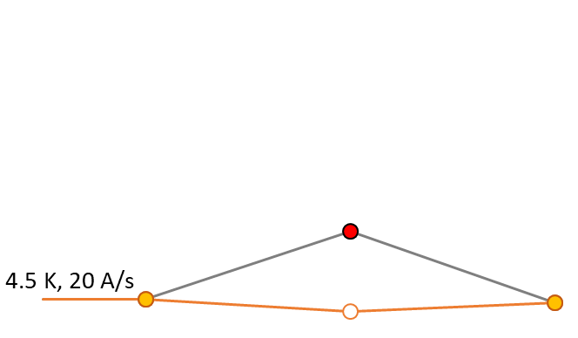
Trim powering results
Ultimate current
Nominal current

Slide 25
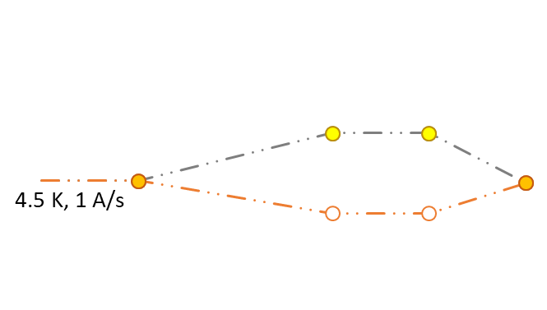
Trim powering results
Ultimate current
Nominal current

Slide 26
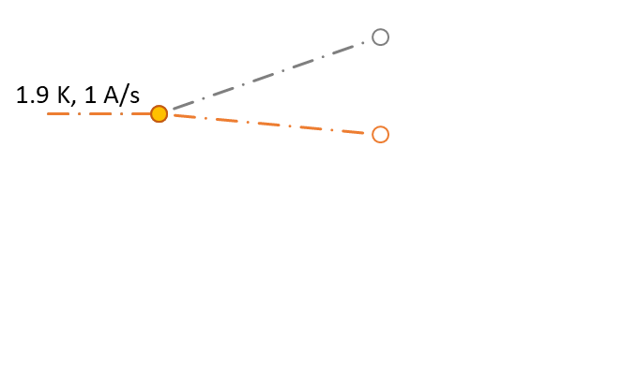
Trim powering results
Ultimate current
Test-plan limit
Nominal current

Slide 27
Take home message – Trim powering
Trim powering validated on a short model and implemented in the MQXFBP2 prototype. Procedures, circuit analysis (with support from MPE), validation through short model testing, and risk mitigation measurements developed
Trimmed powering of MQXFBP2 allowed us to see the quench limit in at least two other coils. At least 3 limited at various levels of severity.
Enhanced trim powering (up to 2 kA) for the next magnets to have a lower lead-time assessment of the new coil manufacturing procedure

Slide 28
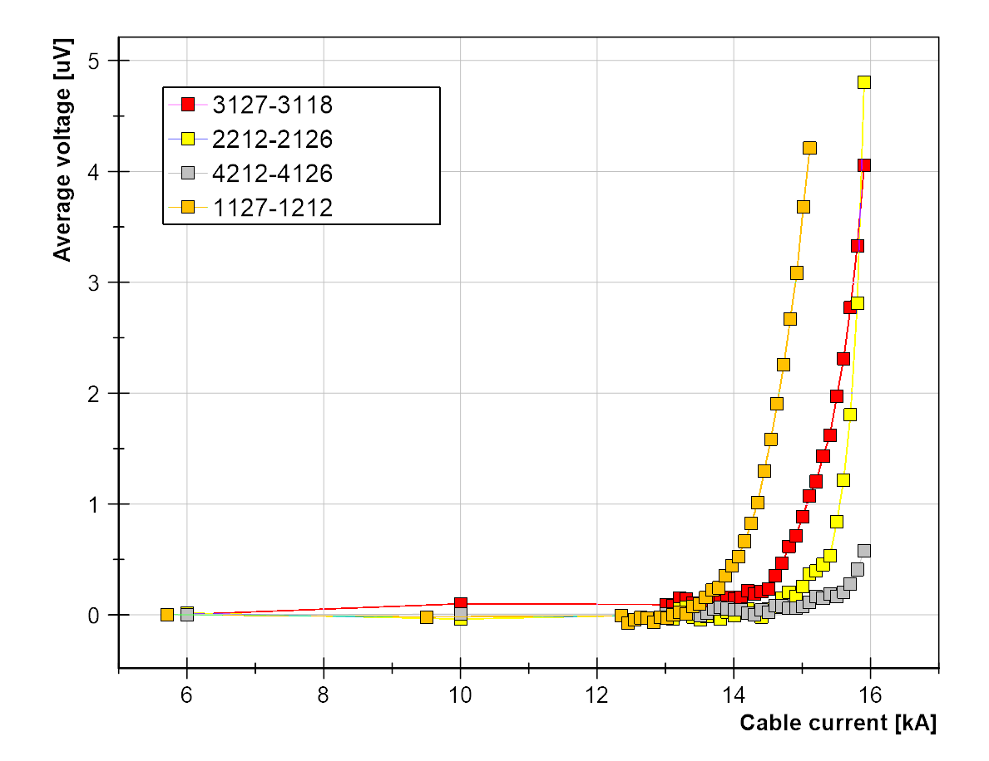
V-I measurements with 5% trim at 4.5 K
Inner pole turn segments in the four coils show same transition. In the quenching coils ~5 uV, in P4 ~0.6 uV
15.4 kA
N-value strongly depends on B (~60 at 10.5 T
~45 at 12.3 T) which in turn depends strongly on position in the coil
Notes:
Other coils show the same degradation as Coil 1 (green) . Numering convention for taps: coil / layer / 1 = connection side 2 = non-connection side , numerical order

Slide 29
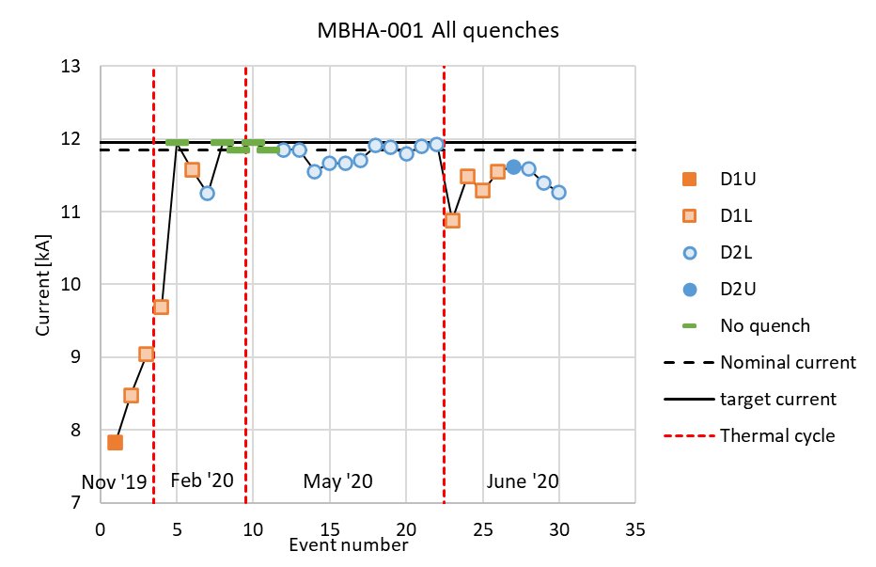
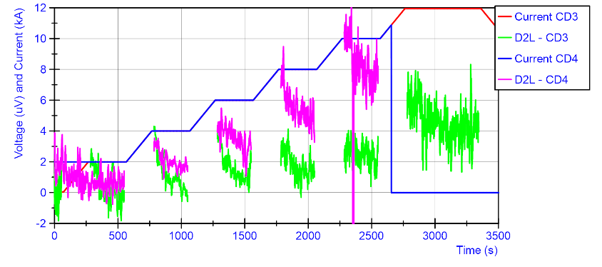
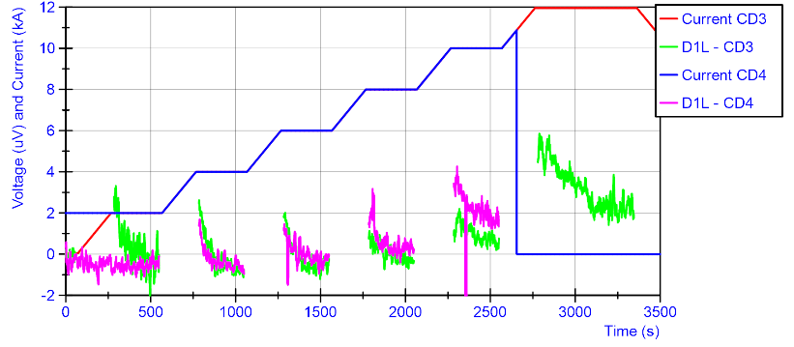
MBHA-001
Lower coil aperture 2
Lower coil aperture 1
11T from 2018 to 2021: V-I over full coil gave conclusive results. MQXFBP2, april 2021: V-I measurements on full coil were disturbed. MQXFBP2, November 2021: Issue solved by putting less voltage measurements in parallel and better cable routing

Slide 30
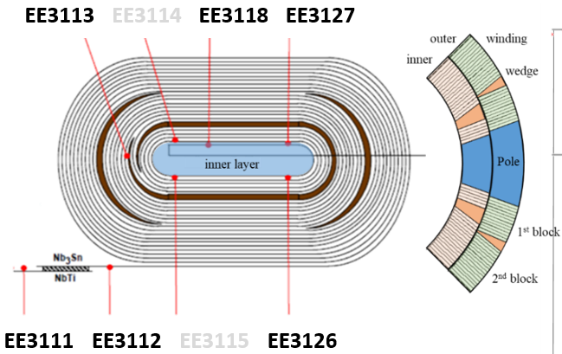
V-I measurements – MQXFBP01
Magnet always quenched at same current level: 15.1 kA (1.9 K) Voltage taps within the coil. Decaying voltage signals on current plateau of 14 kA
  Negative on straight segment (3127-3118)
  Positive in the head (3126-3127) and multiturn (3113-3126)
  According to simulations, negative voltage is possible when measuring in front or after the defect. Ongoing R&D, special test foreseen on a SMC with artificially degraded conductor
MQXFBP01
P3
Inner layer
108
Negative VI @ 14 kA
Positive VI @14 kA
Positive VI @14 kA

Slide 31
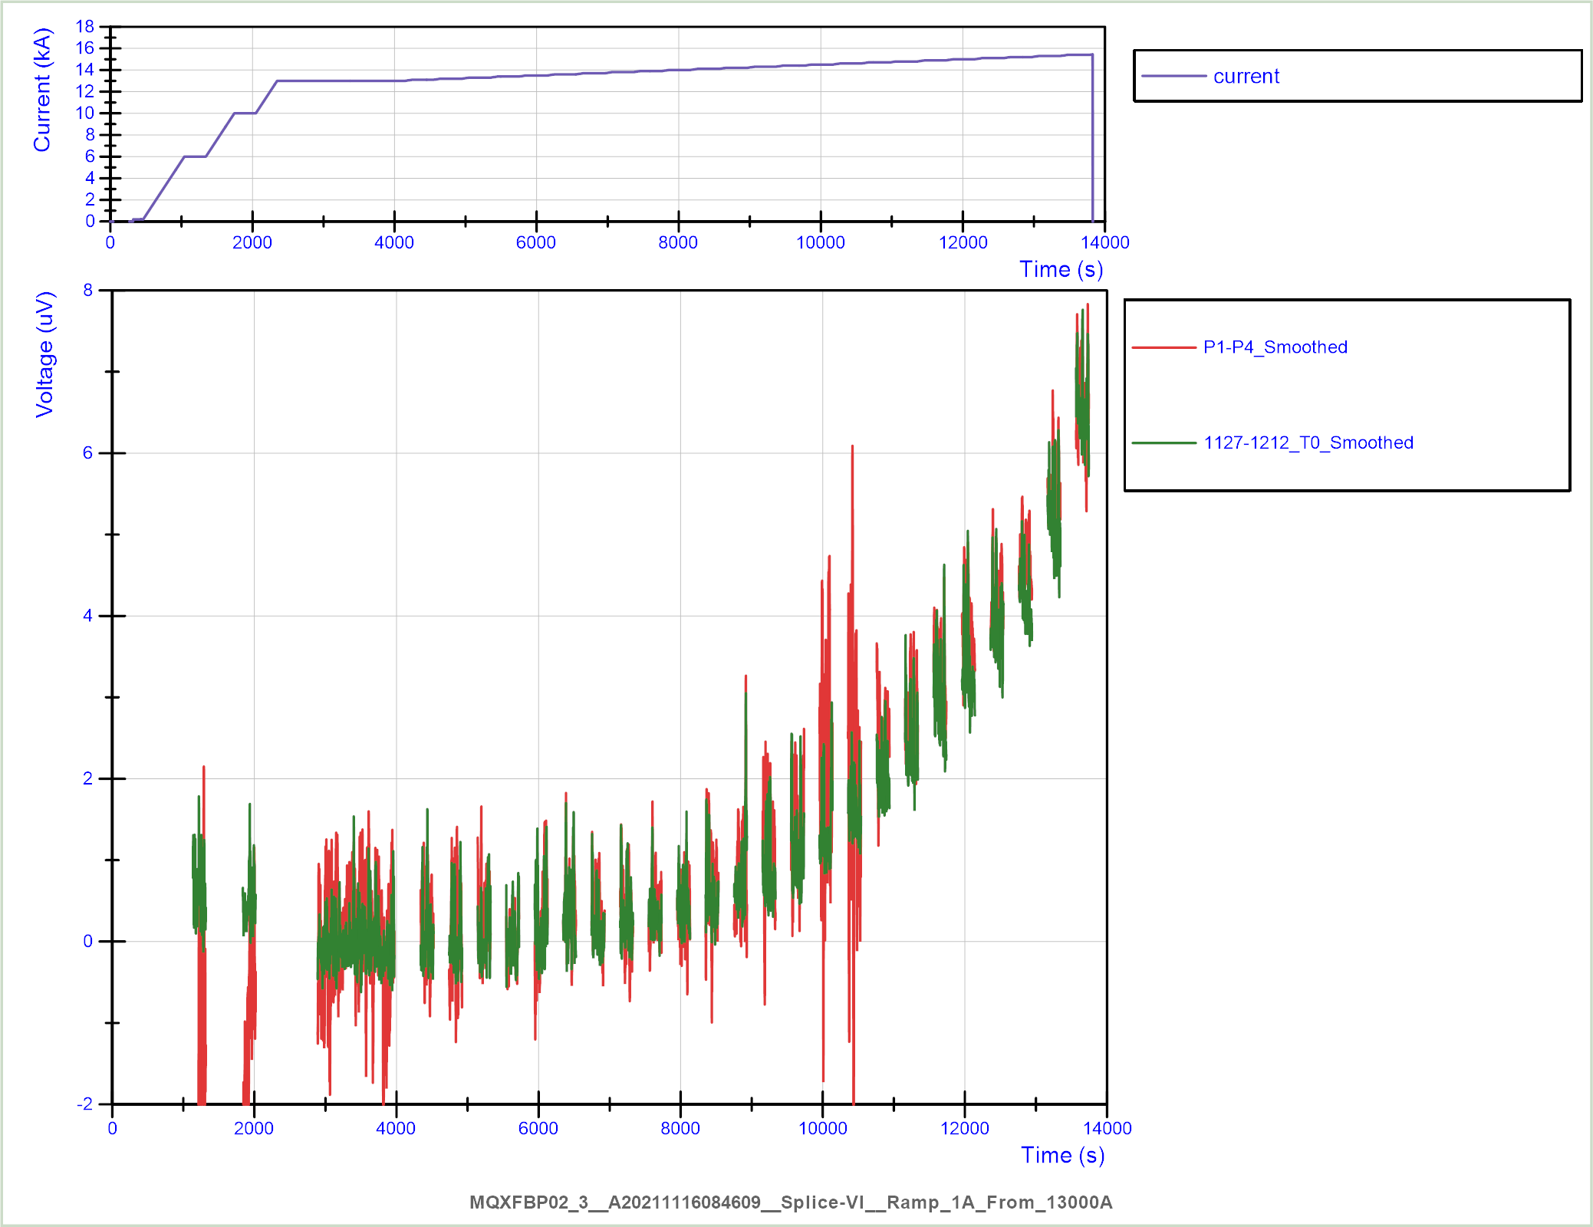
Comparison pole turn versus full coil measurement
Direct measurement of the pole turn (voltage tap 1127-1212) and V(P1) – V(P4)
The direct measurement has slightly less noise, but the final result is not significantly different.
Conclusion:
For P1 all degradation is in the pole turn, not in any other turn.

Slide 32
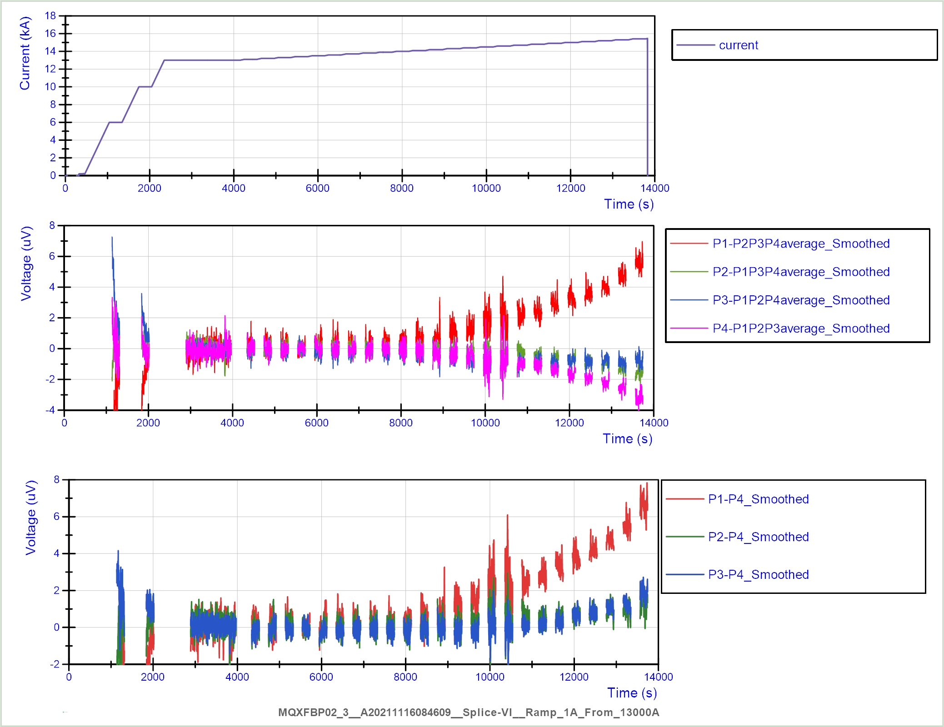
Full-coil V-I
Example MQXFBP2, November 2021
Current plateaus at 4.5 K, each 100 A
Ramp of 1 A/s between plateaus.
(good setting for non-decaying signals; for decays use a faster ramp).
13 kA
15.4 kA
Remove inductive voltage from signals.
Identify the coil with least degradation (P4 in this case).
Buck the average voltage to this coil (removes noise, magnetization decay, noise from power converter, etc.)
13 kA
15.4 kA
13 kA
P1 has the most degradation, P2 and P3 show some degradation at about 14 kA

Slide 33
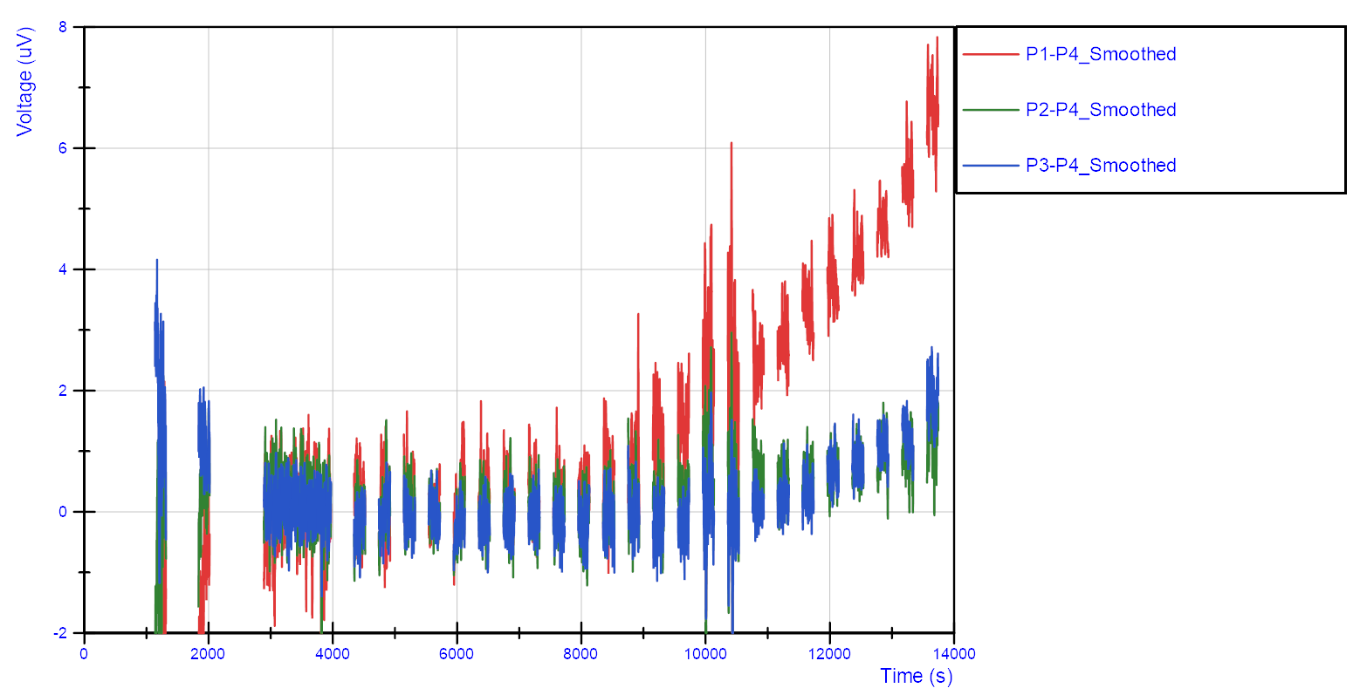
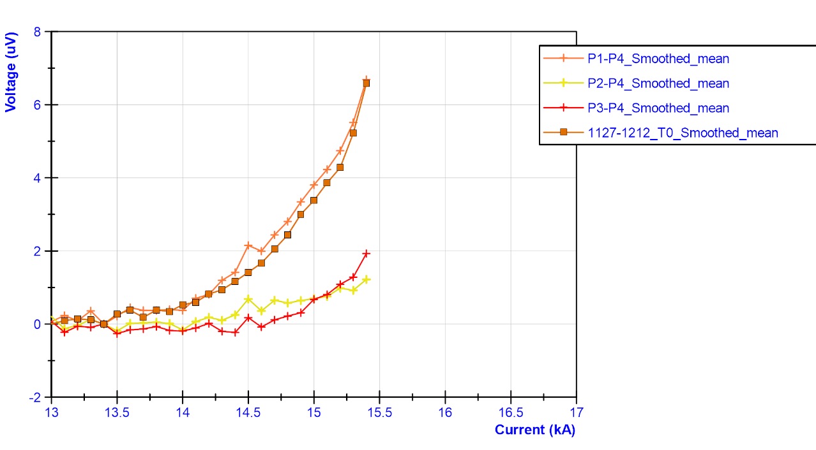
Comparison pole turn vs full coil measurement (2)
Average per plateau translates to a V-I plot
Measurements without trim up to 15.4 kA show that a voltage buildup starts also in P2 and P3 from about 15 kA.
In a test without trim, even the full coil measurement can show the start of voltage build up.

Slide 34
Take home message – V-I measurements
Decaying signal in MQXFBP1 indicates local conductor defect, stronger at quench location 1.B (a bit closer to center) than 1.A
Numerical modelling can qualitatively explain the phenomenon and predicts a few broken strands. Special test foreseen on a SMC with artificially degraded conductor
Assuming that not all coils are limited, even full-coil measurements can reveal defects without trim powering.
V-I Measurements are a good example for operation at 4.5 K.
No overstressing as SS is about 10% less for Nb3Sn
Conductor more stable which helps measurements close to SS limit
Check the operational margin
Distinguish between conductor limitation/degradation/defectation

Slide 35
Summary
SM18 upgrade for HL-LHC magnet testing according to plan and no more on the critical path
Safety issues are addressed (objective and subjective risks). Presentation TE-TM 2.05.2022
Large experience accumulated on the testing and diagnostics of Nb₃Sn magnets
New diagnostics tools (V-I, quench antenna) allow better understanding and localization of the quench phenomenology of Nb₃Sn magnets
Trim powering enables us to probe coil-by-coil

