Slide 1

Feedback from MQXFA and MQXFS
E. Todesco, A. Devred, S. Izquierdo Bermudez, H. Felice, A. Milanese, D. Duarte Ramos, on behalf of WP3 and of the AUP collaboration
29 April 2022

Slide 2
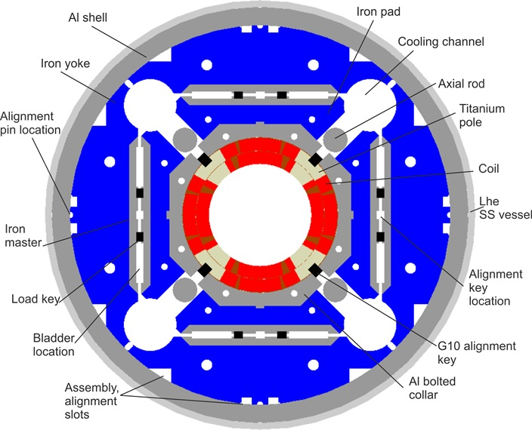
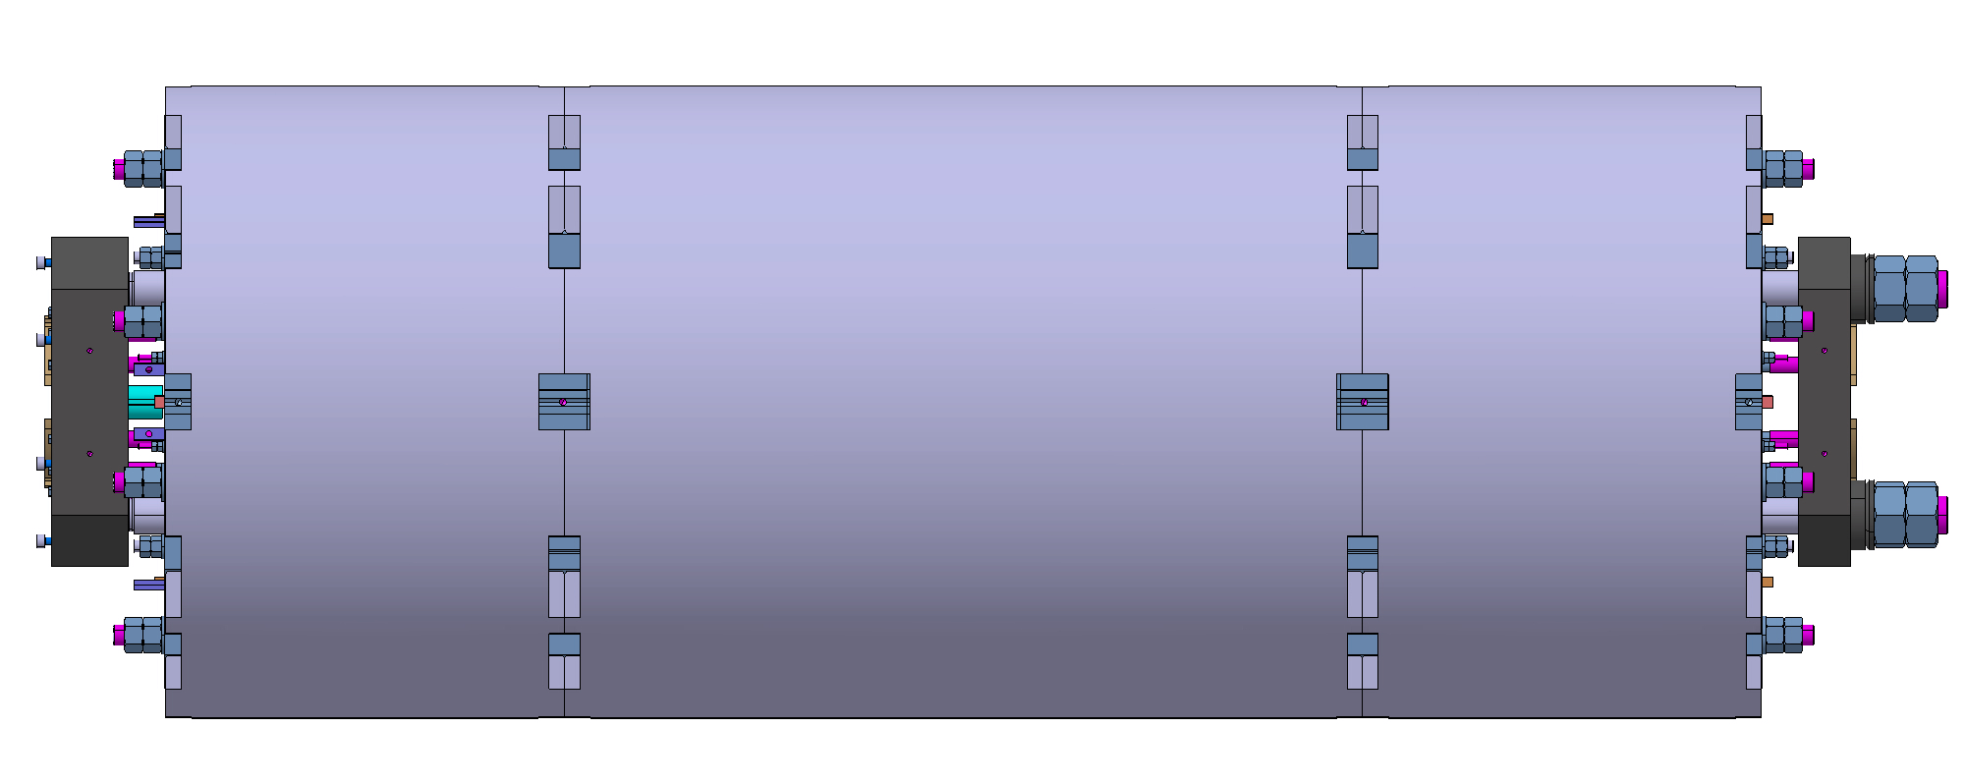

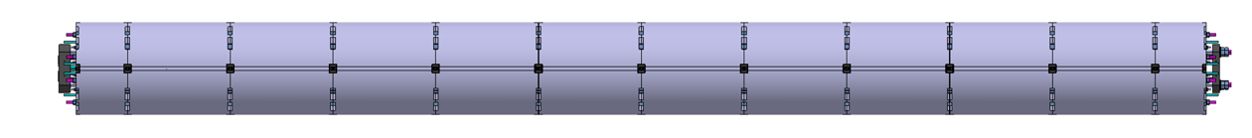
DIFFERENCES MQXFA/MQXFB/MQXFS
MQXFA (AUP 4.2-m-long magnet), MQXFB (CERN 7.15-m-long magnet) and MQXFS (AUP-CERN joint short model program) share the same design
  However, manufacturing and components are not exactly identical, and in some cases evil is in detail
  MQXFA has two manufacturing lines, one in BNL and one in FNAL - magnets with coils from both lines were built, are being mixed in the same magnet, and reached performance
  MQXFS coils were manufactured in CERN 927 and in FNAL – magnets with coils from both lines were built, and reached performance
  MQXFB has one manufacturing line in 180
  Cold masses have the same requirement on the welding tension, but different requirements on the fixed point, and at the present status, different designs
MQXFS
(1.2 m)
MQXFA
(4.2 m)
MQXFB
(7.15 m)

Slide 3

A summary of the MQXF short model program
Nominal conductor peak field at 7 TeV operation is 11.4 T
Endurance tests on MQXFS1, MQXFS4:
8 thermal cycles, 1000 powering cycles
MQXFS1: >7.5 TeV, 12.9 T
Integration of SS shell in
MQXFS1, MQXFS7
MQXFS3: ~6.5 TeV, ~10.6 T
PIT conductor in MQXFS5,
MQXFS6 and MQXFS7
MQXFS5: >7.5 TeV, 12.7 T
T₀: aperture and cable selection
MQXFS4: >7.5 TeV, 13.1 T
MQXFS6: >7.5 TeV, 13.4 T
RED indicates conform magnets
MQXFS7: >7.5 TeV, 12.7 T
2013
2014
2015
2016
2017
2018
2019
2020
2021
2022
T₀+3

Slide 4
FEEDBACK FROM MQXFS
Goals of the short model program were achieved
  Performance, field quality, protection satisfying the requirements
  Reproducibility of performance (4 out of 5 magnets with virgin coils reaching 7.5 TeV operation at 1.9 K)
  Proof of temperature margin (operation at 7.5 TeV reached at 4.5 K)
  No retraining after thermal cycle, even at 7.5 TeV operation
  Two magnets operated above 13 T peak field (nominal peak field is 11.4 T), and other two above 12.5 T peak field
  Endurance proved on 3 magnets, with 5 to 8 thermal cycles, up to 7.5 TeV operation
  The magnets can operate with large range of preload (axial and transversal)
What the short model program cannot prove: all issues related to length scale up
  Voltage levels are scaling with lengths, therefore all issues related to insulation are much easier on short models
  Winding, contact toolings for coil manufacturing, and assembly modularities are different
  All issues related to thermal shrinkage differential in the axial direction (heat treatment, magnet cool-down, impact of SS shell integration)

Slide 5
FEEDBACK FROM MQXFA
Coil fabrication: 43 coils in FNAL and 30 coils in BNL completed (out of ~110 total)
  Rejected coil rate (20%) is non negligible and larger than expected (as at CERN)
  Relevant information on electrical robustness for a small production as HL-LHC, see talk by H. Felice
  Relevant information on coil mechanical properties, sizes, etc.
Magnet assembly: 8 magnets (2 proto, 5 preseries, 1 series) assembled and tested vertical (out of 23 total)
  AUP set the specification for the maximum observable stress during assembly at 110 MPa (for 4.2-m-long magnets, measured in one point), see also talk by S. Izquierdo Bermudez
  4 succesful magnets test in vertical position out of 8
Cold mass: no completed cold mass tested until now
  Here CERN is more advanced since two cold masses (even though temporary) were tested MQXFP1 and MQXFP2
  Therefore the feedback of AUP is not yet available for this area of manufacturing, see also talk of H. Prin
Here we will focus on the feedback from test, in particular
  Short summary of performance
  Could we have the same performance limitations as in MQXFB ?
  The performance limitation in MQXFA
  Status of endurance tests

Slide 6
REVIEW OF THE MQXFA RESULTS
Prototypes
  MQXFAP1: 17.3 kA reached, then coil lost for a short (see slide 9)
    Issue understood, non conform component critical for impregnation
  MQXFAP1b: limited at ~13 kA, reverse behaviour (see slide 6)
    Not understood, limited by a coil previously used in MQXFAP1 and not limiting
  MQXFAP2: limited at ~14 kA
    Issue understood (broken Al structure due to sharp edges)
Preseries
  MQXFA03: reached nominal + 300 A (see slide 11)
  MQXFA04: reached nominal + 300 A (see slide 11)
  MQXFA05: reached nominal + 300 A (four test runs, see slide 7)
  MQXFA06: reached nominal + 300 A (see slide 11)
  MQXFA07: limited at 15 kA (but possibly at lower levels during holding current, not tried), reverse behaviour (see slide 6)
Series
  MQXFA08: limited at ~13 kA, reverse behaviour (see slide 6 and 12)
RED indicates conform magnets

Slide 7
PERFORMANCE LIMITATIONS AS IN MQXFB ?
Q: can we exclude that MQXFS and MQXFA are affected by the same performance limitation seen in MQXFB ? (see talk of S. Sgobba)
  Obviously, this would happen at a higher level of current, i.e. with less broken strands
MQXFS
  MQXFS4 and MQXFS6 reached 95% of short sample at 1.9 K
  MQXFS1 and MQXFS7 reached 90% of short sample at 1.9 K
  It is higly improbable that the performance limitations seen in MQXFB affects MQXFS
MQXFA
  MQXFA03-MQXFA07 were tested (succesfully) up to 16530 A (i.e. 16230 required for 7 TeV operation plus 300 A) – this is 80% of short sample
    However, the 16230 A reached at 4.5 K represents 87% of short sample
  MQXFAP1 reached 17.3 kA (200 A less than 7.5 TeV operation) – this is 83% of short sample
  We never observed quenches with the same phenomenology as in MQXFBP1 and MQXFBP2
  It is improbable that the performance limitations seen in MQXFB affects MQXFA

Slide 8
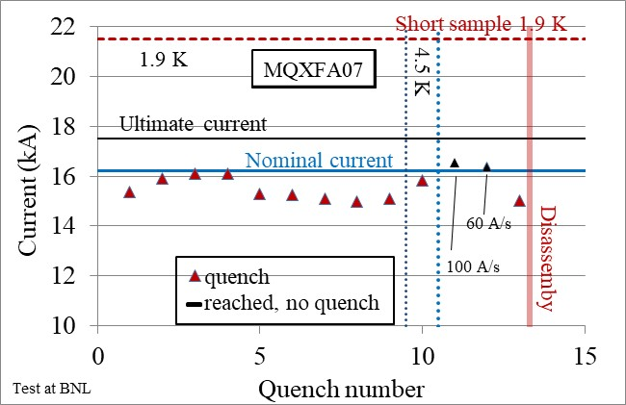
PERFORMANCE LIMITATIONS
SEEN IN MQXFA (AND MQXFS)
A totally different phenomenology of performance limitation is visible in MQXFA, affecting the production and appears similar to the limitation seen in MQXFAP1b and in short model MQXFS3
  Reverse behaviour: better performance at 4.5 K than 1.9 K, and at high ramp rates – typical source are current redistribution triggered/superconductor instabilites by mechanical damage
    Quench location close to heads, AUP team is working on the hypothesis of assembly issue (interference with keys)
    Efforts are also being done to characterize this performance limitation via tomographies/metallographies of limiting coil of MQXFA07 and the presence of popped strands (see S. Sgobba talk)
  We cannot exclude that these limitations will be visibile in MQXFB in the future
Training of MQXFA07 and of MQXFAP1b [AUP collaboration]

Slide 9

PERFORMANCE LIMITATIONS
SEEN IN MQXFA
Steps carried out by AUP following the three unsuccessful prototypes
  Postpone the approval of full DOE contribution and ask funding for 5 magnets (pre-series, MQXFA03 to MQXFA07), with approval of the full contribution after the succesful test of two magnets
  MQXFA03 and MQXFA04 satisfied requirements, and DOE approved the contribution in 2020
  The following magnets MQXFA05 and MQXFA06 were also succesful
Steps carried out b yAUP following the unsuccessful test of MQXFA07 and MQXFA08
  Tapering of the coil production: continuing with coils in the pipeline but not winding new coils
  Take three months to review all the QA/QC record of the magnets
  Production restarted in February 2022
    MQXFA09 had a non conformity during assembly and had to be disassembled
  Next test will be MQXFA10, already in BNL but waiting for the end of the endurance test of MQXFA05

Slide 10
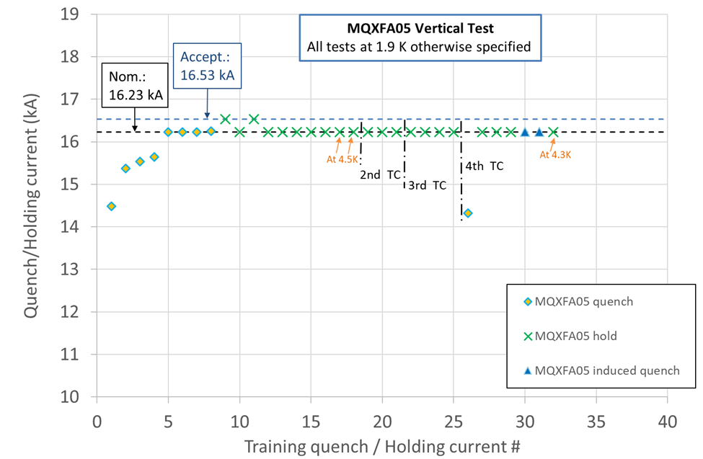
ENDURANCE TESTS IN MQXFA
So far, MQXF never showed any sign of performance degradation after successive thermal cycles
  Intensive endurance test were succesfully carried out on three MQXF short models (10 thermal cycles, 100 quenches, powering cycles …)
  So far, each MQXFA went through two powering tests: one (virgin) and one after thermal cycle
  MQXFA05 went through four powering cycles, and a a fifth is planned
    This test was initially foreseen in horizontal conditions, it was anticipated to clarify if MQXF has issues with degradation similar to 11 T and FNAL 15 T short model (MDPCT1)
    So far so good: no degradation, and large margin (the magnet can operate at nominal also at 4.5 K)
Endurance test of MQXFA05 [AUP collaboration]

Slide 11
CONCLUSIONS
Performance limitations seen in MQXFBP1 and MQXFBP2 are related to specific manufacturing processes, not affecting MQXFS and MQXFA
MQXFA magnets are affected by a different phenomenology of performance limitation (reverse behaviour), seen also in MQXFS3
  Not visibile in MQXFBP2 with trimmed powering up to 17 kA
  However, we cannot exclude that this will affect the MQXFB production
Endurance tests on a long magnet (MQXFA05) in vertical position is ongoing: will include four thermal cycles (cool-down&warm up), one virgin plus four non-virgin powering cycles, and 50 quenches at high current

Slide 12
APPENDIX: SUMMARY PLOTS OF MQXFA AND MQXFS PERFORMANCE

Slide 13
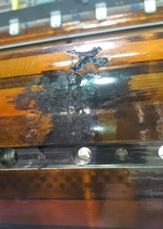
APPENDIX: PERFORMANCE LIMITATIONS IN MQXFA
Training plot of MQXFAP1, interrupted by an electrical short
Note that 17.3 kA is the highest current achieved so far on a long MQXF magnet (7.5 TeV needs 17.5 kA)
Training of MQXFAP1 [AUP collaboration]
QH to coil short in one coil of MQXFAP1

Slide 14
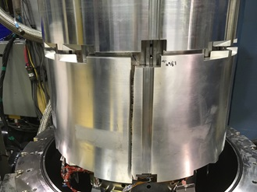
APPENDIX: PERFORMANCE LIMITATIONS IN MQXFA
Training plot of MQXFAP2, limited by the broken shell
Training of MQXFAP2 [AUP collaboration]
Broken shell in MQXFAP2

Slide 15
APPENDIX: PERFORMANCE LIMITATIONS IN MQXFA
Training plot of MQXFAP1b
Training of MQXFAP1b [AUP collaboration]

Slide 16
APPENDIX: PERFORMANCE IN MQXFA
The four consecutive succesful magnets MQXFA03-04-05-06
  Note the slower training in MQXFA06 due to test at 4.5 K
Training of MQXFA03-07 [AUP collaboration]

Slide 17
APPENDIX: PERFORMANCE LIMITATIONS IN MQXFA
Training plot of MQXFA07
Training of MQXFA07 [AUP collaboration]

Slide 18
APPENDIX: PERFORMANCE LIMITATIONS IN MQXFA
Training plot of MQXFA08
Training of MQXFA08 [AUP collaboration]

Slide 19
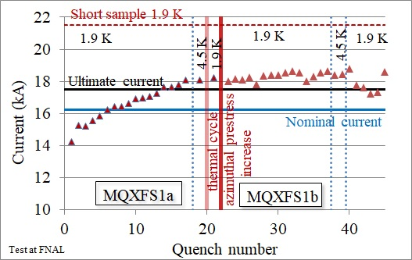
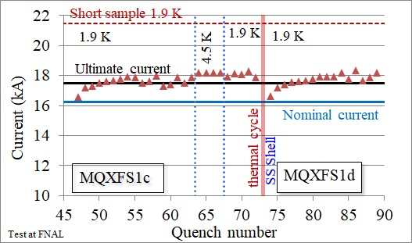
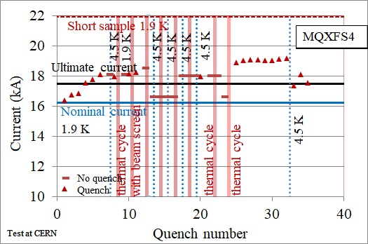
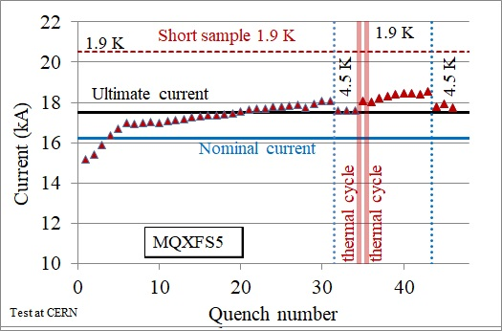
APPENDIX: PERFORMANCE IN MQXFS
Training plot of MQXFS1, MQXFS4, MQXFS5
Training of short models [CERN and AUP collaboration]

Slide 20
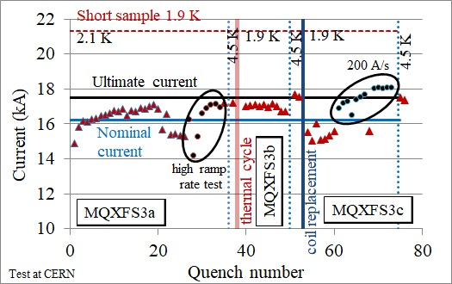
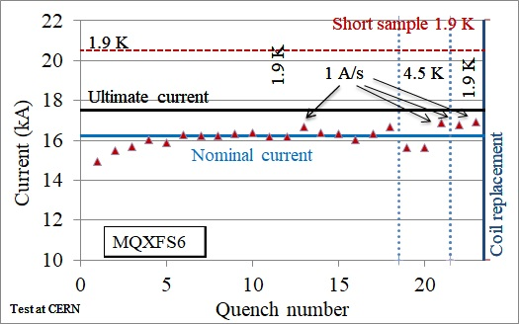
APPENDIX: PERFORMANCE LIMTATIONS
IN MQXFS
Training plot of MQXFS3 and MQXFS6
(Note: MQXFS6 had two coils with RRR out of spec, replaced in MQXFS6b, see next slide)
Training of MQXFS3 and MQXSF6 [CERN]

Slide 21
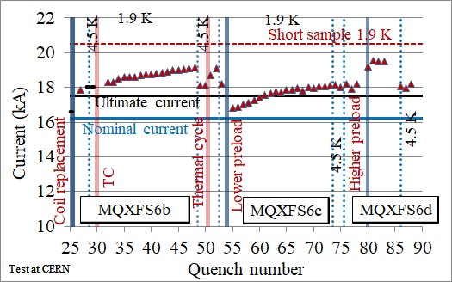
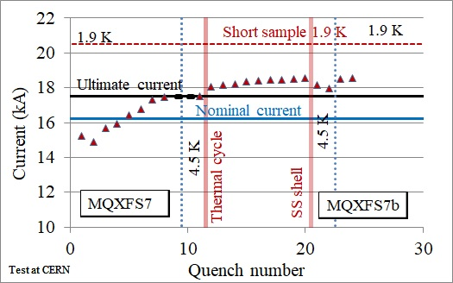
APPENDIX: PERFORMANCE IN MQXFS
Training plot of MQXFS6, MQXFS7
Training of MQXFS6b and MQXFS7 [CERN]

