Slide 2
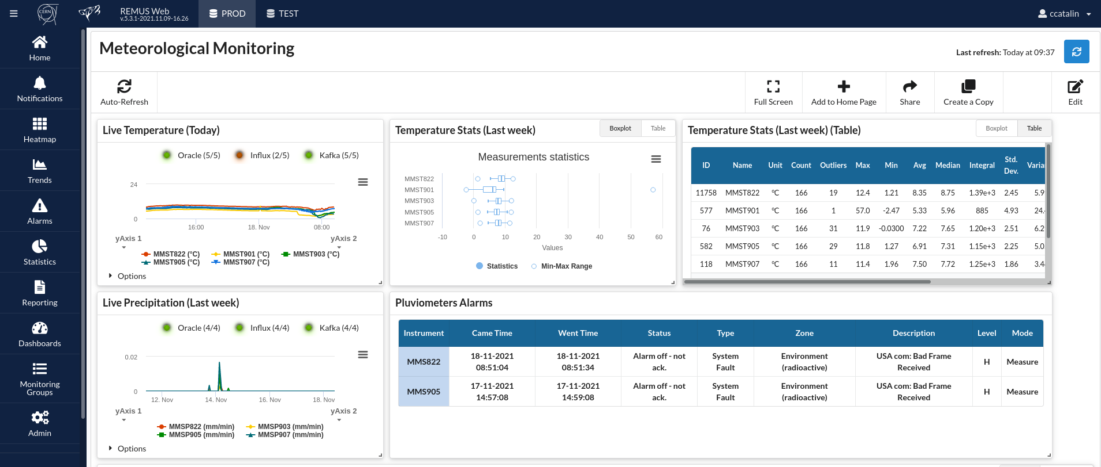
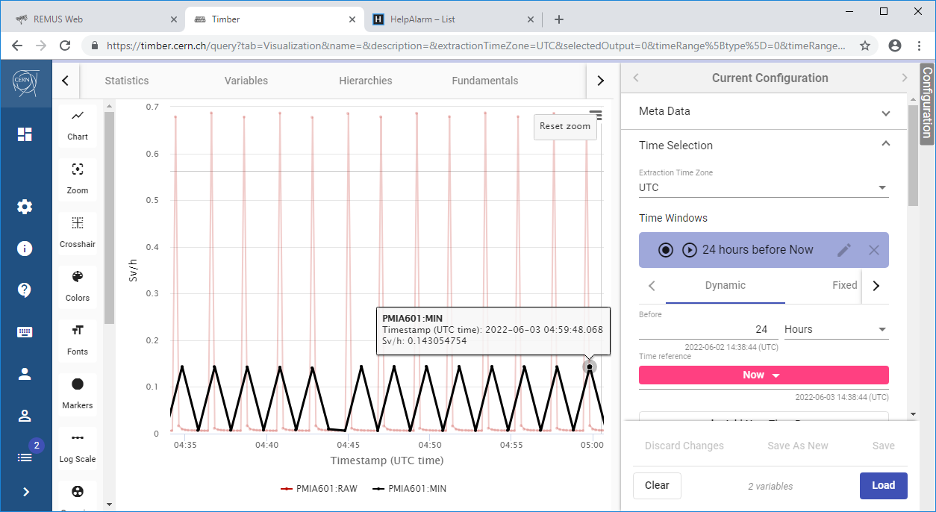
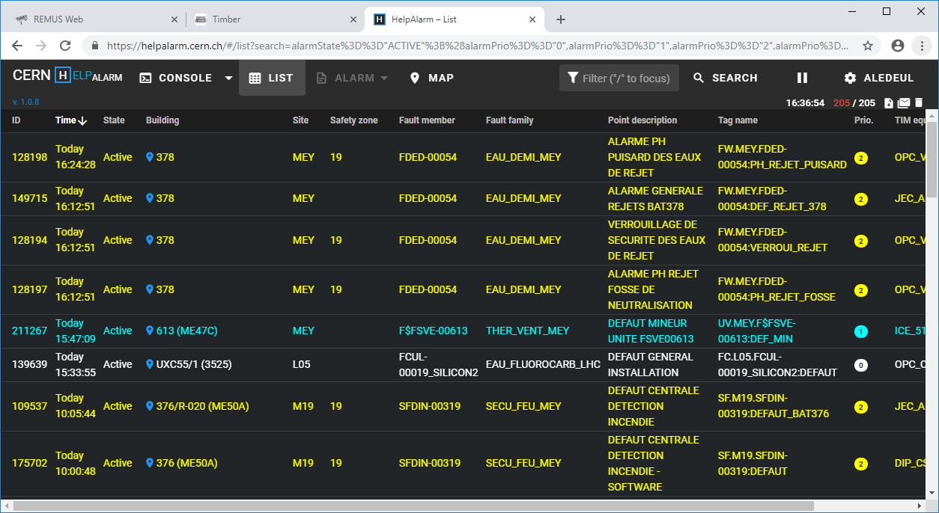
HSE Seminar:
Exploiting data of the Radiological and Environmental Monitoring System
CERN HSE Unit
A. Ledeul, G. De La Cruz, F. Malacrida, M. Widorski, J. Regnard, C. Chiriac, H. Boukabache

Slide 3
Introduction

Slide 4
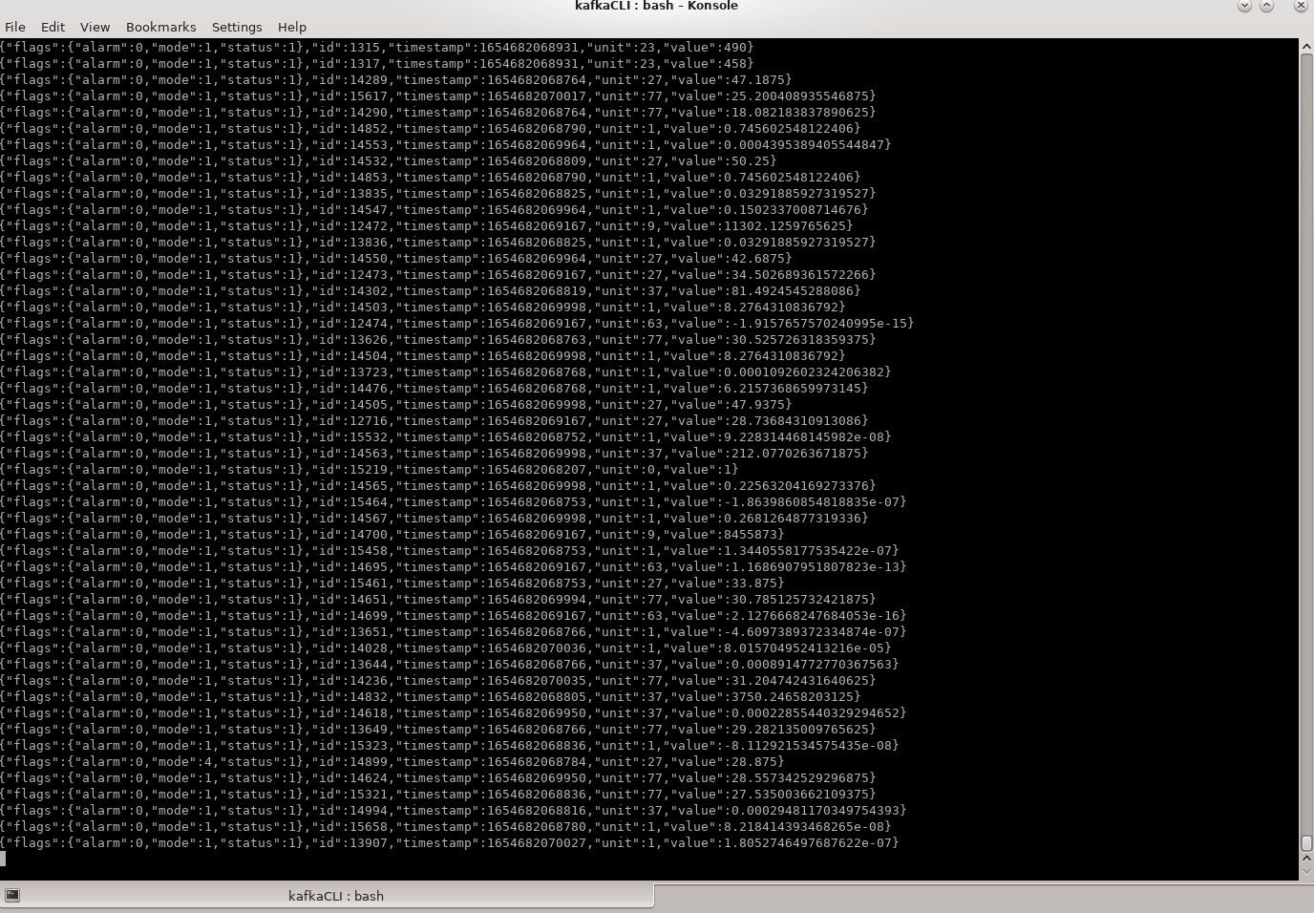

Slide 5
How to make sense of this ?

Slide 6
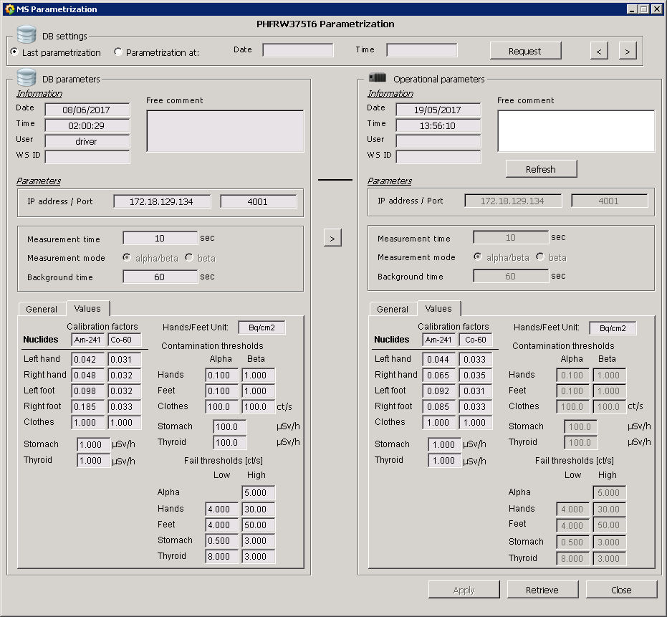
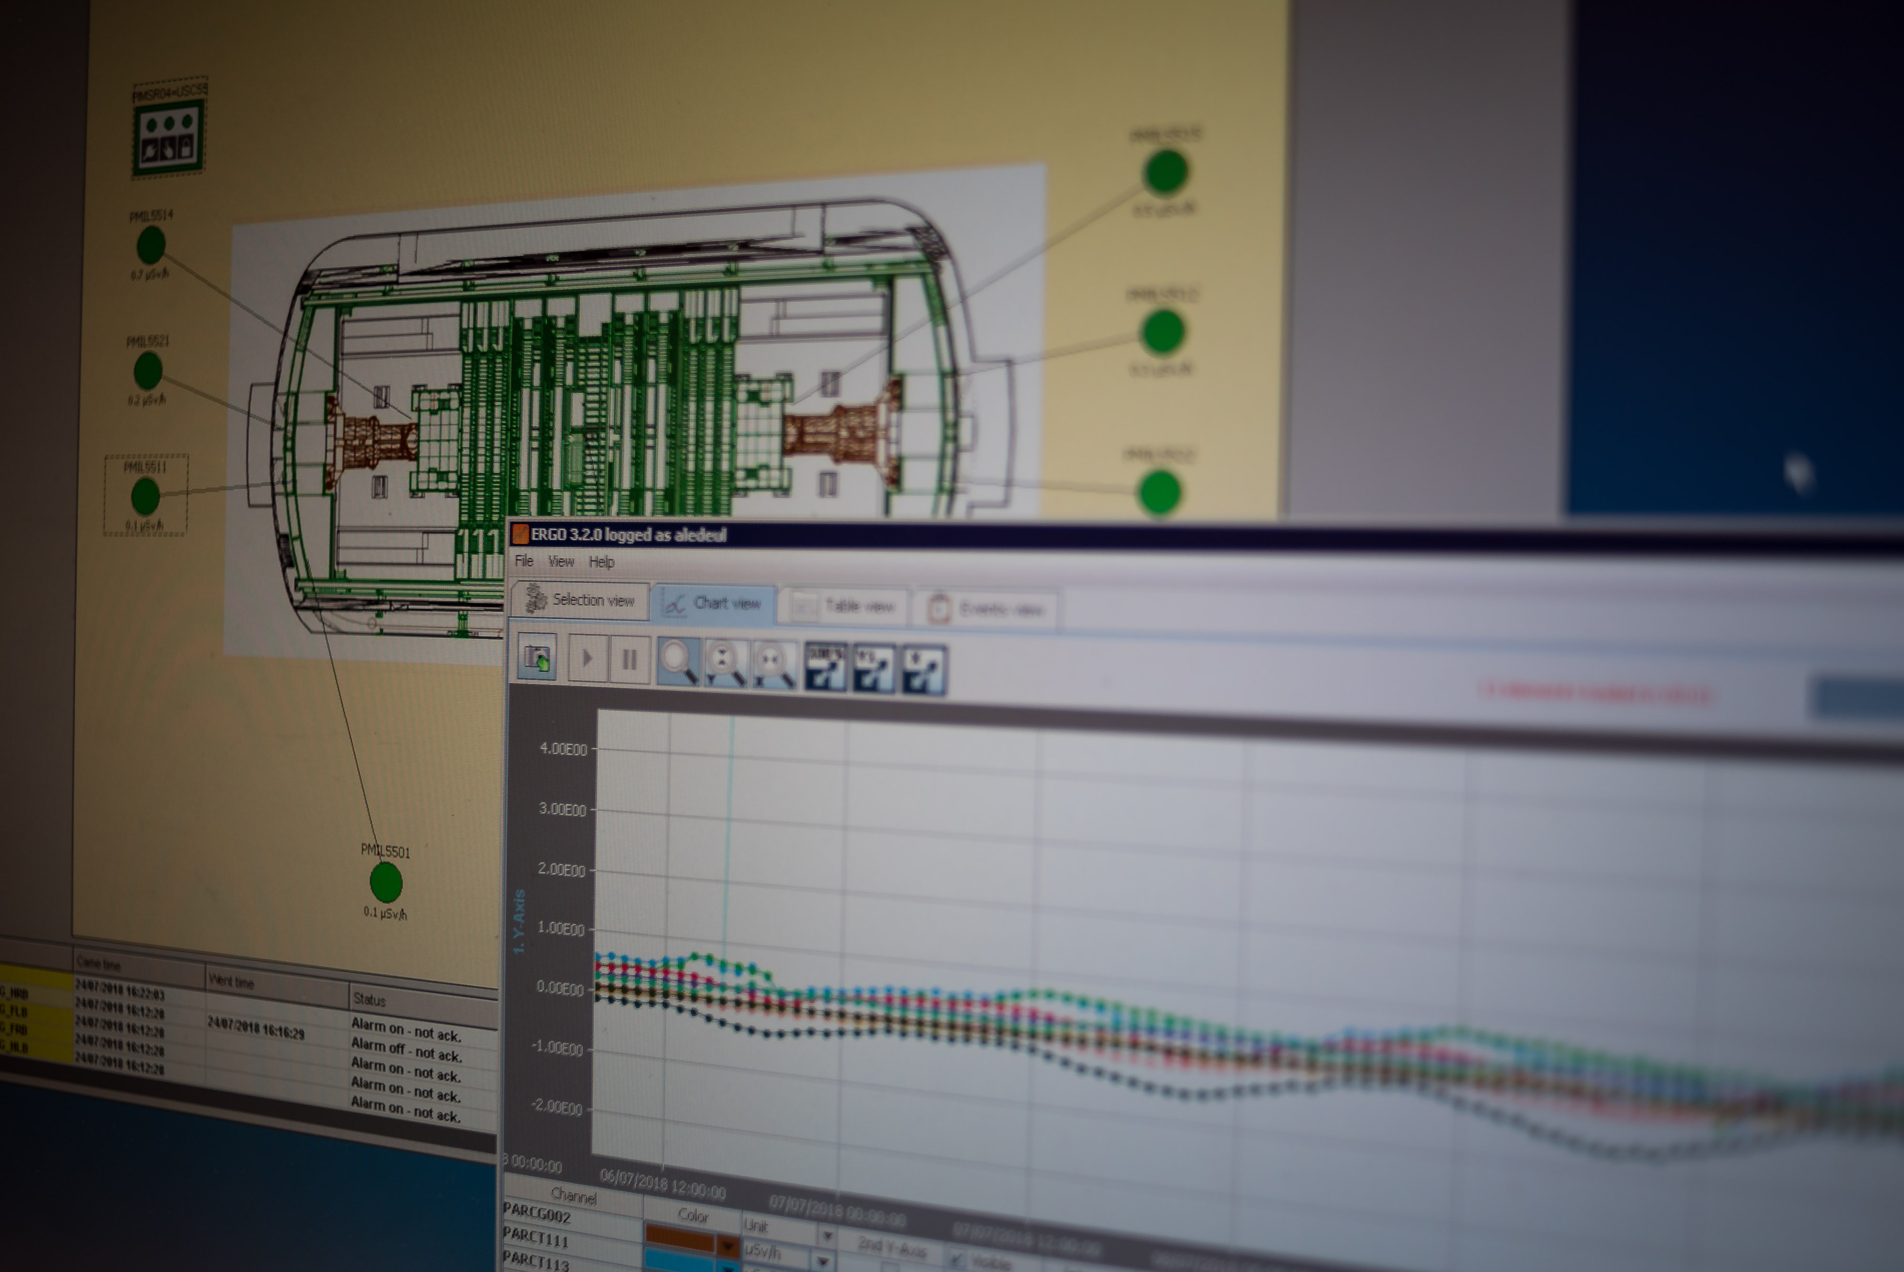
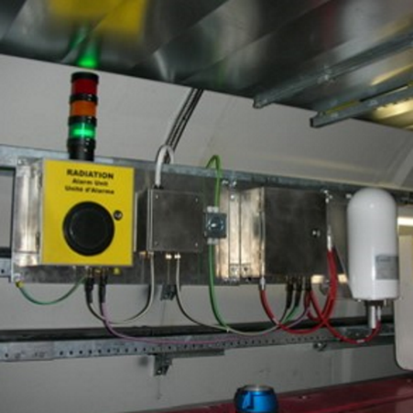
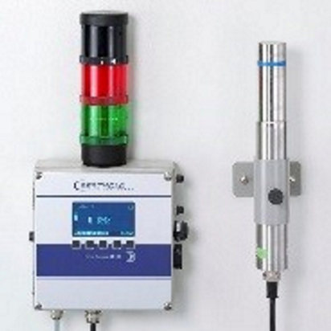
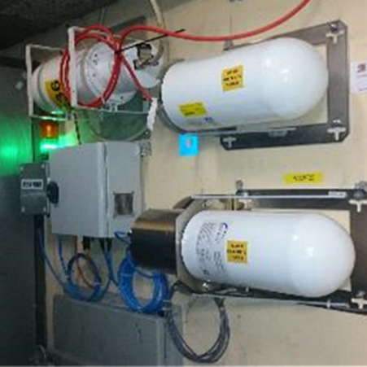
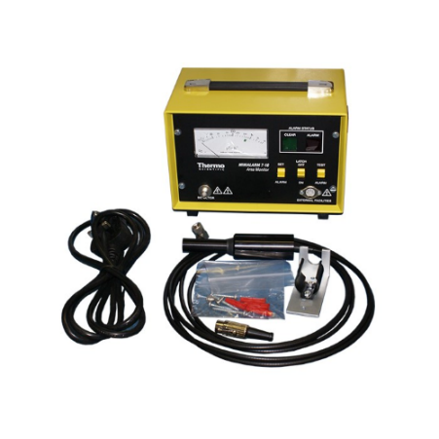
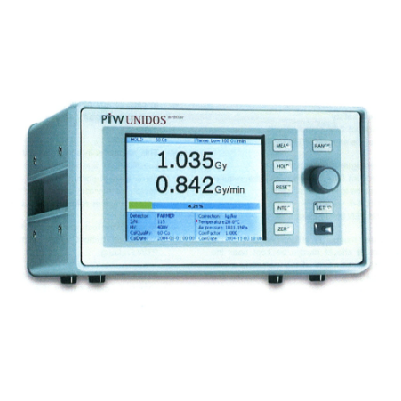
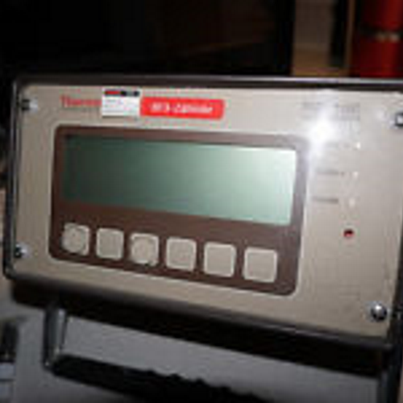

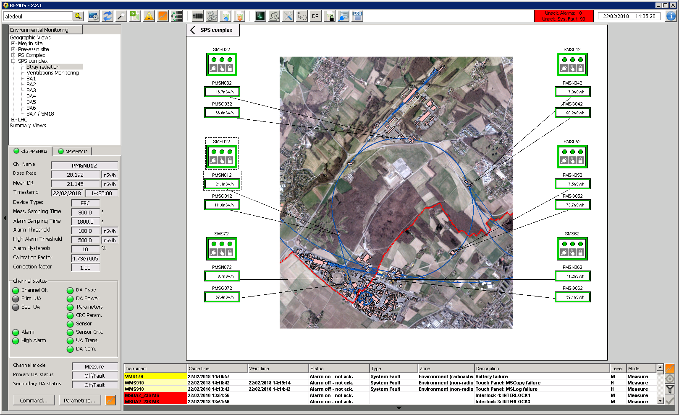
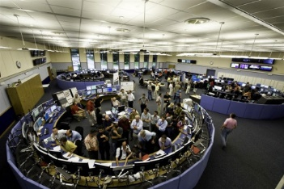
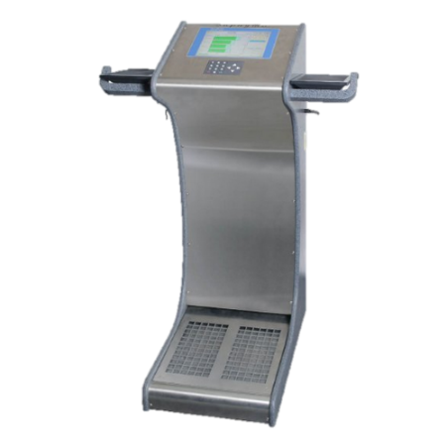
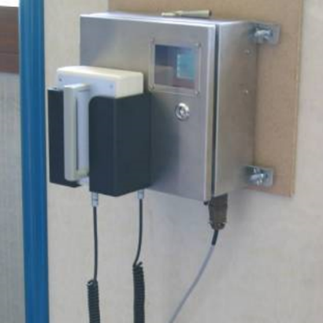
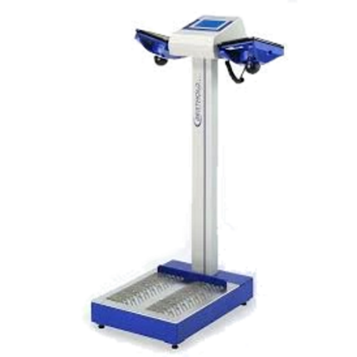
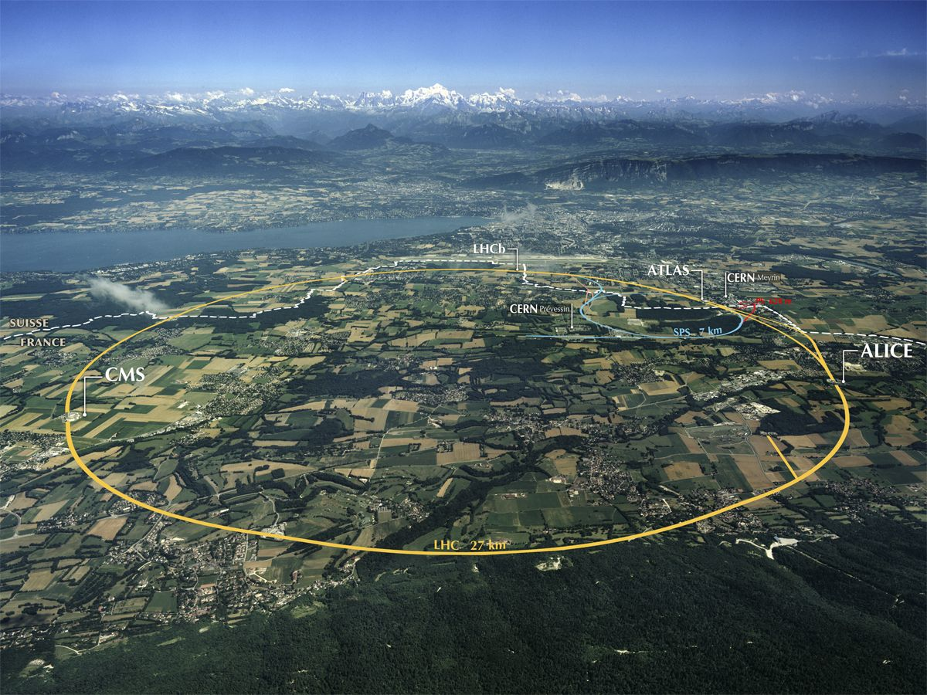
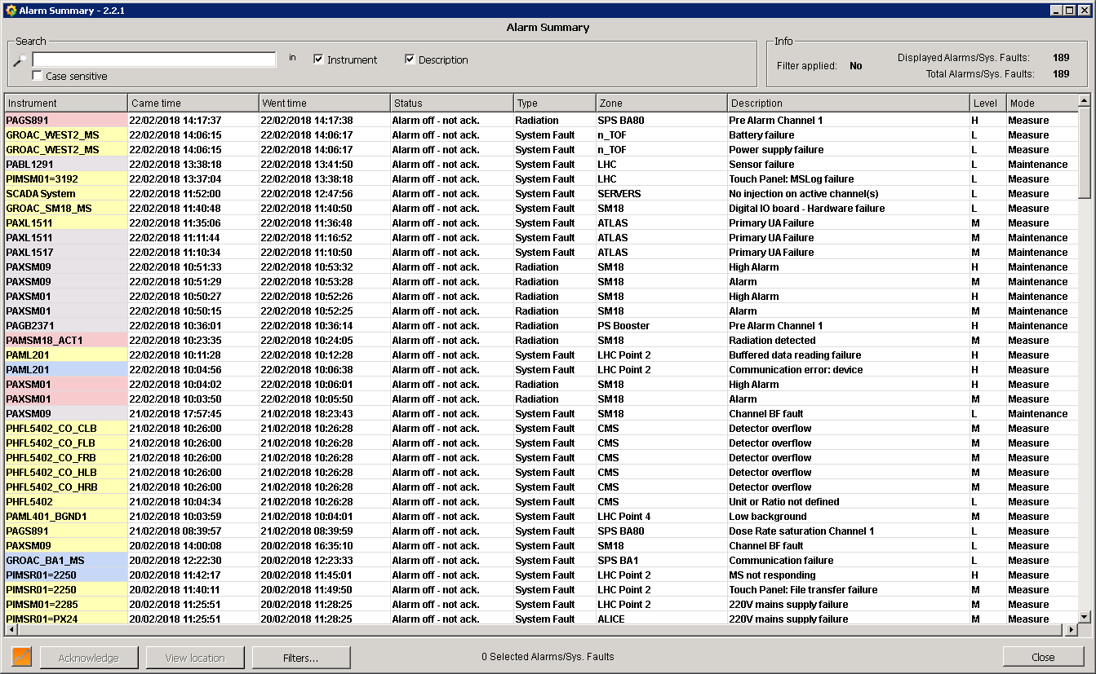

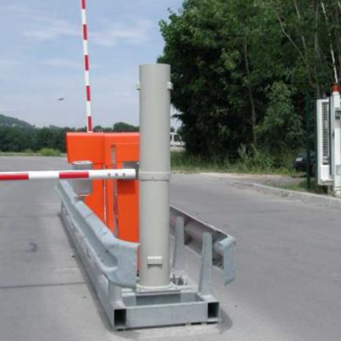
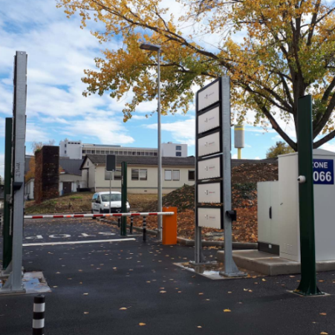
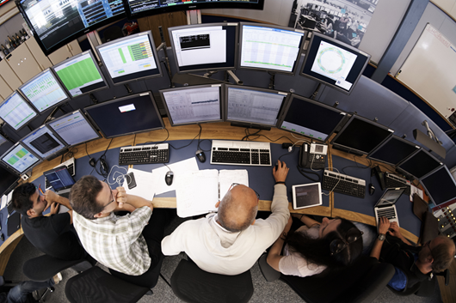
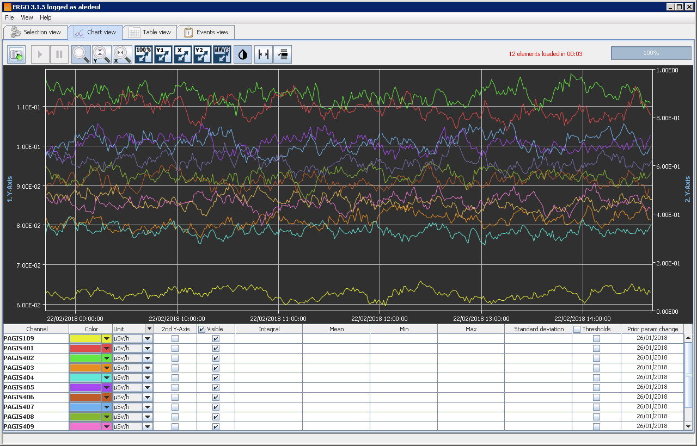
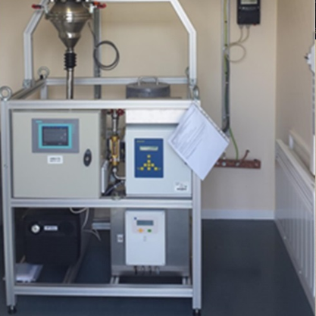
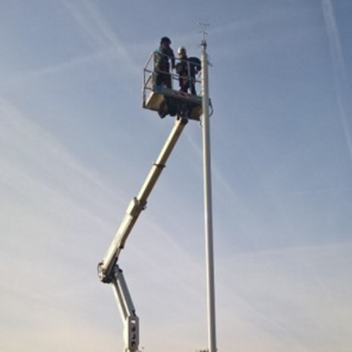
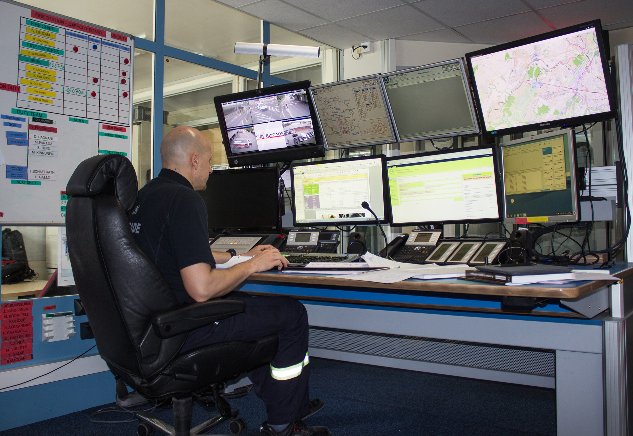
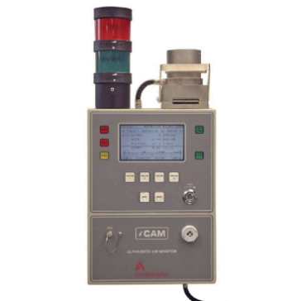
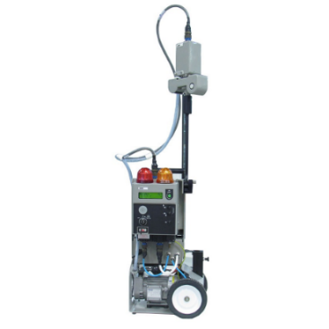
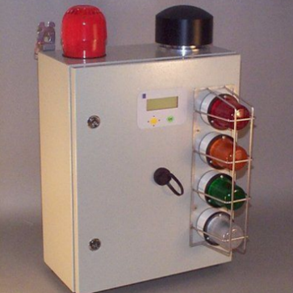
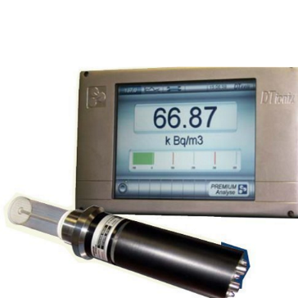
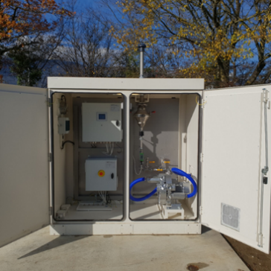
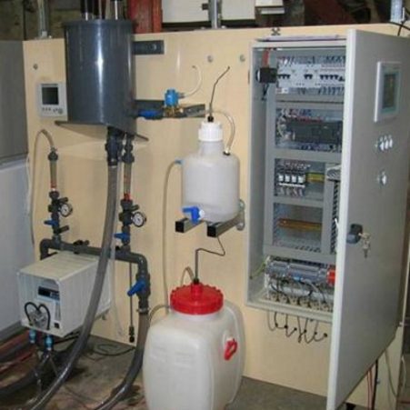
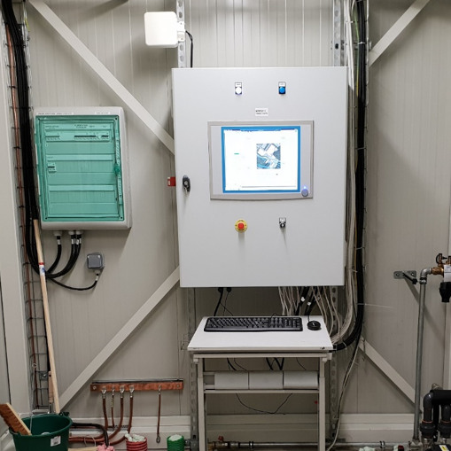
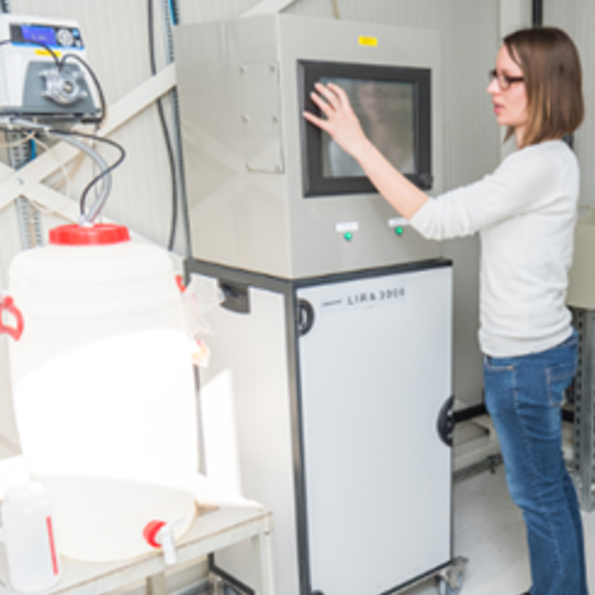
Context
From Instrumentation to Operation
OPERATIONAL RADIATION PROTECTION
50k parameters
Commands
On, Off, Sample, etc.
Parameters
Thresholds, Units, etc.
Radiation Protection & Environmental Experts
REMUS
Supervision
Control
Data Acquisition
CONTAMINATION
800 synoptic
300 active users
GATE
CERN Control Centre
800 stations
120k defined alarms
VENTILATION
WEATHER
Experiments Control Rooms
ERGO
Data Visualization
Measurements
Alarm signals
Faults
Process Statuses
10M meas./hour
AIR
WATER
REMS = Radiological and Environmental Monitoring System
REMUS = Radiation and Environment Monitoring Unified Supervision
ERGO = Environment and Radiation Graphic Observer
SCADA = Supervisory Control and Data Acquisition
Safety Control Room

Slide 7
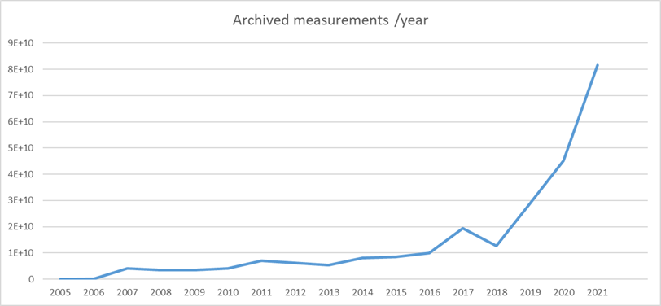
Problem Statement
From Data to Information
REMUS Data in Numbers
1,000,000 online variables
50,000 remote parameters
90,000,000,000 measurements / year
Alerts to Control Rooms
Reports to host state authorities
Data analysis
Dashboards
Aggregated statistics
Predictive maintenance
Anomaly detection

Slide 8

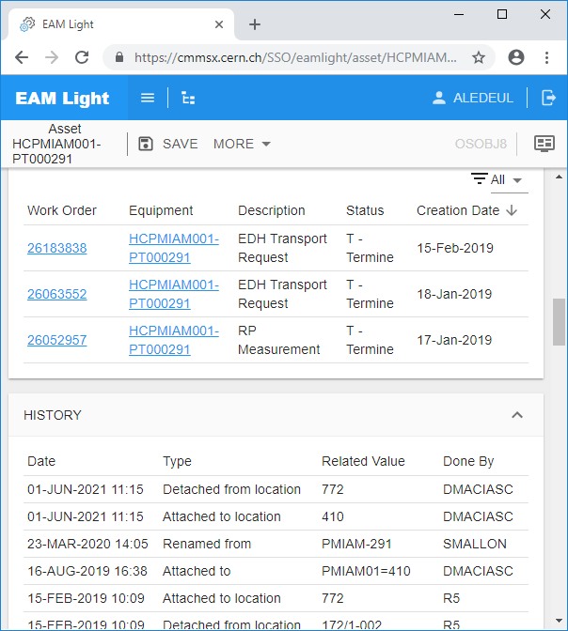

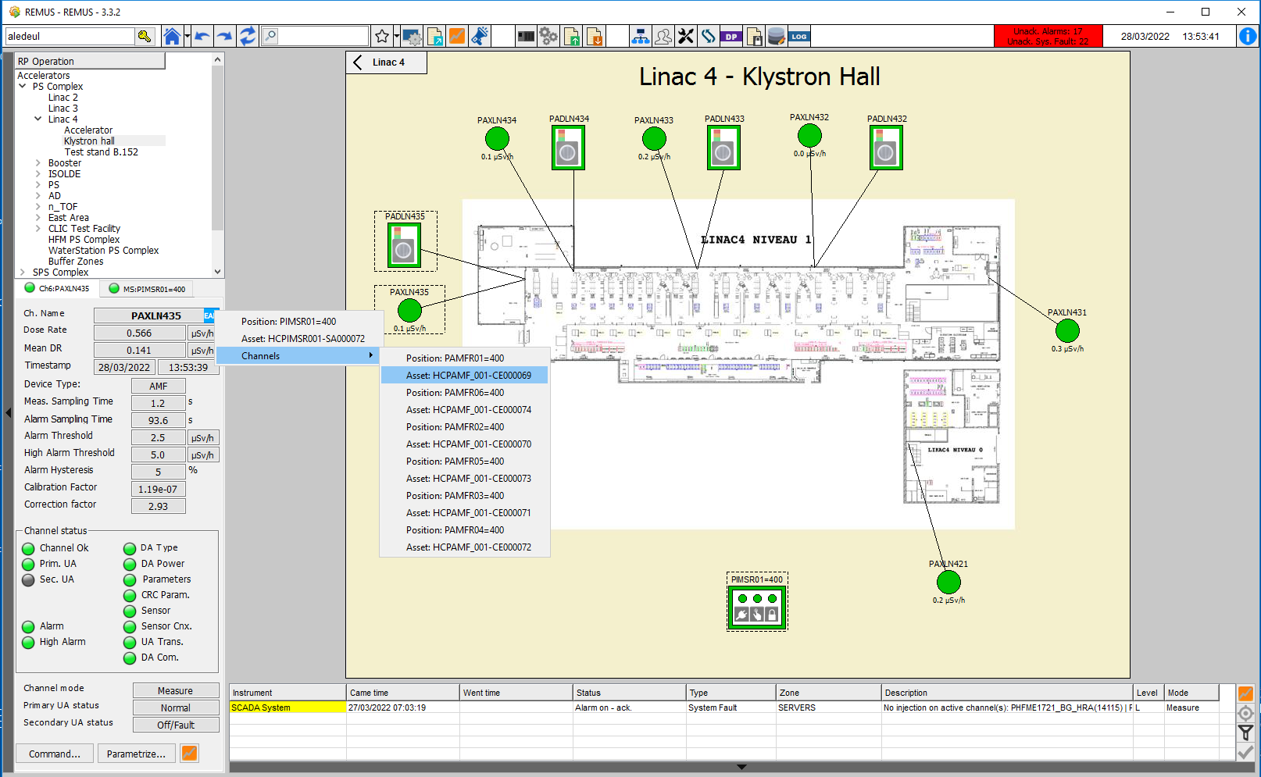



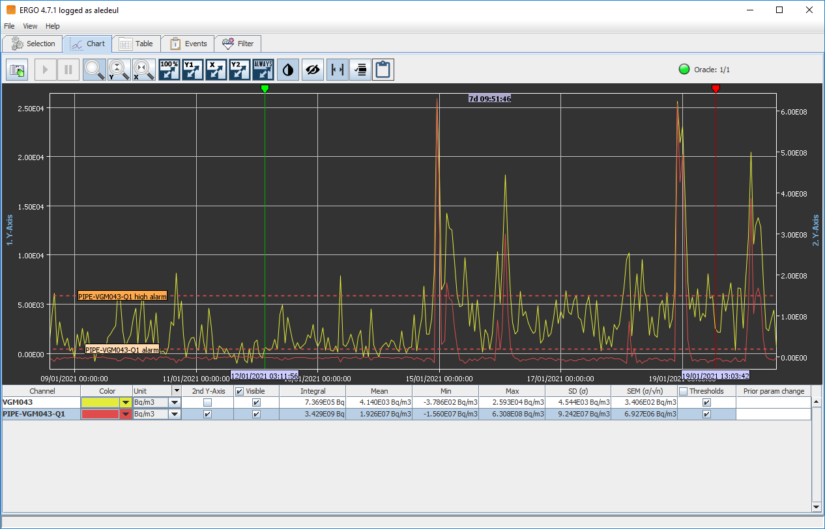
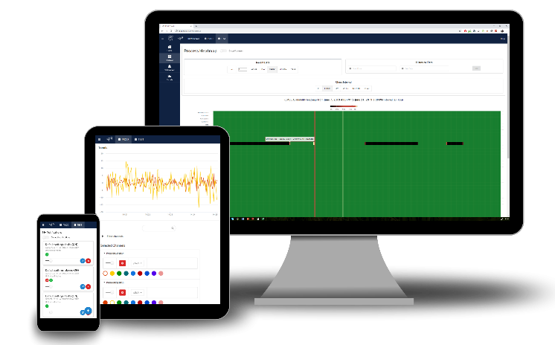
REMADS Project (2019-2021)
Integrated in HSE RAMSES Program
6 months discussions with REMS Users
User Requirement Specification
Project Proposition
  REMUS GPN
  Secured GPN LAN/Wifi/4G/LoRaWAN connectivity
  CERN data-stores
  Integration with Kafka and Hadoop (NXCALS)
  InforEAM Integration
  Maintenance Management
  Information System
4G
  REMUS Web
  Data Analysis toolbox
  Portable system for on-site intervention
  ERGO 4.0
  Complex transformation operations on Trends
REMADS = REMus Analytics and Data Services
GPN = General Purpose Network
LAN = Local Area Network
LoRaWAN = Long Range Wide Area Network
NXCALS = Next CERN Accelerators Logging Service
EAM = Enterprise Asset Management

Slide 9






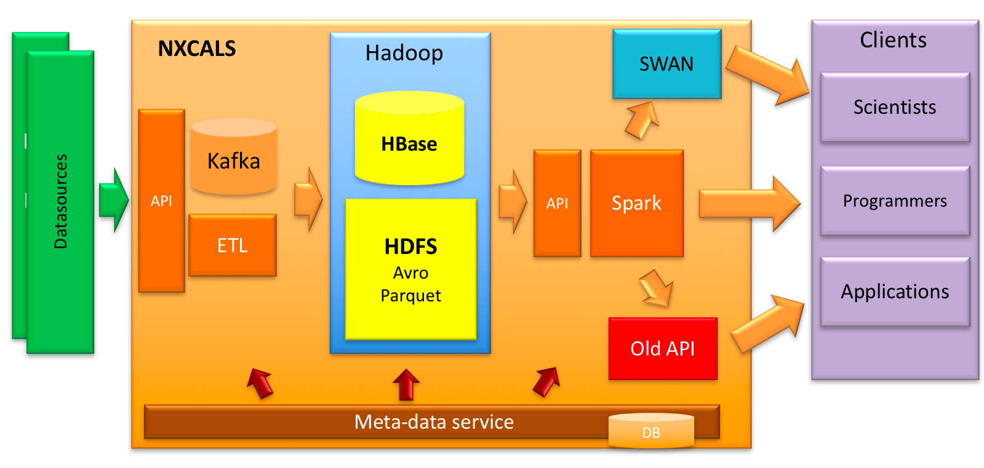

Collaboration with other Departments
CERN-wide services used
Apache Kafka®:
open-source distributed streaming platform
NXCALS
Big data technologies
Centralizes CERN accelerator data
Managed by BE
Data
Data Streaming Platform
Transmit Real-Time data out of REMUS
Managed by IT
Long Term Storage
Near-Real Time
Time Series Database
Buffer Real Time data
Managed by IT
Source: NXCALS - Architecture and Challenges of the Next CERN Accelerator Logging Service,
J. Woźniak and Chris Roderick, 2019
NXCALS = Next CERN Accelerators Logging Service

Slide 10
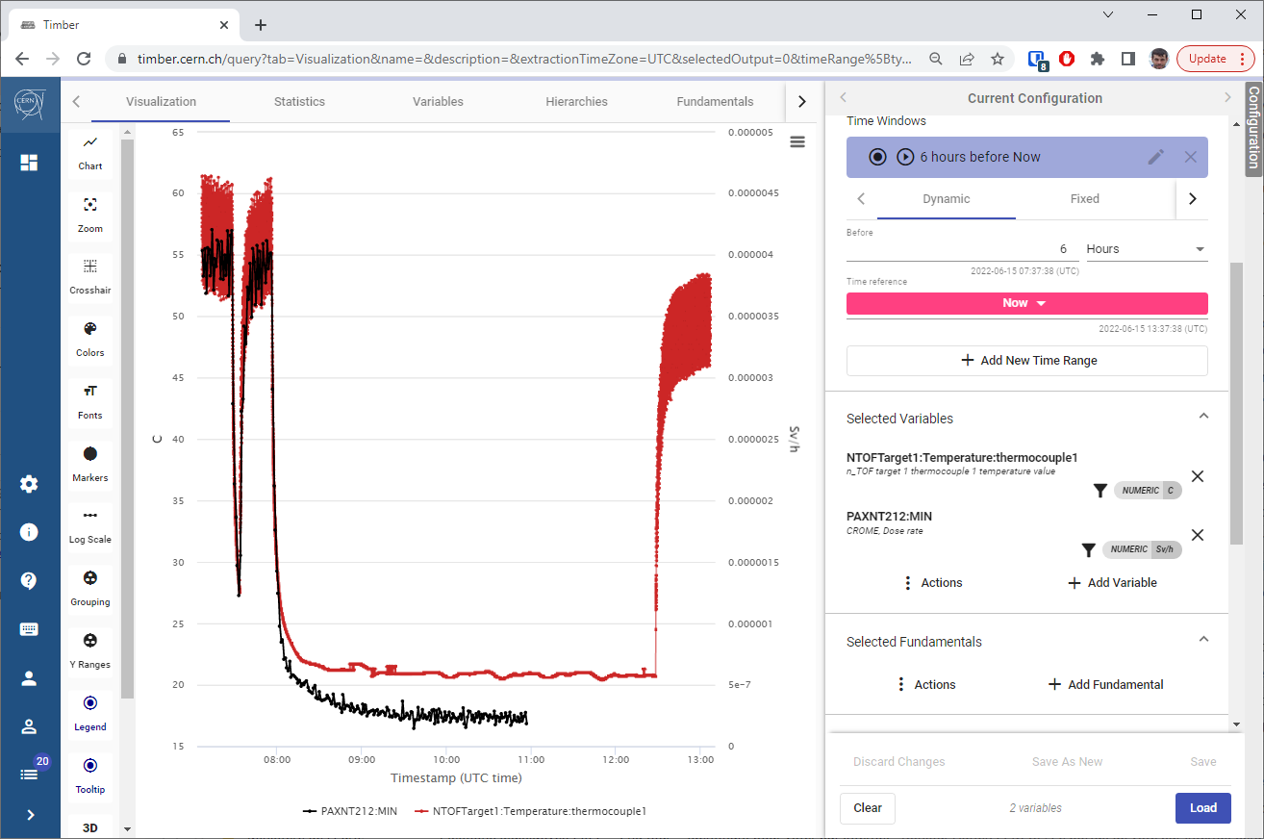
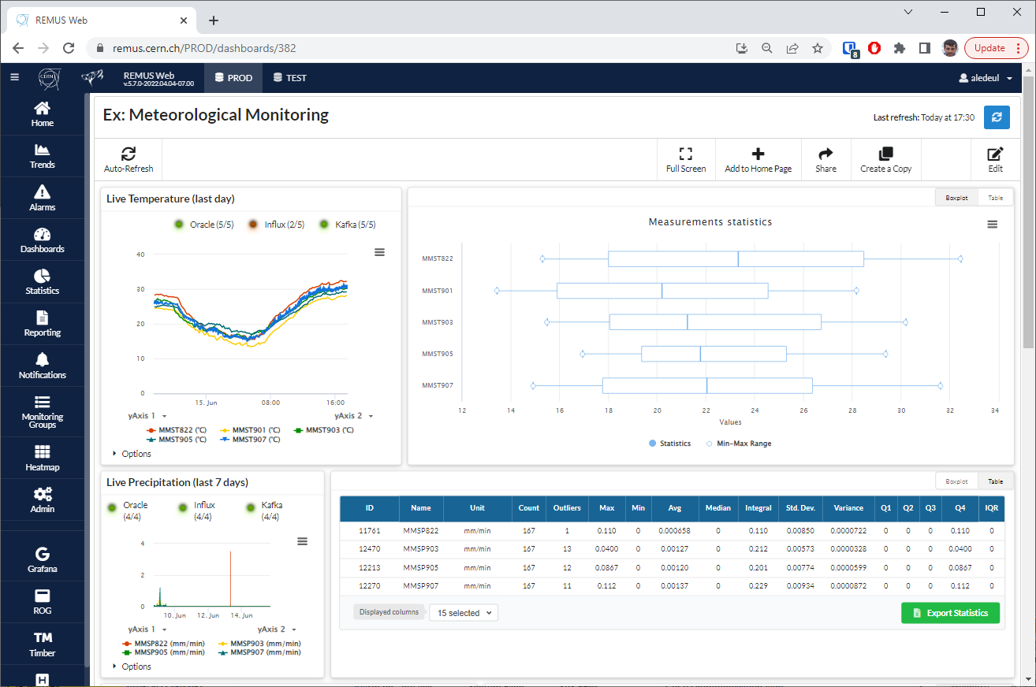
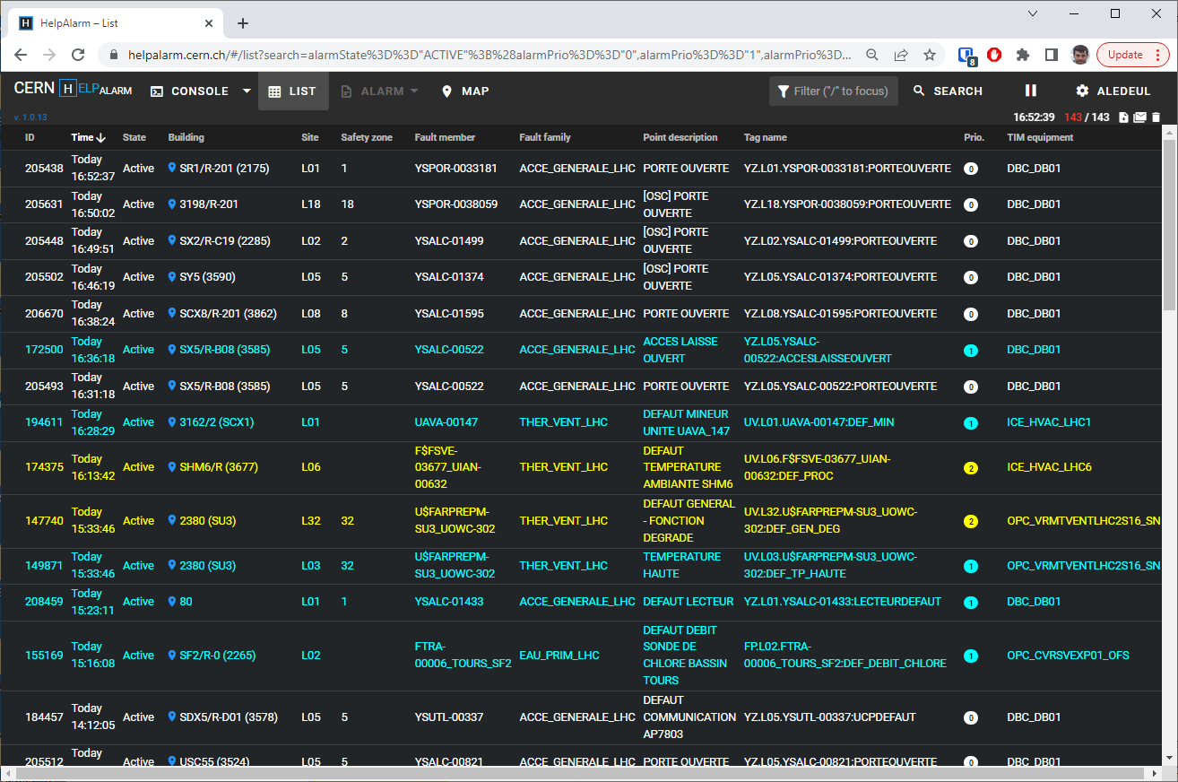

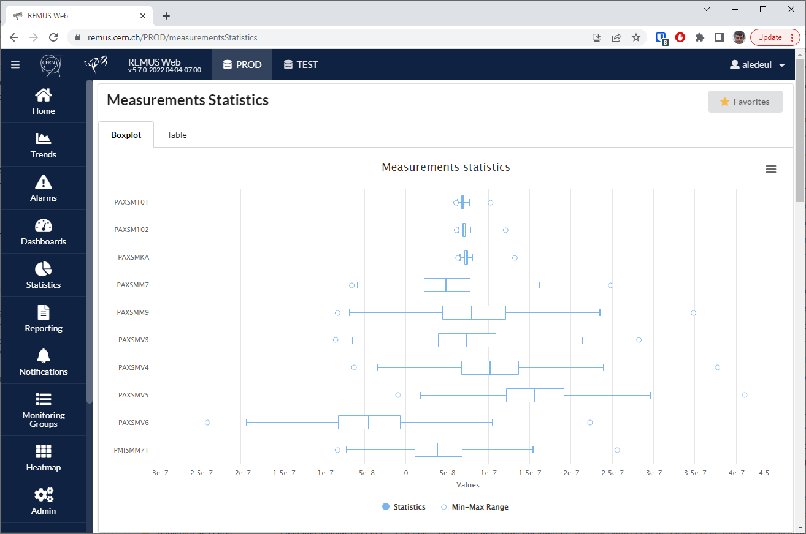
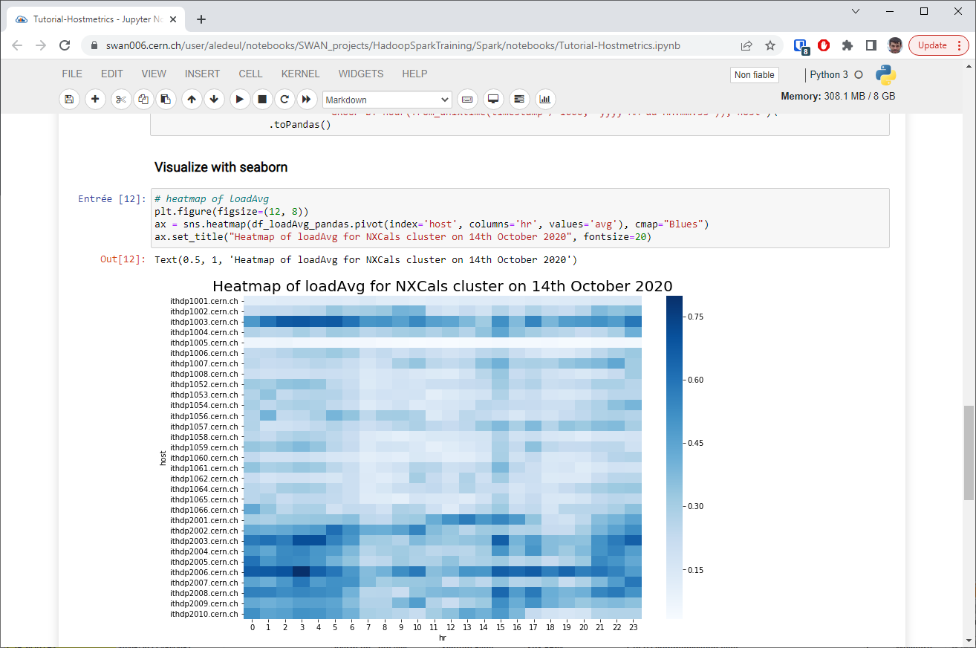
Why & How to use the newly available Software Tools ?
Use-cases & Demos
BE
NXCALS & TIMBER
Speaker: Catalina Chiriac (HSE-TS)
HSE
Dashboards
Speaker: Fabrice Malacrida (HSE-RP)
EN & BE
HSE
InforEAM & HelpAlarm
Speaker: Julien Regnard (HSE-ENV)
REMUS Web
Speaker: Gonzalo De La Cruz (HSE-TS)
HSE
IT & BE
Statistics & Reporting
Speaker: Markus Widorski (HSE-RP)
Data Analysis using SWAN Speaker: Hamza Boukabache (HSE-RP)

Slide 11
REMUS Web

Slide 12
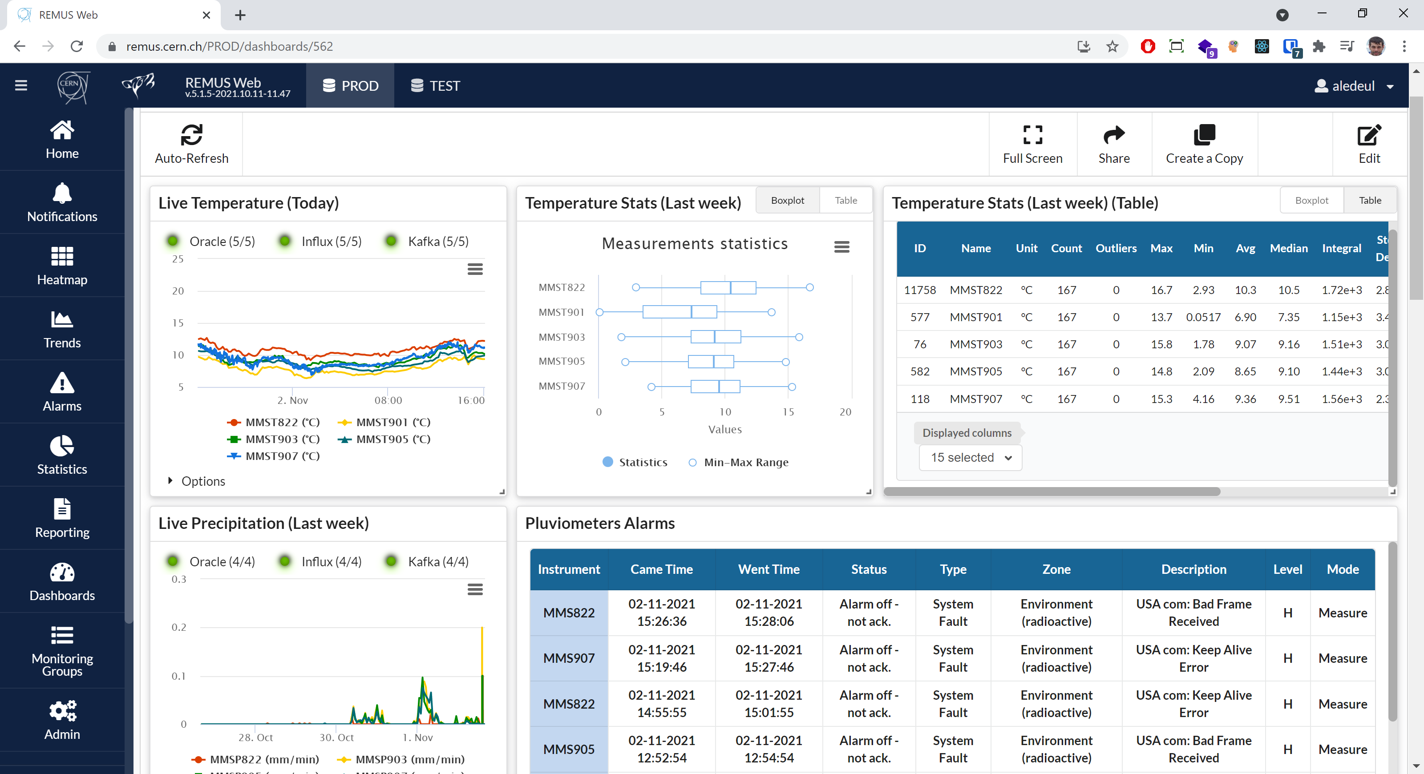
REMUS Web
Dedicated platform for the analysis and exploitation of REMUS data.
Goals:
  Facilitate access to REMUS data.
  Provide data analysis tools for REMUS users.
  Transform REMUS data into meaningful information.

Slide 13
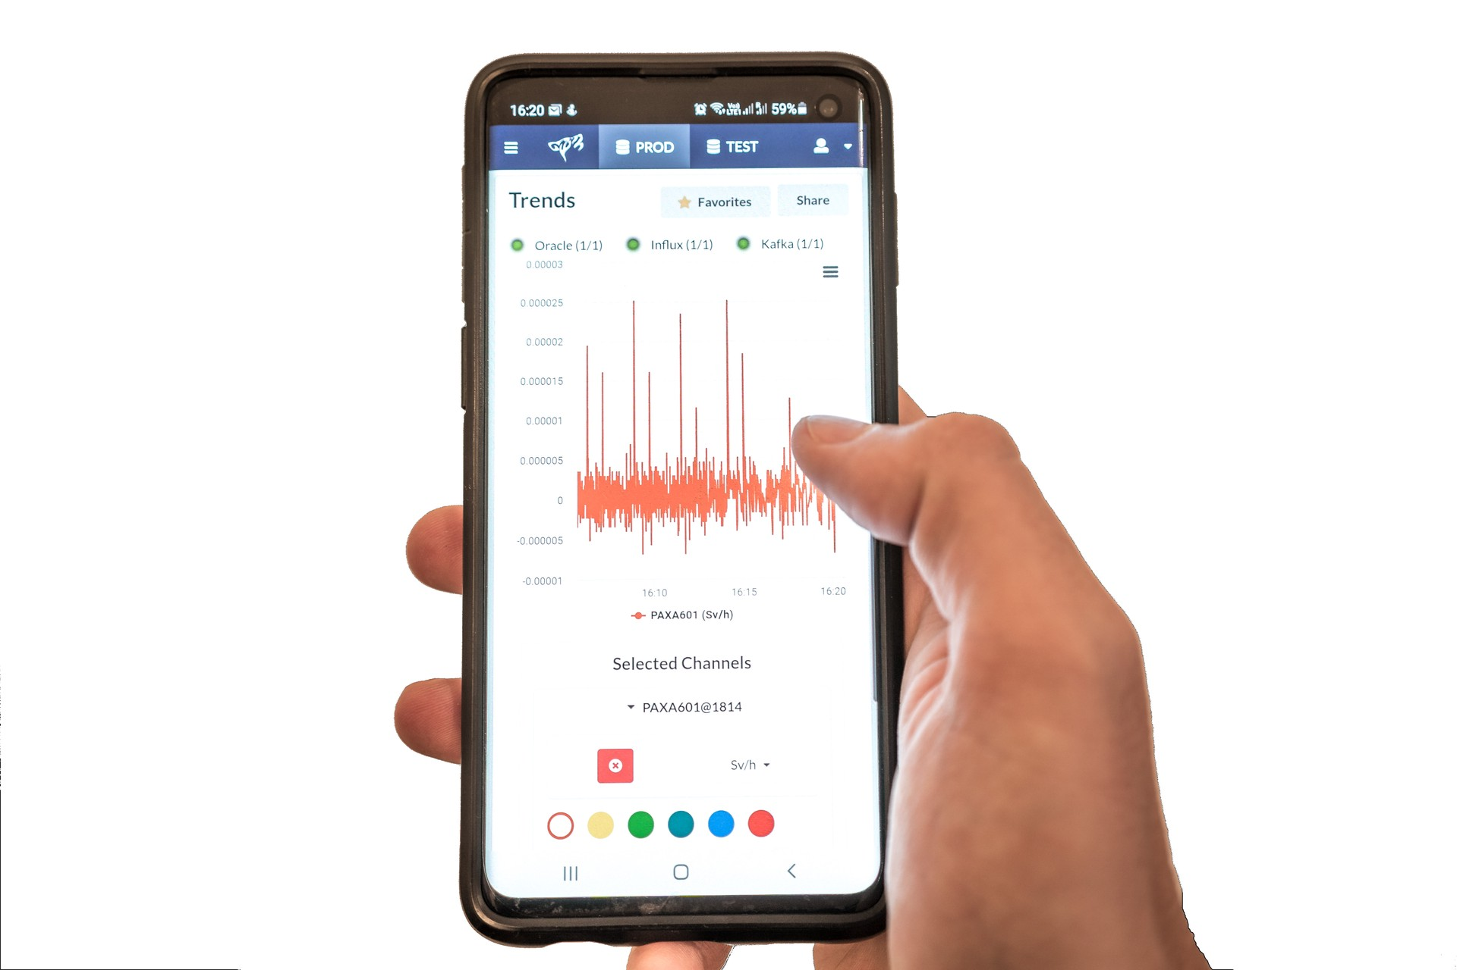
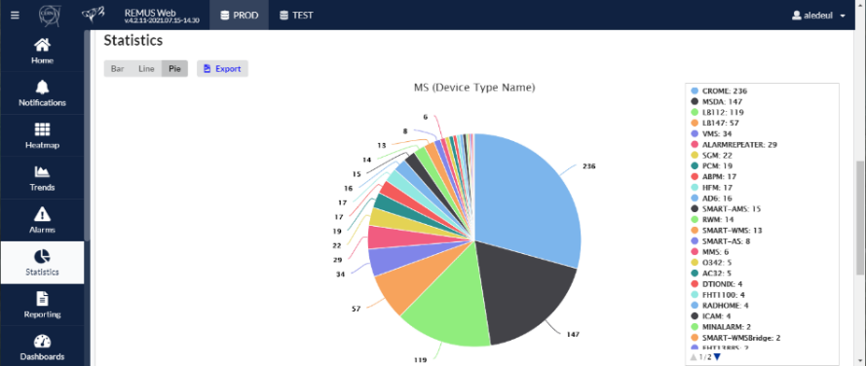
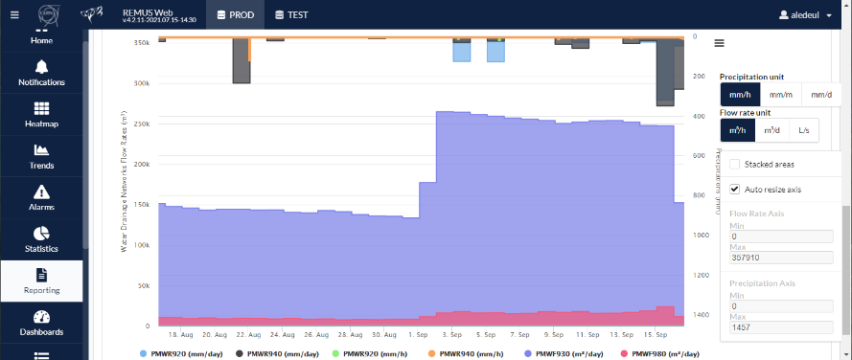
REMUS Web Key Features
Remote access to REMUS data from any desktop or mobile devices.
Tailor-made data analysis and data extraction tools for Radiation and Environmental protection experts
Generation of domain-specific reports for internal analysis and to report to CERN’S host states authorities.
Powerful tool for the creation and visualization of Dashboards.

Slide 14
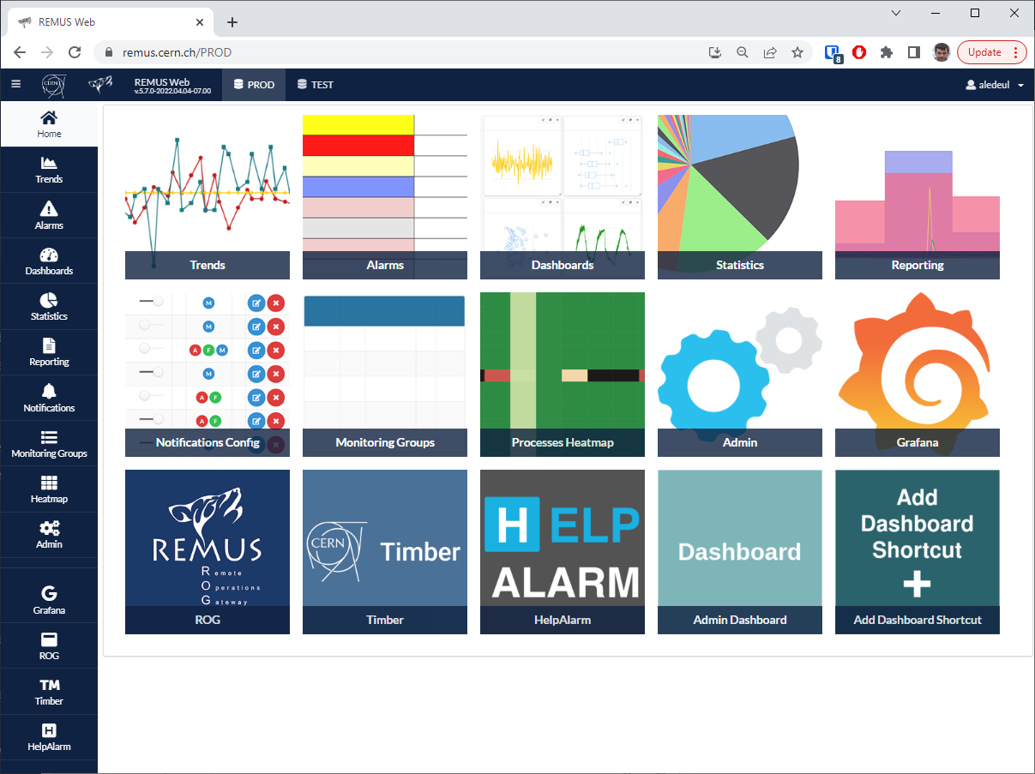
Demo
  https://remus.cern.ch

Slide 15
REMUS Web Dashboards

Slide 16



Demo
  https://remus.cern.ch/PROD/dashboards/844
  https://remus.cern.ch/PROD/dashboards/645
  https://remus.cern.ch/PROD/dashboards/502

Slide 17
REMUS Web Statistics & Reporting

Slide 18

EDMS no: 2746071

Slide 19

EDMS no: 2746071

Slide 20
Statistics → Channels / Events
Retrieve monitor/channel names and types in a specific area
Access the EAM links to a specific measurement position
Create statistics on specific types of events (alarms, faults): Listing and aggregating
EDMS no: 2746071

Slide 21



EDMS no: 2746071

Slide 22



EDMS no: 2746071

Slide 23

EDMS no: 2746071

Slide 24
Reporting → Measurement / Parameter / Snapshot
Get summary statistics of measurements on a group of channels for extended periods
Check parameters settings of a groups of channels for quick validation or comparison
Reporting specific for control measurements (HFM, Portal monitors) to generate statistics on number and results of controls
EDMS no: 2746071

Slide 25



Measurement reporting
EDMS no: 2746071

Slide 26

Parameter reporting
EDMS no: 2746071

Slide 27




Snapshot reporting
EDMS no: 2746071

Slide 28


Demo
  https://remus.cern.ch/PROD/statistics
  https://remus.cern.ch/PROD/reporting

Slide 29
InforEAM & HelpAlarm

Slide 30




InforEAM & HelpAlarm
No possibility to aggregate the maintenance activities by MS/Channel
SharePoint will be obsolete soon
…
Since 2009
130 Environmental Monitoring Stations
125 Mi datapoints / year
InforEAM
HSE
2200 pieces of equipment declared
750 Preventive maintenance activities / year planned
Fully operational by October 2022
EN

Slide 31

InforEAM & HelpAlarm
Preventive maintenance activity

Slide 32


InforEAM & HelpAlarm
https://cmmsx.cern.ch/SSO/eamlight/position/PEMWM01=3876

Slide 33
InforEAM & HelpAlarm
HelpAlarm
90 alarms requiring immediate intervention
160 Environmental Monitoring Stations
BE
125 Mi datapoints / year
InforEAM
750 Preventive maintenance activities / year
HSE
EN

Slide 34


Demo
  https://cmmsx.cern.ch/SSO/eamlight
  https://helpalarm.cern.ch

Slide 35
REMUS data in NXCALS/TIMBER

Slide 36

Data Sharing to NXCALS
NXCALS
TIMBER Web
HSE-CEN
HSE-RP
BE-OP
EP
Notes:
Industrial Controls (QPS, Cryo, Vacuum, etc.) CMW (Beam Instrumentation, RF, Beam Transfer, Powering, etc.) Many special cases (Fundamentals, Converters, LHC Fills and Beam Modes, etc.)

Slide 37

NXCALS System
Shared Big Data storage of all CERN control systems
Help in beam observation devices and investigate problems with accelerator equipment or unexpected beam behavior.
Keep data for long period of time and assure good and performant analyses and data extraction by the physicists.
CERN Control Center
EDMS no: 2746071

Slide 38

Demo
  https://timber.cern.ch

Slide 39
Data Analysis using SWAN (NXCALS data)

Slide 40




CROME System
Data Analysis using SWAN (NXCALS data)
CERN Radiation Monitoring Electronics (CROME)
Rackable
Two configurations :
Radiation Monitoring and processing units
Conceptual view of CROME at CERN
CROME Rack at EHN1 (North Area)
Plastic Air filled ionization chamber
Bulk
SPA6 cable
Up to 1km
1000V
100fA
CROME Junction Box
High Radiation Area
Low Radiation Area
Uninterruptible Power Supply
Includes a battery for continuous operation

Slide 41




CROME System
Data Analysis using SWAN (NXCALS data)
CERN - Radiation & Environmental Monitoring System
650 Radiation Protection and Environmental monitoring devices
CROME
2021
1984
CROME
2004
Self production capabilities
2028
LHC
Tests / validation inside climatic chambers
North Area
SPS
AWAKE
AWAKE
AD
HIE-ISOLDE
LHC injectors
TTs
East Area
n-TOF
LINACs
PS
CTF3
Assembly Workshop
For more info : https://crome.web.cern.ch/node/35

Slide 42






CROME System
Data Analysis using SWAN (NXCALS data)
CROME/REMUS Network
ECA4 - SPS
CERN Control Room
Maintenance
CERN NTP Servers
Technical Network
IT Socket
IT Socket
IT Socket
IT Socket
6 Ethernet connections
IT Socket
12 Ethernet connections
1 Eth connection
Real Time Measurements
Events
Status
Historical Values
Status
1 Eth connection
1 Eth connection
CROME Radiation Monitor
Real Time Measurements
Events
Status
Historical Values
CROME Radiation Monitor
Real Time Measurements
Events
Status
Historical Values
Real Time Measurements
Events
Status
Historical Values
42

Slide 43






CROME System
Data Analysis using SWAN (NXCALS data)
Operational Data
NXCALS
Dose rate
Integrated doses
Temperature
Humidity
High voltage
Events
Statuses
Injection
Wireless CROME rad. det.
TIM
CERN Technical Network
Internal Voltages
Internal Temperatures
SoC internal parameters
…
Injection
Wired CROME radiation detectors
Non-Operational Data
CMPU – Rack Electronics

Slide 44



CROME System
Data Analysis using SWAN (NXCALS data)
Work Package Overview
Currently: Data sent to NXCALS remains unused
Goal: Use data on NXCALS for Predictive Maintenance
Develop Anomaly Detection process to identify failure precursors

Slide 45

CROME System
Data Analysis using SWAN (NXCALS data)
Challenges for Anomaly detection
No System Failures known
No data available that represents healthy state of system
No definition of anomalous behavior
Anomalies are rare and different
Focus on noise in signals
Use multi-level wavelet transform (MRA-WT) for noise extraction

Slide 46



CROME System
Data Analysis using SWAN (NXCALS data)
Anomaly Detection Process
Being evaluated
NXCALS
CROME Internal Data
Optional
Pre-Processing:
Feature Engineering: Calculate statistical features (raw and extracted noise signal)
Handling of Missings
Scaling
Apply Algorithms:
Isolation Forest, Autoencoder

Slide 47






CROME System
Data Analysis using SWAN (NXCALS data)
Preliminary Architecture
Maintenance?
Feedback Loop
Retrain Model
Normal
Anomaly
Training data
Model training
e.g. AE
Manual analysis
Assign Label
Daily, Weekly, …
Ranking
Sample | Anomaly score
PMIST214 | 8.564
PMINA0603 | 4.371
PAXNT211 | 2.093
… | …
NXCALS
Operational
Calculate anomaly scores
+ Internals?

Slide 48

Demo
  https://swan.cern.ch
Find the tutorial here : https://gitlab.cern.ch/hboukaba/nxcals/

Slide 49
Conclusion

Slide 50
Summary
Evolutions necessary for the operation
REMUS Web
  REMUS data analysis gateway
REMUS Web Dashboards
  Share data summary with other
REMUS Web Statistics & Reporting
  Efficiently generate reports for analysis and reporting
InforEAM & HelpAlarm
  Interface CERN-wide Maintenance and Alarm systems
REMUS data in NXCALS/TIMBER
  Long term Data storage at high resolution
  Allow comparison and correlation with other control systems’ data
REMUS data in NXCALS/SWAN
  Extended big-data analysis capabilities

Slide 51

What’s next? : REMUS Web Application Editor
Ease REMUS Application Edition

Slide 52



What’s next? : Net Ambient Doses and Releases Reports
A step further into Knowledge Integration
Streamline the generation of adjusted Ambient Doses and Releases Reports
  Increase reliability of data treatment
  Minimize risk of human error
  Guaranty repeatability and traceability
Net Ambient Doses and Releases Reports functional specifications.
Credit: F. Malacrida (HSE-RP)

Slide 53


A glimpse into the future
Other CERN Web Technologies Projects for Control Systems
Growing trend in Industrial Control Systems at CERN and beyond
CTTB Working group
  Web Technologies task Force
W.R.A.P. (BE-CSS)
  Cross-system live charts
Flow Project (EN-SMM/BE-CEM)
  Live web widgets
WRAP. Credit: BE-CSS
Flow Project. Credit: BE-CEM
CTTB = ATS Common Hardware & Software Technologies Technical Board
WRAP = Web Rapid Application development Platform

Slide 54
Thank you!

Slide 55
Questions

