Slide 1

Coordinator Report to the 6th ARIES Governing Board Meeting
Status, scientific progress, contractual obligations
Maurizio Vretenar, CERN, Project Coordinator, 31 May 2022

Slide 2
The ARIES timeline
2014: internal call for proposals to go into a new project under the name of «Eucard3» (51 proposals submitted).
Early 2016: the name ARIES (Accelerator Research and Innovation for European Science and Society) is selected.
Proposal submitted 4 April 2016.
26 August 2016 received the Evaluation report: 14.5/15, the highest ever for an accelerator integration project. ARIES is 3rd out of 28 projects.
1 May 2017: official start of the project.
End of February 2020: start of the Covid-19 crisis, all meetings go online and access is drastically reduced.
September 2022: an Amendment to the Grant Agreement redistributes the target figures for Transnational Access and extends the TA’s by one full year, and the other WP’s by a few (maximum 9) months.
End of December 2022: all NA’s and JRA’s are terminated.
End of April 2022: ARIES is officially closed, time until end of June to submit final reporting and all deliverables.
2 - 3 May 2022: final Project Meeting at CERN (first in person since April 2019).

Slide 3




What we promised: the four ARIES pillars
excellence
access
innovation
sustainability
Develop key accelerator technologies to make more performant, affordable, reliable and sustainable the present and future accelerators
Improve the European accelerator infrastructure
New scheme of Transnational Access opening 14 accelerator test facilities
Enlarged consortium with 20 new partners in accelerator projects and 6 new countries in the East and South of Europe
Enhanced industrial participation (7 industries and 1 association)
3 new co-innovation programmes with industry
Development of societal applications (medicine, industry, environment)
Joint programme with TIARA to develop a model for sustainable accelerator science in Europe
Training programme for the new generations of accelerator scientists and engineers

Slide 4
Main ARIES success stories (personal view)
We have contributed to promote plasma and laser based acceleration, creating the environment for the success of EuPRAXIA in ESFRI.
We have contributed to relaunching after many years the study in Europe of the Muon Collider.
High Temperature Superconductivity magnet studies have continued in Europe only thanks to ARIES.
The Proof-of-Concept Innovation Fund has started an efficient scheme for internal selection and support of innovative projects.
New applications to society have been identified and supported, in particular for the environment (ship exhaust, sludge, etc.).
The WP6 Workshops have investigated many new perspectives for accelerators (muon collider, gravitational waves, etc.).
An electron gun for electron lenses has been assembled and tested for the first time.
Most of our innovative TNA facilities have provided access to a variety of users, producing science and enlarging our user community.
The MOOC (Massive Open Online Course) has inaugurated a new way of teaching accelerators and of reaching to the younger generations.

Slide 5

From ARIES to the ESPP Update
The conclusions of the recent update of the European Strategy for Particle Physics fully incorporate the strategic objectives of ARIES, and base many of their accelerator R&D recommendations on the results of ARIES:
Strengthen the European ecosystem of research centres: one of the main goals of ARIES.
Launch a vigorous R&D on innovative accelerator technologies: was the main goal of ARIES, and continues now in I.FAST (HTS magnets, muon colliders, plasma wakefield)
Develop synergies with neighbouring fields: ARIES (and before EuCARD2) have launched a strong synergetic effort with synchrotron light sources, neutron sources, and industrial/societal applications.
Mitigate environmental impact of particle physics: one of the key themes of ARIES.
Knowledge and technology transfer, training of next generation, education and communication: key topics in ARIES.

Slide 6
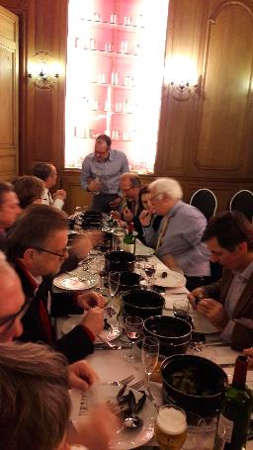
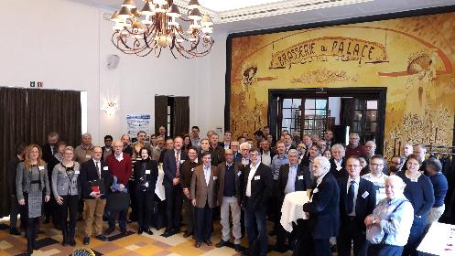
The ARIES «soft objectives»
One of the main goals of ARIES was not only to produce science and innovation, but to create a community including both industry and researchers around that would sustain the science and innovation.
ARIES-industry co-innovation workshop, Brussels 2018

Slide 7
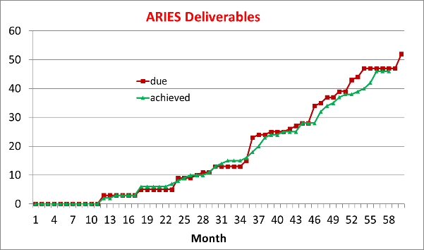
Measurable results: the ARIES Deliverables
Missing only the 5 deliverable reports from the TA’s (being compiled at CERN, will be submitted in June) and the final version of D16.3 (Test of electron gun completed) by IAP, ready but waiting for final beam measurements to take place in June.
Successful final rush, with 12 Deliverables submitted between April and December 2021

Slide 8
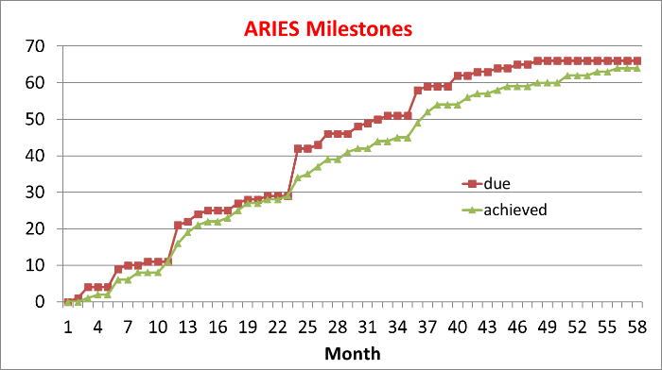
ARIES Milestones
For the Milestones, we only miss only MS62 (Dissemination of R&D results) in preparation from WP17 (material studies)

Slide 9
The ARIES Transnational Access
The total number of Access Units promised in the Amended Annex1 (18’724) has been largely exceeded (23’905, 128%).
Only 2 facilities have provided zero or very limited access because of technical problems: Gersemi at UU and SINBAD at DESY.
Other facilities have provided a reduced access, compensated by others.
In a discussion with the Project Officer, he acknowledged that this situation is typical of R&D projects and should not lead to a reduction in EC contribution.

Slide 10
ARIES and Covid-19
Main effects of Covid: a) all in-person meetings went online, losing the important direct personal contacts that are an essential background to innovation; b) many laboratory activities were slowed down; c) access to some TA facilities was not possible – and could not be made virtual.
But we succeeded: despite the delays, deliverables and access were completed thanks to the dedication and efforts of the teams – and to the extension foreseen in the Amendment.
One positive aspect: I encouraged the Task Leaders to use unspent travel budget to hire and support additional young collaborators, to be used to improve the quality of our deliverables. This worked well in many laboratories.

Slide 11
The 3rd and last Periodic Report
By the deadline of 30 June, we have to submit the Periodic Report 3 covering the last 2 years of the project (May 2020 – April 2022). This report will indicate that all ARIES goals have been reached (including deliverables, milestones, and an adequate amount of access) – a “Final Report” is no longer needed.
The Work Packages that ended in 2021 (all Networks and JRA’s) have already provided the text that will be used for preparation of the Report. The TNAs have been provided their text at the end of April.
The CERN Project Team (Valerie and Sabrina) is assembling the Periodic Report that should be submitted at the end of this month.

Slide 12
The Final Review
The new Project Officer, Antonio Ventura from the REA Agency, has organised a «Final Review» of the Project in the form of a 1-day Zoom event on 15 July, at the presence of the Expert reviewer Prof. Maria José Garcia Borge.
The Review will include a general presentation on the project, and 15’ presentations by all WP Coordinators – using the same format and content of the Final Annual Meeting of May.
This Review is an essential step to claim the full success of the project and unblock the final payment.

Slide 13

The legacy of ARIES: I.FAST
Innovation Pilots,
a new EC instrument for «super-advanced» Research Infrastructure communities
In November 2020, the EC has approved the Innovation Pilot Project I.FAST (Innovation Fostering in Accelerator Science and Technology), submitted to the last call of Horizon 2020.
I.FAST is a collection of joint R&D activities with industry and strategy groups to develop ideas and technologies for the next generation of particle accelerators, grouped into 13 thematic areas.
There is no Transnational Access, some Networks activities continue as strategy groups, and the largest fraction of the project is made of JRA-type activities with strong industry participation.

Slide 14
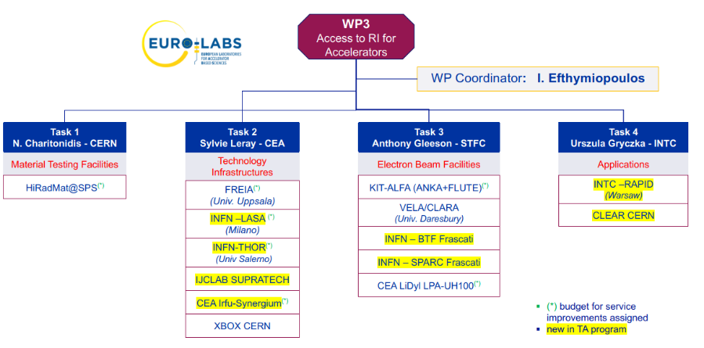
The legacy of ARIES: EURO-Labs

Slide 15

A final word
At the end of 5 fruitful years of work, I wish to thank the ARIES Governing Board and its Chair for their continuous support and encouragement.
The success of a project is also due to the competence and engagement of its governing bodies.

