Slide 1

LHC BLM:
Status of MP system commissioning before first beam
Machine Protection Panel
April 2022
Christos Zamantzas on behalf of BLM team
SY-BI-BL: Anders Toft Lernevall, Jean Michel Meyer, Jose Carlos Esteban Felipe, Belen Maria Salvachua Ferrando, Sara Morales Vigo, Eva Calvo Giraldo, Ewald Effinger, Mathieu Saccani, William Vigano'
SY-BI-SW: Georges-Henry Hemelsoet, Manuel Gonzalez Berges, Mathieu Rodrigues Da Conceicao, Stephen Jackson

Slide 2
Update on new installations

Slide 3
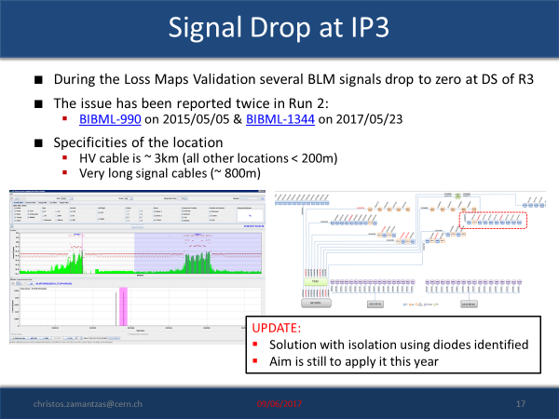
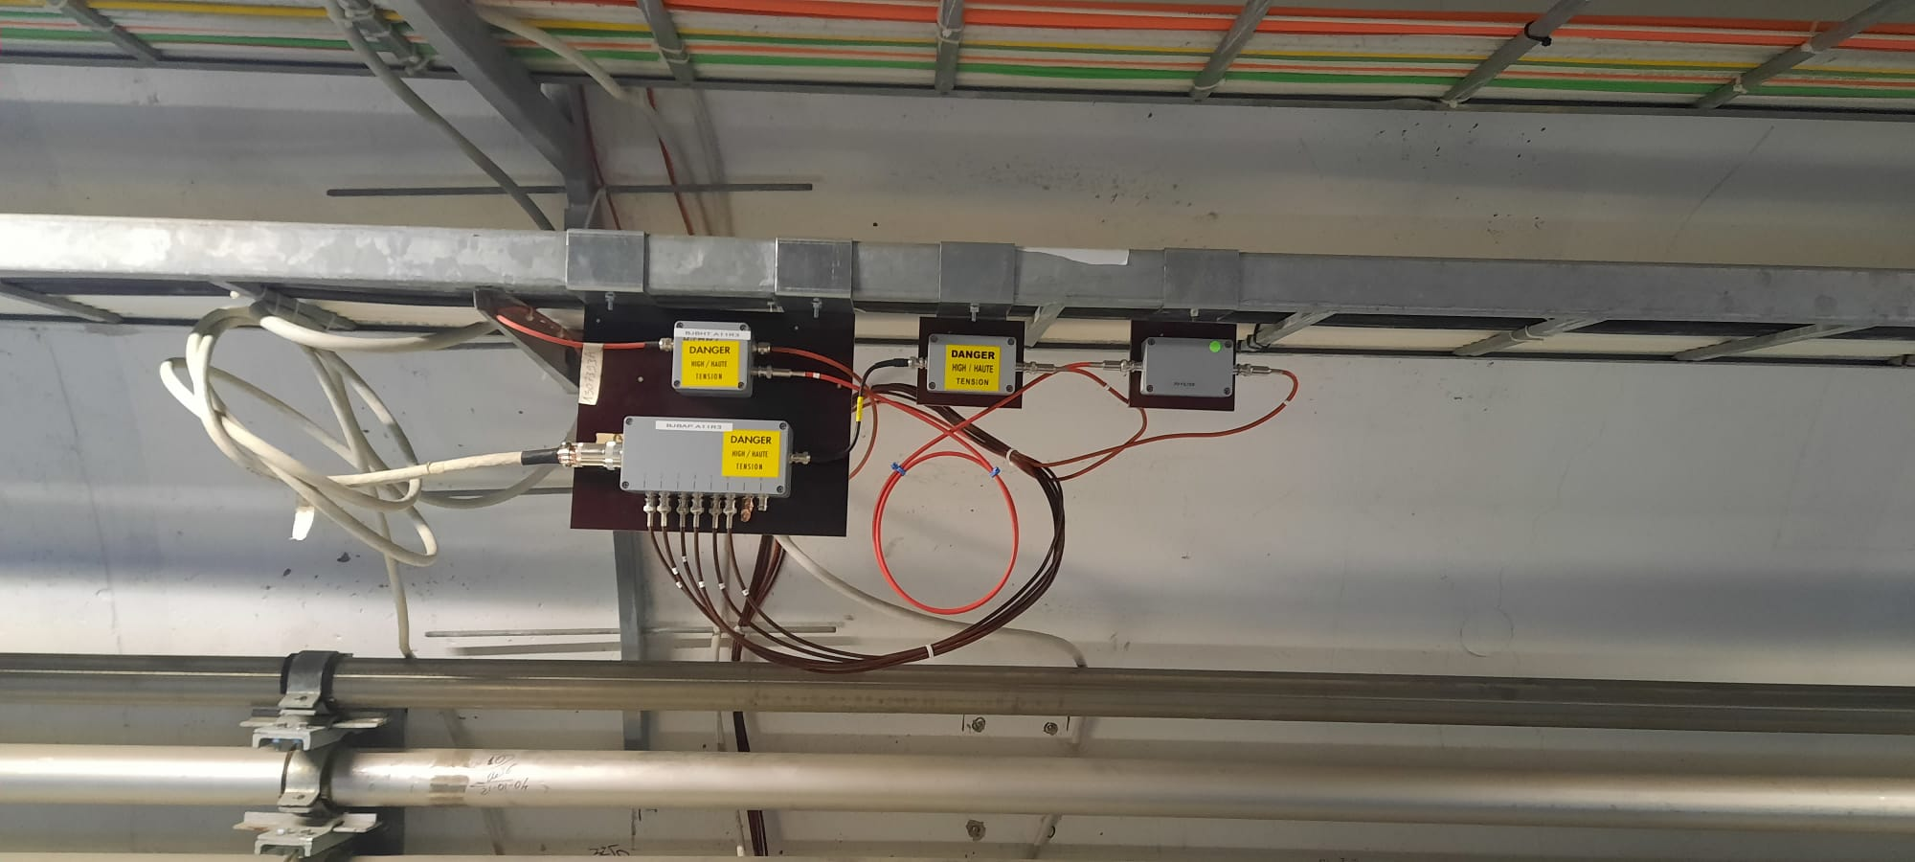
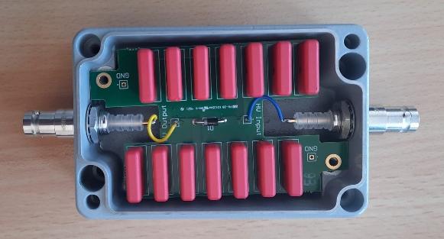
Diode Boxes installation in LSS3
Installed 36 Diode boxes in LSS3
Validated at the lab and
Tested with modulation of the detector’s bias supply at LHC installation.

Slide 4
Additional Signal Filters
Filters added to the following detectors:
  On top of the QBBI interconnects (cell 8/9 left of IR2), i.e.
    BLMBI.08L2.B0T10_MBB-MBA_07L2
    BLMBI.09L2.B0T10_MBB-MBA_08L2
Filters prepared for future installation (if needed):
  For Beam 1 detectors on Q7/Q8 right of IR8, i.e.
    BLMQI.07R8.B1I10_MQM
    BLMQI.07R8.B1I20_MQM
    BLMQI.07R8.B1I30_MQM
    BLMQI.08R8.B1I10_MQML
    BLMQI.08R8.B1I20_MQML
    BLMQI.08R8.B1I30_MQML

Slide 5
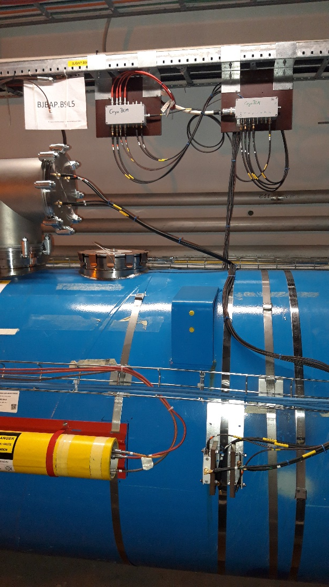
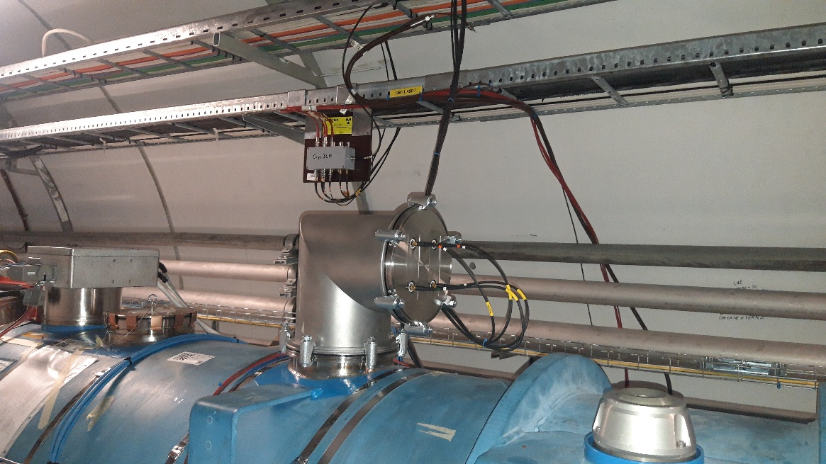
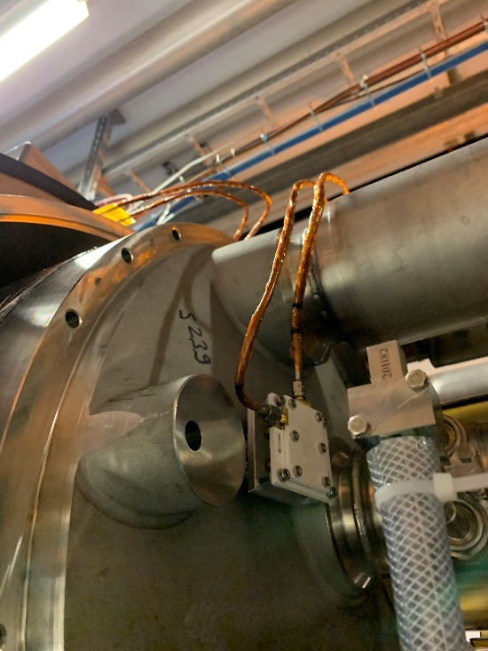
CryoBLM Installation at 9L5 and 9R7
Installation completed with two CryoBLM detectors per point
Additional external Diamond detectors for cross-check
All detectors in DC measurement mode with standard LHC electronics
  BLECF modules integrating at 40 μs
Could be modified in the future for AC measurements

Slide 6
Interlock Inhibit at Injection

Slide 7
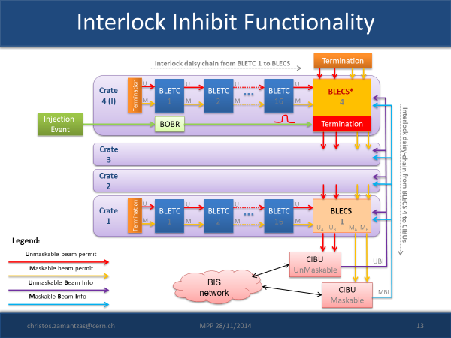
Interlock Inhibit Firmware
Run 2
  Special firmware version at two ‘injection’ crates
  Would be active only if
    Energy < 491 GeV, i.e. first two energy levels
    Timer is set > 0
    Injection event received
  Would act only to the channels defined as ‘MASKABLE’
Run 3
  Deployed in all LHCBLM crates
    Same firmware version/binary since 2015
  Newer version under development;
    mostly ready, some issues with the ‘Sanity Checks’ holding us back
  Conditions to become active remain the same
  Roll-back to version without this functionality is very quick, i.e. link old version and reboot.

Slide 8
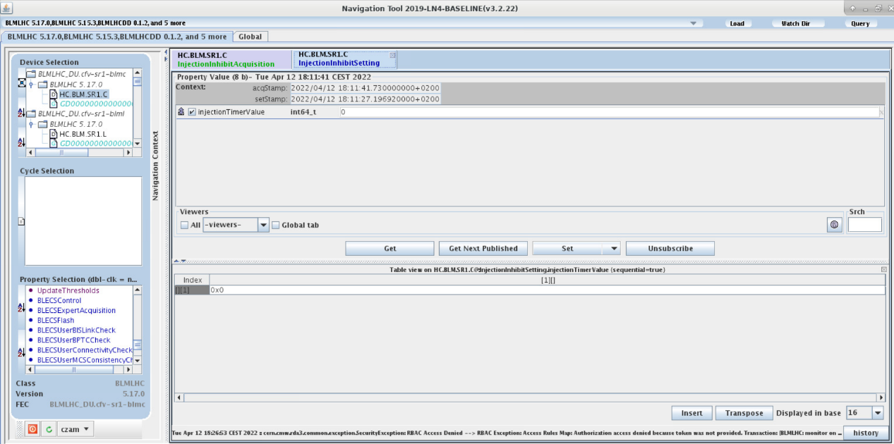
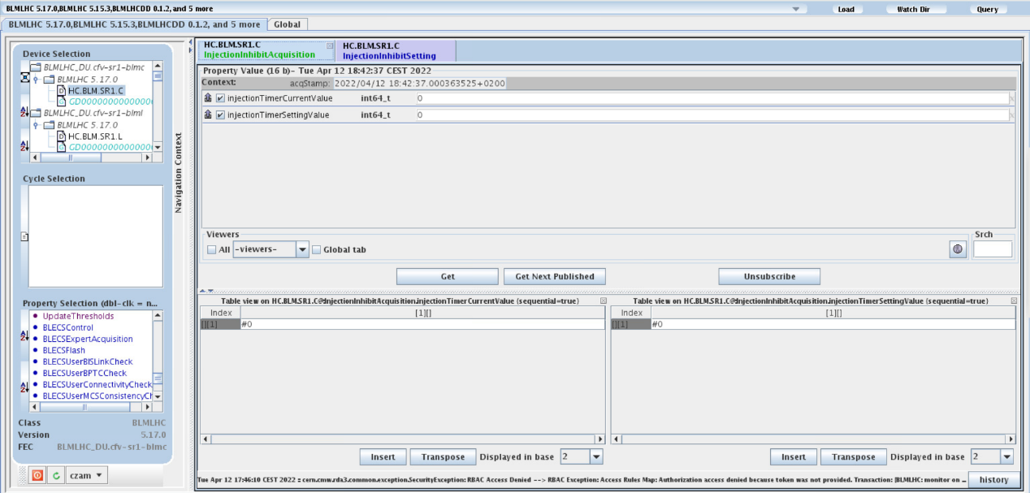
Interlock Inhibit Software
Two new properties to set and monitor the function
InjectionInhibitSetting
  Set the timer value for the inhibit
InjectionInhibitAcquisition
  Timer Setting
    Shows the value configured for this crate
  Timer Countdown
    MSB is high when the function is active
    The remaining bits show the value of the timer as it decreases

Slide 9
Injection Interlock Inhibit
Prerequisite before any test
  Decide which crates & detectors need the functionality
  For the identified crates:
    Set Timer (some value other than zero) to those crates
    Change flag of all channels that should not be blindable to ‘UNMASKABLE’
    Change flag of all channels that should be blindable to ‘MASKABLE’
Tests with pilot beam
  During commissioning of injection protection system
  Create losses above dump threshold
  Modify blindout time
  Record interlock input from blindable/non-blindable crates
  If losses above dump threshold cannot be reached, lower the monitor factor of blindable crates BLMs
Tests with trains
  288 b or what is being used for scrubbing
  Tighten TCDIs from 5 sig to 4.5 sig (likely settings for Hilumi)
  Tighten monitor factor
Criteria for successful test:
Functionality: ‘blindable’ detectors DO NOT interlock within given blindout time and losses above threshold
Redundancy: ‘non-blindable’ detectors DO interlock in case losses go above threshold on those, while blindable ones do not interlock
Inhibit time: setup the necessary blindout time – not critical, can be adjusted later

Slide 10
Known issues

Slide 11
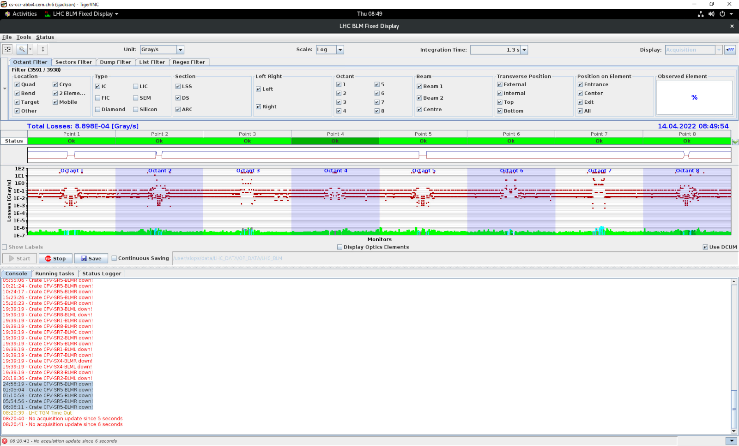
Crate Missing Messages
Fixed display warns regularly with messages that one of the crates is ‘down’
  Frequency ~ 5-6 messages per 24h
  Crates are random
Data in NXCALS do not have gaps
Could not find correlation with any activity/action
  Not a critical issue but could mislead
  Will continue investigation

Slide 12
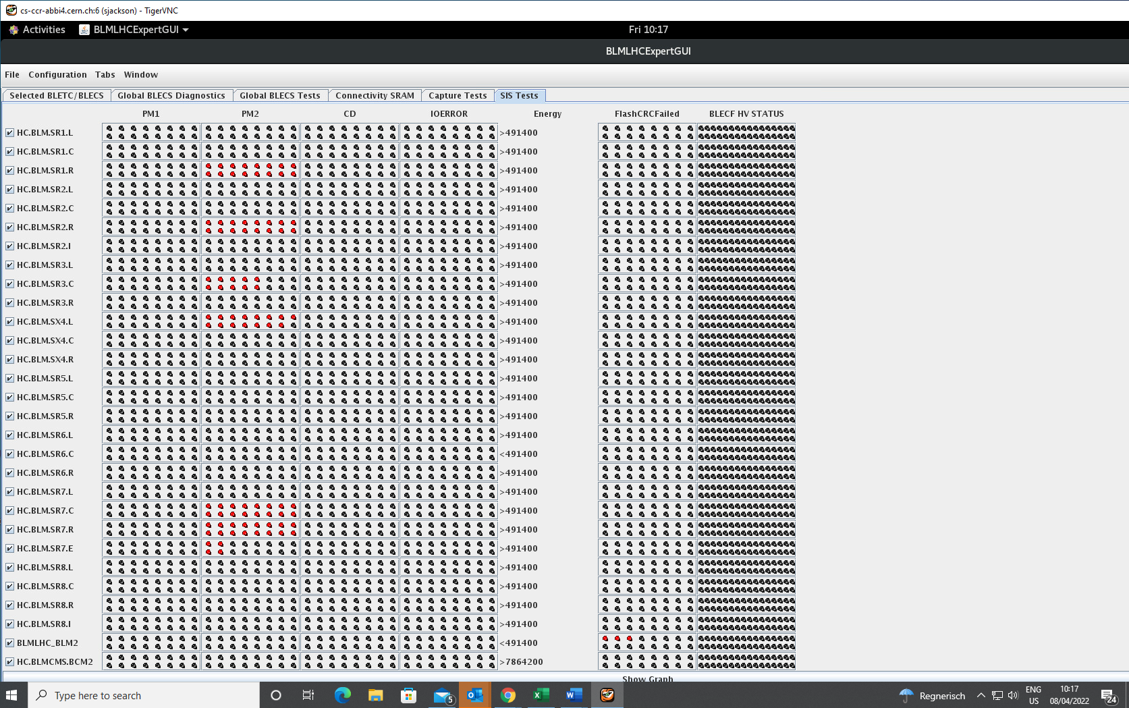
XPOC & PM Buffers
XPOC and PM buffers remain frozen or do not get restarted causing missing data
Functionality (simplified):
  Two memories serve XPOC-b1, XPOC-b2 and PM
  BeamDumped1 & 2 freeze the buffers
  Server waits if there is also a GPM1 before restarting them to read the additional data
  Buffers are restarted if all actions completed or wait time reached.
Issue seems like a ‘race condition’
Did not manage to reproduce it
  Additional debugging info added to the design

Slide 13
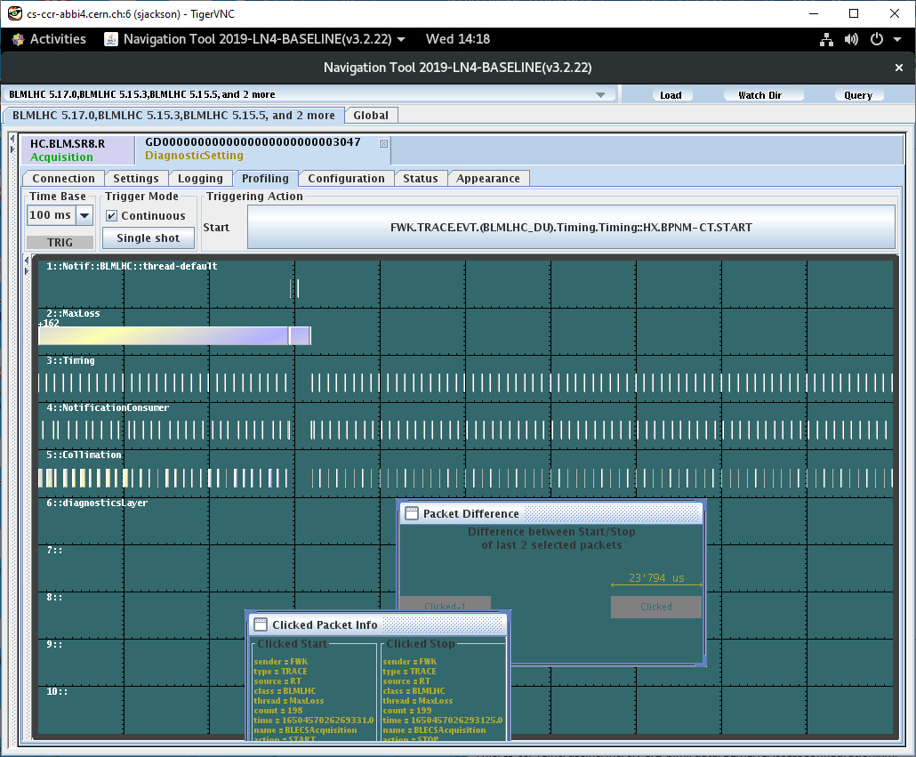
Collimation Data
Few packets are missing regularly from the 100 Hz data
Issue identified to be with the readout and validation of all the settings
  VME bus is occupied for 20-30 ms reading the flash memory contents
  Part of the new functionality that checks everything at 1 Hz
New version to be deployed
  Will remove (for now) the check for the BLECS settings; settings will continue to be checked before each injection
  Keep this function only for the BLETC, i.e. thresholds, names, flags and all critical parameters
Need deployment window from OP
  Could be today or any of the next days

Slide 14
System Checkout

Slide 15
System Checkout
Hardware Checkout completed:
All detector connection vs LSA verified
Thresholds & flags have been updated
  Verified all settings & tools are in good state
Energy level distribution in the crate
  Ramps show correct threshold selection
Interlocks are generated & propagate to the CIBUs
  All bypass for LS2 development removed
Machine Checkout parts pending:
SIS interlocks for missing HV, crate or corrupted settings
  Need an hour in the CCC with help from OP

Slide 16
Thank you

Slide 17
Special systems (modified LHCBLM types)
CMS: Beam Condition Monitoring
  Complete system w/ LHC interlocks to be supported
  Support threshold management
  Outside the LHC Controls environment with add. complexity to diagnose issues
ATLAS: Beam Condition Monitoring
  Processing electronics
  Support threshold management
  Custom firmware (circa 2011 – unmaintainable)
SPS: detectors and electronics are deployed mostly for MDs
  Detectors at LSS2, LSS4 and LSS5
  Electronics at BA2 and BA5
CHARM: detectors and electronics for spill monitoring
  Complete system to maintain
  Not interlocked

