Slide 1
SM18 changes after safety audit & safety awareness
F.J.Mangiarotti – 14.04.2022

Slide 2


Changes
New role: “Operateur Responsible” (OR) who allows or denies tests and access
Clearly defined test areas with their OR
More strict procedure for non-standard tests
A few new activities in the horizontal and vertical test plans
Several new written documents in EDMS
Affects all who work near our benches
Subject of the training later
Affects mainly our team

Slide 3
Non-standard tests
https://edms.cern.ch/document/2718369
Triggered if:
New test, equipment or configuration
Equipment not foreseen in safety analysis
PLC modifications required
We need a test procedure with (main points):
On-site meeting with OR, TSO, test engineer
Risk analysis (in this station and others, and in other power circuits)
List of steps and check list to prepare the test, do the test and return to standard after test

Slide 4
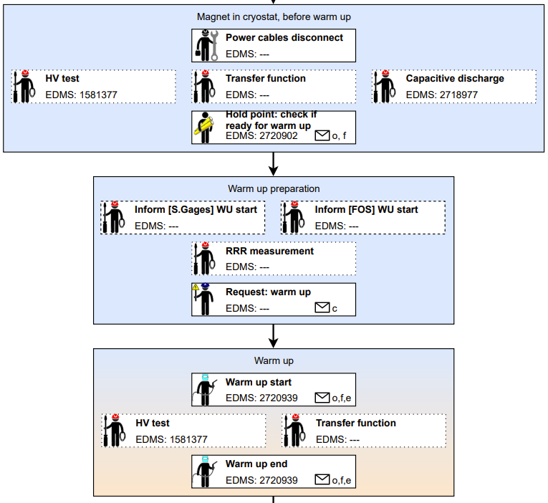
New activities in the test plan (Carpenter)
There are some new activities that act as “holding points”:
For the test engineer (before cool down, high current powering and warm up)
For the OR (request cool down, patrol and fencing, etc)
It will be important that the person who does the work signs
Implementation in Carpenter expected during the week of 25.04

Slide 5
New (and old) documents in EDMS
Test zone definition
Operator Responsible
Non-standard test procedure
Horizontal and Vertical test procedure
DC circuits for ABC (ongoing), Cluster D and Cluster G+H
Lockout procedure for ABC, Cluster D and Cluster G+H
Modus operandi for Horizontal and Vertical magnets
Training presentation

