Slide 1
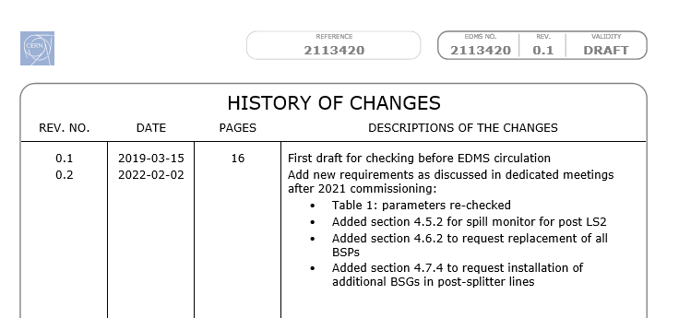
Brainstorm on updated NA primary lines spec requests – May 2022
Aurelie , Michel, Federico
Func specs circulated in 2019: https://edms.cern.ch/document/2113420/0.1
Updated version prepared after 2021 experience and debrief during topical meetings
  Final draft presented @ https://indico.cern.ch/event/1087079/
  Not on EDMS yet, not circulated not approved
Next slides: summarize changes between 2 versions

Slide 2
4.6.2 Improved beam position monitoring in TT21 The operational set-up and steering of the beam through the North Area primary transfer lines is complicated by the lack of resolution on the beam position measured by the split foils position monitors (BSP: 2 channels only, H: left/right and V: up/down). In addition, the beam profile is non-Gaussian in the horizontal plane affecting the accuracy of the reconstructed beam position. The problem encountered recently is that the optics measurements (kick response and dispersion measurements) needed to qualify and validate different transfer line optics settings are challenging to carry out and intrinsically inaccurate. With the operational implementation of crystal-assisted slow extraction in Run 3 becoming increasingly likely it will be important to be able to qualify new optics applied in TT21-25 to deal with the portion of the beam that is channelled into the transfer lines.
Specs 2019 | Specs 2022
It is requested to upgrade the BSP monitors in TT21 with the requested specification collected in Table 6, see [14] for more details. Although the proposed solution is an exchange of three BSP systems with BSG (grid with 15 wires per plane) and a new vertical BSG system, the choice of technology is of course optional. The specification considers both the operational optics and the TT20 BDF optics that was tested during recent MD’s testing the prototype BDF target on in front of T6. | It is requested to update all BSPs in TT20 lines with more accurate position monitors, which could be BPMs, BSGs or any other beam position monitor device that is able to cope with the beam parameters specified in Table 1. The number of devices per line are listed in Table 6.
3 BSPs → BSG + 1 new BSG
All BSPs → BSG
Numbers in next slide

Slide 3
Specs 2019 | Specs 2022
Table 6: Requested modifications for the beam position/profile monitors in TT21
Table 6: Available BSPs in TT21/22/23/24/25 which are requested to be exchanged with more performant devices.
4.7.4 Improved extracted beam profile monitoring in TT22/23/24/25
To ensure higher accuracy optics measurements and steering on the target, it is requested to update BSPs to BSGs. The simulated beam sizes for 2 different optics settings are detailed in Table 9. It is expected to cover +/- 10 sigmas.
Also, for better controlling the beam alignment at the targets, replacement of BSPs in both TBIU and TBID for all 3 primary targets is requested. The simulated beam sizes for 2 different optics settings are detailed in Table 10. It is expected to cover +/- 15 sigmas.
Current device | Horizontal [mm] |  | Vertical [mm]
 | Resolution (σ) | Coverage (σ) | Resolution (σ) | Coverage (σ)
BSP.210508 | 1.5 (1.0 – 1.5) | 22.5 (15 - 23) | 1.5 (1.2 – 1.3) | 22.5 (18 – 20)
BSP.210858 | 2.5 (0.8 – 1.7) | 37.5 (12 – 25) | 2.5 (0.9 – 2.0) | 37.5 (14 – 30)
Location downstream of QNLD211 (tbd) [11] | none |  | 2.5 (1.1 – 2.1) | 37.5 (16 – 31)
BSPH.211411 | 5.0 (1.9 – 2.3) | 75.0 (29 – 34) | none
Line | Number or BSPs
TT21 | 19
TT22 | 3
TT23 | 4
TT24 | 4
TT25 | 5
Table 9: Requested modifications for the beam position/profile monitors
BSP to be replaced | Qsplit: sigma [mm] | NoQsplit: sigma [mm] | Plane
bsph.230950 | 0.50 | 0.37 | Horizontal
bspv.230949 | 0.17 | 0.15 | Vertical
bsph.230950 | 0.12 | 0.07 | Vertical
bsph.241149 | 0.49 | 0.68 | Horizontal
bsph.241150 | 0.48 | 0.59 | Horizontal
bspv.241149 | 0.42 | 0.40 | Vertical
bsphv.241150 | 0.39 | 0.36 | Vertical
bsph.251247 | 1.11 | 0.84 | Horizontal
bsp.251248 | 1.12 | 0.90 | Horizontal
bspv.251247 | 0.76 | 0.73 | Vertical
bsp.251248 | 0.69 | 0.66 | Vertical
Table 10: Requested modifications for the beam position/profile monitors in TT21⁽¹⁾ TBIU-TBIDs
Assuming wire grid technology with 16 channels, resolution = wire spacing,  computed with ∆p/p = 0.
For the integration of the proposed new BDF beam line an existing SEM grid tank (BSGV.220075) has to be modified mechanically as the present tank is too wide, see [4] for more details.
BSP to be replaced | Qsplit sigma [mm] | NoQsplit sigma [mm] | Plane
bsph.220075 | 1.20 | 1.63 | Horizontal
bsm.230905 | 4.88 | 4.40 | Horizontal
bsph.230949 | 0.36 | 0.38 | Horizontal
bsph.240212 | 6.23 | 5.03 | Horizontal
bsm.241105 | 5.65 | 4.89 | Horizontal

Slide 4
Specs 2019 | Specs 2022
4.5.2 Fast intensity (spill quality) monitor Future MD studies will focus on manipulating the time structure of the extracted beam and such a device will play a key role. A device capable of observing the frequency spectrum of the extracted beam intensity from 43 kHz (beam revolution frequency) up to and including the main 200 MHz (RF frequency) is requested [12]. The device should readout the frequency spectrum at a rate of at least 10 Hz, or faster, throughout the spill without a variable integration window to be defined. The functionality of the present spill monitor must remain operational (up to 2.5 kHz), in order to correct the low frequency harmonics of 50 Hz coming from power converter ripple. Future experiments are requesting a knowledge of the beam frequency spectrum up to 10 GHz | 4.5.2 High-bandwidth intensity (spill quality) monitor for after LS2 To maintain a high-quality spill delivering to the current experiments, and to the ones that will come to the NA, it was shown to be paramount to have access to a higher bandwidth spill monitor than what is available today. For this reason, a spill monitor capable of resolving up to 100 kHz is needed. This will allow measurements up to half the revolution frequency and assess the debunching quality. The functionality of the present spill monitor must remain operational (up to 2.5 kHz), in order to correct the low frequency harmonics of 50 Hz coming from power converter ripple. The noise floor of the instrument used to measure up to 300 Hz must be lower than the noise from the main power supplies. 4.5.3 Fast intensity (spill quality) monitor for after LS3 Future MD studies will focus on manipulating the time structure of the extracted beam and such a device will play a key role. A device capable of observing the frequency spectrum of the extracted beam intensity from 43 kHz (beam revolution frequency) up to and including 800 MHz (highest harmonic RF frequency) is requested [12]. The device should readout the frequency spectrum at a rate of at least 10 Hz, or faster, throughout the spill without a variable integration window to be defined. Future experiments are requesting a knowledge of the beam frequency spectrum up to 10 GHz.

