Slide 1
FCC-ee Magnet Interconnections Space Requirements
Carl Järmyr Eriksson, Jérémie Bauche (TE-MSC)
FCC-ee Tuning meeting 2022-04-22

Slide 2
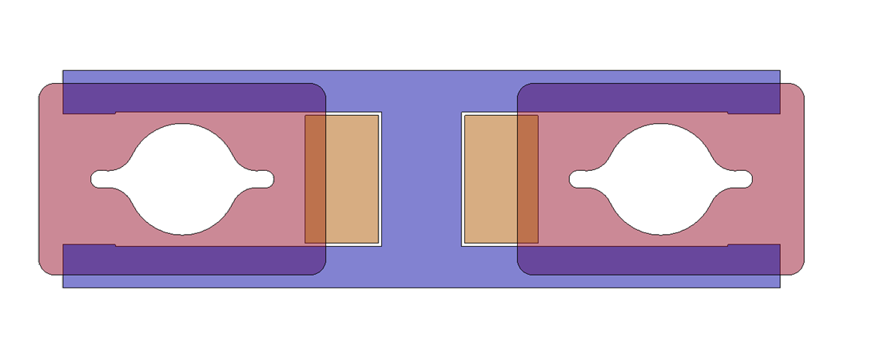
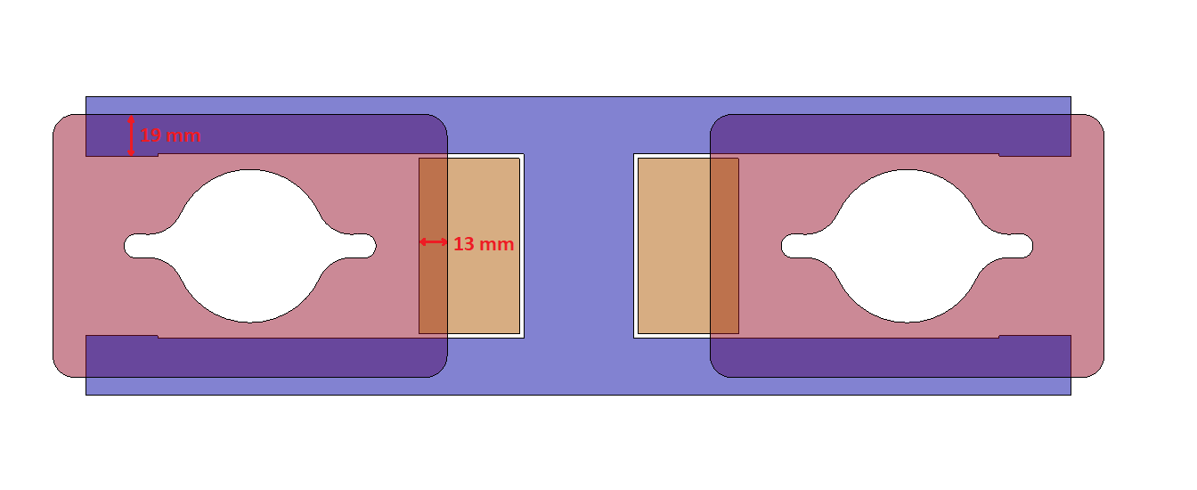
Overlap – flange connection (D-D)
Assuming that the flange connection (without bellows) is possible at the dipole-dipole connection:
In order to add plates over & under D-D connection, gap height must be increased by at least 40 mm, from 84 to 124 mm (assumes at least 1 mm on each side for clearance)
In order to run busbars straight through D-D connection, inter-beam width must be increased by at least 28 mm, from 300 to 328 (1 mm on each side for clearance)
19 mm
Busbars
VC flange
13 mm
Yoke

Slide 3
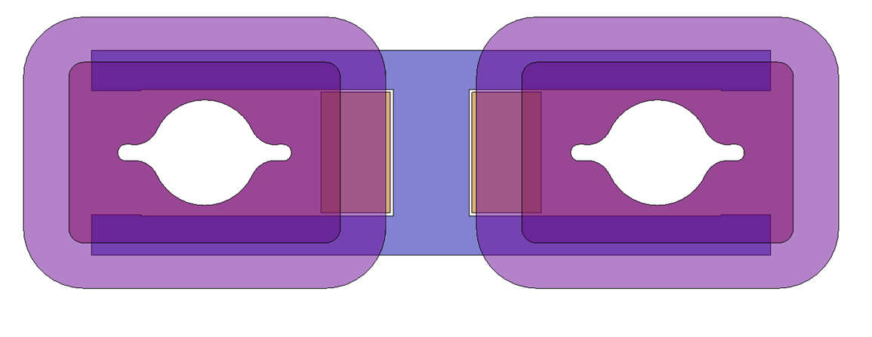
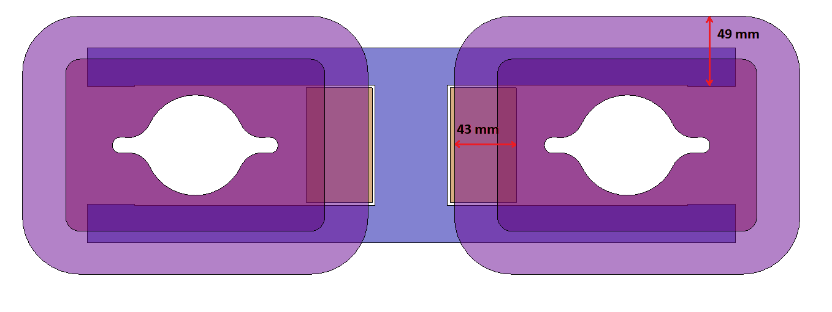
Overlap – bellows
If the bellows are to be taken into account:
46
49 mm
43 mm

Slide 4
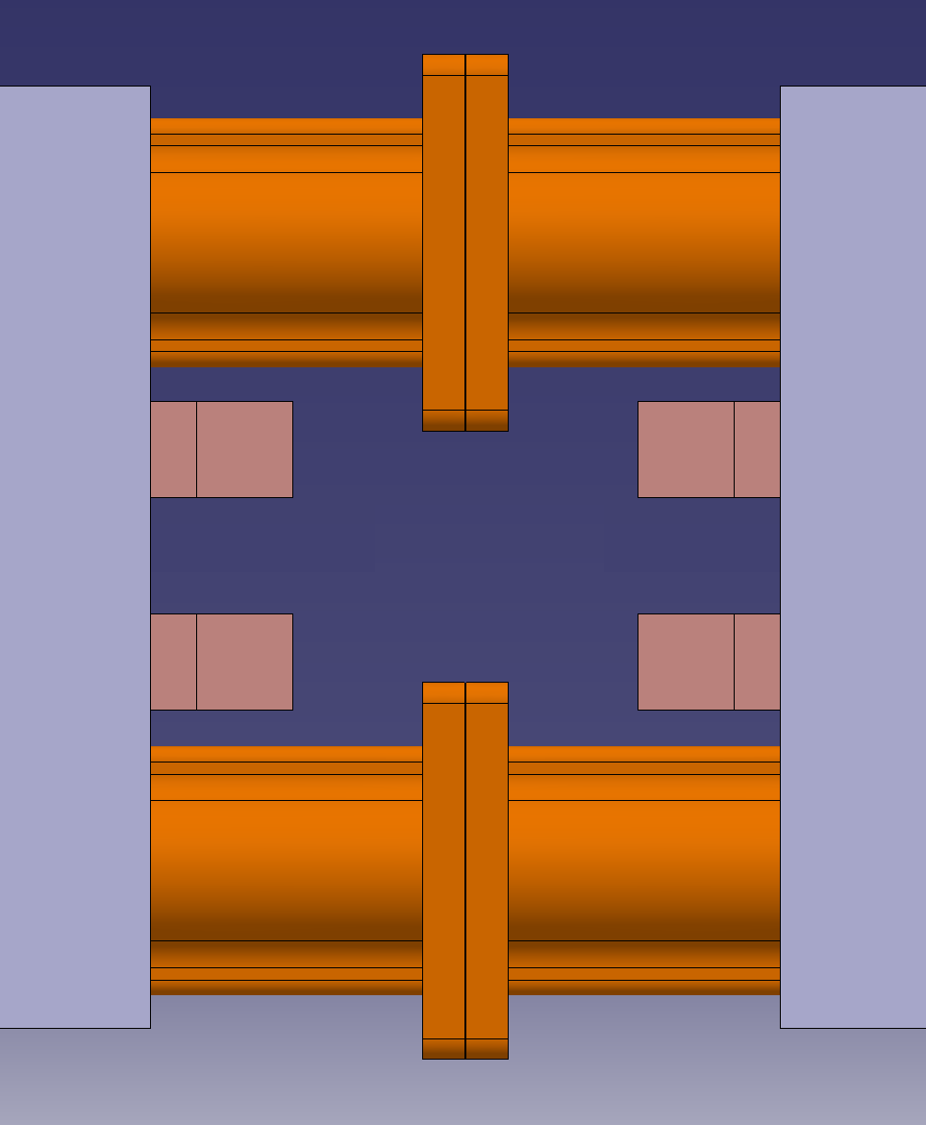
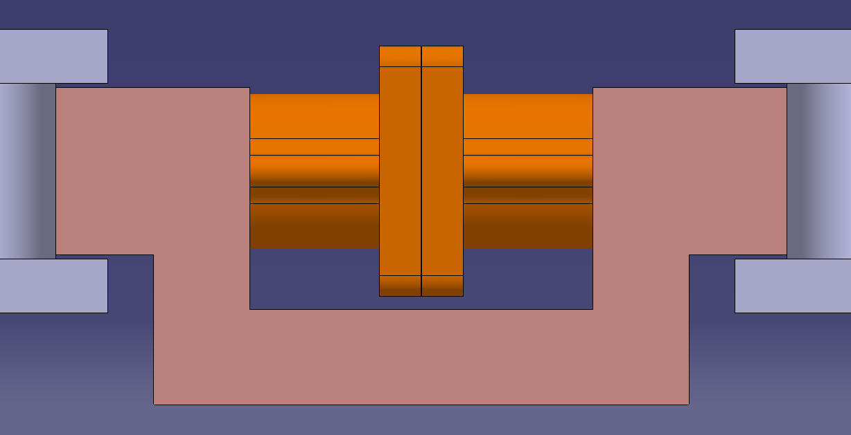
Available space – D-D connection
[mm]
Assumes flange connection at D-D
Assumes 300 mm gap between dipoles yokes
Assumes same coil dimensions, same coil protrusion from dipole edge as in prototype
The actual magnetic gap (distance between magnetic lengths ”edges”) would be in the range of 220 mm
62
13
68
46
164
54
Busbar
Side view: busbars connect underneath flange
300

Slide 5
Available space – D-D connection
[mm]
Assumes flange connection at D-D
Assumes 300 mm gap between dipoles yokes
Assumes same coil dimensions, same coil protrusion from dipole edge as in prototype
The actual magnetic gap (distance between magnetic lengths ”edges”) would be in the range of 220 mm
62
13
68
46
164
54
Sideways water connectors undesirable: 54 mm space must be shared by both busbars’ connectors
Busbar
Side view: busbars connect underneath flange
62 mm available for straight water connector b/w busbar and flange
300

Slide 6
Available space – D-D connection
[mm]
Assumes flange connection at D-D
Assumes 300 mm gap between dipoles yokes
Assumes same coil dimensions, same coil protrusion from dipole edge as in prototype
The actual magnetic gap (distance between magnetic lengths ”edges”) would be in the range of 220 mm
62
13
68
46
164
Example: connectors brazed to busbar ends, flexible pipe in between (not to scale)
54
Busbar
Side view: busbars connect underneath flange
300

Slide 7
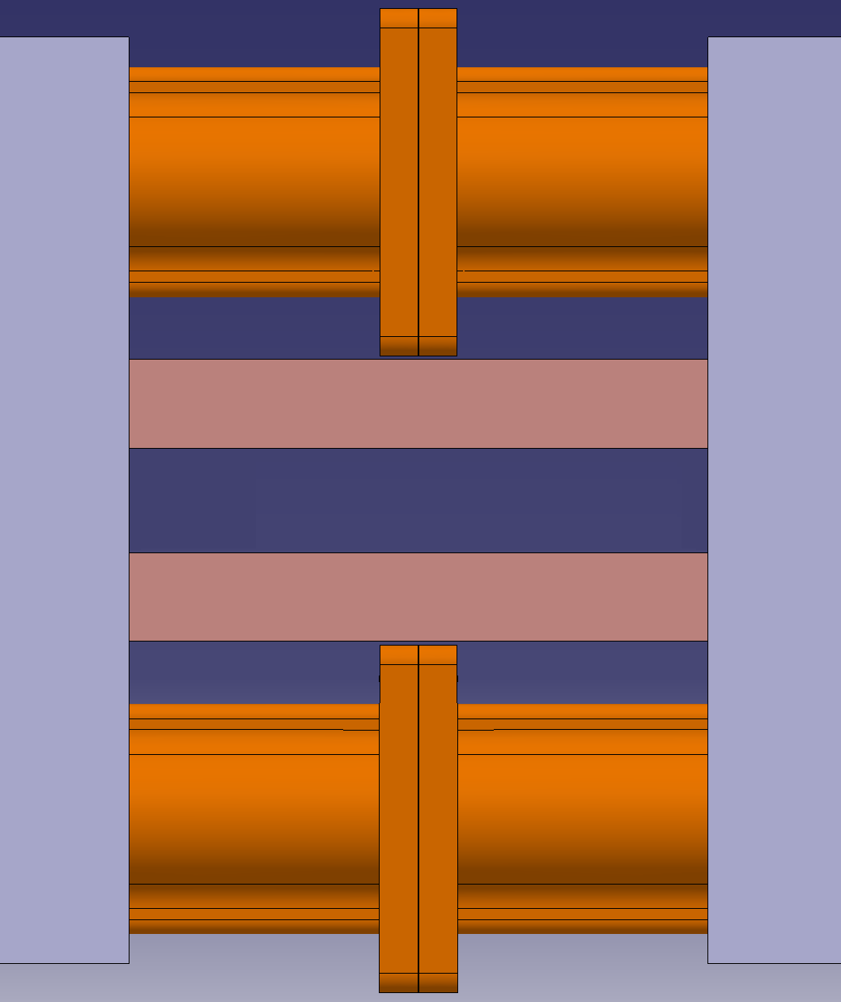
Available space – D-D connection, widened for clearance for busbars
[mm]
[mm]
Same coil dimensions as in prototype
Assumes inter-beam width extended to at least 328 mm
13
62
68
46
164
54
2× ~12 m busbars to be welded together at interconnection
300

Slide 8
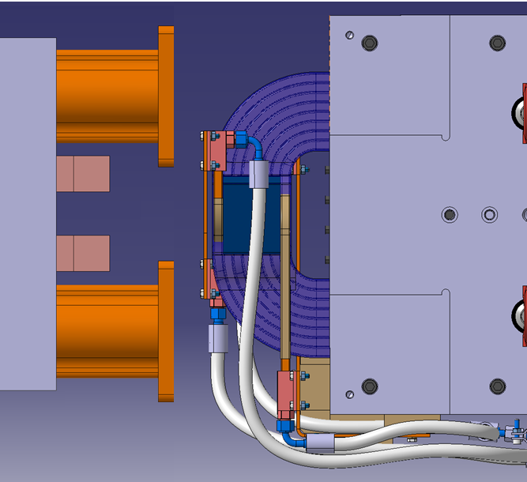
D-Q connection
162
Assumes same dimensions as in prototypes
Dimensions of interconnections not taken into account – only accounts for space needed by each magnet.
62
68
Dipole
Quadrupole

Slide 9
Sextupoles
The S-S distance assumed in the optics model is 100 mm.
Only a conceptual cross section of the magnet exists at this stage, the 3D will be developped this year.
From existing similar size sextupoles, we estimate that:
    The space required on either sides of the magnet for power and cooling connections is 80 mm;
    Additional space may be required if flanges are needed between the two sextupoles, but we would assume that they can be assembled with a common vacuum pipe going through the two magnets (to be confirmed by TE-VSC)
  → S-S distance 160 mm
19 mm
13 mm

