Slide 1

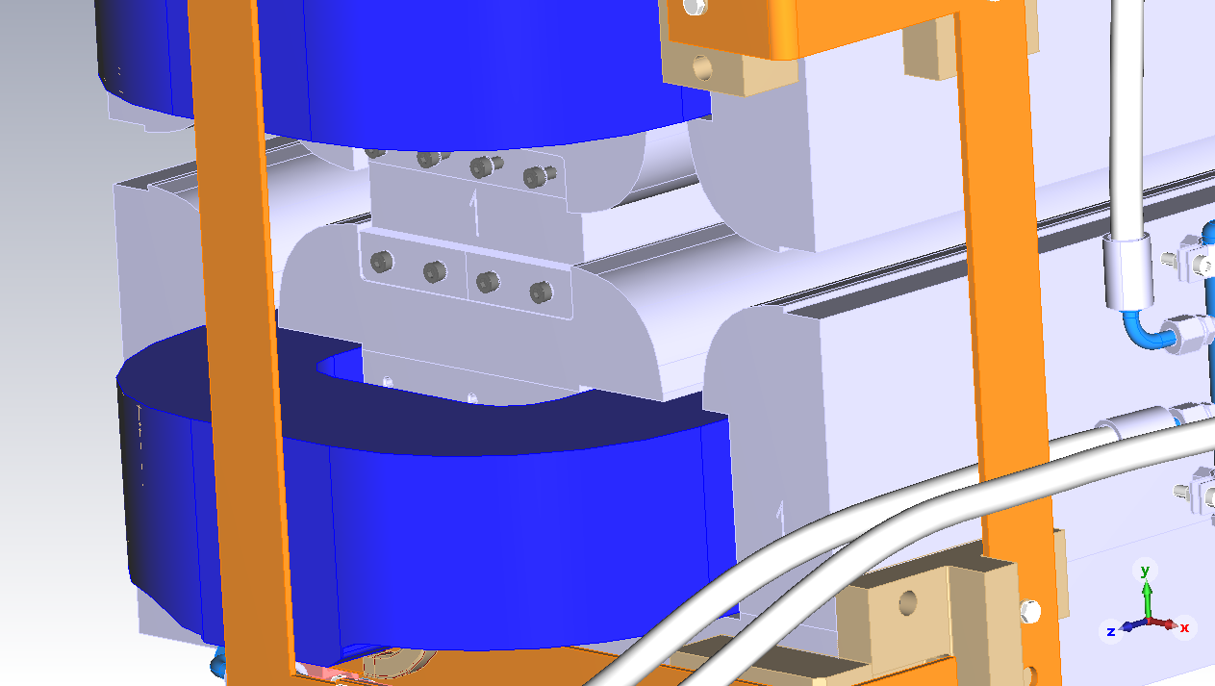
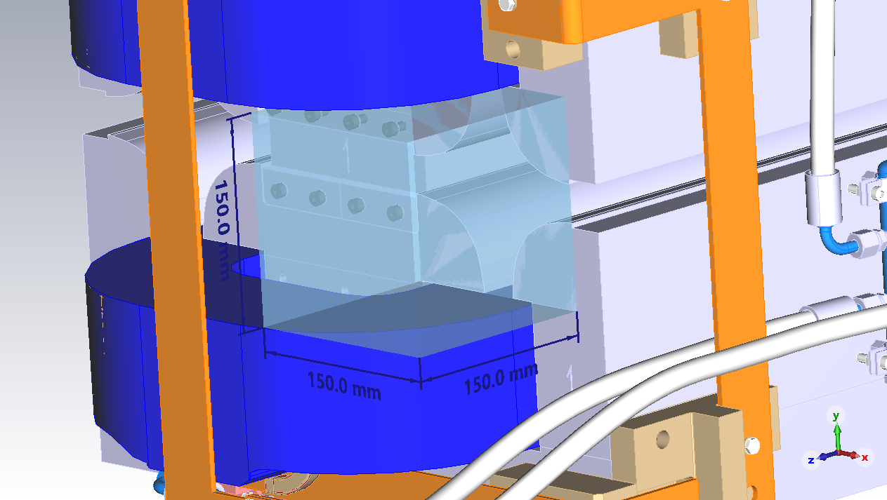
FCC-ee Main Ring BPM Real Estate

Slide 2
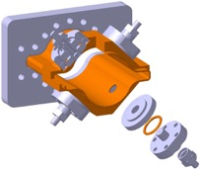
Some thoughts…
BPM design activities have not yet started in the CERN BI group
  Seems some ideas are already in the minds…
    Need to align R&D activates among various teams
  150mm³ real estate within the quad looks tight,
  but reasonable to fit a button-style BPM pickup with feedthrough and cables
  in the “shadow” of the quadrupole magnet.
    No extra space for the BPM required
    Flanges, bellows, etc. to be discussed
    Preferable: align and fix BPM housing on the magnet surface
FCC-ee BPM pickup design activities
  Dedicated PhD activity in collaboration with University of Oxford (starting early 2023)
  Cover all design aspects of the BPM pickup
    BPM requirements, beam parameters
    Wakefield / impedance, RF heating, trapped eigenmodes, etc.
    Integration, mechanics, tolerances, UHV feedthroughs, radiation aspects, position non-linearities
    Calibration, mass production, costs,…
    Prototyping, laboratory measurements, beam studies,…

