Slide 1
Impact of Magnet Gaps on Lattice Performance
Leon van Riesen-Haupt

Slide 2
Method
First estimate of the impact of a more “realistic” lattice
  Based on first estimates of hardware restrictions
    Maximum magnet length about 10 m
    Separation between magnets about 30 cm (about 3%)
Implementation in SAD
  Replace magnets that are longer than 10 m with equivalent sequences
    Made of dipoles and drifts
    Same overall length and angle
  Used tt 217 lattice
Properties to check
  Geometric properties: How it affects the layout
  Beam properties: Change in optical function and emittance (due to smaller bending radius and beating)

Slide 3
Example of Method
Original:
BEND BC1 = (L = 40.83210757448959 ANGLE = .001779891805493594 E1 =.5 E2 =.5 );
Split:
DRIFT LSEP =(L =0.3); ! Separation drift
BEND BC1_s =(L =((40.83210757448959 - 3*0.3)/4) ANGLE = (.001779891805493594/4) E1 =.5 E2 =.5 ); !4 segments, 3 drifts
LINE BC1 = (BC1_s, LSEP, BC1_s, LSEP, BC1_s, LSEP, BC1_s); ! Equivalent sequence

Slide 4
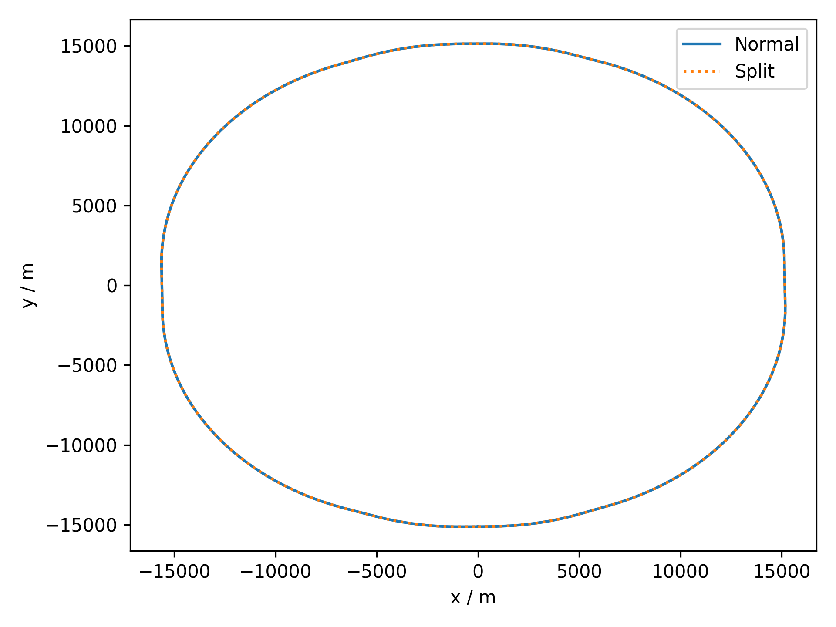
Geometrical Check
Obtain survey from original and modified lattice
  Plot on top of each other as a first check

Slide 5
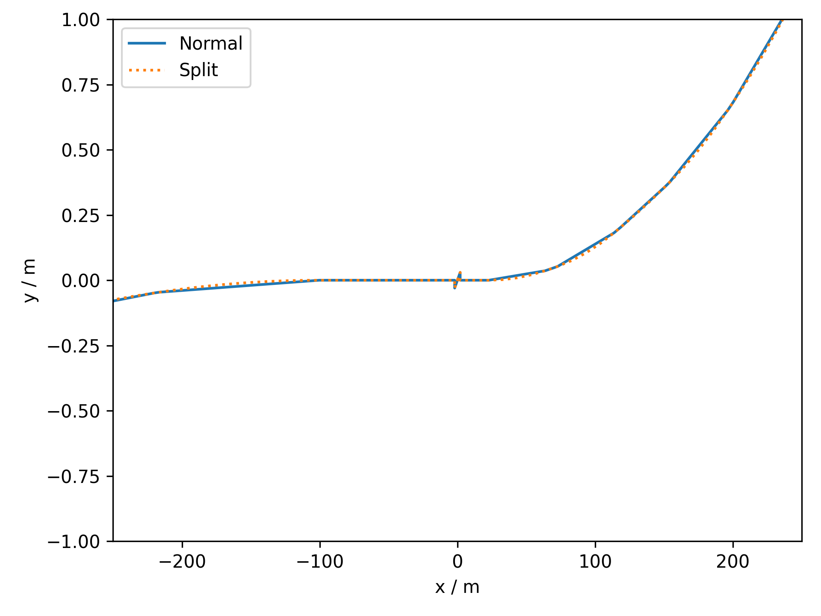
Geometrical Check
Obtain survey from original and modified lattice
  Plot on top of each other as a first check
More informative when zooming into IP1
  See local layout of segments
  Check that the sequence closes on itself
IP: Sequence closes on itself
(Some solenoid weirdness)
BWL: One of the longest (116 m) magnets

Slide 6
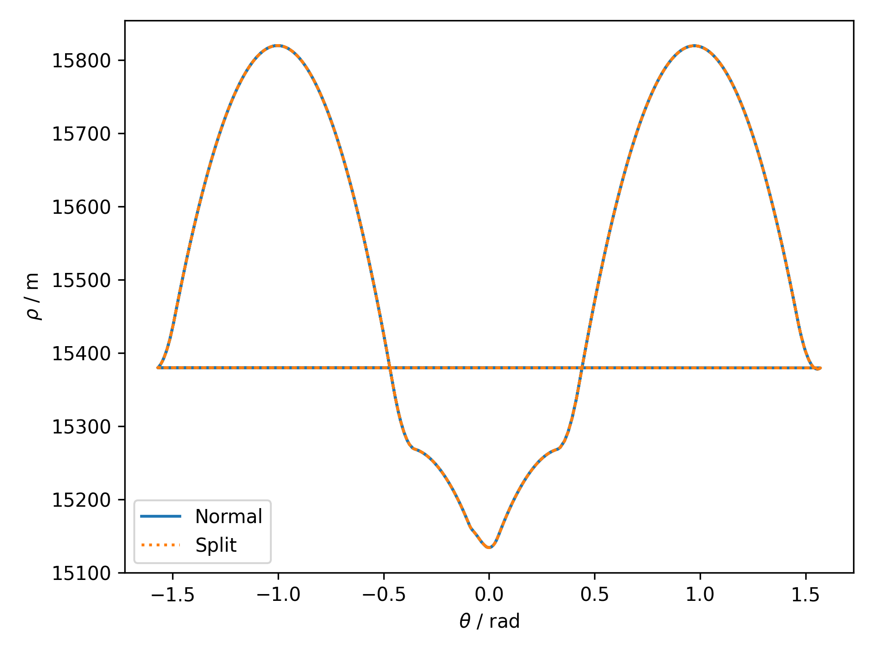
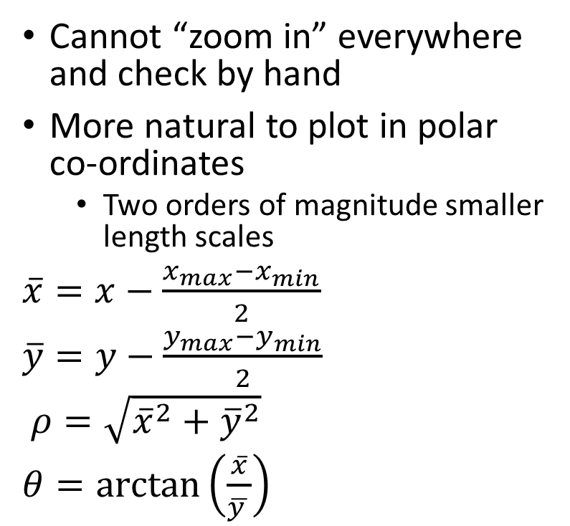
Geometry Check II
Cannot “zoom in” everywhere and check by hand
More natural to plot in polar co-ordinates
  Two orders of magnitude smaller length scales
$\overline{x}=x−\frac{x_{max}−x_{min}}{2}$
$\overline{y}=y−\frac{y_{max}−y_{min}}{2}$
$ρ=\sqrt{{\overline{x}}^{2}+{\overline{y}}^{2}}$
$θ=\arctan\left(\frac{\overline{x}}{\overline{y }}\right)$

Slide 7
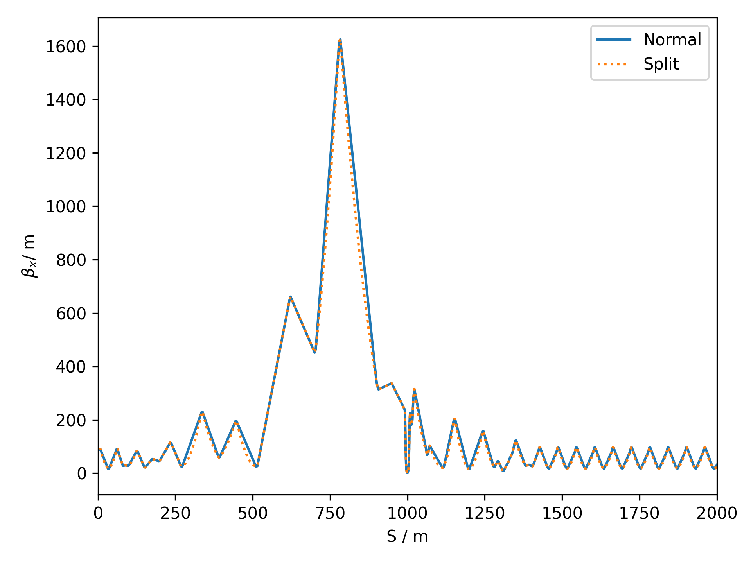
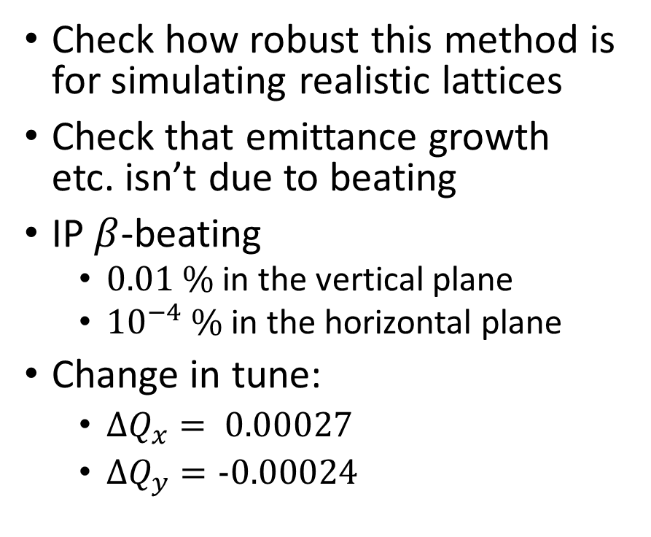
Optics Check
Check how robust this method is for simulating realistic lattices
Check that emittance growth etc. isn’t due to beating
IP $β$-beating
  $0.01 \%$in the vertical plane
  ${10}^{−4} \%$ in the horizontal plane
Change in tune:
  $ΔQ_{x}= 0.\text{00027}$
  $ΔQ_{y}=\text{-0.0002}\text{4}$

Slide 8
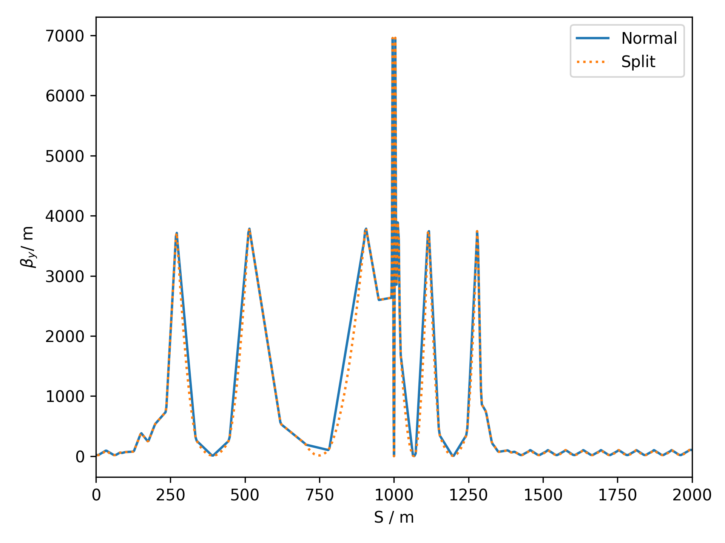
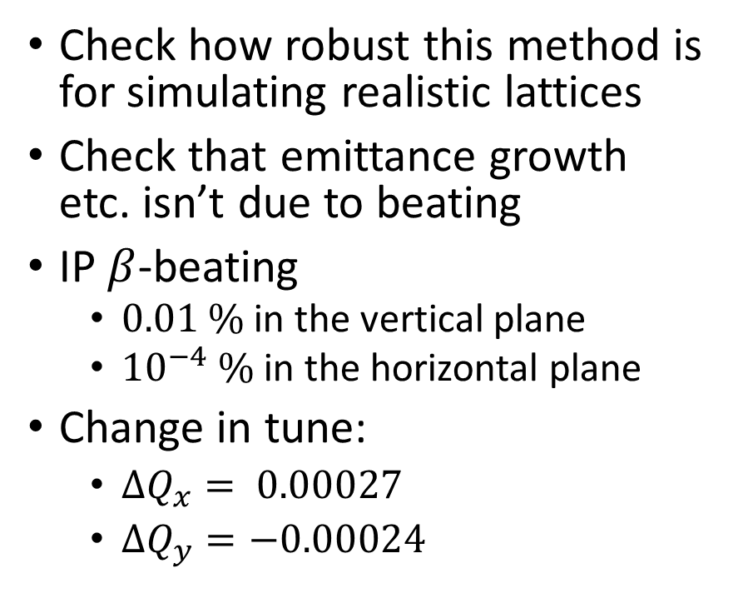
Optics Check
Check how robust this method is for simulating realistic lattices
Check that emittance growth etc. isn’t due to beating
IP $β$-beating
  $0.01 \%$in the vertical plane
  ${10}^{−4} \%$ in the horizontal plane
Change in tune:
  $ΔQ_{x}= 0.\text{00027}$
  $ΔQ_{y}=\text{−0.0002}\text{4}$

Slide 9
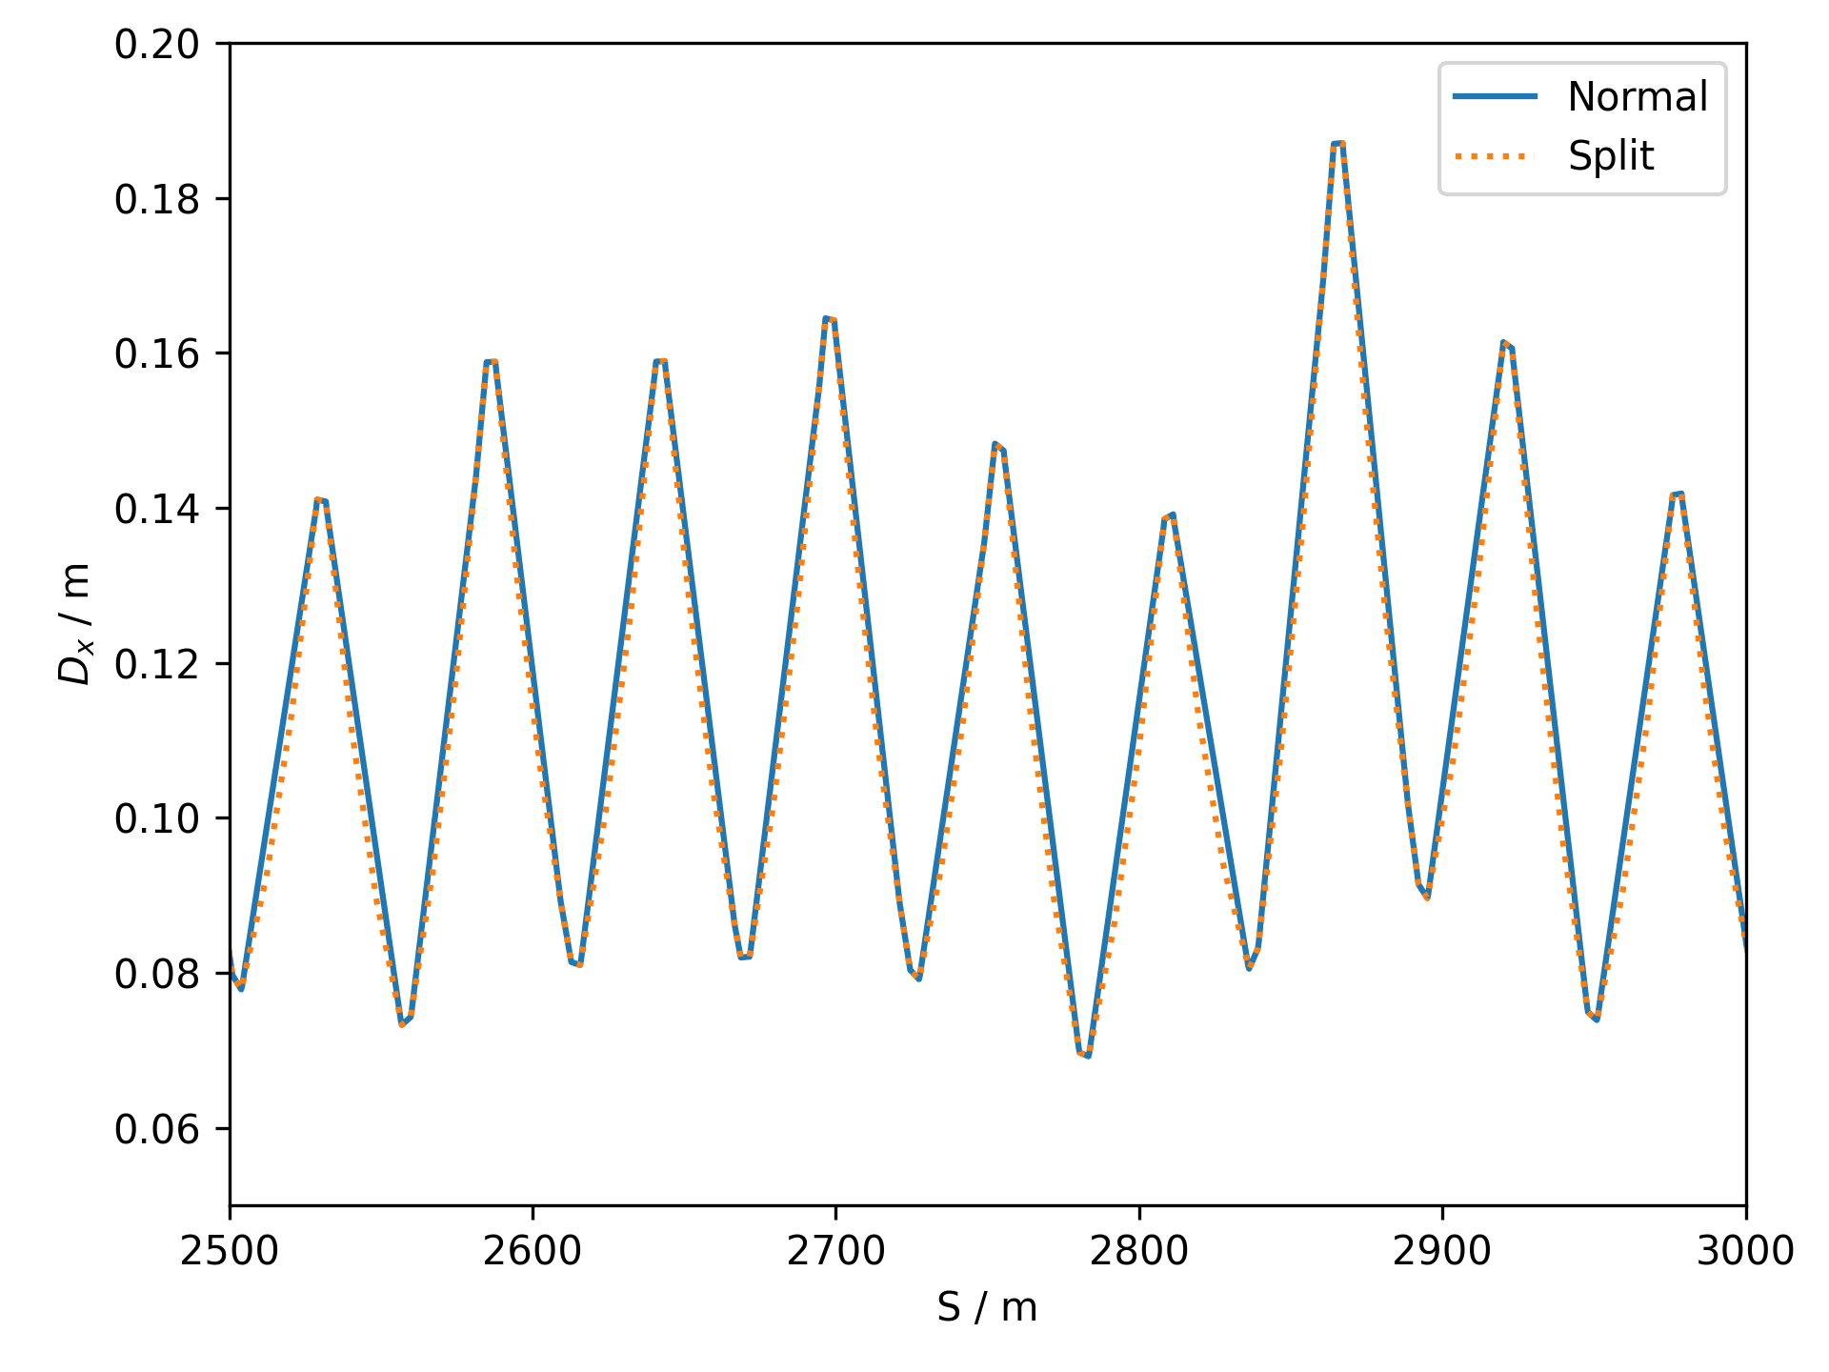
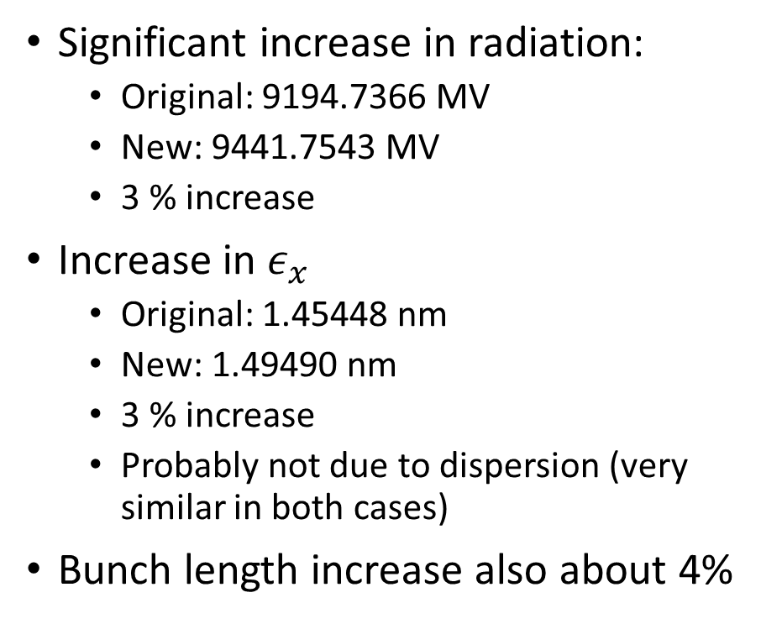
Impact on Radiative Effects
Significant increase in radiation:
  Original: 9194.7366 MV
  New: 9441.7543 MV
  3 % increase
Increase in $ε_{x}$
  Original: 1.45448 nm
  New: 1.49490 nm
  3 % increase
  Probably not due to dispersion (very similar in both cases)
Bunch length increase also about 4%

Slide 10
Conclusions
Established an effective method of easily introducing realistic features into FCC-ee lattices
  Replace element definitions with more realistic subsequences
  No need to change the actual sequences
  Can easily be extended to other requirements
    Different lengths of magnets and gaps, introduction of instrumentation or correctors
  No significant impact on linear optics and overall geometry
Impact of dipole splitting with 10 m length and 30 cm gaps
  About 3% increase in radiation and beam emittance
Possible future steps
  Implementation of other realistic features and updates of these ones
  Translation to MADX (e.g. the same way current SAD lattices are translated)
  Addition of realistic circuits and naming conventions

