Slide 1



FCC HEB lattice options
B. Dalena, A. Chance
Thanks to:
B. Haerer, L. Van Riesen-Haupt, T. Charles, R. Tomas, T. Persson, F. Antoniou, O. Etisken, M. Zampetakis, M. Hofer, F. Carlier, B. Holzer, A. Franchi, A. Latina

Slide 2
Outline
Layout of the HEB ring
60°/60° and 90°/90° Optics
DA vs momentum
Momentum detuning

Slide 3
Layout
~200 m
Total length | m
Collider | 91174.117
HEB | 91172.691
~20 m

Slide 4
60°/60° Optics
Magnet | Parameter | Unit | Value
Dipole | Field at injection (20 GeV) | G | 71
 | Field at W energy (80 GeV) | G | 284
 | Length | m | 11.1
Quadrupole | Gradient at injection (20 GeV) | T/m | 1.74
 | Gradient at W energy (80 GeV) | T/m | 6.9
 | Length | m | 1.5
Sextupole | Gradient at injection (20 GeV) | T/m² | 75
 | Gradient at W energy (80 GeV) | T/m² | 300
 | Length | m | 0.5
FODO cells of ~52 m
Made of 4 dipole, 2 quadrupoles and 2 sextupoles
Distance between dipoles: 0.65 m
Distance between quadrupole and sextupole: 0.15 m
Distance between dipole and sextupole: 0.356
Distance between quadrupole and dipole: 0.704 m
(it includes BPM and dipole correctors)
# dipoles = 2×2944
# quadrupoles = 2944
# sextupoles = 2632/6

Slide 5
90°/90° Optics
Magnet | Parameter | Unit | Value
Dipole | Field at injection (20 GeV) | G | 71
 | Field at ttbar energy (182.5 GeV) | G | 650
 | Length | m | 11.1
Quadrupole | Gradient at injection (20 GeV) | T/m | 2.5
 | Gradient at ttbar energy (182.5 GeV) | T/m | 22.5
 | Length | m | 1.5
Sextupole | Gradient at injection (20 GeV) | T/m² | 174
 | Gradient at ttbar energy (182.5 GeV) | T/m² | 1582
 | Length | m | 0.5
FODO cells of ~52 m
Made of 4 dipole, 2 quadrupoles and 2 sextupoles
Distance between dipoles: 0.65 m
Distance between quadrupole and sextupole: 0.15 m
Distance between dipole and sextupole: 0.356
Distance between quadrupole and dipole: 0.704 m
(it includes BPM and dipole correctors)
# dipoles = 2×2944
# quadrupoles = 2944
# sextupoles = 2632/4

Slide 6



DA at injection with multipole errors
Static dipole field errors of the CT dipole design at 56Gs considered + 10% random part
Dynamic field effect not taken into account in this simulations: dipole and multipole reproducibility expected to be ≤ 5×10⁻⁴
Courtesy of F. Zimmermann and Jie Gao
 | CT dipole |  | Iron-core dipole
GFR=R26 | 28Gs | 56Gs | 28Gs | 56Gs
B1/B0 | -5.20E-04 | -1.04E-04 | -1.56E-03 | -2.60E-04
B2/B0 | 4.73E-04 | 5.41E-04 | -2.03E-03 | -2.03E-04
B3/B0 | -7.03E-06 | 1.05E-04 | 3.52E-04 | 1.76E-04
B4/B0 | -9.14E-04 | -3.66E-04 | 4.57E-04 | -1.83E-04
B5/B0 | 3.56E-05 | -2.38E-05 | -2.38E-05 | -3.56E-05
B6/B0 | 6.18E-04 | 2.16E-04 | -3.09E-04 | 9.27E-05
91km 60°/60° optics
relative values @ R = 26 mm
Stable initial action @ 4500 turns (~15% tx 20 GeV)
60 seeds
MadX Thin-Lens Tracking
Geometric emittance injected 1.27e-9 nm
$$β_{x}=83.2$$
$$β_{y}=32.2$$
$$D_{x}=0$$

Slide 7







DA at injection with multipole errors
91km 90°/90° optics
$$β_{x}=79.5$$
$$β_{y}=17.0$$
$$D_{x}=0$$
$$Q_{x}=417.225$$
$$Q_{y}=413.29$$
$$Q_{x}=416.565$$
$$Q_{y}=413.595$$

Slide 8
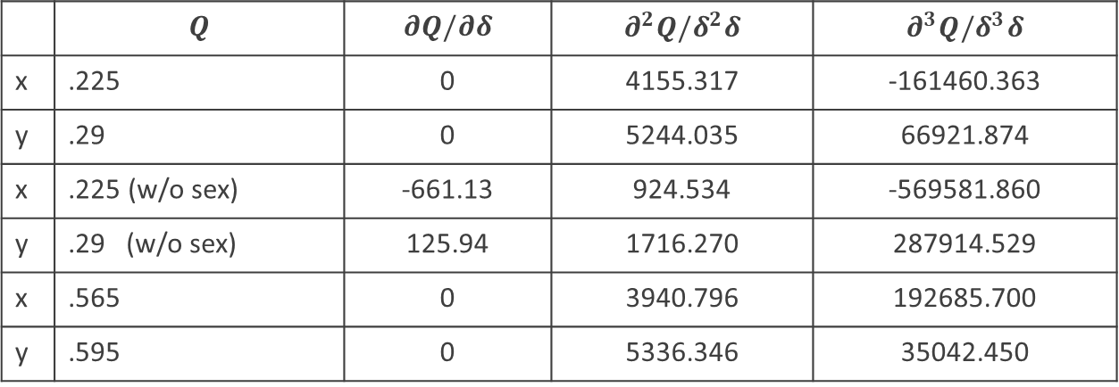
Momentum detuning
91km 60°/60° optics
91km 90°/90° optics
 | $$Q$$ | $$∂Q/∂δ$$ | $$∂^{2}Q/δ^{2}δ$$ | $$∂^{3}Q/δ^{3}δ$$
x | .225 | 0 | 4155.317 | -161460.363
y | .29 | 0 | 5244.035 | 66921.874
x | .225 (w/o sex) | -661.13 | 924.534 | -569581.860
y | .29 (w/o sex) | 125.94 | 1716.270 | 287914.529
x | .565 | 0 | 3940.796 | 192685.700
y | .595 | 0 | 5336.346 | 35042.450

Slide 9
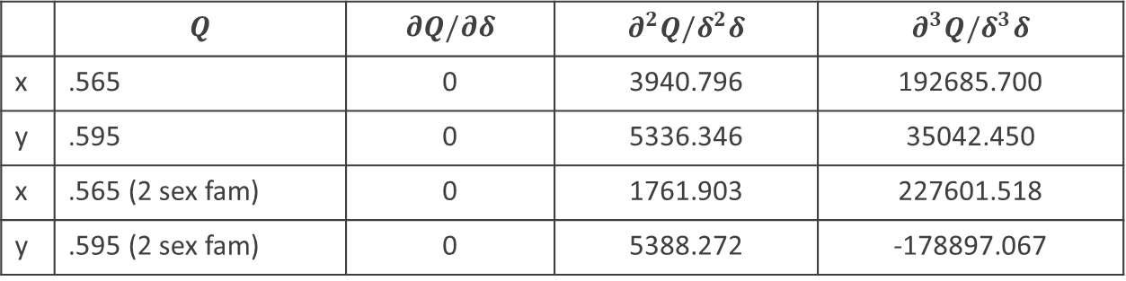

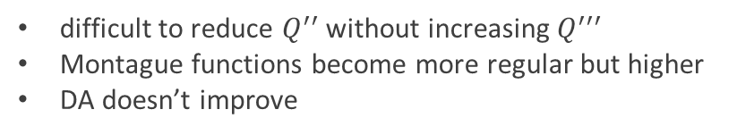
Optimizing momentum detuning with two sextupole families
Strategy:
0
abs < 0.2
abs < 0.05
$$(\frac{δp}{p_{0}}=0.01)$$
difficult to reduce $Q^{′′}$ without increasing $Q^{′′′}$
Montague functions become more regular but higher
DA doesn’t improve
 | $$Q$$ | $$∂Q/∂δ$$ | $$∂^{2}Q/δ^{2}δ$$ | $$∂^{3}Q/δ^{3}δ$$
x | .565 | 0 | 3940.796 | 192685.700
y | .595 | 0 | 5336.346 | 35042.450
x | .565 (2 sex fam) | 0 | 1761.903 | 227601.518
y | .595 (2 sex fam) | 0 | 5388.272 | -178897.067

Slide 10
Conclusions & Perspectives
Iterate on HEB layout
  Improve superposition with collider with 10 m (< 10 m) shift at IPs
Improve off-momentum DA for the 90°/90° optics
  Octupoles ?
  Phase advance between arcs?
  Other strategy for sextupoles families optimizations (MOGA,…) ?
HEB optics repository and alternative optics
Define tolerances and correctors for linear imperfections

Slide 11
Back-up

Slide 12
Multipoles field errors at injection (> b2)
Static dipole field errors of the CT dipole design at 56Gs considered + 10% random part
Dynamic field effect not taken into account in this simulations: dipole and multipole reproducibility expected to be ≤ 5×10⁻⁴
Courtesy of F. Zimmermann and Jie Gao
 | CT dipole |  | Iron-core dipole
GFR=R26 | 28Gs | 56Gs | 28Gs | 56Gs
B1/B0 | -5.20E-04 | -1.04E-04 | -1.56E-03 | -2.60E-04
B2/B0 | 4.73E-04 | 5.41E-04 | -2.03E-03 | -2.03E-04
B3/B0 | -7.03E-06 | 1.05E-04 | 3.52E-04 | 1.76E-04
B4/B0 | -9.14E-04 | -3.66E-04 | 4.57E-04 | -1.83E-04
B5/B0 | 3.56E-05 | -2.38E-05 | -2.38E-05 | -3.56E-05
B6/B0 | 6.18E-04 | 2.16E-04 | -3.09E-04 | 9.27E-05
97km 60°/60° optics
relative values @ R = 26 mm
Stable initial action @ 4500 turns (~15% tx 20 GeV)
60 seeds
MadX Thin-Lens Tracking
Geometric emittance injected 1.27e-9 nm

Slide 13
Amplitude detuning

Slide 14
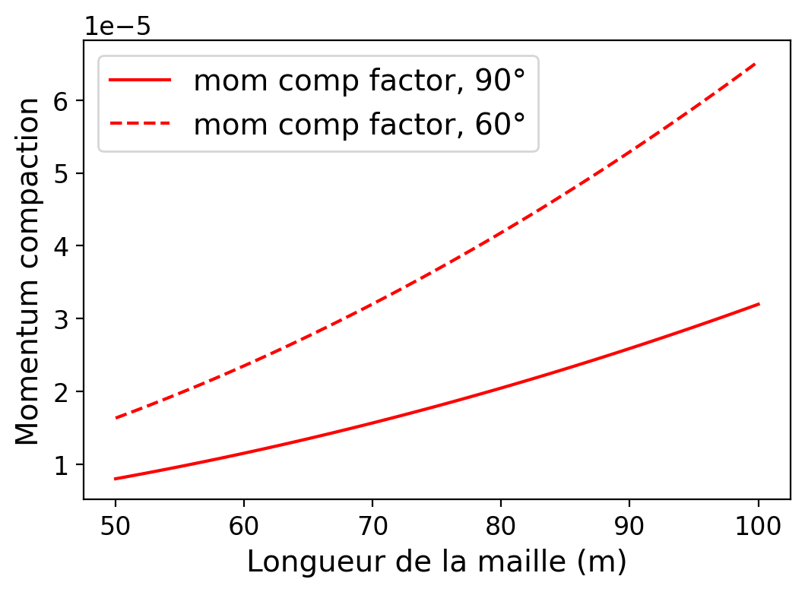
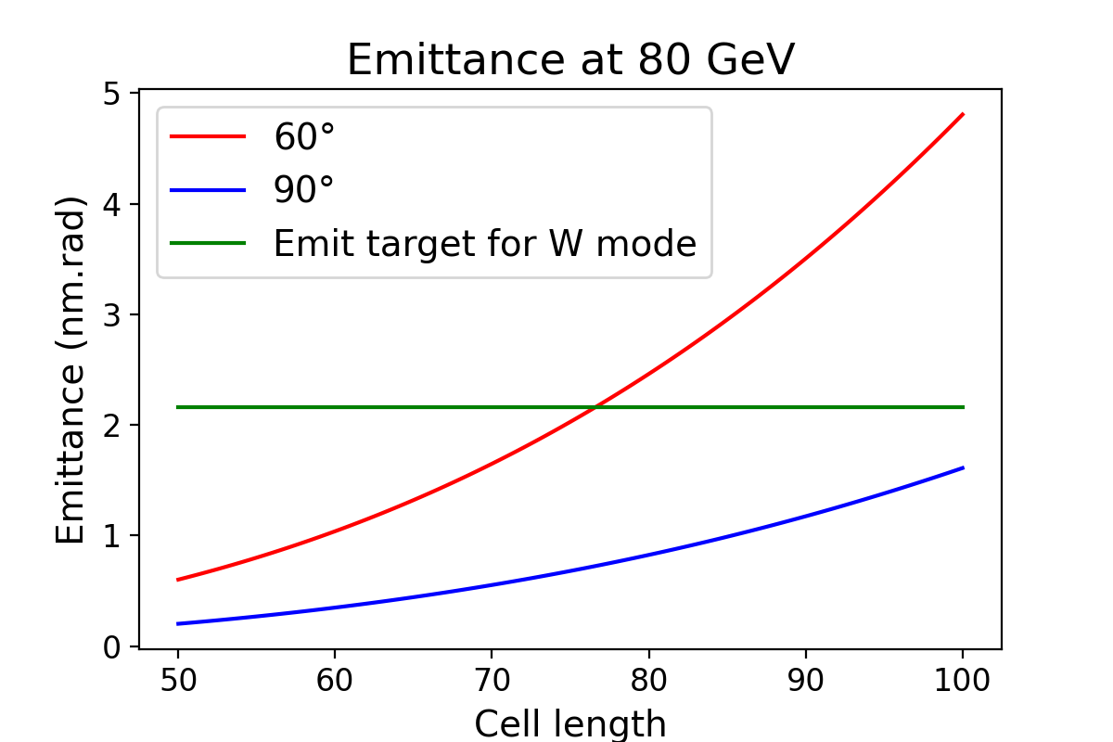
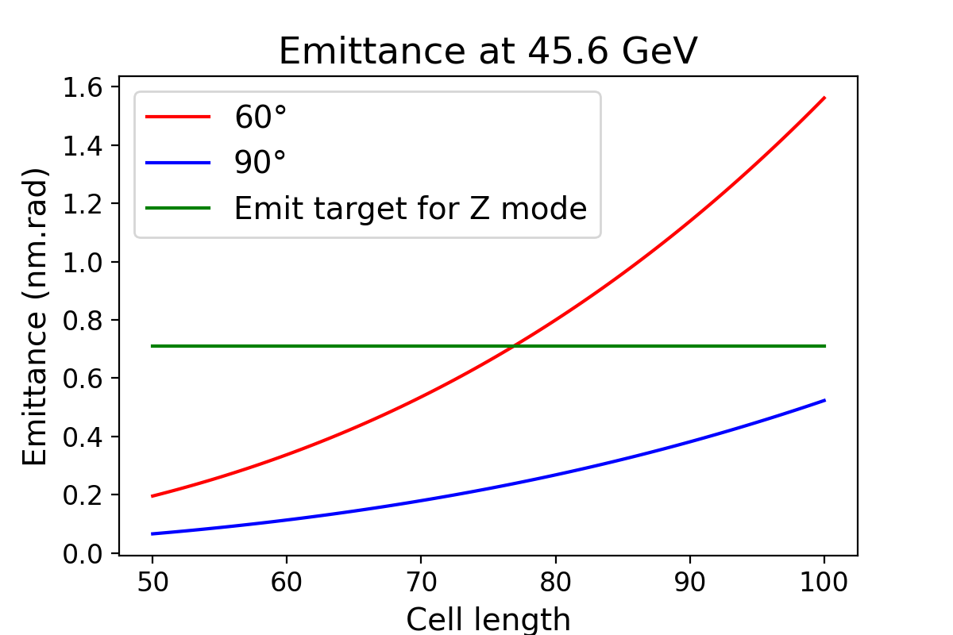
Equilibrium emittances
Booster Equilibrium rms emittance ≤ collider
new
Beam Energy [GeV] | Eq. Emittance [nm rad] 60°/60° | Eq. Emittance [nm rad] 90°/90° | Eq. Emittance Collider [nm rad]
45.6 (Z) | 0.235 | 0.078 | 0.24
80 (W) | 0.729 | 0.242 | 0.84
120 (H) | 4.229 | 0.545 | 0.63
175 (tt) | 3.540 | 1.172 | 1.48
Eq. emittance Collider new [nm rad]
0.71
2.16
0.64
1.49
Cell length (m)
60°/60° retained for Z and W operation (mitigation of MI and IBS)
90°/90° 100 m cell could gain a bit in momentum compaction at Z & W
90°/90° required for H and ttbar final emittances
[m]

Slide 15
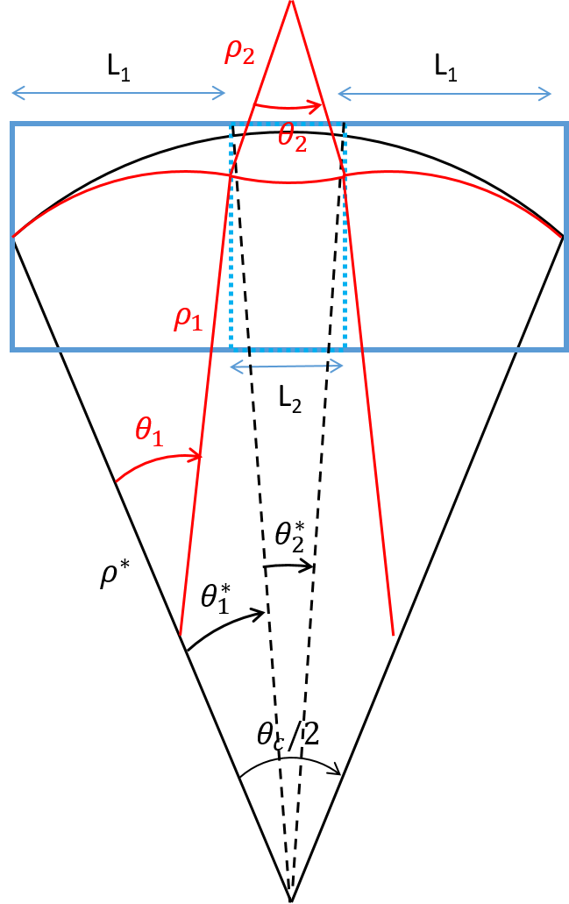



2 dipoles families optics
2 dipoles with two different curvatures,
proposed for the electron-ion collider (EIC)
Damping time can be reduced by playing on the ratio between the two different fields.
Advantages:
No impact on the layout
Increase I2 without damping wigglers
Higher dipole field at injection energy
Drawbacks:
Different reference orbits ⇒ reduction of beam stay clear?
More synchrotron radiation and in opposite direction of foreseen absorber (at injection) ⇒ vacuum quality to be investigated
$$a=\frac{L2}{L0}$$
$$b=\frac{ρ^{∗}}{ρ_{2}}$$
$${I_{i}=I}_{i}(μ_{x}, L_{cell}, θ_{c}/2, a,b)$$
A. Chancé

Slide 16
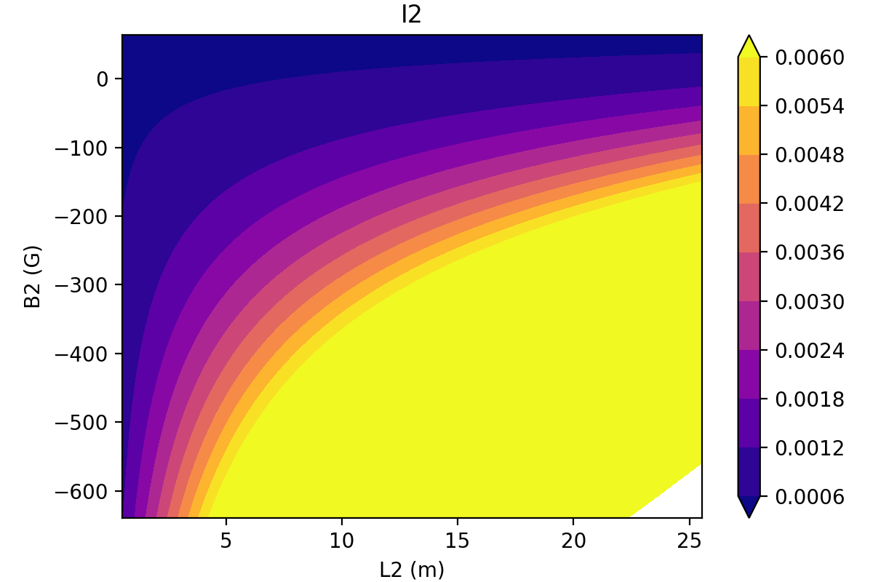
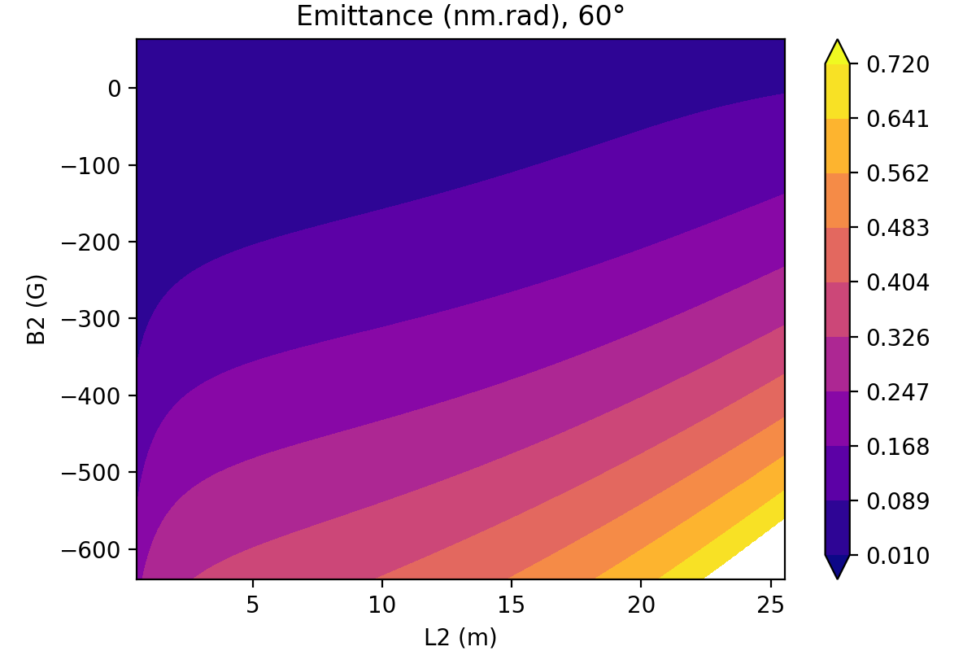
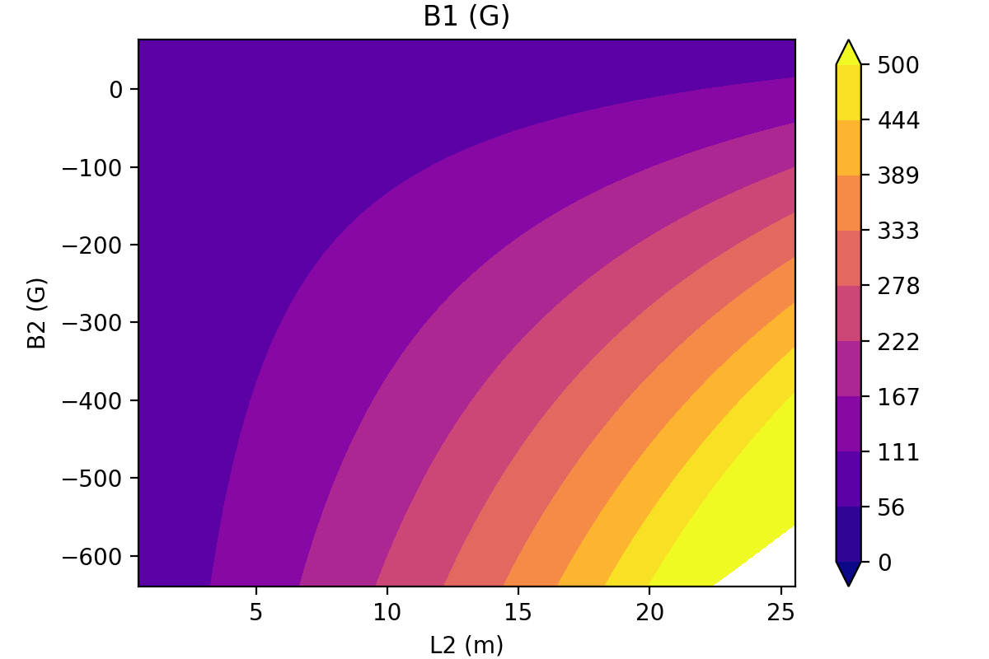
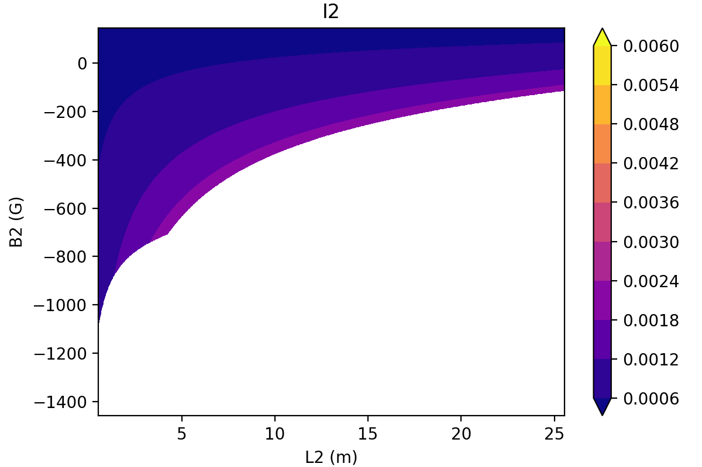
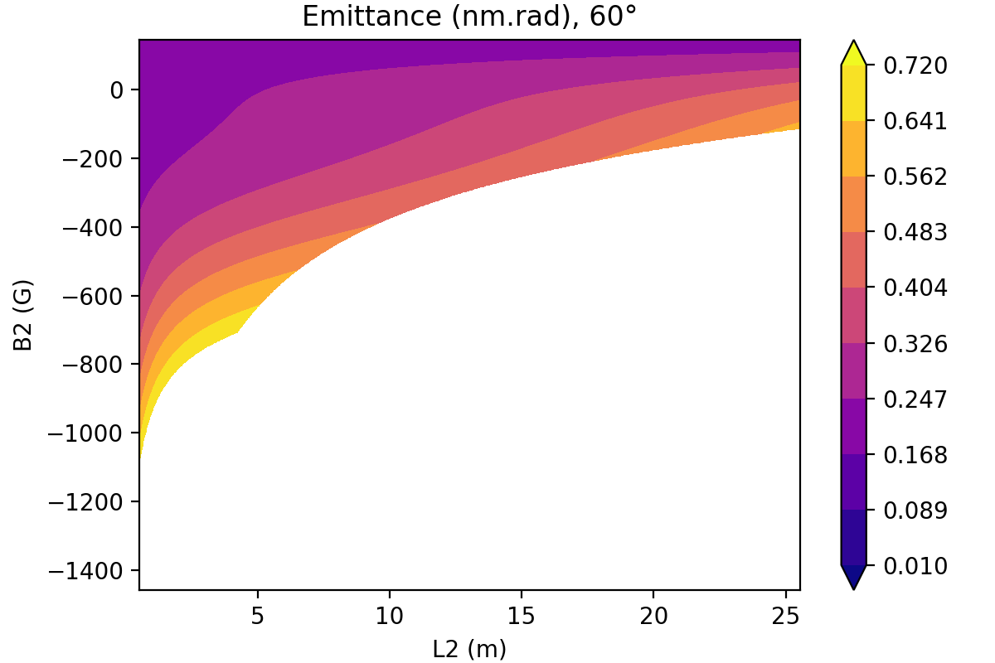
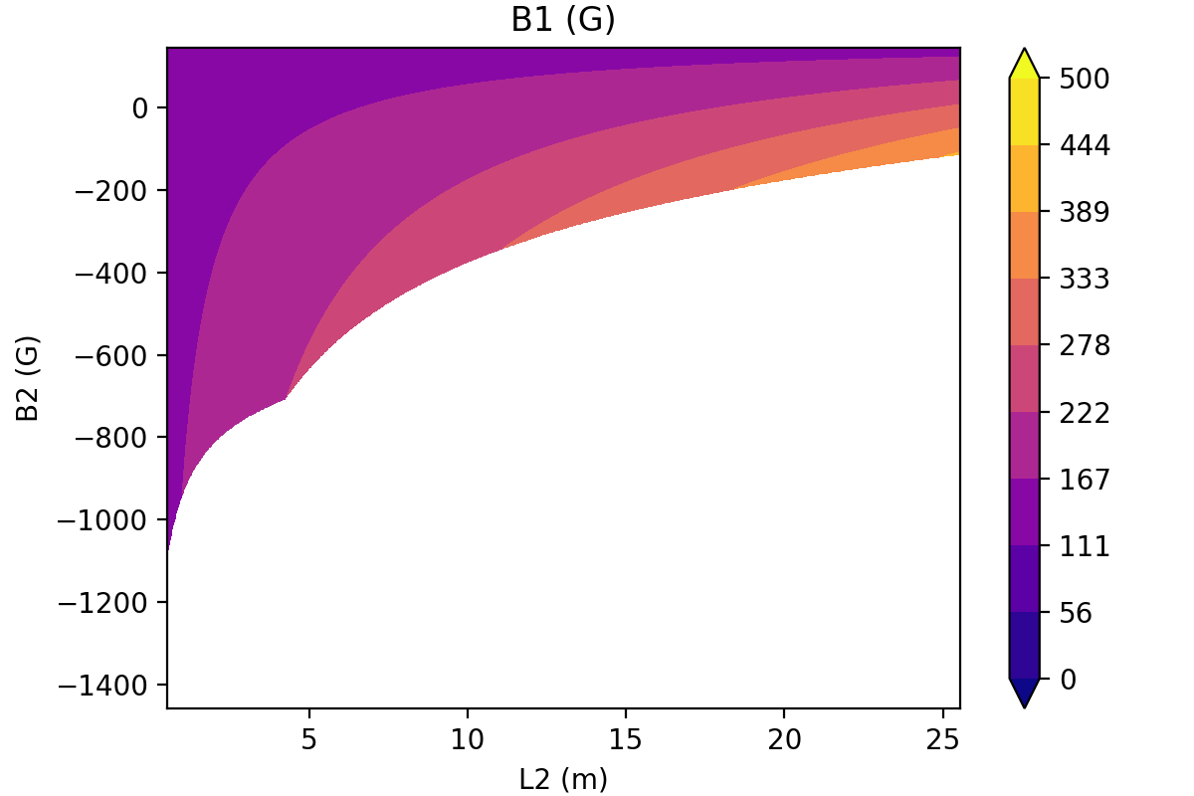
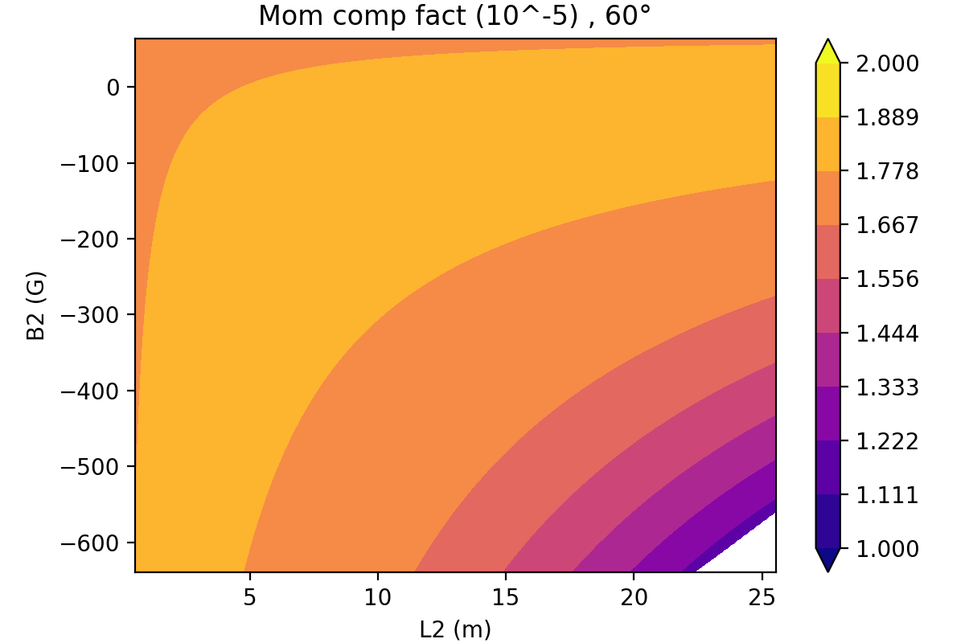
Preliminary results of two dipoles families optics
20 GeV
45.6 GeV
Constraints: Energy loss per turn ≤ 126 MeV (~wiggler), eq. emit < 0.72 nm
4 × I2 can be obtained with a L2 ~5 m, B2~-200 G, B1 ~170 G at 20 GeV and B₂ ~-400 G, B1 ~200 G at 45.6 GeV
Minimum dipole field at injection ~ 3×present lattice
Momentum compaction ~1.8 10⁻⁵ (~ 60°/60° lattice)
Which is the maximum allowed budget for radiated power ?
Which is the possible maximum field derivative for the two dipoles ?
H. De Grandsaignes, A. Chance

Slide 17
Main Linear field errors (b1, b2) only
Main quadupoles :
b2 = 2×10⁻⁴ relative random error
Main Dipoles:
b1 = 1×10⁻⁴ relative random error
b2 = -1 ×10⁻⁴ relative systematic error + 10% random component
Courtesy of F. Zimmermann and Jie Gao
Without orbit, beta-beating and dispersion correction:
orbit
beta-beating
normalized-dispersion

Slide 18
100 μm random quadrupole offset only (x,y)
Removing all other mis-alignment except for quadrupole offsets
Reducing the randomly distributed offset values to ±3 σ= 100 μm
Type | Δx (μm) | Δy (μm) | ΔS (μm) | ΔTheta (μrad) | ΔPhi (μrad) | ΔPsi (μrad) | Field Errors
Arc quad | 100 | 100
Arc sext
Dip
Girders
BPM
Without orbit, beta-beating and dispersion correction:
orbit
beta-beating
normalized-dispersion

