Slide 1
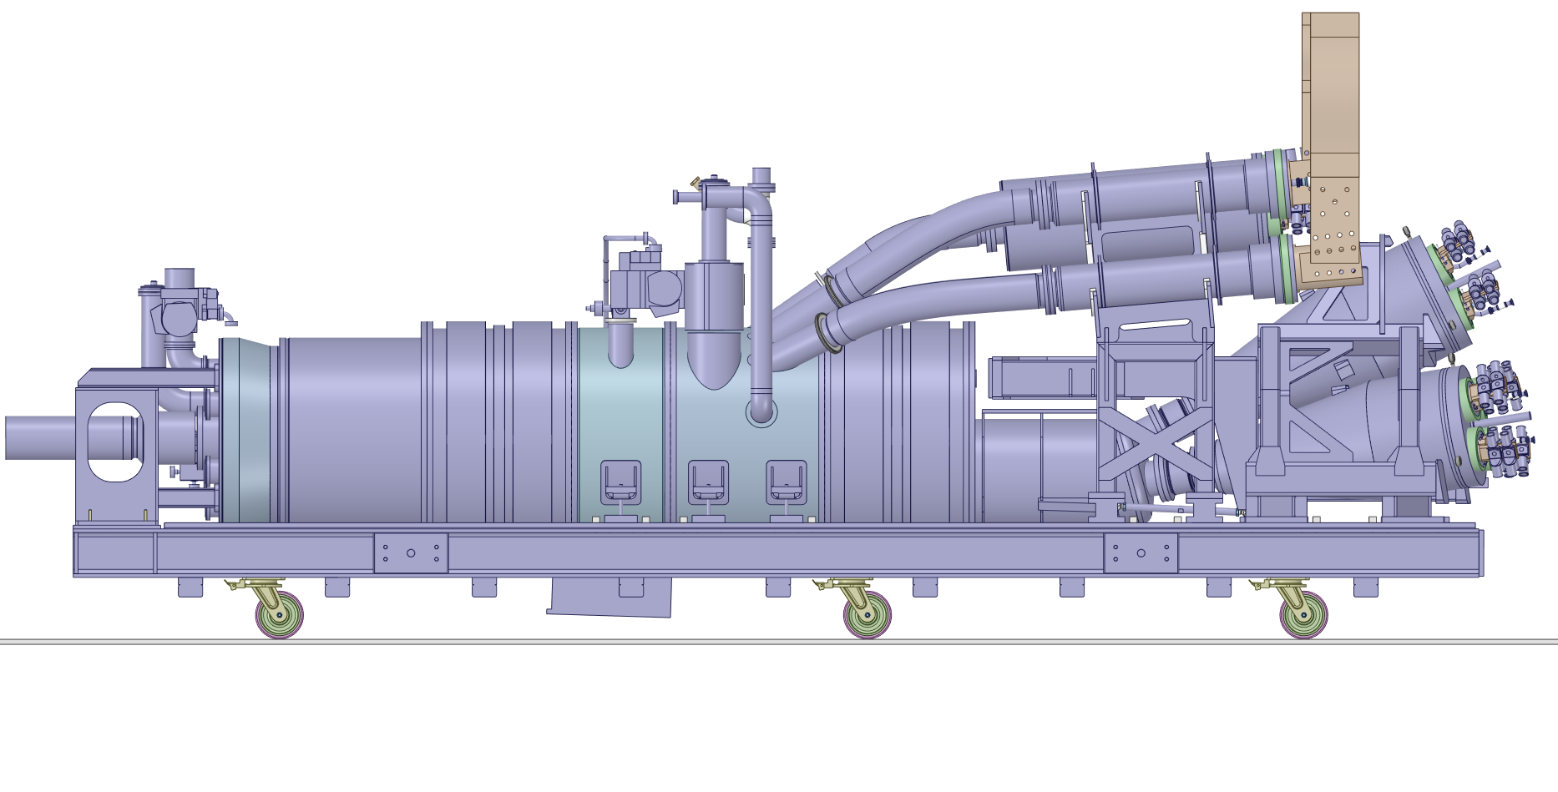
1 – DFHX positioning to horizontally match Busburs
Reference point
DFHX → Y_{RP_DFHX} = 1517 mm without wheel spacer
BusBar → Y_{RP_BB} = 1611 mm
1611
1517
Y

Slide 2
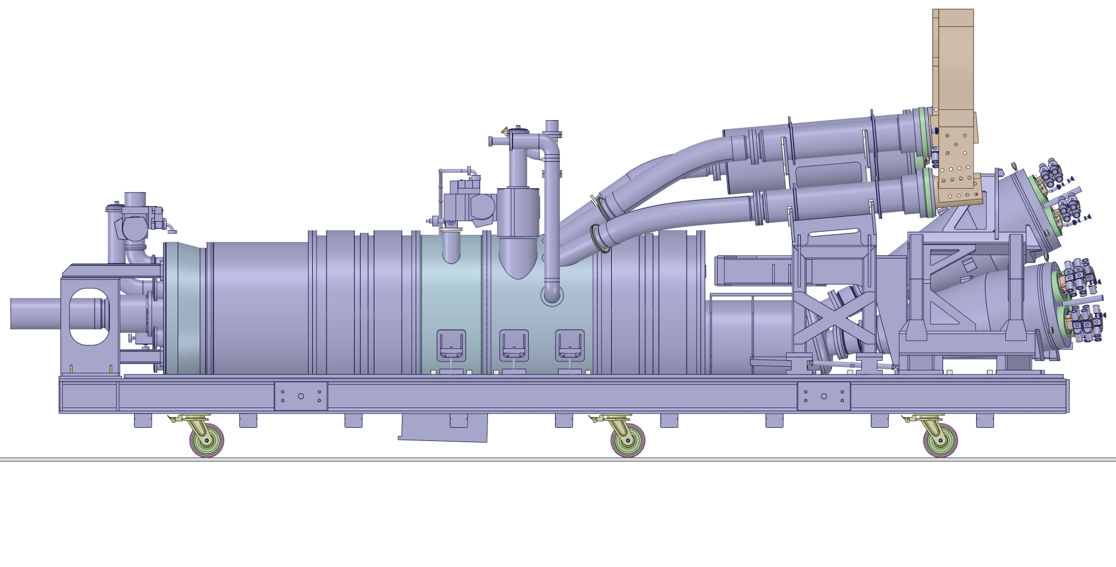
2 – Horizontal displacement
Horizontal displacement to compensate the one caused by the rotation (see Phase 7)
38mm

Slide 3
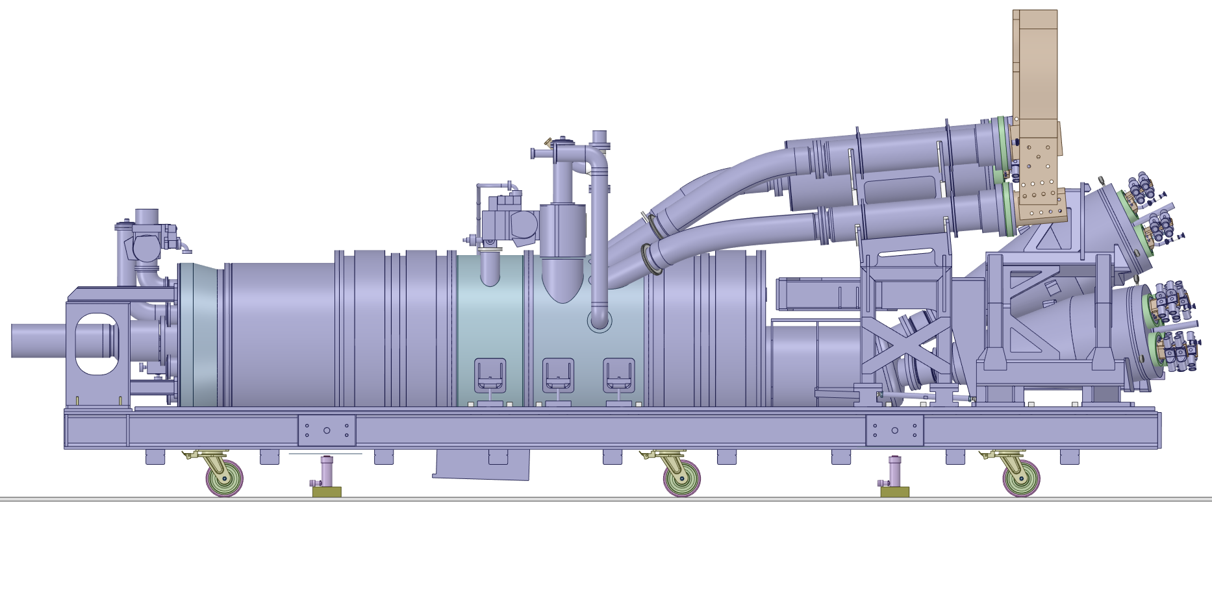
3 – Jack system installation

Slide 4



4 –Jack system brought to contact with the frame
$≈$35mm
$≈$35mm

Slide 5
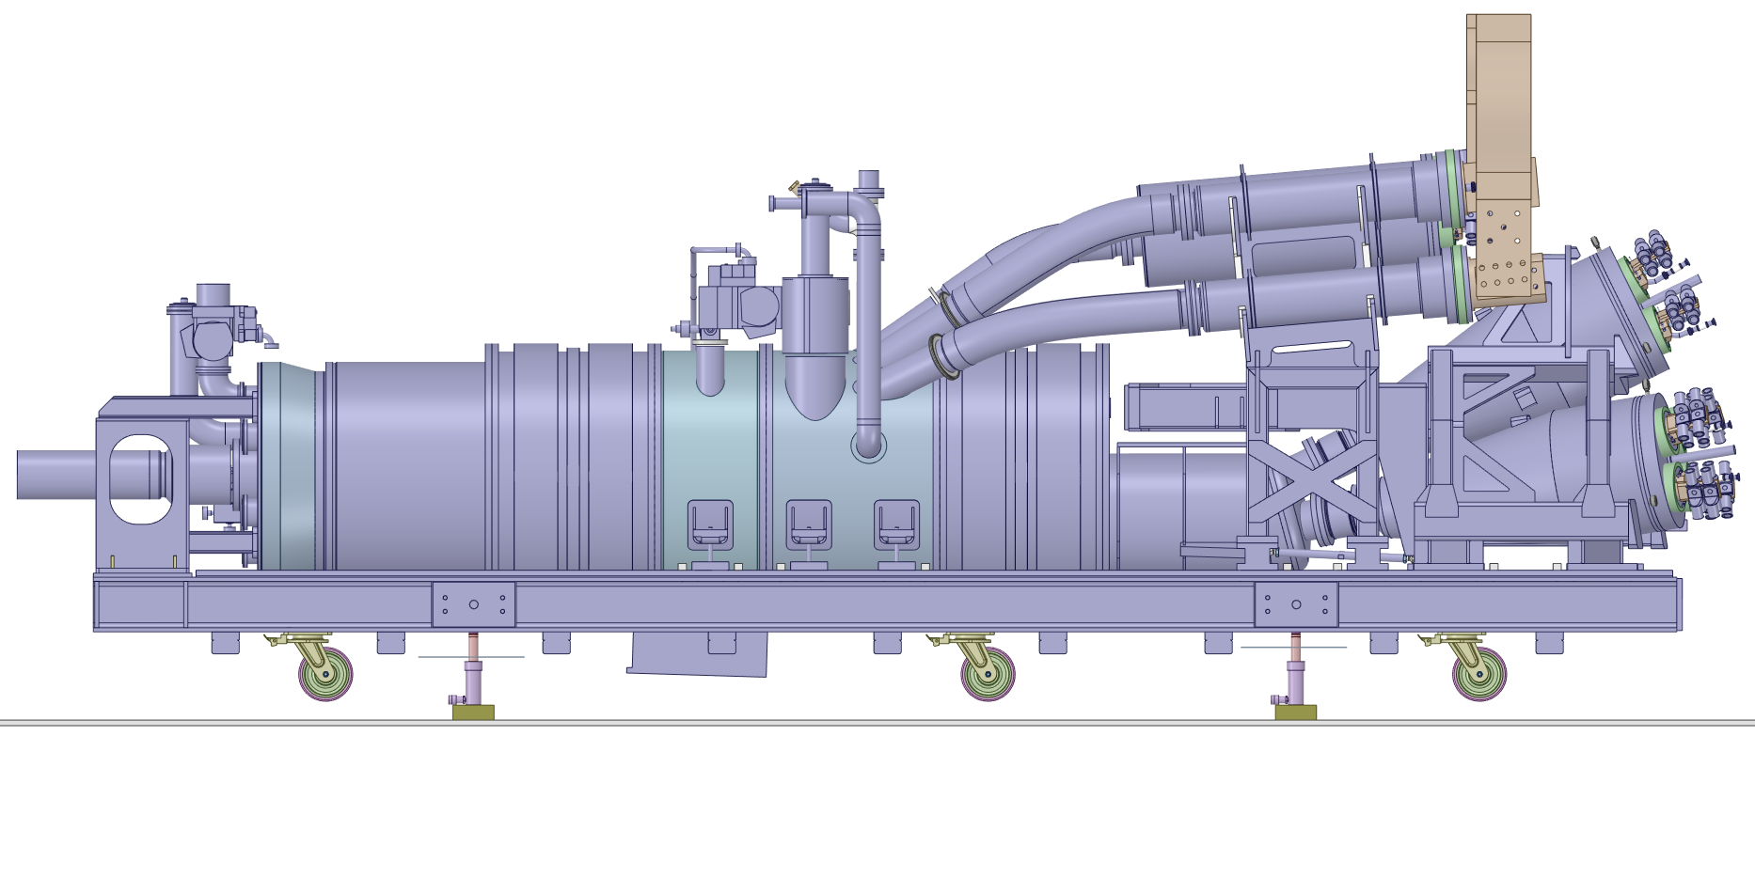


5 – Cryostat lifted up
$≈$68mm
$≈$68mm

Slide 6
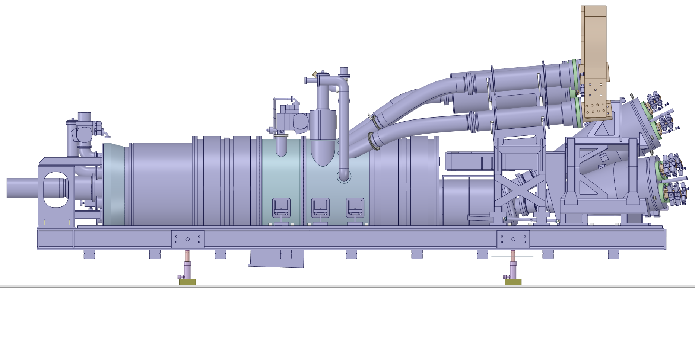
6 – Wheels removal

Slide 7
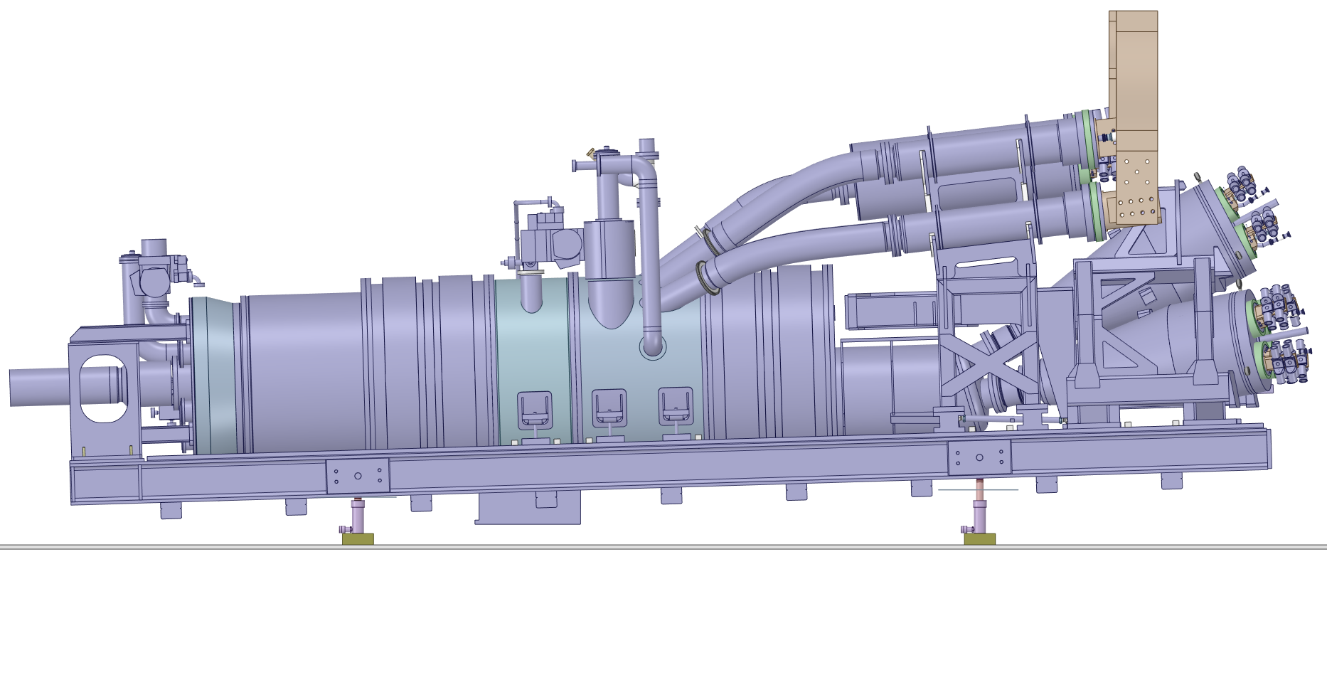


7 – Cryostat tilted
1.7°
Rotation Point
$≈89$mm
$≈0$mm

Slide 8
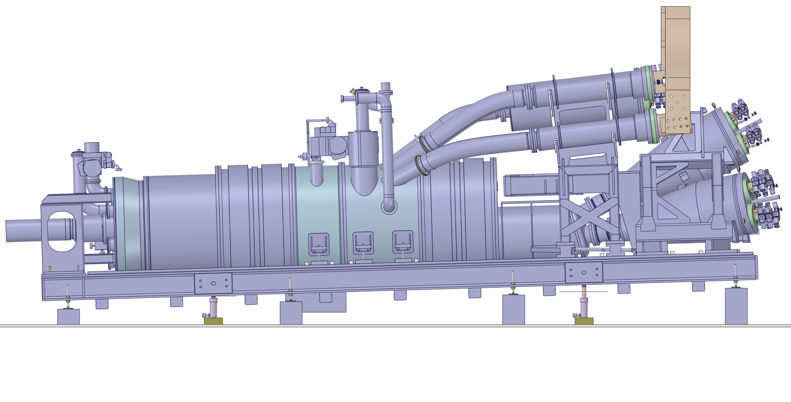
8 – Cryostat secured to the floor
Feet installation
Fixation system installation

Slide 9
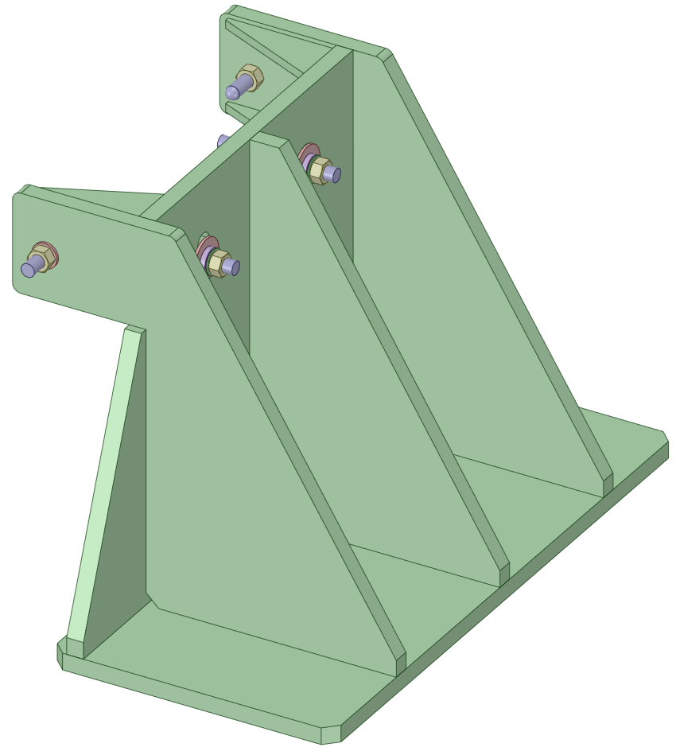
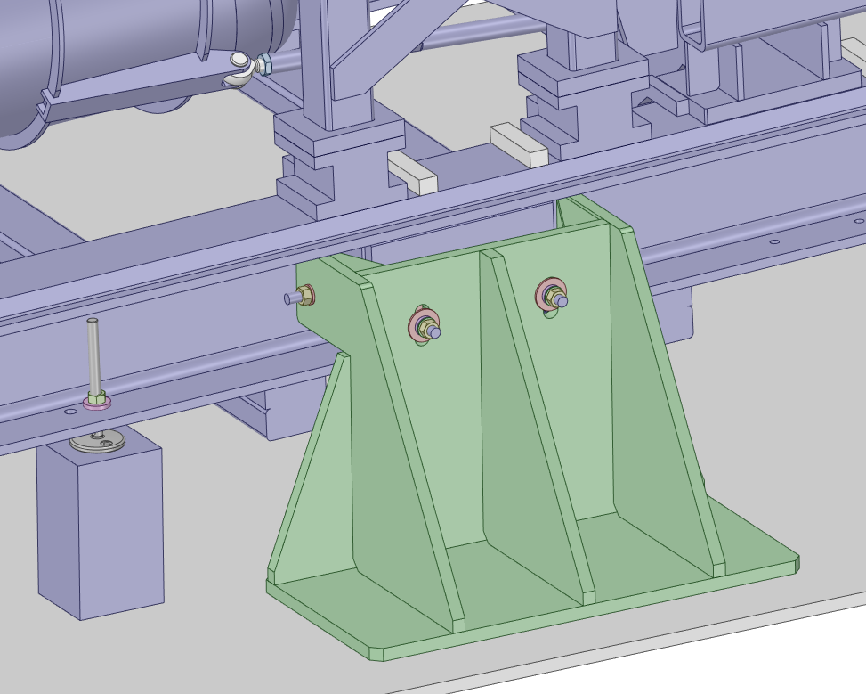
Fixation Bracket Model

Slide 10
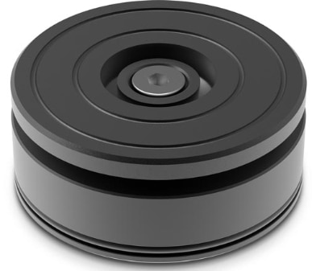
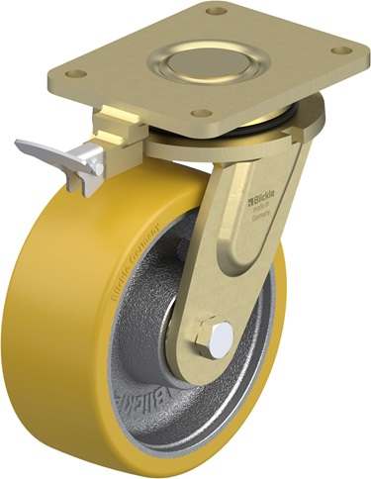
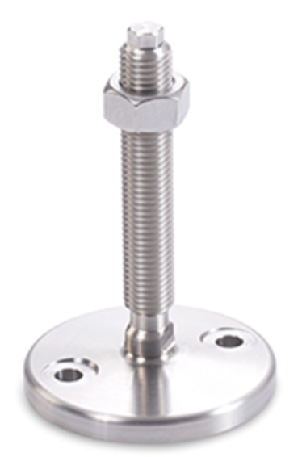
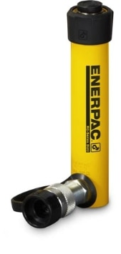
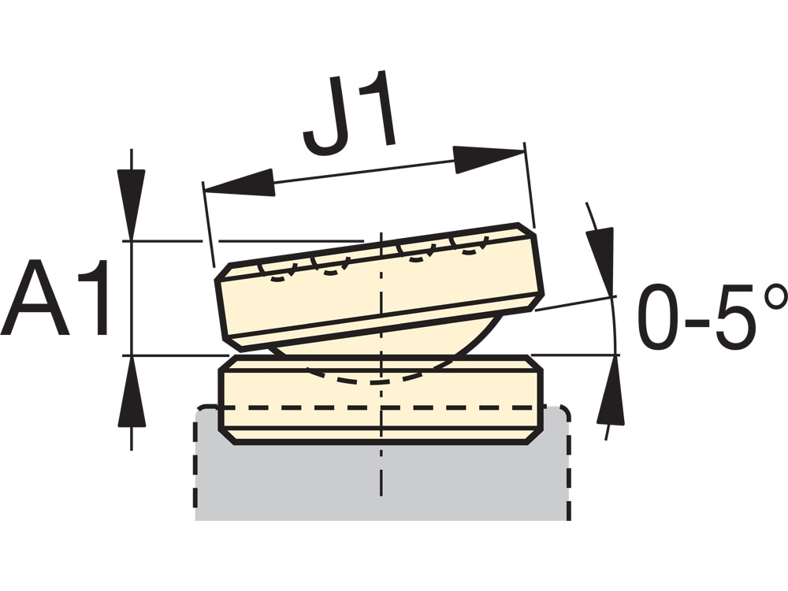
Equipment
Hydraulic cylinder → Enerpac RC55, 4.9-ton Capacity, 5.00’’ Stroke + Tilt saddle to absorb the inclination
Wheel → Blickle LS-GTH 202K-RI4, Ø = 200mm, Height = 255, Capacity (static) = 4-ton
Feet → elesa+Ganter GN 23 Stainless Steel-Levelling feet
Enerpac RC55 + Tilt Saddle
Blickle LS-GTH 202K-RI4
GN 23 Stainless Steel-Levelling feet

