Slide 1
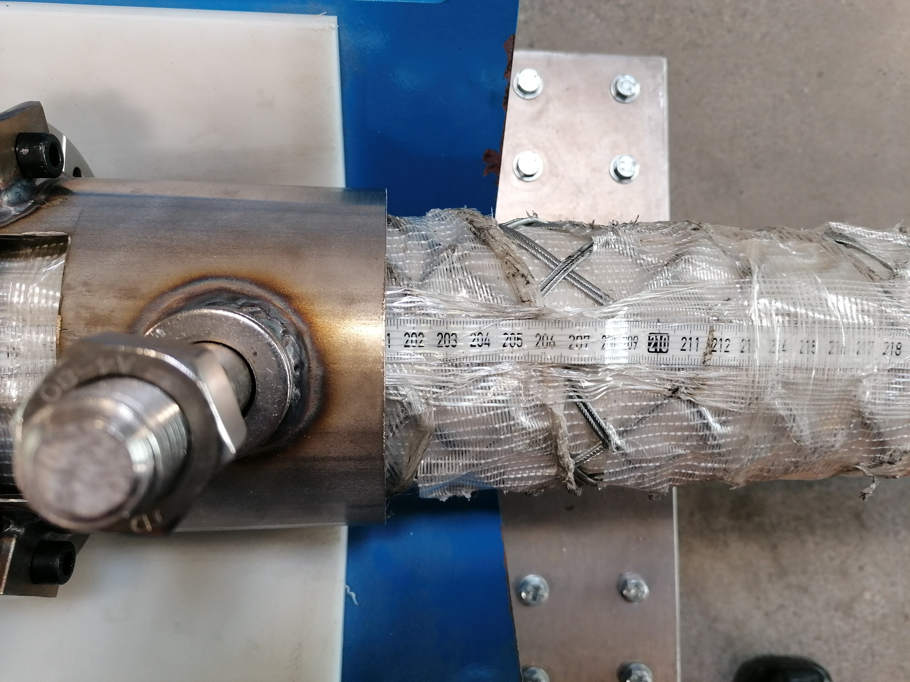
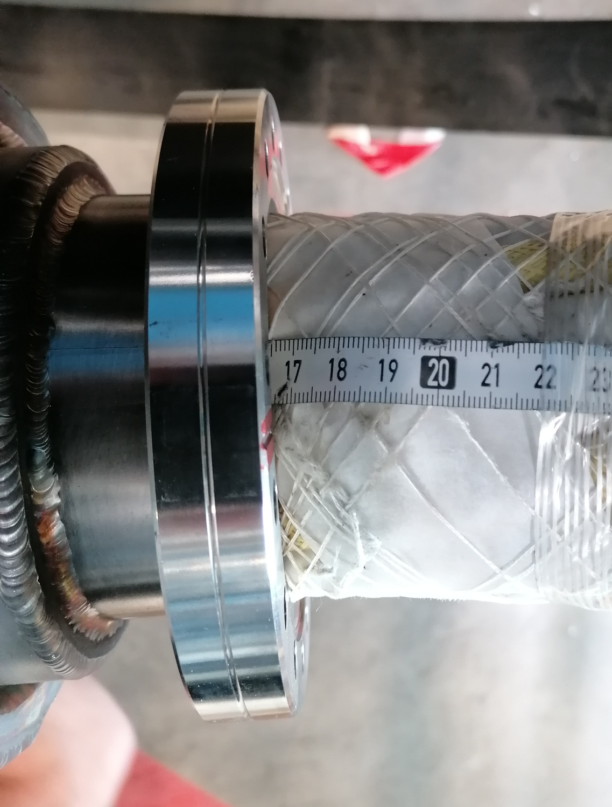
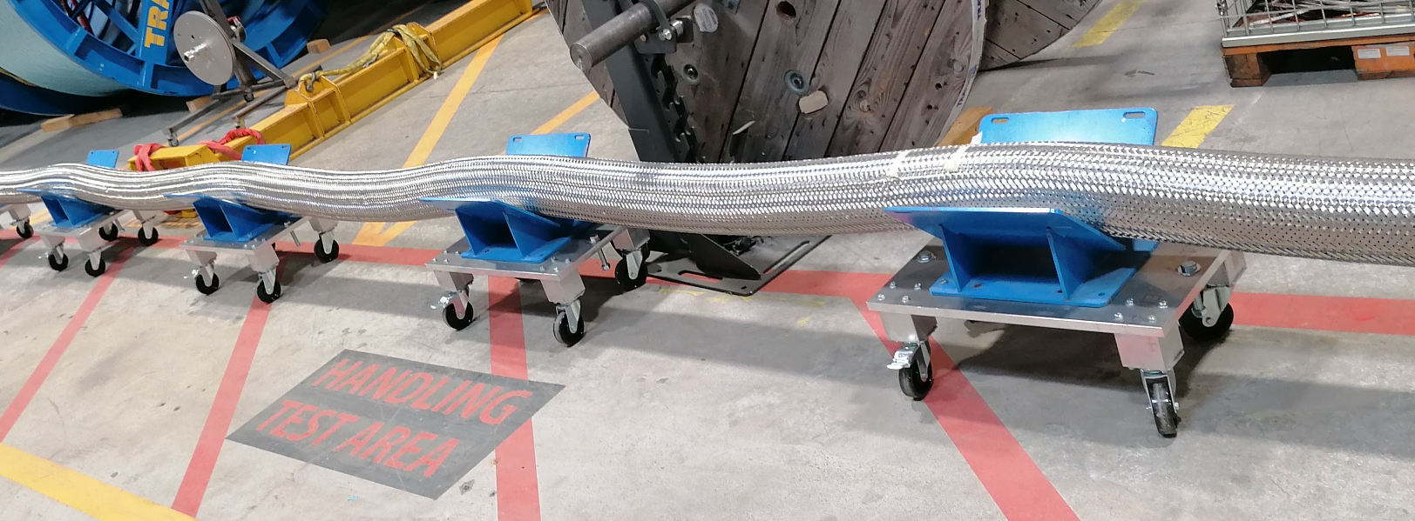
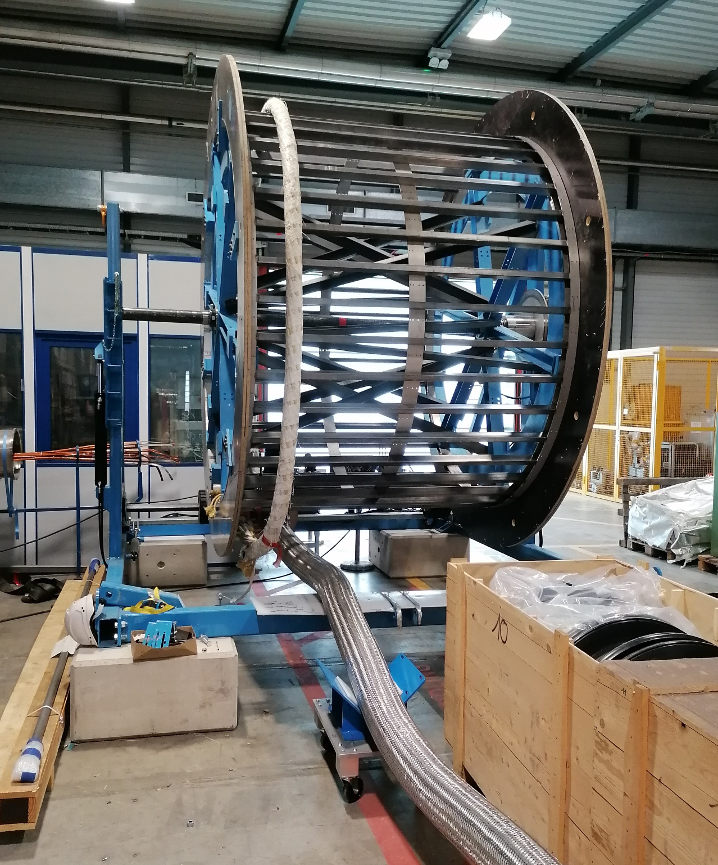
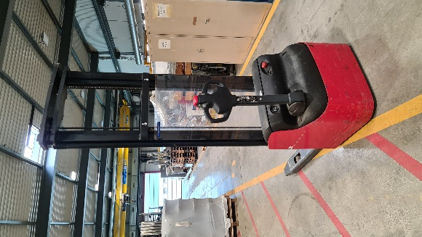
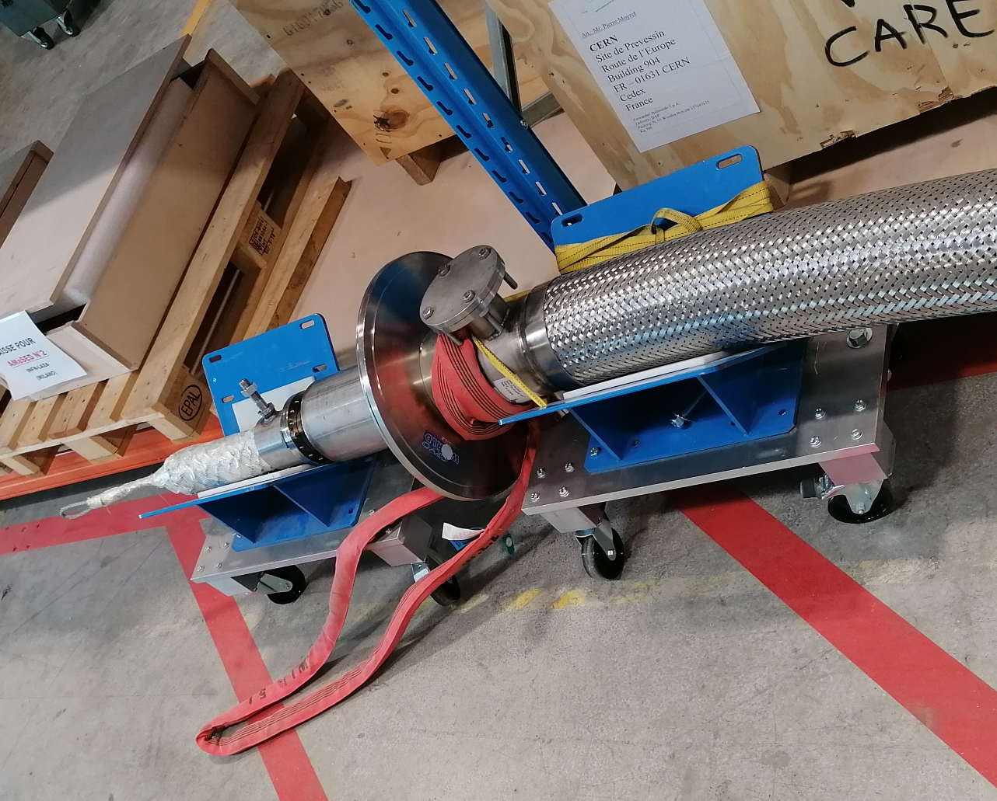
Spooling Tests 927 – Paul, Marc, Marcin, Erik (24/03/2022)
Test config:
62 m Demo cryostat
Demo cable Ø92 mm
Sc link on trolleys
Spool Ø3m
Cable free at A & B
Spooling: pulled by spool
Unspooling: pulled at cryostat flange
‘+’ cable movement out wrt flange (mm)
‘-’ cable movement in wrt flange (mm)
B
A
B
A

Slide 2
Spooling Tests 927 (24/03/2022)
State | rel.disp A (mm) | rel.disp B (mm)
Initial | 0 | 0
1 | +66 | -173
2 | -124 | +23
3 | -69 (wrt state 2, +55 ) | not measured
4 | -199 | +103
B
A
Test config:
62 m Demo cryostat,
Demo cable Ø92 mm,
Sc link on trolleys,
Spool Ø3m,
Cable free at A & B,
Spooling: pulled by spool on spooler,
Unspooling: pulled at cryostat flange,
‘+’ cable movement out wrt flange (mm)
‘-’ cable movement in wrt flange (mm)
0 m
60 m
B
A
Unspooling achieved by
pulling on cryostat flange
Unspooling achieved by
pulling on cryostat flange

Slide 3
Spooling Tests 927 (24/03/2022)

Slide 4
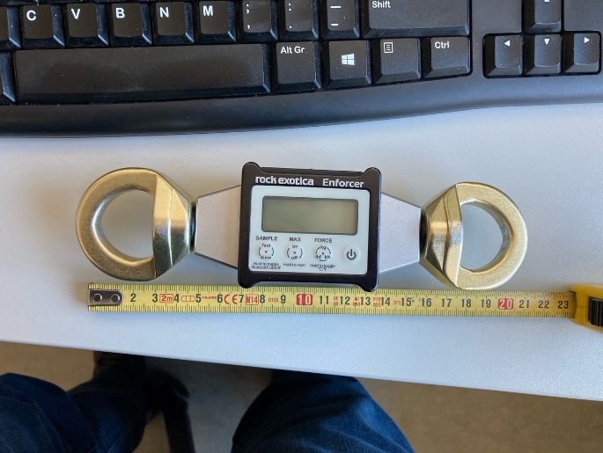
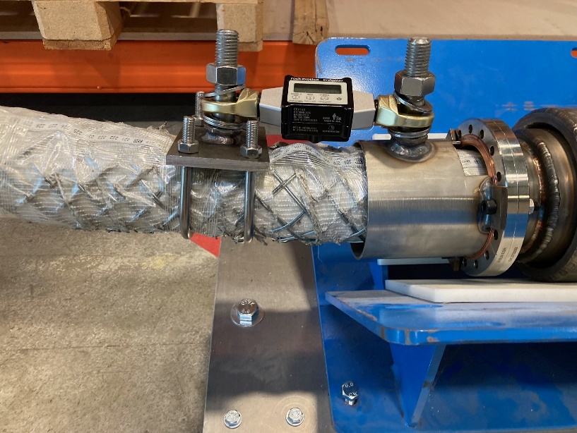
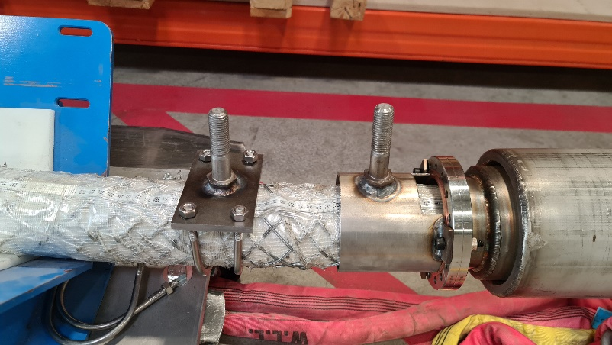
Spooling Tests 927 (Marc & Marcin) (??/03/2022)
State | rel.disp A (mm) | rel.disp B (mm)
Initial | 0 | 0
1 | 0 | +10
B
A
Test config:
62 m Demo cryostat,
Demo cable Ø92 mm,
Sc link on trolleys,
Spool Ø3m,
Cable held at A & free at B,
Spooling: pulled by spool on spooler,
Unspooling: pulled at cryostat flange,
‘+’ cable movement out wrt flange (mm)
‘-’ cable movement in wrt flange (mm)
60 m
0 m
B
A
D: distance Cryostat déployé (m) | F: force de traction (N). | M1: Cable position mm | M2: Cable position mm
60 | 40N | 1888 | 240
50 | 80N | 1888 | 240
40 | 100N | 1888 | 240
30 | 120N | 1888 | 240
20 | 160N | 1888 | 250
10 | 660N | 1888 | 250

Slide 5
Next steps spooling trials….
Further spooling test with restraint at A (& force measurement)
Spool/unspool/spool/unspool to check force observation
……..next week in 927
Check forces during unspooling using ‘gerbeur’
  What are the forces
  Where/how to pull - do we need to link the chariots and pull at the chariot instead of cryostat flange.
  Other ?

