Slide 1
DFHX integration sequence in SM18
Updates
27/04/2022
Stefanos Christos Spathopoulos

Slide 2
Overview
Iterative process to study various options conducted through the weekly WP6a technical meetings
Presented time durations are preliminary, iterations in progress for fine tuning (time unit is “day”, on-going work to define “hours” rather than days)
Agenda
  Latest integration sequence (iterations in progress)
  Preliminary “optimistic” planning overview

Slide 3
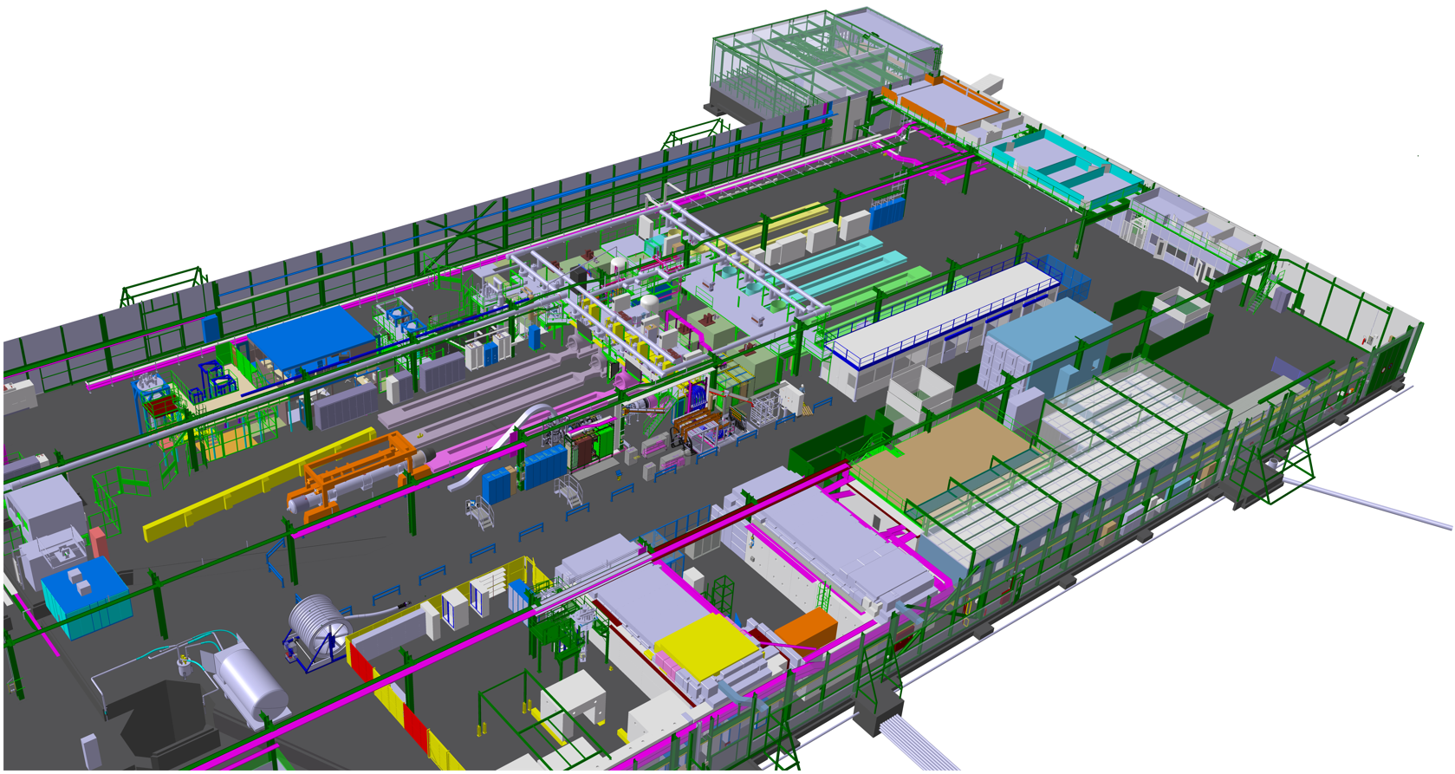
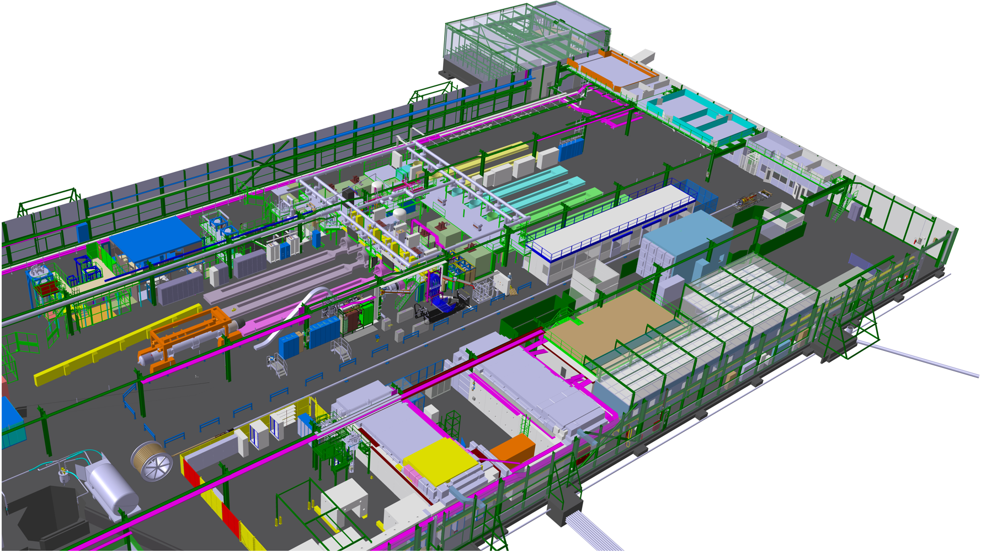
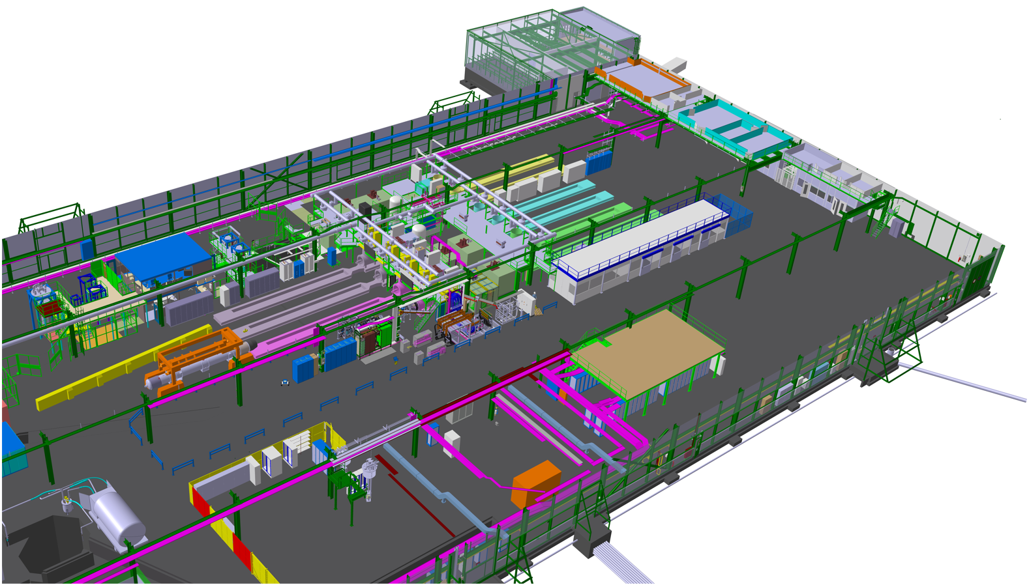
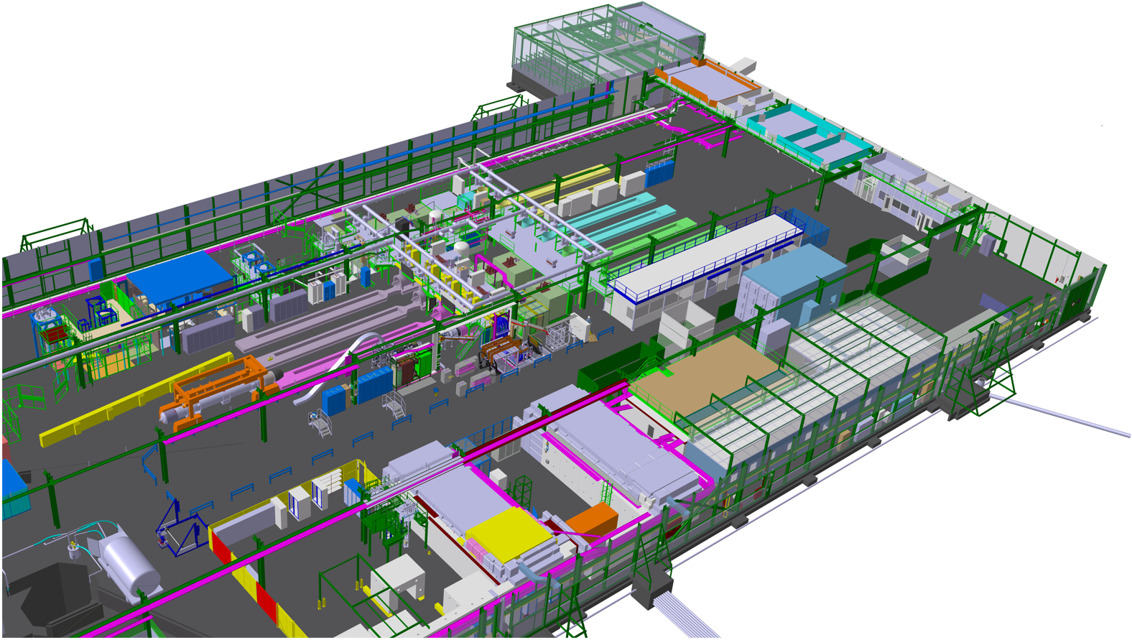
Phase 0: SCLink Cryostat+DFHx frame installation
Action | Duration
Spooler transportation | (1w)
Cryostat spool transportation | (3d)
Cryostat spool installation | 0.5d
Cryostat unspooling | 1d
Cryostat straightening+fixing | 1d
DFHx frame positioning | 0.5d
Cryostat spool removal | 0.5d

Slide 4
Phase 0: SCLink Cryostat+DFHx frame installation
Action | Duration
Spooler transportation | (1w)
Cryostat spool transportation | (3d)
Cryostat spool installation | 0.5d
Cryostat unspooling | 1d
Cryostat straightening+fixing | 1d
DFHx frame positioning | 0.5d
Cryostat spool removal | 0.5d

Slide 5
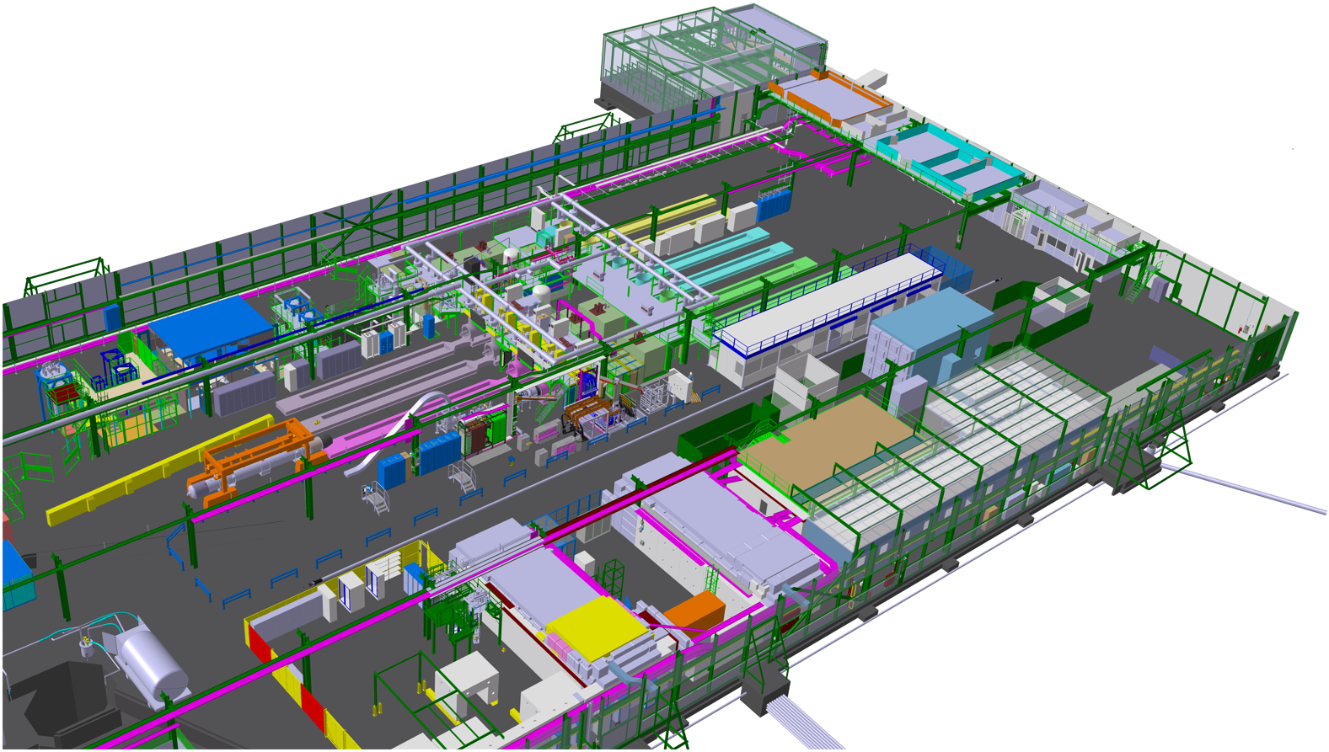

Phase 0: SCLink Cryostat+DFHx frame installation
Action | Duration
Spooler transportation | (1w)
Cryostat spool transportation | (3d)
Cryostat spool installation | 0.5d
Cryostat unspooling | 1d
Cryostat straightening+fixing | 1d
DFHx frame positioning | 0.5d
Cryostat spool removal | 0.5d

Slide 6

Phase 0: SCLink Cryostat+DFHx frame installation
Action | Duration
Spooler transportation | (1w)
Cryostat spool transportation | (3d)
Cryostat spool installation | 0.5d
Cryostat unspooling | 1d
Cryostat straightening+fixing | 1d
DFHx frame positioning | 0.5d
Cryostat spool removal | 0.5d

Slide 7
Phase 0: SCLink Cryostat+DFHx frame installation
Action | Duration
Spooler transportation | (1w)
Cryostat spool transportation | (3d)
Cryostat spool installation | 0.5d
Cryostat unspooling | 1d
Cryostat straightening+fixing | 1d
DFHx frame positioning | 0.5d
Cryostat spool removal | 0.5d

Slide 8
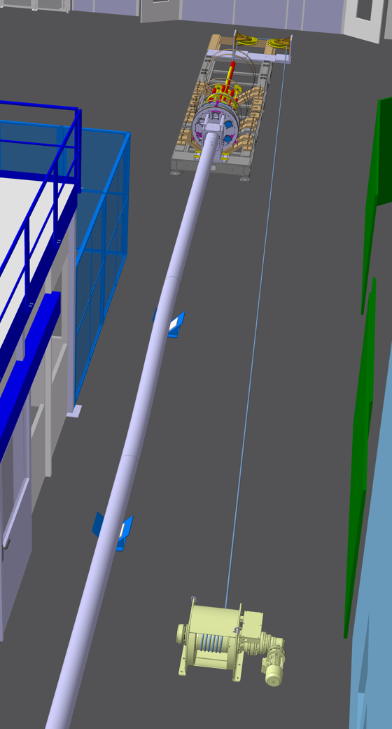
Phase 1: MgB2 spool installation + cable pulling
Action | Duration
Winch installation | 1d
MgB2 spool transportation | (3d)
MgB2 spool installation | 0.5d
Route winch cable inside the cryostat | 0.5d
Assembly flange on frame | 0.5d
Pulling MgB2 cable | 1d

Slide 9

Phase 1: MgB2 spool installation + cable pulling
Action | Duration
Winch installation | 1d
MgB2 spool transportation | (3d)
MgB2 spool installation | 0.5d
Route winch cable inside the cryostat | 0.5d
Assembly flange on frame | 0.5d
Pulling MgB2 cable | 1d
5m

Slide 10
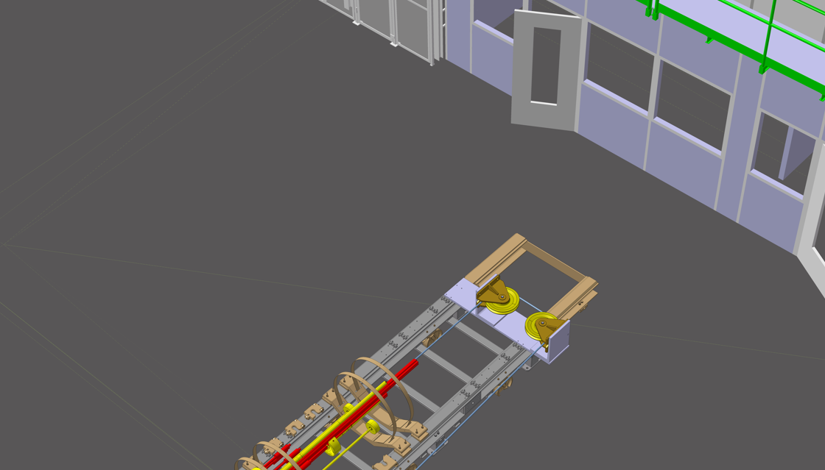
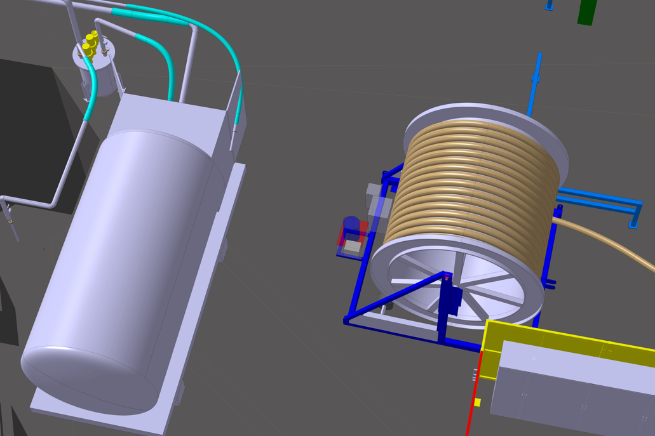
Phase 1: MgB2 spool installation + cable pulling
-Partially occupying the main transport corridors
(2m and 2.5 space available)
2.5m
2m
Action | Duration
Winch installation | 1d
MgB2 spool transportation | (3d)
MgB2 spool installation | 0.5d
Route winch cable inside the cryostat | 0.5d
Assembly flange on frame | 0.5d
Pulling MgB2 cable | 1d
5m

Slide 11

Phase 2: MgB2 spare cable unspooling
-Configuration fits without any major issues
25m
Action | Duration
Pull DFHx frame | 0.5d
Cut MgB2 cable | 0.5d
MgB2 spool removal | 0.5d

Slide 12
Phase 2: MgB2 spare cable unspooling
-Configuration fits without any major issues
25m
Action | Duration
Pull DFHx frame | 0.5d
Cut MgB2 cable | 0.5d
MgB2 spool removal | 0.5d

Slide 13
Phase 2: MgB2 spare cable unspooling
-Configuration fits without any major issues
Action | Duration
Pull DFHx frame | 0.5d
Cut MgB2 cable | 0.5d
MgB2 spool removal | 0.5d

Slide 14
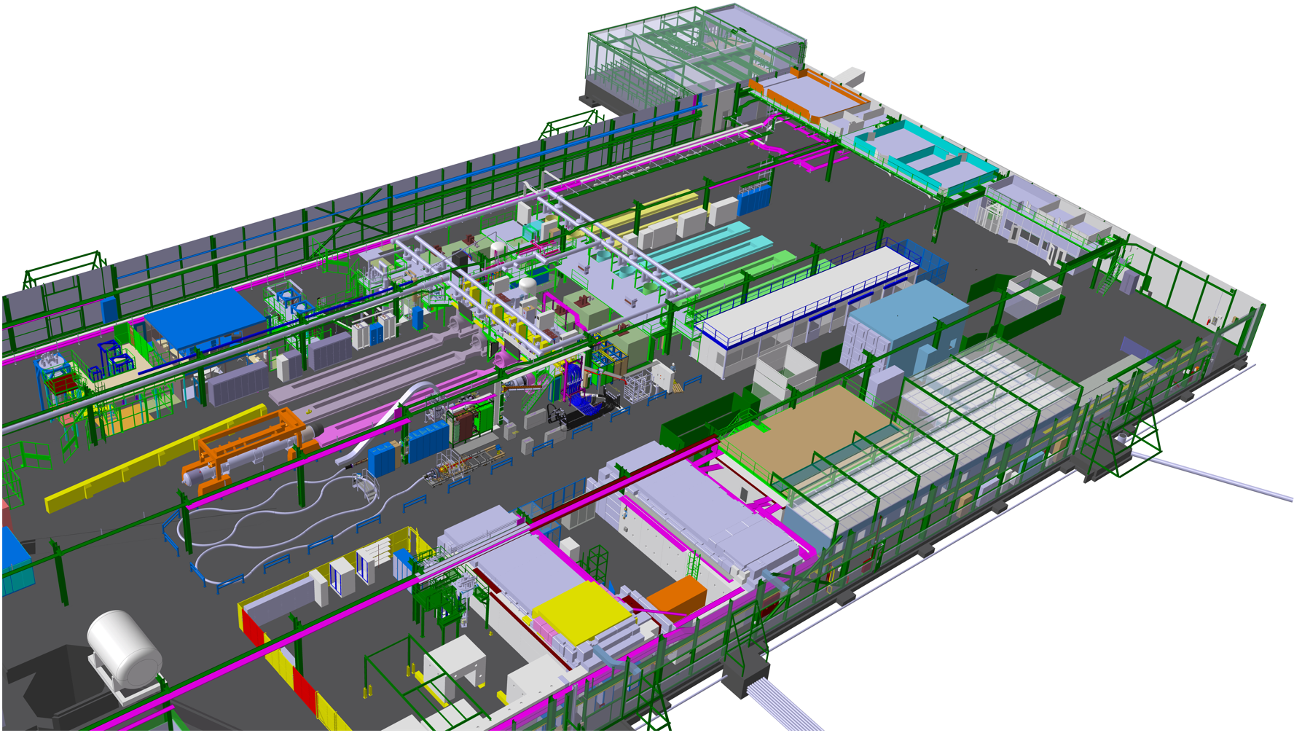
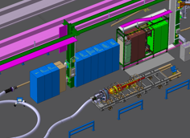
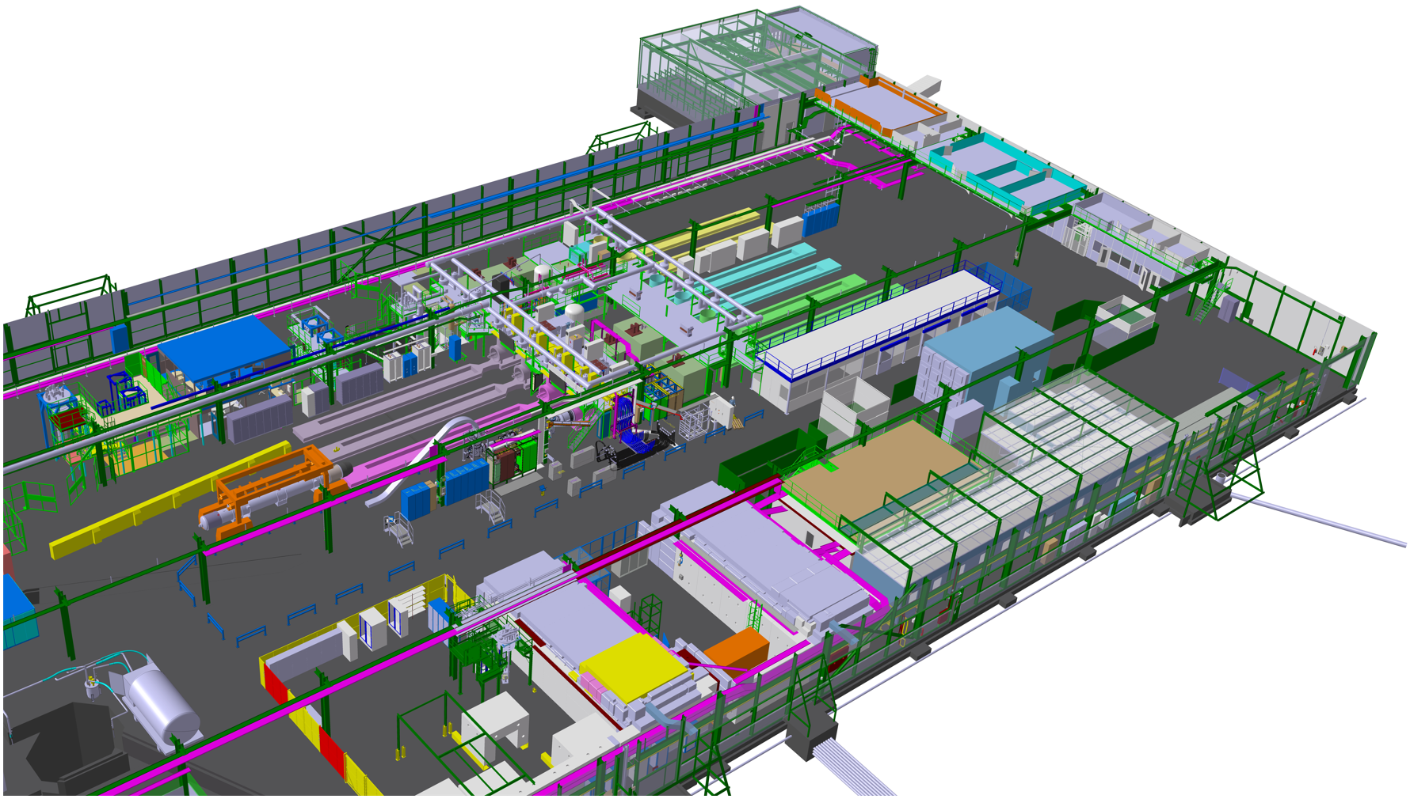
Phase 3: DFHx +SCLink positioning at the reserved WP6a zone
Action | Duration
Position and Route DFX end | 1.5d
Position DFHx extremity | 0.5d

Slide 15
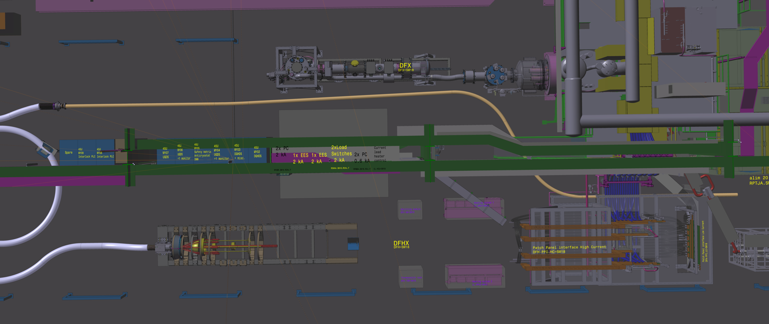
Phase 3: DFHx +SCLink positioning in reserved space
MgB2 routing (Sc1)
5m
10m
R: 2m
15m
R: 2m
20m
25m
7m
MgB2 cable pass near the patch panel-> Crowded area-Limited space
Action | Duration
Position and Route DFX end | 1.5d
Position DFHx extremity | 0.5d

Slide 16
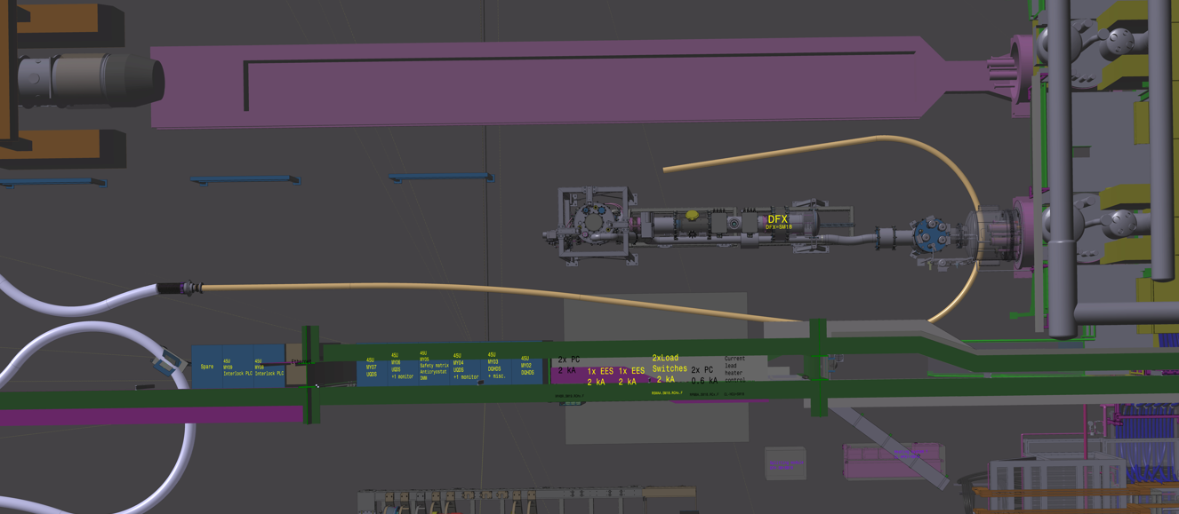
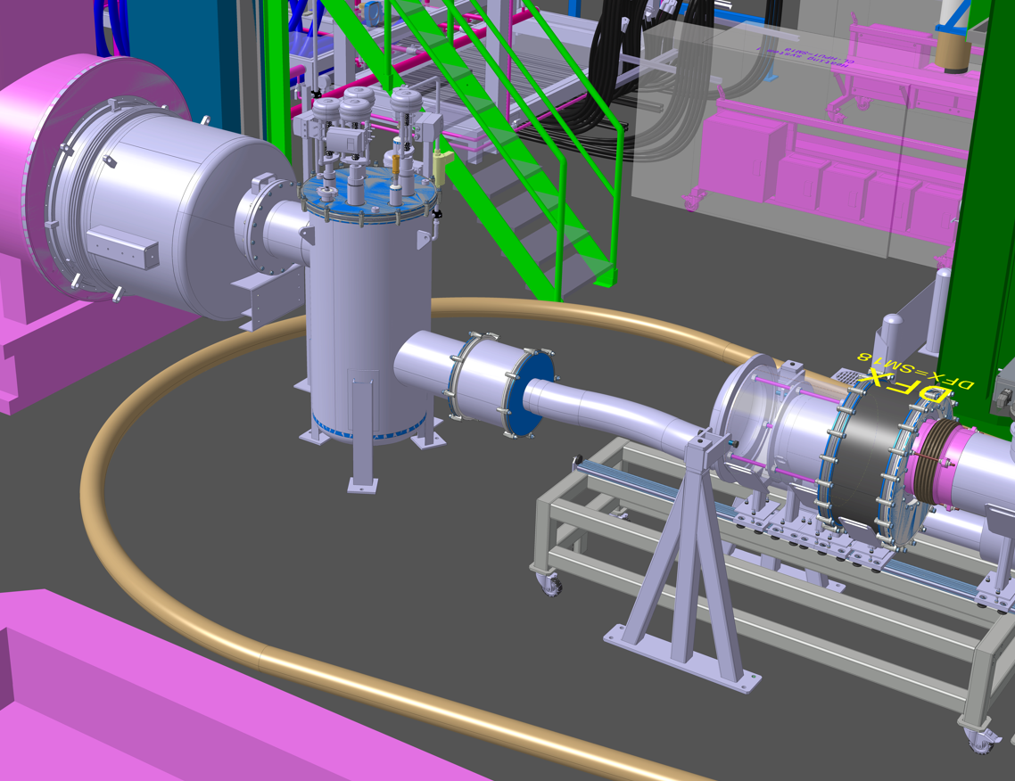
Phase 3: DFHx +SCLink positioning in reserved space
MgB2 routing (Sc2)
R: 2m
MgB2 cable bended, passing behind the Gas Mixing Chamber
Action | Duration
Position and Route DFX end | 1.5d
Position DFHx extremity | 0.5d

Slide 17
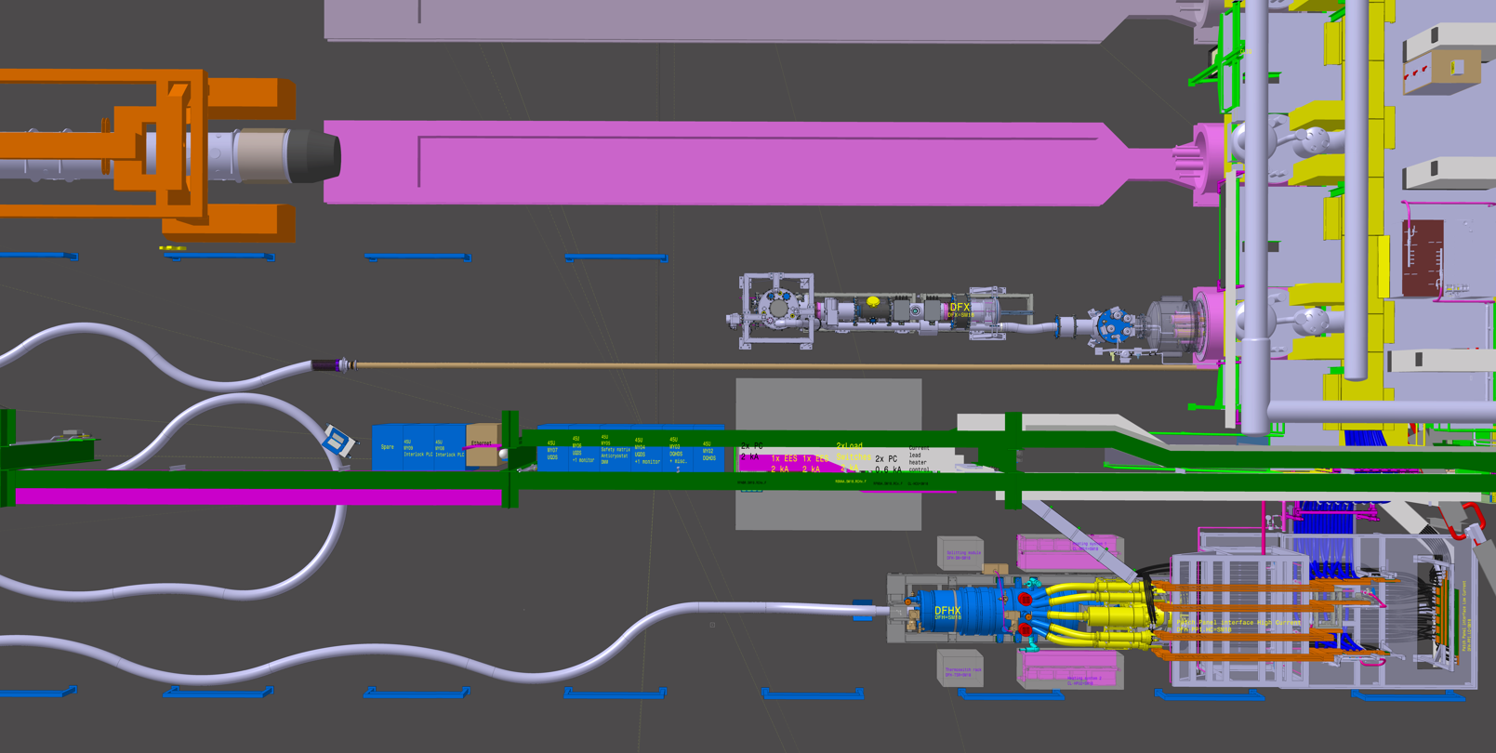
Phase 3: DFHx +SCLink positioning in reserved space
MgB2 routing (Sc3)
MgB2 cable remain straight -> MgB2 cable of max 22m can be accomodated
Action | Duration
Position and Route DFX end | 1.5d
Position DFHx extremity | 0.5d

Slide 18
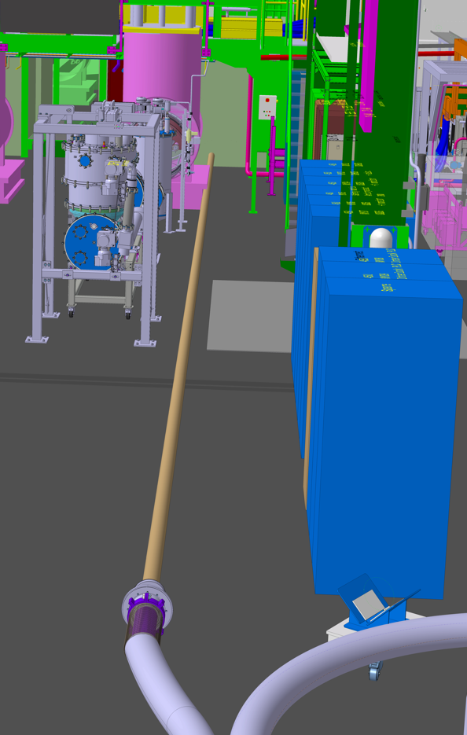
Phase 3: DFHx +SCLink positioning in reserved space
MgB2 routing (Sc3)
22m
MgB2 cable remain straight -> MgB2 cable of max 22m can be accomodated
Action | Duration
Position and Route DFX end | 1.5d
Position DFHx extremity | 0.5d

Slide 19
Phase 3: DFHx +SCLink positioning at the reserved WP6a zone
Space of 7m left between the DFHx frame and patch panel -> Provide enough space for assembly
7m
Action | Duration
Position and Route DFX end | 1.5d
Position DFHx extremity | 0.5d

Slide 20
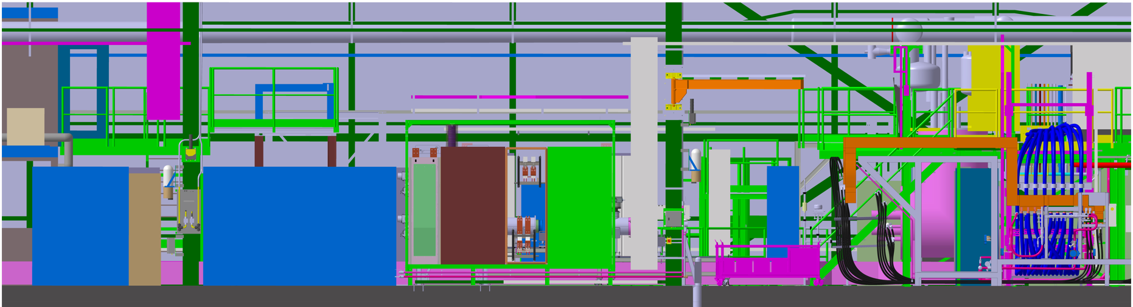
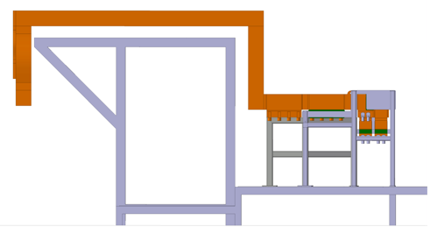
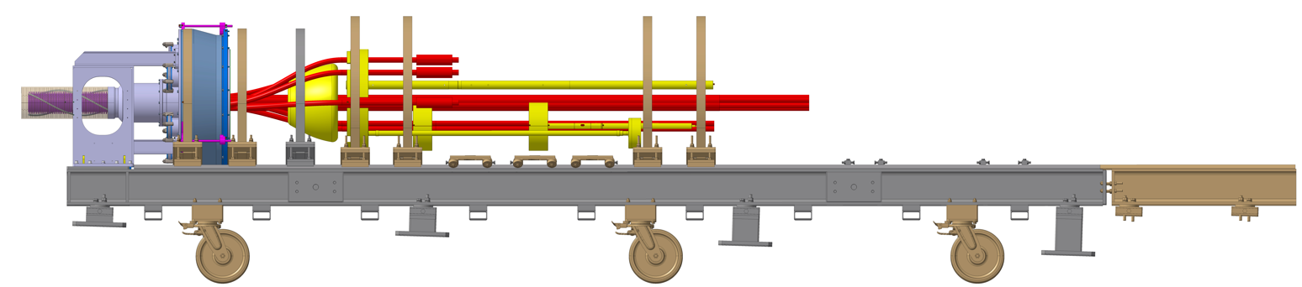
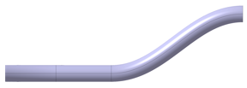
Phase 4: DFHx assembly & preparation to connect to Cluster F2
Action | Duration
DFHx assembly & Connection to ClusterF2 | 4.5m
Step 1: Position the frame at the nominal assembly position
Step 2: Install the jacks under the frame
Step 3: Lift the frame till the wheels are detached from the floor [Maintain the whole configuration straight]
Step 4: Assemble the cryostat
Step 5: Lower down the assembled cryostat
Step 6: Slide it towards the patch panel and reach the final installation position
Step 7.1: Install the jacks under the frame
Step 8: Lift the cryostat till the wheels are detached from the floor
Step 9: Remove the wheels
Step 10: Lower down the jacks (or brackets) till the cryostat reach the needed inclined position
Step 11: Add the fixation point
Step 12: Connect the cryostat to the patch panel

Slide 21
Phase 4: DFHx assembly & preparation to connect to Cluster F2
Action | Duration
DFHx assembly & Connection to ClusterF2 | 4.5m
Step 1: Position the frame at the nominal assembly position
Step 2: Install the jacks under the frame
Step 3: Lift the frame till the wheels are detached from the floor [Maintain the whole configuration straight]
Step 4: Assemble the cryostat
Step 5: Lower down the assembled cryostat
Step 6: Slide it towards the patch panel and reach the final installation position
Step 7.1: Install the jacks under the frame
Step 8: Lift the cryostat till the wheels are detached from the floor
Step 9: Remove the wheels
Step 10: Lower down the jacks (or brackets) till the cryostat reach the needed inclined position
Step 11: Add the fixation point
Step 12: Connect the cryostat to the patch panel

Slide 22
Phase 4: DFHx assembly & preparation to connect to Cluster F2
Action | Duration
DFHx assembly & Connection to ClusterF2 | 4.5m
Step 1: Position the frame at the nominal assembly position
Step 2: Install the jacks under the frame
Step 3: Lift the frame till the wheels are detached from the floor [Maintain the whole configuration straight]
Step 4: Assemble the cryostat
Step 5: Lower down the assembled cryostat
Step 6: Slide it towards the patch panel and reach the final installation position
Step 7.1: Install the jacks under the frame
Step 8: Lift the cryostat till the wheels are detached from the floor
Step 9: Remove the wheels
Step 10: Lower down the jacks (or brackets) till the cryostat reach the needed inclined position
Step 11: Add the fixation point
Step 12: Connect the cryostat to the patch panel

Slide 23
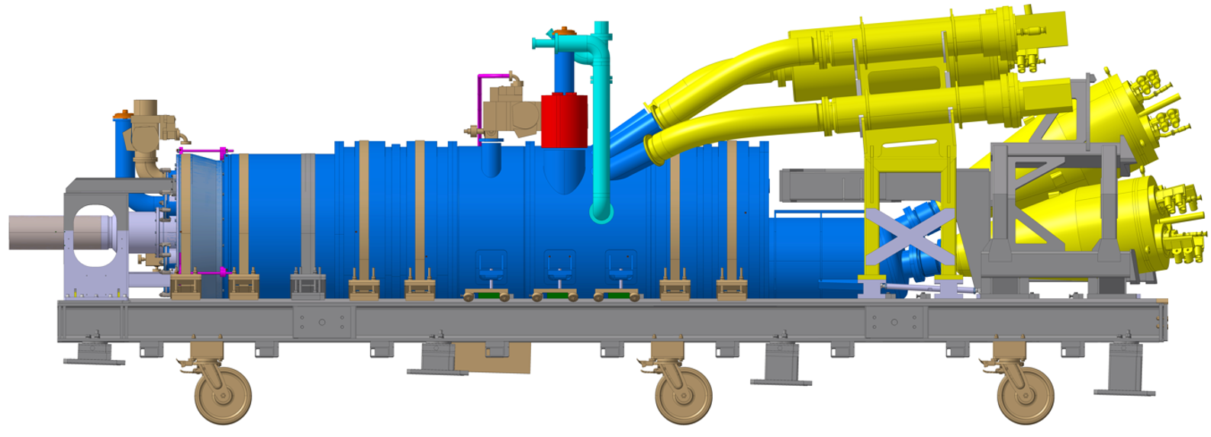
Phase 4: DFHx assembly & preparation to connect to Cluster F2
Action | Duration
DFHx assembly & Connection to ClusterF2 | 4.5m
Step 1: Position the frame at the nominal assembly position
Step 2: Install the jacks under the frame
Step 3: Lift the frame till the wheels are detached from the floor [Maintain the whole configuration straight]
Step 4: Assemble the cryostat
Step 5: Lower down the assembled cryostat
Step 6: Slide it towards the patch panel and reach the final installation position
Step 7.1: Install the jacks under the frame
Step 8: Lift the cryostat till the wheels are detached from the floor
Step 9: Remove the wheels
Step 10: Lower down the jacks (or brackets) till the cryostat reach the needed inclined position
Step 11: Add the fixation point
Step 12: Connect the cryostat to the patch panel

Slide 24
Phase 4: DFHx assembly & preparation to connect to Cluster F2
Action | Duration
DFHx assembly & Connection to ClusterF2 | 4.5m
Step 1: Position the frame at the nominal assembly position
Step 2: Install the jacks under the frame
Step 3: Lift the frame till the wheels are detached from the floor [Maintain the whole configuration straight]
Step 4: Assemble the cryostat
Step 5: Lower down the assembled cryostat
Step 6: Slide it towards the patch panel and reach the final installation position
Step 7.1: Install the jacks under the frame
Step 8: Lift the cryostat till the wheels are detached from the floor
Step 9: Remove the wheels
Step 10: Lower down the jacks (or brackets) till the cryostat reach the needed inclined position
Step 11: Add the fixation point
Step 12: Connect the cryostat to the patch panel

Slide 25
Phase 4: DFHx assembly & preparation to connect to Cluster F2
Action | Duration
DFHx assembly & Connection to ClusterF2 | 4.5m
Step 1: Position the frame at the nominal assembly position
Step 2: Install the jacks under the frame
Step 3: Lift the frame till the wheels are detached from the floor [Maintain the whole configuration straight]
Step 4: Assemble the cryostat
Step 5: Lower down the assembled cryostat
Step 6: Slide it towards the patch panel and reach the final installation position
Step 7.1: Install the jacks under the frame
Step 8: Lift the cryostat till the wheels are detached from the floor
Step 9: Remove the wheels
Step 10: Lower down the jacks (or brackets) till the cryostat reach the needed inclined position
Step 11: Add the fixation point
Step 12: Connect the cryostat to the patch panel

Slide 26
Phase 4: DFHx assembly & preparation to connect to Cluster F2
Action | Duration
DFHx assembly & Connection to ClusterF2 | 4.5m
Step 1: Position the frame at the nominal assembly position
Step 2: Install the jacks under the frame
Step 3: Lift the frame till the wheels are detached from the floor [Maintain the whole configuration straight]
Step 4: Assemble the cryostat
Step 5: Lower down the assembled cryostat
Step 6: Slide it towards the patch panel and reach the final installation position
Step 7.1: Install the jacks under the frame
Step 8: Lift the cryostat till the wheels are detached from the floor
Step 9: Remove the wheels
Step 10: Lower down the jacks (or brackets) till the cryostat reach the needed inclined position
Step 11: Add the fixation point
Step 12: Connect the cryostat to the patch panel

Slide 27
Phase 4: DFHx assembly & preparation to connect to Cluster F2
Action | Duration
DFHx assembly & Connection to ClusterF2 | 4.5m
Step 1: Position the frame at the nominal assembly position
Step 2: Install the jacks under the frame
Step 3: Lift the frame till the wheels are detached from the floor [Maintain the whole configuration straight]
Step 4: Assemble the cryostat
Step 5: Lower down the assembled cryostat
Step 6: Slide it towards the patch panel and reach the final installation position
Step 7.1: Install the jacks under the frame
Step 8: Lift the cryostat till the wheels are detached from the floor
Step 9: Remove the wheels
Step 10: Lower down the jacks (or brackets) till the cryostat reach the needed inclined position
Step 11: Add the fixation point
Step 12: Connect the cryostat to the patch panel

Slide 28
Phase 4: DFHx assembly & preparation to connect to Cluster F2
Action | Duration
DFHx assembly & Connection to ClusterF2 | 4.5m
Step 1: Position the frame at the nominal assembly position
Step 2: Install the jacks under the frame
Step 3: Lift the frame till the wheels are detached from the floor [Maintain the whole configuration straight]
Step 4: Assemble the cryostat
Step 5: Lower down the assembled cryostat
Step 6: Slide it towards the patch panel and reach the final installation position
Step 7.1: Install the jacks under the frame
Step 8: Lift the cryostat till the wheels are detached from the floor
Step 9: Remove the wheels
Step 10: Lower down the jacks (or brackets) till the cryostat reach the needed inclined position
Step 11: Add the fixation point
Step 12: Connect the cryostat to the patch panel

Slide 29
Phase 4: DFHx assembly & preparation to connect to Cluster F2
Action | Duration
DFHx assembly & Connection to ClusterF2 | 4.5m
Step 1: Position the frame at the nominal assembly position
Step 2: Install the jacks under the frame
Step 3: Lift the frame till the wheels are detached from the floor [Maintain the whole configuration straight]
Step 4: Assemble the cryostat
Step 5: Lower down the assembled cryostat
Step 6: Slide it towards the patch panel and reach the final installation position
Step 7.1: Install the jacks under the frame
Step 8: Lift the cryostat till the wheels are detached from the floor
Step 9: Remove the wheels
Step 10: Lower down the jacks (or brackets) till the cryostat reach the needed inclined position
Step 11: Add the fixation point
Step 12: Connect the cryostat to the patch panel

Slide 30
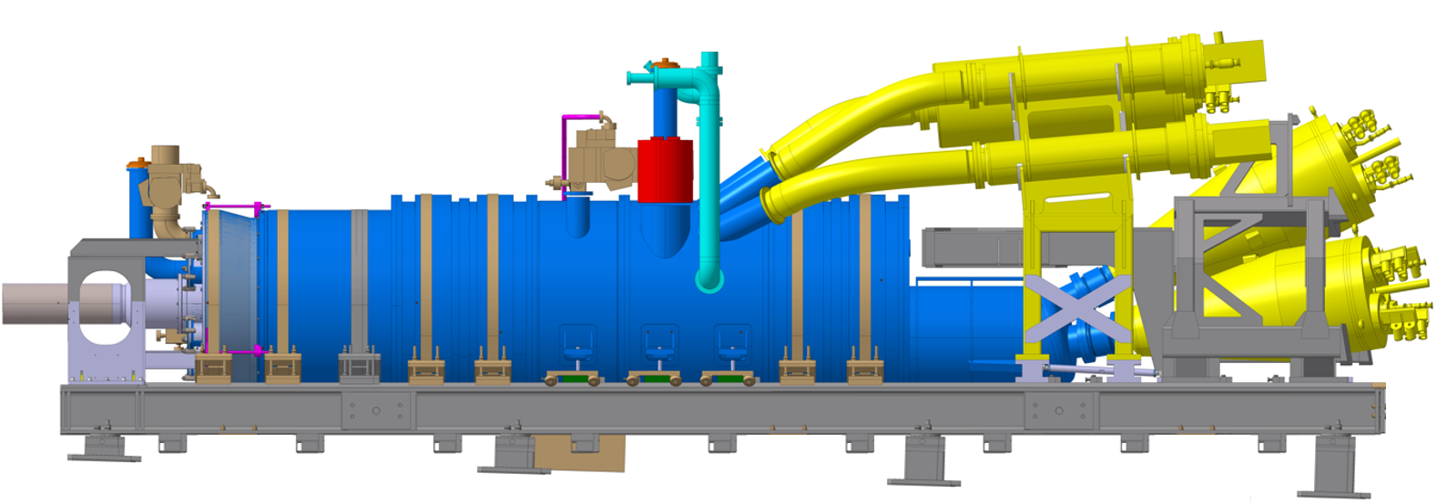
Phase 4: DFHx assembly & preparation to connect to Cluster F2
Action | Duration
DFHx assembly & Connection to ClusterF2 | 4.5m
Step 1: Position the frame at the nominal assembly position
Step 2: Install the jacks under the frame
Step 3: Lift the frame till the wheels are detached from the floor [Maintain the whole configuration straight]
Step 4: Assemble the cryostat
Step 5: Lower down the assembled cryostat
Step 6: Slide it towards the patch panel and reach the final installation position
Step 7.1: Install the jacks under the frame
Step 8: Lift the cryostat till the wheels are detached from the floor
Step 9: Remove the wheels
Step 10: Lower down the jacks (or brackets) till the cryostat reach the needed inclined position
Step 11: Add the fixation point
Step 12: Connect the cryostat to the patch panel

Slide 31
Phase 4: DFHx assembly & preparation to connect to Cluster F2
Action | Duration
DFHx assembly & Connection to ClusterF2 | 4.5m
Step 1: Position the frame at the nominal assembly position
Step 2: Install the jacks under the frame
Step 3: Lift the frame till the wheels are detached from the floor [Maintain the whole configuration straight]
Step 4: Assemble the cryostat
Step 5: Lower down the assembled cryostat
Step 6: Slide it towards the patch panel and reach the final installation position
Step 7.1: Install the jacks under the frame
Step 8: Lift the cryostat till the wheels are detached from the floor
Step 9: Remove the wheels
Step 10: Lower down the jacks (or brackets) till the cryostat reach the needed inclined position
Step 11: Add the fixation point
Step 12: Connect the cryostat to the patch panel

Slide 32
Phase 4: DFHx assembly & preparation to connect to Cluster F2
Action | Duration
DFHx assembly & Connection to ClusterF2 | 4.5m
Step 1: Position the frame at the nominal assembly position
Step 2: Install the jacks under the frame
Step 3: Lift the frame till the wheels are detached from the floor [Maintain the whole configuration straight]
Step 4: Assemble the cryostat
Step 5: Lower down the assembled cryostat
Step 6: Slide it towards the patch panel and reach the final installation position
Step 7.1: Install the jacks under the frame
Step 8: Lift the cryostat till the wheels are detached from the floor
Step 9: Remove the wheels
Step 10: Lower down the jacks (or brackets) till the cryostat reach the needed inclined position [Fix cryostat by installing the adjustable feet & Remove the jacks]
Step 11: Add the fixation point
Step 12: Connect the cryostat to the patch panel

Slide 33
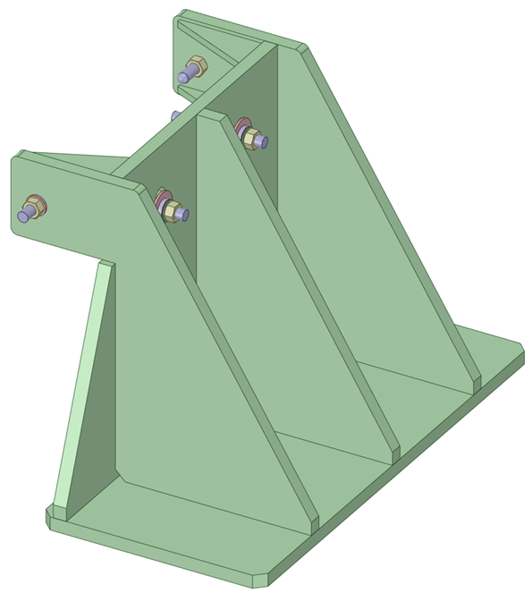
Phase 4: DFHx assembly & preparation to connect to Cluster F2
Action | Duration
DFHx assembly & Connection to ClusterF2 | 4.5m
Step 1: Position the frame at the nominal assembly position
Step 2: Install the jacks under the frame
Step 3: Lift the frame till the wheels are detached from the floor [Maintain the whole configuration straight]
Step 4: Assemble the cryostat
Step 5: Lower down the assembled cryostat
Step 6: Slide it towards the patch panel and reach the final installation position
Step 7.1: Install the jacks under the frame
Step 8: Lift the cryostat till the wheels are detached from the floor
Step 9: Remove the wheels
Step 10: Lower down the jacks (or brackets) till the cryostat reach the needed inclined position [Fix cryostat by installing the adjustable feet]
Step 11: Add the fixation point
Step 12: Connect the cryostat to the patch panel
Courtesy:
Franco Di Ciocchis

Slide 34
Phase 4: DFHx assembly & preparation to connect to Cluster F2
Action | Duration
DFHx assembly & Connection to ClusterF2 | 4.5m
Step 1: Position the frame at the nominal assembly position
Step 2: Install the jacks under the frame
Step 3: Lift the frame till the wheels are detached from the floor [Maintain the whole configuration straight]
Step 4: Assemble the cryostat
Step 5: Lower down the assembled cryostat
Step 6: Slide it towards the patch panel and reach the final installation position
Step 7.1: Install the jacks under the frame
Step 8: Lift the cryostat till the wheels are detached from the floor
Step 9: Remove the wheels
Step 10: Lower down the jacks (or brackets) till the cryostat reach the needed inclined position
Step 11: Add the fixation point
Step 12: Connect the cryostat to the patch panel

Slide 35
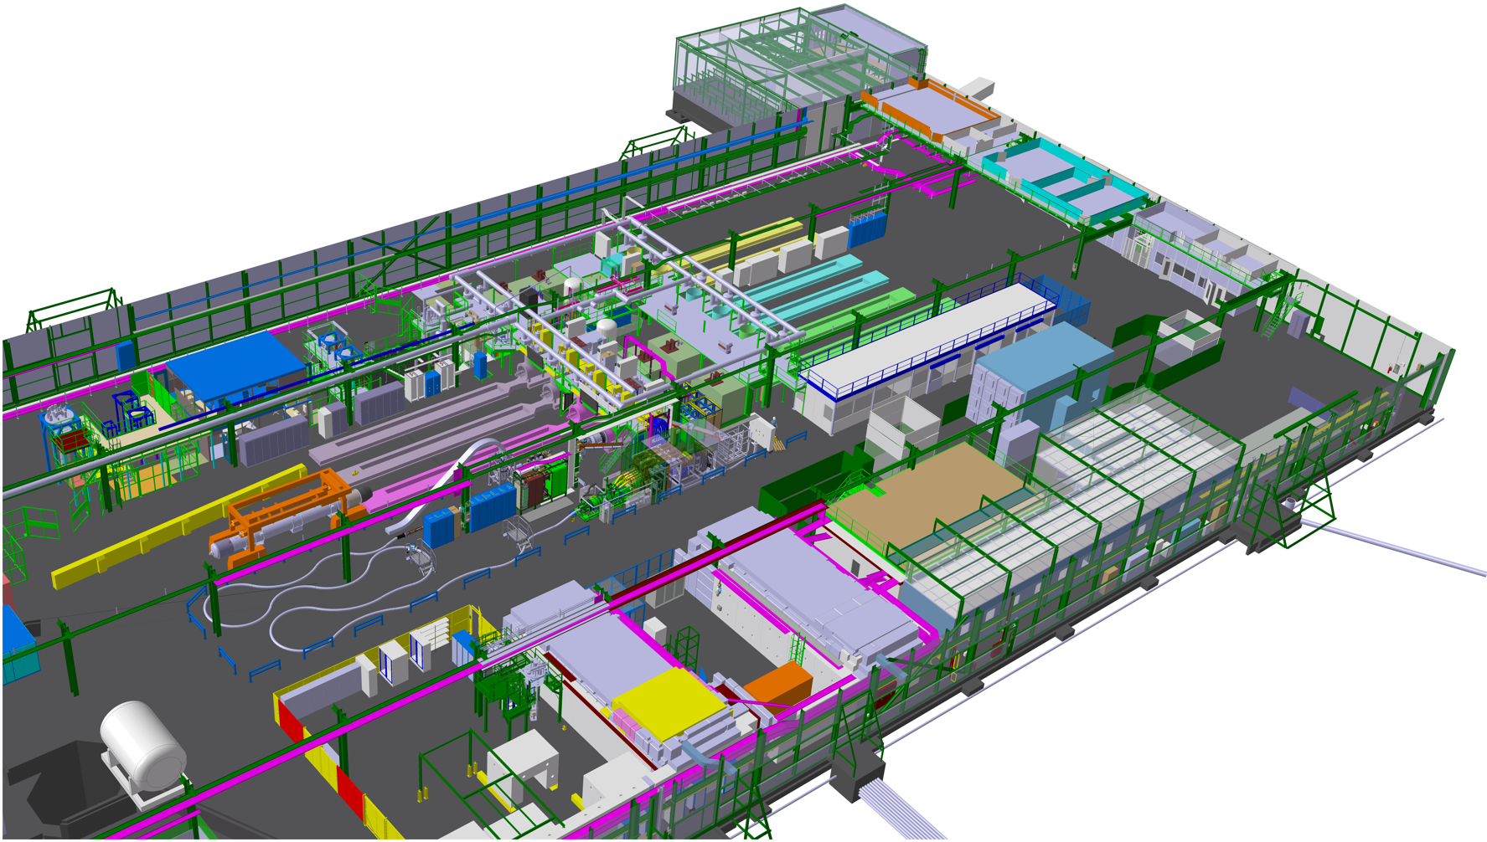

Phase 5: DFHx connection to ClusterF
Action | Duration
MgB2-NbTi splices | 3w
DFX assembly | 1w
DFX SCLink insertion | 1w
DFX Connection to ClusterF2 | 1w

Slide 36
Preliminary overview of optimistic planning until DFX-DSHX-DFHX are located in the reserved WP6a zone
Assuming resources, space and services are available
  8 days to fit in the WP6a reserved zone
  4 days to be ready to pull MgB2 cable
 |  |  | Cumulative days
 | Action | Duration | 1 | 2 | 3 | 4 | 5 | 6 | 7 | 8 | 9
Phase 0 | Spooler transportation | (1w)
 | Cryostat spool transportation | (3d)
 | Cryostat spool installation | 0.5d
 | Cryostat unspooling | 1d
 | Cryostat straightening+fixing | 1d
 | DFHx frame positioning | 0.5d
 | Cryostat spool removal | 0.5d
Phase 1 | Winch installation | 1d
 | MgB2 spool transportation | (3d)
 | MgB2 spool installation | 0.5d
 | Route winch cable inside the cryostat | 0.5d
 | Assembly flange on frame | 0.5d
 | Pulling MgB2 cable | 1d
Phase 2 | Pull DFHx frame | 0.5d
 | Cut MgB2 cable | 0.5d
 | MgB2 spool removal | 0.5d
Phase 3 | Position and Route DFX end | 1.5d
 | Position DFHx extremity | 0.5d
Phase 4 | DFHx assembly & Connection to ClusterF2 | 4.5m
Phase 5 | MgB2-NbTi splices | 3w
 | DFX assembly | 1w
 | DFX SCLink insertion | 1w
 | DFX Splice box installation + closure | 1w
 | DFX Connection to ClusterF2 | 1w

