Slide 1
Figure 1

Slide 2
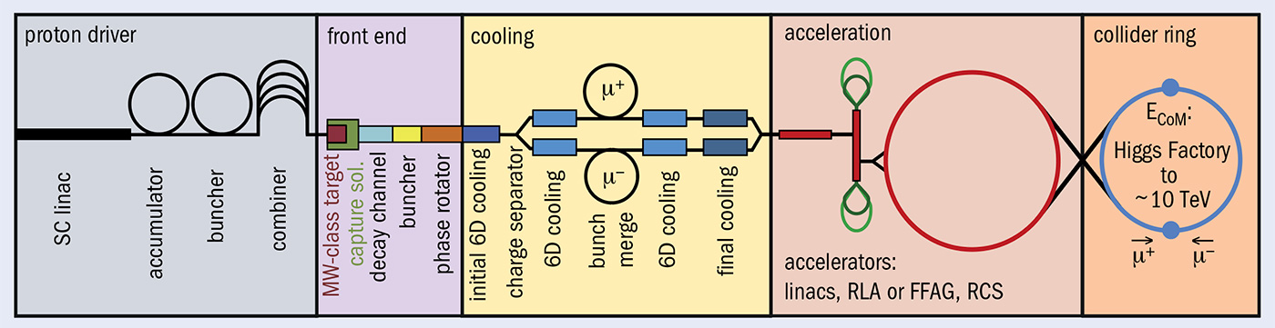
Figure 2

Slide 3
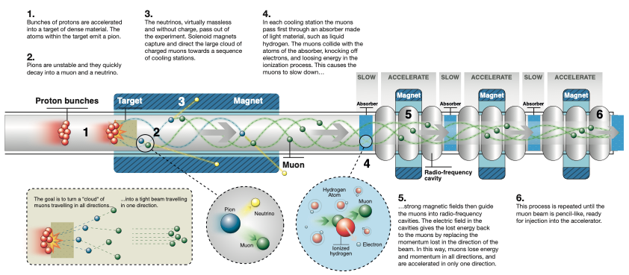
Figure 3

Slide 4
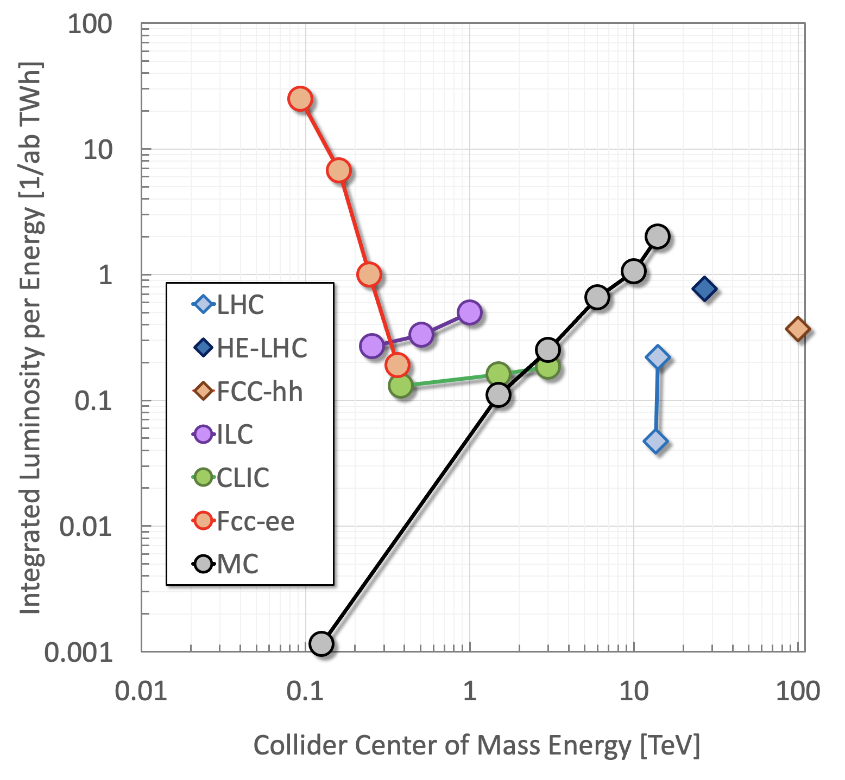
Figure 4a

Slide 5
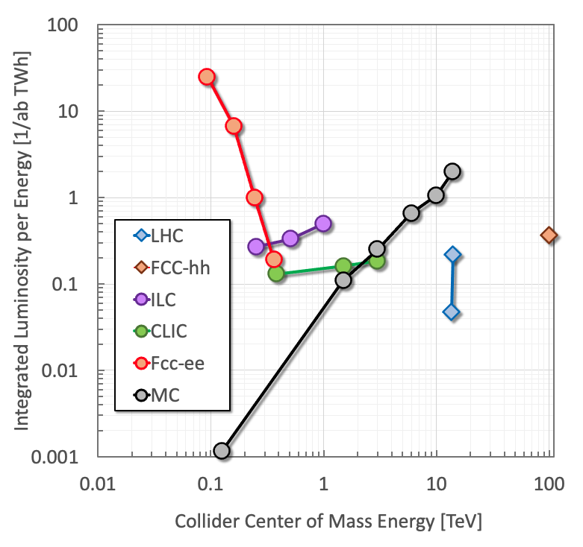
Figure 4a – no HE-LHC

Slide 6
LHC
27 km
FCC
≈ 90 km
Muon Collider
≈ 30 km
CLIC
≈ 50 km
10 km
Figure 4b

Slide 7



CERN Council
MuCol Consortium
Study Leader
Management Committee
Collaboration Board
Advisory Committee
Project Office
WP1 – Coordination and Communication
WP3 - Proton Complex
WP5 – High-Energy Complex
WP7 – Magnets Systems
WP2 - Physics and Detector Requirements
WP4 - Muon Production and Cooling
WP6 – Radio Frequency Systems
WP8 - Cooling Cell Integration
Figure 5

Slide 8
Beam parameters
Beam parameters
Beam parameters
WP3 – Proton Complex
Linac
Accumulator
Compressor
Ring specification and design
WP4 – Muon Production and Cooling
Target system design
Rectilinear cooling development
Final cooling design
WP4 – High Energy Complex
Fast acceleration chain
Collider ring design
Final focus design
Neutrino flux mitigation
WP2 – Physics and Detector Requirements
Beam induced background
Detector configuration and parameters
Detector performance at various ECM
Beam background
WP6 – Radio-Frequency Systems
RF systems requirements and concepts
RF systems inventory
RF parameters selection consistent across the complex
Breakdown mitigation studies
High-efficiency RF sources
Specs, technology, limits
WP7 – Magnet Systems
Magnet systems requirements and concepts
Magnet systems inventory
Target and final cooling solenoids design
Fast ramped accelerator magnets and powering system design
Collider ring magnets design
Cell design constraints and integration
Specs, technology, limits
WP8 – Muon Cooling Cell
Radiofrequency
Absorber
Solenoid
Cooling cell integration
Figure 6

Slide 9
WP2 - Physics and Detector Requirements
WP4 - Muon Production and Cooling
WP6 – Radio Frequency Systems
WP3 - Proton Complex
WP5 – High-Energy Complex
WP7 – Magnet Systems
WP8 - Cooling Cell Integration
High-Charge Proton Beams
High-Charge Muon Beams
Muon Beams Cooling
Muon Beams Acceleration
Collider Ring
Impact of Muon Decay and Loss
Collective Effects
Machine-Detector Interface
Figure 7

Slide 10
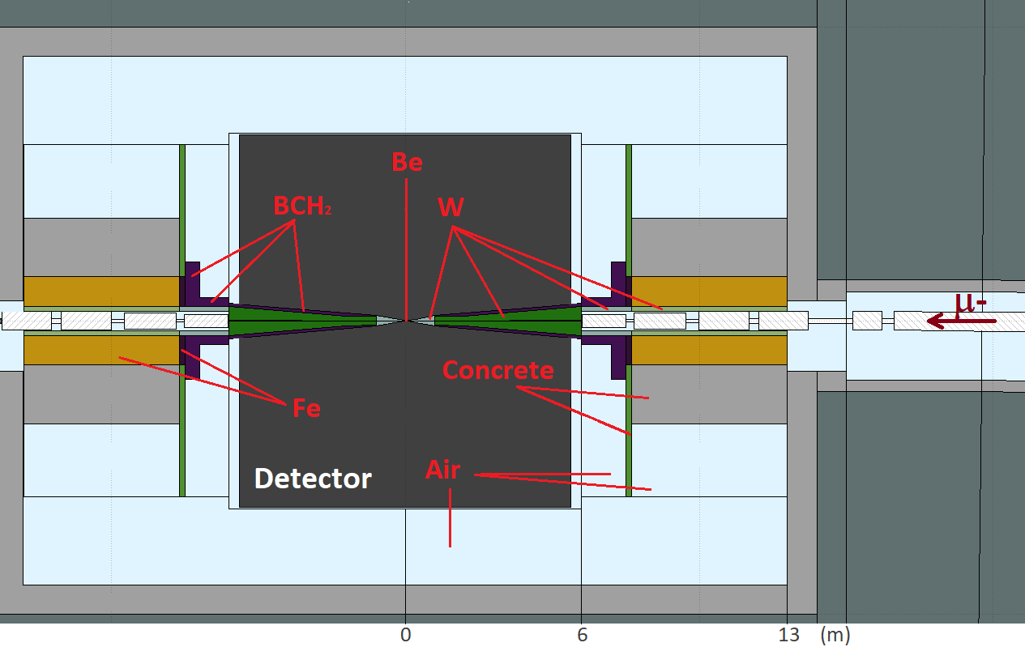
Figure 8

Slide 11
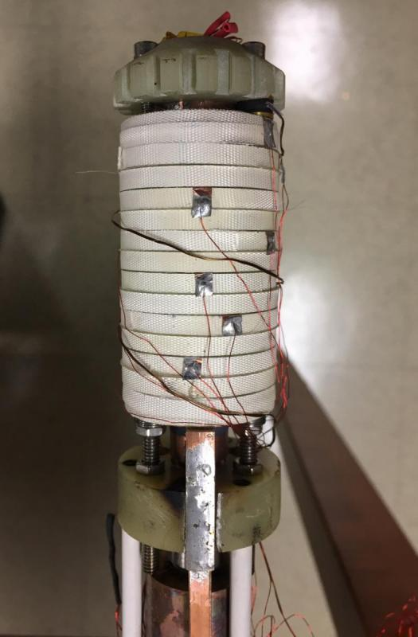
Figure 9

Slide 12
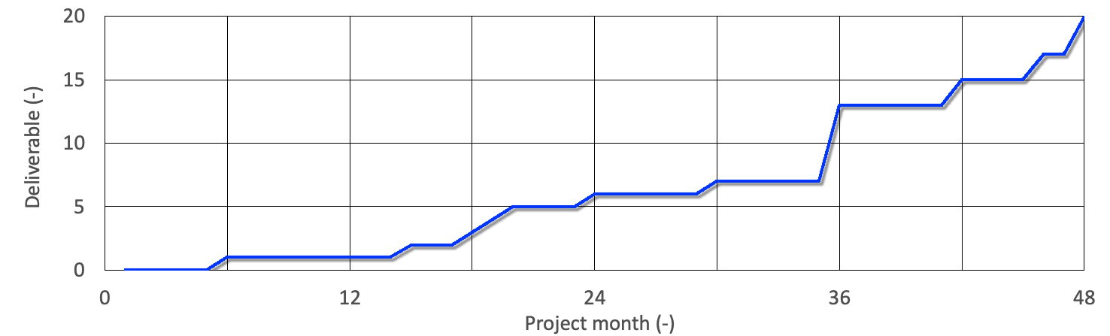
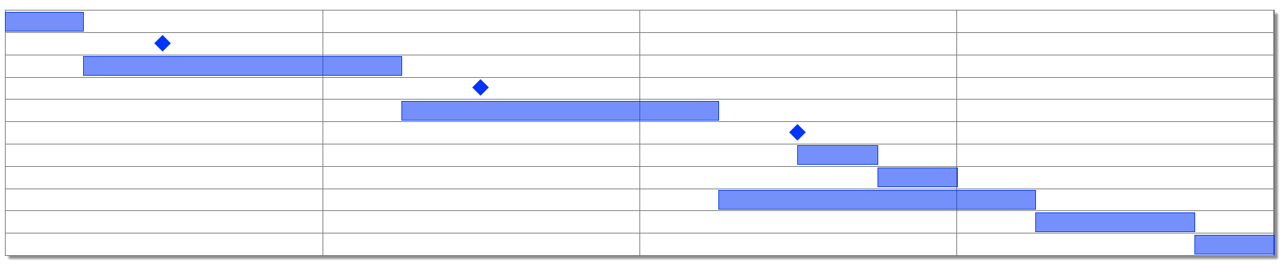
Figure 10

Slide 13
Work material

Slide 14
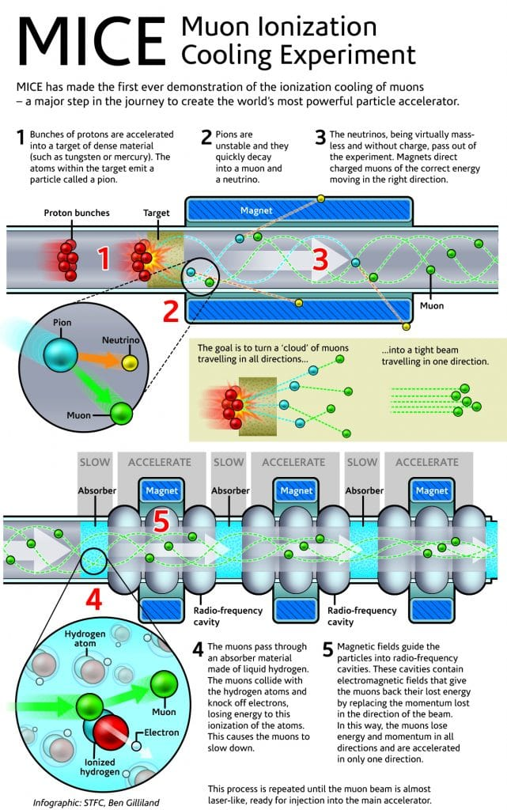
1. Bunches of protons are accelerated onto a target of dense material. The atoms within the target emit a pion.
2. Pions are unstable and they quickly decay into a muon and a neutrino.
3. The neutrinos, virtually massless and without charge, pass out of the experiment. Solenoid magnets capture and direct the large cloud of charged muons towards a sequence of cooling stations.
4. In each cooling station the muons pass first through an absorber made of light material, such as liquid hydrogen. The muons collide with the atoms of the absorber, knocking off electrons, and loosing energy in the ionization process. This causes the muons to slow down…
5. …strong magnetic fields then guide the muons into radio-frequency cavities. The electric field in the cavities gives the lost energy back to the muons by replacing the momentum lost in the direction of the beam. In this way, muons lose energy and momentum in all directions, and are accelerated in only one direction.
6. This process is repeated until the muon beam is pencil-like, ready for injection into the accelerator.
6

Slide 15
Slow
Accelerate
Slow
Accelerate
Slow
Accelerate
Solenoid magnet
Proton bunches
Target
Muon
Neutrino
Pion

