Slide 1
CERN guides meeting
IR-ECO-VI Visitor and Event Operations
April 2022

Slide 2
Agenda
COVID-19 a quick review
Overview of status and capacities of all visit points
Restart of training sessions
Reminder of some good practices
New website for the guides
A few words about Science Gateway
Q&A

Slide 3

COVID-19, a quick review
2020
Q1
2020
Q2
2020
Q3
2020
Q4
2021
Q1
2021
Q2
2021
Q3
2021
Q4
2022
Q1
2022 Q2
Individual guided tours
Group guided tours
CERNers guided tours
Permanent exhibitions
Updates by mail
3 Mar
4 Jun
28 Aug
2 Dec
11 Mar
31 May
14 Oct
6 Dec
8 Jan
11 Feb
7 Mar
14 Mar
Unavailable
Available with limitations
Fully available

Slide 4
COVID-19, a quick review
Despite all the cancellations, during COVID-19 we still offered:
497 virtual talks for 12985 participants in 9 languages since April 2020
112 virtual tours for 4177 participants in 7 languages since February 2021
1010 individual guided tours for 18744 participants in 2 languages since July 2021
713 guided tours organised by CERN members of personnel for 4528 participants
A new website and new booking procedures
Thanks to all who participated !
New offer!

Slide 5
Overview of status and capacities of all visit points
In May 2022, CERN will resume group guided tours after 2 years of cancellation
We are back to standard rules for guides
  Maximum 9 hours of guiding per week (for any visit points)
  2 tours in a row with different groups to be avoided at all costs
But we are far from a normal situation, capacity-wise
  Because of COVID-19 measures
  Because of logistics reasons

Slide 6
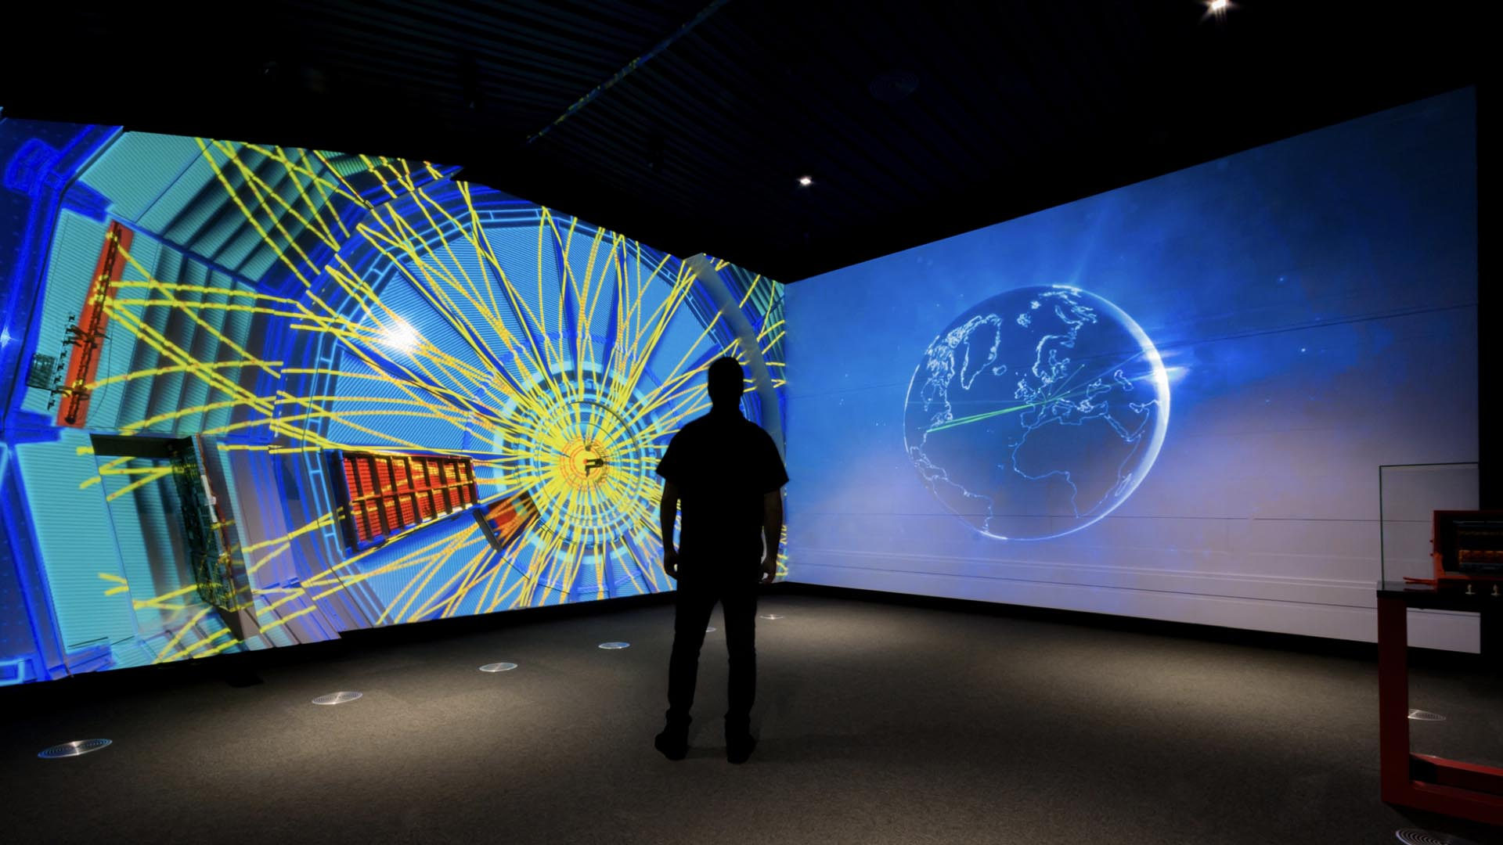
ALICE surface
Current Capacity | 24 (was 48 in 2019)
Visitors/guide | 24
Wearing of a mask | Yes (Type 1)
Age limit | 10
Reduced Mobility | Yes
Pregnant women | Yes
Medical implants | Yes
Extra information | Maximum 24 in total on the site
 | Both exhibition and window on control room can welcome 24 visitors
 | Can be split in 2x12 but 2nd guide needed

Slide 7
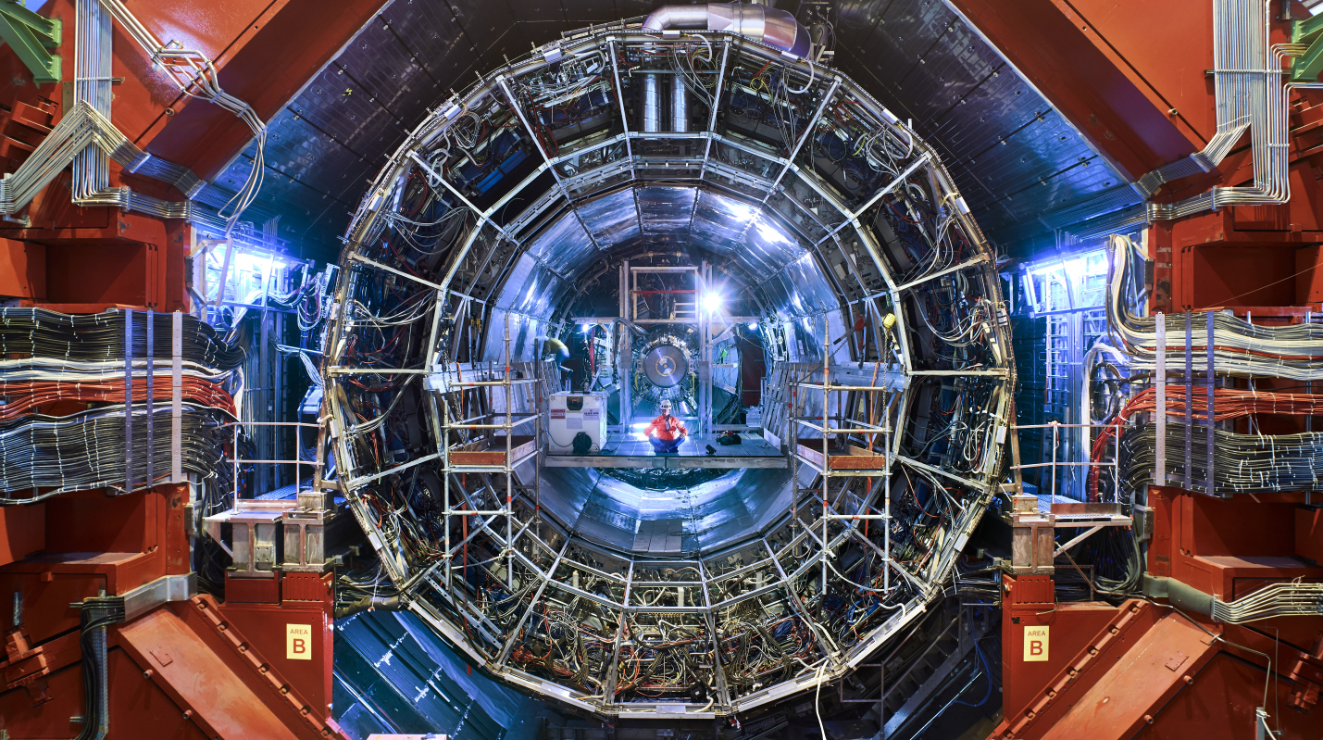
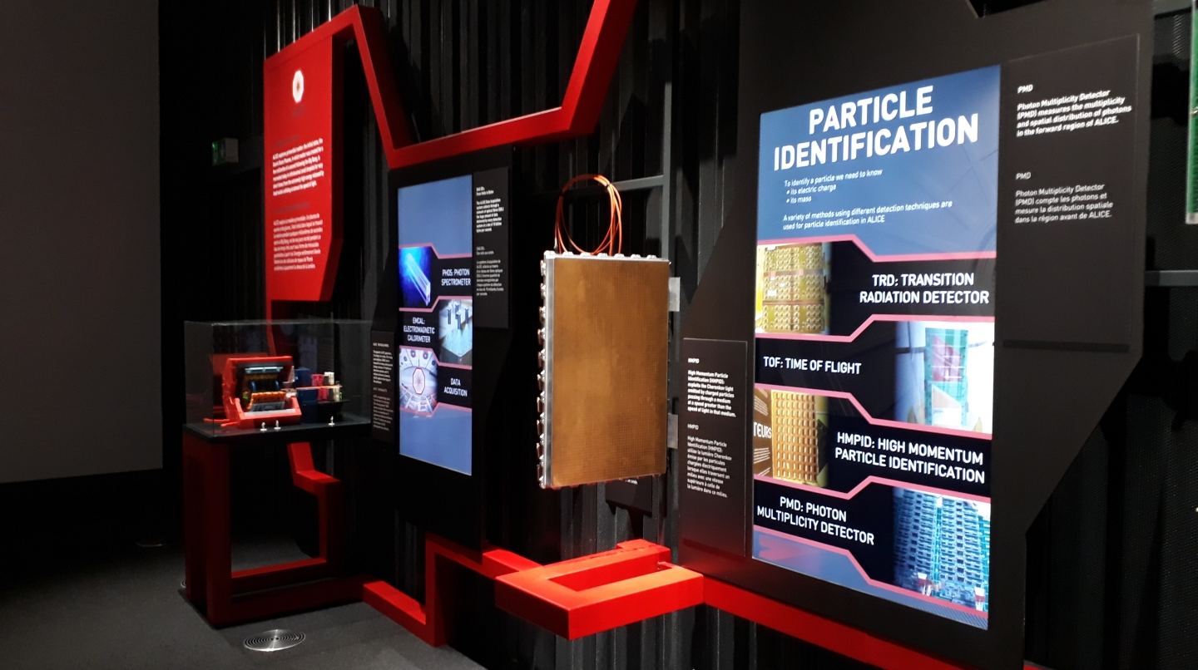
ALICE underground
Current Capacity | 7 (was 12 in 2019)
Visitors/guide | 7
Wearing of a mask | Yes (FFP2)
Age limit | 16
Reduced Mobility | No
Pregnant women | No
Medical implants | Limits exist
Extra information | Not accessible when beams are on
Not accessible
Since March 2022

Slide 8
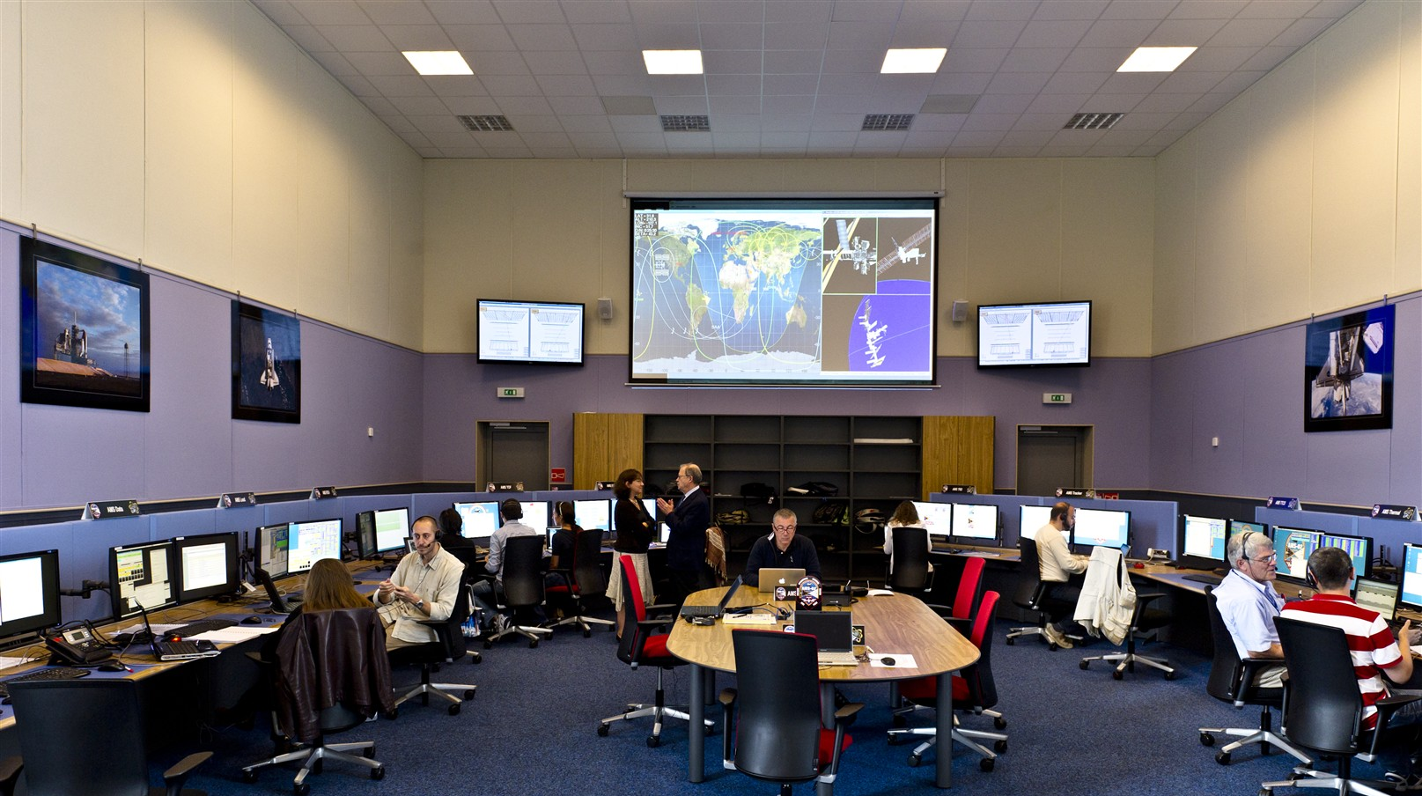
AMS Control Room
Current Capacity | 0 (was 24 in 2019)
Visitors/guide | 0
Wearing of a mask | -
Age limit | 10
Reduced Mobility | Yes
Pregnant women | Yes
Medical implants | Yes
Extra information | Not available until further notice

Slide 9
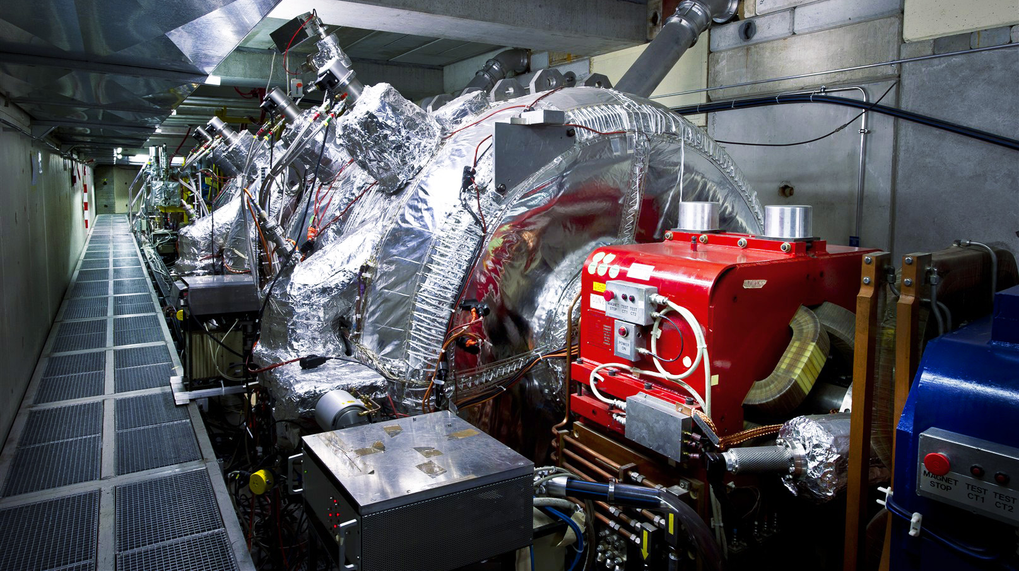
Antimatter Factory
Current Capacity | 36
Visitors/guide | 12
Wearing of a mask | No
Age limit | 16
Reduced Mobility | No
Pregnant women | No
Medical implants | Yes
Extra information | No access in AD tunnel when beam is on
 | Apr 2022-May 2022: no access through building 393; ELENA platform not accessible during 8 weeks

Slide 10
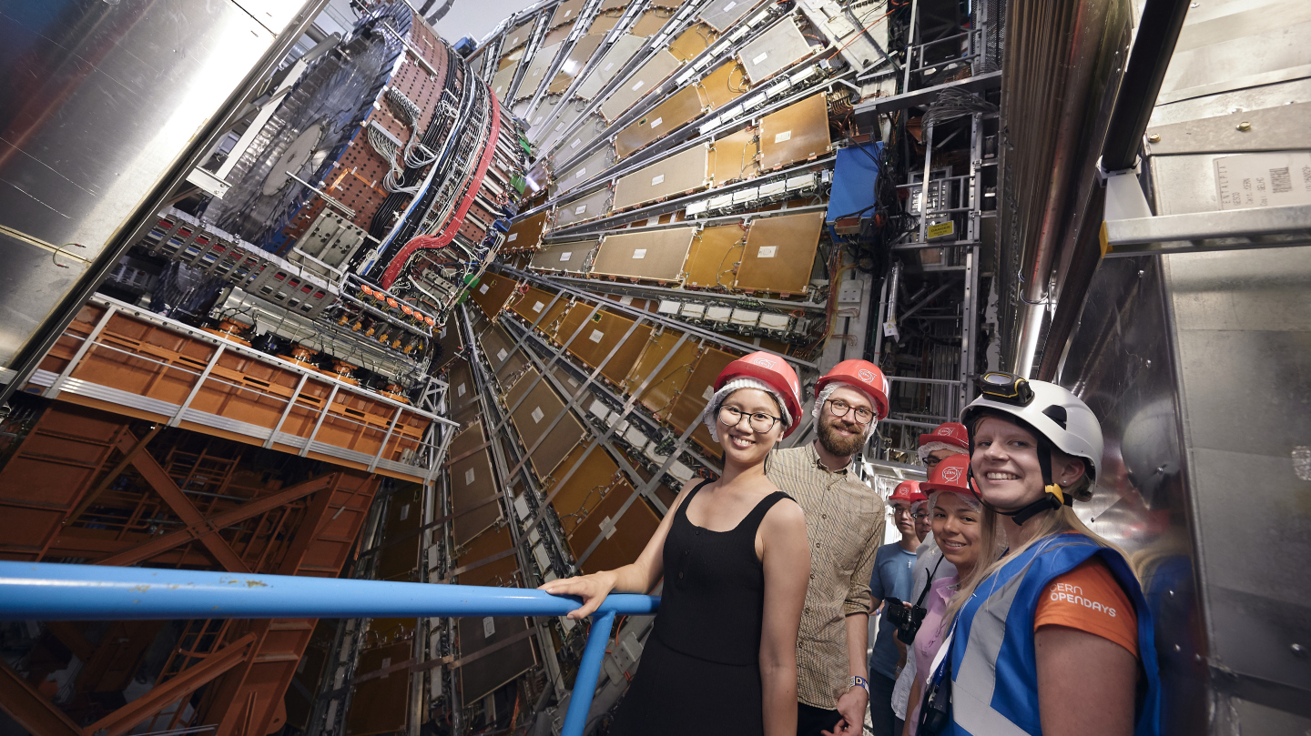
ATLAS Cavern
Current Capacity | 4 per hour (was 6 per 45 mins in 2019)
Visitors/guide | 4
Wearing of a mask | Yes (FFP2)
Age limit | 16
Reduced Mobility | No
Pregnant women | No
Medical implants | Limits exist
Extra information | No access when beam is on
 | Number of visitors in 2023 not yet decided
Not accessible
Since March 2022
Not accessible
Since March 2022

Slide 11
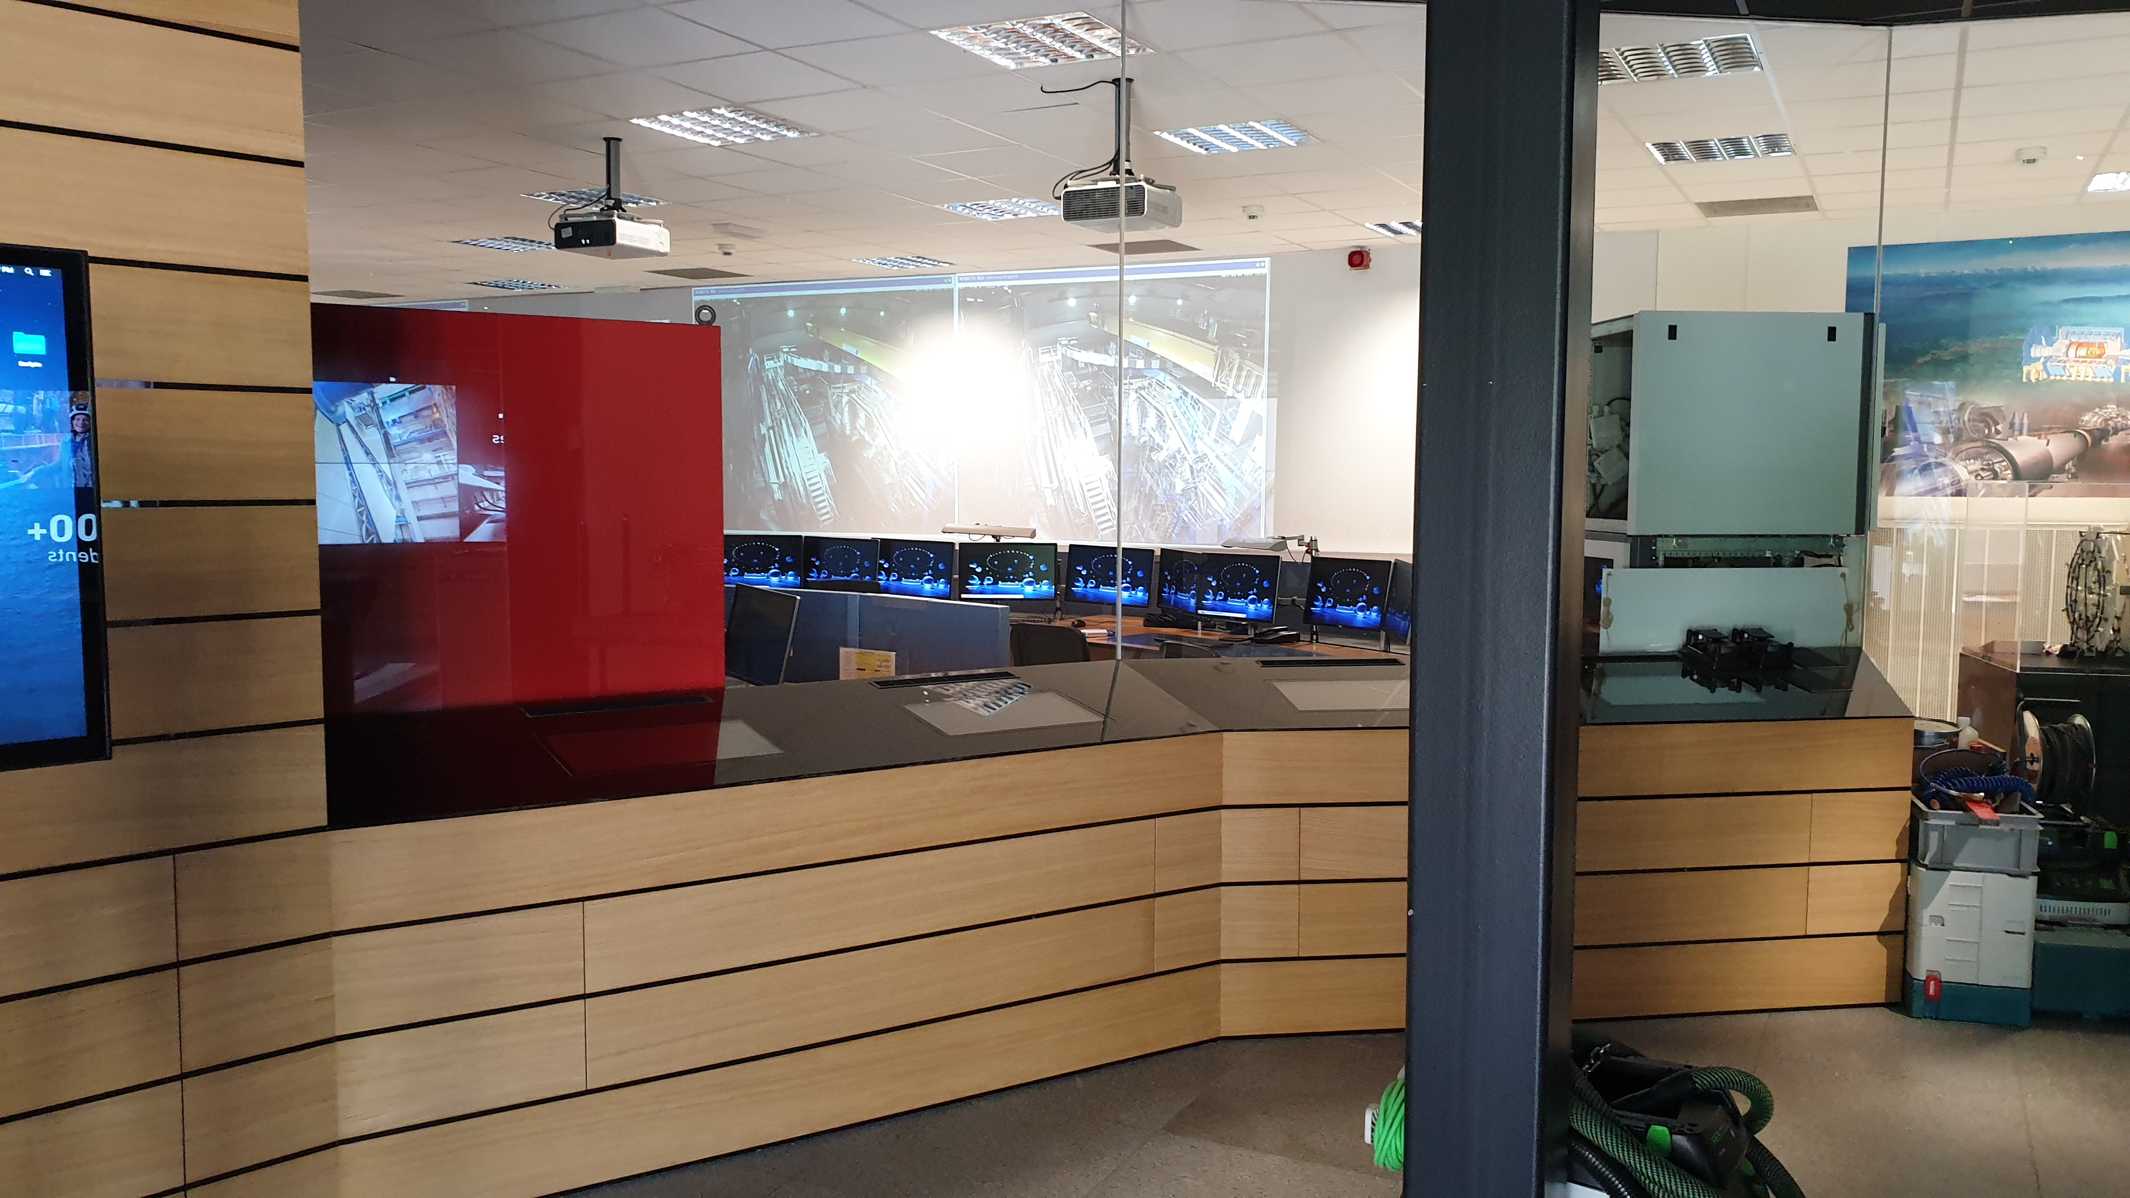
ATLAS Visitors Centre
Current Capacity | 24/12* (was 48 in 2019)
Visitors/guide | 24
Wearing of a mask | No (except 3D movie)
Age limit | -
Reduced Mobility | Yes
Pregnant women | Yes
Medical implants | Yes
Extra information | Been completely redesigned and rebuilt since October 2019
 | Reopened since April 2022
 | Training refresh requested for all guides
 | * 3D movie limited to 12 + Type 1 mask. Visits Service cannot use it practically.

Slide 12
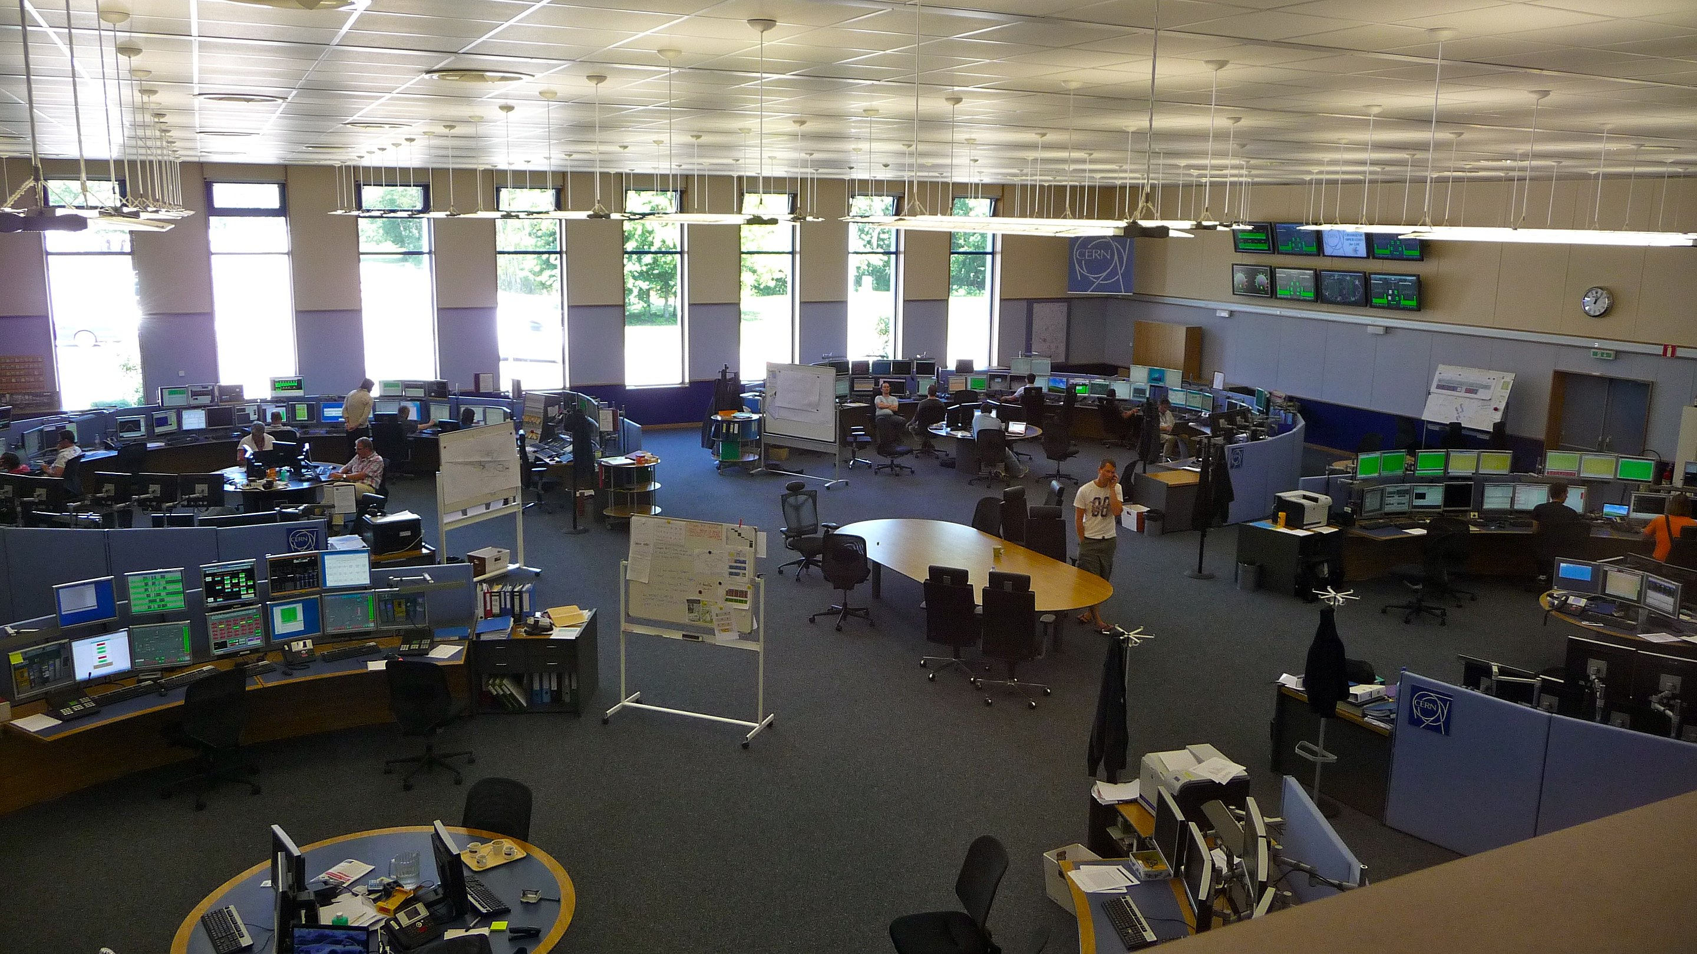
CCC Visitors Centre
Current Capacity | 24
Visitors/guide | 24
Wearing of a mask | Yes (Type 1)
Age limit | 10
Reduced Mobility | Yes
Pregnant women | Yes
Medical implans | Yes
Extra information | No stop in the entrance of building 774

Slide 13
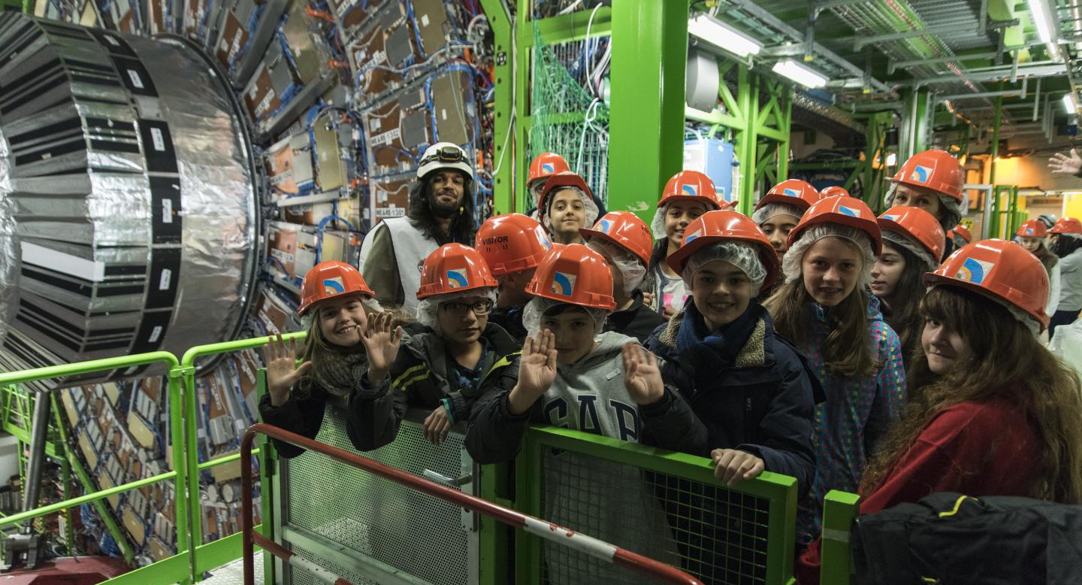
CMS Underground
Current Capacity | 24 (was 48 in 2019)
Visitors/guide | 12
Wearing of a mask | Yes (FFP2)
Age limit | 8
Reduced Mobility | Yes
Pregnant women | Yes
Medical implants | Limits exist
Extra information | Only service cavern when beam is on
EXPERIMENTAL CAVERN
Not accessible
Since March 2022

Slide 14
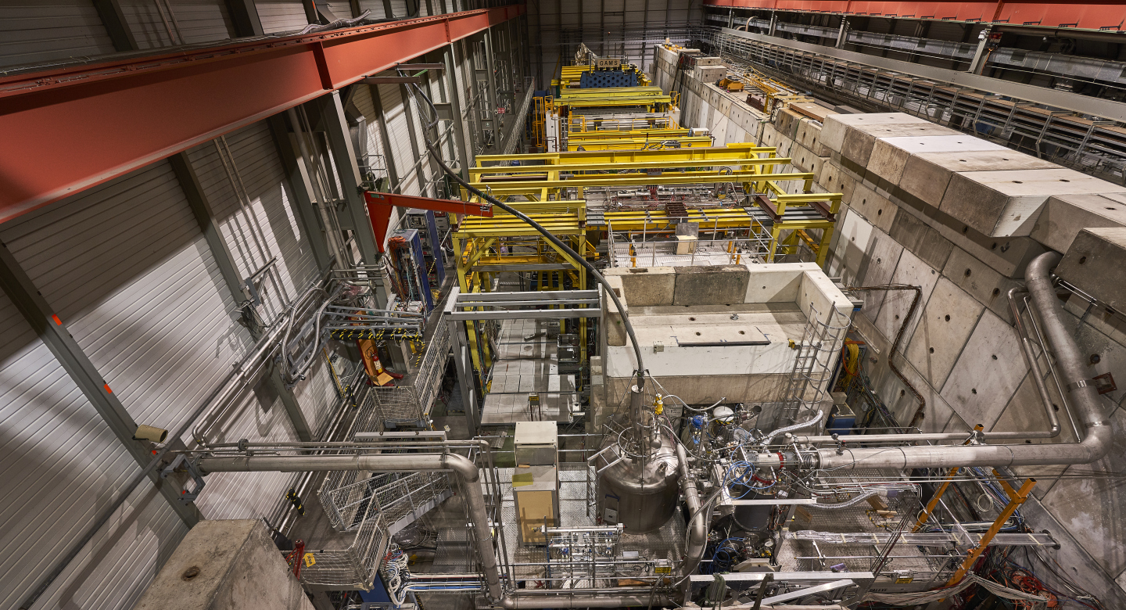
Compass
Current Capacity | 48
Visitors/guide | 12
Wearing of a mask | No
Age limit | 16
Reduced Mobility | No
Pregnant women | No
Medical implants | Yes
Extra information | No access when beam is on

Slide 15
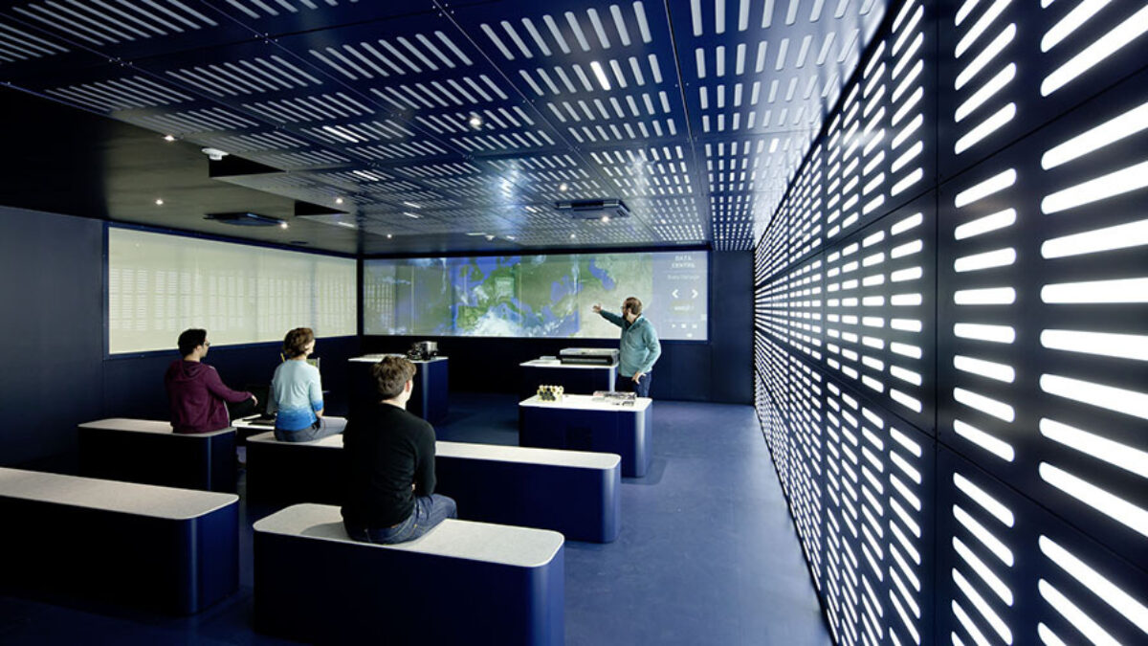
Data Centre Visitors Point
Current Capacity | 24
Visitors/guide | 24
Wearing of a mask | Yes (Type 1)
Age limit | 10
Reduced Mobility | Yes
Pregnant women | Yes
Medical implants | Yes
Extra information | -

Slide 16
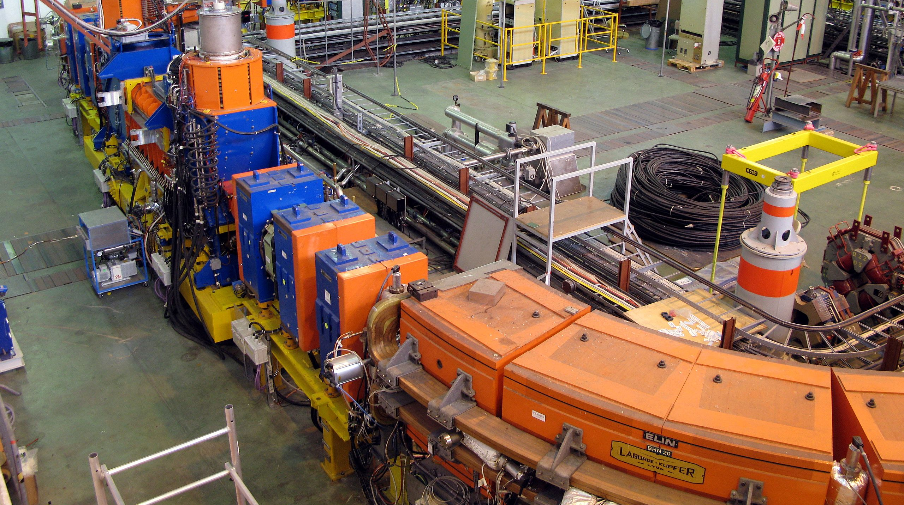
LEIR
Current Capacity | 24
Visitors/guide | 12
Wearing of a mask | No
Age limit | 16
Reduced Mobility | No
Pregnant women | No
Medical implants | Yes
Extra information | 12 on the platform + 12 near PAD/MAD
 | LINAC2 considered for reopening

Slide 17
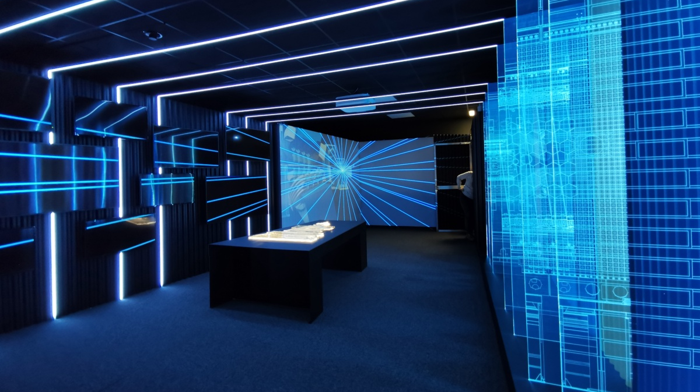
LHCb surface (+ CAST)
Current Capacity | 0 but soon 36 (was 48 in 2019)
Visitors/guide | 12
Wearing of a mask | No
Age limit | 10
Reduced Mobility | Yes
Pregnant women | Yes
Medical implants | Yes
Extra information | Brand new LHCb immersive experience (similar to ALICE exhibition) and view on control room to be opened soon + CAST to be reopened soon
 | Exhibition in hall to be redesigned and accessible early 2023
 | Training to be organised soon

Slide 18
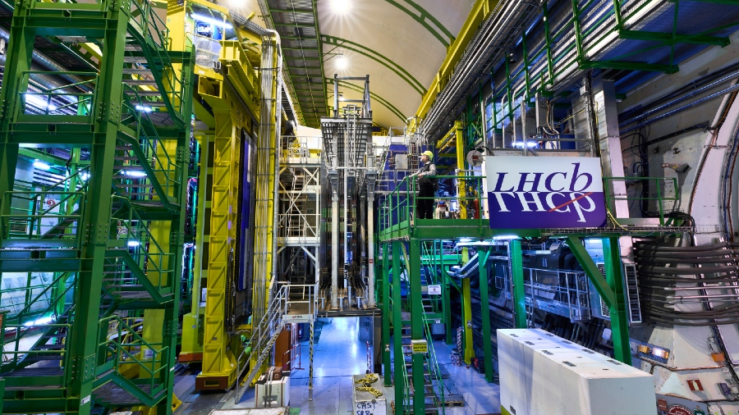
LHCb underground
Current Capacity | 0 (was 24 during LS1)
Visitors/guide | -
Wearing of a mask | -
Age limit | -
Reduced Mobility | -
Pregnant women | -
Medical implants | -
Extra information | No Visits Service guided tours allowed since Run 2

Slide 19
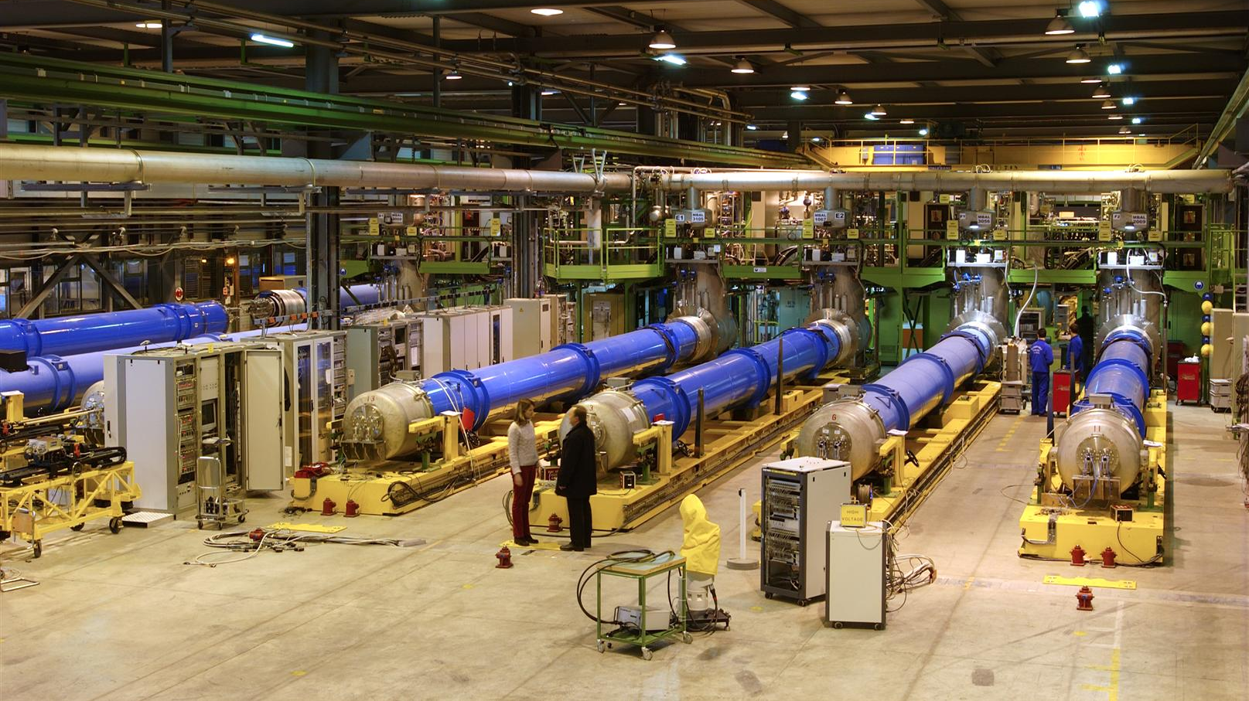
SM18
Current Capacity | 24 (was 48 in 2019)
Visitors/guide | 12
Wearing of a mask | No
Age limit | 10
Reduced Mobility | Yes
Pregnant women | Yes
Medical implants | Yes
Extra information | Access is now forbidden in the hall
 | Tours are limited to 2 groups of 12 in panorama room + LHC tunnel mockup and 40 minutes duration
 | We are working on a new visitors space with direct view on the test hall (works will start soon)

Slide 20
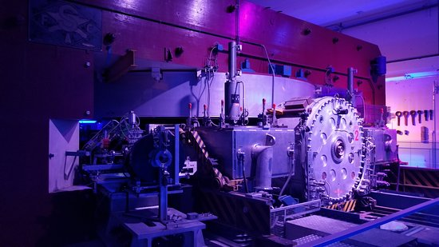
Synchrocyclotron
Current Capacity | 24
Visitors/guide | 24
Wearing of a mask | No
Age limit | No
Reduced Mobility | Yes
Pregnant women | Yes
Medical implants | Yes
Extra information | -

Slide 21
Overview of capacity issues
 | Capacity In 2019 with beams | Capacity In 2019 with no beams | Current Capacity with beams | Current Capacity with no beams
ALICE Surface | 48 | 48 | 24 | 24
ALICE Cavern | 0 | 12 | 0 | 7
AMS Control Room | 24 | 24 | 0 | 0
Antimatter Factory | 36 | 36 | 36 | 36
ATLAS Cavern | 0 | 6 | 0 | 4
ATLAS Visitors Centre | 48 | 48 | 24/12 | 24/12
CCC Visitors Centre | 24 | 24 | 24 | 24
CMS Underground | 48 | 48 | 24 | 24
COMPASS | 0 | 48 | 0 | 48
Data Centre Visitors Point | 24 | 24 | 24 | 24
LEIR | 36 | 36 | 24 | 24
LHCb (+ CAST) | 48 | 48 | (36) | 0
LHCb underground | 0 | 0 | 0 | 0
SM18 | 48 | 48 | 24 | 24
Synchrocyclotron | 24 | 24 | 24 | 24
TOTAL | 408 | 474 | 264 | 287
We don’t have any visit point with 48 visitors capacity at
the moment
Classic combinations
do not work anymore
(e.g. 24 in CCC
+ 24 in AMS)
Actual groups compositions (number, ages, medical conditions) increase complexity

Slide 22
Impact of current capacity on tours
Most guided tour programmes will have to be shortened (May groups have been informed)
Visits Service will not be in position to accept as many tour requests as usual (and that includes those organised by Members of the Personnel)
We need your help to
  Respect tours timings
  Respect shortened programmes
  Respect specific COVID-19 measures
  Adapt your content to new time constraints (reduce / summarize content)

Slide 23
Other visit points not used by Visits Service
There are some other visit points currently not used / accessible to Visits Service as they are not designed for large groups
Visits Service is in contact with them for specific requests or exceptions
Some of them are already using / integrated in Visits Service tools
  ISOLDE
  Large magnets test facility (180)
  CLOUD
  CLIC
  Neutrino Platform
  Etc.

Slide 24
Visit points development
IR-ECO is constantly working at developing or creating new visit points in collaboration with departments and experiments
This is a time and resource consuming process
Points considered
  SM18 new visitors space with a view on the test hall – work to be started soon
  LHCb new exhibition – work ongoing
  LINAC2 – low level revamp
  CAST – low level revamp
  Neutrino Platform – new visit point ?
  NA61 – new visit point ?
  Etc.

Slide 25
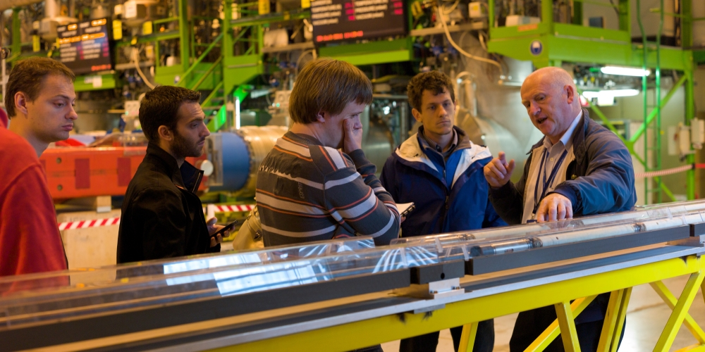
Restart of training sessions
Will be announced on the new website for guides
Register in time and inform us if you cannot come (50% no show was not unusual!)
We will give priority to sites with best capacity or recently updated
Please note that you don’t need to require
access authorization for many visit points
handled by Visits Service, it is automatically
granted once trained (check new website)

Slide 26
Reminder of some good practices
Assess your group’s level at the beginning and adapt your content accordingly
Give inspiring guided tours, not a lecture
Get regular feedback from visitors, let them ask questions
Leave some slots for less experienced guides (max 9 hours / week in any case)
Respect timings and programmes
Respect safety rules (especially in visit points having COVID-19 measures)
Always call VTC (166222) in case of problems: technical problem, delay, transport etc
Always call 74444 in case of emergency

Slide 27
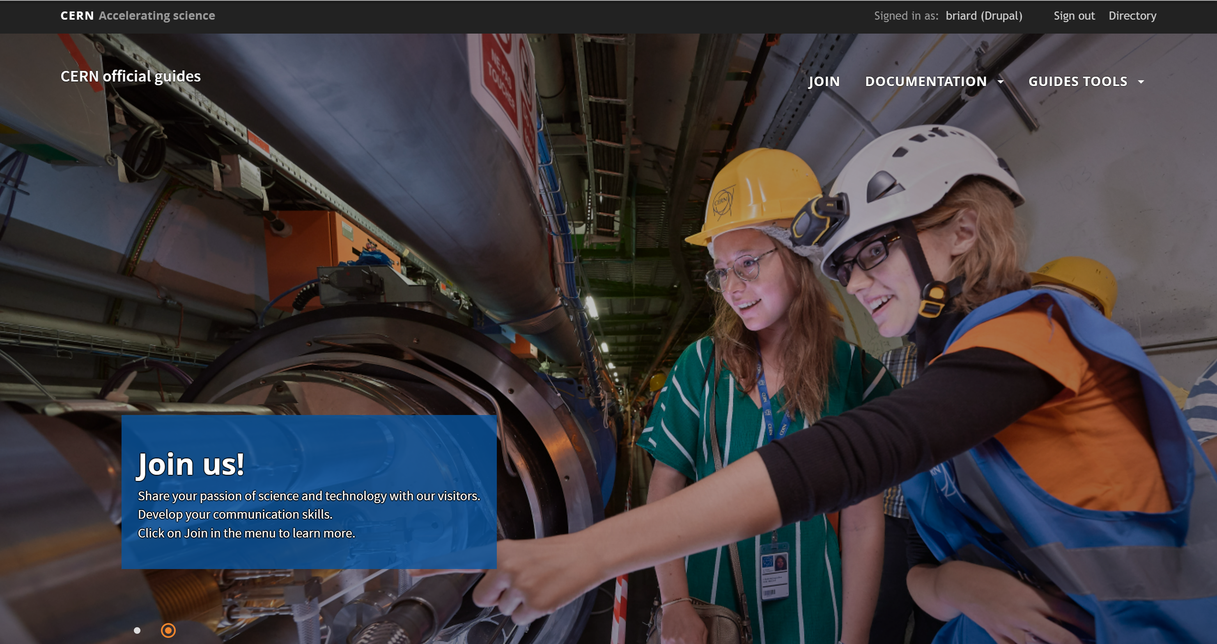
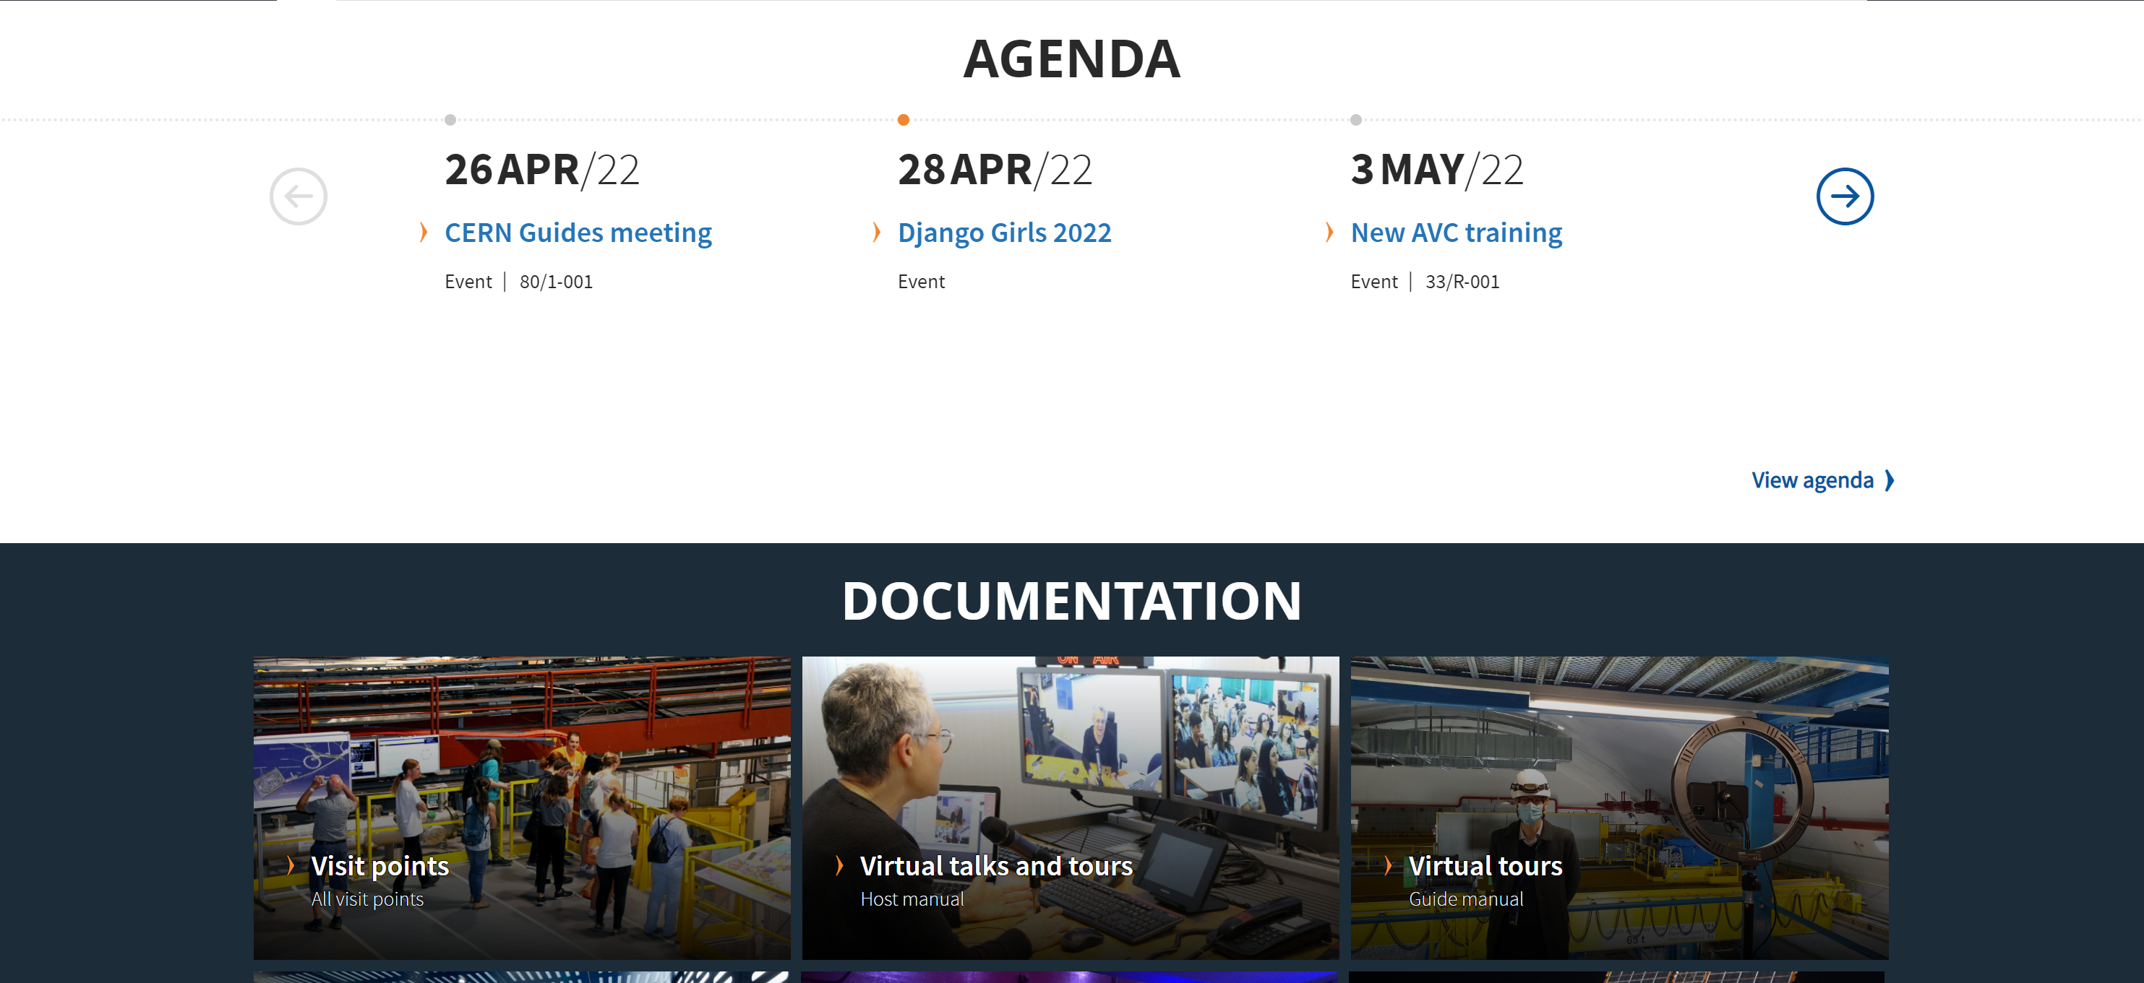
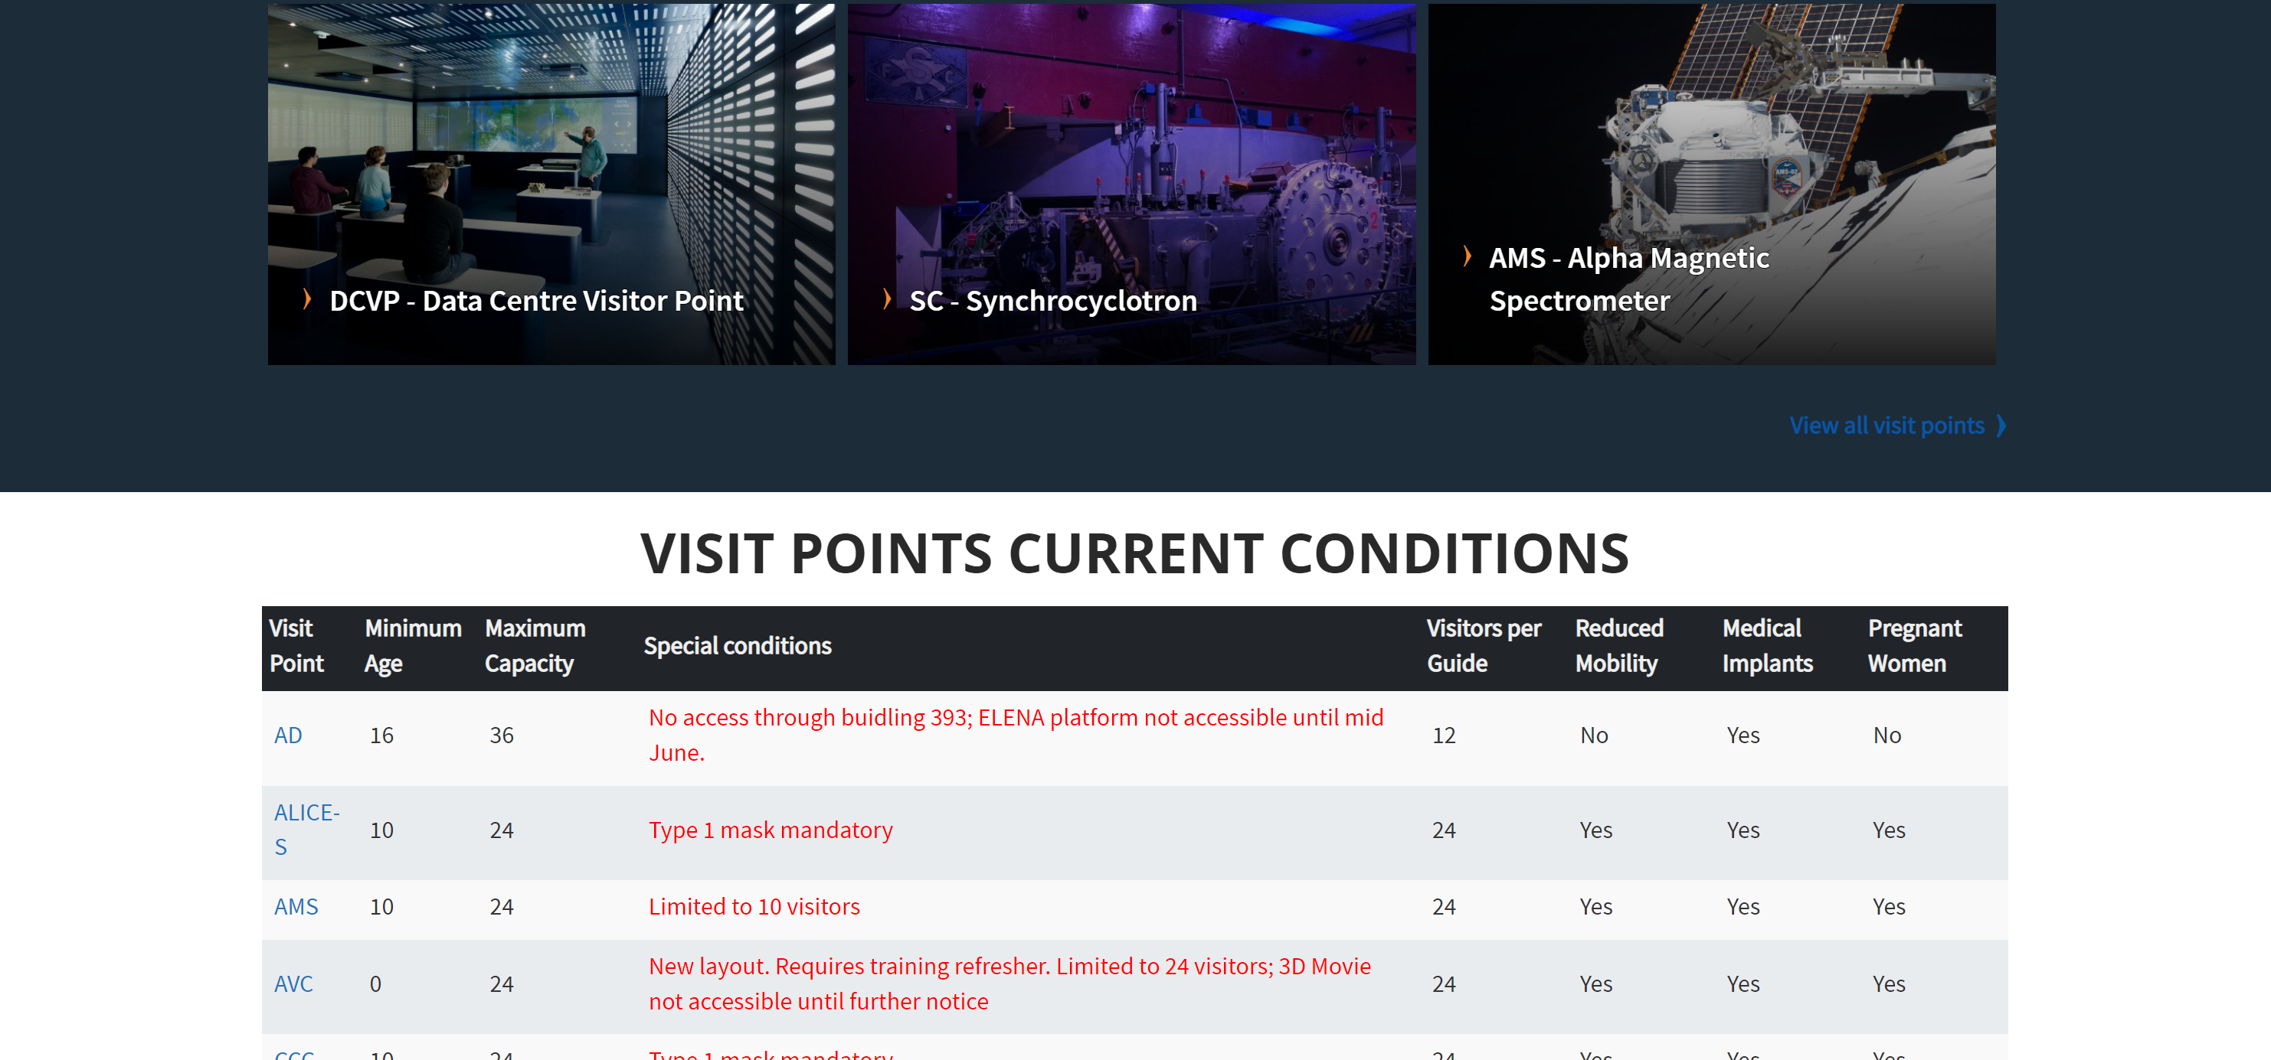
New website
https://guides.web.cern.ch
Current status of visit points
Detailed documentation: visit points, virtual tours, reference documents, introduction movie
Centralised agenda of all visits service events and public events
Central repository of links to guides tools (public outreach agenda, visits tools etc)
New Mattermost channel !

Slide 28
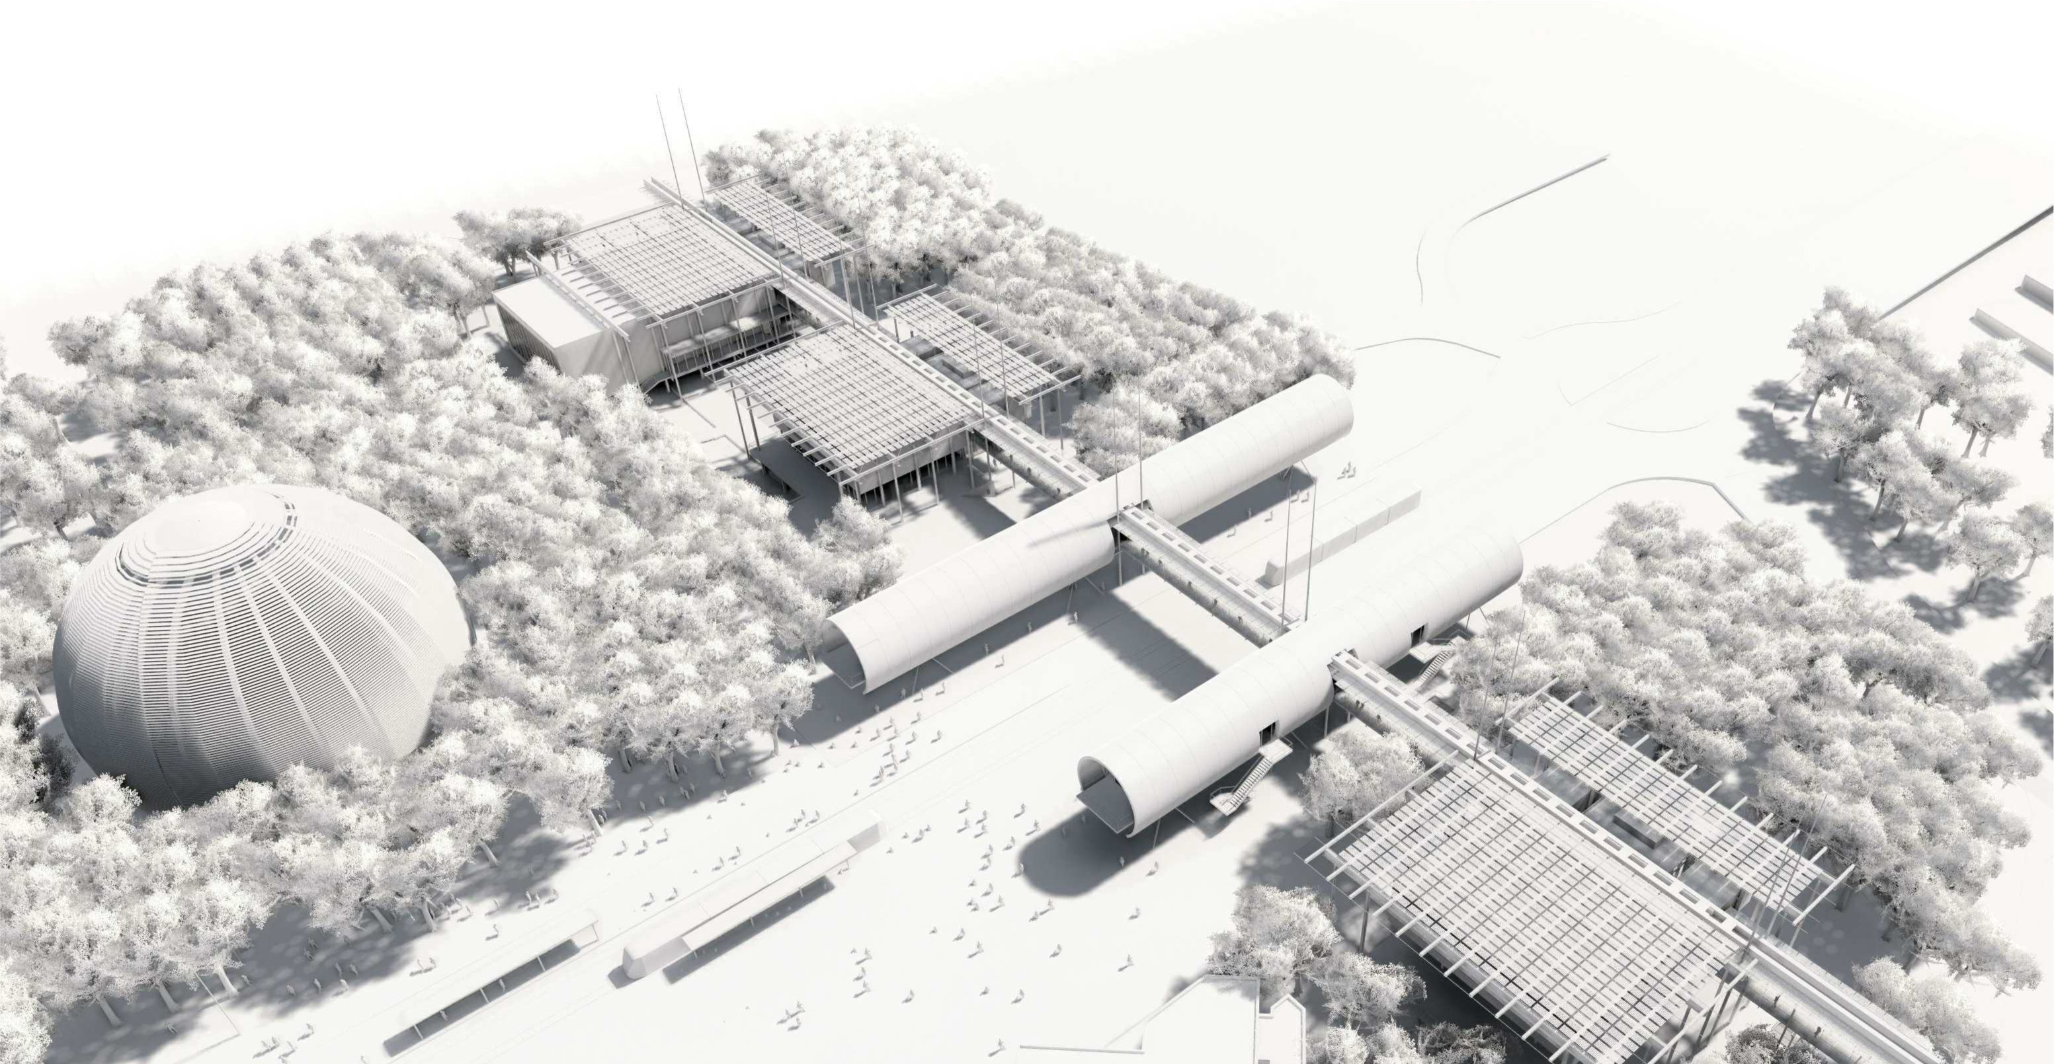
A few words about Science Gateway

Slide 29
Thank you!
A huge thanks to all of you who are helping to make CERN, science, technology, international collaboration more visible to our visitors.
Thanks especially for your flexibility in this very special period.
You are the best ambassadors of CERN and make more ambassadors out of our visitors.
We value your time and commitment.
We remain available to answer your proposals and comments on the way we work.

Slide 30
Q&A
Let’s start by one questions from Visits Service to you:
What would you like the Visits Service to develop for you?
Soft rewards?
More trainings?
More conferences?
Events?
Certificates?
Feel free to contact us after this presentation on visits.service@cern.ch
Or use our new Mattermost channel

