Slide 1
Task 10.6: Machine Learning Techniques for Accelerator and Target Diagnostics
I.FAST WP10.6 team meeting, 22-04-12
Thomas Shea

Slide 2
Discussion points

Slide 3
SNS Collaboration
Checking on MoU with Wim, Fulvia (Tom)
  Needed to share data
  Data exchange format (look also at SLAC standard)
Add to IFAST as associate or similar?
Errant pulse prediction technique
  Miha’s offer to contribute – available from next week
  Develop concept to implement on ESS platform; adapt to ESS parameters and attempt to remove limitations of SNS implementation
  Add instrumentation devices (BPM/phase, FC, Fast BPM, BLMs) with same technique
  TODO:
    Review SLAC standard and comment (Clement)
    Define near-term objectives with Miha (Tom, Kaj, input from others)

Slide 4
ESS model
Broader exploration proposed by Irena
  More detail to come
  Begin with simple model through DTL (Natalia?)
  Include all planned diagnostics
  Explore sensitivities, maybe even predictive power
  As best that we can, acquire relevant data during DTL1 commissioning
  Develop beam studies proposals in time for DTL4 commissioning
  TODO: More detail (Irena); studies plans and data acquisition requirements (All)

Slide 5
Collaboration tools
CERN
  IFAST Sharepoint site
  Indico site (Miha’s presentation is uploaded)
ESS
  Confluence/Jira
  Reading list (book club!)
  TODO:
    Accounts for RTU collaborators
    Curation of journal articles, ML references

Slide 6
Review

Slide 7
Project Summary
Long term mission: Develop low-latency Machine Learning (ML) techniques to improve performance and availability of high-power facilities at the intensity frontier.
WP10.6 task goal: Identify signatures of potential errant beam conditions
WP10.6 task scope:
  Assess the predictive capabilities of selected ML models
  Prototype: proof of principle demonstration
    The most promising ML model to be implemented on a low-latency network of FPGAs processing signals from array of detector channels.

Slide 8
Motivation and Background
High power hadron facilities
Performance on the intensity frontier is enabled by controlling loss/activation and mitigating beam-induced damage
Tails of the beam distribution are important contributors to activation
Subtle changes might be predictors of future damage events
Challenging to directly measure tails and subtle changes without invasive techniques
Result: predictions and decisions are based on incomplete and imprecise measurements

Slide 9
Strategy
Graded approach
  Deployed as trust increases.
  Intelligent trigger: gather the relevant data for model selection and initial training
  Alarms to operators
  Automatic functions: protection and feedback
Enablers
  Many provided outside of the IFAST program. Task 10.6 extends and leverages these technologies to achieve goals.
  Triggered, buffered Data Acquisition at the network edge
  Low latency communication for sensor aggregation
  Platform to host low latency algorithms
  Adequate data transport and storage – collaboration with ESS Neutron Science
  Tools for curation, analysis and offline training
  At the heart of this: Standard data structures for exchange within the team and with other facilities: NeXuS

Slide 10
Collaborators and responsibilities
Beneficiaries
ESS
  Expertise: Diagnostic scientists, Data manager, FPGA engineers
  Contribution:
    Construction/Commissioning phase
    FPGA-based diagnostics
    Low latency communications
RTU – Faculty of Computer Science and Information
  Expertise: AI, ML and FPGA experts
  Contribution
    Full-time master student
    Master student supervision (senior researcher/professor)
Additional participants
CosyLab – via subcontract from ESS
  FPGA specialist
SNS/ORNL – collaboration
  > decade of operational data
  Active machine learning project

Slide 11
Timeline
Preparation (Q3 2021 – Q1 2022)
  ML model exploration
  Data format preparation
Assess the predictive capabilities of selected ML models, trained with (Q1 2022 – Q2 2023):
    simulation results
    existing SNS operation data (13 years of operation data)
    ESS experimental data anticipated within the time line of the project (ESS Normal Conducting linac ongoing commissioning)
ML FPGA platform development (Q2 2021 - Q4 2022)
  Low-latency network development and optimisation
  Acceleration of ML model on FPGA platform
Demonstration (Q1 2023 - Q2 2024)
  In the lab
  In real conditions
Report (March 2024)

Slide 12
Low-latency applications under consideration
Currently exploring several Low-Latency applications
ML based Intelligent Trigger for Data-On-Demand (DoD)
ML based machine protection
  Beam Loss
  Beam destination protection
  Additional sensor aggregation applications
Interesting low-latency, single-device applications considered but de-emphasized (particle discrimination, image recognition, etc)

Slide 13
1. ML-based Intelligent Trigger for Data Acquisition
Goal:
  Identify “off-normal/interesting” and “normal” events
  Trigger DoD* acquisition for each “off normal” event
    Data-On-Demand (DoD) definition: partially or fully processed highly detailed data, buffered and then extracted from the FPGA level on event occurrence (on demand)
Relevant systems: Beam Loss, Beam Position, Beam Current
Challenges
  Select appropriate model for anomaly detection
  Conditions will change with time – may require “online learning” (unsupervised ML model; adaptive ML)
  Identify relevant data
    dataset type and structure (what data to take from each system)
    dataset preparation/”cleaning” (for example remove beam study data)

Slide 14
2. ML-based machine protection
Goal: inhibit beam production when dangerous conditions are recognised/predicted
Relevant systems: BLM and BCM; also BPM, FC for protecting specific beam destinations.
Can be considered as advanced version of ”intelligent trigger” application
  Correlation of known failures with the datasets extracted with ”intelligent trigger” as precursors (offline analysis)
  Use these identified precursor datasets (loss patterns or other errant conditions) as training datasets for ML based machine protection

Slide 15
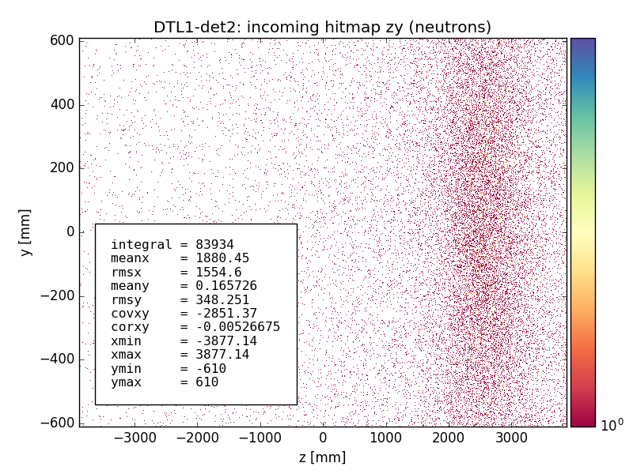
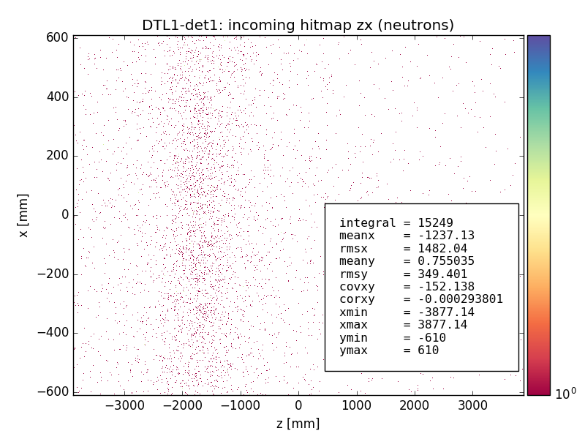
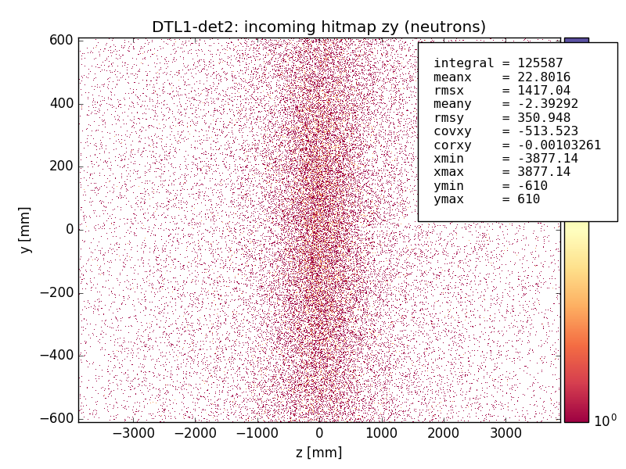
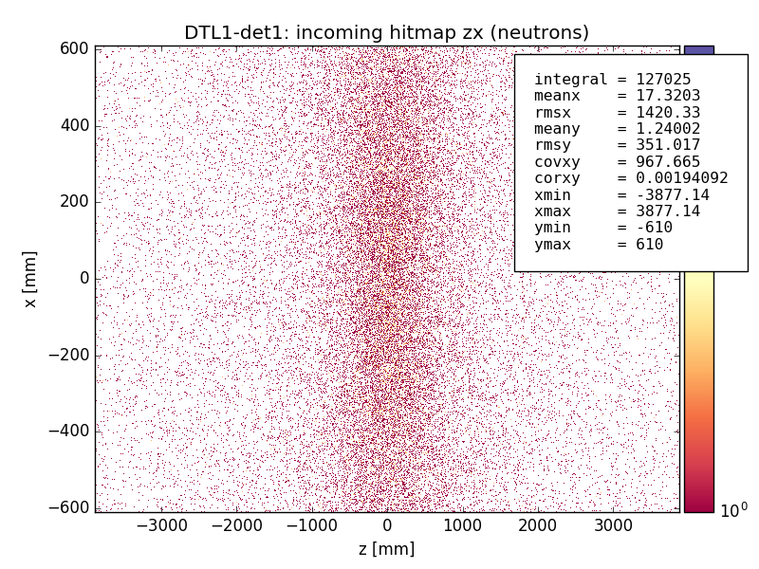
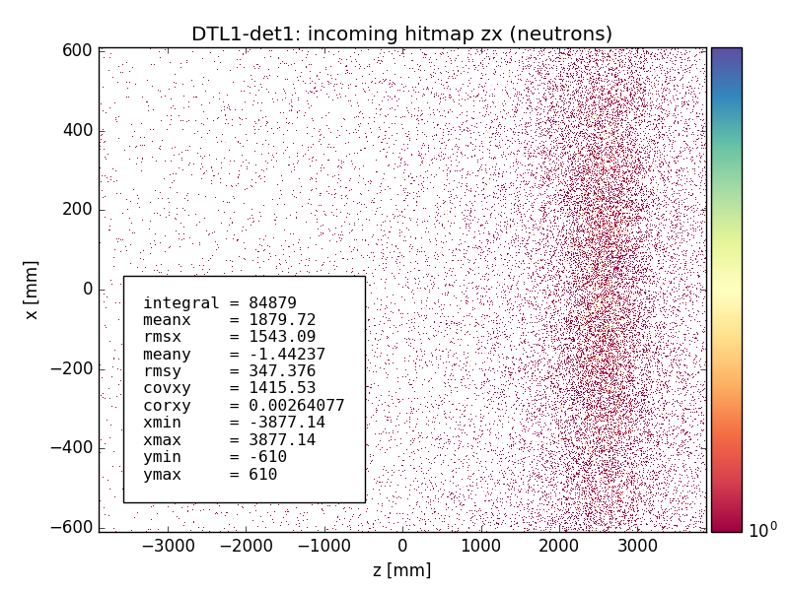
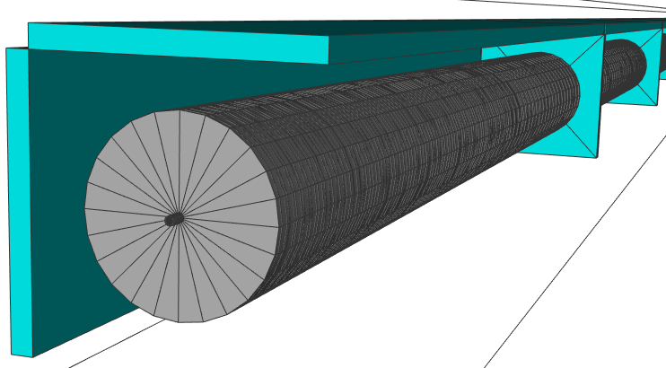
Example: Beam Loss in the ESS Linac
Figure: Incoming neutron hit maps for different localized loss locations along a DTL tank
This map is sampled by small number of detectors
Resulting signal has complex relationship to the beam properties at the potential damage point
det0
y
det2 “detector” volume
x
z
det1

Slide 16
Example: Energy deposition on beam destinations
Damage in Faraday cups and beam stops depends on beam properties that are not directly measured
  Transverse density distribution
  Low energy tail of longitudinal distribution
Relevant measurement devices
  BPM (centroid phase -> energy)
  FC – BCM current difference
  Option: BLM (combine with others to account for upstream loss)
Use these imperfect but low-latency signals to predict thermo-mechanical response and the resulting damage potential

Slide 17
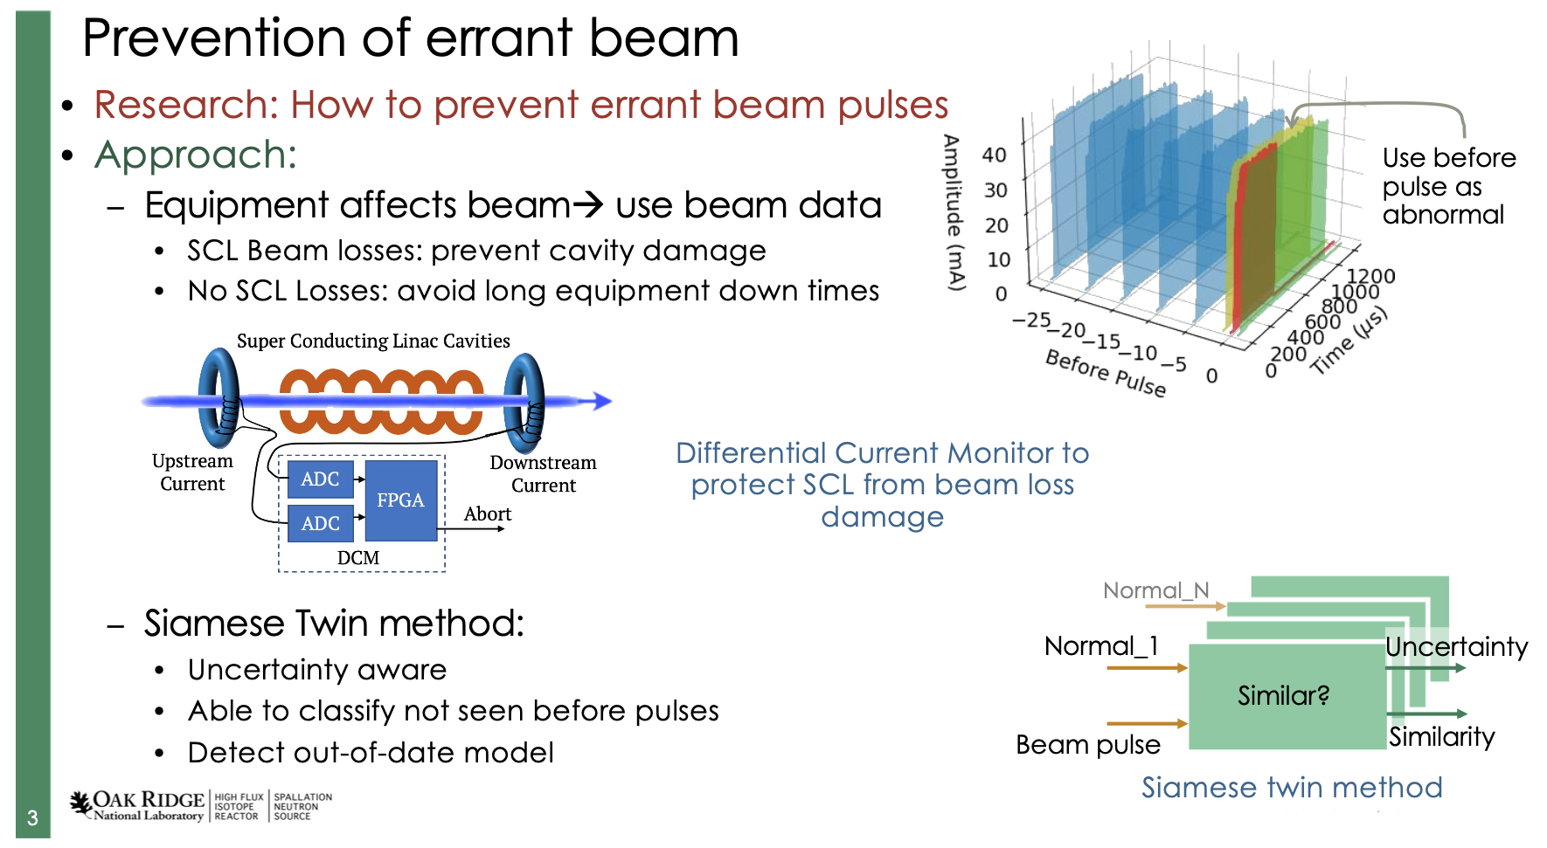
ORNL/SNS Example
from
W. Blokland

Slide 18
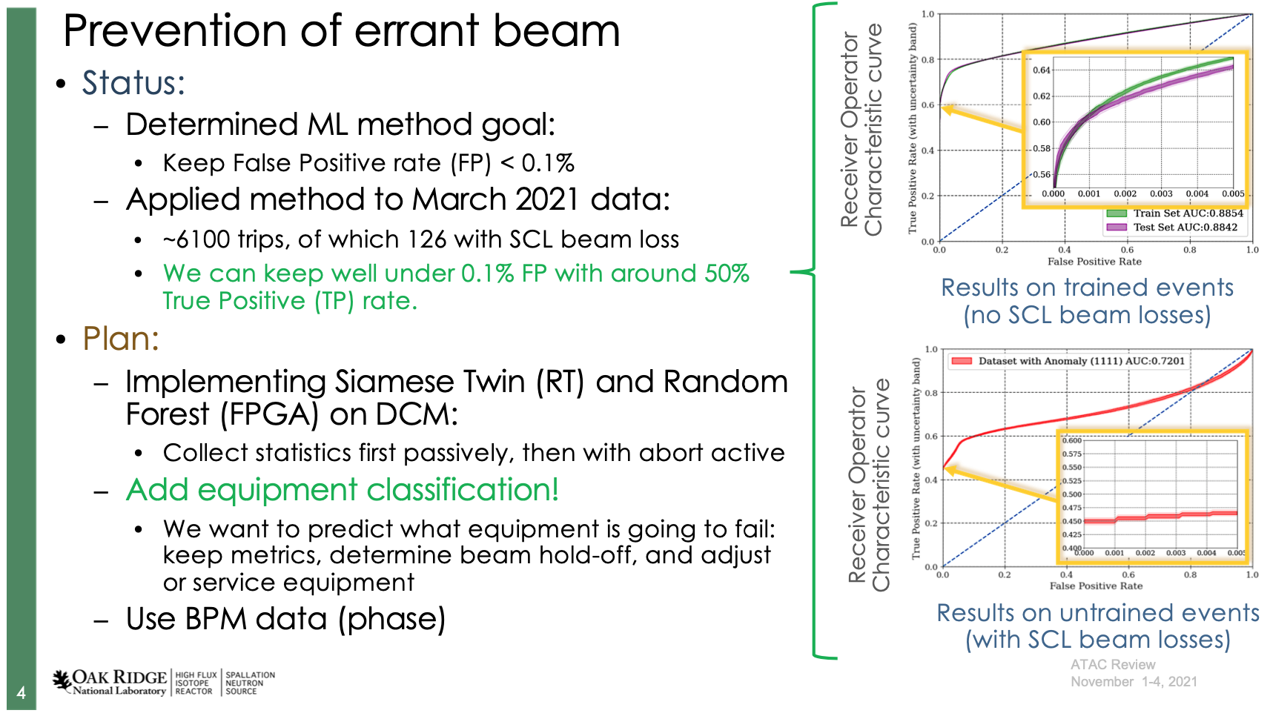
ORNL/SNS Example
from
W. Blokland

Slide 19
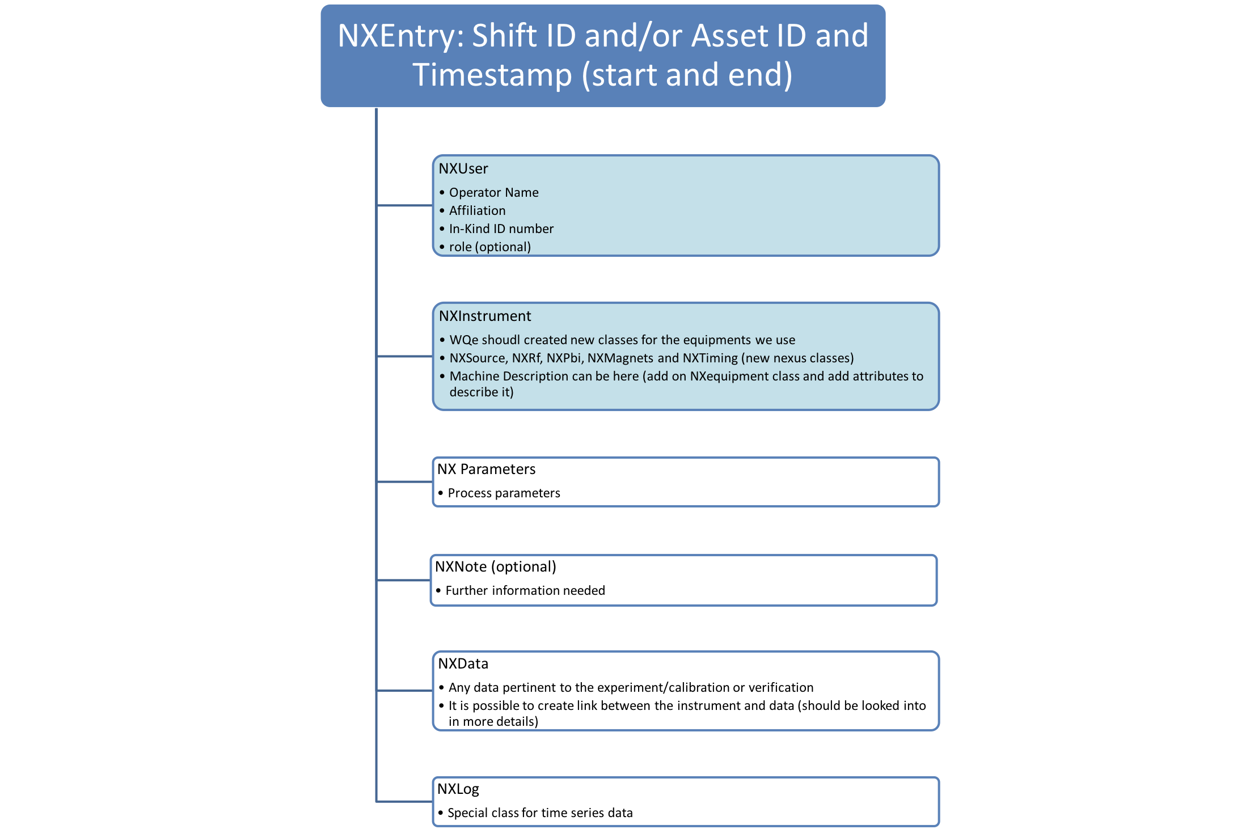
Data
NeXus data format (example ESS diagnostics data)
Developing Data Exchange based on NeXus (https://www.nexusformat.org)
Standard in the neutron and X-ray communities
First example: agreement with ORNL on emittance data structure.
  We will build on this to cover ML-related data that we intend to exchange
Scope:
  Operations data from SNS
  Commissioning data from ESS
  Simulation data from ESS

Slide 20
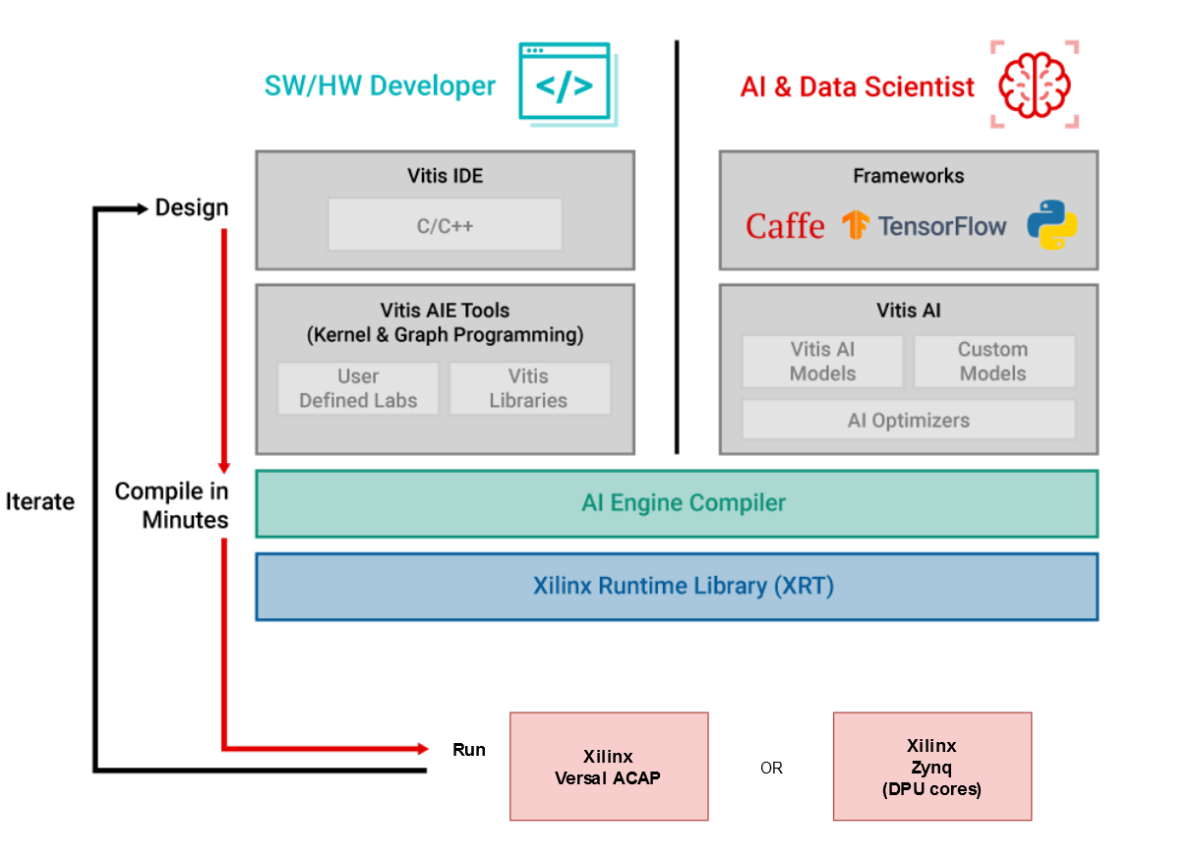
Tools
Tools based on Xilinx AI flow accelerated on FPGA platform. Two options being investigated.
  Xilinx Zynq: Current generation FPGA platform AI accelerator cores in FPGA logic (Deep learning Processor Unit, DPU)
  Xilinx Versal ACAP: Bleeding edge FPGA with dedicated AI acceleration cores
The tool flow would provide short turn-around and flexibility when exploring ML applications
The downside is that the solution are compiled SW running on accelerator cores which means additional latency.
  On Xilinx Zynq there is SW (XRT) in the loop to feed the accelerator cores.
  On Xilinx Versal the programming model supports feeding AI cores directly from FPGA logic so should provide lower latency.

Slide 21
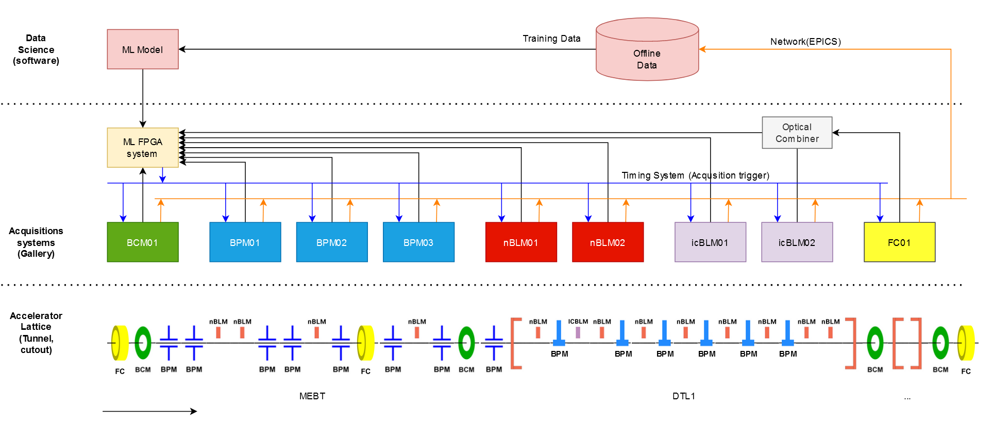
ML Prototype – Normal Conducting Linac, Low Energy Section
System covering Normal Conducting Linac (NCL)
Goal ML FPGA System can detect “off normal” events and request readout via timing system (DoD).
System could connect to interlock system (not shown)

