Slide 1



SNEWS
SUPERNOVA EARLY
WARNING SYSTEM
multimessenger/supernova*
Tool for calculating CEvNS interactions
Melih Kara
kara@kit.edu
SNEWS Collaboration Meeting
05.08.2022 Thursday
* cause we are running out of abbreviations
click me-ow

Slide 2
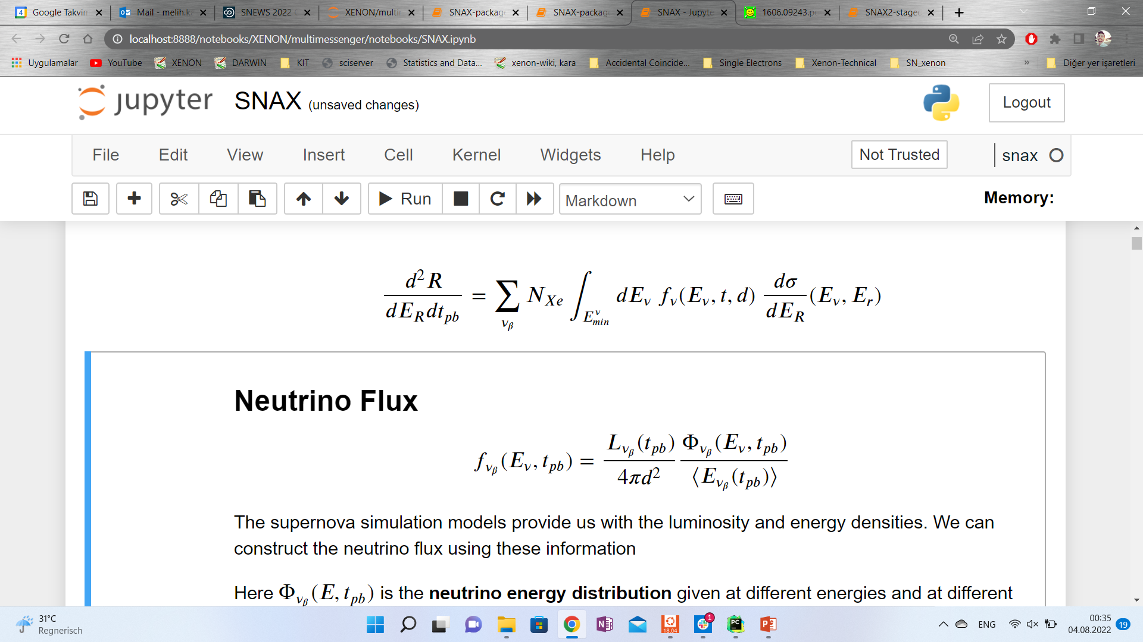
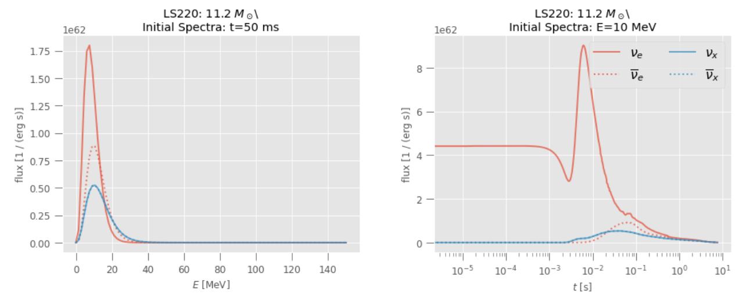
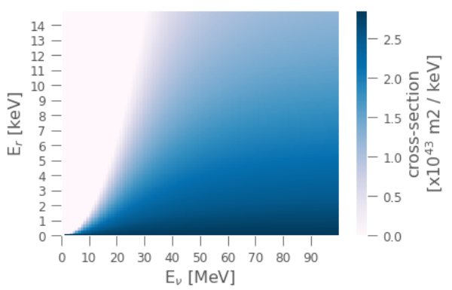
CEvNS interaction Rates
fluxes
Cross-sections
1

Slide 3
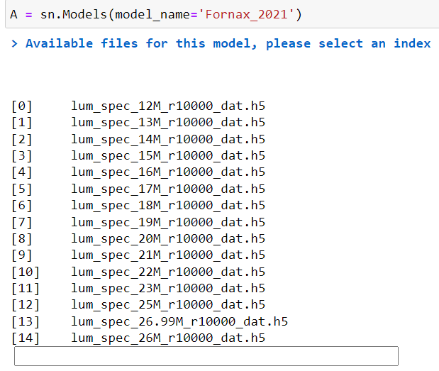
CEvNS interaction Rates
Object oriented
Flexible (change the input composite)
Scalable by the distance
Computes rates per time, rates per recoil energy
per neutrino flavor, per isotope
Fluxes can be fetched from any snewpy model
2

Slide 4
CEvNS interaction Rates
Object oriented
Flexible (change the input composite)
Scalable by the distance
Computes rates per time, rates per recoil energy
per neutrino flavor, per isotope
Fluxes can be fetched from any snewpy model
2

Slide 5
CEvNS interaction Rates
Object oriented
Flexible (change the input composite)
Scalable by the distance
Computes rates per time, rates per recoil energy
per neutrino flavor, per isotope
Fluxes can be fetched from any snewpy model
2

Slide 6
CEvNS interaction Rates
Object oriented
Flexible (change the input composite)
Scalable by the distance
Computes rates per time, rates per recoil energy
per neutrino flavor, per isotope
Fluxes can be fetched from any snewpy model
2

Slide 7
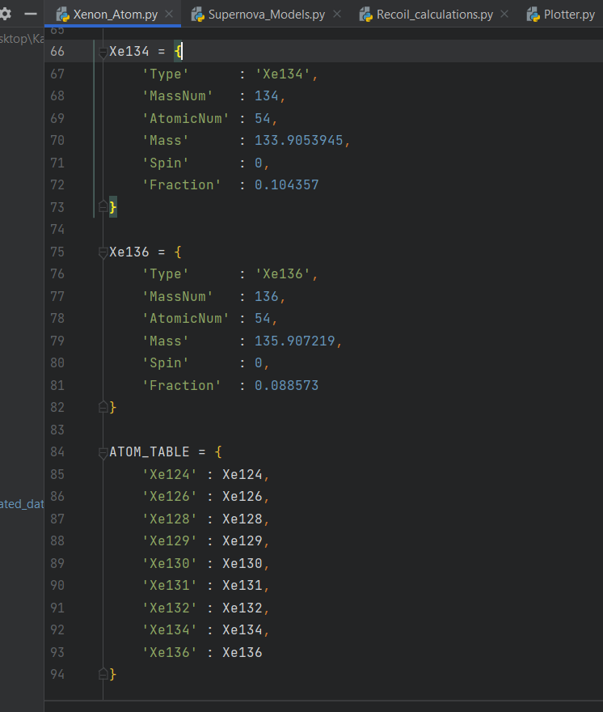
CEvNS interaction Rates
Object oriented
Flexible (change the input composite)
Scalable by the distance
Computes rates per time, rates per recoil energy
per neutrino flavor, per isotope
Fluxes can be fetched from any snewpy model
2

Slide 8
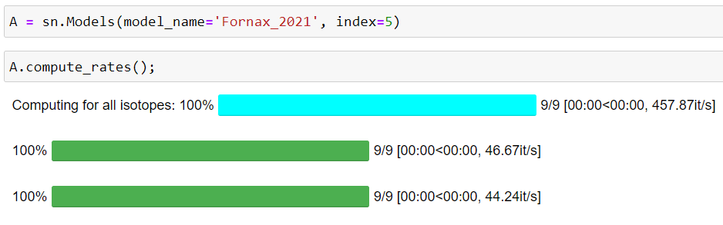
CEvNS interaction Rates
Once computed, can always be fetched in < 1s
Object oriented
Computes rates per time, rates per recoil energy
Computes per isotope
Flexible (change the input composite)
Scalable by the distance
Fluxes can be fetched from any snewpy model
2

Slide 9
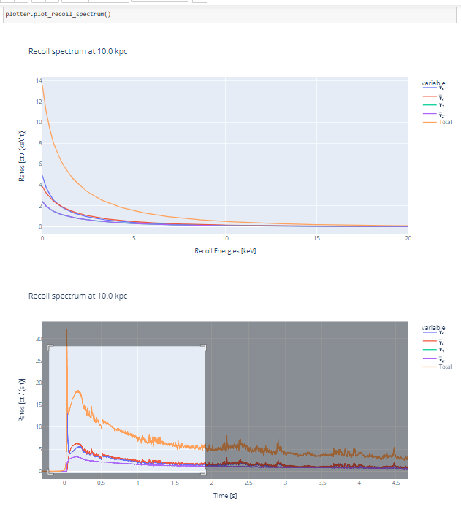
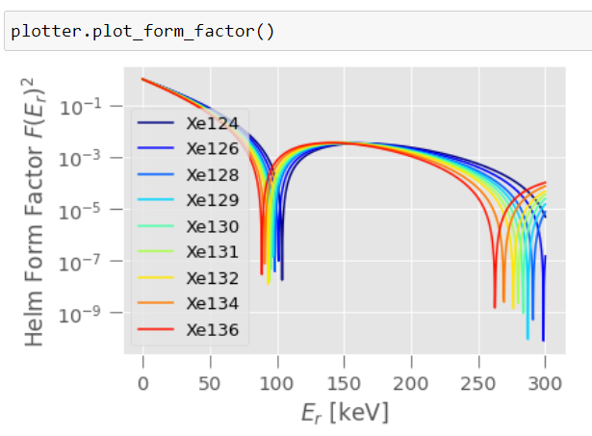
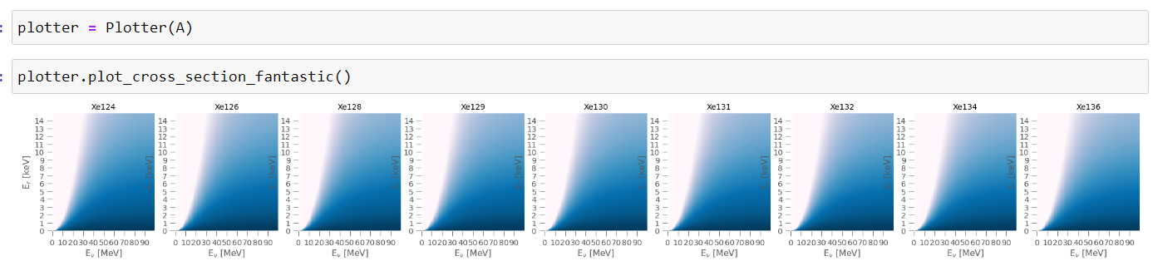
CEvNS interaction Rates
Has a built-in plotter
interactive
3

Slide 10
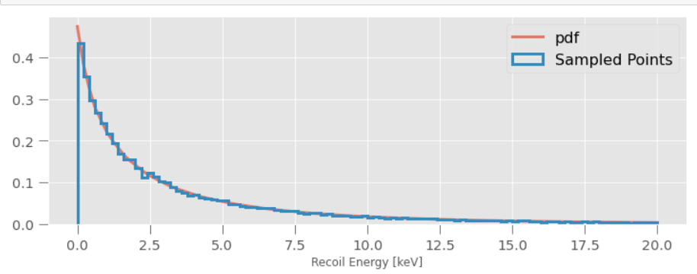
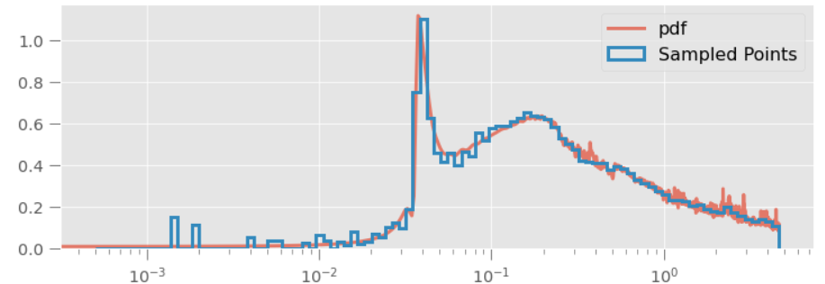
In XENONnT …
sample recoil energies, times
simulate and analyze signal
using WFSim

Slide 11
Summary:
An efficient way of computing interaction rates
For any snewpy model
at any given time
for any given recoil energy
from any given neutrino energy
for any given atom/isotope
for all neutrino flavors

Slide 12
Backup

Slide 13
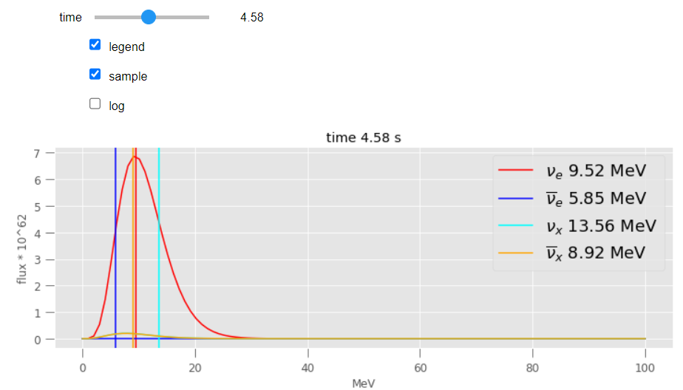
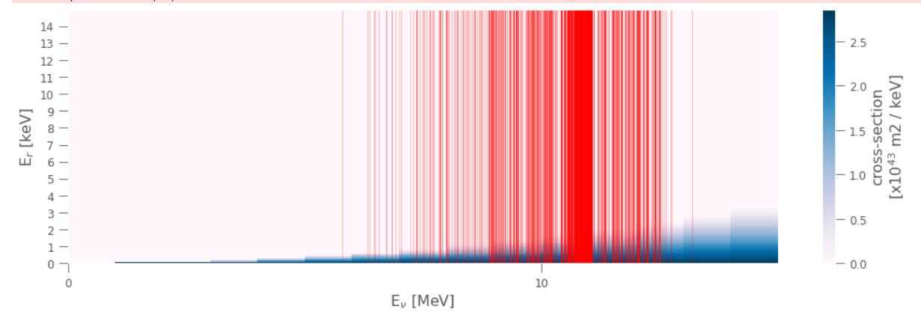
In XENONnT …
Sample from time distribution
At that time, sample from neutrino energies
At that neutrino energy sample a recoil energy based on cross-section probability

Slide 14
This method actually gives you a terrible spectra
Regardless if you sample from time first (almost only returns first second)
Or sample time uniformly and look at the energy distributions.
Although you get those neutrinos more, they don’t recoil energetic enough.
So you only see the high energy ones (and there are still a lot 10^12)
It makes more sense to study what we can see, and energy neutrino can detect those.
Then looking into flux distribution to see what models can generate enough of those events, and at what times
Sampling from time integrated recoil energy distribution is probably the best approximation to this.

