Slide 1
LHC MDs 2022: Intro
Jan Uythoven, Matteo Solfaroli, Gianni Iadarola
LSWG 26/04/2022

Slide 2
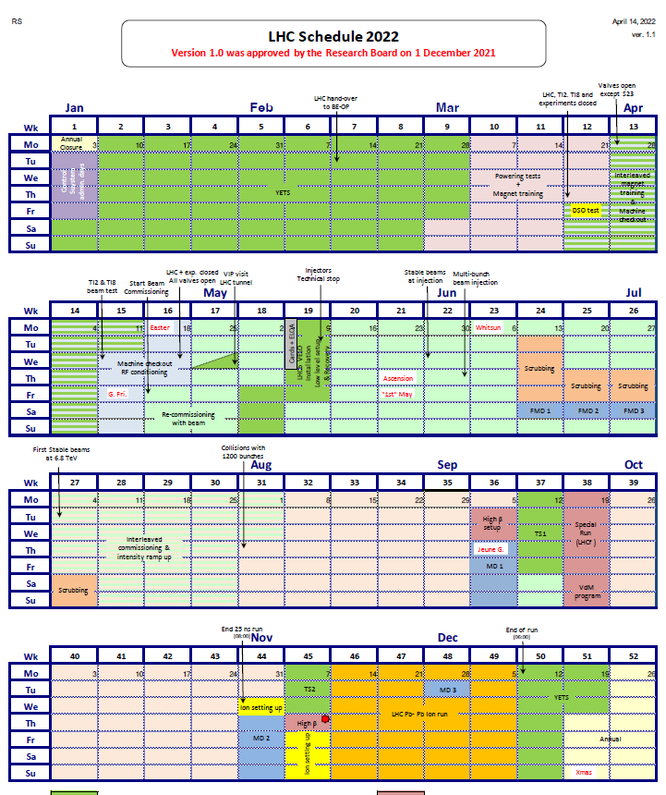
MDs in 2022
Floating MD Block
  Reduced by 1 day
  First day 18th June
MD block 1
  Also reduced – tbc
  Starting 8 Sept
MD block 2
  Also reduced – tbc
  Starting 3rd Nov

Slide 3
Next dates – tbc
26/4 LSWG
03/5 Request for procedures
11/5 LMC presentation on MDs
17/5 Procedures submitted – new format
24/5 rMPP meeting
Schedule
18/6 First Floating MD

Slide 4
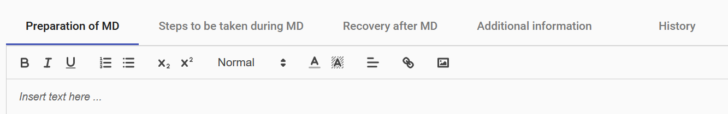
Integrated in the ASM-form
  Intelligent editor, can upload pictures etc.
  Avoid double information on beam characteristics etc.
Please complete all the different tabs
Update the beam characteristics if needed

