Slide 1
Validation of method to measure aperture margin between IR6 and TCTs with non-nominal phase advance
MD#7008
Cédric Hernalsteens, Christoph Wiesner, Daniel Wollmann
26/04/2022

Slide 2
Introduction
Goal
  Beam-based measurement of aperture margin between TCDQ (IR6) and TCTs in IP5
  to validate protection in case of an asynch. dump (Beam 2)
  Validate the method for non-nominal optics conditions (detuned phase advance and beta-beating)
Method
  Simulate async. MKD kicked trajectory with a closed bump between IR6 and IP5 (based on model)
    Correct the orbit outside the IR6-IP5 region to recover a closed bump
  Measure bump shape and beam position with BPM at TCTPH.4R5.B2
  Blow-up the beam to define aperture at TCDQ
  For nominal TCDQ position, move TCTPH (IP5) in until beam losses are observed to measure aperture
Method successfully tested for nominal optics conditions in 2018 (MD 2186)
Validate the method in non-nominal optics conditions and
quantify the retraction between TCDQ/TCSP and IR5 TCT

Slide 3
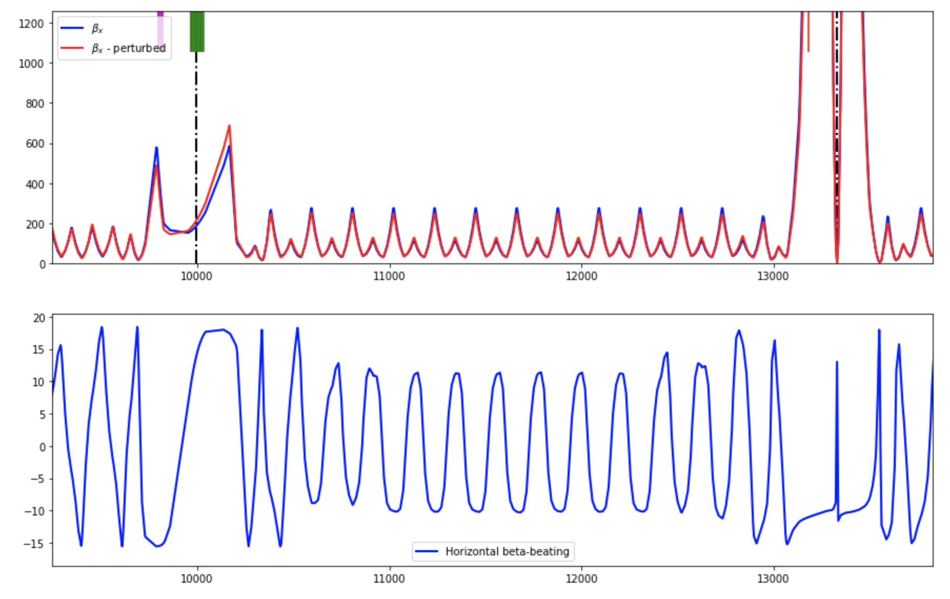
Optics detuning
Detuning with MQTs bringing the MKD-TCT phase to 48 degrees (from 28 degrees)
Optics detuning that can affect the protection of the IR5 TCT
  Phase advance between MKD and TCTPH.4R5.B2
  Beta-beating at the location of TCTPH.4R5.B2
Use end of squeeze optics with r_tele = 1 (beta* = 60 cm) to minimize the impact of the change in phase advance per cell
Two options
  Use MQTs to induce beta-beating and phase advance detuning
  Use MQs to detune the phase advance while minimize the beta-beating (cleaner situation)

Slide 4
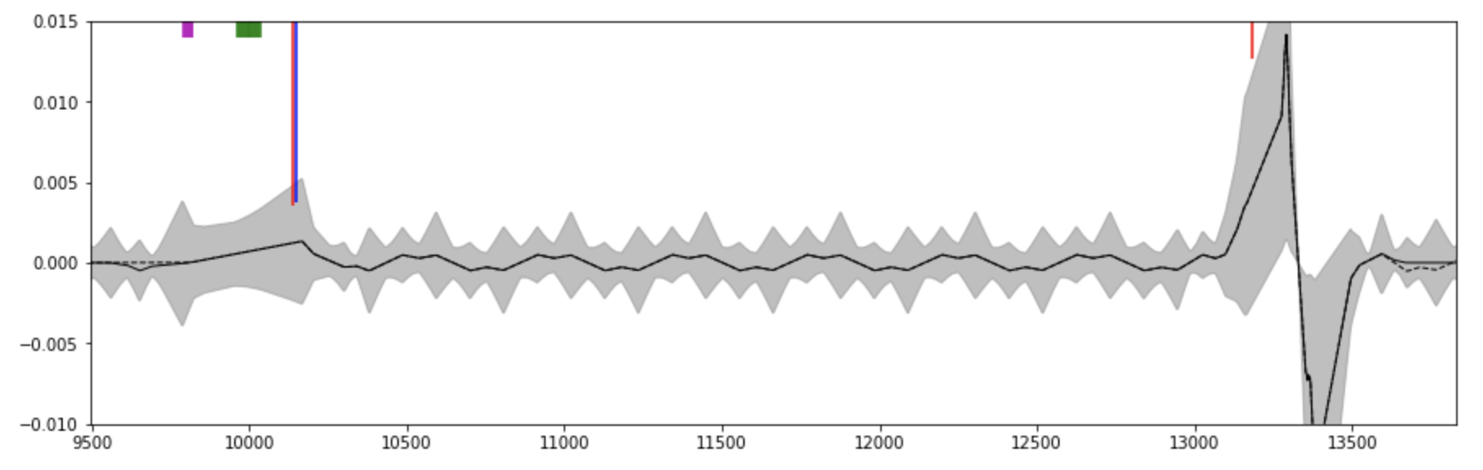
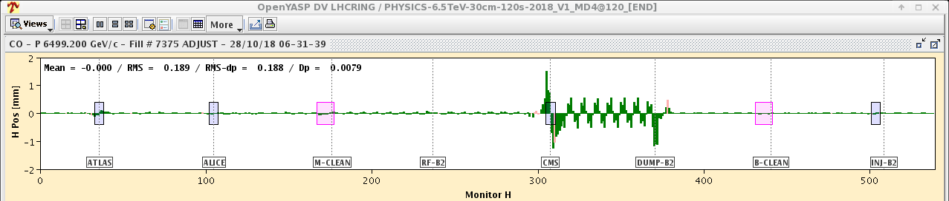
Long closed bump from IR6 to IR5
Model
2018 measurement
(MD2186)

Slide 5
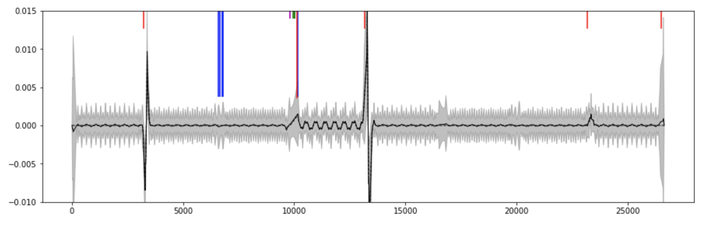
Bump non-closure from optics detuning
Correct and close the bump with YASP

Slide 6
Measurements
Measure bump amplitude with the BPM at TCTPH.4R5.B2
  Compare with model to obtain retraction margin reduction due to non-nominal optics
Perform aperture measurement with BBA of TCTPH.4R5.B2
  Due to the bump the TCDQ/TCSP will be the aperture bottleneck
  Blow-up the beam and verify that losses appear at the TCDQ
  Use the BBA tool to move in the TCT until losses are detected

Slide 7
MD parameters
Machine and beam
Only Beam 2
3 bunches (~ 1E10 P+, buckets 1, 8911, 17851)
6.8 TeV, end of squeeze (β* = 60cm, tele-index = 1) Collapsed separation
Optics detuning (option 1)
Phase advance detuning between IR6 and IR5 with beta-beating using MQTs
kqtf.a56b2 kqtd.a56b2 to detune the phase advance
dQx.b2_sq dQy.b2_sq to correct the tune
Optics detuning (option 2)
Phase advance detuning between IR6 and IR5 with beta-beating using MQTs
kqf.a56 to detune the phase advance
kfq.a45 to correct the tune
Long bump
MCBH.11R6.B2 MCBCH.9R6.B2 MCBCH.9L5.B2 MCBCH.7L5.B2
+ additional correctors to close the bump (YASP)

Slide 8
Conclusion
New method to validate and measure, with circulating beams, the retraction between IR6 absorbers (TCDQ and TCSP) and TCT in IR5
  Assess that insufficient retraction can be identified and quantified
Validated with nominal optics conditions during MD2186 (2018)
Proposal: validate the sensitivity of the method for non-nominal optics conditions

Slide 10
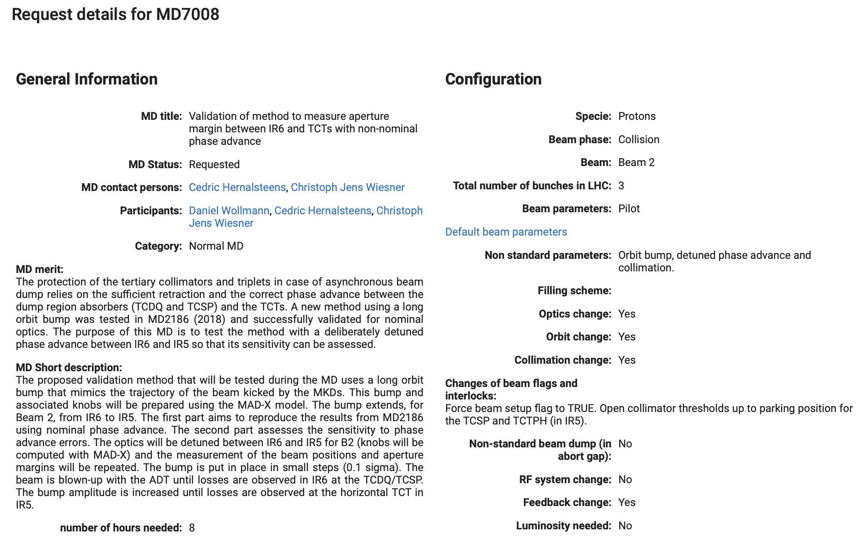
MD request

Slide 11
References
LHC MD day 2020
2019 MD block #5 results
New method for validation of aperture margins in the LHC triplet, IPAC 2015
Experimental test of a new method to verify retraction margins between dump absorbers and tertiary collimators at the LHC, IPAC 2021
Asynchronous beam dump tests at the LHC, IPAC 2018

Slide 12
Results from MD2186
2018

Slide 13
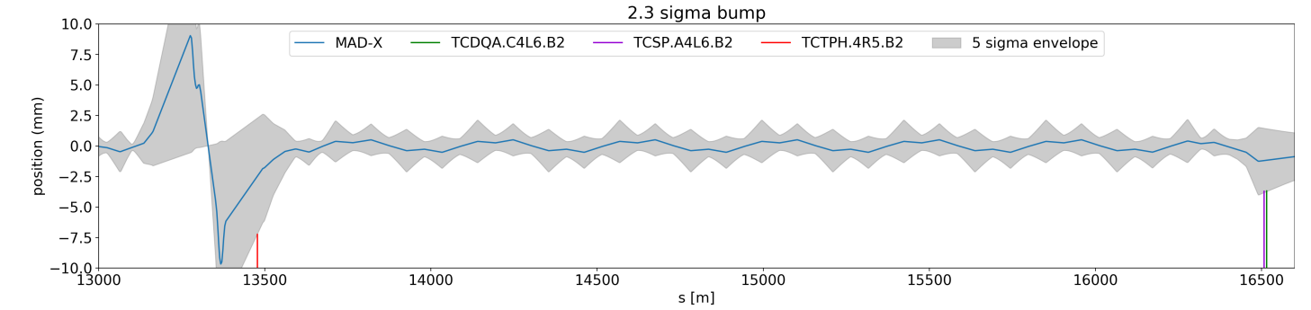
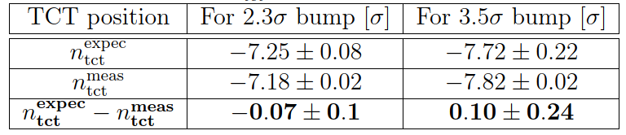
Validation of retraction margin TCDQ-TCT using orbit bump
MD2186
Method verified for Beam 2 (IR6→IR5) during MD2186.
Extension of method for Beam 1 and using a longer orbit bump under discussion.
Very good agreement within 0.1σ between expected and measured position of beam envelope at TCT (IR5) achieved.
CDS#2705434
MD goal | Probe feasibility of new validation method for both beams
Beam energy | Flat top
Intensity | A few pilot bunches
Remarks | Study together with COLL, ABT, OP… Depending on outcome of ongoing studies, certain tests might be already proposed for commissioning

Slide 14
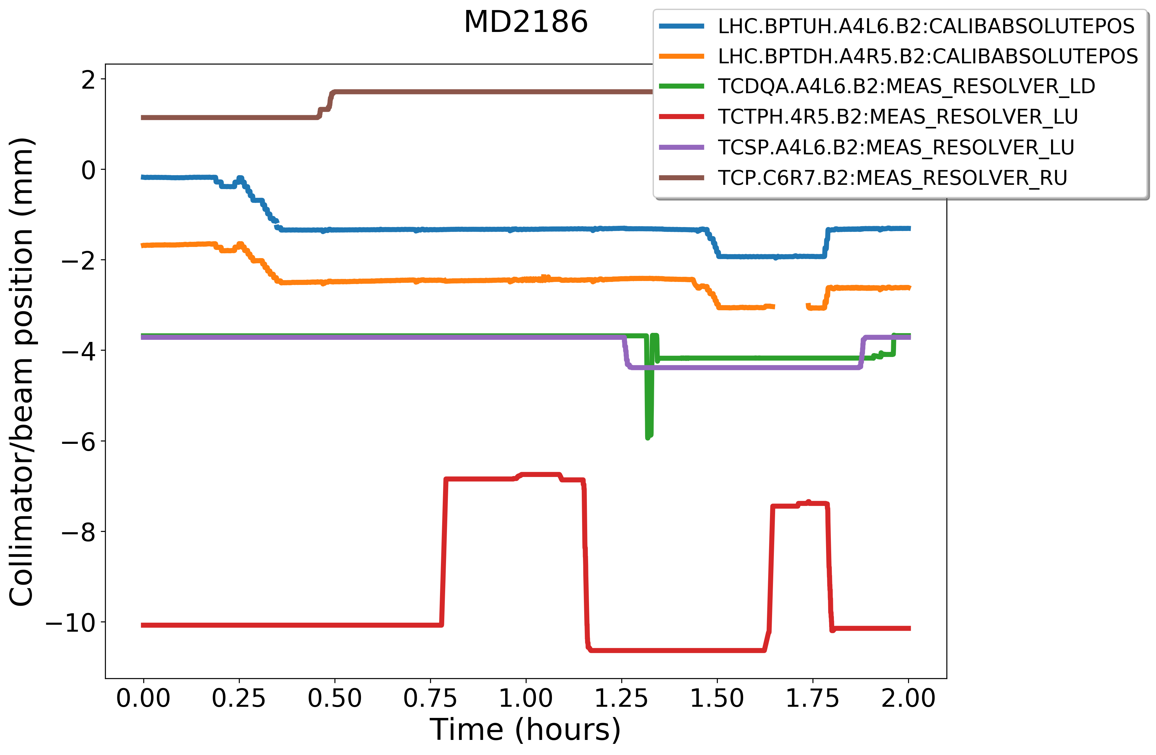
MD Overview
bump at TCT
Move TCDQ and TCSP out
2.3σ bump at TCDQ
Move TCPs out to ~7 σ
Increase bump to 3.5σ and blow up beam
Blow-up / losses at TCDQ
Move TCT in (BBA) #2
Move TCT in (BBA) #1
After each BBA: Verified that losses are coming from the left jaw of TCTPH.4R5.B2 by stepping each side in with 10 um steps

Slide 15
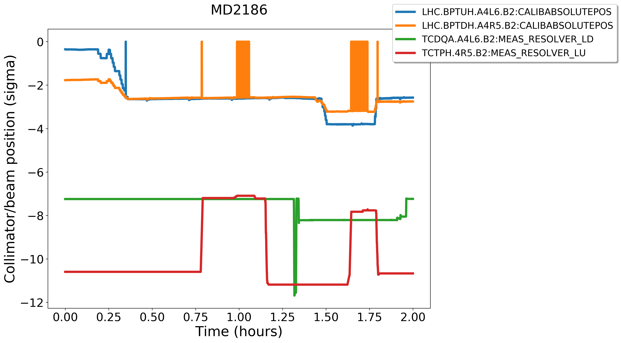
MD Results
beam position at TCDQ
-0.3σ
beam position at TCT
-2.6σ
beam envelope at TCDQ after 1st blow-up: ~4.6σ
measured beam envelope at TCT: ~4.6σ
Good agreement between expected and measured TCT positions
beam envelope at TCDQ after 2nd blow-up: ~4.4σ
measured beam envelope at TCT: ~4.6σ
-7.2σ
TCDQ position
TCT position
σ_{x} (TCT) = 0.95 mm
σ_{x} (TCDQ) = 0.53 mm

