Slide 2
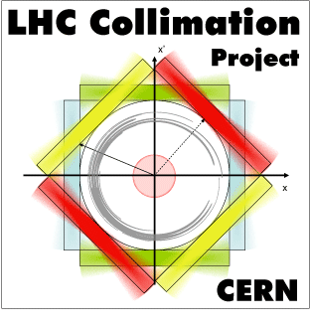
Crystal Collimation MDs with Proton Beams
M. D’Andrea, R. Bruce, R. Cai, D. Mirarchi, S. Redaelli
LSWG Meeting: Floating MD preparation

Slide 3
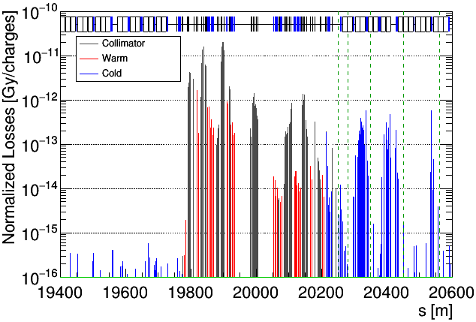
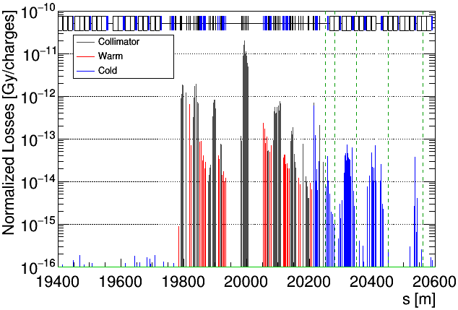
Motivation and scope of crystal MDs
Following results obtained in Run 2, crystal collimation planned to be used already during 2022 Pb ion run to mitigate losses in IR7-DS
  Vertical crystal collimators on both beams replaced with new devices in LS2
B1H STD
B1H CRY
Aim of tests with proton beams: validation of new devices, consolidation of strategies and previous findings, verify implementation of interlock functions
Early feedback on these aspects is crucial in preparation of deployment with Pb ion beams - could have implications for choice of beam energy in Pb ion run (to be made summer 2022)

Slide 4
Present schedule and readiness
In present schedule, two slots (12h+12h) assigned to crystal collimation tests during commissioning
  MD requests as “backup” in case measurements cannot be completed or additional tests are required
Extensive interlock and control checks without beam carried out in past weeks by D. Mirarchi and CEM team
All proposed measurements based on tests performed during Run 2: procedure well established and refined
Possible conflicting schedule of floating MDs for some participants due to superimposition with IPAC22
  Quorum of experts anyway available to cover MD slots

Slide 5
Beam setup and collimator settings
Both beams at injection and flat top
Up to 30 pilot bunches, respecting intensity limit of 3$⋅$10¹¹ total protons per beam
Operational collimator settings
CRY
“Adiabatic” insertion of crystals in standard system (0.25 σ tighter)
Proposed settings for use in operation with ion beams
TCP
TCSG
TCSG
TCLA
Optimized collimator settings
CRY
Settings used for validation studies and potential further cleaning improvement
Different settings of downstream TCSGs and TCLAs
TCP
TCSG
TCSG
TCLA

Slide 6
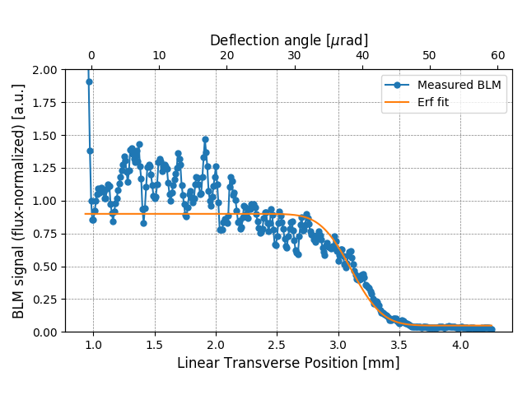
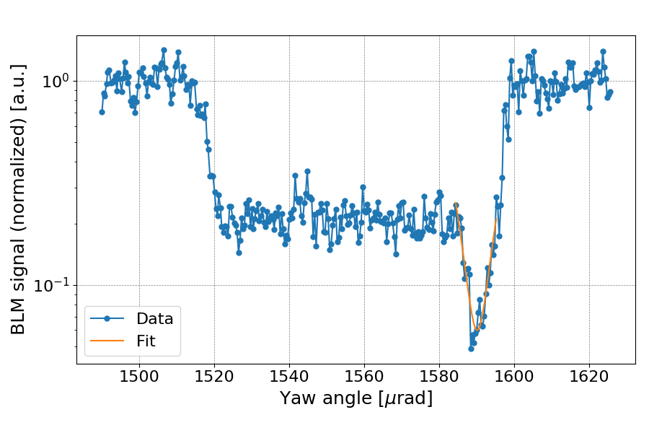
MD #7006
Validation of Crystal Collimators with Proton Beams
Beam-based linear alignment of crystal collimators
Typical characterization measurements with upstream collimators open and ADT excitation
Angular scan of crystal
Linear scan with secondary collimator
Loss maps at flat top for cleaning efficiency measurements using operational settings, optimized settings, possibly more configurations
Estimated time: 10 hours

Slide 7
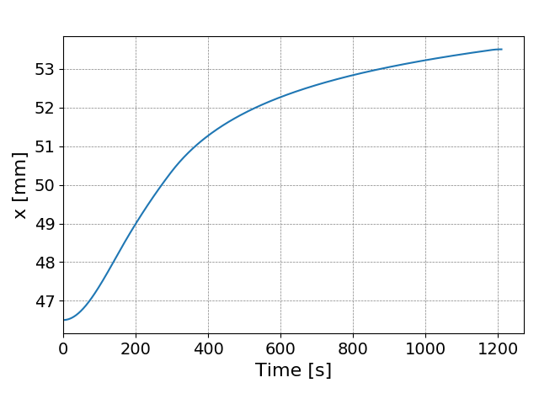
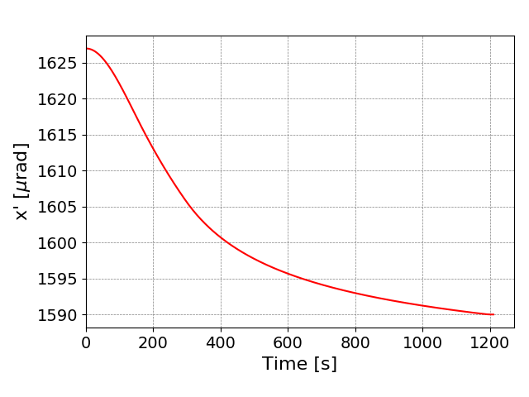
MD #7007
Operation of Crystal Collimators during Energy Ramp
Generation of linear and rotational ramp functions and interlocks using optimal alignment position and orientation previously found
Multiple ramp attempts with all 4 crystals in channeling: monitoring of channeling conditions via loss maps every ~500 GeV
Any leftover measurements at flat top if time allows
Estimated time: 10 hours

Slide 8
Thank you for your attention!

