Slide 1
Beam Instrumentation MDs
LSWG for Floating MD preparation
22/04/2022
Sara Morales on behalf of the BI MD requesters

Slide 2
MD#6948: RF cogging and orbit bumps in IR5 for HL-LHC BPM electronics development
What is the future use of the MD?
  Development of new electronics for the future HL-LHC IR1/5 BPMs (data acquisition for offline testing of accuracy improvement algorithms)
Why should it be now, as floating MD, or could it be moved to a later MD block?
  It can be moved to a future MD block in 2022
Any special beam / hardware requirements?
  Yes. One B1 bunch and one B2 bunch crossing each other at the location BPMSY.4L5. Each beam should also contain another "test" bunch separated from the MD bunch by at least 1 us.
  RF cogging required (± 6.25 ns in ~ 5 steps), beam orbit change at the location BPMSY.4L5 required (± 10 mm in ~ 6 steps)
Are you ready?
  Yes. We need ~1 day notice to prepare for installing test electronics in IR5
  RF team needs to be ready and aware of this

Slide 3
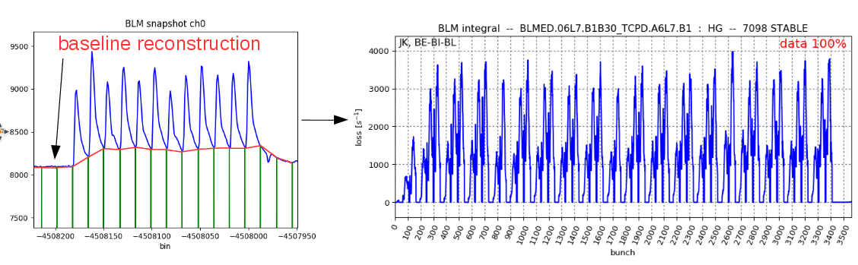
MD#6949: Validation of bunch-by-bunch diamond detectors functionalities
What is the future use of the MD?
  Development of a correction mechanism for the bunch-overlap in the diamond detector signal, allowing to obtain an accurate value of the bunch-by-bunch losses
Example of algorithm used at the end of Run 2, courtesy of Jiri Krall

Slide 4
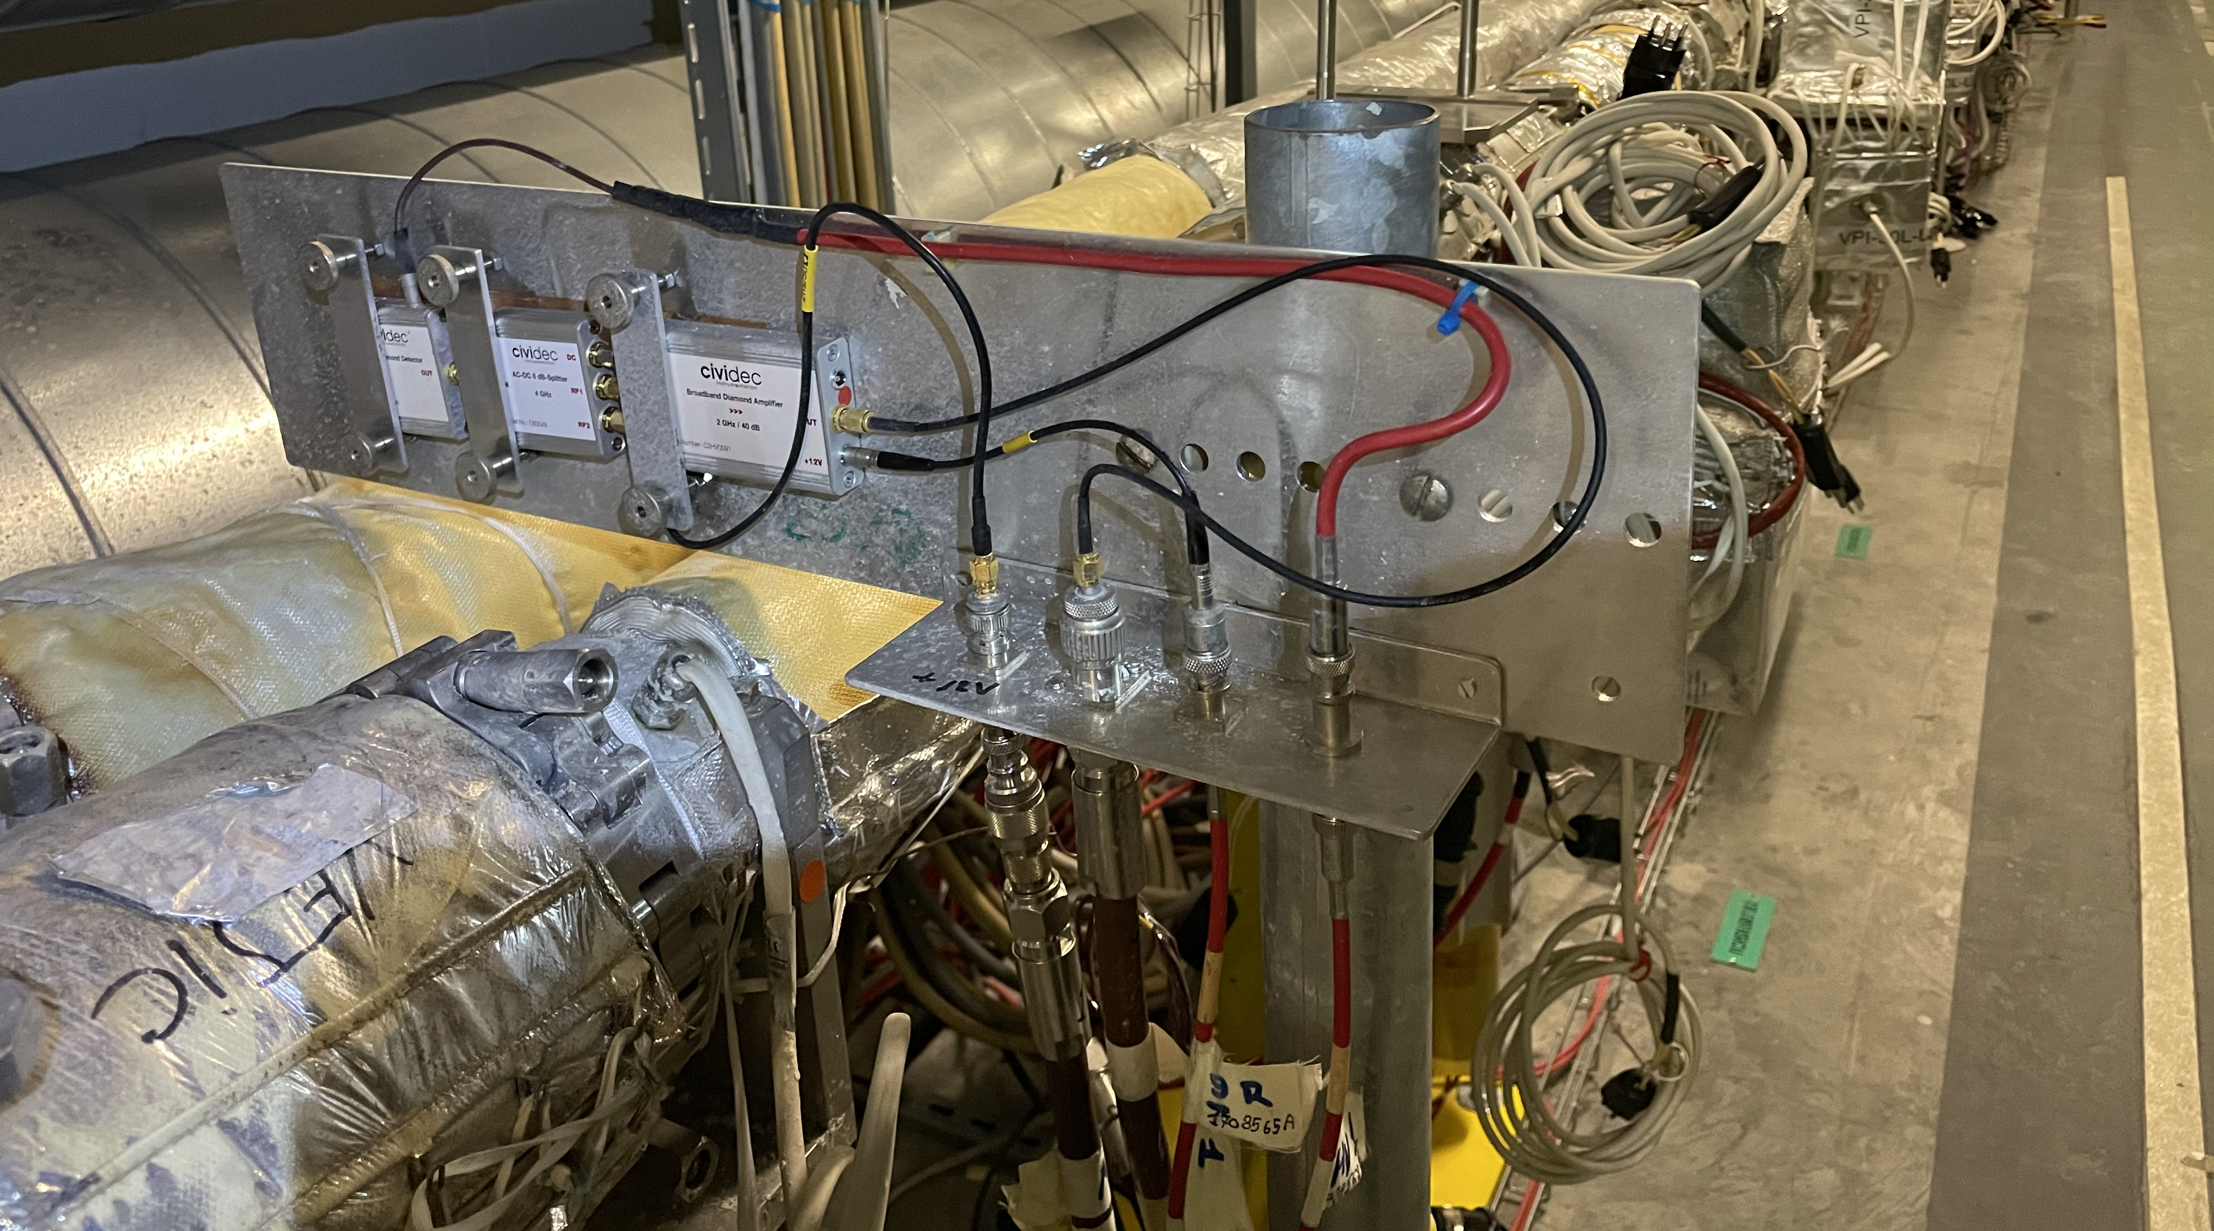
MD#6949: Validation of bunch-by-bunch diamond detectors functionalities
What is the future use of the MD?
  Characterisation of the system limitations regarding sensitivity
Detector
AC-DC splitter
40 dB Amplifier
2 outputs: non amplified and amplified signal

Slide 5
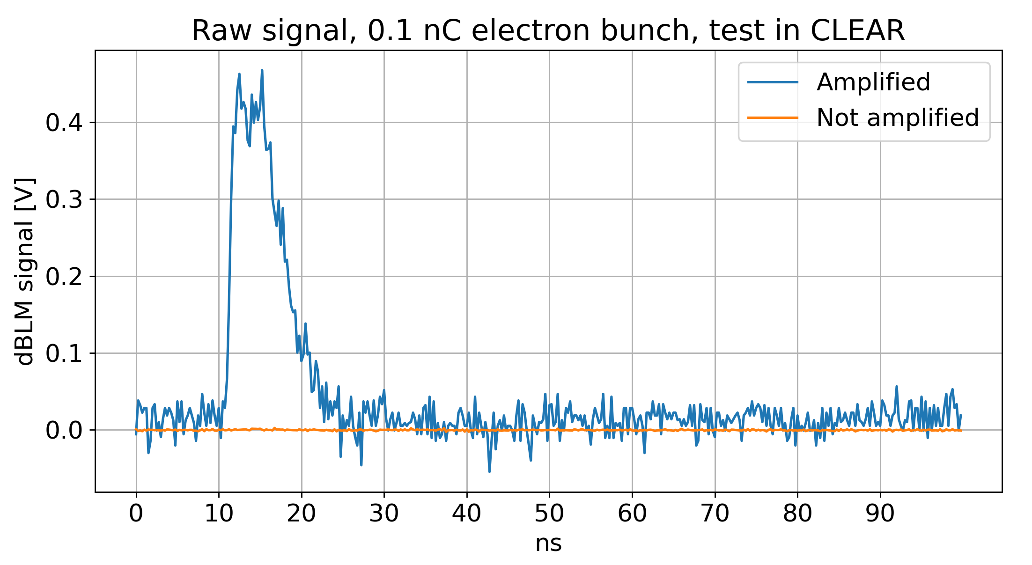
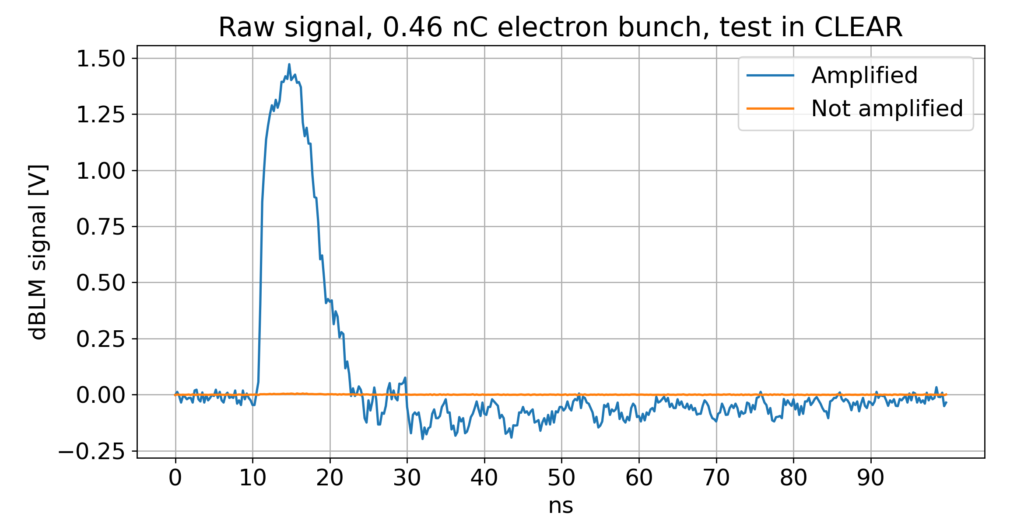
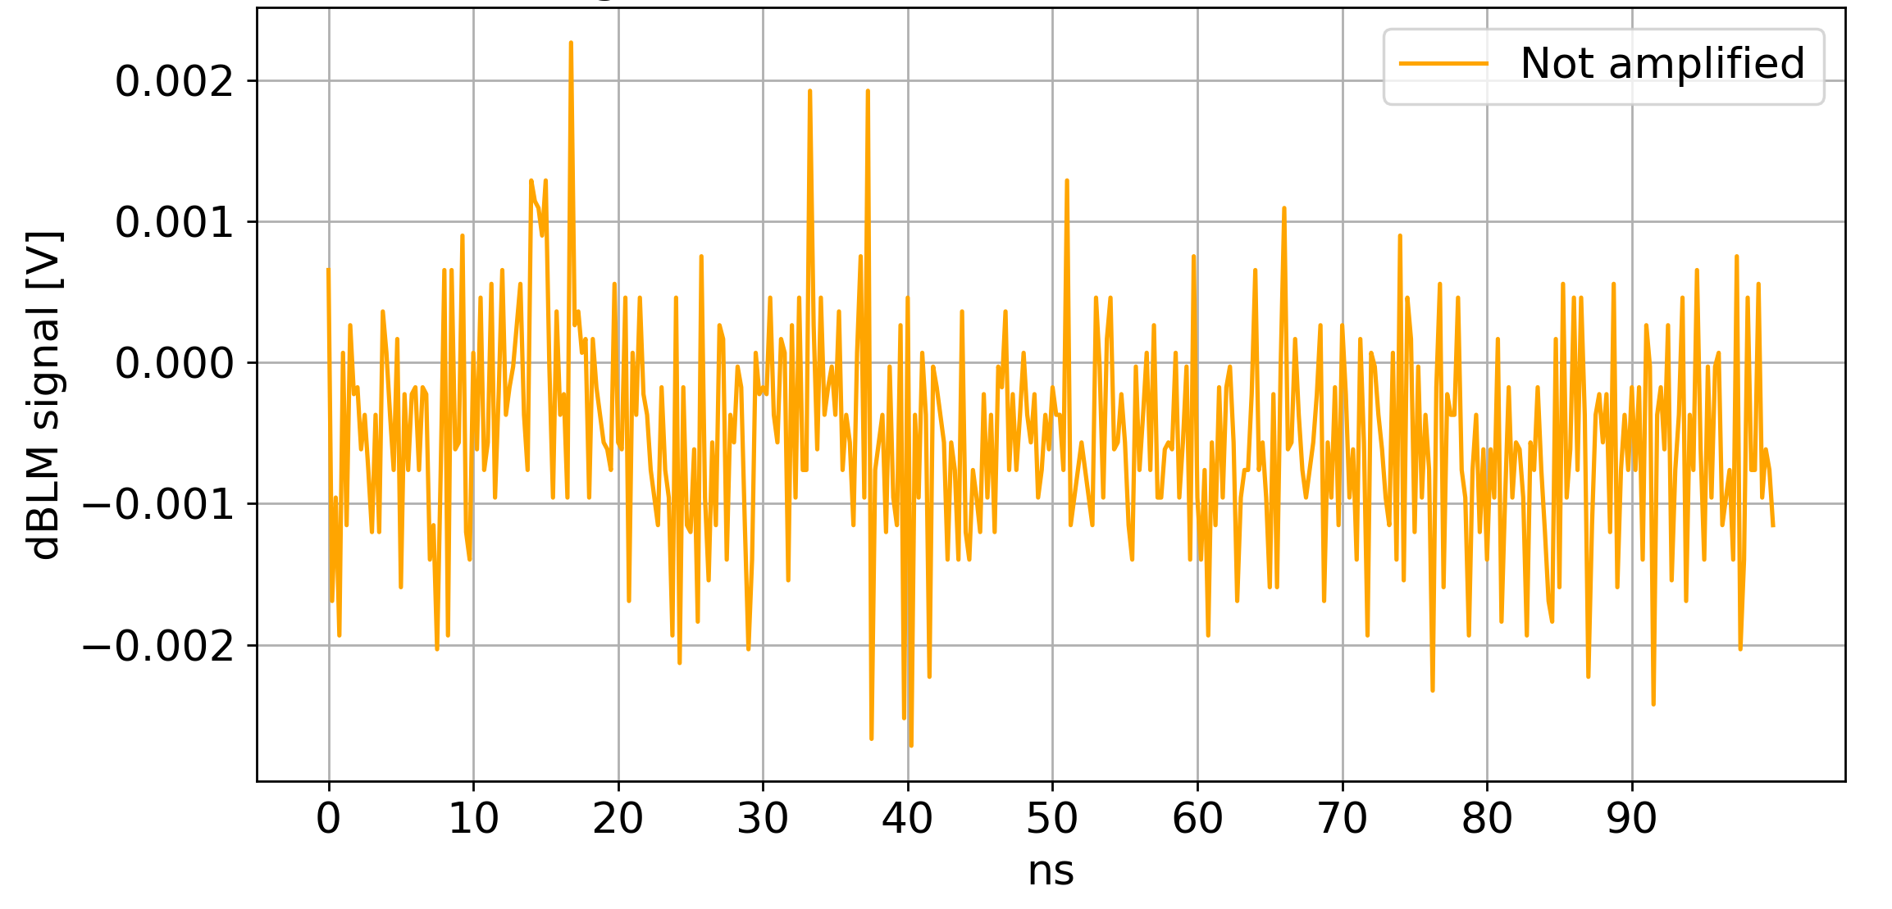
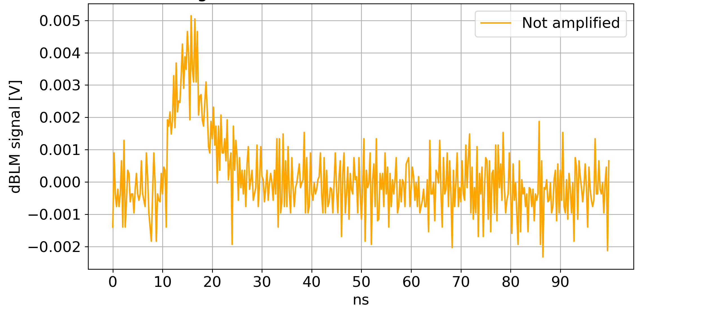
MD#6949: Validation of bunch-by-bunch diamond detectors functionalities
1.5V -> Saturation value for the amplified signal
What is the future use of the MD?
  Characterisation of the system limitations regarding sensitivity
Amplified signal reaching saturation when not amplified signal starts being visible
Not amplified signal not distinguished from noise

Slide 6
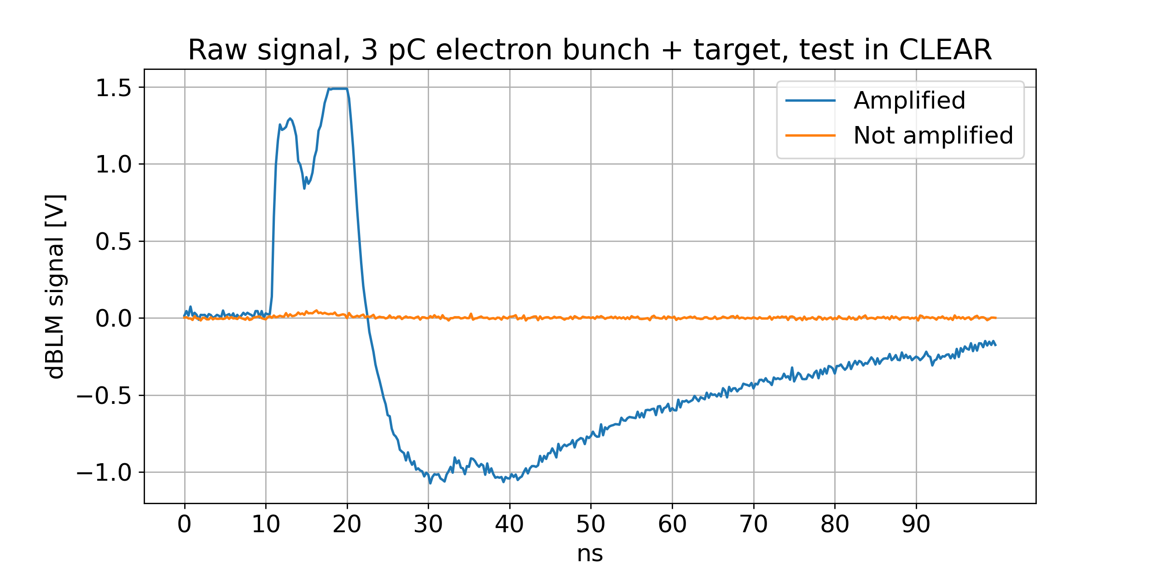
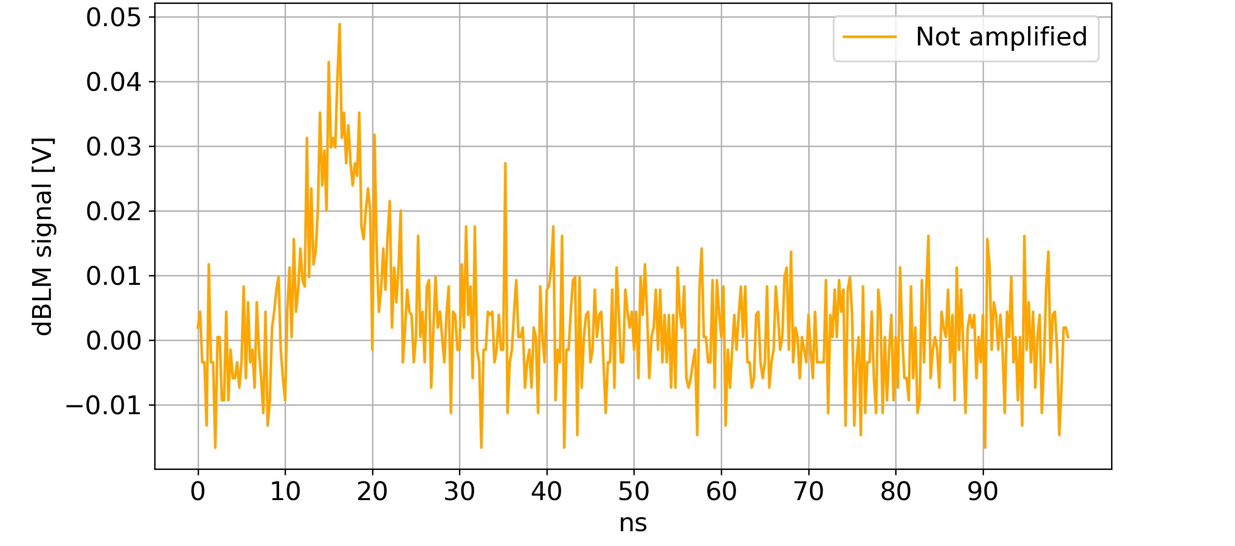
MD#6949: Validation of bunch-by-bunch diamond detectors functionalities
1.5V -> Saturation value for the amplified signal
What is the future use of the MD?
  Characterisation of the system limitations regarding sensitivity
Amplified signal oversaturated and amplified signal still low
Study and selection of the optimal amplification gain!

Slide 7
MD#6949: Validation of bunch-by-bunch diamond detectors functionalities
What is the future use of the MD?
  Development of a correction mechanism for the bunch-overlap in the diamond detector signal, allowing to obtain an accurate value of the bunch-by-bunch losses
  Characterisation of the system limitations regarding sensitivity -> Amplifier selection
  Understanding of different firmware functionalities like UFO-event auto-trigger, BST bunch selection on the capture, etc
Why should it be now, as floating MD, or could it be moved to a later MD block?
  It can be moved to a future MD block in 2022
Any special beam / hardware requirements?
  Yes. Injected trains with 12 bunches spaced by 25 ns. Blowup of selected bunches with the ADT transverse damper and trigger capture data of diamonds.
  Move primary collimators in IP7 and TCSP in IP6 in order to localise the losses in IP7 or IP6.
Are you ready?
  Yes. Detectors and electronics already installed in the LHC.

