Slide 1
Electron cloud studies in the Floating MDs
Konstantinos Paraschou, Sofia Johannesson, Giovanni Iadarola, Lotta Mether, Luca Sabato
MD#6843: First instability measurements before scrubbing with 1 train MD#6924: Slow beam degradation from incoherent electron cloud effects
1

Slide 2
MD#6843:
First instability measurements before scrubbing with 1 train
Goal: Characterize electron cloud instabilities at injection energy:
Instability growth rate vs 1) Chromaticity, 2) Octupole current, 3) Transverse Damper
Attitude opposite to scrubbing - we want to observe instabilities. In scrubbing, beam is kept stable as much as possible.
Merits:
Crucial benchmark for the modelling of coherent beam instabilities driven by electron clouds.
Provide important input (optimal stabilization strategy) for a most efficient scrubbing run.
Time:
MD needs to happen before scrubbing in order to observe instabilities with 48/72 bunches. Small number of bunches: 1) limits total intensity, 2) minimizes delay between measurements. 1 shift of 8 hours.
Hardware: FBCT, BSRT, ADT ObsBox, Head-tail monitor, Wire scanner
We are ready.
2

Slide 3
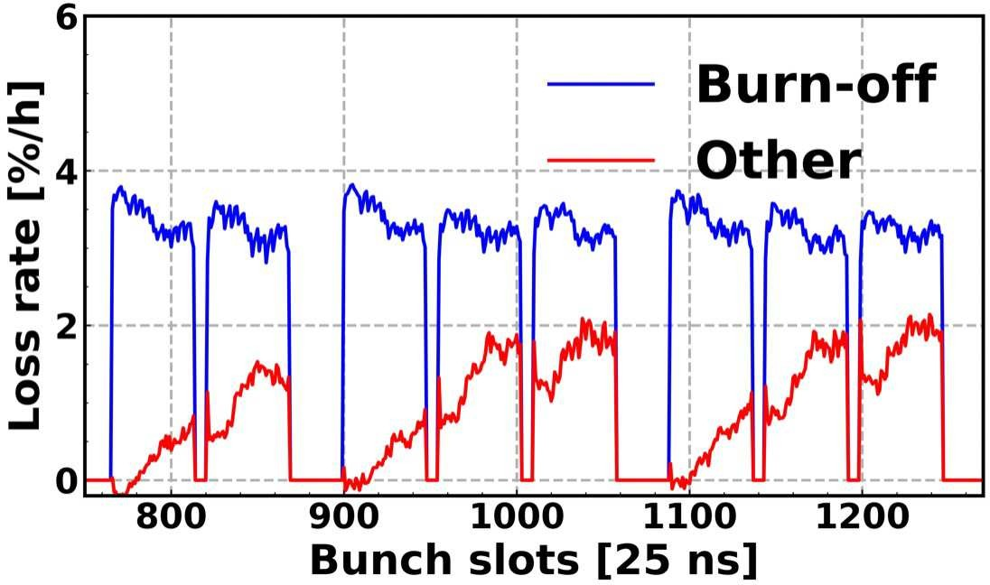
MD#6924:
Slow beam degradation from incoherent electron cloud effects - preparation
Motivation: E-cloud is observed to cause significant losses during stable beams.
Recent advances in simulation allow us to simulate incoherent effects (slow losses and emittance growth).
Need experimental data to validate modelling, starting at injection energy.
Goal:
Measurement of beam lifetime and slow emittance growth with multiple trains at injection:
Approaching of 3Qy resonance.
Measure for different betatron tune, chromaticity, octupole strength, linear coupling.
Measurements with large and small emittances at nominal intensity (to be set-up in the PSB)
3

Slide 4
MD#6924:
Slow beam degradation from incoherent electron cloud effects - preparation
Floating MD: Before using bunch trains, we want single bunches to study underlying effects in absence of electron clouds.
Characterization and compensation of 3Qy resonance in the absence of electron cloud (strong synergy with nonlinear optics MD#6904)
Exploration of parameter space (betatron tune, chromaticity, octupole strength, linear coupling).
Time:
  4 hours in FMD. (MD#6924) Ideally separate from second part to ensure enough time for analysis and troubleshooting.
  8 hours in MD1. (MD#6923) for the study with multiple trains. MD1 preffered over MD2 due to stronger e-clouds (machine will have been scrubbed less).
Hardware: FBCT, BSRT, ADT (Expert support for the configuration when changing Q)
We are ready.
4

