Slide 1
Organizational Issues
Coordinators: Ralph Assmann (CERN/EuCARD)
Jens Osterhoff (U. Hamburg/DESY)
Henri Videau (ecole Polytechnique)
Scientific secretary: Steffen Hillenbrand
Will help with talk upload, minutes, other scientific issues
Merethe Morer-Olafsen, Nadine Andrey, Delphine Rivoiron gave crucial help. Many thanks. Also very busy with other work…
Lunch: Walk over to CERN Restaurant 2.
Welcome drink (today 18h00) and dinner (Wed): see program.
Access cards: Conference badge serves as access card.
  External visitor: Collect at reception.
  CERN registered: Collect at workshop.
Please see us for any requests, proposals, …

Slide 2
European Network on Novel Accelerators
1st CERN EuroNNAc Workshop
Ralph W. Aβmann
CERN, 3.5.2011
http://www.cern.ch/euronnac

Slide 3
EuroNNAc 2011
Number of registrants: 92
Europe:
  11 countries
  FRANCE , GERMANY, HUNGARY, ITALY, NETHERLANDS, PORTUGAL,
  ROMANIA, RUSSIA, SWEDEN, SWITZERLAND, UNITED KINGDOM
  37 institutes
Outside Europe:
  3 countries
  CHINA, JAPAN, UNITED STATES OF AMERICA
  11 institutes
Thanks to the EuroNNAc organization committee!

Slide 4
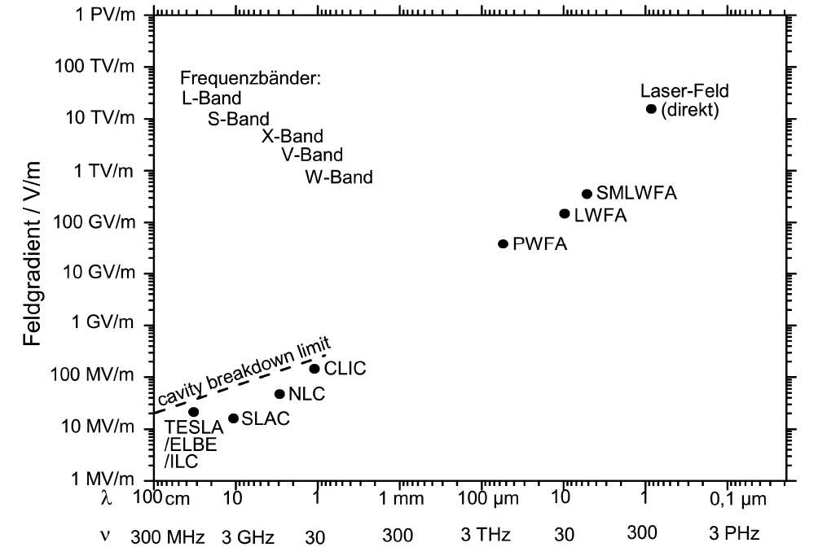
Very Successful Field…
Plasma walls cannot be destructed!
Conventional metallic RF structures are fundamentally limited!
B. Hidding

Slide 5
Very Successful Field…
The dream: Build accelerators 100-1000 times more compact.
A compact synchrotron light accelerator (FEL, …) for each university lab and industry!
Compact (and affordable) TeV colliders for high energy physics.
Compact medical accelerators.
Plasma walls cannot be destructed!
Conventional metallic RF structures are fundamentally limited!
B. Hidding

Slide 6
…but also very diverse.
Plasma Science
Laser Science
Ultra-fast Science
Accelerator Science

Slide 7
…but also very diverse.
Plasma Science
Laser Science
Many challenges:
Different notations, language and scientific cultures.
Different goals (scientific achievement versus building operational accelerators).
More centralized “big science” versus more decentralized university-based research.
Complex, inter-disciplinary science problems.
Ultra-fast Science
Accelerator Science

Slide 8

Identify
synergies
Plasma Science
Laser Science
EuroNNAc
European proposal for facility
Build bridges
European Network for Novel Accelerators
Ultra-fast Science
Accelerator
Science
Define
roadmap

Slide 9
Network Boundary Conditions
Network combines synchrotron radiation and particle physics uses.
Focus on novel methods for e⁻ acceleration (ion/p not included):
  Higher chance of success if we focus on one particle type!
  Only after it works reliably for science applications, medical applications become realistic!
Network must be open to all interested parties in Europe!
No selection of members!
Network invites main actors in Asia/US for discussion and decisions!
Selected international experts will be invited to organization committee.

Slide 10
Network Goals I
Comparison of different methods to drive plasma wakefields and dielectric structures: lasers, electron beams, proton beams.
  Investigate an optimal strategy in combining different technologies for a novel accelerator facility.
Description of required R&D that is still needed for verifying various technologies and establishing the required technological basis.
  What work can and should be done at universities?
  Is help from large research facilities required?
  How could existing large accelerator infrastructure be used to best advance the field of novel acceleration?
Roadmap towards a novel beam test facility with first test applications (medical, synchrotron, ultra-fast science).
  Is a European test facility needed to complement the ongoing US efforts (BELLA/LBNL and FACET/SLAC projects)?
  How to combine efforts inside Europe but also with the US and Asia to best advance the field?

Slide 11
Network Goals II
Roadmap towards high energy physics applications with intermediate applications for applied science.
  How can a 1 – 10 GeV beam test facility be best used for developing ultra-high gradient technology for high energy physics?
Coordination of European expertise towards one or several test facilities, including close collaboration with the US and Asian communities.
  Define coherent goals to focus efforts.
  Make use of synergy between institutes and labs.
  Build bridges from the accelerator world to the ELI project.

Slide 12
Timeline | Milestone
May 2011 (first week) | EuroNNAc Workshop at CERN: Review activities and discuss strategy
Jun 2011 | First small initiative(s) into EuCARD2, if possible
Jun 2011 – 2012 | Prepare coherent European strategy, maximizing synergy and maintaining productive competition
2012 – 2013 | Agree on possibilities for a substantial FP8 proposal, prepare proposal

Slide 13
Goals of Workshop
Initial network creation in coherence with existing European & international activities (ICFA, ICUIL, ELI, …)
Define draft goals, both general and specific: First idea on possible FP8 proposal on test facility
Prepare the creation of a steering committee (request expression of interest from institutes)
Prepare writing of white paper on “Draft European Strategy on Novel e-Beam Acceleration”
Define next steps

Slide 14
Format of Workshop
Diversity requires to first provide overview: status and plans in Europe and the world (Tuesday & Wednesday).
Use discussion, coffee breaks, welcome drink, dinner to digest information and build common understanding.
Working day is Thursday: most of time free for discussion and ad-hoc presentations! Prepare your input, announce to us and present Thursday!
Summary is Friday morning.

Slide 15
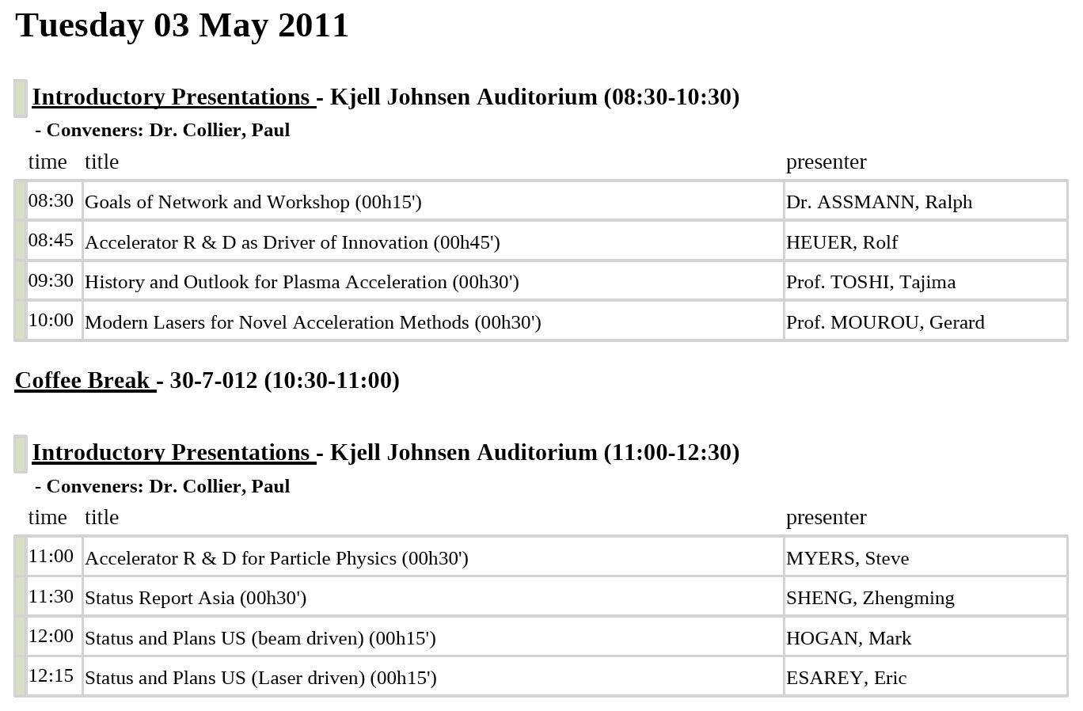
Program Workshop…

Slide 16
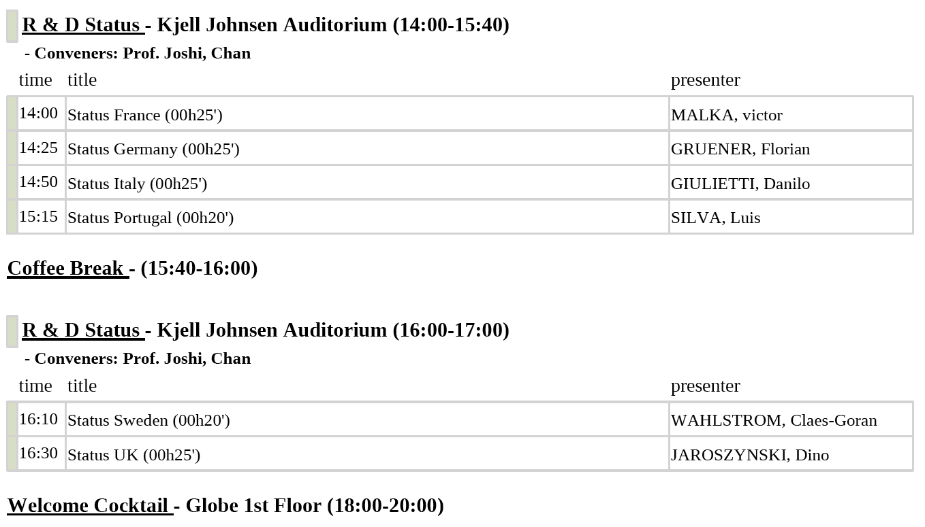
Program Workshop…

Slide 17
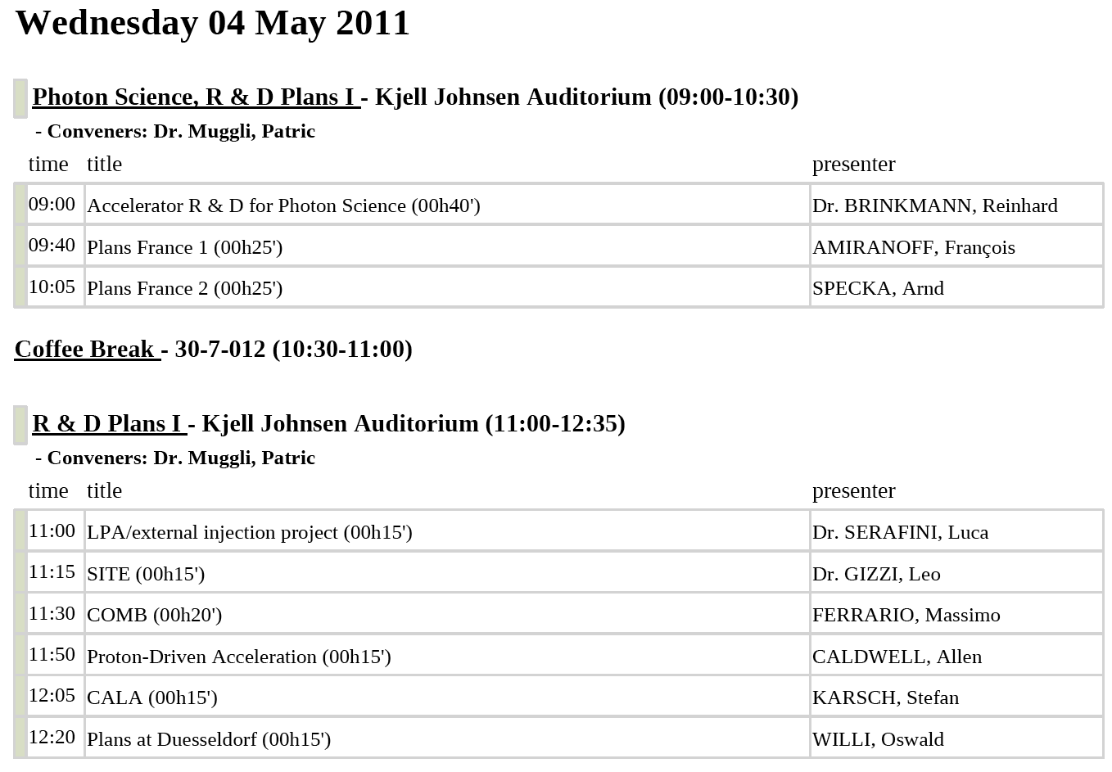
Program Workshop…

Slide 18
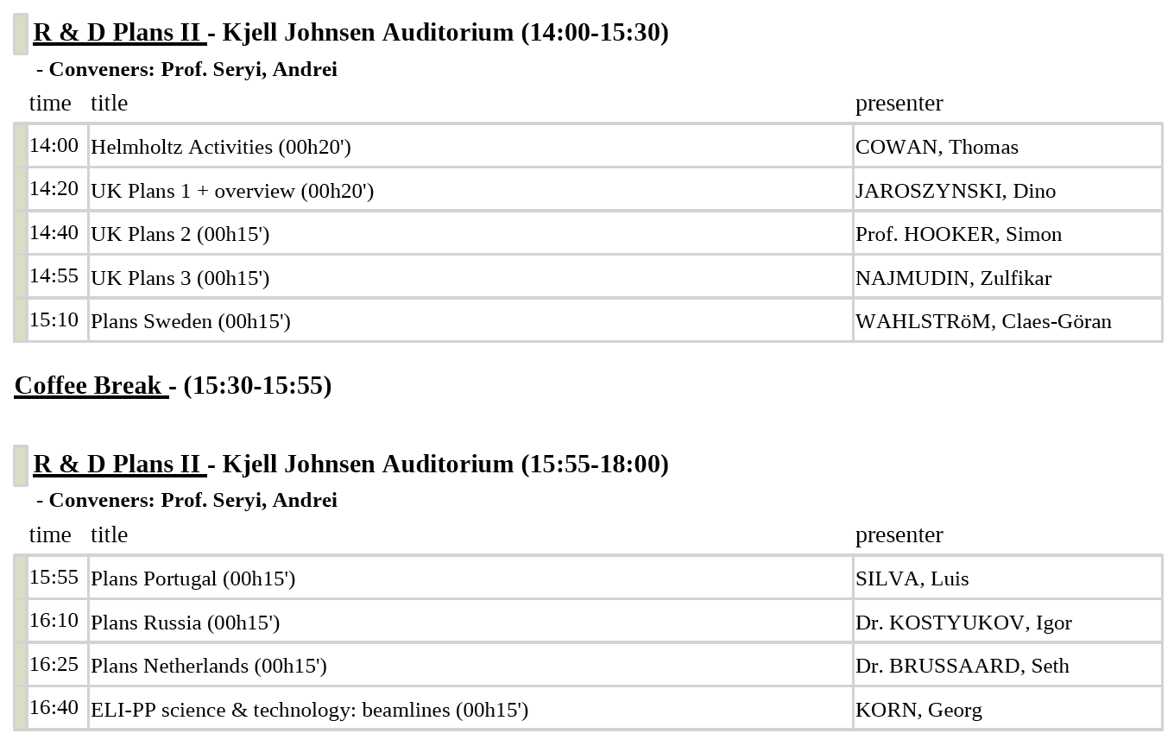
Program Workshop…

Slide 19
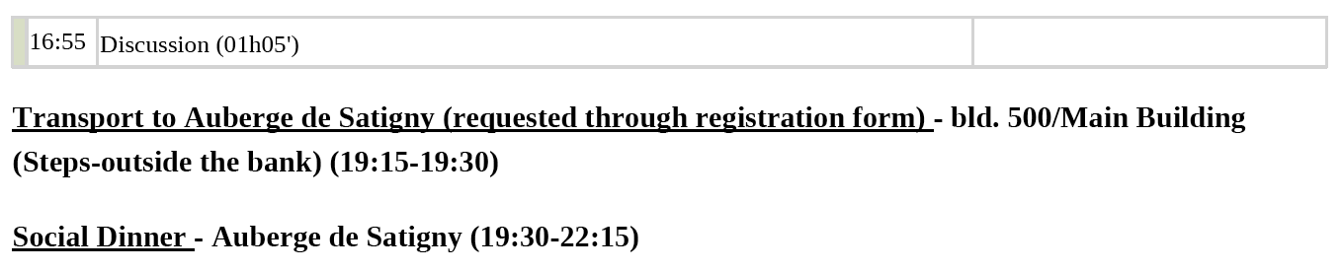
Program Workshop…

Slide 20
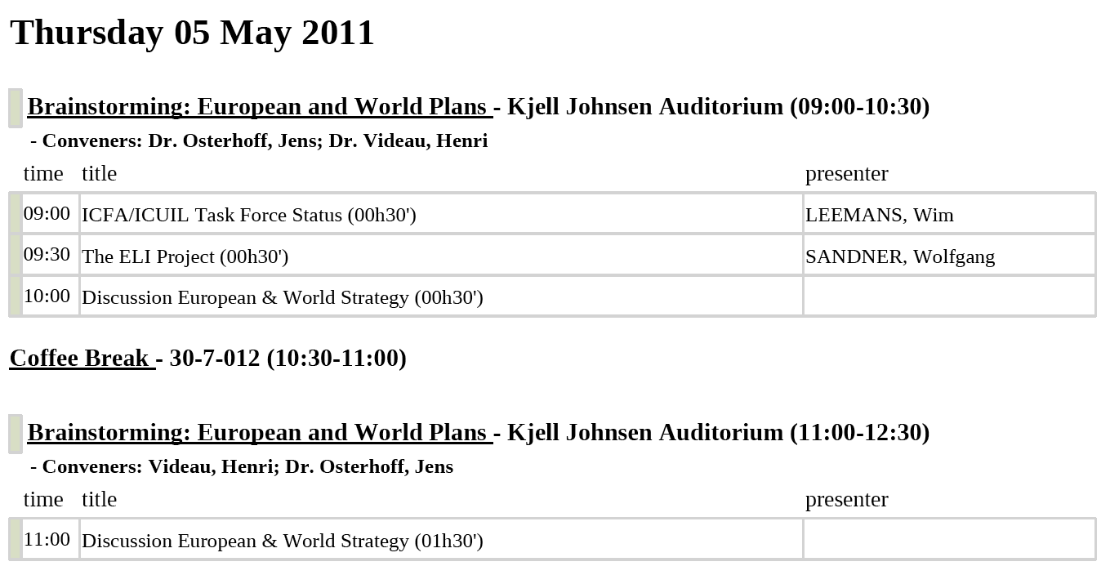
Program Workshop…
➔ 2 h free for discussions and additional short presentations (~5 min)

Slide 21
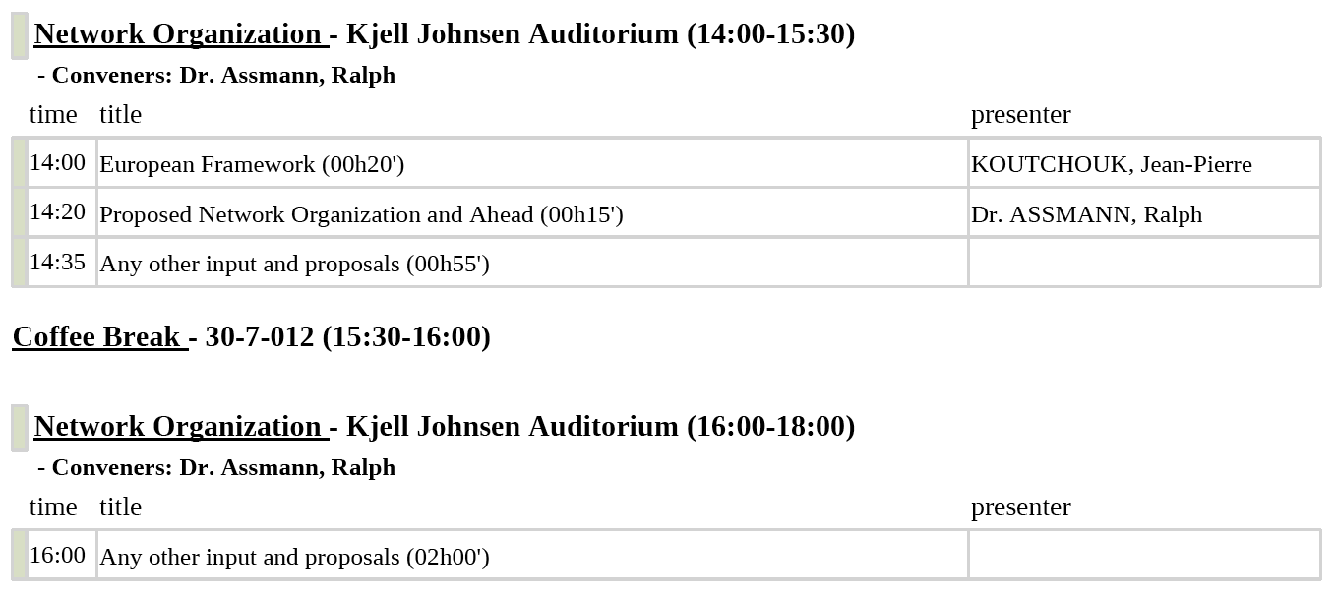
Program Workshop…
➔ 2h55 free for discussions and additional short presentations (~5 min)

Slide 22
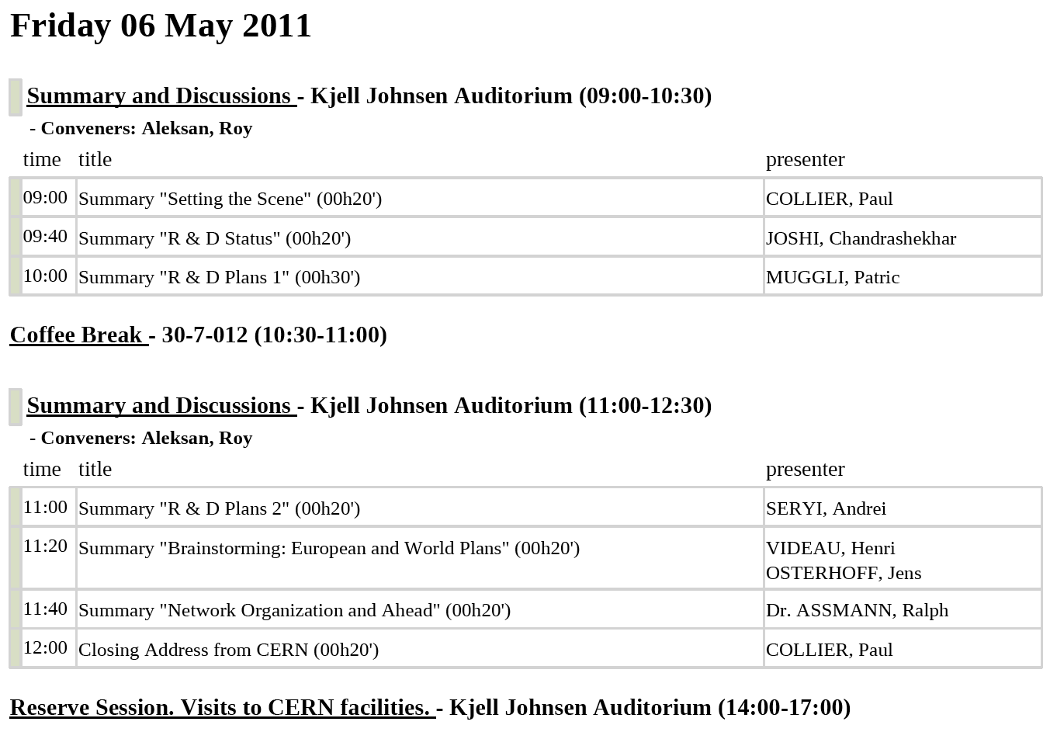
Program Workshop…

Slide 23
Thanks…

Slide 24
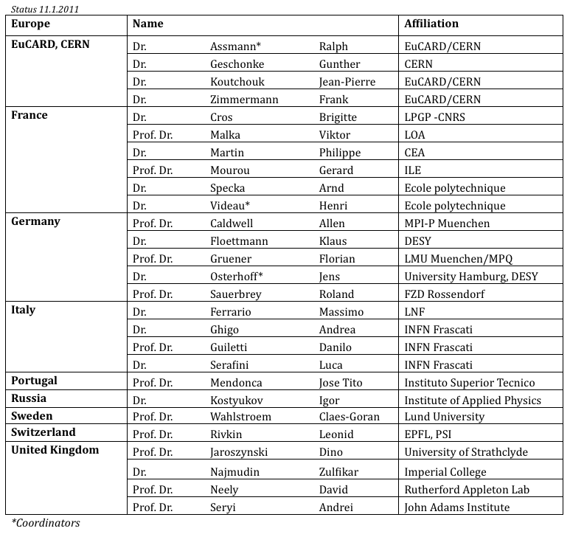
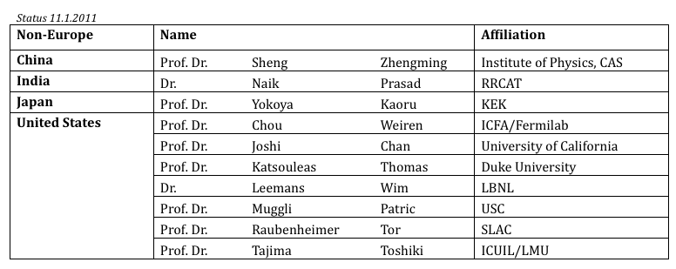
Organization Committee
… thanks to the EuroNNAc organization committee for help in organization of this workshop!

Slide 25
Towards Applications: My View
(Advanced Lepton Acceleration)
R&D on p⁺ driven acceleration
R&D on e⁻driven acceleration
R&D on laser driven acceleration
Advanced synchrotron light source
Adv. medical e⁻ acc.
Adv. HEP
acc.
Huge community out there: Lasers can be bought from industry. Many universities and labs active!
Stability
Adv. laser inj. (0.1 – 1 GeV)
Proof of principle
Acc. Labs: SLAC, LBNL, DESY, KEK, France, UK, Italy, CERN, …
Tests
Tests
Staged adv. acc.
Stability
γ
Classical undulator
ε growth
First ideas for pro-posals (e.g. SOLEIL, Germany, Italy, …)
CERN and collaborators
EuroNNAc
One or several? EuroNNAc proposal for Europe in 2013?
Plasma undulator
Staging
γ
Av. power, eff. & cooling
Pilot facility with reserved time for medical and HEP accelerator tests!
Pilot facility
Established technology now ripe for medical treatments.
ε growth
Established technology then extended to High Energy Physics applications
Reliability
Reliability
High power, eff. & cooling
Pilot facility
Tests

