Slide 1
Optics measurements & correction in the old ESRF storage ring (2010-2018)
Andrea Franchi (ESRF, Grenoble)
mini-workshop on FCC-ee optics tuning and alignment, 11-12 May 2022

Slide 2
Outlines
Understanding & correcting linear coupling (2009-2010)
Nonlinear optics & magnet calibration via turn-by-turn (TbT) BPM data (2010-2013)
Error analysis of linear optics measurements via orbit & TbT analysis (2016-2017)
Applications of AC Orbit data (2016-2019)
Experience of AC dipole & TbT BPM data (2016-2018)

Slide 3
Outlines
Understanding & correcting linear coupling (2009-2010)
Nonlinear optics & magnet calibration via turn-by-turn (TbT) BPM data (2010-2013)
Error analysis of linear optics measurements via orbit & TbT analysis (2016-2017)
Applications of AC Orbit data (2016-2019)
Experience of AC dipole & TbT BPM data (2016-2018)

Slide 4
Understanding & correcting linear coupling
Misconception #1: In the presence of coupling we deal with vertical emittances (plural is not a typo)
Misconception #2: Coupling correction is a linear problem not needing CPU-intense random/genetic/non-linear optimizers
Misconception #3: Guignard formulas don’t apply to modern synchrotron light sources & damping rings (integer part of tunes Q_{x}>>Q_{y})
Misconception #4: “indirect measurements” of vertical emittance should be avoided

Slide 5
Understanding & correcting linear coupling
Misconception #1: In the presence of coupling we deal with vertical emittances (plural is not a typo)
Misconception #2: Coupling correction is a linear problem not needing CPU-intense random/genetic/non-linear optimizers
Misconception #3: Guignard formulas don’t apply to modern synchrotron light sources & damping rings (integer part of tunes Q_{x}>>Q_{y})
Misconception #4: “indirect measurements” of vertical emittance should be avoided

Slide 6
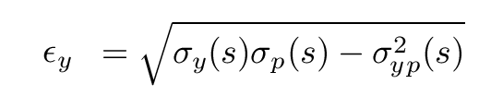
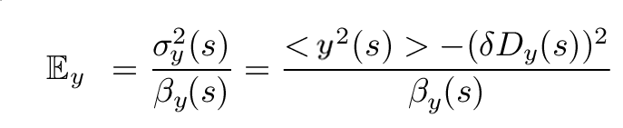
Understanding & correcting linear coupling
Vertical emittance in the absence of coupling
Eigen-emittance E: constant along the ring, with Ev≅0
Non measurable RMS emittance:
Measurable emittance from RMS beam size:
Ev=εy=Ey=const.
With zero vertical dispersion, Ev=εy=Ey≅0

Slide 7
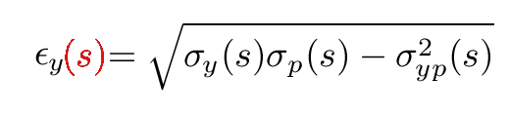
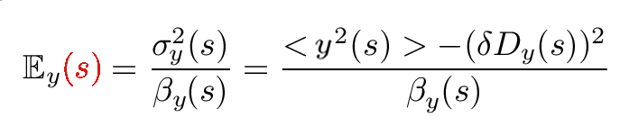
Understanding & correcting linear coupling
Vertical emittances in the presence of coupling
Eigen-emittance E: constant along the ring, but Ev≠0
Non measurable projected s-dependent RMS emittance:
Measurable apparent s-dependent emittance from RMS beam size:
Ev=const ≠ εy(s) ≠ Ey(s)

Slide 8
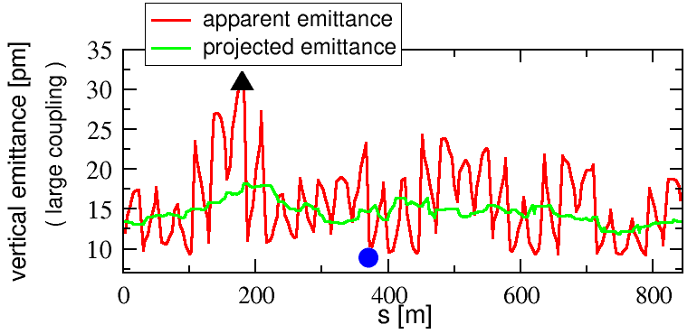
Understanding & correcting linear coupling
Vertical emittances in the presence of coupling
Measurable apparent emittance:
Non measurable projected emittance:
Lattice errors from Orbit Response Matrix measurement + Accel. Toolbox
eigen-emittance
Ev= 9 pm

Slide 9
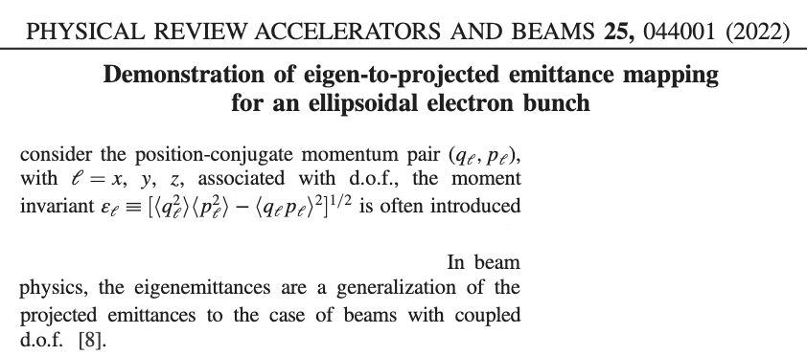
Understanding & correcting linear coupling
Vertical emittances in the presence of coupling
Measurable apparent emittance:
Non measurable projected emittance:
Lattice errors from Orbit Response Matrix measurement + Accel. Toolbox

Slide 10
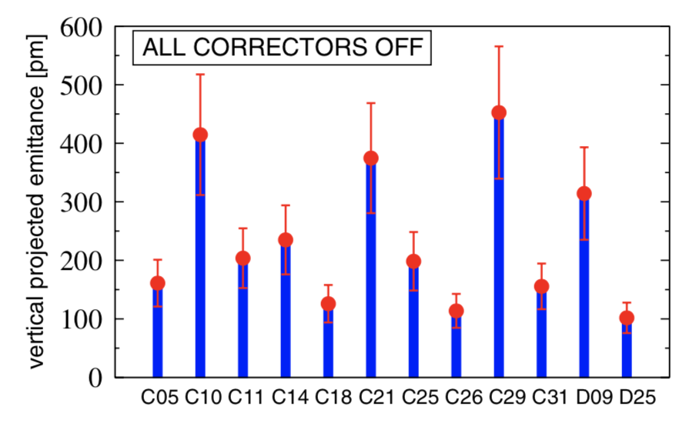
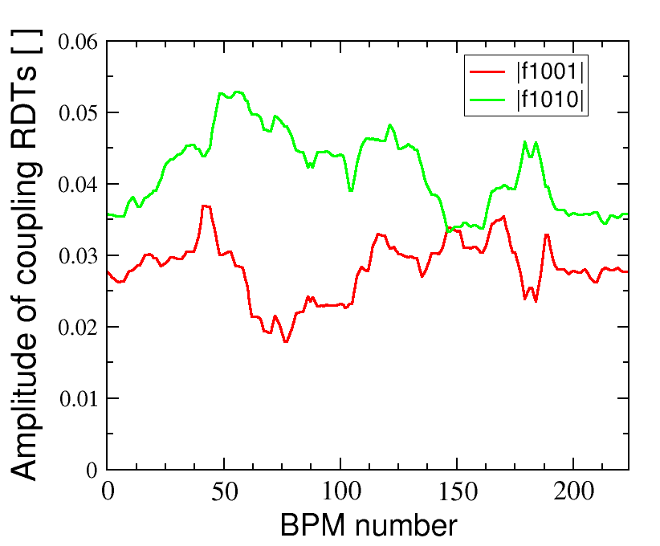
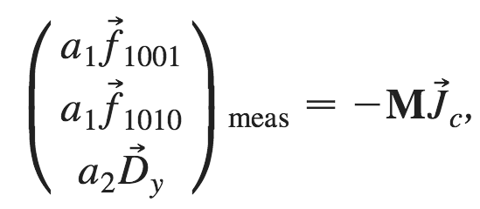
Understanding & correcting linear coupling
Coupling correction is a linear problem not needing CPU-intense random/genetic/non-linear optimizers
all skew quad correctors OFF ε_{y}/ε_{x} ~ 5%
C*, D*: emittance monitors

Slide 11
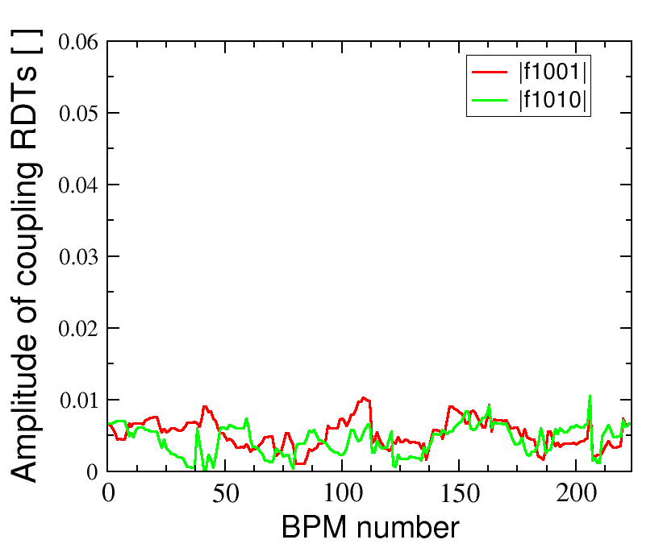
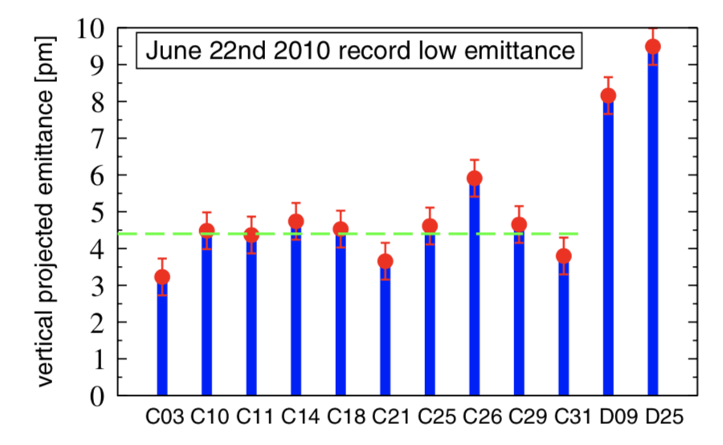
Understanding & correcting linear coupling
Coupling correction is a linear problem not needing CPU-intense random/genetic/non-linear optimizers
after correction ε_{y}/ε_{x} ~ 1‰
~20 min. for ORM
a few seconds for RDT correction
C*, D*: emittance monitors

Slide 12
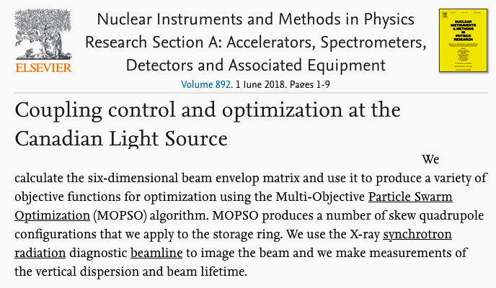
Understanding & correcting linear coupling
Coupling correction is a linear problem not needing CPU-intense random/genetic/non-linear optimizers
after correction ε_{y}/ε_{x} ~ 1‰
~20 min. for ORM
a few seconds for RDT correction
C*, D*: emittance monitors

Slide 13
Outlines
Understanding & correcting linear coupling (2009-2010)
Nonlinear optics & magnet calibration via turn-by-turn (TbT) BPM data (2010-2013)
Error analysis of linear optics measurements via orbit & TbT analysis (2016-2017)
Applications of AC Orbit data (2016-2019)
Experience of AC dipole & TbT BPM data (2016-2018)

Slide 14
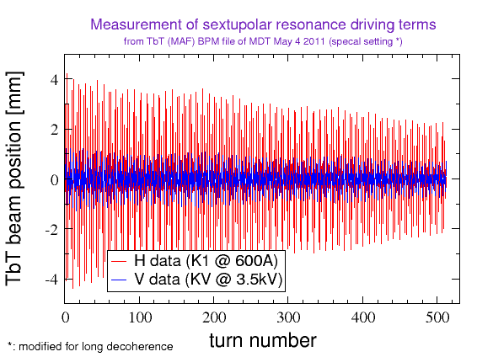
Nonlinear optics & magnet calibration
Get synchronized and decent⁽*⁾ TbT BPM data in both planes
(*) from nonlinear optics with zero chromaticity and zero (linear) amplitude-dependent detuning

Slide 15
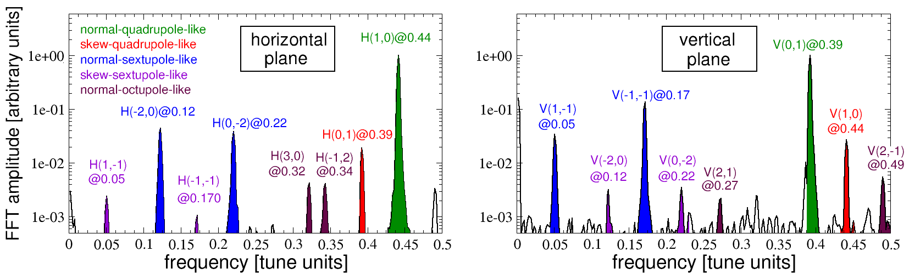
Nonlinear optics & magnet calibration
Perform a suitable FFT of the TbT data & look at the lines popping up in the spectra

Slide 16
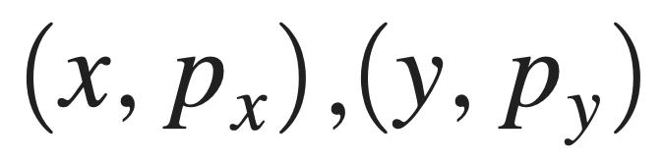
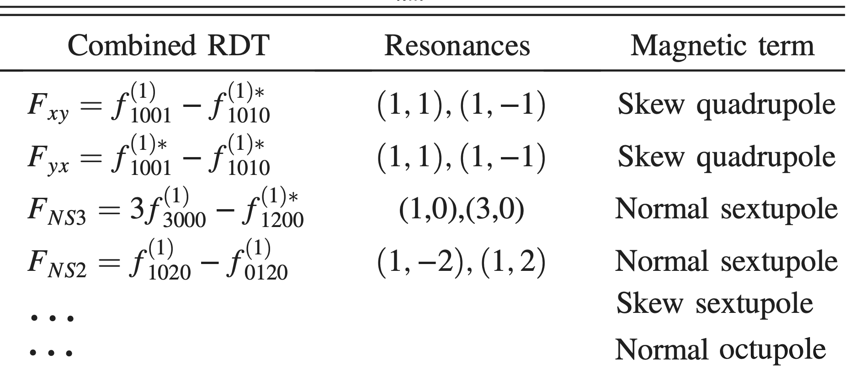
Nonlinear optics & magnet calibration
RDTs require
CRDTs require
less information, but no systematic error from p_{x,y}
from the spectral lines infer the combined resonance driving terms (CRTDs) @ all BPMs

Slide 17
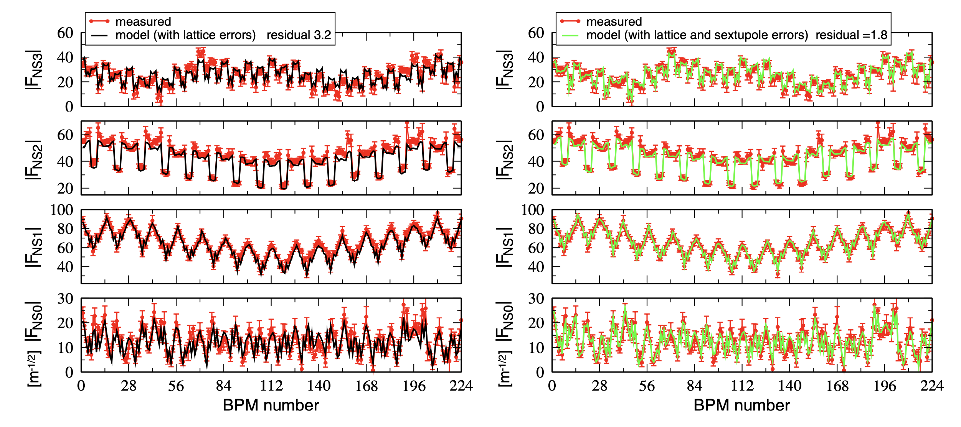
Nonlinear optics & magnet calibration
Compare & fit measured & model CRDTs

Slide 18
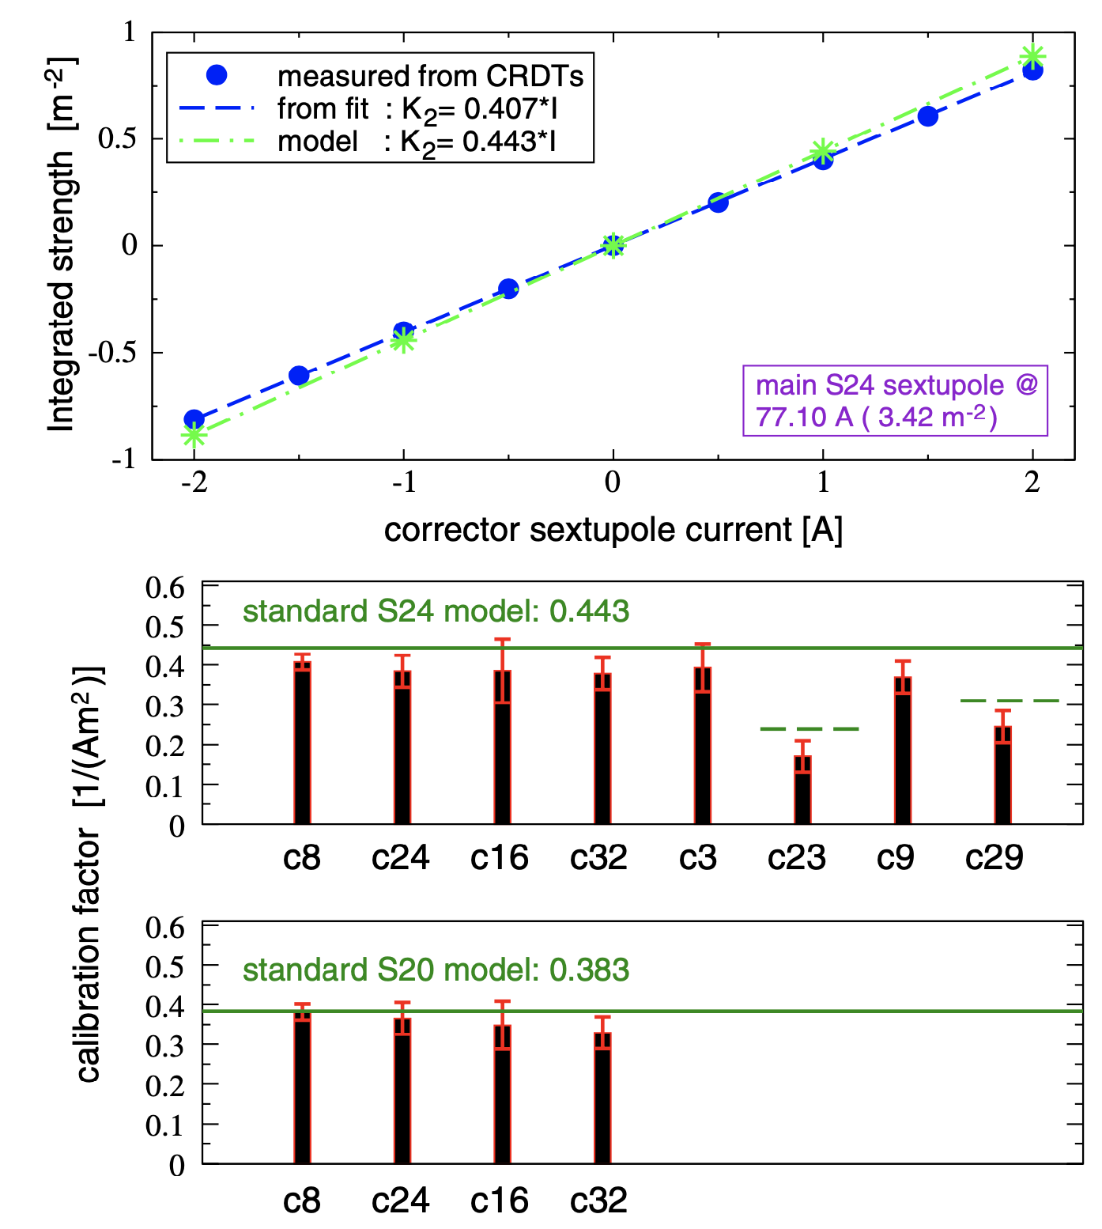
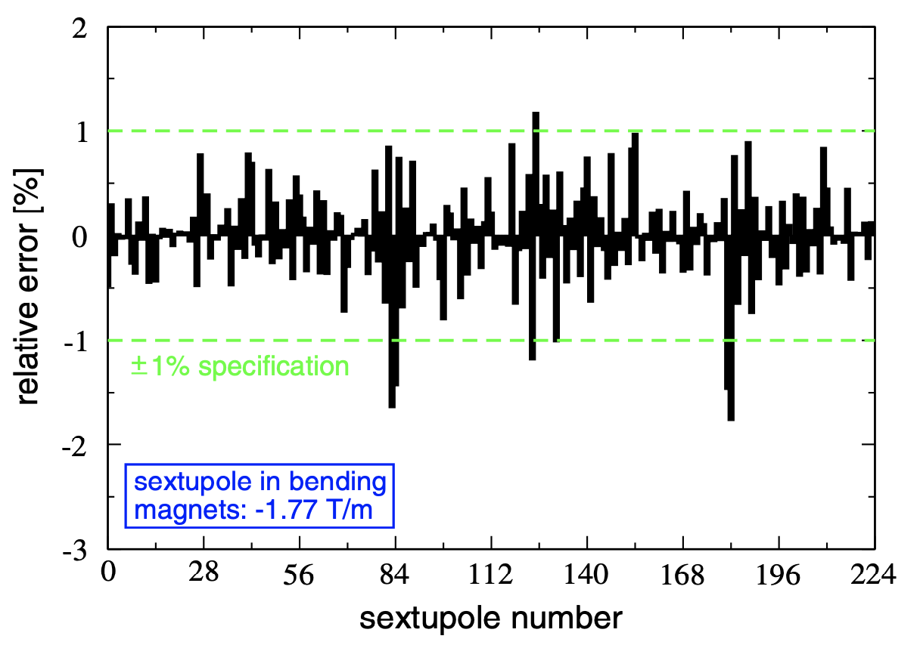
Nonlinear optics & magnet calibration
Compute your sextupole error model or calibrate individual magnets

Slide 19
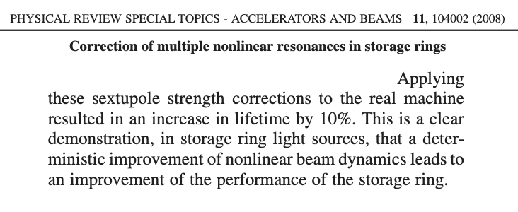
Nonlinear optics & magnet calibration
(optionally) correct your sextupole error model & check beam lifetime
@ Diamond light source

Slide 20
Nonlinear optics & magnet calibration
Not @ESRF: minor lifetime increase in low-intensity-per-bunch mode, detrimental for Touschek-dominated modes
(optionally) correct your sextupole error model & check beam lifetime
@ Diamond light source

Slide 21
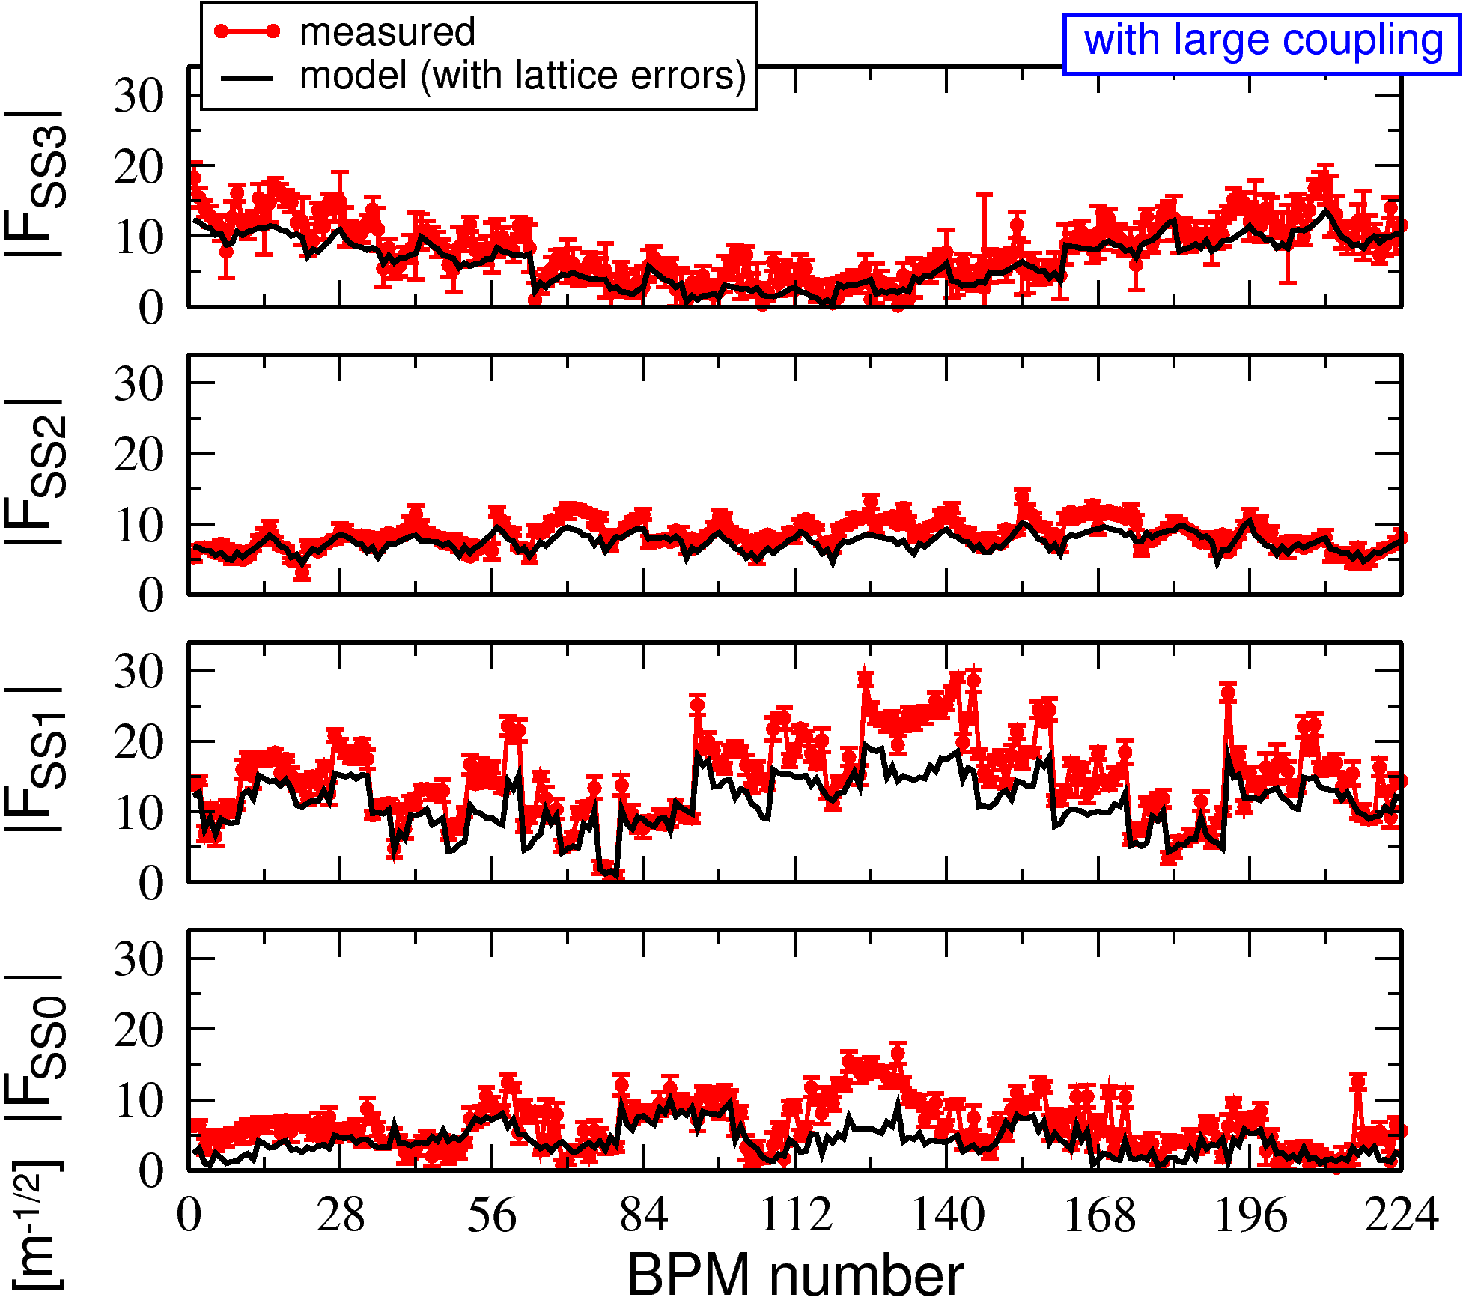
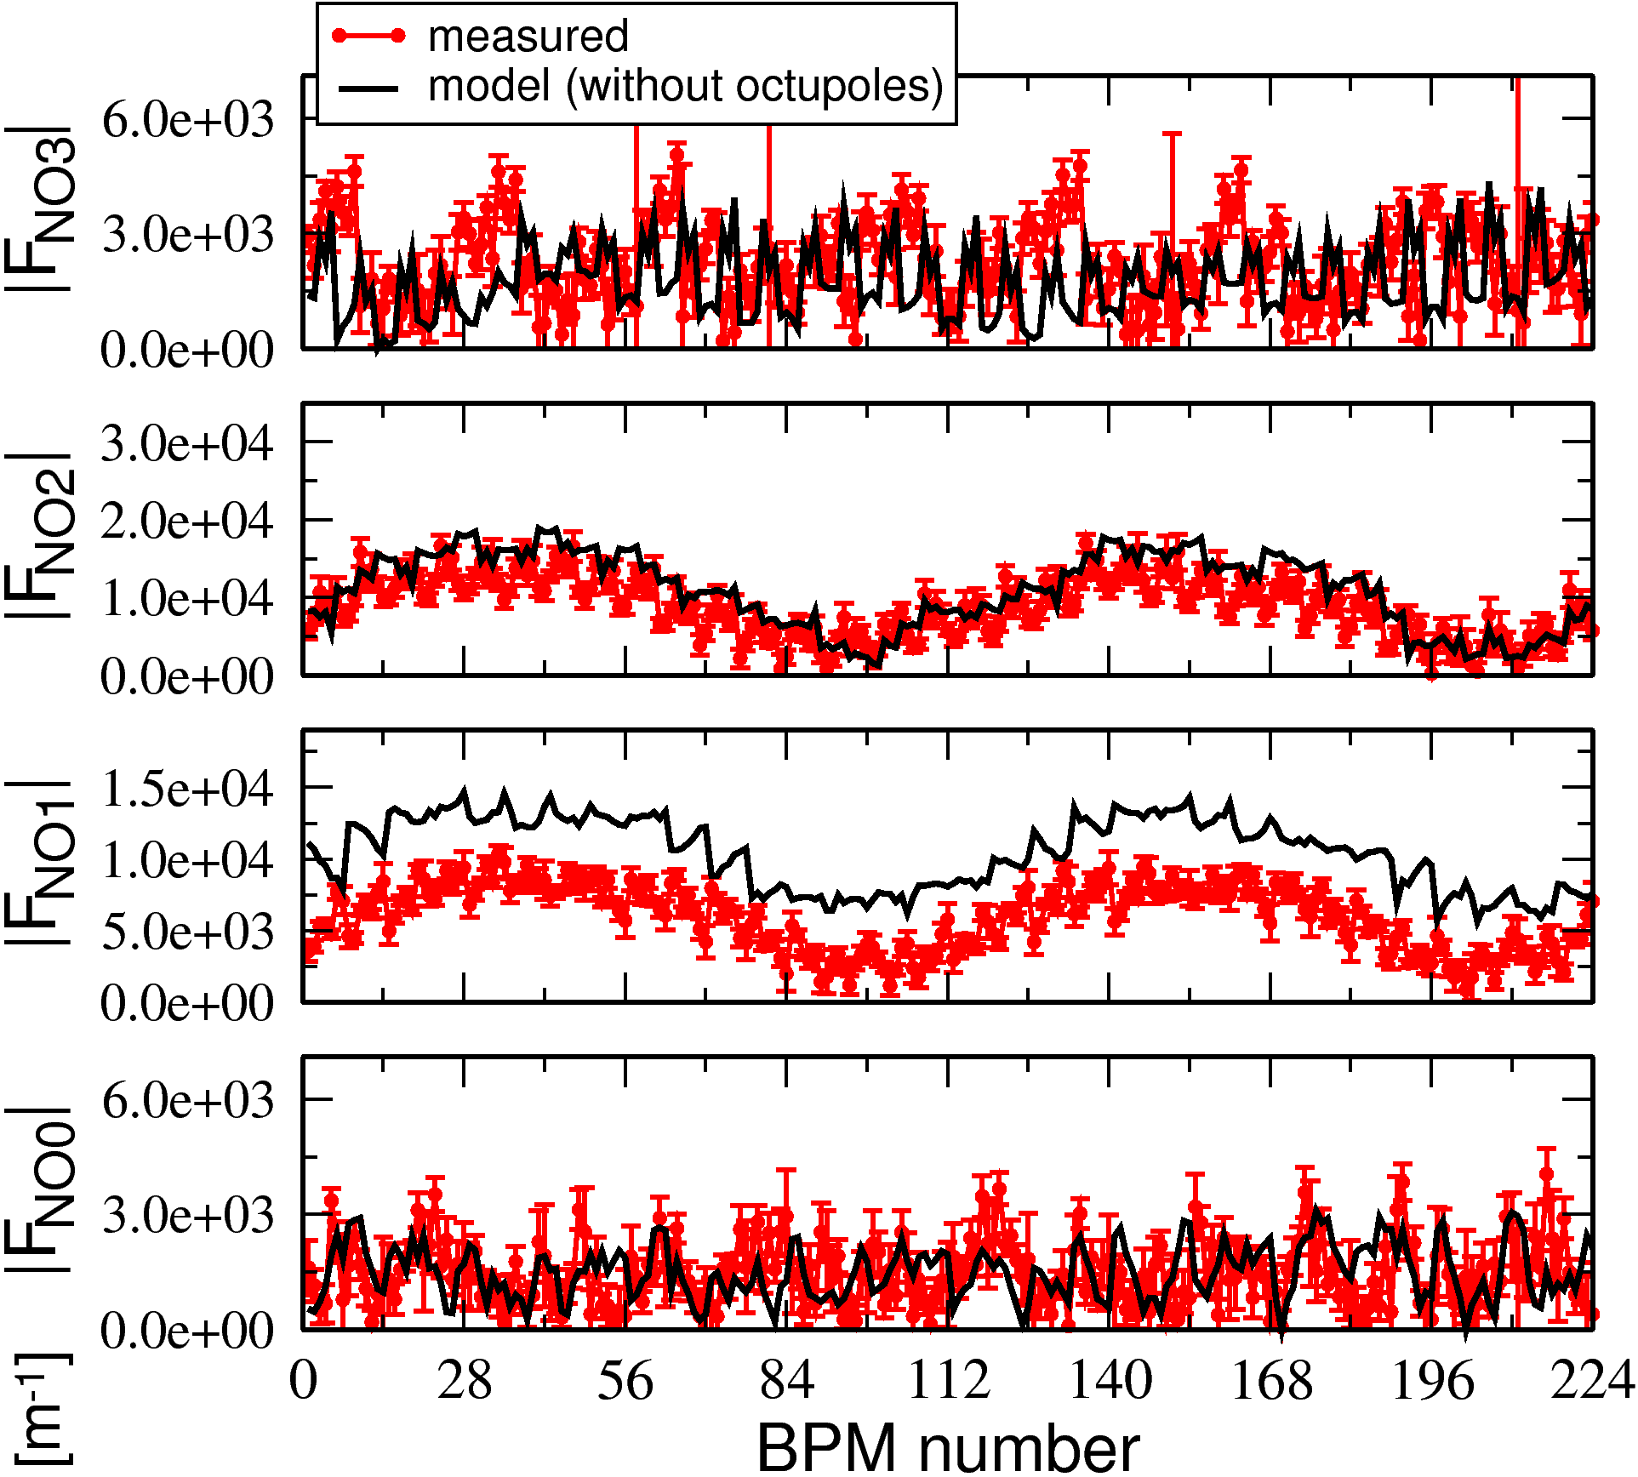
Nonlinear optics & magnet calibration
(for fun) measure second-order terms
skew sextupole CRDTs
normal octupole CRDTs

Slide 22
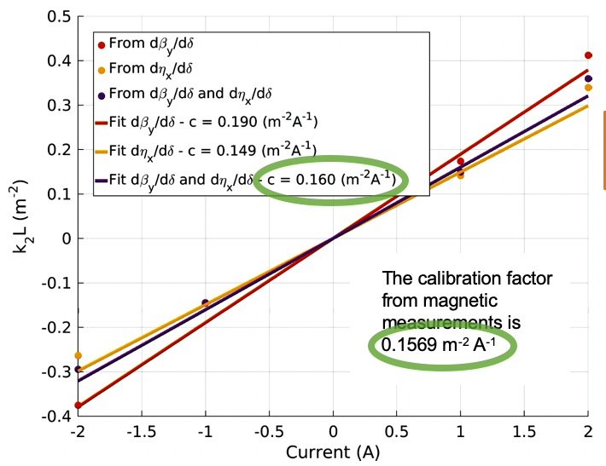
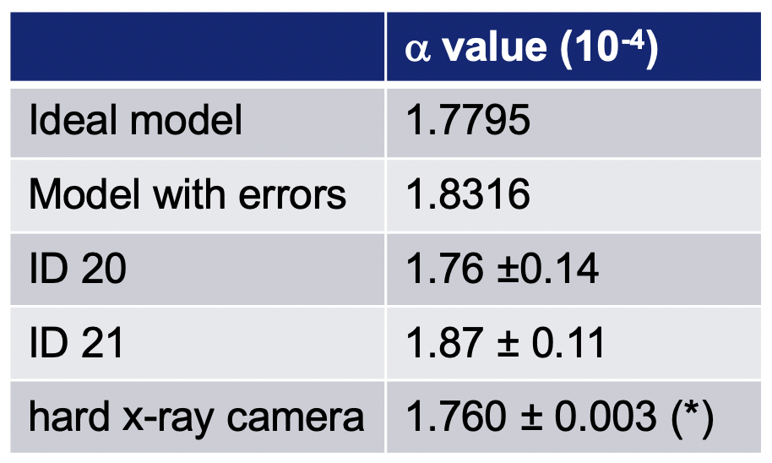
Nonlinear optics & magnet calibration
Digression: a similar beam-based sextupole calibration performed via measurement & fit of off-energy ORM (chromatic functions dβ/dδ, D’, Q’)
momentum compaction
collaboration with Laura Torino & Nicola Carmignani

Slide 23
Outlines
Understanding & correcting linear coupling (2009-2010)
Nonlinear optics & magnet calibration via turn-by-turn (TbT) BPM data (2010-2013)
Error analysis of linear optics measurements via orbit & TbT analysis (2016-2017)
Applications of AC Orbit data (2016-2019)
Experience of AC dipole & TbT BPM data (2016-2018)

Slide 24
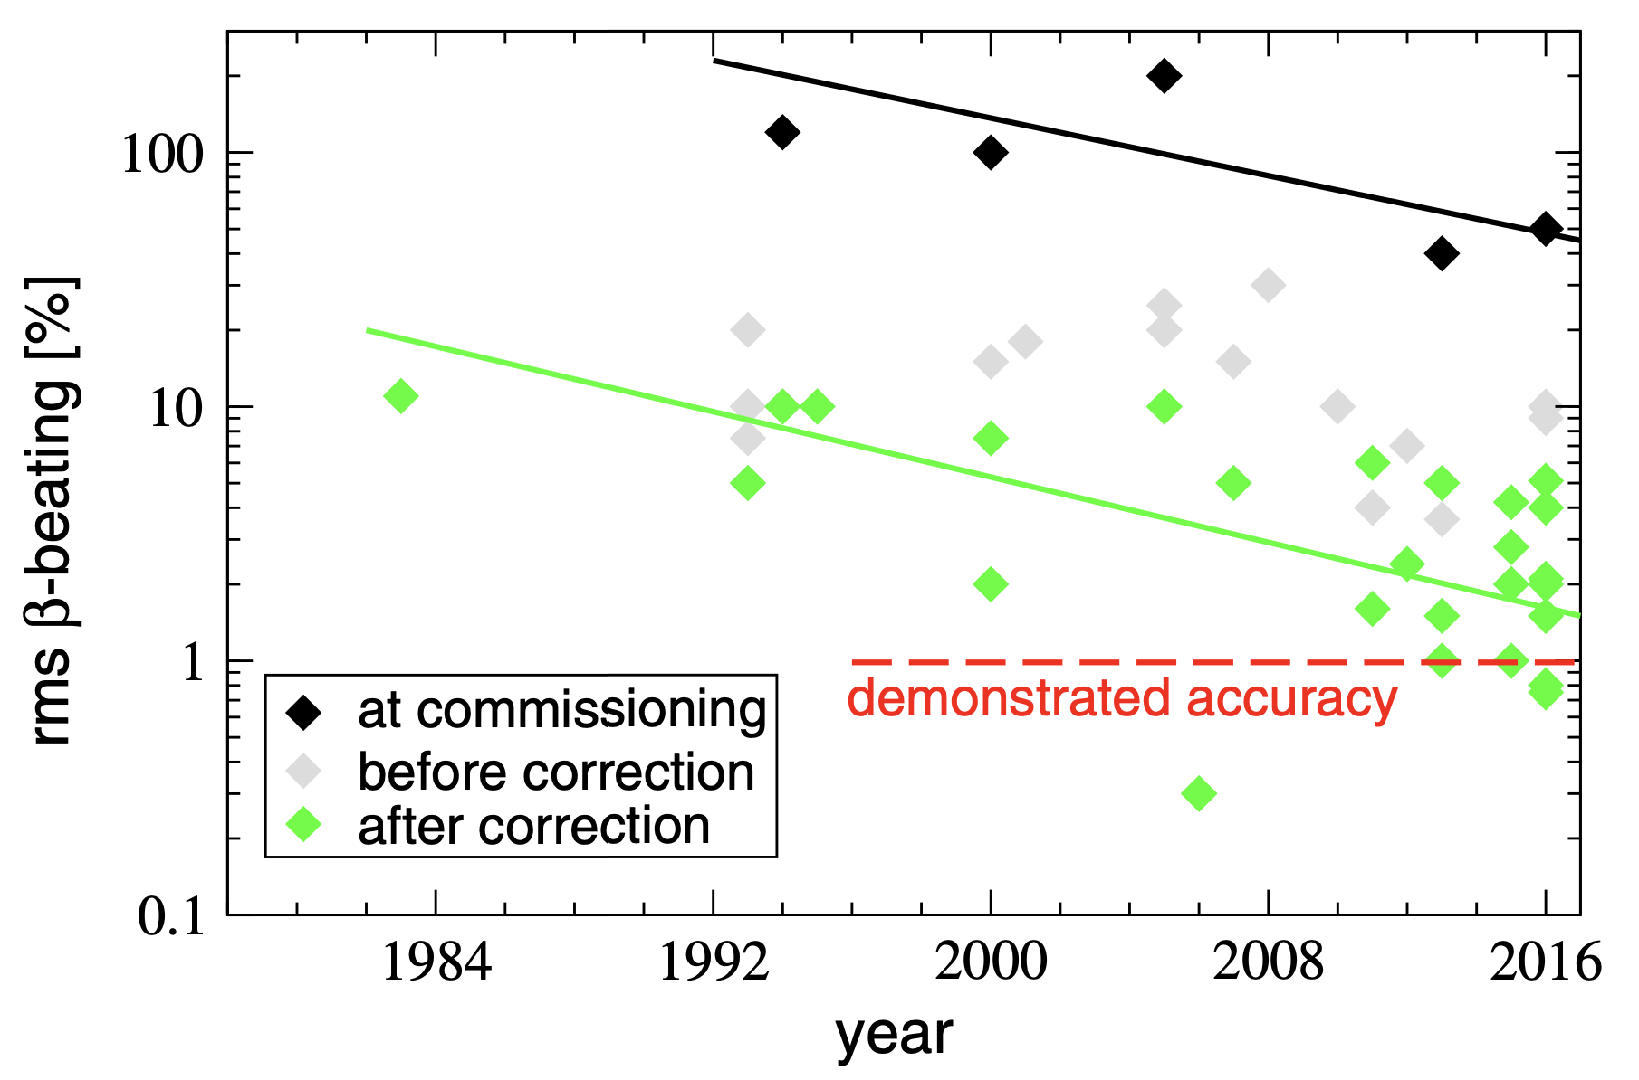
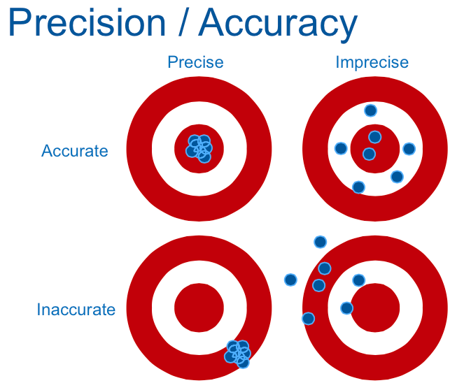
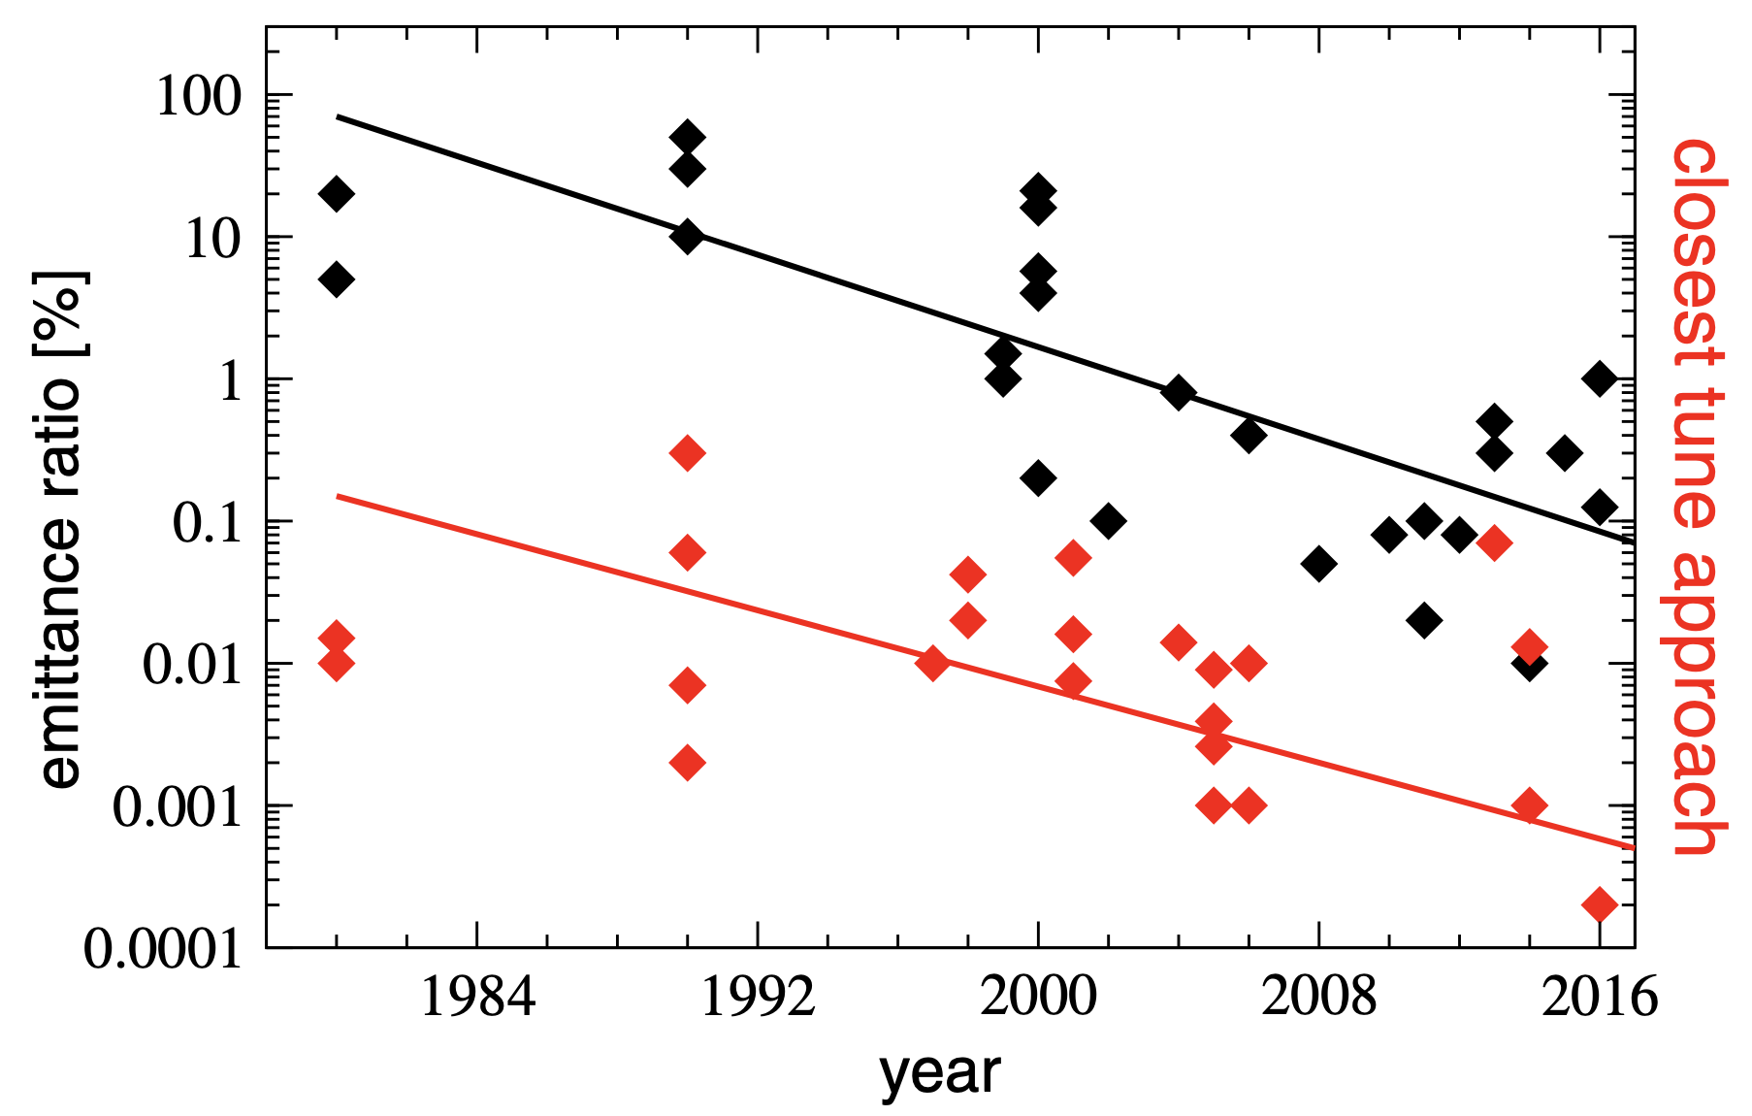
Error analysis of linear optics measurements
L. Malina et. al. PRAB 20, 082802 (2017)
R. Tomás et. al. PRAB 20, 054801 (2017)

Slide 25
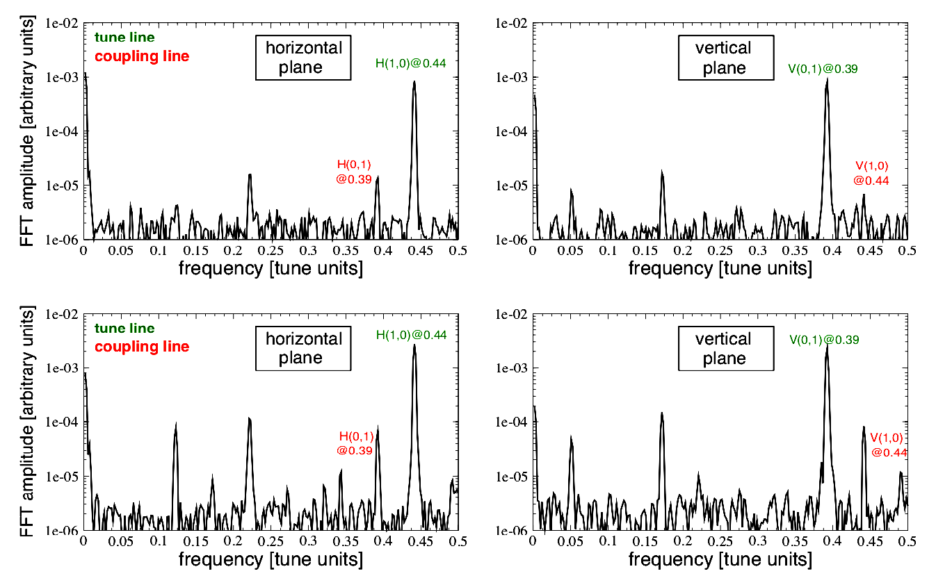
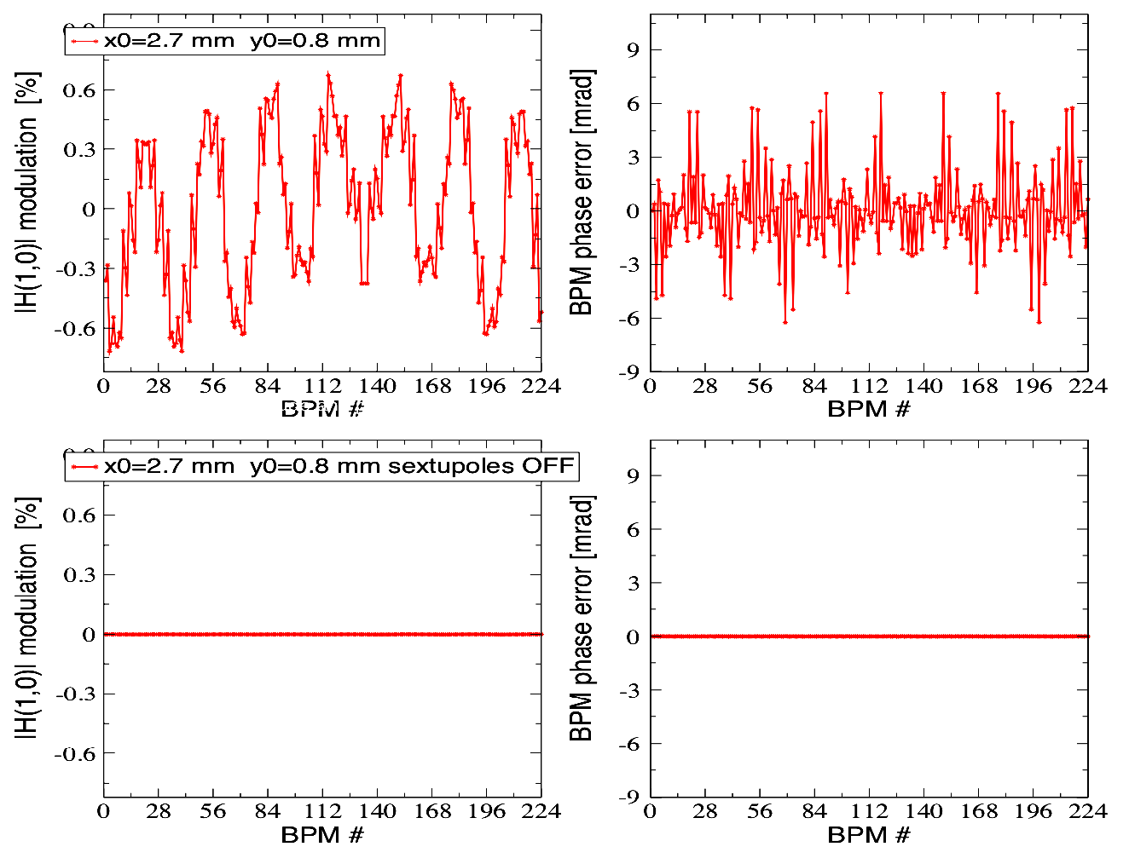
Error analysis of linear optics measurements
low beam excitation incompatible with ultra-low coupling
large beam excitation incompatible with strong chromatic sextupoles
https://arxiv.org/abs/1603.00281

Slide 26
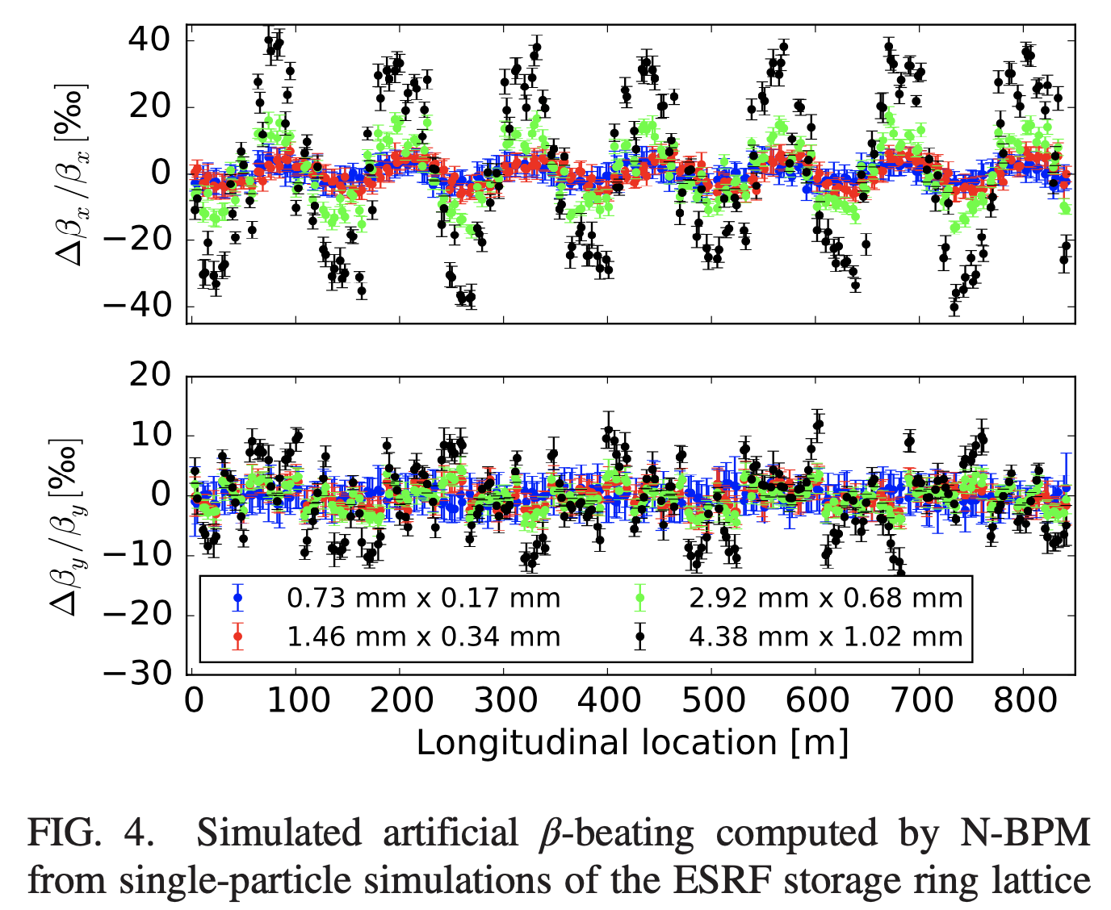
Error analysis of linear optics measurements
large beam excitation incompatible with strong chromatic sextupoles
L. Malina et. al. PRAB 20, 082802 (2017)

Slide 27
Error analysis of linear optics measurements
 | TbT & tune ampli | TbT & tune phase | orbit & ORM
BPM calibration
BPM synchro.
Nonlinear. & chroma
time consuming
model dependent
DC
AC
measured β-functions
best precision TbT: 0.4%
best precision ORM: 0.5%
best accuracy ORM-TbT: ~1%
L. Malina et. al. PRAB 20, 082802 (2017)

Slide 28
Error analysis of linear optics measurements
 | TbT & tune ampli | TbT & tune phase | orbit & ORM
BPM calibration
BPM synchro.
Nonlinear. & chroma
time consuming
model dependent
DC
AC

Slide 29
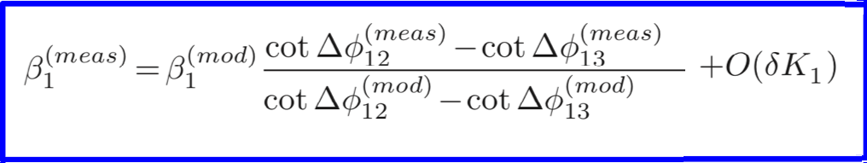
Error analysis of linear optics measurements
 | TbT & tune ampli | TbT & tune phase | orbit & ORM
BPM calibration
BPM synchro.
Nonlinear. & chroma
time consuming
model dependent
Castro’s formula (no error δk₁ between BPMs, model needed)
DC
AC

Slide 30
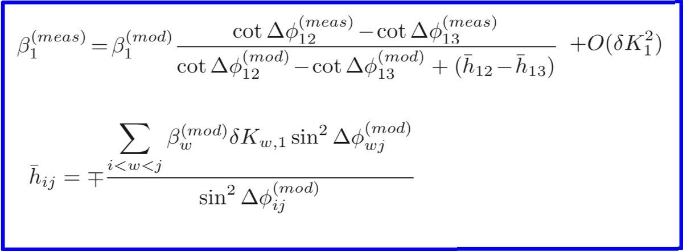
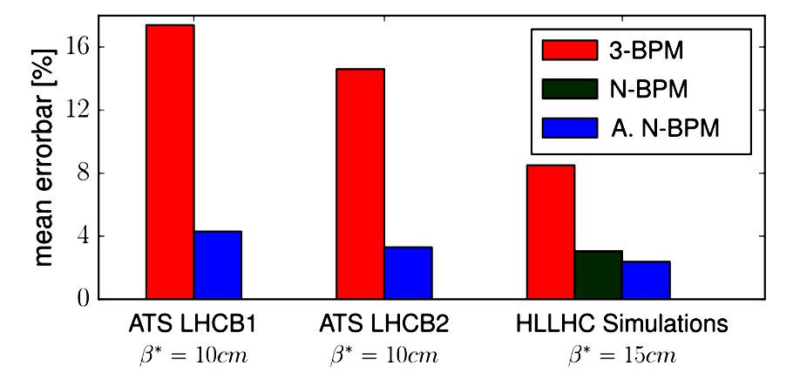
Error analysis of linear optics measurements
 | TbT & tune ampli | TbT & tune phase | orbit & ORM
BPM calibration
BPM synchro.
Nonlinear. & chroma
time consuming
model dependent
New formula (with error δk₁ between BPMs, model needed)
DC
AC
@LHC
A. Wegscheider et. al. PRAB 20, 111002 (2017)

Slide 31
Error analysis of linear optics measurements
 | TbT & tune ampli | TbT & tune phase | orbit & ORM
BPM calibration
BPM synchro.
Nonlinear. & chroma
time consuming
model dependent
DC
AC

Slide 32
Outlines
Understanding & correcting linear coupling (2009-2010)
Nonlinear optics & magnet calibration via turn-by-turn (TbT) BPM data (2010-2013)
Error analysis of linear optics measurements via orbit & TbT analysis (2016-2017)
Applications of AC Orbit data (2016-2019)
Experience of AC dipole & TbT BPM data (2016-2018)

Slide 33
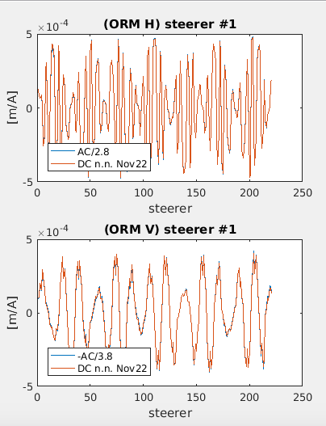
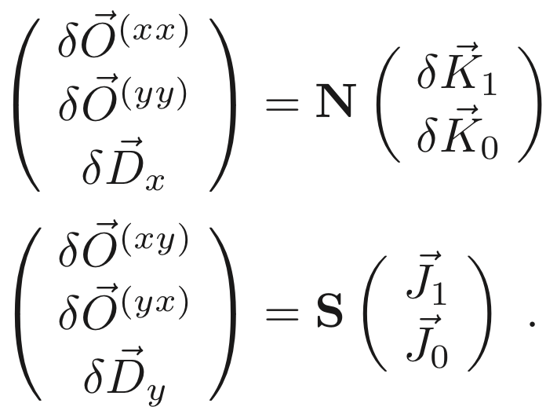
Applications of AC Orbit data
 | TbT & tune ampli | TbT & tune phase | orbit & ORM
BPM calibration
BPM synchro.
Nonlinear. & chroma
time consuming
model dependent
ESRF ORM column: AC Vs DC
analysis
DC
AC
measurement
Orbit response matrix (ORM) @ESRF:
~1 h (DC steerer excitation + numerical response*)
~3’ (AC steerer excitation + analytical response*)
* response : N & S (large matrices)
(AC excitation pioneered @Diamond)
http://arxiv.org/abs/1711.06589

Slide 34
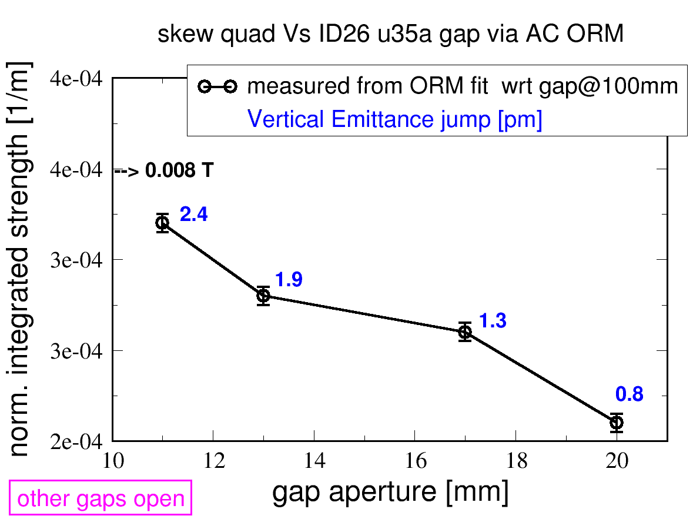
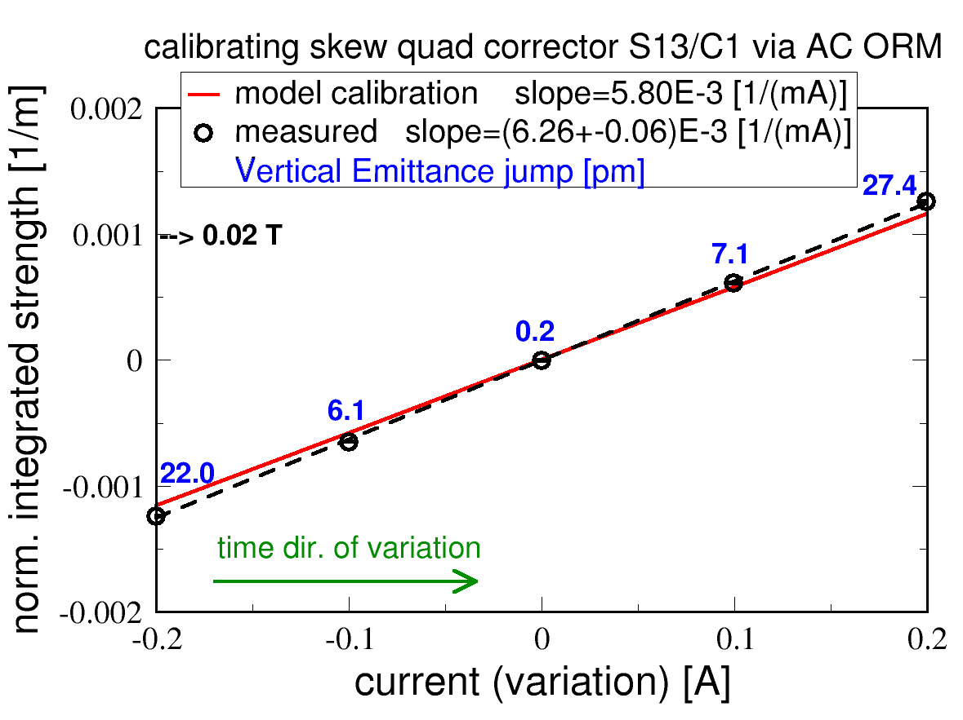
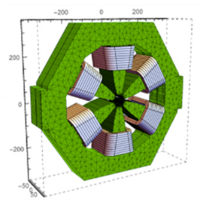
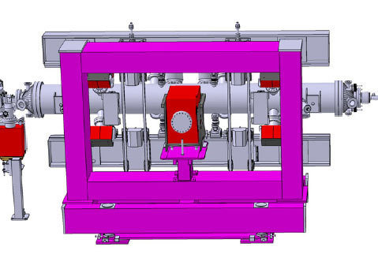
Applications of AC Orbit data
 | TbT & tune ampli | TbT & tune phase | orbit & ORM
BPM calibration
BPM synchro.
Nonlinear. & chroma
time consuming
model dependent
DC
AC
beam-based measurement of skew-quadrupole fields induced by undulators & skew quad correctors
Orbit response matrix (ORM) @ESRF:
~1 h (DC steerer excitation )
~3’ (AC steerer excitation )

Slide 35
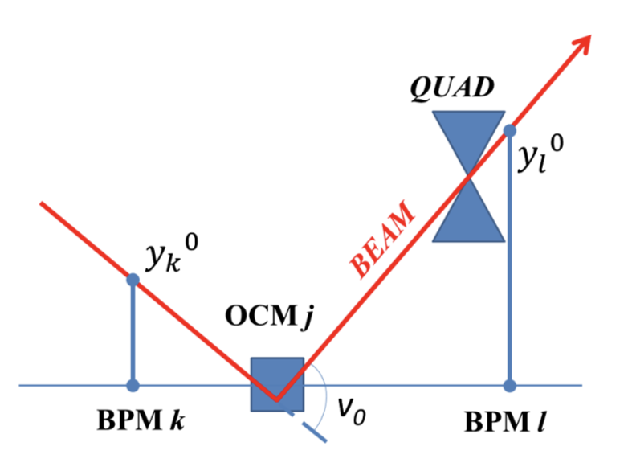
Applications of AC Orbit data
 | TbT & tune ampli | TbT & tune phase | orbit & ORM
BPM calibration
BPM synchro.
Nonlinear. & chroma
time consuming
model dependent
Digression: fast AC beam-based quadrupole alignment derived & applied to ALBA light source (120 quadrupoles):
  serial DC steerer excitation: 5h, precision ~50 μm
  parallel AC steerer excitation: 10’, precision ~15 μm
  applied to sextupoles too.
DC
AC
Z. Marti e. al. PRAB 23, 012802 (2019)

Slide 36
Outlines
Understanding & correcting linear coupling (2009-2010)
Nonlinear optics & magnet calibration via turn-by-turn (TbT) BPM data (2010-2013)
Error analysis of linear optics measurements via orbit & TbT analysis (2016-2017)
Applications of AC Orbit data (2016-2019)
Experience of AC dipole & TbT BPM data (2016-2018)

Slide 37
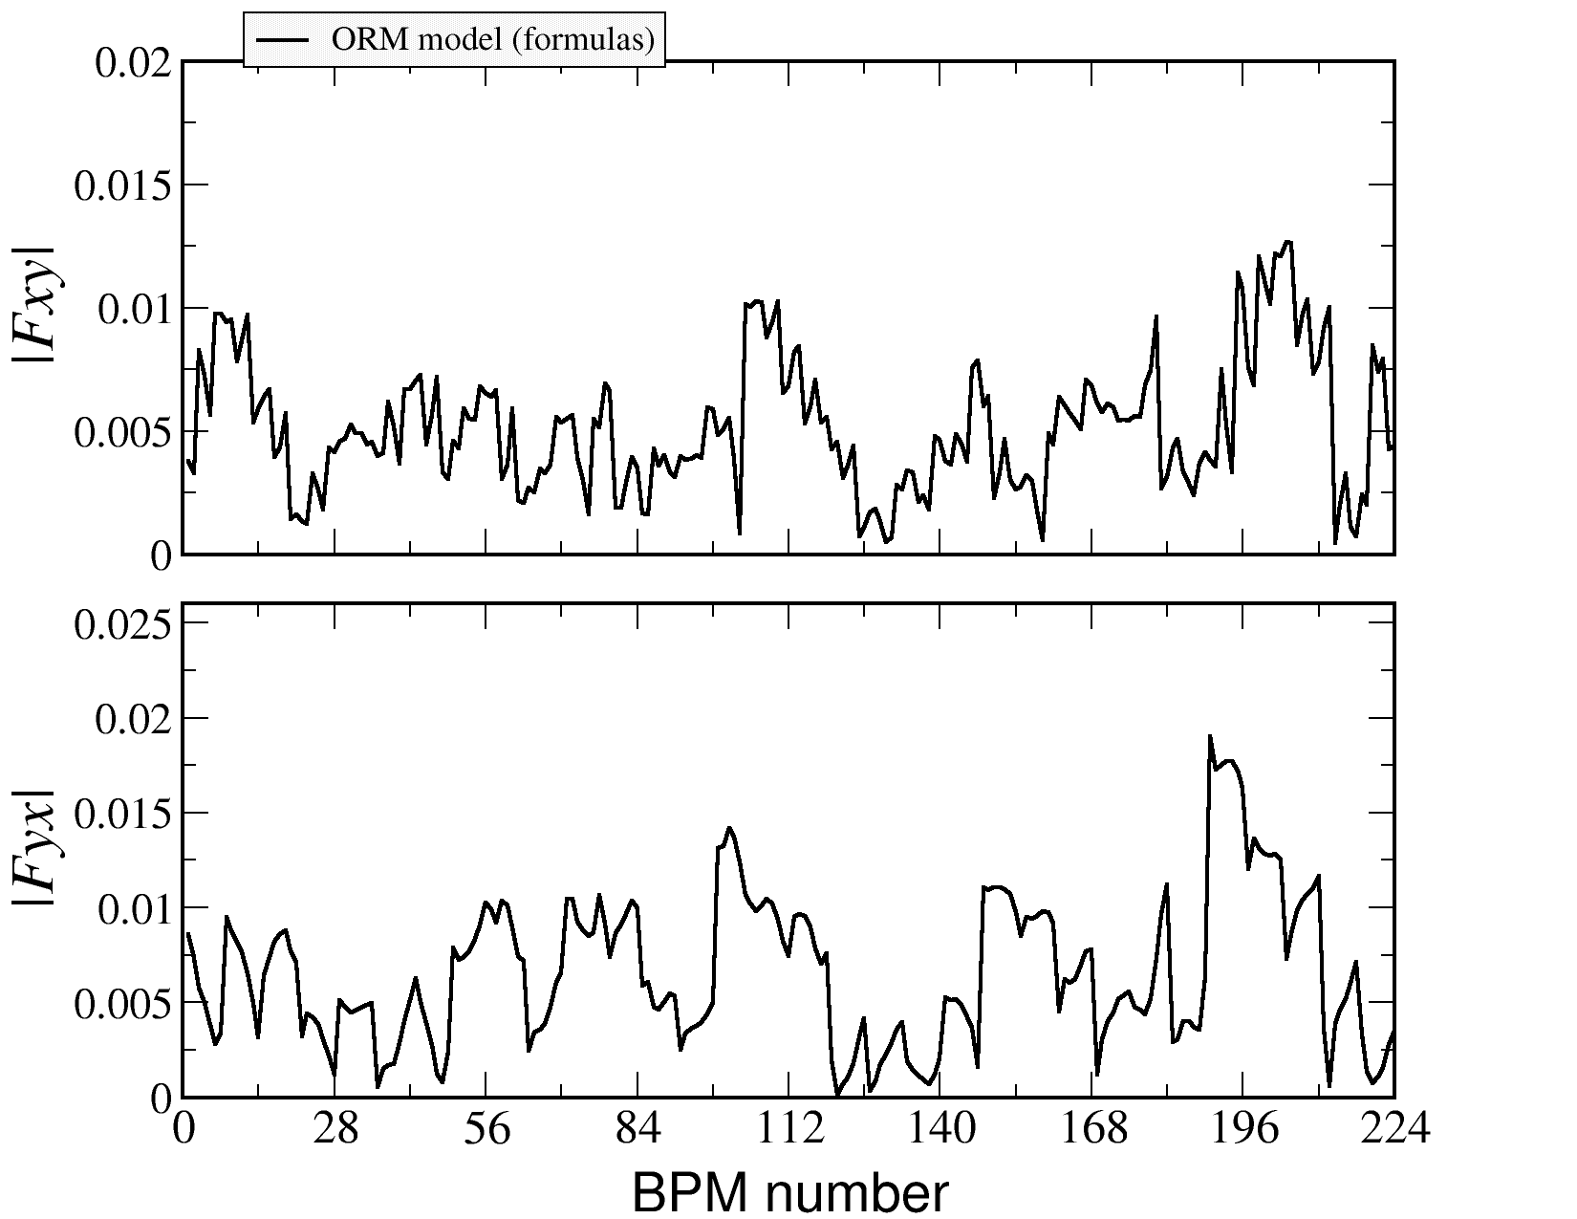
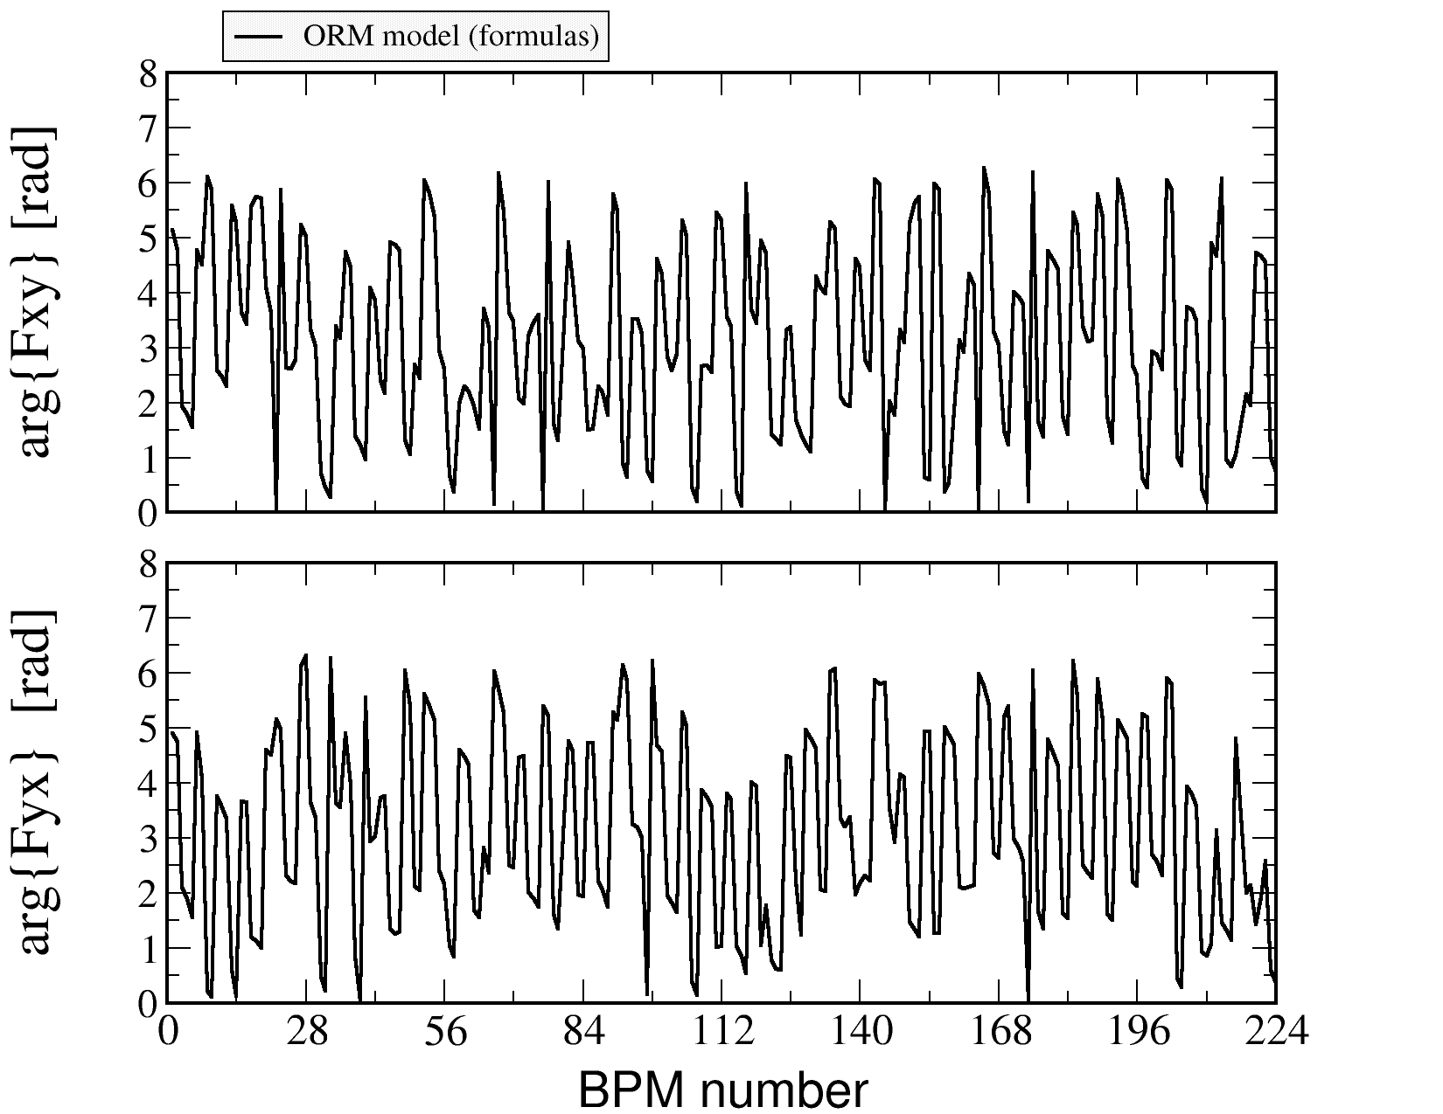
Experience of AC dipole & TbT BPM data
Betatron coupling described by two CRDTs
Fxy =(f₁₀₀₁ - f₁₀₁₀*) & Fyx =(f₁₀₀₁* - f₁₀₁₀*)
Measurement with low chroma (0,0) & detuning sext. optics
compare (ε_{y}/ε_{x}~1‰) ORM model ...
AMPLITUDE
PHASE

Slide 38
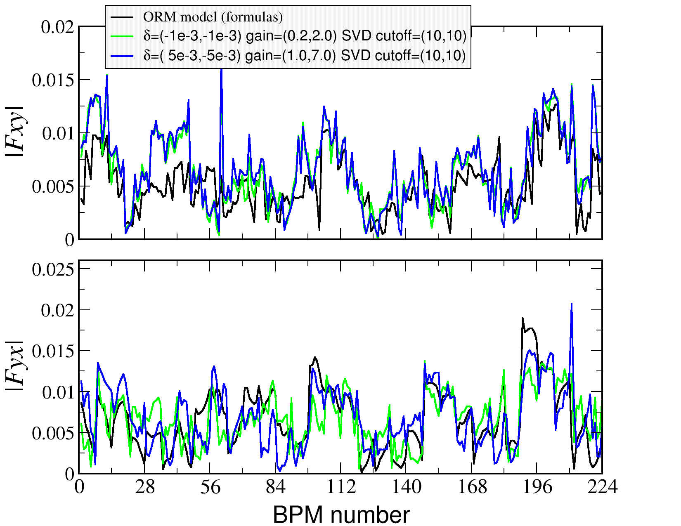
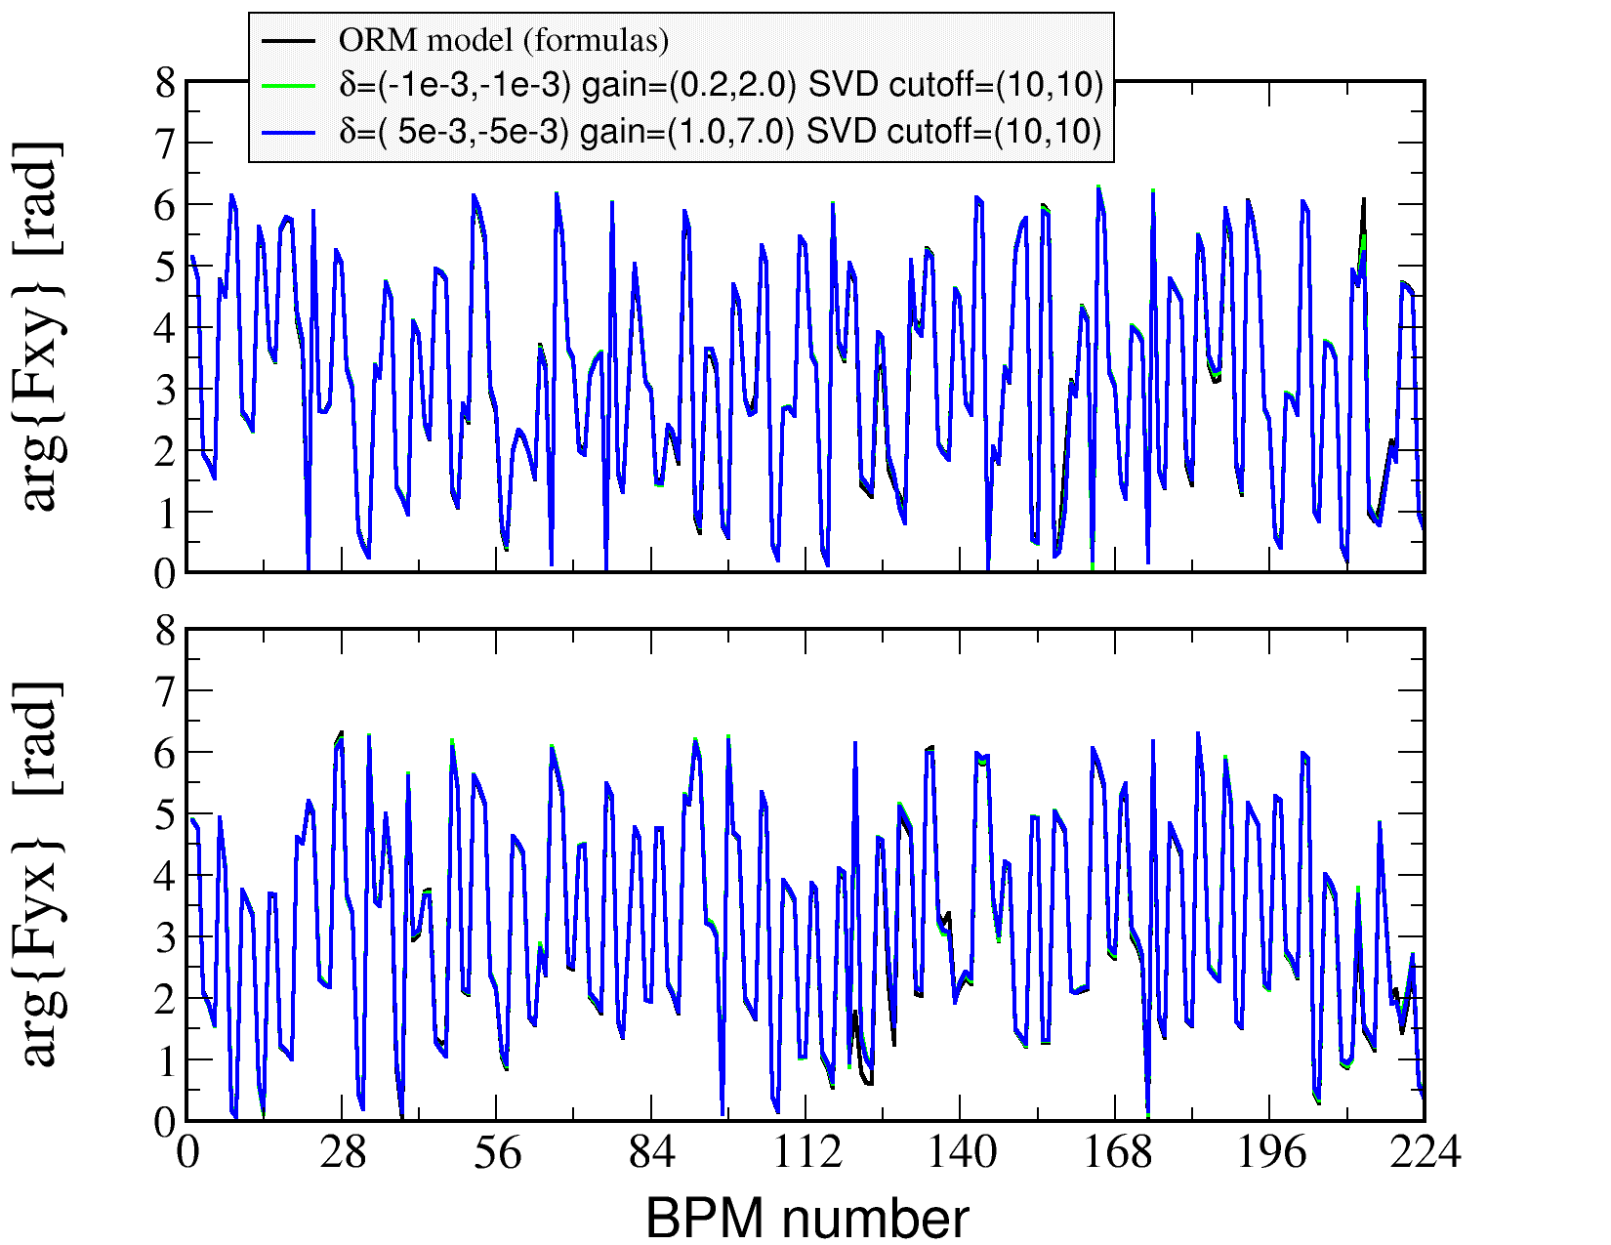
Experience of AC dipole & TbT BPM data
Betatron coupling described by two CRDTs
Fxy =(f₁₀₀₁ - f₁₀₁₀*) & Fyx =(f₁₀₀₁* - f₁₀₁₀*)
Measurement with low chroma (0,0) & detuning sext. optics
compare (ε_{y}/ε_{x}~1‰) ORM model with TbT harmonic analysis
AMPLITUDE
PHASE

Slide 39
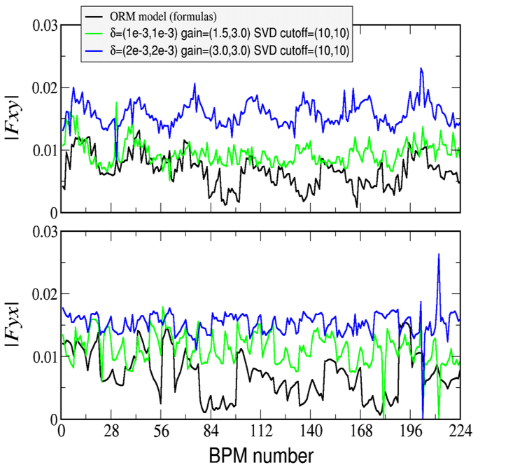
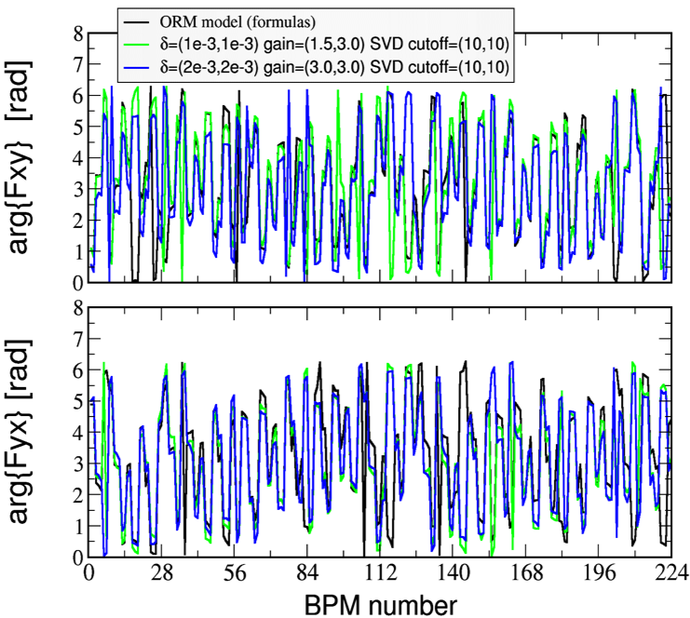
Experience of AC dipole & TbT BPM data
Betatron coupling described by two CRDTs
Fxy =(f₁₀₀₁ - f₁₀₁₀*) & Fyx =(f₁₀₀₁* - f₁₀₁₀*)
Measurement with large chroma (8,13) operational optics
compare (ε_{y}/ε_{x}~1‰) ORM model with TbT harmonic analysis
AMPLITUDE
PHASE

Slide 40
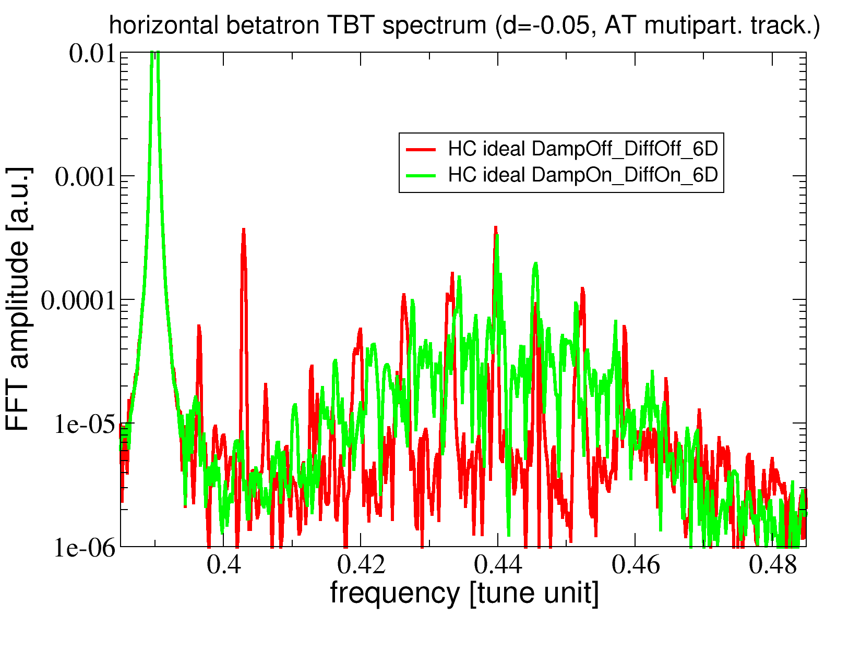
Experience of AC dipole & TbT BPM data
1st experimental observation: AC dipole tuning tedious with high chromaticity: beam lost with setting used for low-chroma optics.
High (8,13) chroma sextupole optics:
RAD OFF & ON (multi-particle simulations)
Q_{AC}=0.39
Qx=0.44

Slide 41
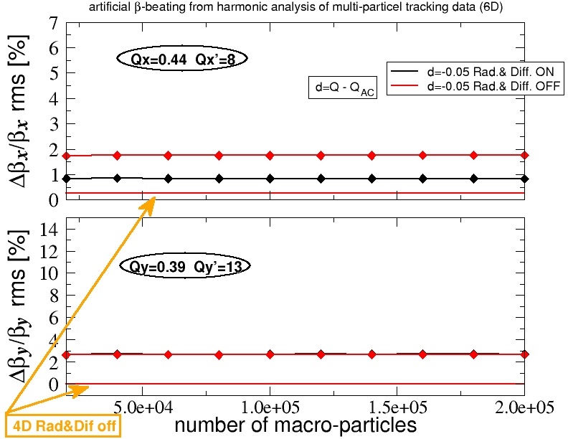
Experience of AC dipole & TbT BPM data
2nd experimental & numerical observation:
synchrotron radiation + diffusion & high chroma => limited accuracy.
AC dipole & data cleaning OK for low-chroma lepton rings.

Slide 42
Outlines
Understanding & correcting linear coupling (2009-2010)
Nonlinear optics & magnet calibration via turn-by-turn (TbT) BPM data (2010-2013)
Error analysis of linear optics measurements via orbit & TbT analysis (2016-2017)
Applications of AC Orbit data (2016-2019)
Experience of AC dipole & TbT BPM data (2016-2018)
Thank you for your attention

