Slide 1

Effects of Misalignments on Dynamic Aperture and Luminosity
D. Shatilov (BINP/CERN)
Acknowledgements: T. Charles
FCC-ee optics tuning and alignment mini-workshop
11 May 2022

Slide 2
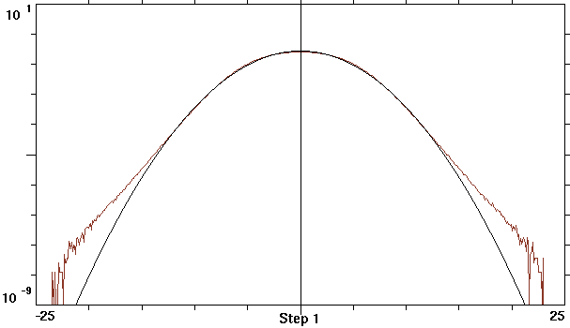
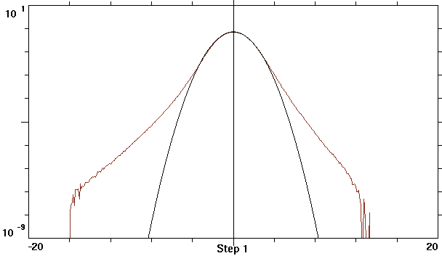
Luminosity and Momentum Acceptance
Luminosity:
How beamstrahlung increases the energy spread:
45.6 GeV
Bending radius in the field of the opposite bunch:
σ_{δ} = 3.5σ_{δ0}
δE/σ_{δ0}
182.5 GeV
Critical energy of beamstrahlung photons:
σ_{δ} = 1.3σ_{δ0}
High luminosity means working with a strong beamstrahlung.
It follows that the luminosity is to some extent proportional to the momentum acceptance.
δE/σ_{δ0}
D. Shatilov FCC-ee optics tuning and alignment mini-workshop, 11 May 2022 2

Slide 3
Misalignments for Simulations
The baseline values for misalignments (sigma):
  Quads, DX and DY: 50 microns
  Sextupoles, DX and DY: 50 microns
  Dipoles, DX and DY: 1000 microns
The previous examples have shown that dynamic aperture and momentum acceptance drop off significantly at these misalignments.
To continue beam-beam simulations, we reduced the misalignments to the following values:
  Quads, DX and DY: 11.5 microns
  Sextupoles, DX and DY: 13.6 microns
  Dipoles, DX and DY: 76.7 microns
So far, such examples have been made only for high energy (ttbar), the last version of the lattice. The corrections were made by Tessa, then I converted all the MADX data to my format and continued modeling with Lifetrac.
D. Shatilov FCC-ee optics tuning and alignment mini-workshop, 11 May 2022 3

Slide 4
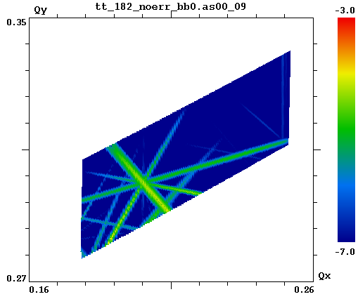
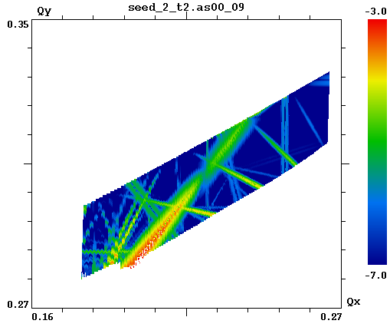
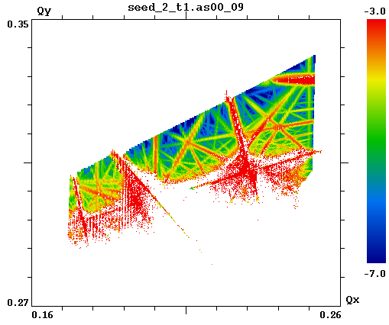
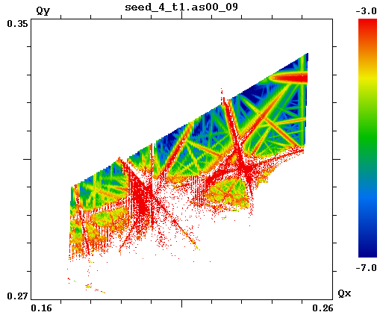
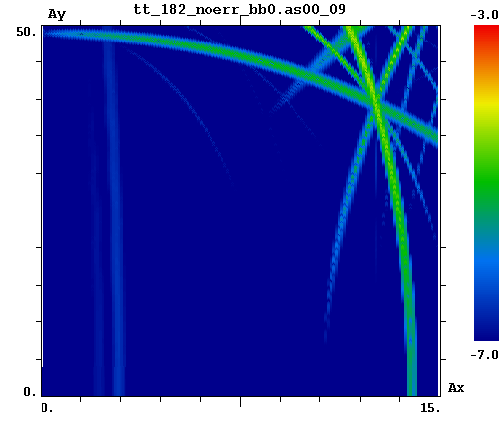
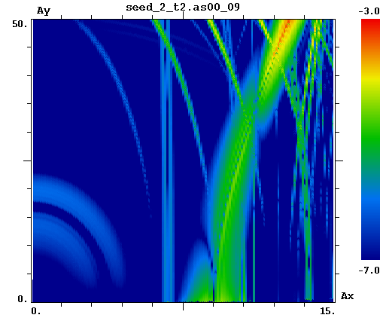
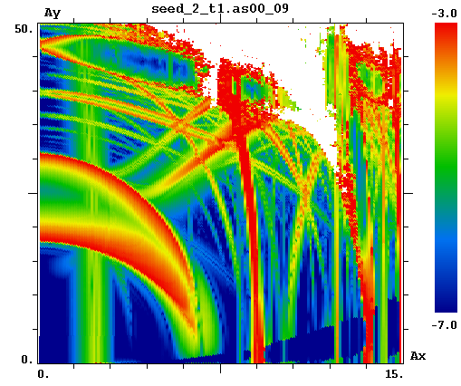
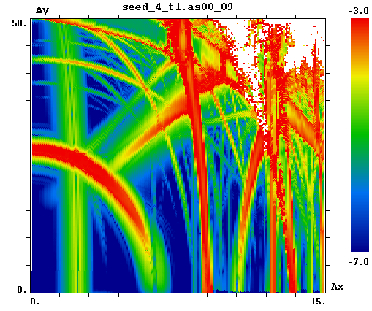
FMA w/o Beam-Beam, A_{s} = 0
Ideal lattice (no errors)
Seed 2, 4-fold symmetry
Seed 2
Seed 4
3ν_{y} = 1
D. Shatilov FCC-ee optics tuning and alignment mini-workshop, 11 May 2022 4

Slide 5
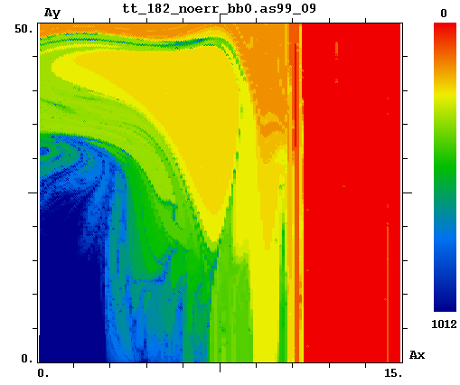
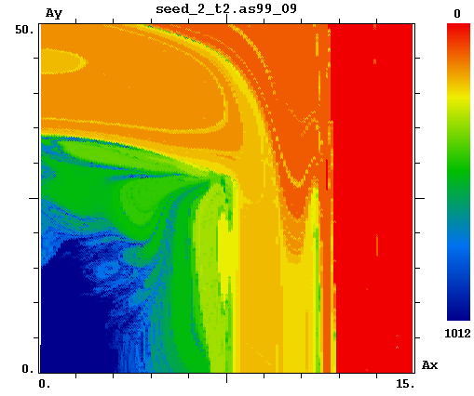
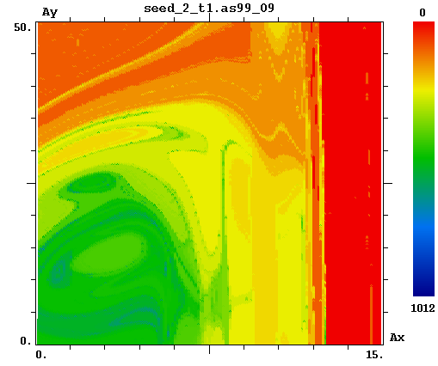
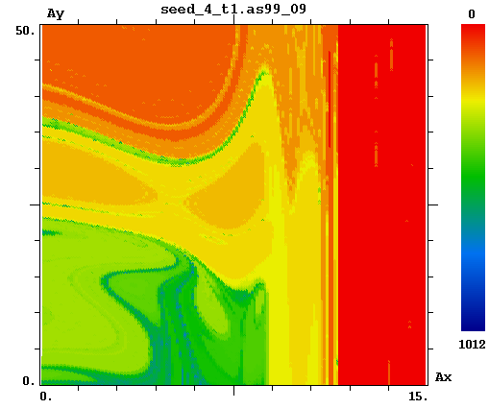
FMA w/o Beam-Beam, A_{s} = 10 (δ_{E} ∼ 1.6%)
Ideal lattice (no errors)
Seed 2, 4-fold symmetry
Seed 2
Seed 4
There is no damping and no noise in these simulations. The color (logarithmic scale) shows how many turns the particle made before death. Dark blue color – for particles that survived after 1012 turns. Dark red – for particle died at the 1st turn.
With account of damping, the dynamic aperture roughly corresponds to the border between green and yellow (∼10 turns).
D. Shatilov FCC-ee optics tuning and alignment mini-workshop, 11 May 2022 5

Slide 6
Beam-Beam Simulations with Misalignments
Corrections at the IPs: betatron tune advances between IPs, beta-functions, dispersions (should be zero), and equilibrium orbit (should be zero).
  In simulations, this can be done artificially by inserting transport matrices and "orbit shifts" around the IP.
Correction at the crab sextupoles: betatron tune advances between CS and IP, beta-functions.
  In simulations, this can be done artificially by inserting transport matrices around the pair of SY1, SY2 sextupoles. But this greatly increases the chromaticity, so the DA drops. Therefore, these requirements must be taken into account from the very beginning when making any corrections.
Large ξ_{x} at ttbar, so the footprint crosses the main coupling resonance.
  This problem appeared only in the model with realistic betatron coupling, and only at ttbar.
  Further parameter optimization at this energy will be required: a decrease in β_{x} and a shift in the working point. But everything will depend on what kind of actual momentum acceptance can be obtained, taking into account misalignments and their corrections. This will determine possible beam-beam tune shifts and the distance to the coupling resonance.
D. Shatilov FCC-ee optics tuning and alignment mini-workshop, 11 May 2022 6

Slide 7
Discussion
We need to develop methods that allow us to restore the orbit and linear optics at critical points (IPs, crab sextupoles) and further maximize the dynamic aperture and momentum acceptance.
Probably, we need to prepare for the fact that we will have to reduce misalignments and errors several times.
  Of course, this increases the cost of the positioning system, but it must be compared with the total cost of the collider. If the total cost increases by a few percent, and the luminosity by fifty, then it probably makes sense.
Thank you for your attention!
D. Shatilov FCC-ee optics tuning and alignment mini-workshop, 11 May 2022 7

