Slide 1

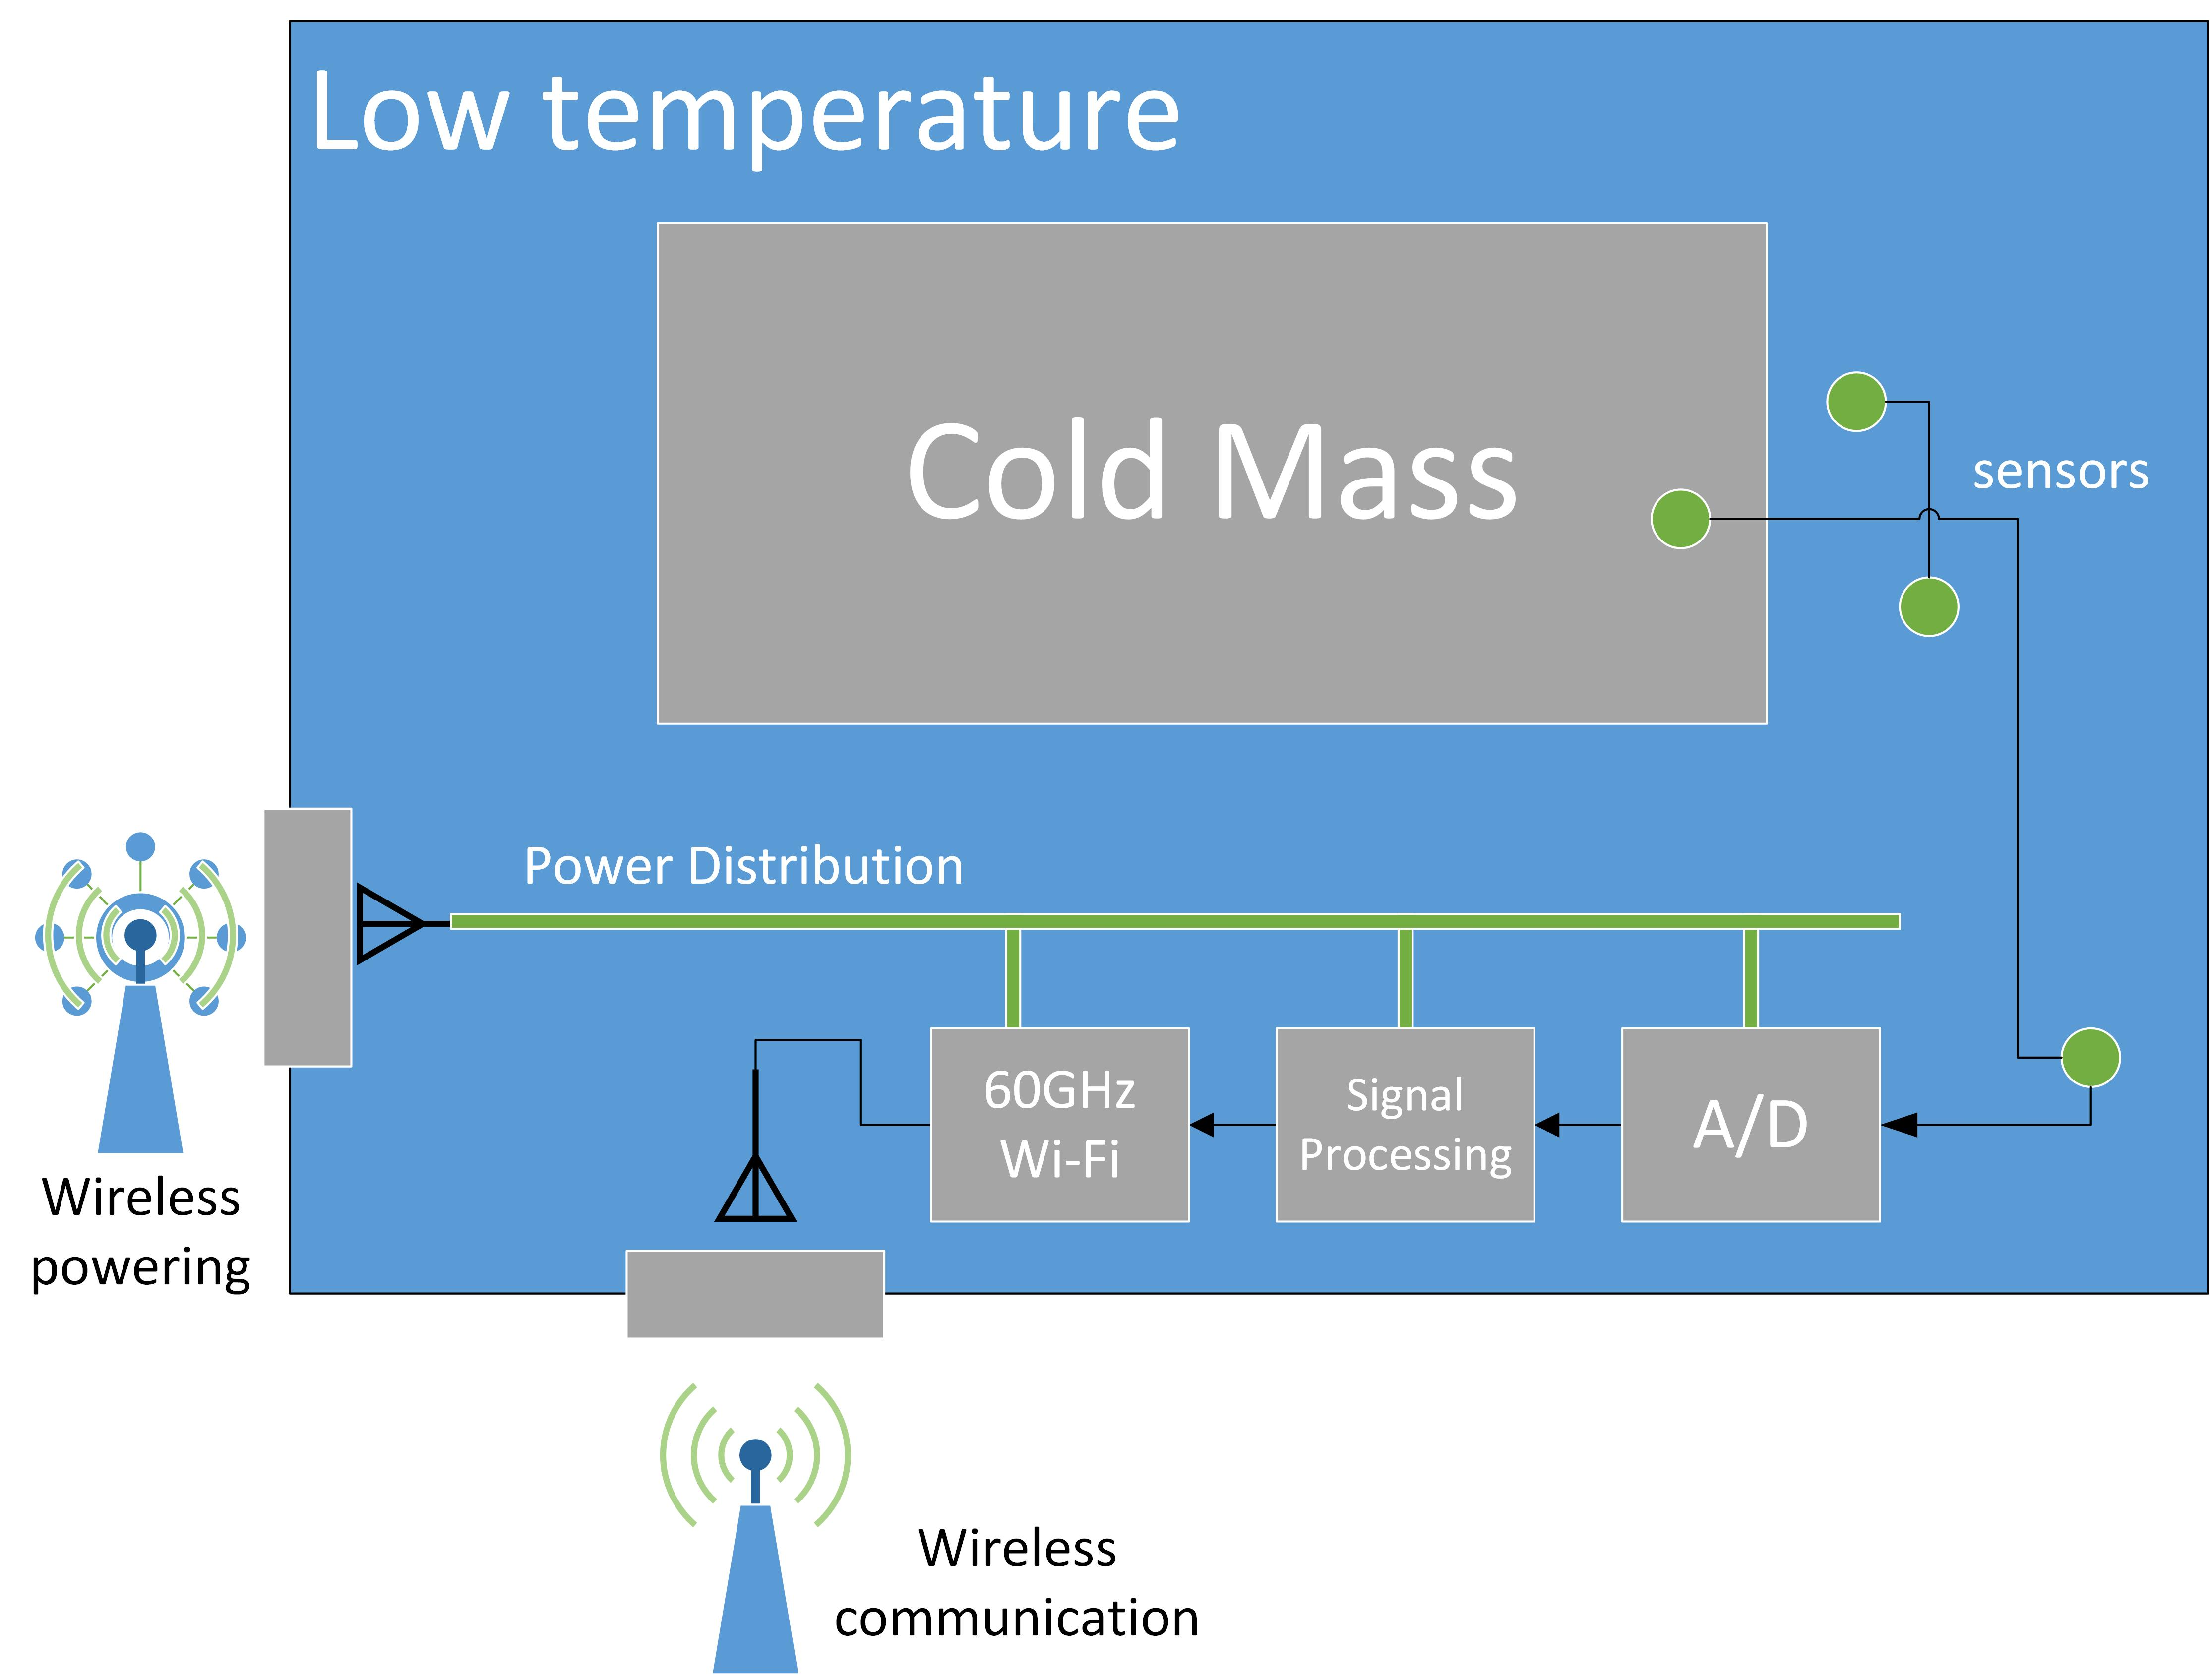


Task 4.3 : Smart Wireless Diagnostics for Superconducting and Cryogenic Applications
The long-term objective is to access a superconducting magnet efficiently and conveniently from remote devices (like smart phones, tablets or intelligent screens). Provide abundant and high precision data for the monitoring, diagnostics, control and protection functionalities, with real-time algorithms using intelligent applications such as Neural Networks, Deep Learning, Artificial Intelligent, etc…
To make this real, the ambitious step forward of this program is to have the instrumentation electronics embedded inside the low temperature vessel with the powering and communication provided by wireless links.
Partners :

Slide 2
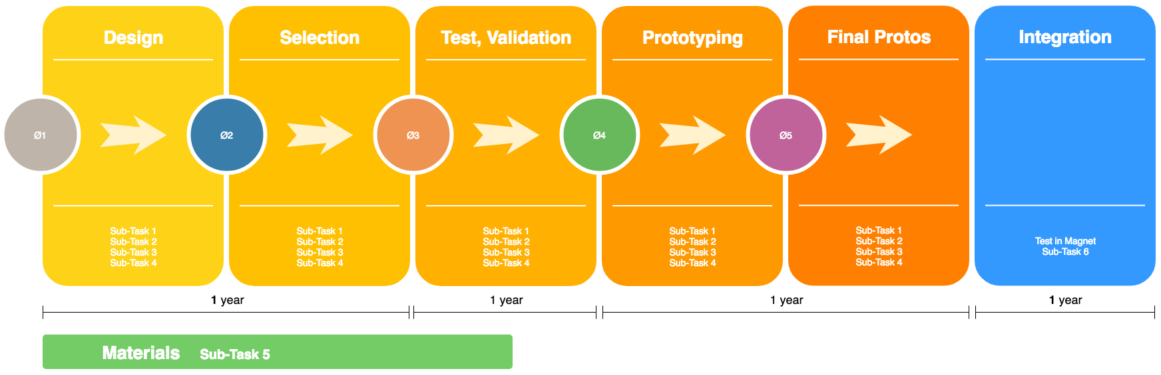
Task 4.3: plan, schedule, cost
Sub-Tasks
electronics 1 - Sensors
electronics 2 - Control, acquisition and data processing
electronics 3 - Wireless communication link
electronics 4 - Wireless powering
Materials
Integration
Estimated costs in Euros
 | Sub-Task 1 | Sub-Task 2 | Sub-Task 3 | Sub-Task 4 | Sub-Task 5 | Sub-Task 6
 | 3 years | 3 years | 3 years | 3 years | 1.5 years | 1 year
Material | 100K | 200K | 150K | 150K | 80K | 100K
Manpower | 150K/year | 250K/year | 180K/year | 180K/year | 180K/year | 150K/year
Use of installation | 80K/year | 80K/year | 80K/year | 80K/year | 80K/year | 80K/year
Total | 790K | 1190K | 930K | 930K | 470K | 330K | 4640K

Slide 3
Who can benefit from this ?
Potential partners
Any application doing measurement at low temperatures (cryogenics environments).
superconducting magnets (MRI, research accelerators and colliders)
superconducting links (electrical distribution)
superconducting generators (windmills)
quantum computers
low cost aerospace devices
intelligent transport of liquefied gases on gasoducts at low temperature
This proposal is open for more partners willing to collaborate.
These institutions :
VTT Technical Research Centre of Finland
KU Leuven - Department of Electrical Engineering - ADVISE and MICAS
were interested only in the case of custom electronics (ASIC) development for low temperature
In the context of FuSuMaTech the outcome of Task 4.3 will provide the abundant information needed by Task 4.1 and will allow to monitor and control any technological pilot (Task 5).
The knowledge collected from the studies of electronics components at low temperature will be stored in the database (Task 4.2) and shared among the members of the Consortium.

