Slide 1
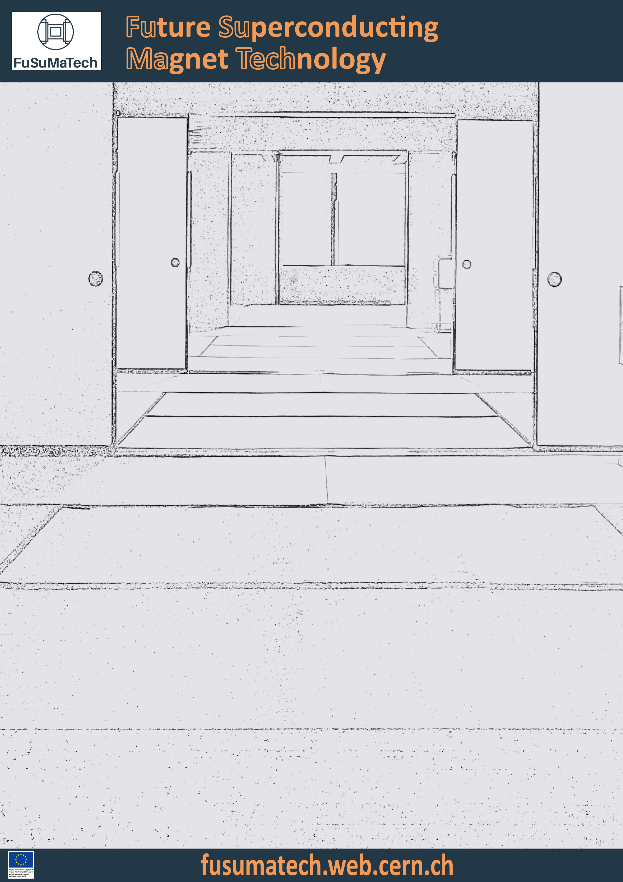




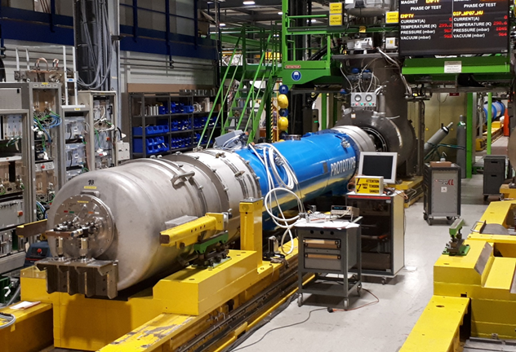
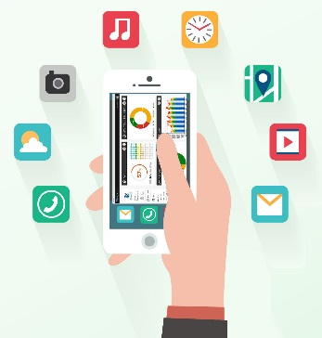
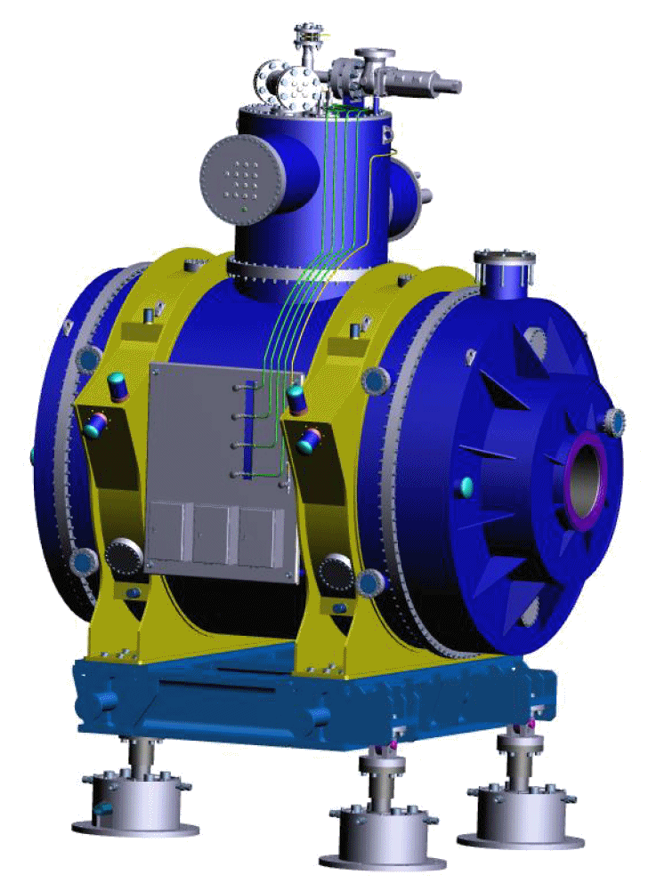
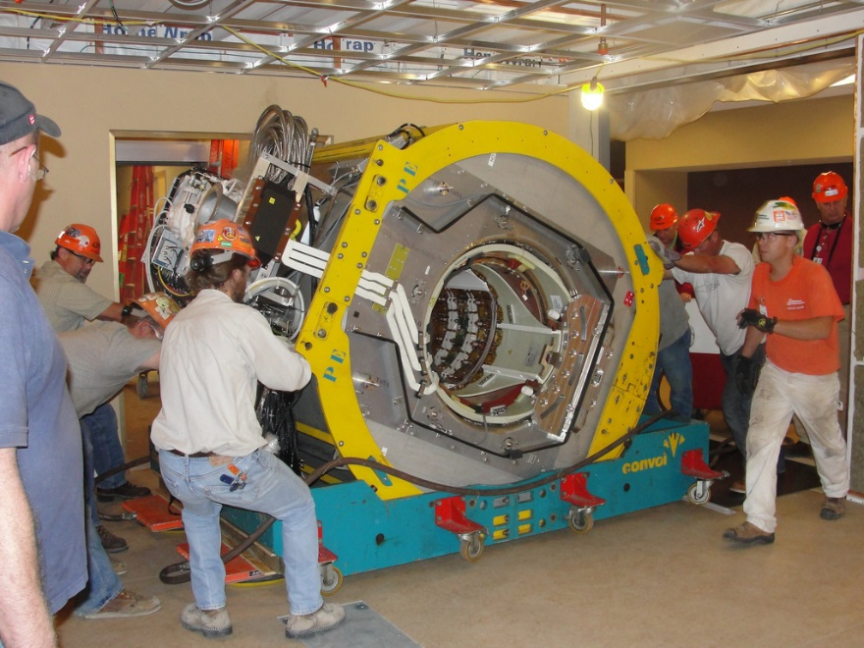
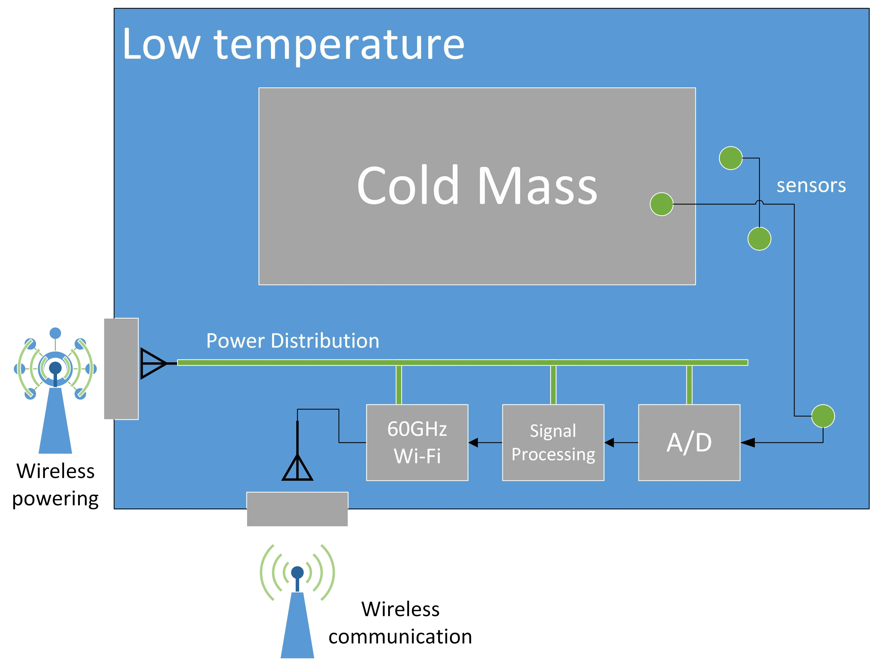

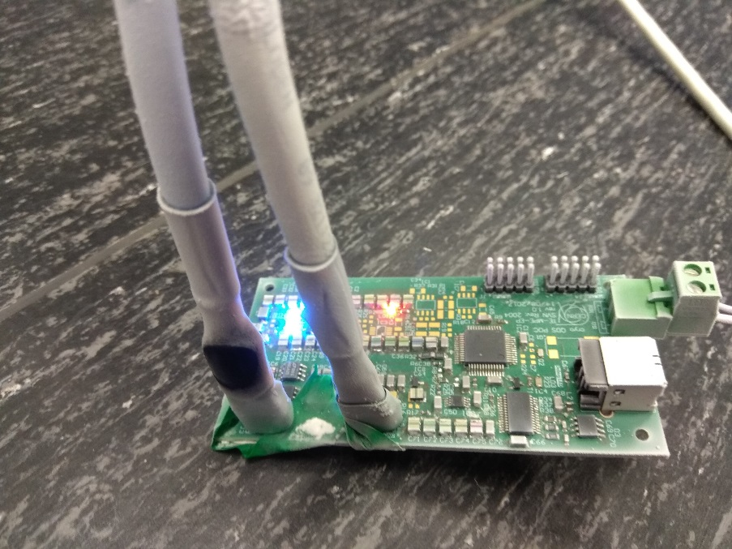
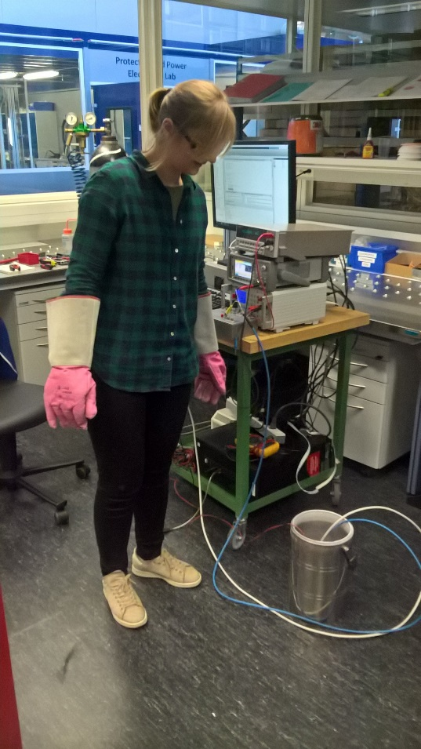
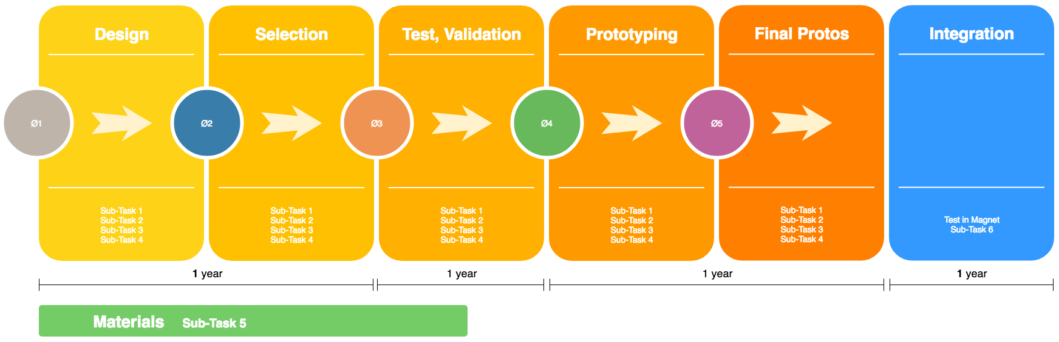
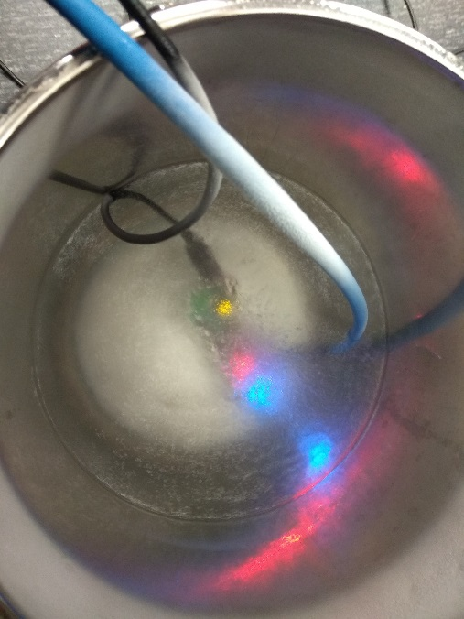
T4.3 Smart Wireless Diagnostics.
What if …
we treat a superconducting magnet as an IoT device.
CERN LHC Dipole
Medical MRI
low temperature : in the order of the thermal shield levels, 50 K to 70 K, or below
What if …
we confine the embedded electronics and sensors for the instrumentation inside the cryogenic vessel with wireless transmission for data and power.
The main objectives are:
to confine the electronics for monitoring, diagnostics, control and protection functionalities inside the superconducting magnet. This reduces the complexity of mechanical and thermal design eliminating the need of inserts for the instrumentation
to have more and different types of sensors that are better and faster in collecting abundant high precision real-time data
to “virtualise” the highly complex instrumentation and profit from the new Big Data technologies and Artificial Intelligence, This will reduce significantly the required time to gain “expert experience” from the superconducting magnets and will allow us to understand and solve the problems we are facing at the technology edge of superconductors
to access a superconducting magnet efficiently and conveniently from remote devices (like smart phones, tablets or intelligent screens)
The main challenges in front of us are:
to develop a working electronic data acquisition system of high precision at low temperature
to develop a working wireless electronic communication link at low temperature
to develop a working wireless powering system at low temperature
to develop a radio frequency transparent material to build a “window” or an antenna, at the wall of the cryogenic vessel, for the wireless communication link and for the wireless powering system
to develop materials and assembly technologies to build flexible PCBs (printed circuit boards) for the confined electronics at low temperature
 | Sub-Task 1 sensors | Sub-Task 2 acq. and control | Sub-Task 3 wireless comm | Sub-Task 4 wireless power | Sub-Task 5 materials | Sub-Task 6 integration
Duration | 3 years | 3 years | 3 years | 3 years | 1.5 years | 1 year
Material | 100K€ | 200K€ | 150K€ | 150K€ | 80K€ | 100K€
Manpower | 150K€/year | 250K€/year | 180K€/year | 180K/year | 180K€/year | 150K€/year
Use of installations | 80K/year | 80K€/year | 80K€/year | 80K€/year | 80K€/year | 80K€/year
Total | 790K€ | 1190K€ | 930K€ | 930K€ | 470K€ | 330K€ | 4640K€

