Slide 1

Doing Business with CERN
Finland and CERN
Anders Unnervik, Head of Procurement and Industrial Services
25 May 2022

Slide 2

CERN is entitled to establish its own internal rules necessary for its proper functioning, including:
Procurement Rules
Safety Rules
Staff Regulation of its own personnel

Slide 3
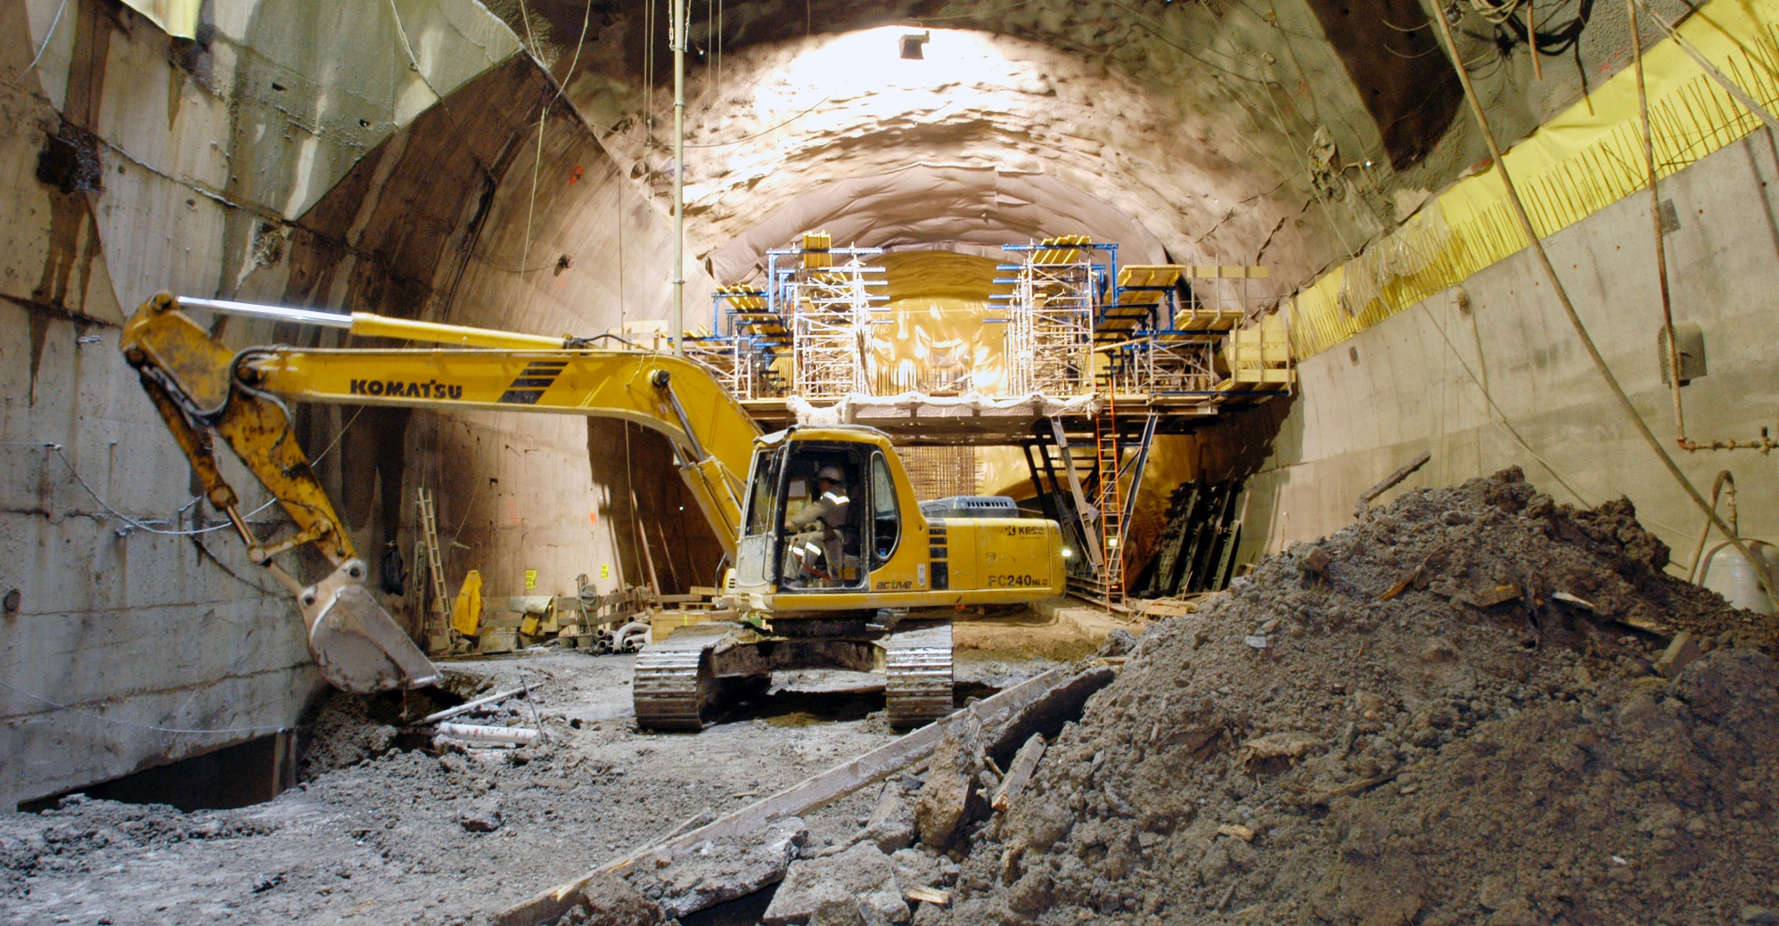
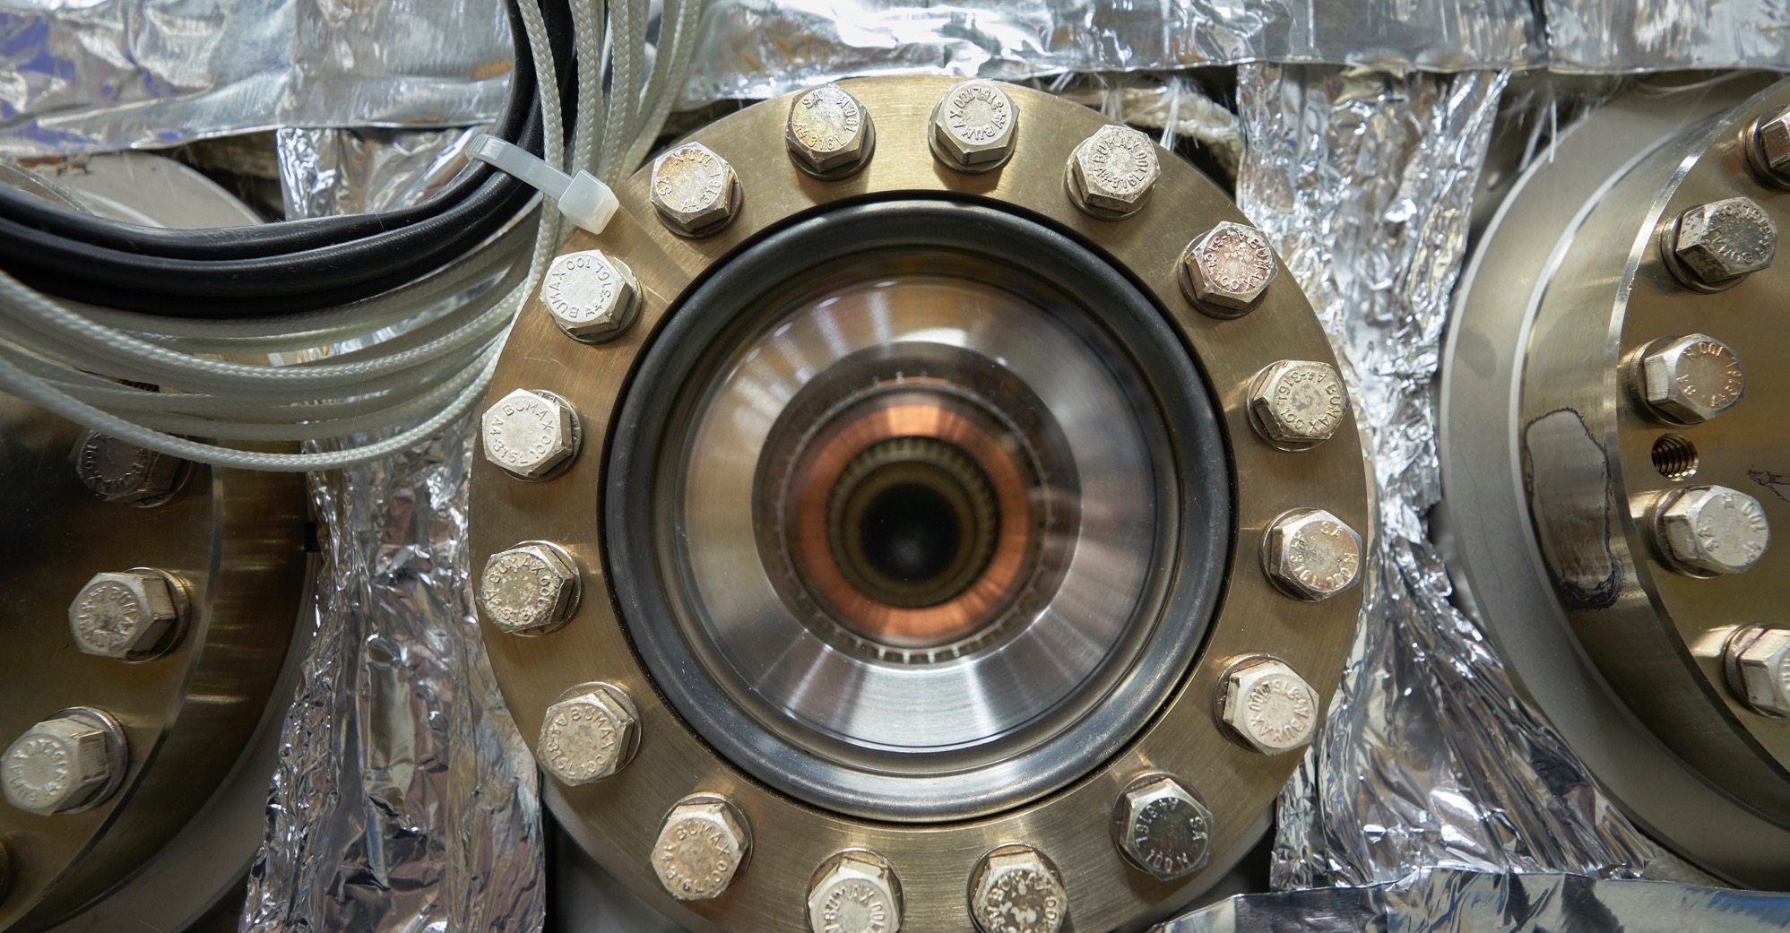
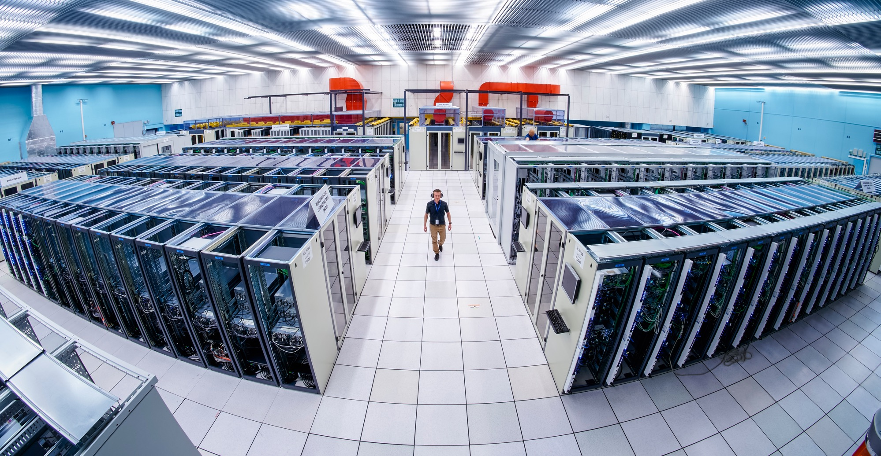
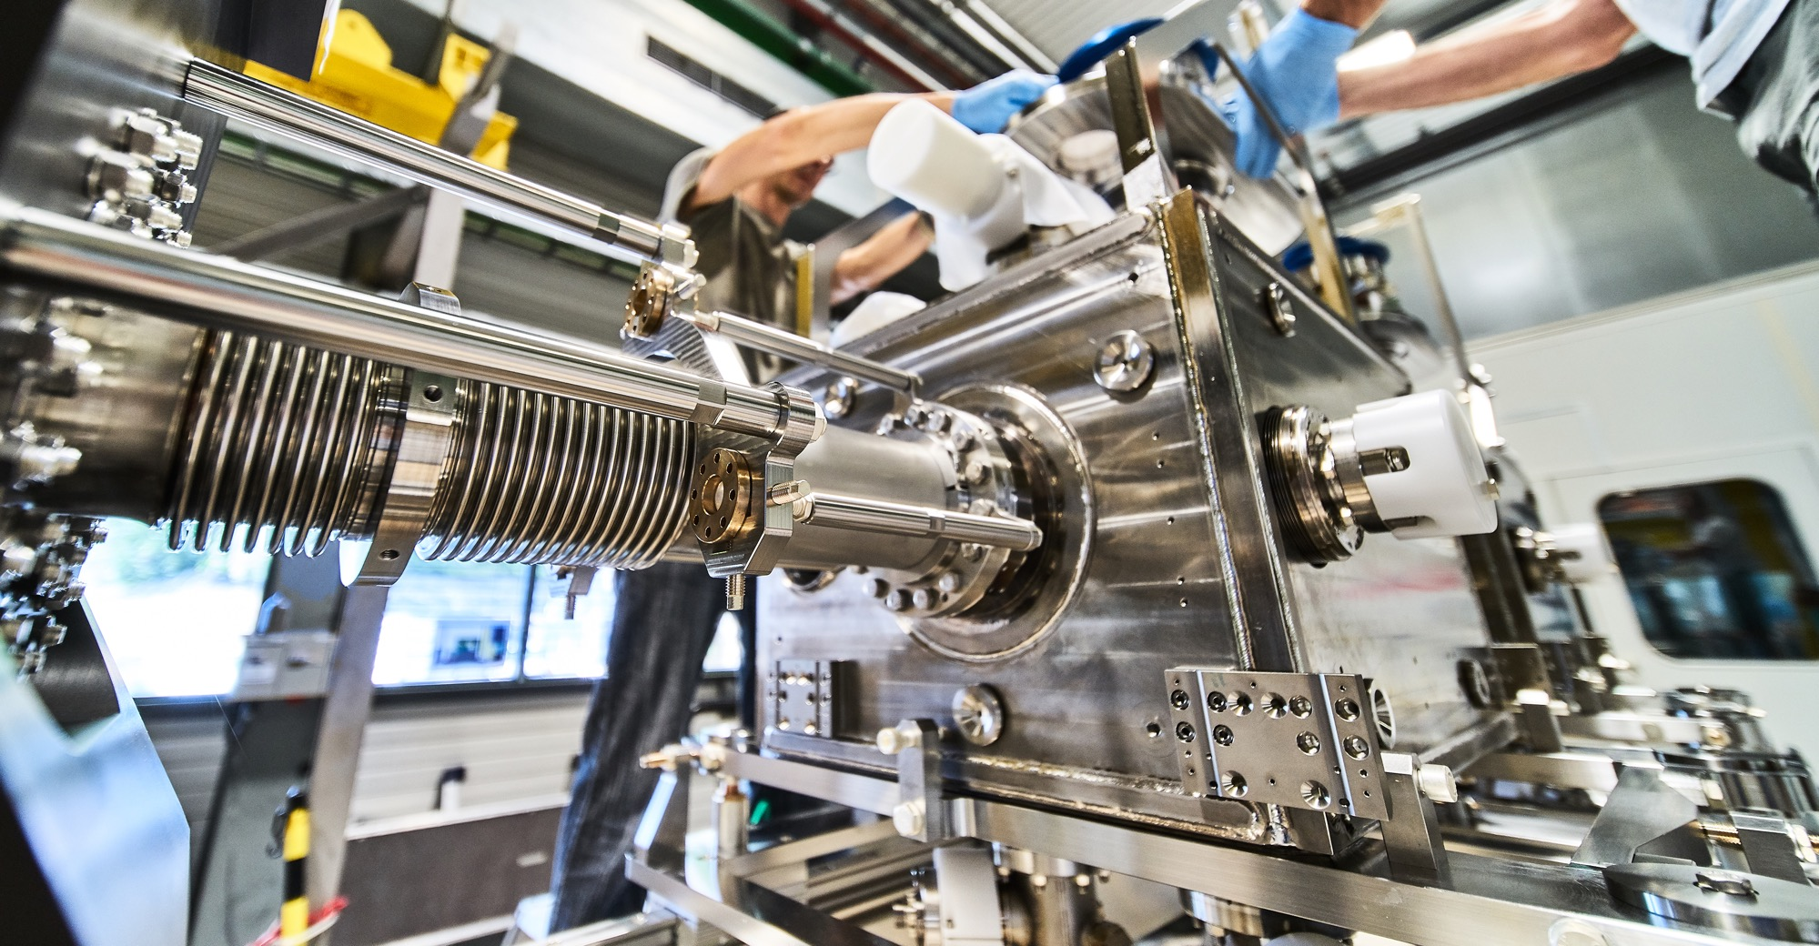
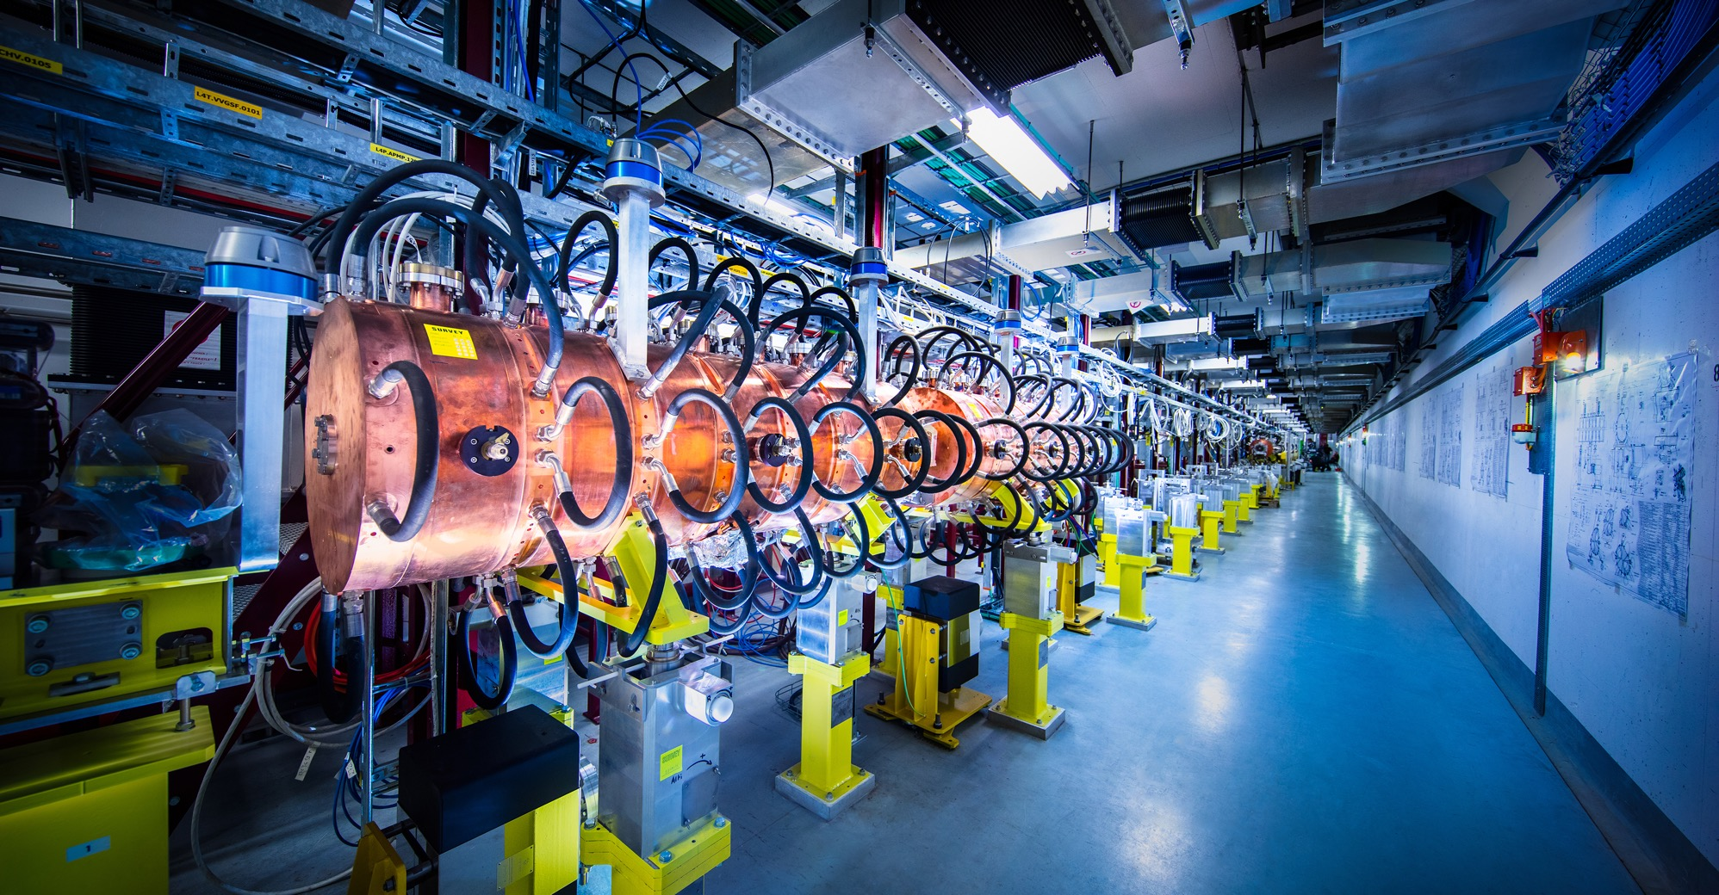
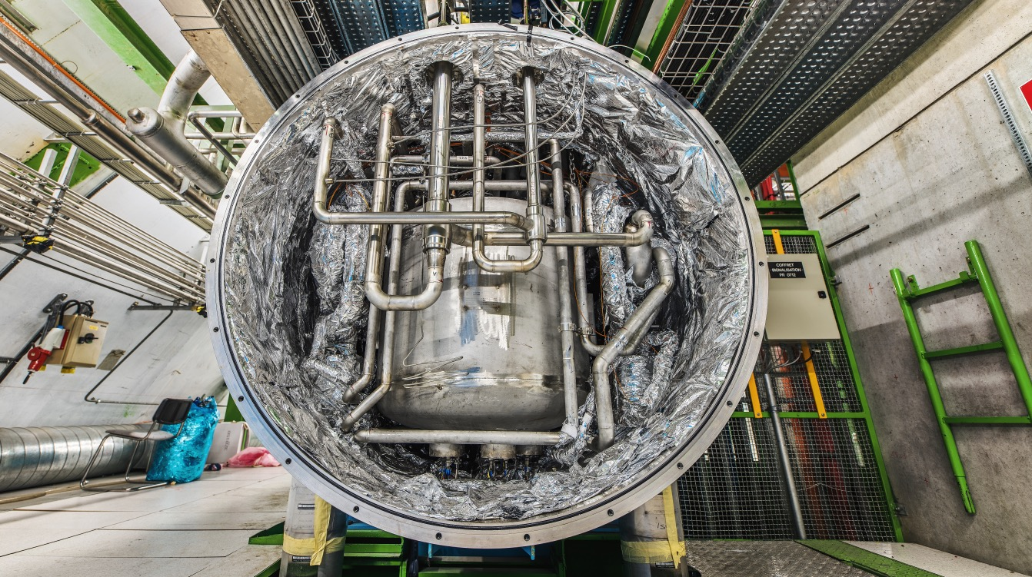
What do we buy?
Civil engineering:
Cooling and ventilation
equipment
Electrical engineering and magnets
ICT
Mechanical engineering and raw materials
Electronics and radiofrequency
Cryogenic and vacuum equipment
Etc….

Slide 4

How do we buy?
  Off-the shelf or non-standard products which can be produced with existing manufacturing techniques or technologies:
  Functional specification
  Non-standard products where industry has neither the required know-how nor the interest to develop and design the products:
  Build-to-Print specification
Prototypes and or Pre-series might be required.

Slide 5
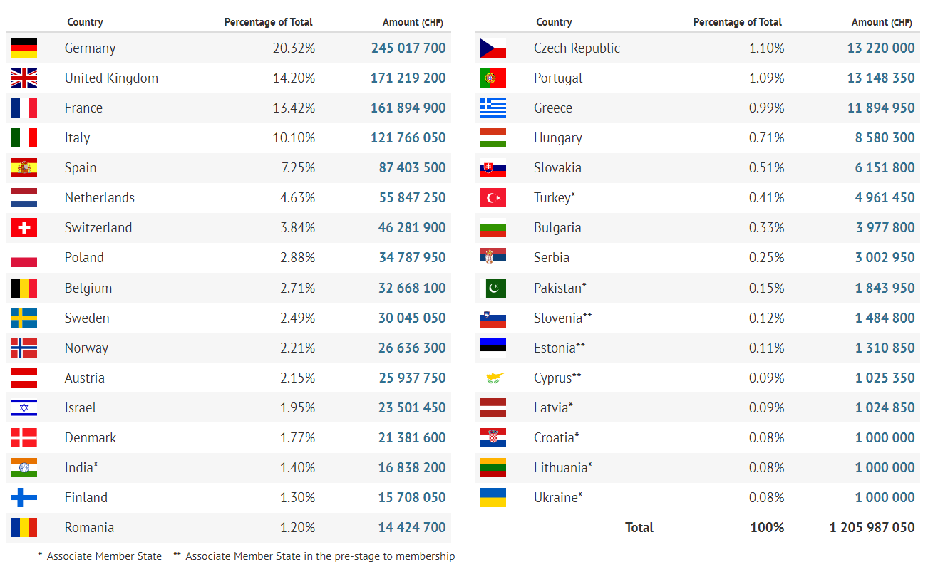
Yearly Budget (contributions 2022)

Slide 6
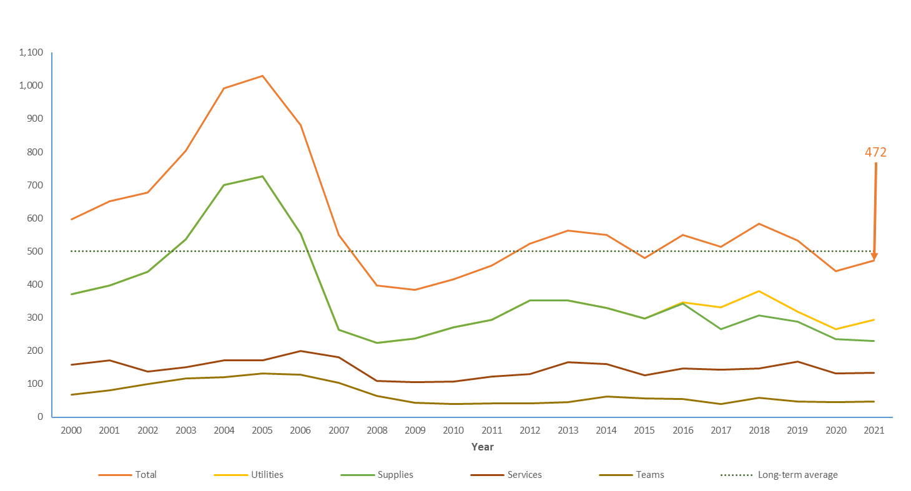
Procurement Expenditure

Slide 7
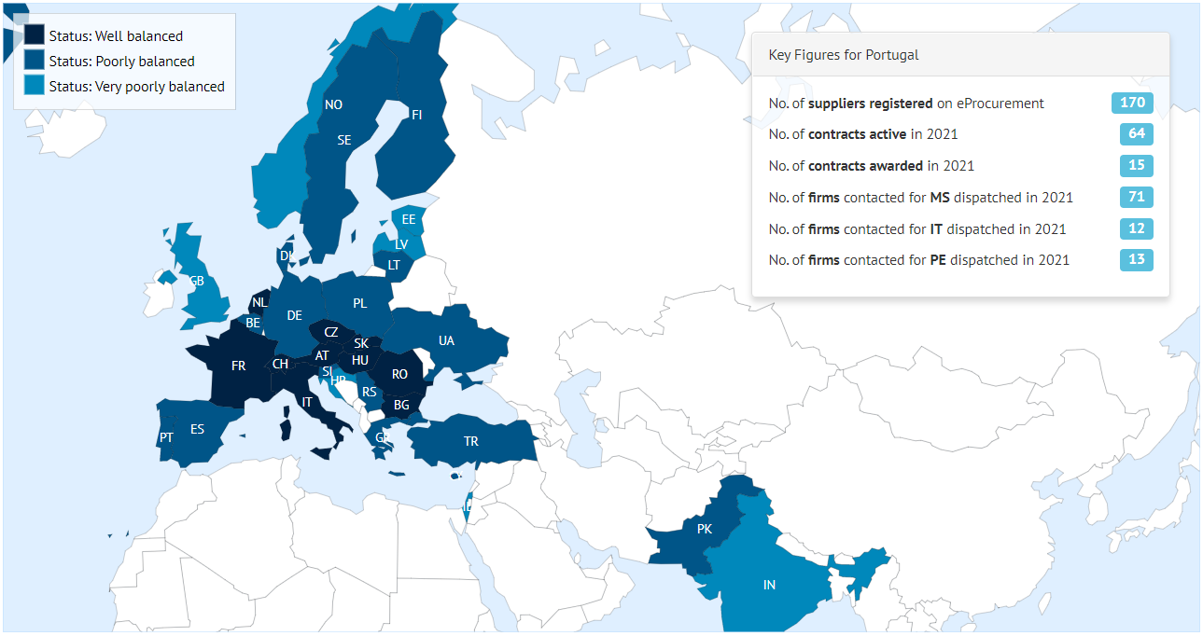
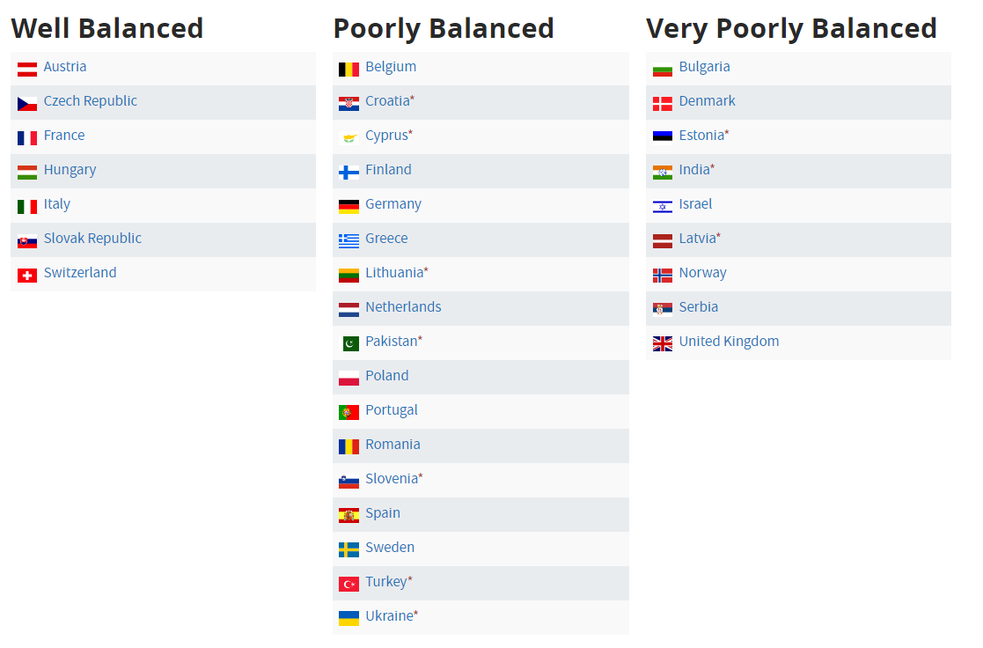
Industrial return to Member States (Supplies)

Slide 8
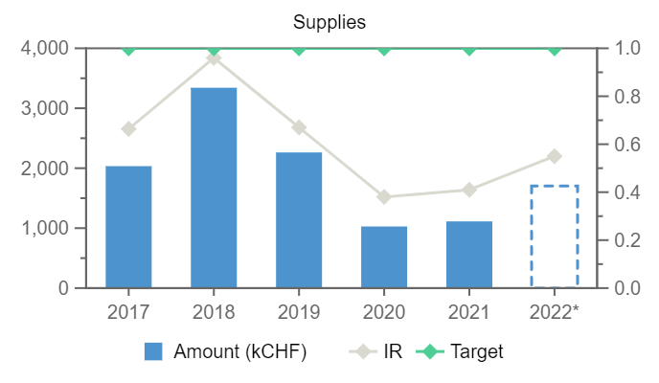
Industrial return to Finland (Supplies)

Slide 9
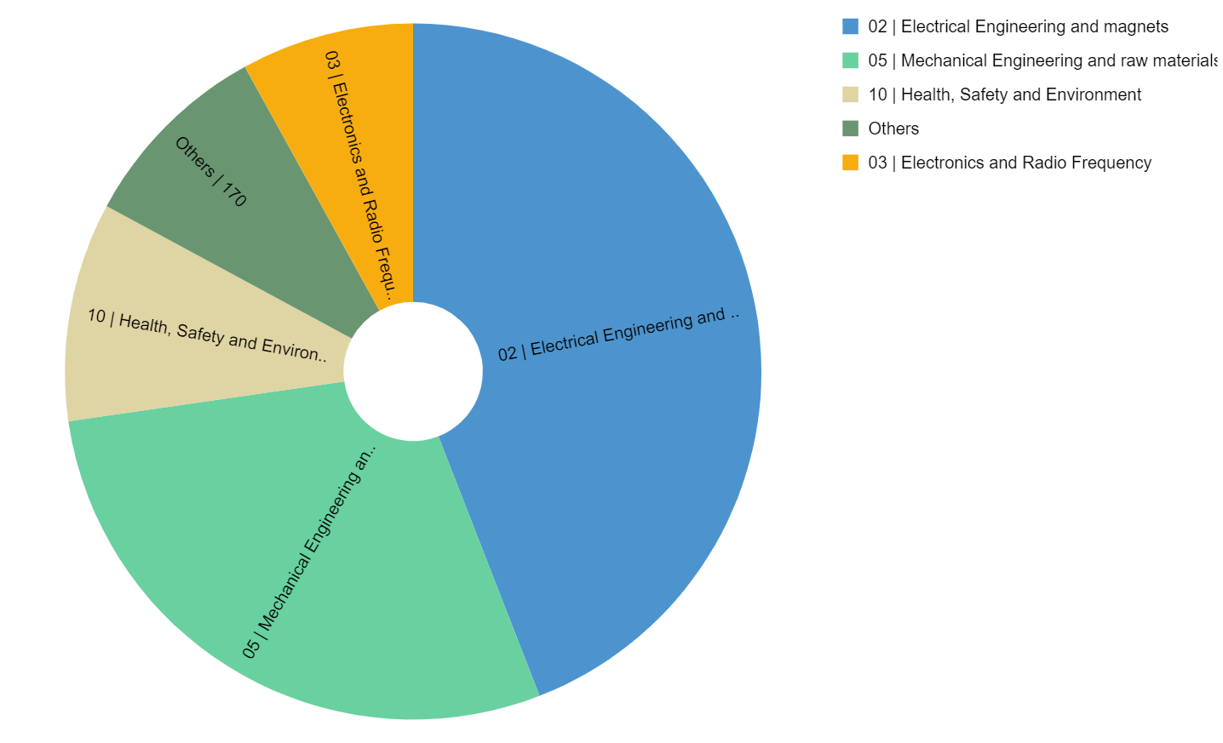
Industrial return to Finland (Supplies)
Expenditure by (Activity|Procurement) Code

Slide 10
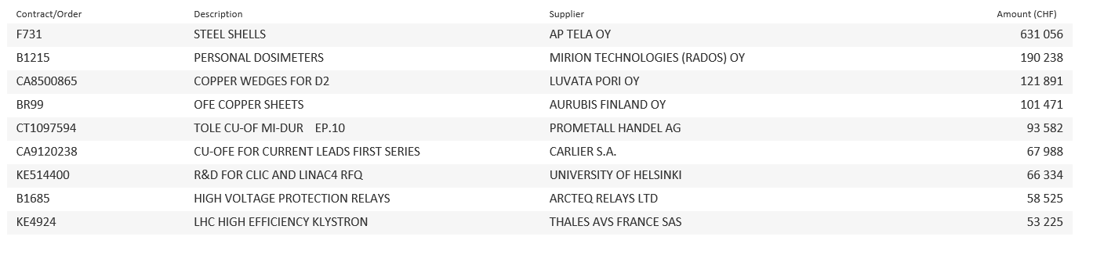
Industrial return to Finland (Supplies)
List of contract/orders with the highest turnover in 2022 for Finland

Slide 11
Thank you

