Slide 1
EN Department
Handling Engineering Group (HE)
‘Business opportunities’

Slide 2
Head of Department: K. Foraz
Deputy: M. Nonis
Access and Alarms
(EN-AA)
GL: P. Ninin
DGL: R. Nunes
Accelerator Coordination & Engineering
(EN-ACE)
GL: J.-Ph. Tock
DGL: S. Chemli
Planning, Administration & Safety
(EN-PAS)
GL: M. Nonis
DGL: S. Knoops
Cooling & Ventilation
(EN-CV)
GL: I. Ruehl
DGL: S. Deleval
Information Management
(EN-IM)
GL: D. Widegren
DGL: J. de Jonghe
Electrical Engineering
(EN-EL)
GL: M. Nonis
DGL: M. Parodi
Handling Engineering
(EN- HE)
GL: C. Colloca
DGL: C. Bertone
Mechanical & Materials Engineering
(EN-MME)
GL: S. Atieh
DGL: A. Bertarelli
Department Head Office
(EN-HDO)
Assistant: S. Escaffre
EN Department
Operation
  Infrastructure
  Accelerators
Projects
  Consolidation
  Upgrades
  New facilities
  Design & Manufacturing
Studies
5
61
67
11
27
32
78
76
37

Slide 3
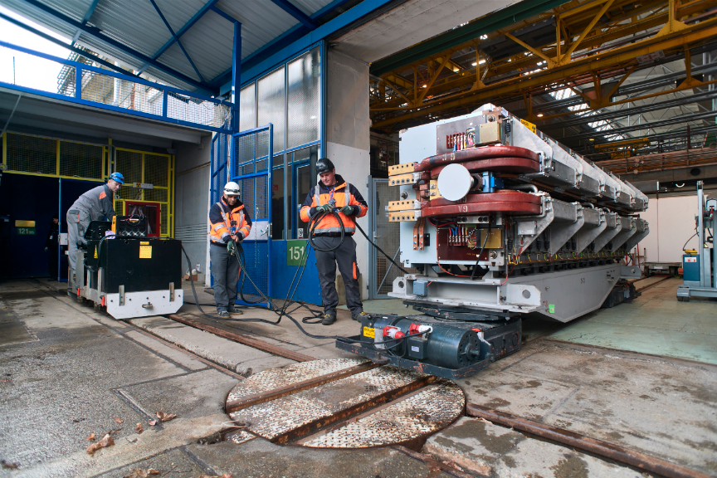
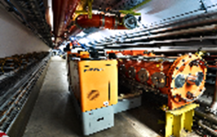
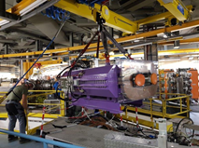
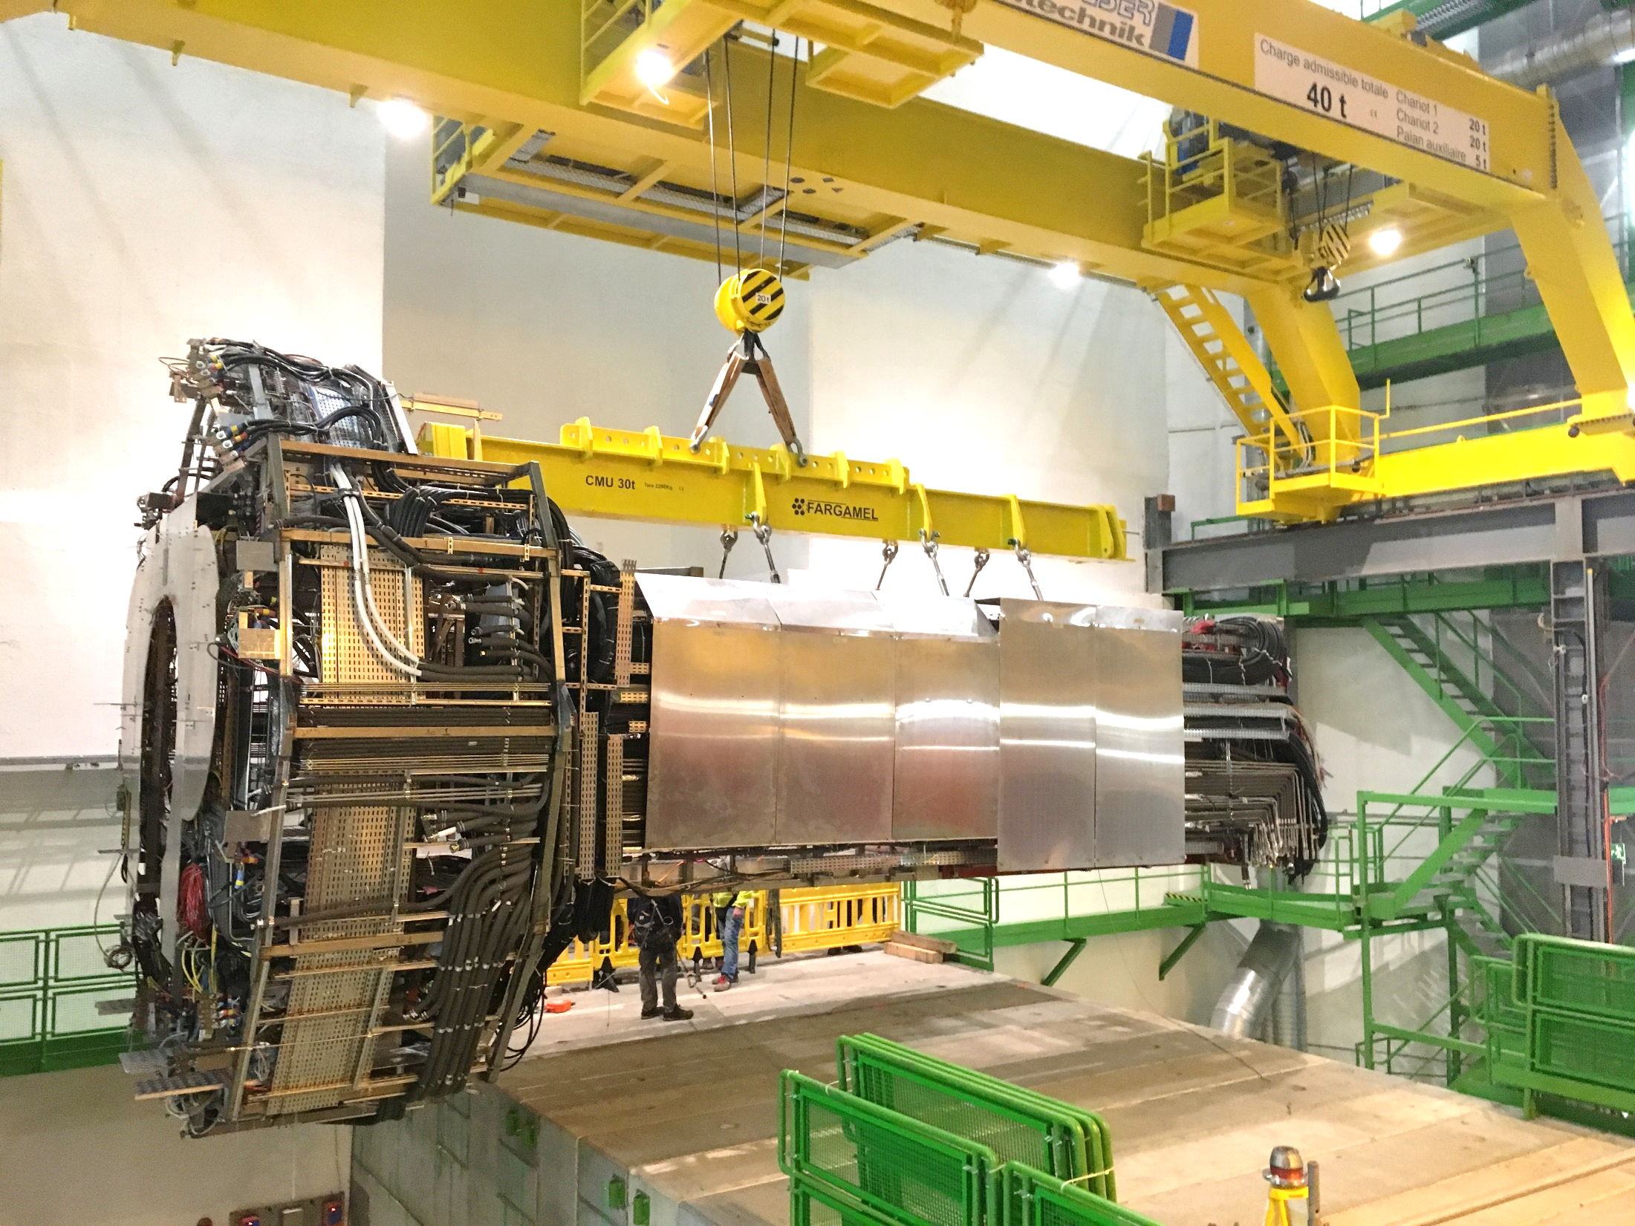
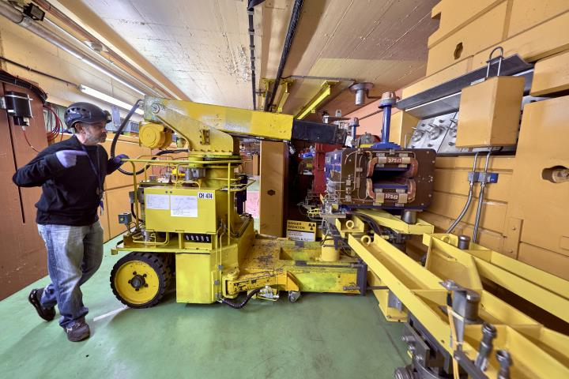
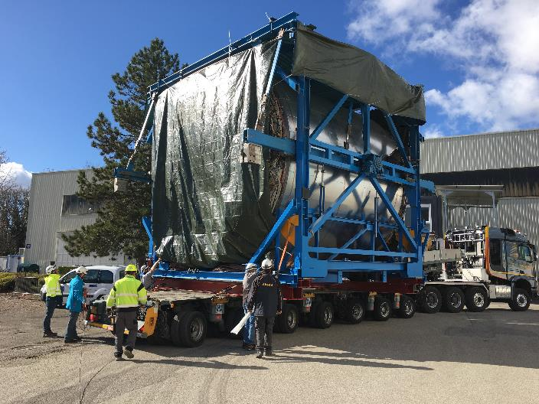
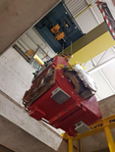
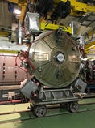
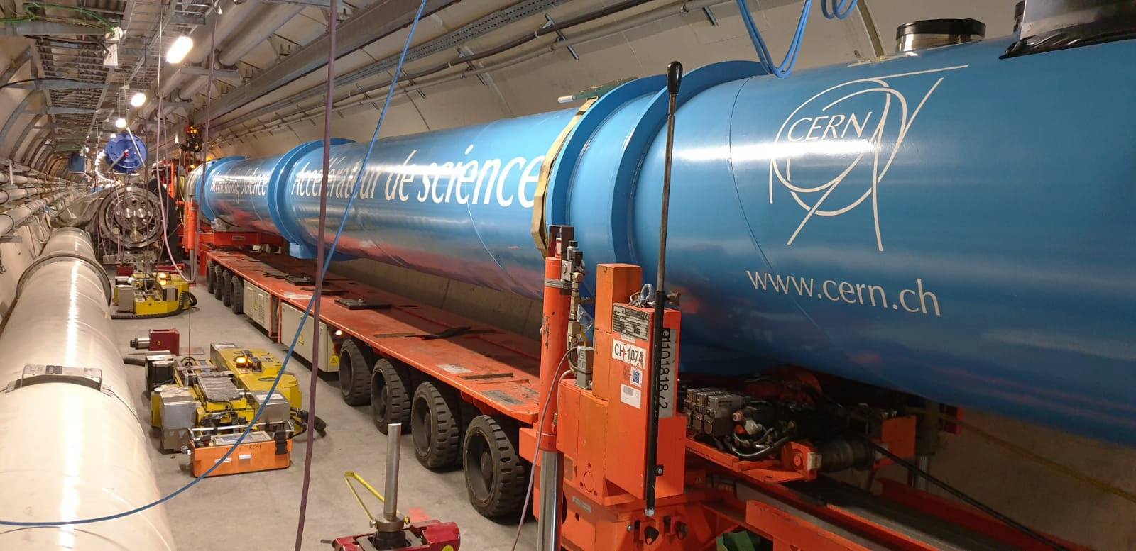
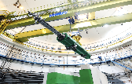
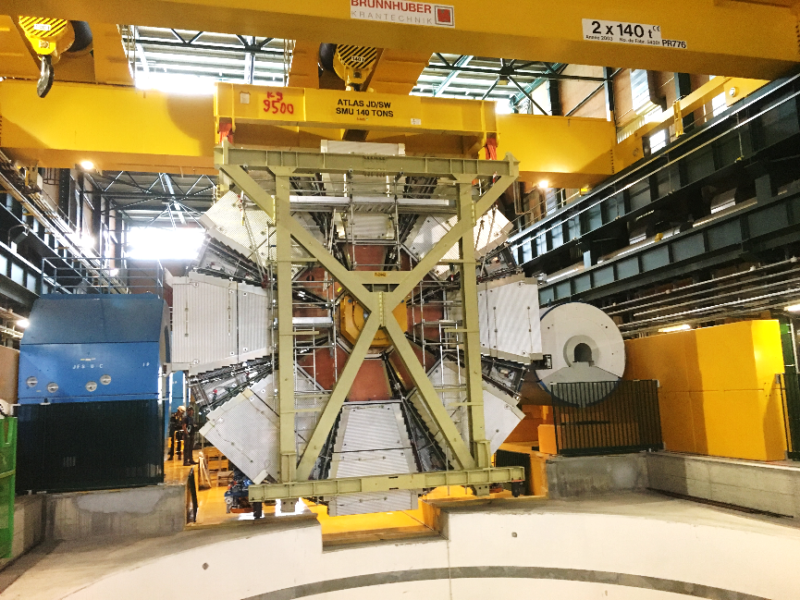
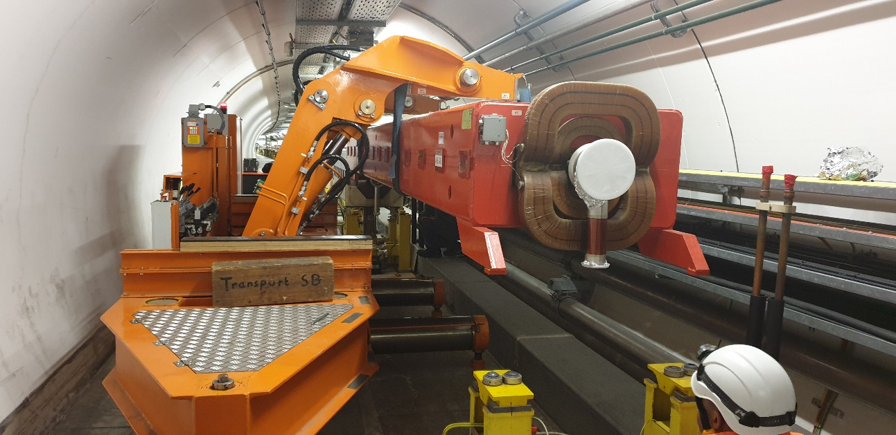
HE - Handling Engineering Group
From enormous pieces of equipment with unconventional shapes, to extremely delicate detector parts, the careful handling and transportation of components is essential at CERN.
The Handling Engineering (HE) Group prepares, organizes and coordinates all transport and handling operations for the CERN accelerators and experiments as well as the transport of thousands of conventional items, chemical and radioactive products per year.
The Group is specialized in the design, integration and feasibility studies related to the transport and handling operations. Both standard industrial and custom-built transport and handling equipment is being procured, installed and commissioned.
The Group manages and maintains all the industrial transport, handling and lifting equipment to ensure the perfect performance all along its lifecycle.
With the accelerator complex deep underground and about 700 buildings on surface, both passenger and goods lifts are very important. The HE Group is responsible for the purchase, installation and maintenance of all of them, regularly checking their performance.

Slide 4
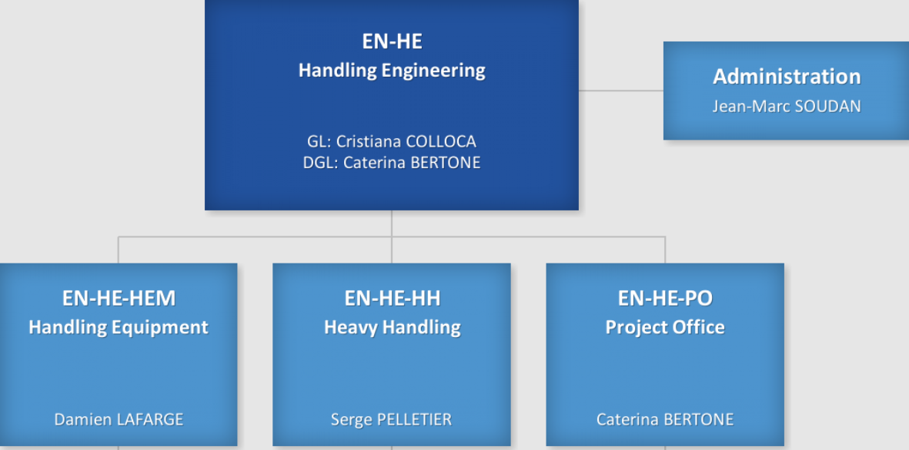
Structure chart

Slide 5
Activities
HEM
HH
PO
Handling Equipment Management
Heavy Handling
Project Office
Travelling cranes, lifts, trucks etc.:
Procurement and commissioning
Data bases and maintenance programs
- Storage and dedicated tools
- Contracts
Handling & Transport management:
- Standard requests
- Special request (ADR)
- On field operation
- Dedicated tools storage
Handling & Transport :
- Operation support & studies
- Contract management & administration
Pre studies, dimensioning equipment and special vehicles. Tools procurement.
Road trucks fleet management, vans, lifting platforms :
- Database
- Contracts
Consolidation
Contracts follow-up
Resources follow-up
GMAO, Web site, IT-linked projects
Operational Safety (WSSs, Safety Link person, Safety Advisor, TSOs, RSSO...)
Group representatives for committees, WPLs…
Contribution to transversal project via correspondents
Contract management (TECH 1 and TECH 2), lifting platforms fleet…

Slide 6
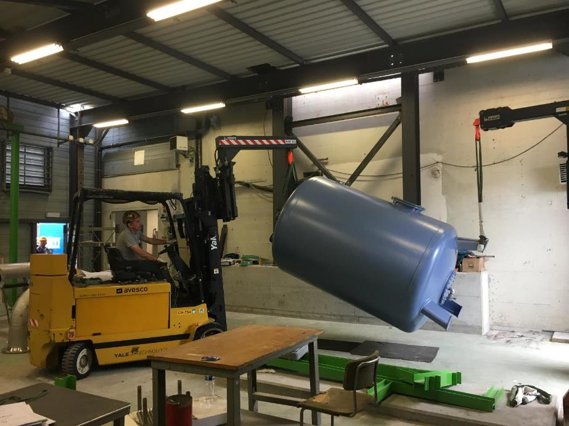
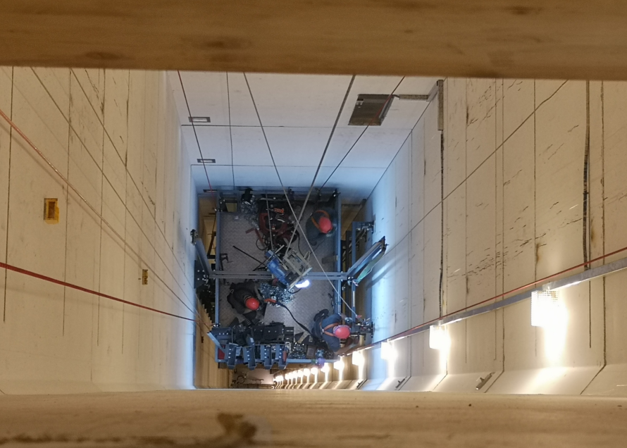
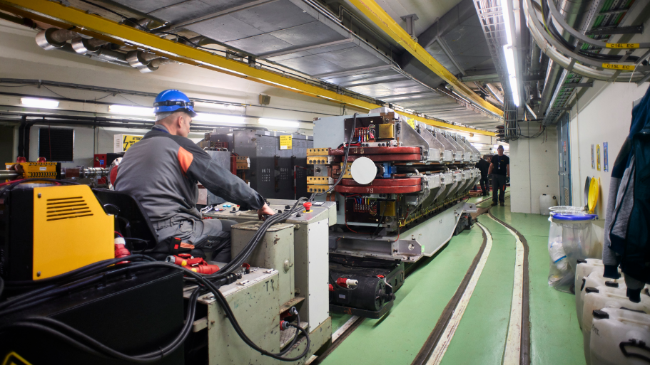
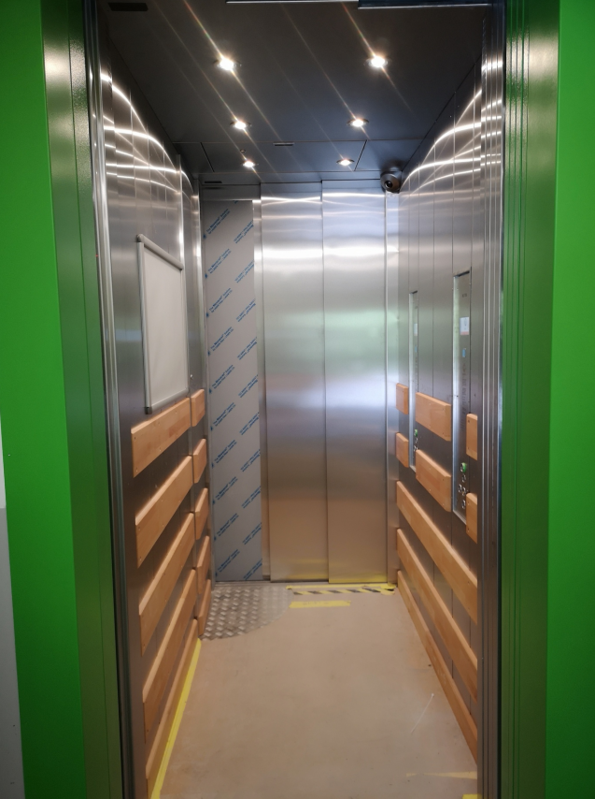
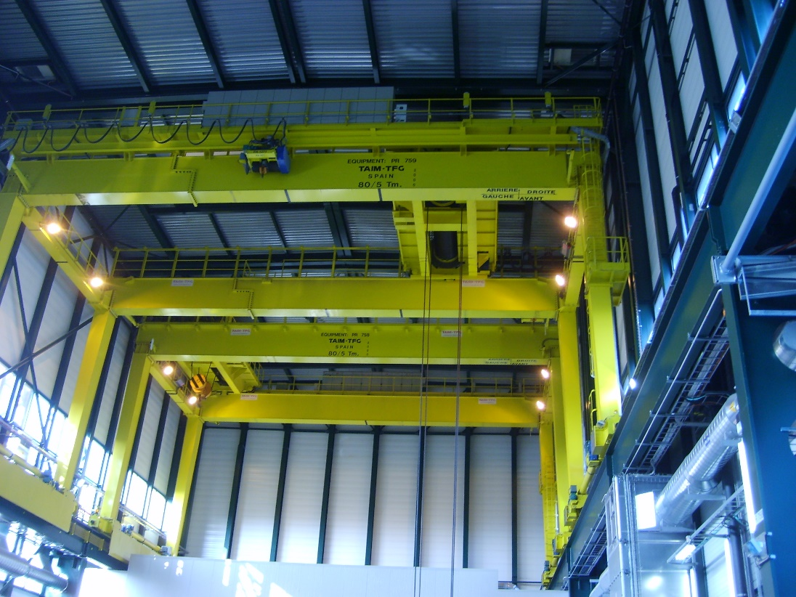
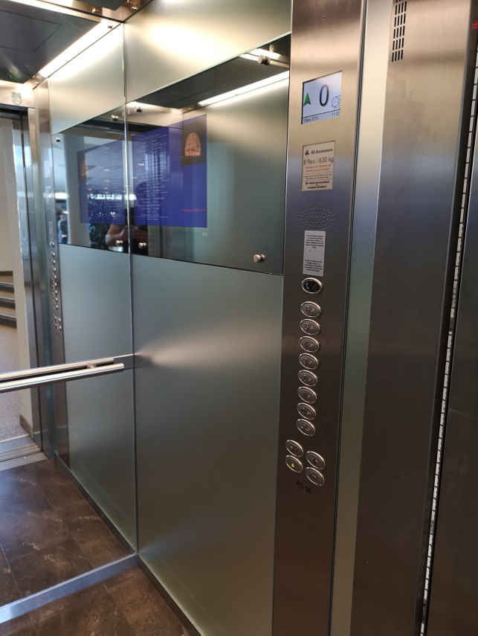
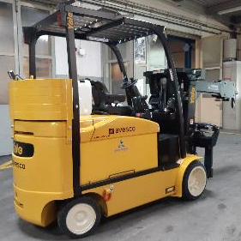
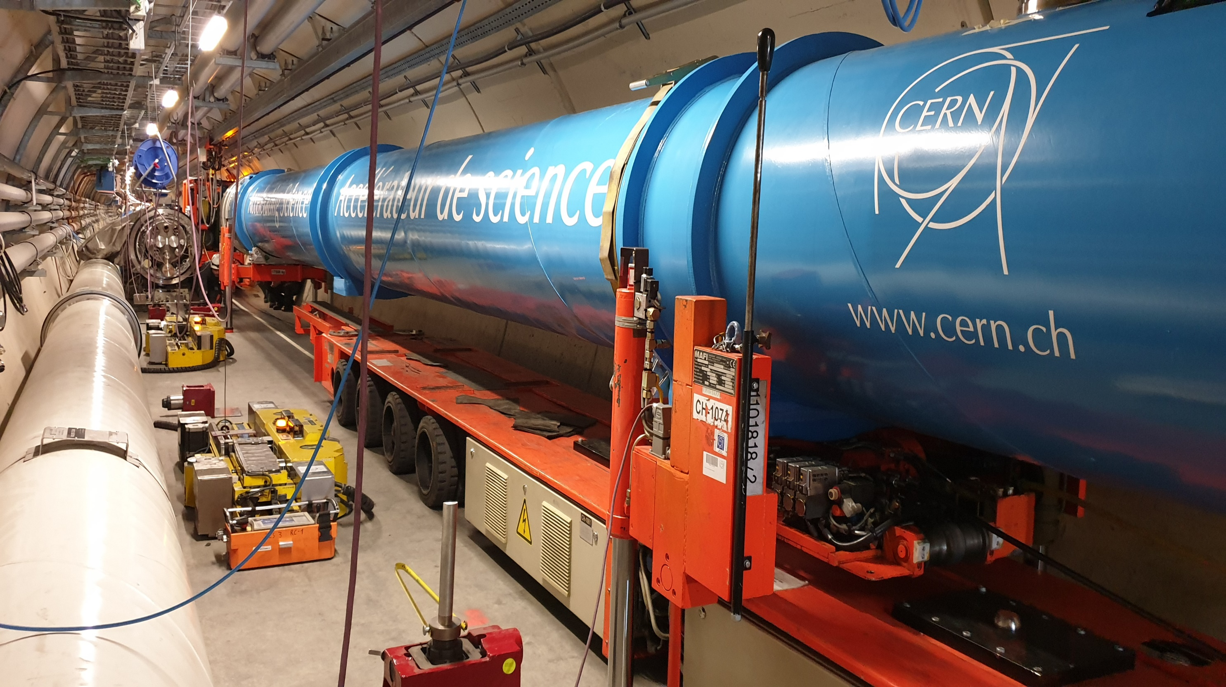
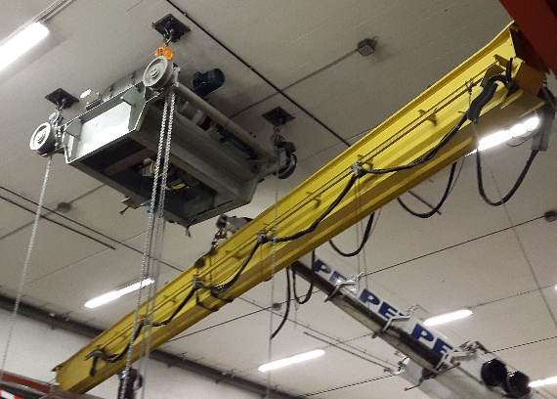
Procurement in HE
Industrial Services (S contracts)
For operation and maintenance
Supply Services (B contracts)
For consolidation campaigns & new equip.
Single supplies of goods (F contracts + DAI)
Equipment (new and consolidation) and tools

Slide 7
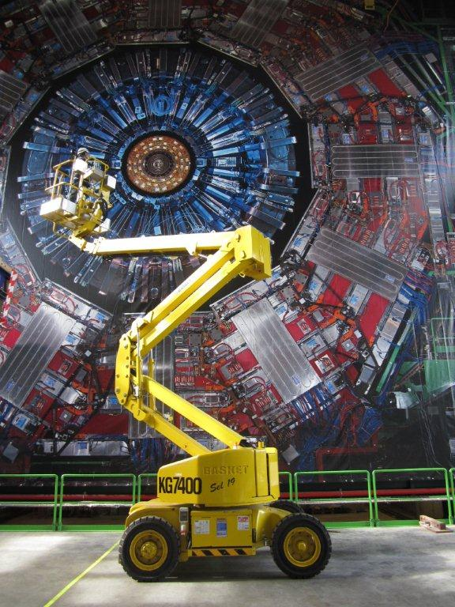
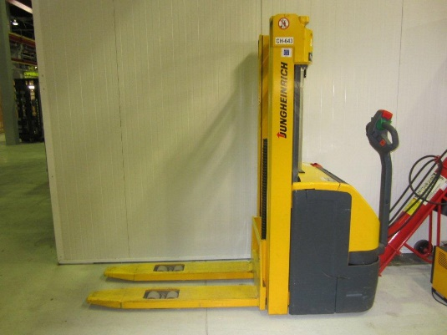
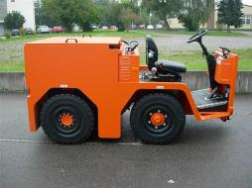
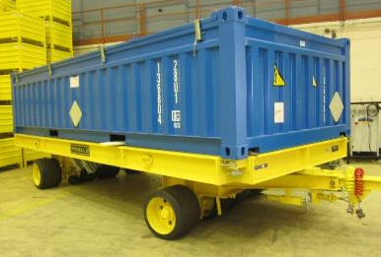
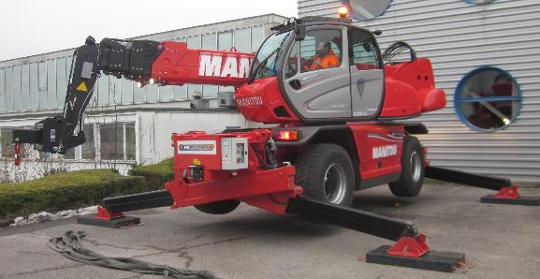
Industrial trucks
HEM
Handling Equipment Management
Examples:
forklifts up to 14 t
lifting platforms up to 17m
trailers of all kind
N. purchases / year: ~10

Slide 8
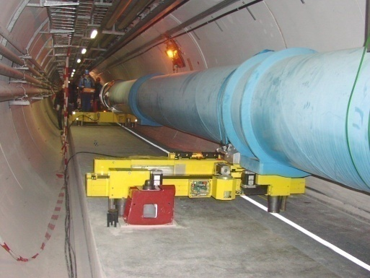
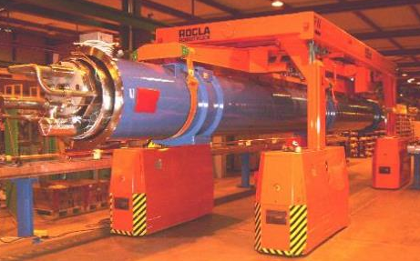
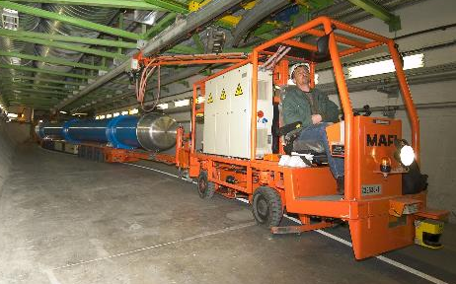
Industrial trucks – special vehicles
HEM
Handling Equipment Management
Examples:
Specific lifting equipment requiring regular refurbishment or purchase
N. purchases / year: max 1

Slide 9
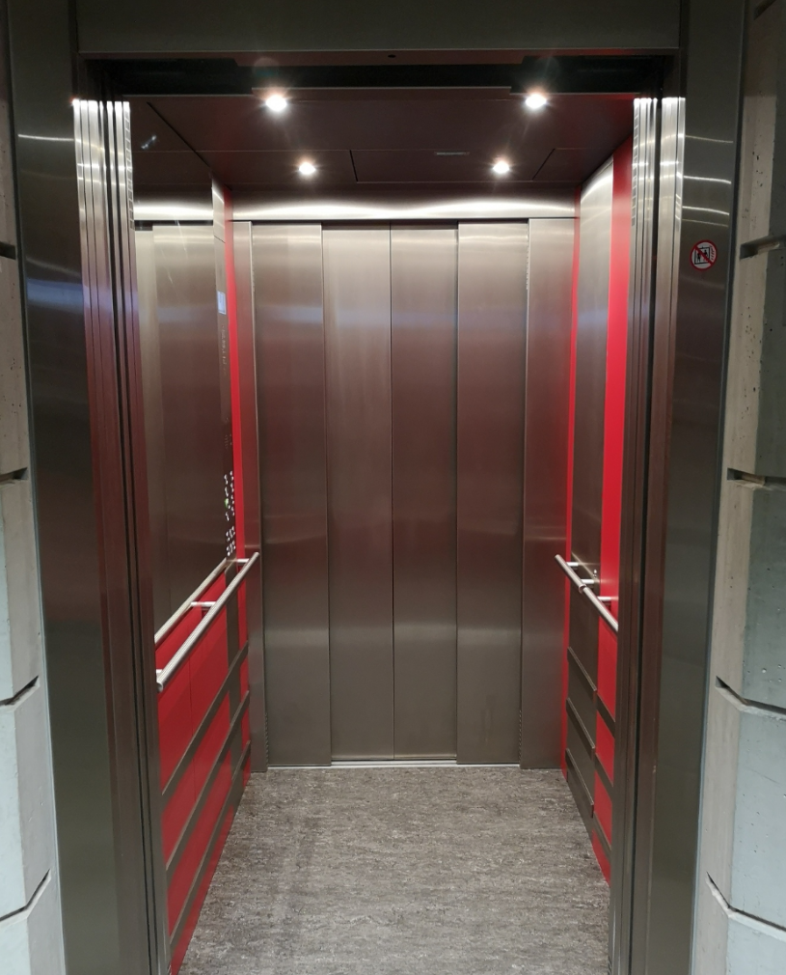
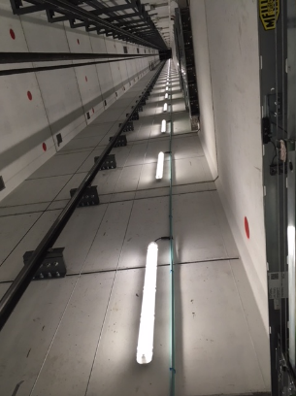
Passenger and goods lifts
HEM
Handling Equipment Management
Passenger lifts
  Capacity up to 3 t
  Height up to 140 m
Goods lifts
  Capacity up to 25 t
  Height up to 50 m
N. purchases / year: 3

Slide 10
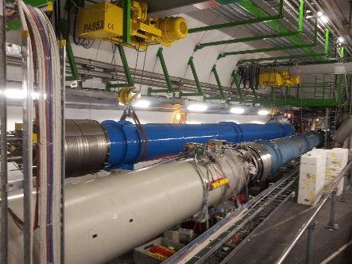
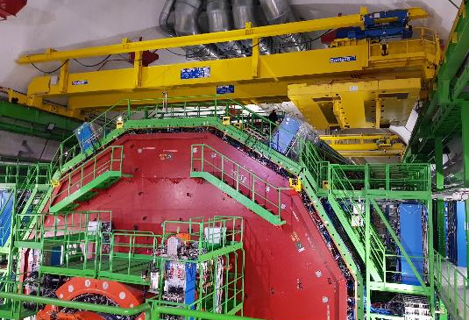
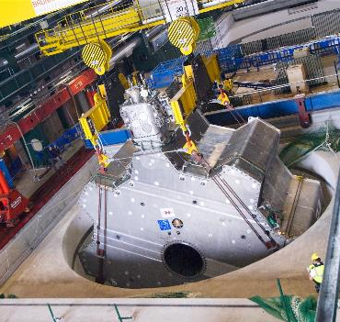
Handling and lifting equipment
HEM
Handling Equipment Management
Overhead cranes
  Capacity up to 280 ton
  Span up to 60 m
  Lifting height up to 140 m
Hoists
N. purchases / year: 8

Slide 11
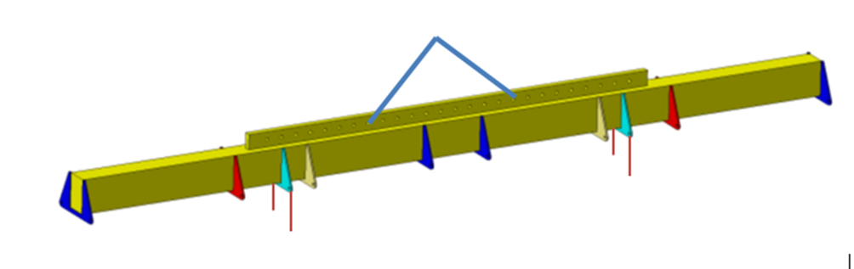
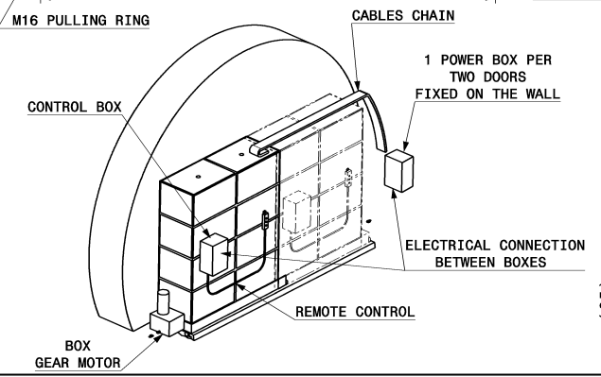
Equipment & tools
PO
Project Office
Examples:
Spreaders
Lifting accessories
- Shielded doors
N. purchases / year: 10-20

Slide 12
Industrial trucks - maintenance
HEM
Handling Equipment Management
Number of contractors : 1
Number of assets: ~2300
Preventative interventions per year : ~ 700
Corrective interventions per year : ~500
+ Periodic Safety Inspections once or twice per year of all assets by external notified body

Slide 13
Passenger & goods lifts - maintenance
HEM
Handling Equipment Management
Number of contractors : 2
Number of assets: ~130
Preventative interventions per year : ~ 1400
Corrective interventions per year : ~300
+ Periodic Safety Inspections once per year of all assets by external notified body

Slide 14
Handling & lifting eq. - maintenance
HEM
Handling Equipment Management
Number of contractors : 1
Number of assets: ~2500
Preventative interventions per year : ~ 500
Corrective interventions per year : ~250
+ Periodic Safety Inspections once per year of all assets by external notified body

Slide 15
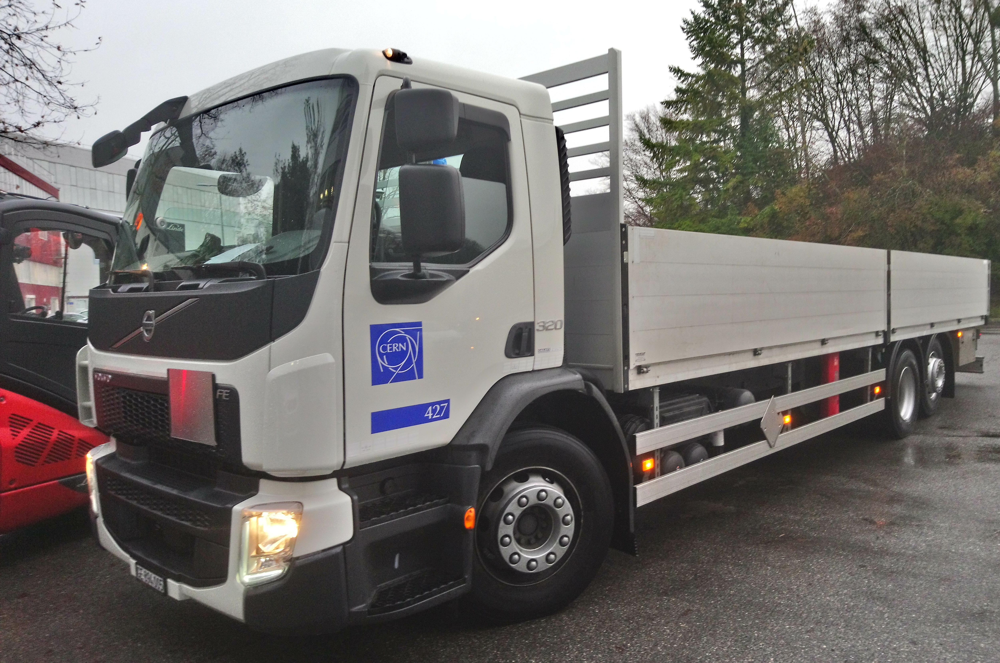
Road trucks – supply and maintenance
PO
Project Office
Number of contractors : 1
Number of assets: ~35 trucks and trailers
Preventative interventions per year : ~ 30
Corrective interventions per year : ~100
N. purchases / year : ~1
Vans – supply and maintenance
Number of contractors : 1
Number of assets: ~35
Preventative interventions per year : ~ 40
Corrective interventions per year : ~30
N. purchases / year : ~2

Slide 16
Handling & transport - operation
PO
Project Office
Number of contractors : 1
Interventions per year
Handling: ~ 11’000
Road transport: ~5’000
Mobile Crane intervention: ~300

Slide 17
On-going/future HE procurement – to-date STATUS

