Slide 1
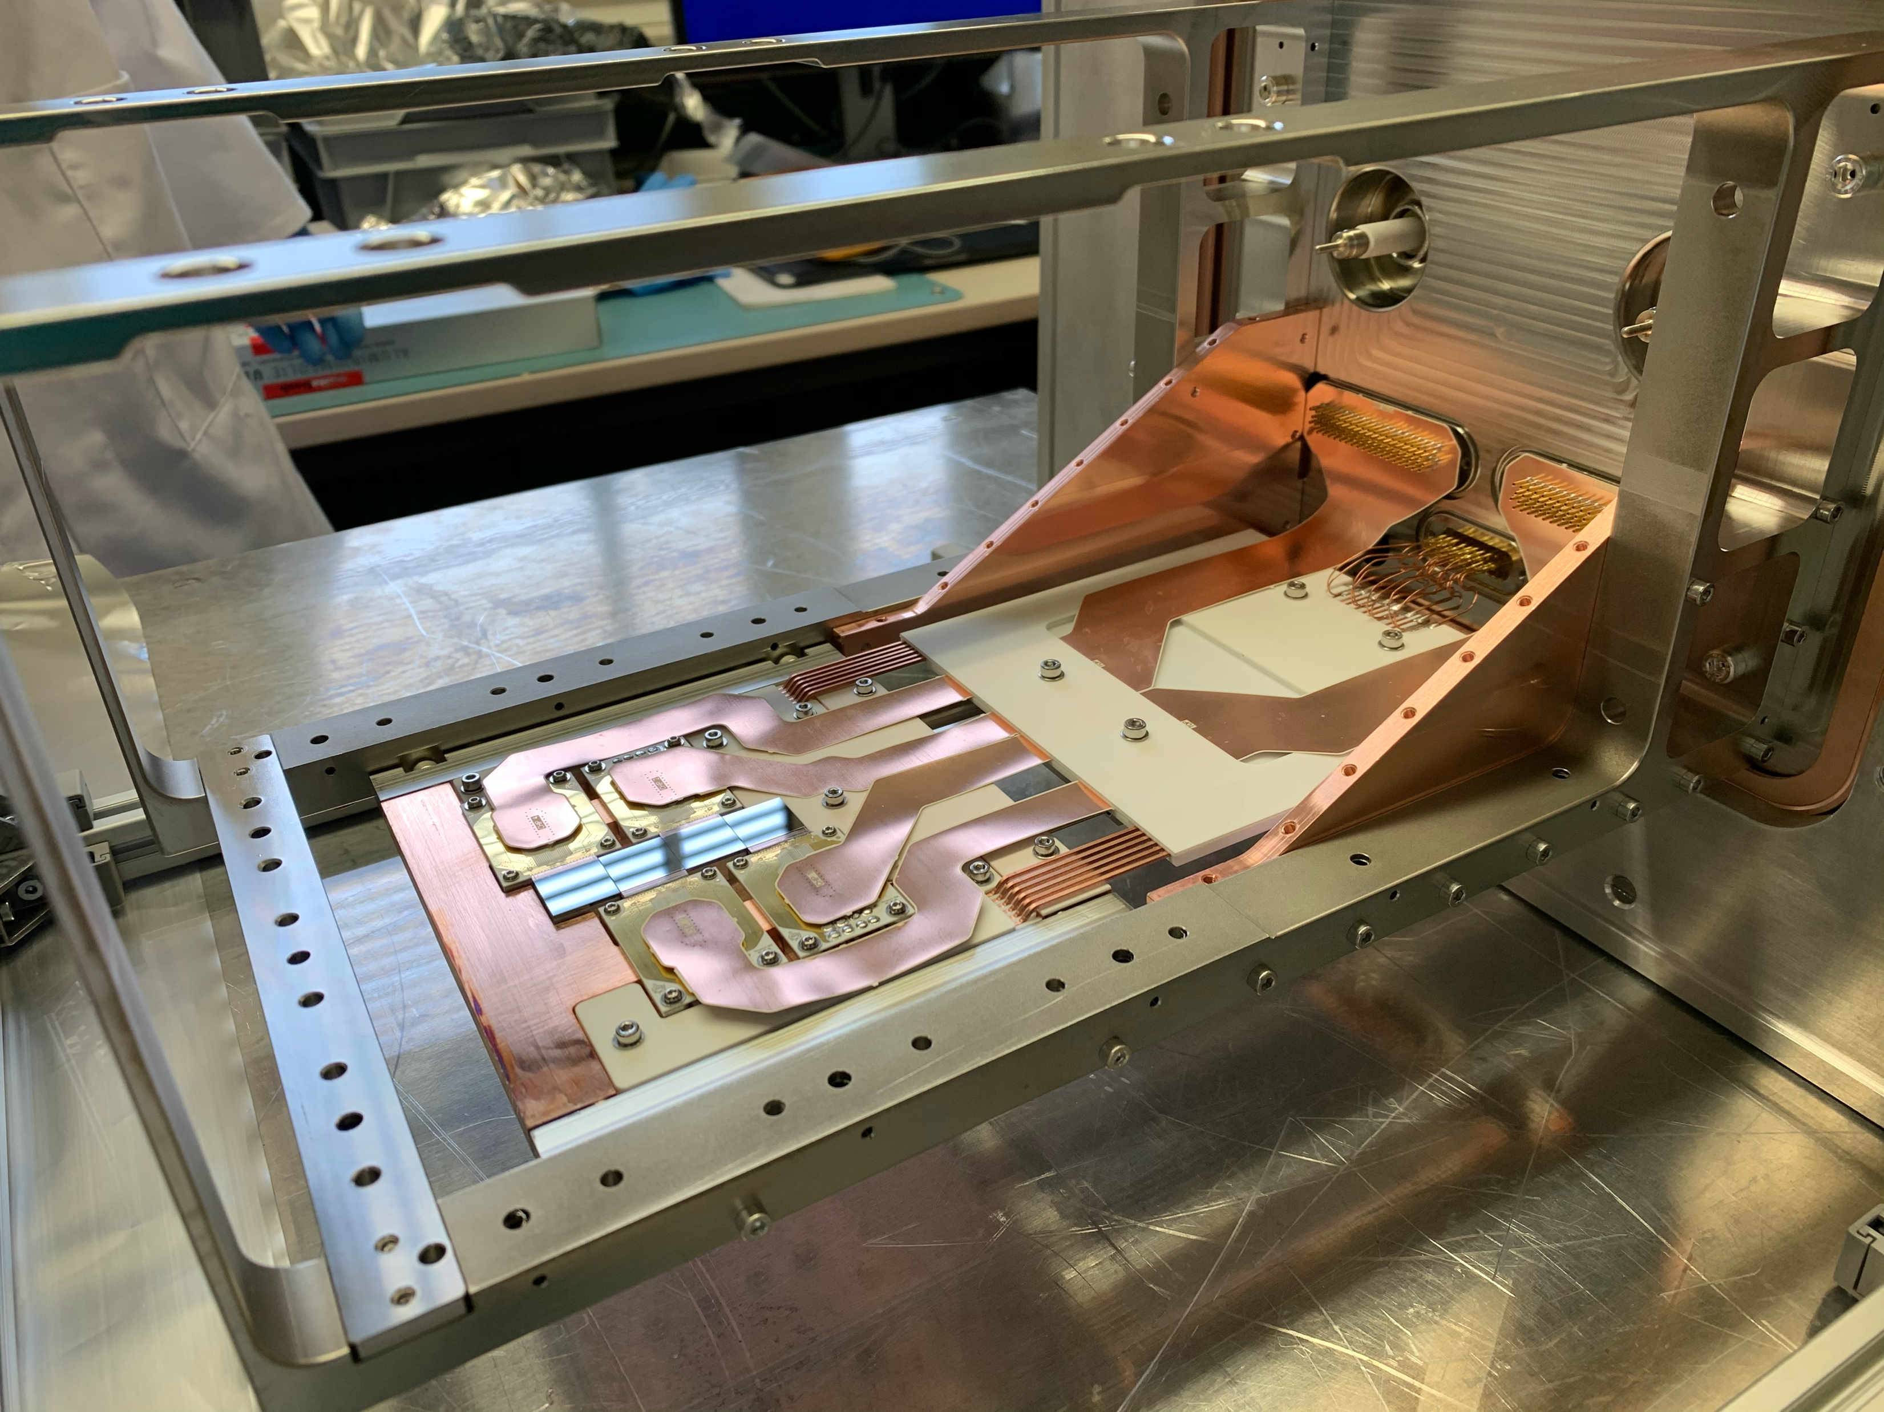
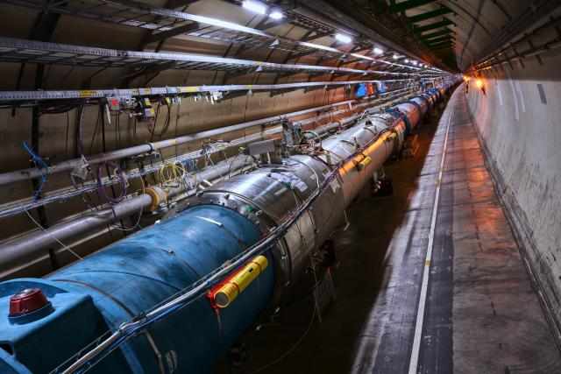
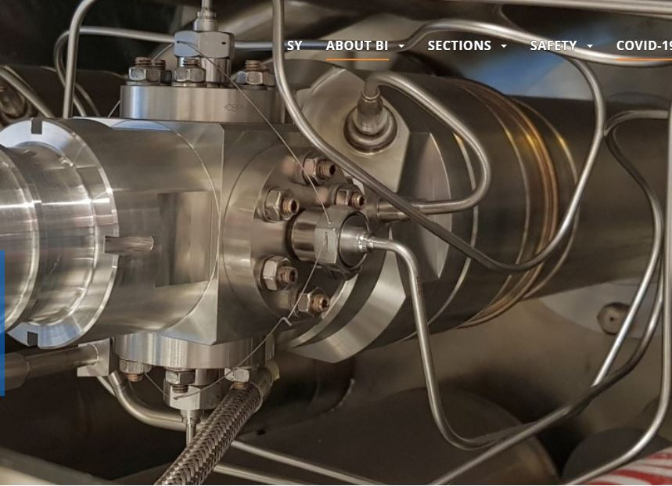
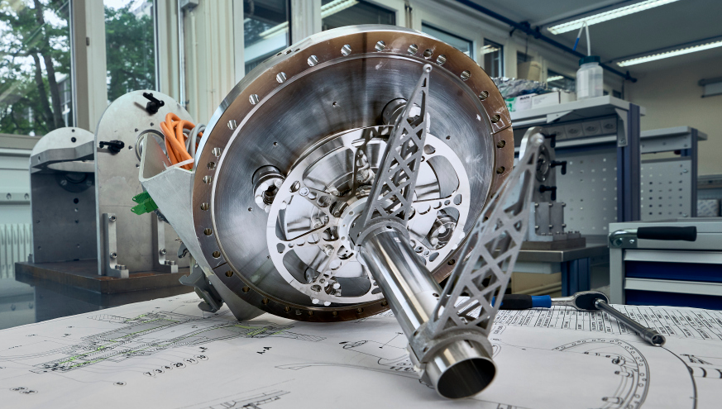
Beam Instrumentation Mandate
The BI Group is responsible for > 10000 instruments that allow observation of the particle beams and the measurement of related parameters:
Beam losses;
Beam position;
Intensity and Tune;
Beam profiles;
Associated equipment control systems and software.

Slide 2
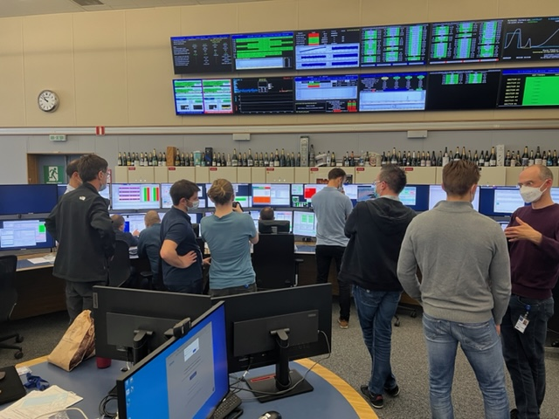
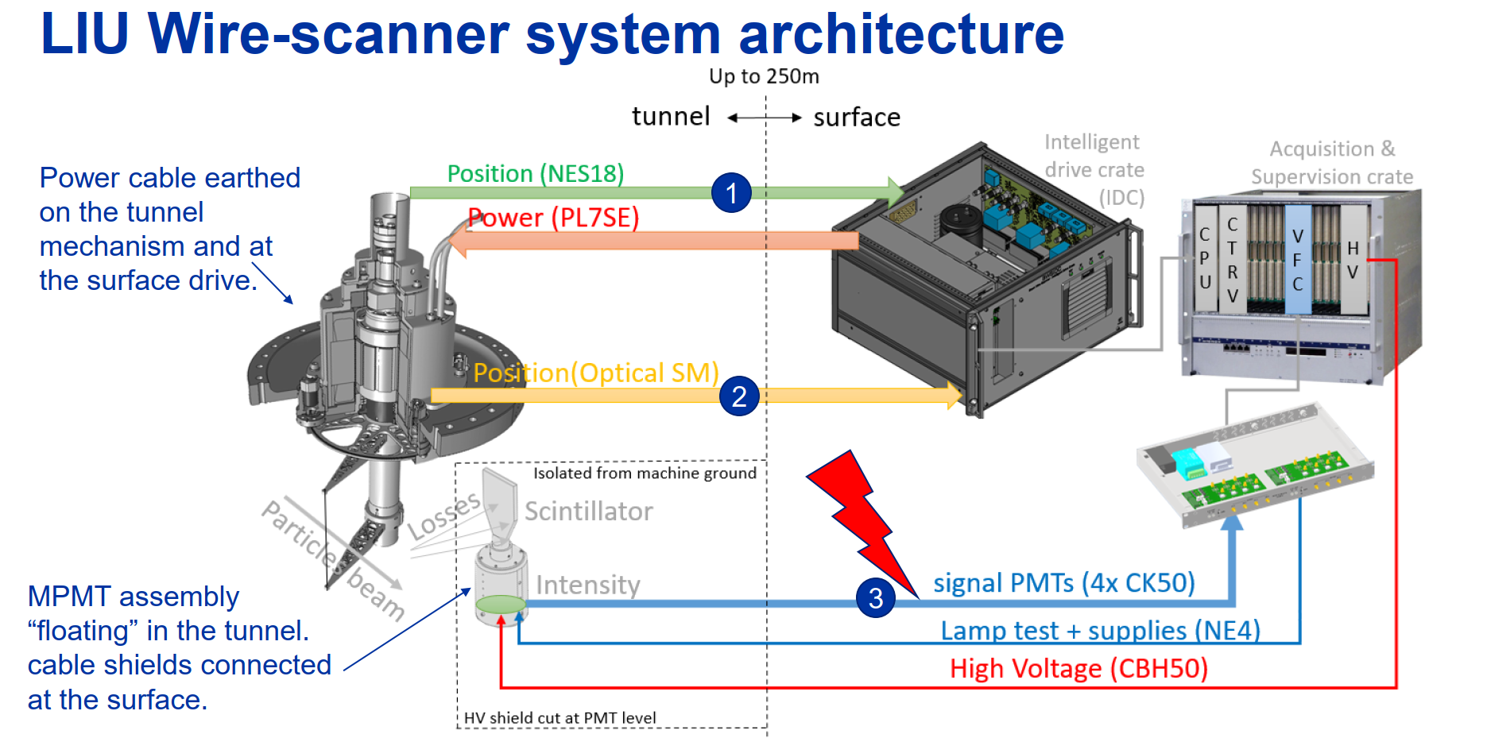
Example of a Beam Instrumentation System ‘Vertical Slice’
Electro-Mechanics
Vacuum engineering
Precision machining
Exotic materials
Motors
Sensors
Optics
Opto-electronics
Radiation detectors
Switches
Control and acquisition electronics
Analogue electronics cards
Digital electronics cards
Motor controllers
Communications
Software
Special cables

Slide 3

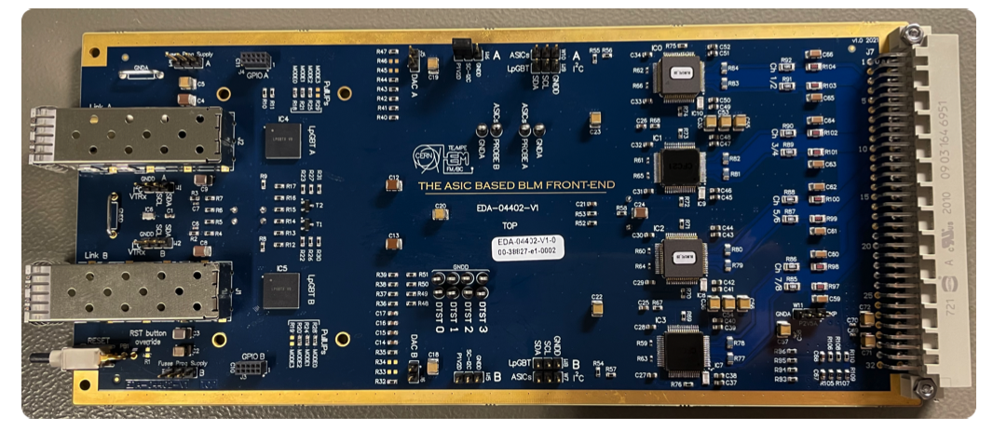
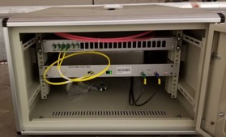
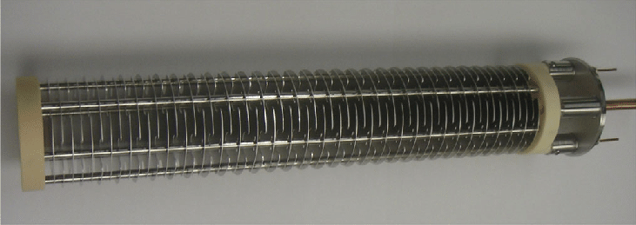

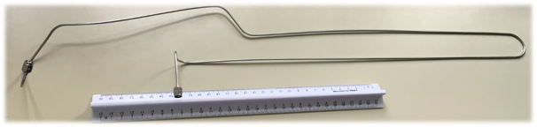
Beam Instrumentation: Current and Future Needs
Production of electronics boards
Production of mini racks for installation in accelerator tunnels
Industrialisation and production of ionization chambers
Production of specific cables and RF vacuum feedthroughs

Slide 4
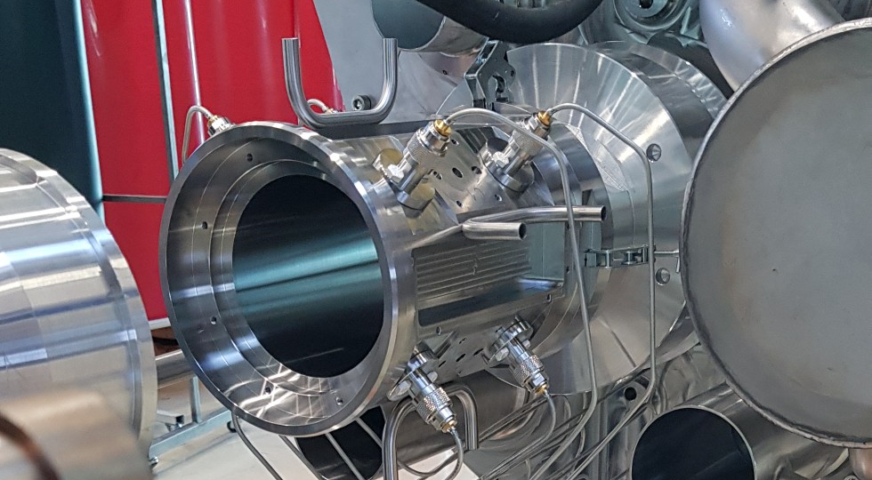
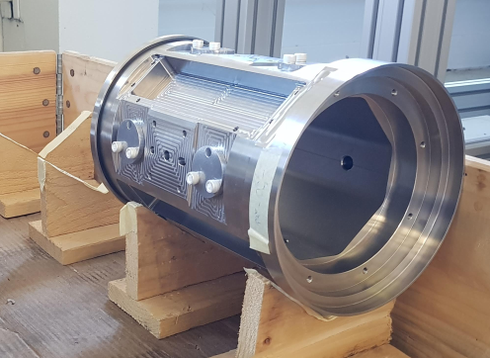
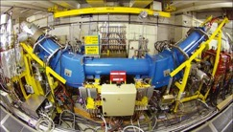
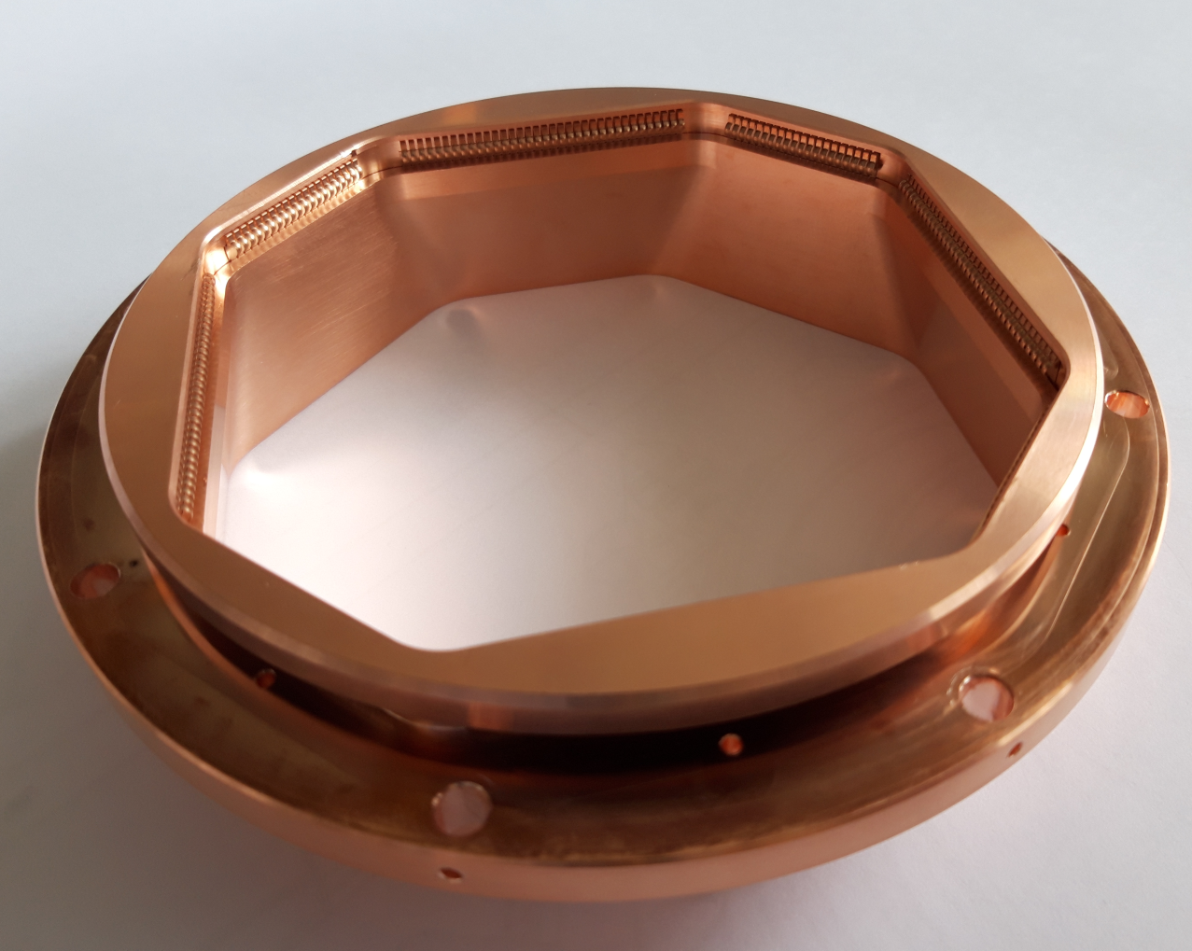
Beam Instrumentation: Current and Future Needs
Production of high precision UHV mechanical objects
Production of electron gun and collector at 80kV

