Slide 1

Workshop on opportunities for Finnish industry at CERN – 25.5.2022
FIBRE OPTICS
D. Ricci, M. Parodi on behalf of EN-EL group

Slide 2
Agenda
  CERN optical fibre infrastructure
  Type of Contracts and examples
  Upcoming industrial opportunities

Slide 3
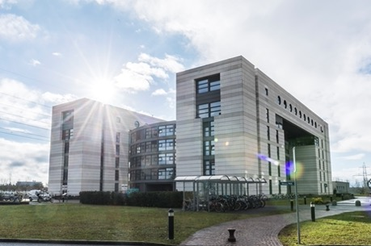


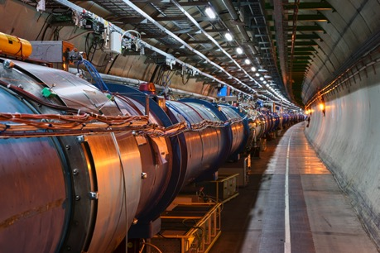
Optical fibre infrastructure at CERN
  Serving: accelerators, experiments, tertiary and IT networks
    Single-Mode fibres, Multi-Mode fibres and special fibres for specific applications
    Projects, Consolidation & Maintenance

Slide 4
Optical fibre insfrastructure at CERN
  Star point topology
  SMF, MMF, and special fibres
  Quantities
    Approx. 50’000 km of installed fibres
    Approx. 200’000 connectors
  Harsh environment with
    High radiation levels
    Very low temperatures

Slide 5
Types of Contracts
  In general:
  Blanket contracts for the supply of equipment
  Service contracts for installation and maintenance
  Supply contracts (blanket purchase)
    Supply of optical fibre cables, pre-terminated cables, terminal hardware, etc…
      2 currently in place, 1 completing tendering process
    Supply of optical fibre ducts for cable blowing
      1 to tender soon
  Service contract
    Installation (by both air-blowing and convential cable pulling )
      1 currently in place

Slide 6
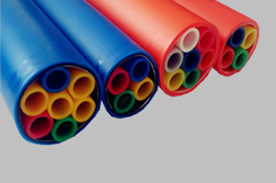
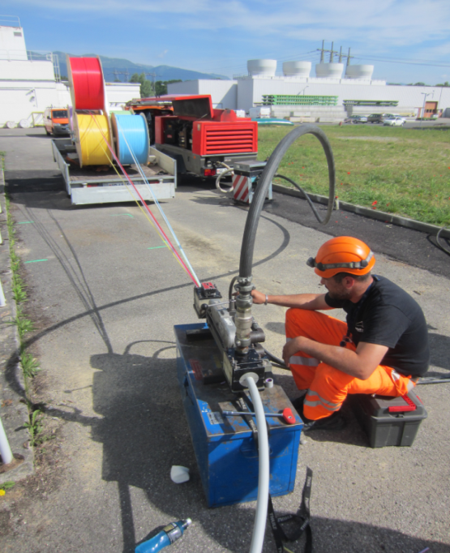

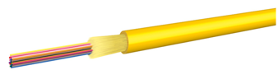
Example – Optical fibre duct & cable blowing
Ducts with microducts
Microduct fibre cable

Slide 7
Upcoming industrial opportunities
  Supply contracts (blanket purchase contracts up to 5 years)
Contract description | Comments | Market Survey | Invitation to Tender | Estimated volume
Supply of optical fibre ducts and microducts | New contract | Q3 2022 | Q4 2022 | 200 km
Supply of optical fibre patch cords and assemblies | New contract | Completed | Ongoing | 6500 pcs
Supply of radiation resistant single mode optical fibres (Specialty) | New contract | 2023 |  | 1500 km
Concerning Specialty Fibres, we are also keen to explore opportunities with sufficiently experienced companies, for manufacturing:
radiation-sensors (e.g. with Phosphorous-doped fibres or radio-luminescent fibres)
Polarization maintaining fibres

Slide 9
Workshop on opportunities for Finnish industry at CERN – 25.5.2022
Power Distribution
D. Ricci, M. Parodi on behalf of EN-EL group

Slide 10
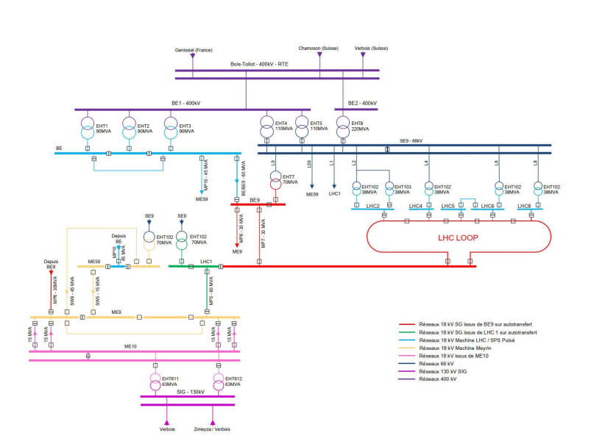
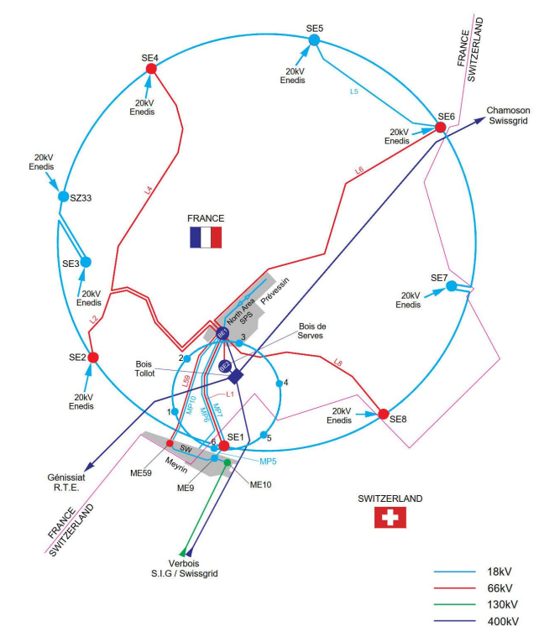
CERN HV Electrical Network

Slide 11
Upcoming Industrial Opportunities
Type of Contract | Description | Adjudication
Supply | Supply of water cooled cables | Mar-23
IS | Maintenance transformateurs HTB | Mar-23
IS+Supply | Supply, installation, commissioning & maintenance of electrical switchgear (18 and 3.3 kV) | Jun-22
IS+Supply | Supply, commissionning, operation and maintenance of modular power converter systems (UPS 48 V & Central safety power supply systems 230 V) | Sep-22
Supply | Supply installation of UPS | Jun-23
IS+Supply | Supply, Installation, Acceptance Tests, and Maintenance of modular metal-enclosed, 400/230 V low voltage switchboards for indoor use (type 1 & 2) | Dec-22
Supply | New 66 kV line LHC5-LHC6 | Mar-23
Supply | 66 kV substation LHC5 and LHC6 | Jun-23
Supply | 66/18 kV transformer LHC5 | Jun-23
Supply | New LHC5 emergency gensets | Mar-24
Supply | UPS for Hostlab 2 | Mar-24
Target: Standard industrial materials/services

Slide 12
Future Opportunities
We are keen to explore opportunities with sufficiently experienced companies for Super-Conductivity applications (particularly HSC) in AC power distribution domain.
Strong experience on SC magnets and SC DC links at CERN, not in specific HSC AC distribution applications.
Potential impact:
  Existing infrastructures
  Future facilities under conceptual study
No specific initiatives on this topic are active at the moment in EN-EL group

