Slide 1
Opportunities for Finnish Industry at CERN
EU Projects
Pablo Garcia Tello
EU Office
May 25th 2022

Slide 2
How EU Projects are “built” at CERN
Bottom-up approach: Researchers interested in EU funding find their own partners for assembling a consortium and submitting a proposal.
The EU Office does not intervene in the process of finding partners unless explicitly requested by the CERN researchers.
BUT…
    It doesn’t mean that industrial and/or public R&D&I organizations interested in the possibility of incorporating CERN as a partner in an EU proposal in construction do not let us know about it.
    If such case is given, the EU Office would help in raising the potential interest of relevant CERN Departments.

Slide 3
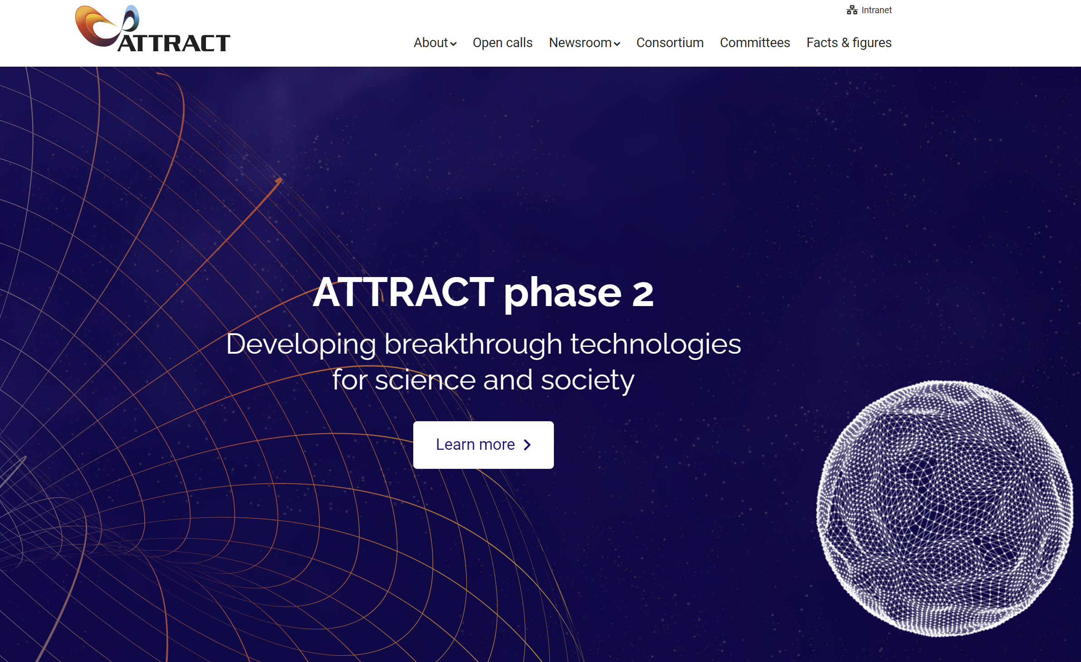
Exceptions to this approach: The ATTRACT initiative
ATTRACT Initiative: An EU funded project coordinated by CERN which launches calls to submit proposals in the field of breakthrough detection and imaging technologies.
https://attract-eu.com/

Slide 4
Exceptions to this approach: The ATTRACT initiative
In 2023 the ATTRACT project will launch an open call for those consortia (minimum 2 partners) interested in submitting a proposal in the field of breakthrough detection technologies for sustainability.
An Independent R&D&I Committee will decide which projects would be awarded.
Each awarded project will receive 100 kE during one year for demonstrating a “proof of concept”.
The call will not look for incremental developments but for breakthrough technologies with a clear potential of disruption.
In past editions, the Finnish participation has been very substantial (~20% of the Finnish submissions have been awarded).

Slide 5
Thanks
and
Questions

