Slide 1
HAC and Target system are collaborating
  Pylog and ScaleHLS are now merged within HLS4ML meetings.

Slide 2
Algorithm-System-Hardware Co-Design for
Efficient Point Cloud Processing
Team at MIT: Zhijian Liu, Haotian Tang, Yujun Lin, Song Han
Achievements in the past month:
  Prepared for the public release (arXiv, codebase and examples) of TorchSparse v2.0 (inference engine for efficient point cloud processing).
  Worked on WOD Challenge 2022 – 3D Semantic Segmentation Track:
    Implemented SPVCNN++ for Waymo Open Dataset .
    Explored self-training to make use of unlabeled data: 1.8% mIoU gain.
Goal for the next month:
  Complete WOD Challenge 2022 – 3D Semantic Segmentation Track:
    TODOs: hyper-parameter tuning, model ensemble.
    Explore self-supervised learning to better utilize the unlabeled data.

Slide 3
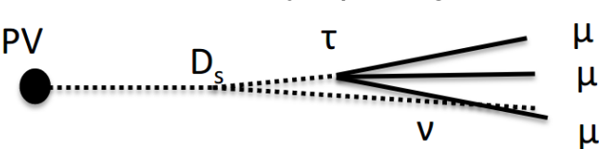
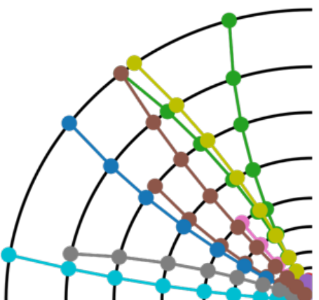
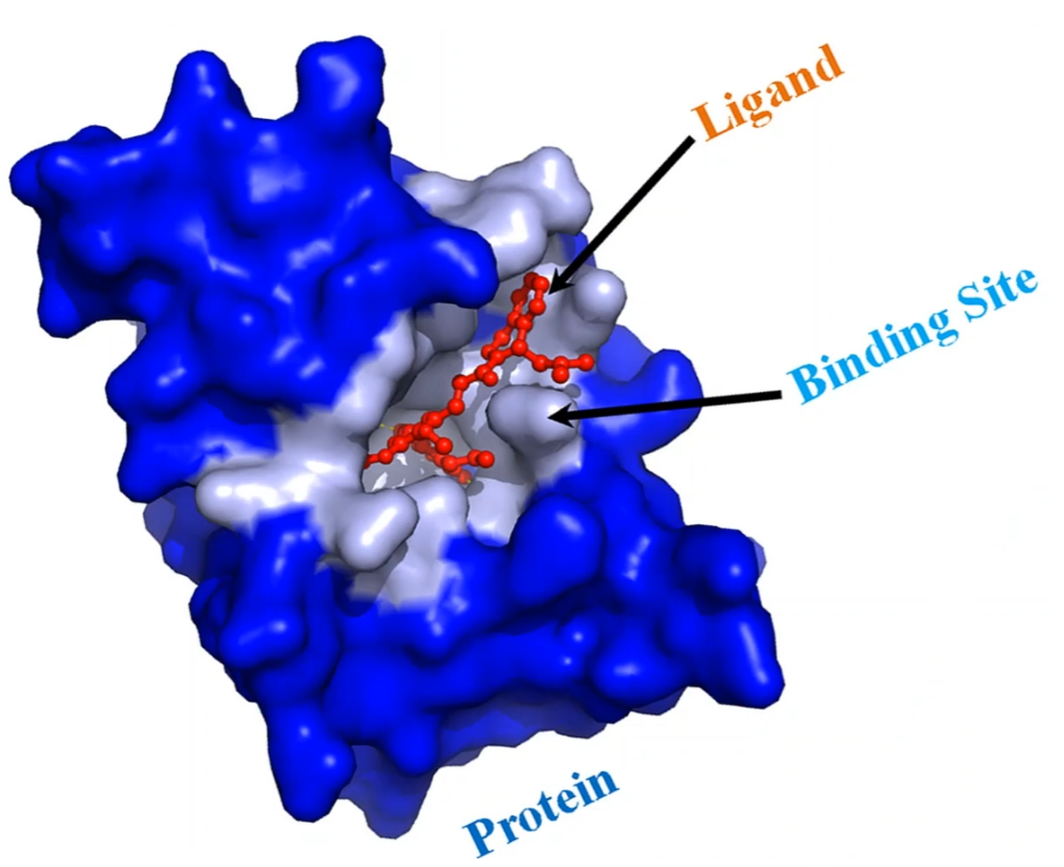
Interpretable Graph/Point Cloud ML
Team at Purdue: Siqi Miao, Miaoyuan Liu, Pan Li
Achievements in the past month:
  Dataset collection & preliminary results (done)
    Tau -> 3mu decay: Ours 0.75 AUC (BL, 0.6)
    Z->mm events: Ours 0.7 AUC (BL 0.5), 95% Prec@10
    Binding affinity: Ours 0.62 AUC (BL 0.5), 0.40 Prec@10
    Synthetic logic: Ours 0.95 AUC (BL 0.7)
Next month:
  Extensively evaluate different backbones/baselines
    Only physical coordinates: PointNet, ParticleNet
    Only graph structures: GNN
    Graph + Physics: Equivariant GNNs

Slide 4
Domain Adaptation on Graph Machine Learning
Team at Purdue: Shikun Liu, Tianchun Li, Miaoyuan Liu, Pan Li, and several external collaborators at Fermi Lab, UIUC, …
Achievements in the past month:
  Empirical results show that graph convolution should be put before domain matching.
  Find suitable inequalities that could be applied under both KL divergence and Total Variation.
Next month:
  Further analysis should be done to figure out the right assumption.
  Analysis combines MC search + math derivation

