Slide 1
Present status of Point 4 Layout drawing and next steps
J. Oliveira
29/04/2022

Slide 2
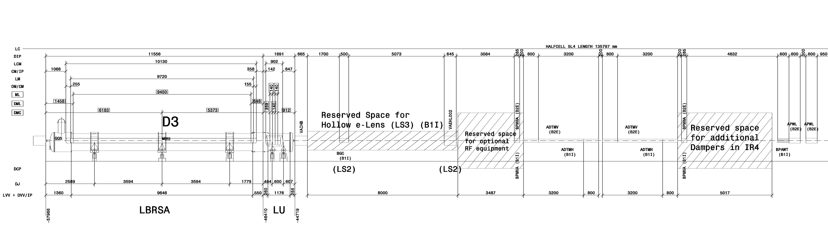
Add wireframe for the HEL and longitudinal position to be defined with A. Rossi
P4 Left

Slide 3
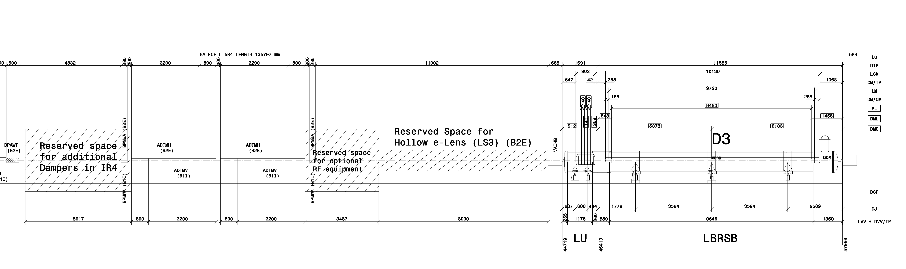
Add wireframe for the HEL and longitudinal position to be defined with A. Rossi.
Add the new sector valve.
P4 Right

Slide 4
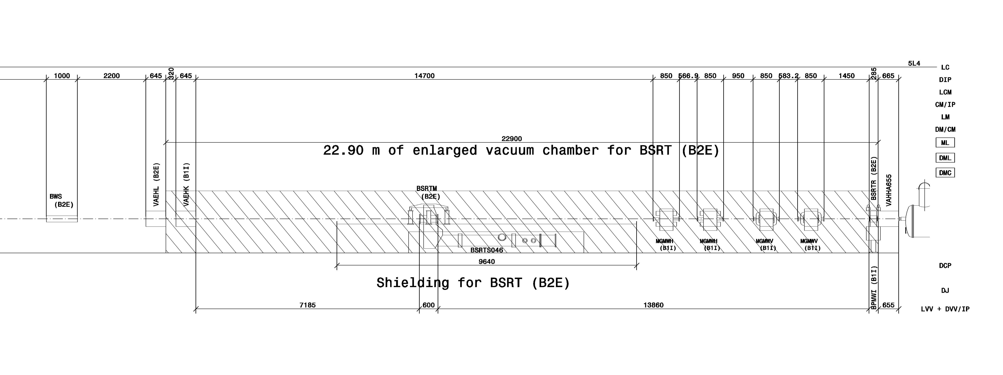
Add a label as not connected to the old BGI magnets
P4 Left

Slide 5
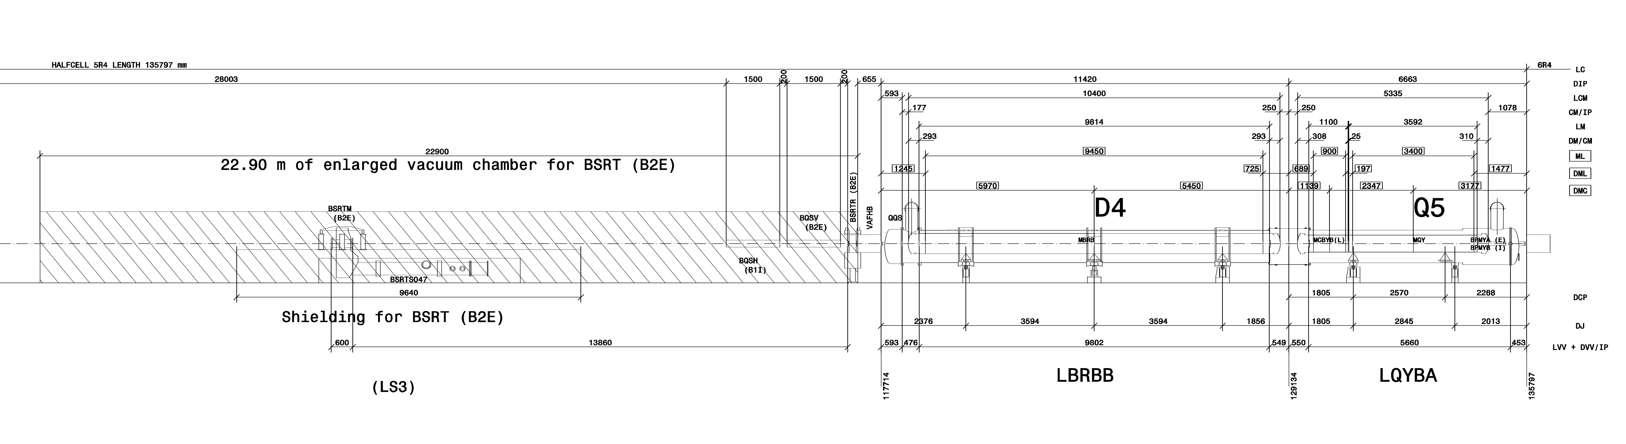
BQKS may be moved to the half-cell 7R4 together with the other existing ones. To allow space for the new BSRT.
2024 to take a decision.
P4 Right

Slide 6
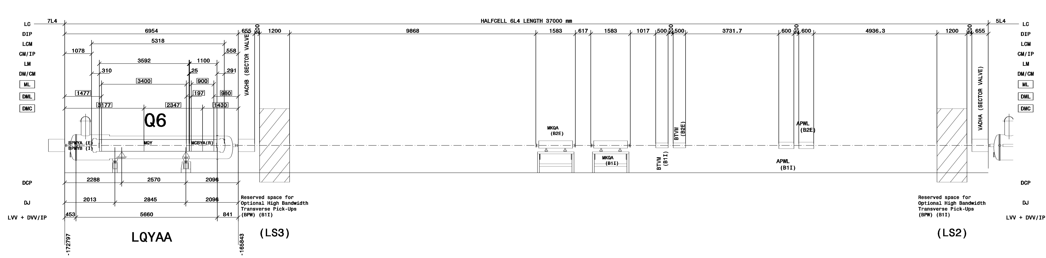
Remove the space reservation since the ECR under preparation by T. Lefevre will be moving this equipment to P1 and P5.
Return to the previous configuration of the BQKH/V (not connected)
P4 Left

Slide 7
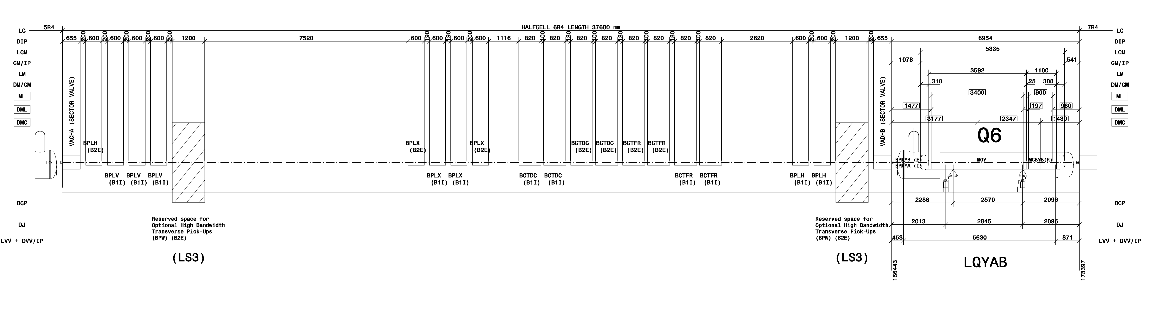
Remove the space reservation since the ECR under preparation by T. Lefevre will be moving this equipment to P1 and P5.
Return to the previous configuration of the BQKH/V (not connected)
New space reservation for the BGV and removal of the one between Q6 and Q7.
In discussion with James Storey
P4 Right

Slide 8
Any Comments or Questions?

