Slide 1
HL-LHC Layout from version 1.5 to 1.6:
- Integration 3D Models
- Layout drawings v.1.5 benchmark
- Next steps towards v.1.6 release
J. Oliveira
29/04/2022

Slide 2
Layout version 1.5
Back in the fall of 2019, the layout v.1.5 was agreed upon and the layout drawings were released based on an independent excel engine detached of the data in the layout database.
Together in that release 2 schematic drawings were done including the cryogenic connections along the LSS and operating temperatures of the cryoassemblies. These are AutoCAD drawings and for now not automatically generated, that are to be released together with the layout drawings v.1.6.
Drawings:
  LHCLSXH_0001
  LHCLSXH_0002
  LHCLSXH_0003
  LHCLSXH_0004
  LHCLSXH_0005
  LHCLSXH_0006
  LHCLSXH_0007
  LHCLSXH_0008
  LHCLSXH_0009
  LHCLSXH_0010
  LHCLSXH_0011
  LHCLSXH_0012
  LHCLSXH_0013
  LHCLSXH_0014
  LHCLSXH_0015
  LHCLSXH_0016
  LHCLSSH_0001
  LHCLSSH_0002
  LHCLSXH_0003
  LHCLSXH_0004
  LHCLSSH_0009
  LHCLSSH_0010
  LHCLSSH_0013
  LHCLSXH_0014
  LHCLSXGH0001
  LHCLSXGH0002
MAD-X:
  ABT studies including FLUKA simulations

Slide 3
LHC digital mock-up toolkit
The LHC digital mock-up toolkit was updated 2022 to allow to use the layout database data as direct input to build the layout drawings.
  All the elements that compose the drawings had to be inserted in the database meaning drifts, spaces, breaks, optical sequence elements and in all the sector valves had to be inserted a point to flag their presence in the drawing.
  Inside the toolkit a new excel engine had to be implemented for our drawings, resulting a complete refactoring of all the dimensions to work together with the new input coming from the layout database.
  So, a successful test was done with LSSR5/L5 drawing including the optics v1.5 to be able to directly compare the dimensions.
The insertions of the layout v.1.6 are on going together with the evolution of the integration 3D models.

Slide 4
New automatic generated drawing v.1.5.

Slide 5
New automatic generated drawing v.1.5.

Slide 6
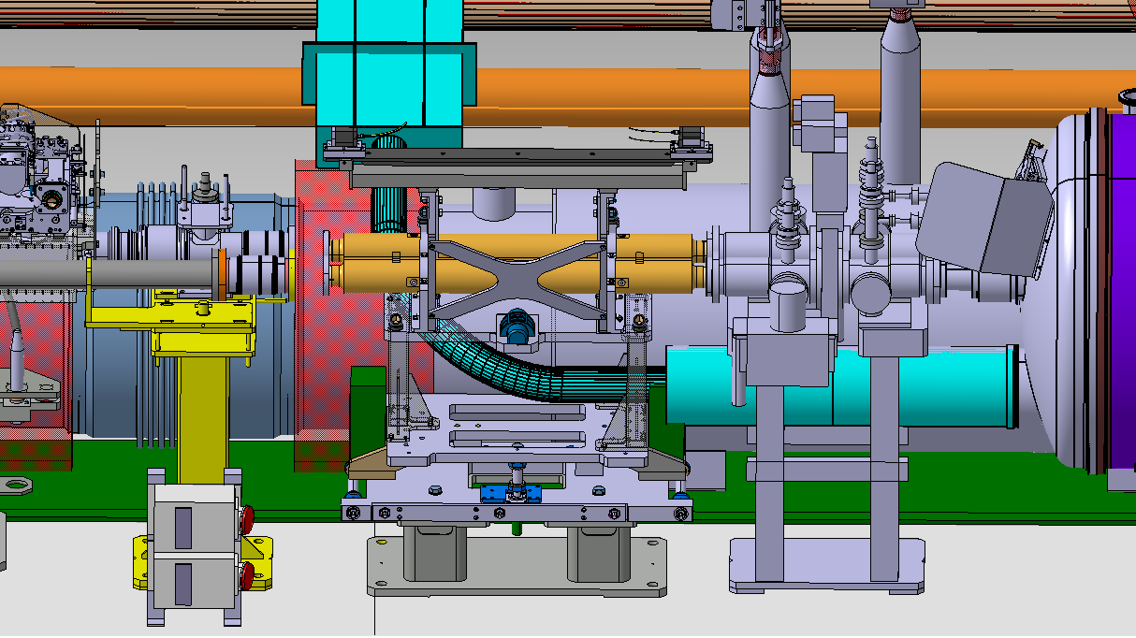
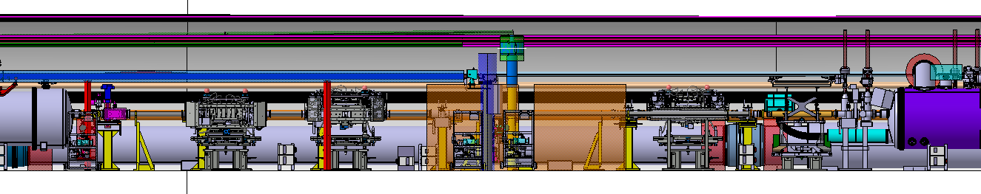
Pending 3D models to complete the Optics v.1.6
→ Addition of a space reservation of 80 mm to compensate the difference in length of the TCLMC from 1120 mm to 1200 mm
!
Layout v.1.6
Simplified designs to be provided
D1: D1-DCM flange to be corrected (already provided)
DCM: DCM-D1 flange to be corrected
TCLMC at Q6: latest simplified version (1120 mm length + 80 mm space reservation)
Vacuum layout Q5-Q6 according last proposal: displaced by 614 mm towards Q5
Final check:
ALL simplified models must be representative of the latest version of all the detailed models
TCTPV
TCTPH
TCL
TCLMC
Q5
Q6
- 614
- 614
- 614
Please remember that is responsibility of the design
teams to communicate to integration, as soon as
possible, any changes of the equipment/system design.

Slide 7
D1-TAXN-D2 Area insertions
It was agreed to follow the same approach as in LHC. But to keep in mind that in the Hilumi case we have the equipment inserted in the mid beam and acting at an angle for the dogleg between D1 and D2.
Add the BPMs markers to the collimators.
Add a Note? For the D1 voluntary displacement for aperture optimization. (Alignment WG meeting #35)
Component | m/IP START | Centre | Length | Interaxis distance at START | Interaxis distance at END | Interaxis distance at Centre | Beamline
TAXN.R5 | 126.954 |  | 4.3 | 0 | 0 |  | C
VAP | 131.254 |  | 0.496 | 0.16142377 | 0.162914205 |  | C
TCTPXV.4R5.C | 131.75 | 132.4895 | 1.479 | 0.162914205 | 0.167358467 | 0.165136336 | C | BPM
TCTPXH.4R5.C | 133.229 | 134.028 | 1.586 | 0.167358467 | 0.172124255 | 0.16975939 | C | BPM
TCLPX.4R5.C | 134.815 | 135.614 | 1.586 | 0.172124255 | 0.176890042 | 0.174525178 | C | BPM
VABCDDAE | 136.401 |  | 0.939 | 0.176890042 | 0.179711653 |  | C
LBRDD.R5 | 137.34 |  | 15.043 | 0.179711653 |  |  | C
MBRD.A4R5 MIDDLE OPTIC m/IP: | 142.095 |  |  | 0.194
Angle (deg): | radians
0.086084268 | 0.001502454

Slide 8
Next steps towards optics v.1.6
Integration 3D models:
  DCM: DCM-D1 flange to be corrected
  TCLMC at Q6: latest simplified version (1120 mm length + 80 mm space reservation)
  Vacuum layout Q5-Q6 according last proposal: displaced by 614 mm towards Q5
Drawings:
  The sequence elements are inserted and reachable via sql query in the table DMU_EXCEL_SEQUENCE_V
  To be added to wireframes of the magnets the connection side and a tag for remote alignment.
  P1 and P5 Drawings to be finished in two weeks by 13th May 2022.
    LHCLSXH_0001 & LHCLSXH_0002 & LHCLSXH_0009 & LHCLSXH_0010
Aperture:
  The equipment owners are being contacted to deliver the missing information for the complete definition of the aperture.

Slide 9

Thank you for your time.
“Strive not to be a success, but rather to be of value.” – Albert Einstein

Slide 10
Spare Slides

Slide 11
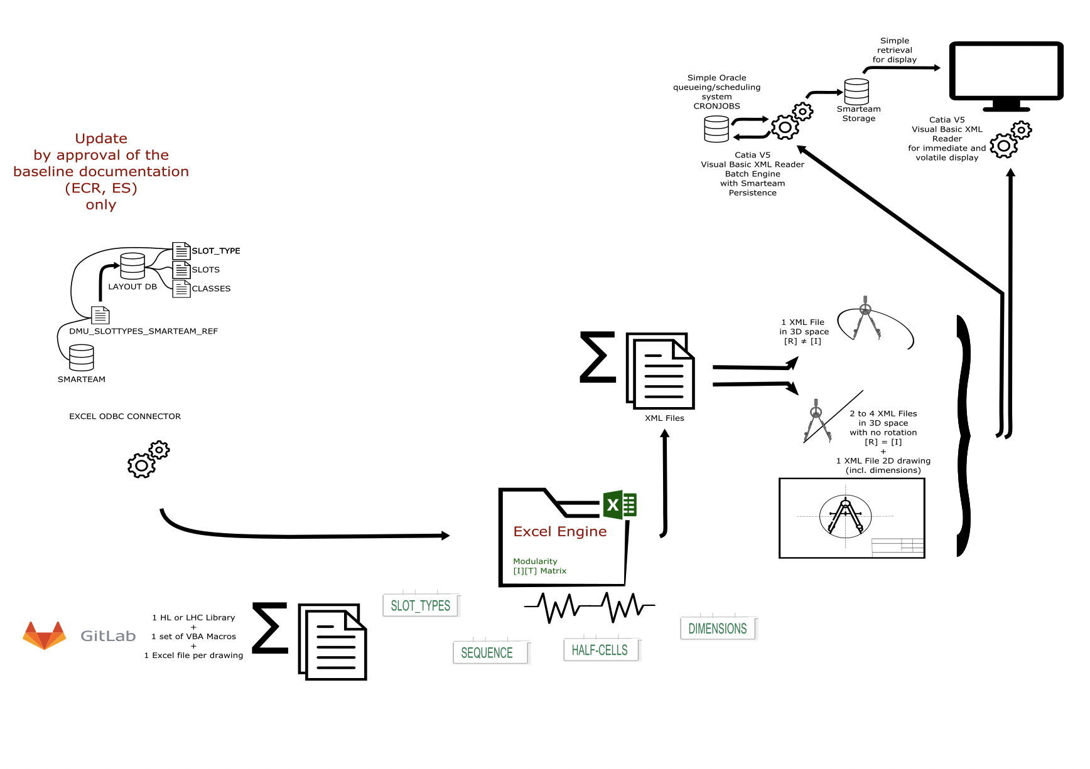

Digital Mock-up Excel Engine

Slide 12
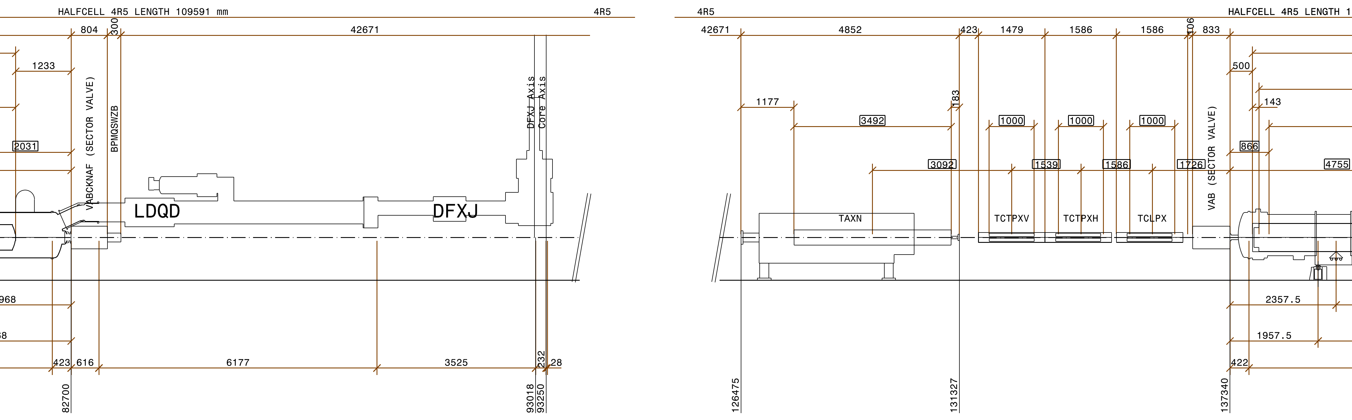
Insertions needed for the new sequence
Drift
Break
Spaces

