Slide 1
HL-LHC MDs in 2022
G. Iadarola with input from:
H. Bartosik, X. Buffat, C. Bracco, R. Bruce, R. Calaga, E. Metral, S. Redaelli, M. Solfaroli Camillocci, G. Sterbini, R. Tomas, D. Wollmann, J. Uythoven, M. Zerlauth

Slide 2
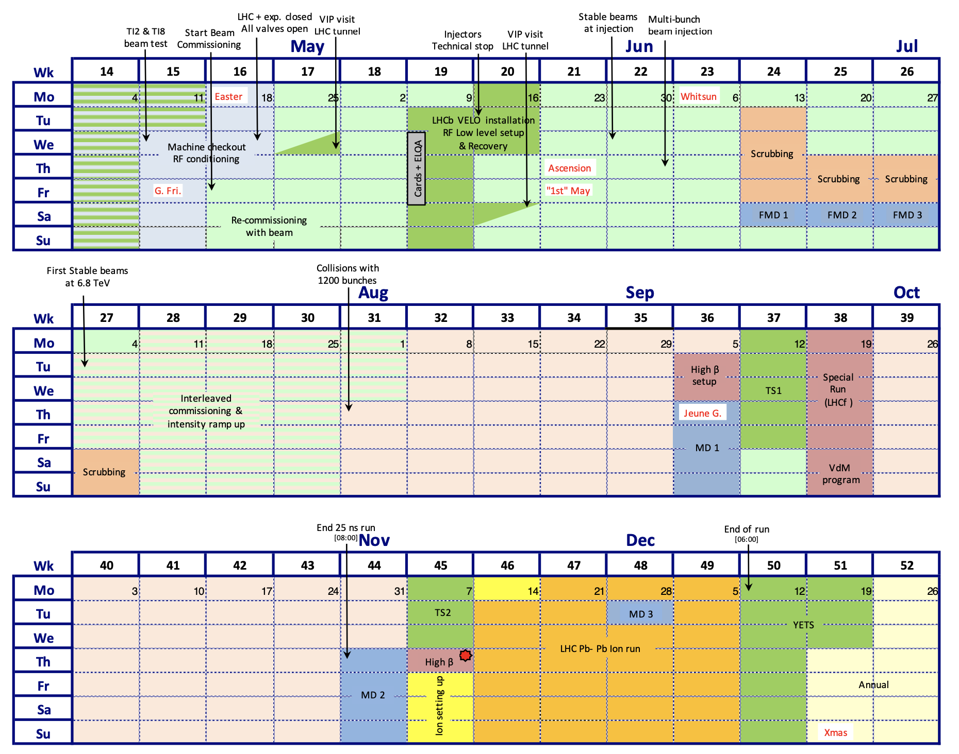
HL-LHC MDs for 2022
Run a quick survey across teams involved in HL-LHC beam dynamics studies on required dedicated MD time with protons in 2022 to have a first estimate of the total time.
HL-LHC project relies on MD studies to be performed in 2022 in order to gain information toward baseline updates (11 T, low-impedance collimators, RF)
Dedicated MD time with protons in 2022 is very limited (11d in latest draft schedule - was 14d)

Slide 3
HL-LHC MDs for 2022
Losses and collimation studies
Crystal collimation studies → counting on commissioning time
Characterization of the collimator impedance → commissioning
Quench test with protons (16 h)
Halo/beam loss characterization with high intensity trains (8 h)
UFO studies (12 h)
Additional collimator impedance studies (8 h in 2022):
  Asymmetric collimation
  Retraction of the secondaries at flat top
Impedance and beam stability
Stability threshold measurements - octupole scans (8h)
Instability growth rate measurements (4 h)
BTF for chromaticity control → 4 h (inj.) + 8h (top energy)
44 h
24 h
3

Slide 4
HL-LHC MDs for 2022
Optics correction
(assumes several other activities are done in commissioning)
Correction of b6 error, focusing on amplitude detuning (12 h)
Non-linear optics corrections with low excitation amplitudes (12 h)
Electron cloud
Single-beam fills for SEY characterization (10 h)
Dependence of heat loads on bunch intensity (8 h)
Studies on incoherent effects (8 h)
Stability studies (4 h) → counting on synergy with scrubbing
RF
RF Voltage calibration (8h - FMD block)
Minimum capture voltage vs losses (8h - MD1 block, September)
Thresholds for Loss of Landau damping (8h - MD2 block, November)
Incoherent effects
Effect on the beam of UPS noise (5h)
Emittance preservation studies (8h)
24 h
30 h
24 h
13 h
4

Slide 5
HL-LHC MDs for 2022
Topic
Losses and collimation | 44 h
Impedance and beam stability | 24 h
Optics measurement and correction | 24 h
Electron cloud | 30 h
RF | 24 h
Incoherent effects | 13 h
Total
159 h
Accounting for additional 20 % (for ramp-down, machine reconfig., availability) HL-LHC beam dynamics studies would require 8.3 days of dedicated MD time amounting to 75% of the scheduled MD time in 2022.

Slide 6
Thanks for your attention!

