Slide 1
HL-LHC BGV Aperture
R. De Maria
4/8/2020

Slide 2
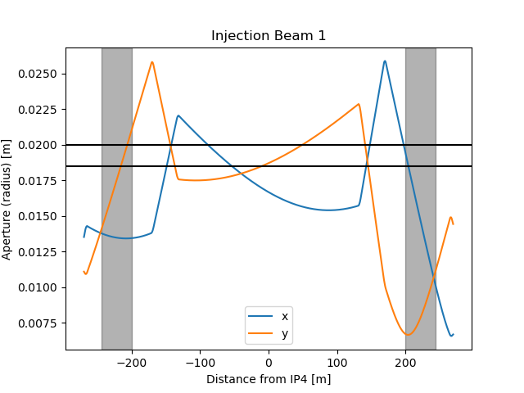
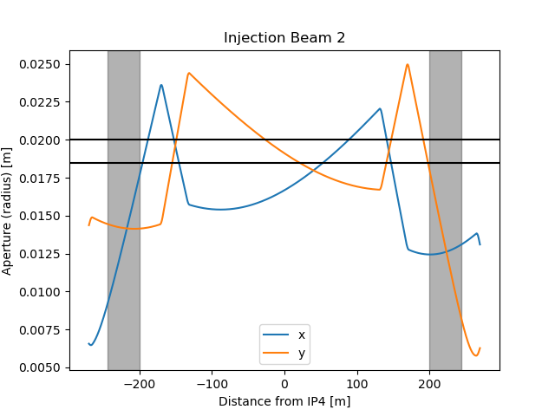
Introduction
First aperture analysis for BGV done for positions: 200 m to 244 from IP4 on 4/8/2020 https://indico.cern.ch/event/944582/
An aperture of at least 45 mm is recommended, provided that the 1.5 mm of margin (shape + alignment) can be guaranteed. Bottleneck at injection.
On 8/12/2021 B. Kolbinger new request to investigate the region on the right side of IP4 between Q5 and Q6 [142.5 m, 150 m] for an aperture of 21.5 mm.
Minimum aperture at 12.6 sigma at injection

Slide 3
Input for BGV
Vacuum apertures:
Region: 200 m to 244 from IP4
Beam pipe: 40 mm nominal diameter
Tolerances: 1.5 mm in radius for shape and alignment to be confirmed
J. Storey, R. Veness 7/7/2020
Optics scenarios:
Optics scenarios are under development. Present baseline is being updated to take into account the new requests of slow luminosity ramp-up and stability requirements.
Optics in IR4 depends on beta* in Point 5. In particular, the optics functions on the right side (outside the dogleg) can change considerably during the physics fill.
Round and flat optics scenario are taken into account.

Slide 4
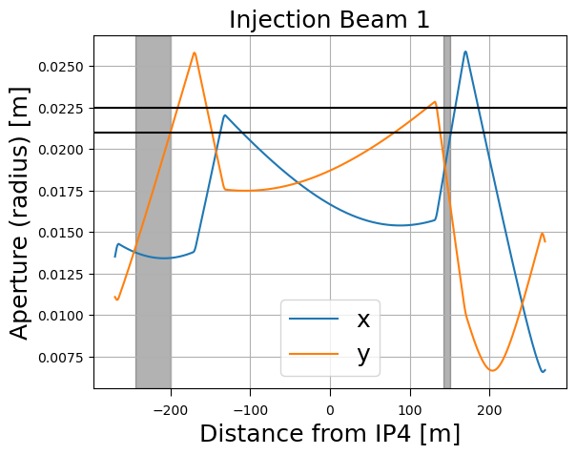
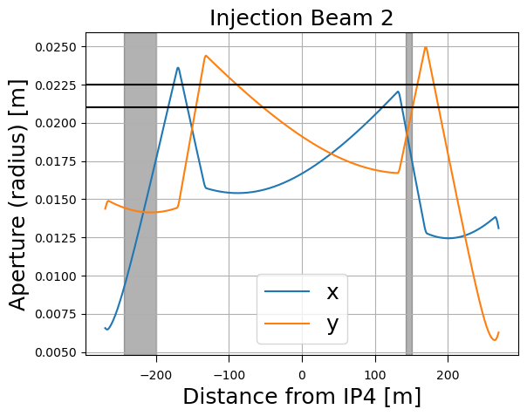
Detailed plots and conclusion
Aperture of 45 mm at the limit in the 142.5 -150 m region:
Area sensitive to optics details (i.e. would not work with 2022 optics), it would freeze Point 4 optics which is not desirable at this stage of the project.
Potentially becoming global aperture bottleneck, detailed scattering studies required (action for WP5).
Ideal solution using 50 mm aperture.

Slide 5
Back-up

Slide 6
Protected Apertures
Δµ_{x} MKD-TCT [°] | Aperture [σ@2.5µm]
0-20 | 11.2
30 | 11.9
40 | 12.9
50 | 13.8
60 | 14.5
70-90 | 14.6
No TCT | 19.4
Injection | 12.6
Parameter | 7 TeV | 0.45 TeV
Radial CO [mm] | 2
Mom offset | 2 10⁻⁴ |  | 8.6 10⁻⁴
Dispersion | 0.1 |  | 0.14
Beam size | 1.1 | 1.05
R. Bruce et al. CERN-ACC-2017-0051

Slide 7
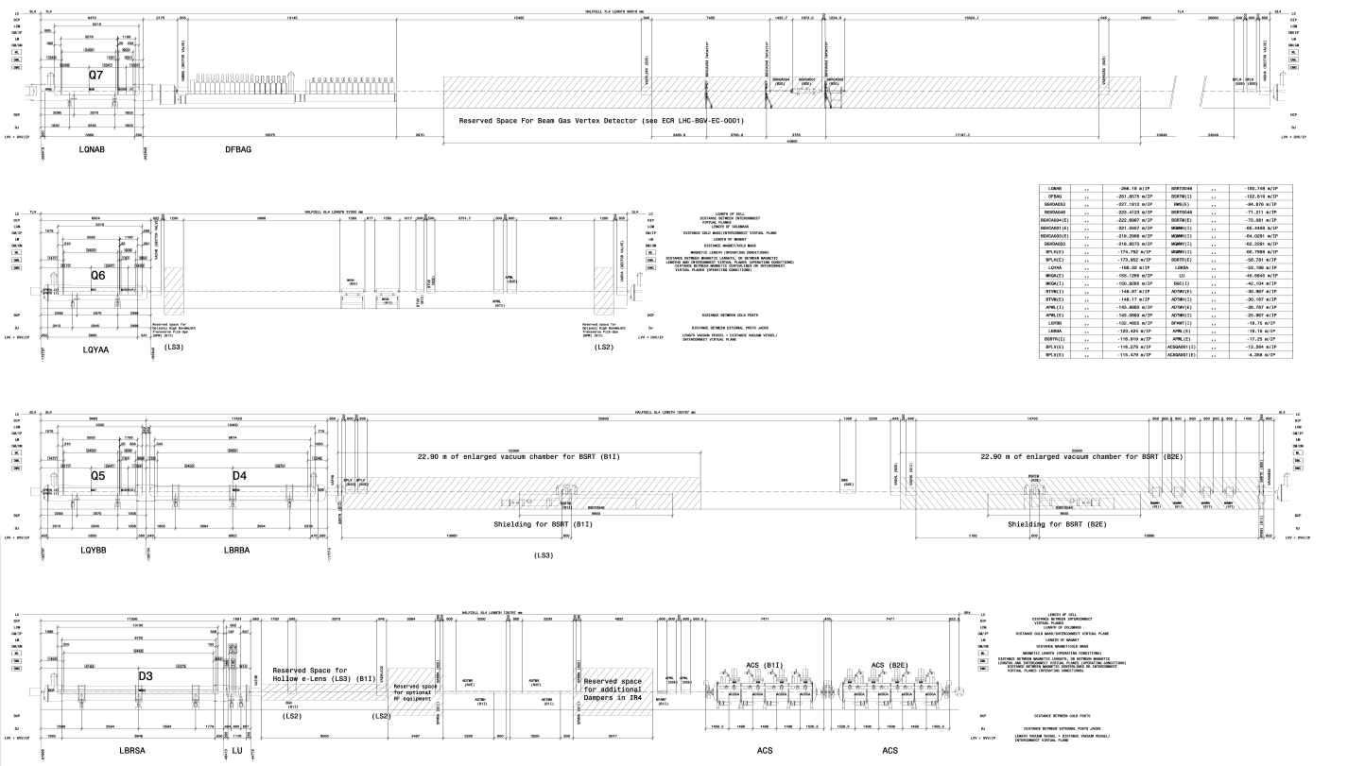
Layout Left

Slide 8
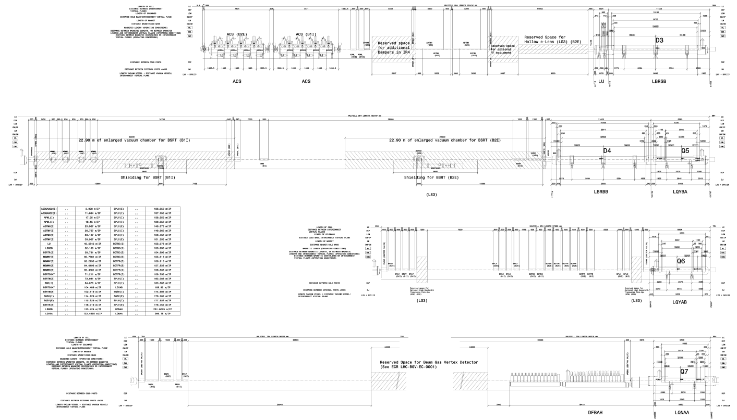
Layout Right

Slide 9
Injection
An aperture of 40 mm in diameter with 1.5 mm of tolerances is in not compatible with the aperture in some in a subset of the region of interest.

Slide 10
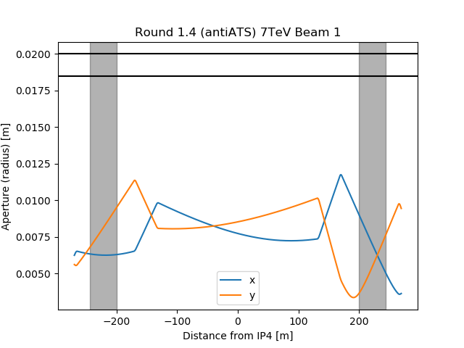
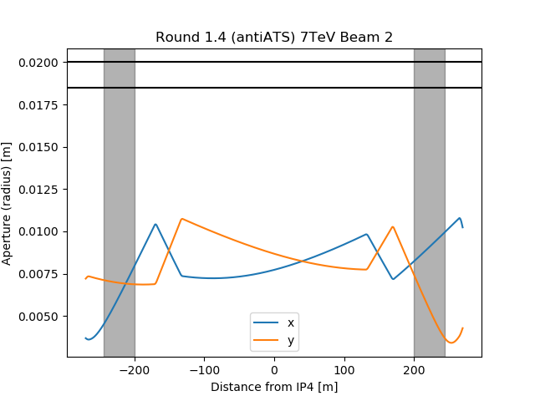
Flat top beta*=1.4m anti-ATS at 7 TeV
At 7 TeV and part of the ramp there is enough aperture margin for this scenario.

Slide 11
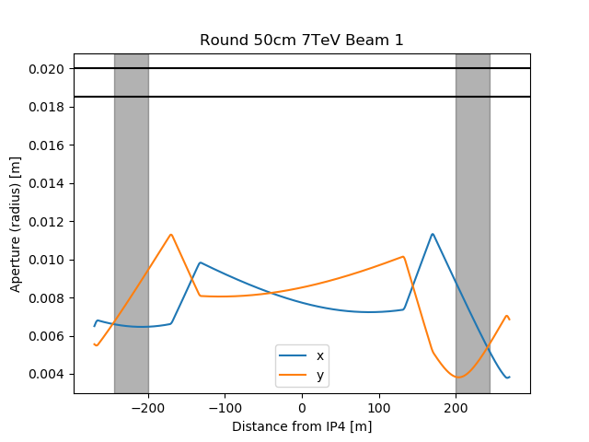
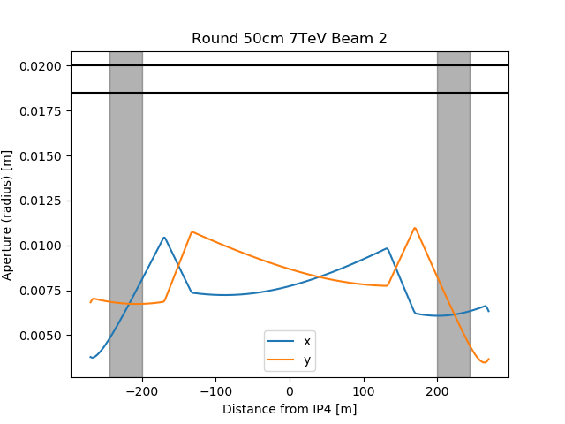
Flat top beta*=50cm at 7 TeV
At 7 TeV and part of the ramp there is enough aperture margin for this scenario.

Slide 12
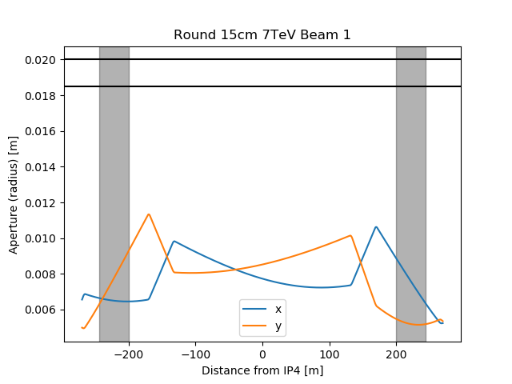
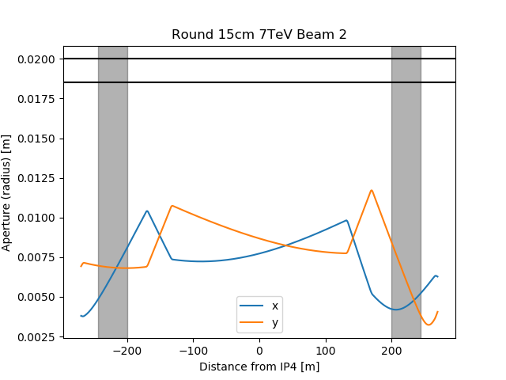
Flat top beta*=15cm at 7 TeV
At 7 TeV and part of the ramp there is enough aperture margin for this scenario.

Slide 13
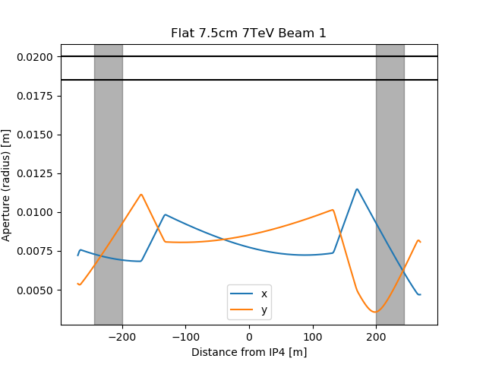
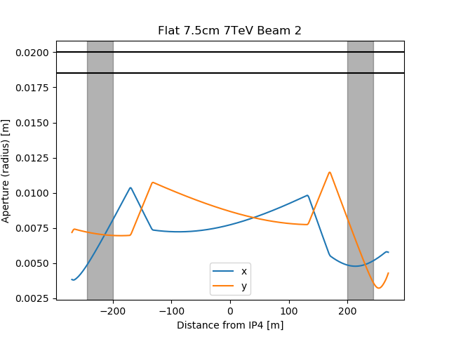
Flat top beta*=7.5/30cm at 7 TeV
At 7 TeV and part of the ramp there is enough aperture margin for this scenario.

Slide 14
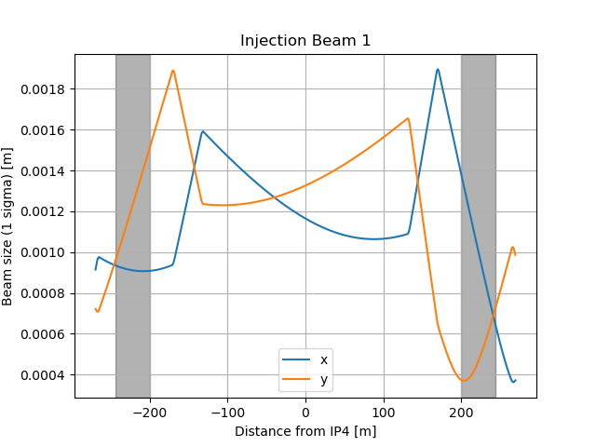
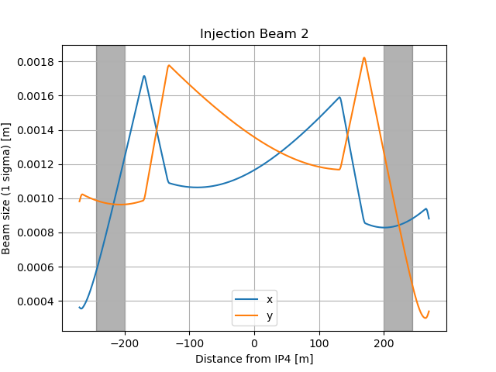
Beam sizes

Slide 15
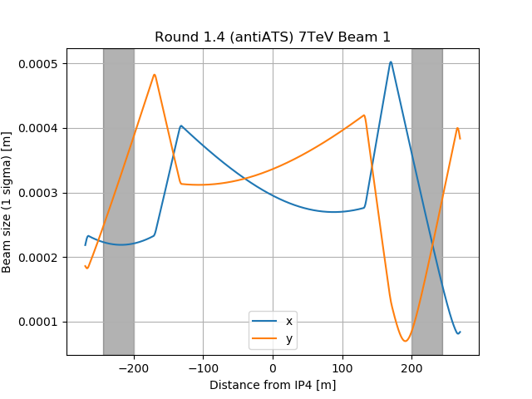
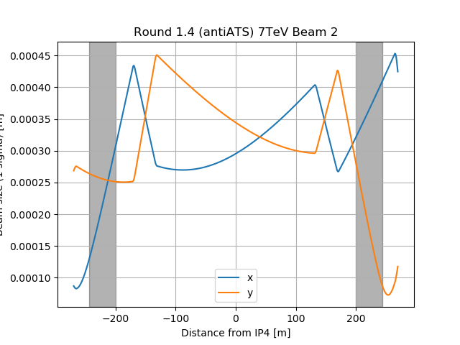
Beam sizes

Slide 16
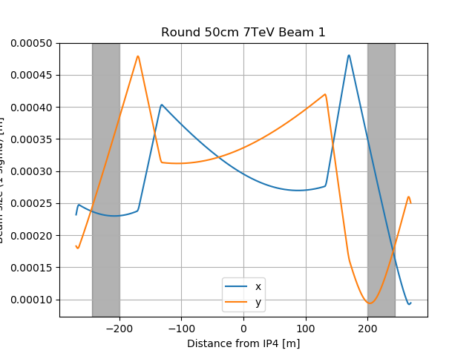
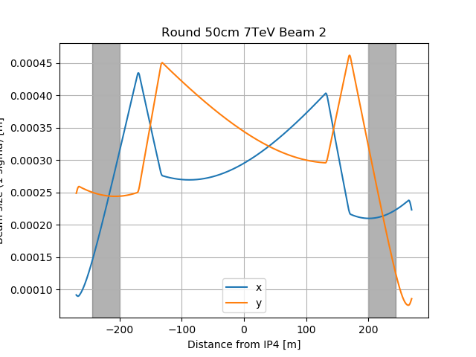
Beam sizes

Slide 17
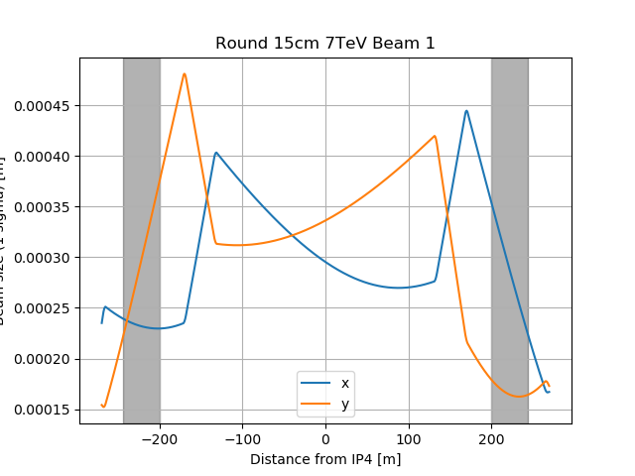
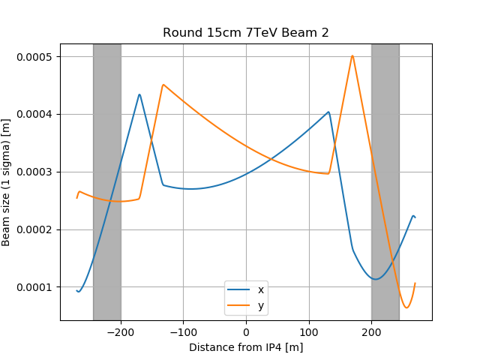
Beam sizes

Slide 18
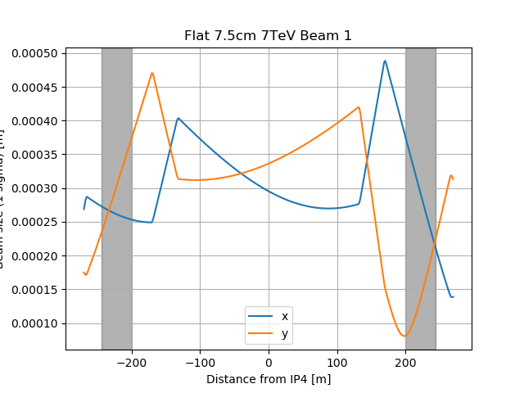
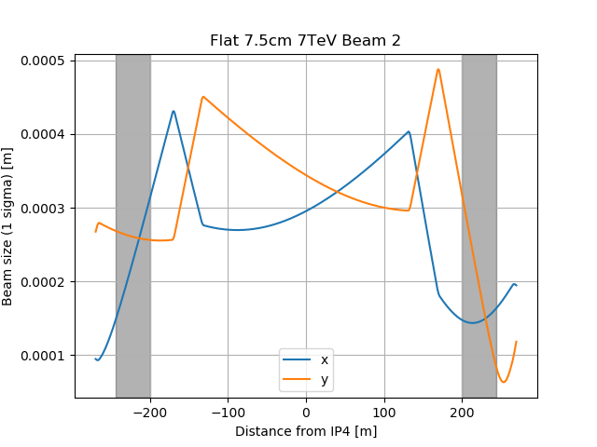
Beam sizes

Slide 19
Conclusion
An aperture of 40 mm constrains the location of the BGV in the region of interest due to aperture restriction at injection.
An aperture of at least 45 mm is recommended, provided that the 1.5 mm of margin (shape + alignment) can be guaranteed.
Alternative locations at higher beta functions could not be found in Point 4

