Slide 1
Aperture considerations on
BSRTMB settings for Run 3
R. De Maria, R. Bruce, S. Redaelli, F. Van Der Veken
CWG 29/4/2022

Slide 2
Aperture consideration
Summary
  BSRTMB is part of an instrument foreseen for HL-LHC.
  BSRTMB requested to operate in Run 3 for validation purposes.
  Target settings given for HL-LHC based on the nominal HL optics V1.5 and expected aperture. See WP2 meeting on 7/9/2021.
  Actual settings for Run 3 and Run 4 depends on actual optics, machine conditions and commissioning state (see LHC-BSRTM-EC-0003 v.0.1)
Considerations for actual Run 3 settings:
  Should account for measured Run 3 apertures
  Should not worsen global aperture as BSRTMB is not a critical device for Run 3
    Compare with aperture measurements
  No close BLM installed => cannot be sure to detect local losses if device would be closer to the beam than thought => does not allow to trust beam loss pattern to validate mirror positions, and requires special commissioning
  Mirror is a thin scatterer => potentially different loss behaviour from other aperture bottlenecks (tentative settings do not take into account this), requires extra care.
    Simulation would be required to approach target settings.

Slide 3
Run 3 settings and commissioning strategy
 | 450 GeV | 6800 GeV
Target BSRTMB HL-LHC settings | 22.9 mm | 11.2 mm
Calculated aperture using Run 3 optics | 11.2 sigma | 17.7 sigma
Additional margin | 1.7 mm | 0 mm
Estimated settings (present proposal) | 24.5 mm | 11.2 mm
Injection: calculated aperture close to ring aperture, tentatively add 1 sigma margin to stay in the shadow
Top energy: other bottlenecks expected to be smaller at flat top, possibly don’t need to add additional margin
Commissioning procedure to validate mirror position:
  Mirror to be part of aperture measurements and standard loss maps and asynchronous dump tests.
  No BLM installed, potentially blind to local losses => request additional aperture measurements to compare loss pattern and global aperture (from BBA measurement) with mirror parked and at nominal position. 2 hours additional commissioning time.
If found in measurements that mirror is not transparent to the loss pattern, step back in setting

Slide 4
Back-up

Slide 5
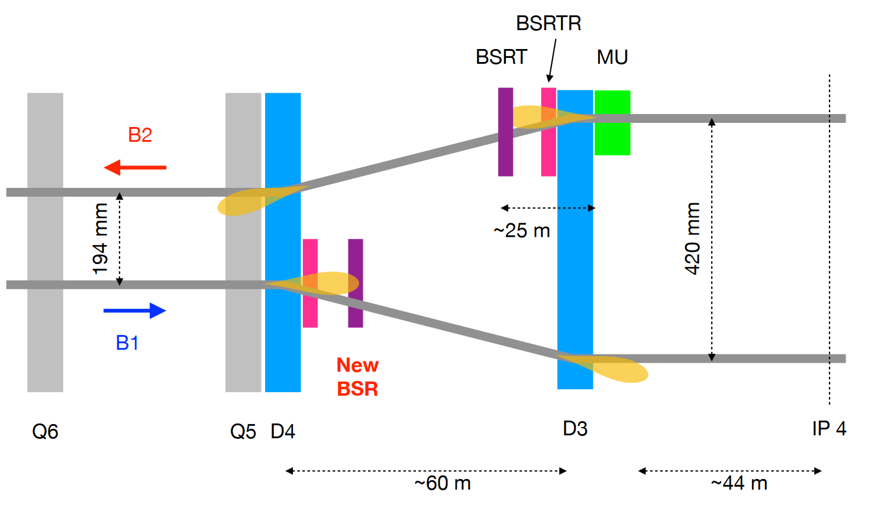
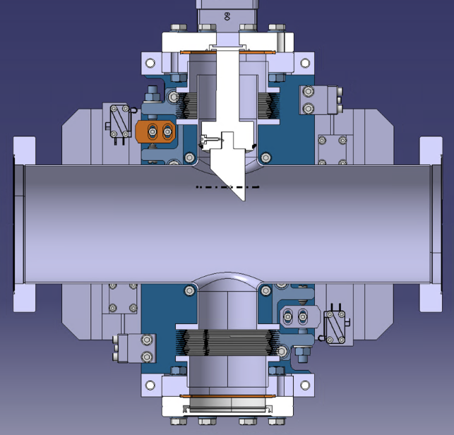
BSRTM
New synchrotron radiation monitor installed in Point 4: LHC-BSRTM-EC-0003-0-1.docx at
Operational requirement: mirror as close a possible to the beam
Operational range: 10 mm to 40 mm from the axis.
Ideal position
Position Margin
Beam Margins
Ideal beam

Slide 6
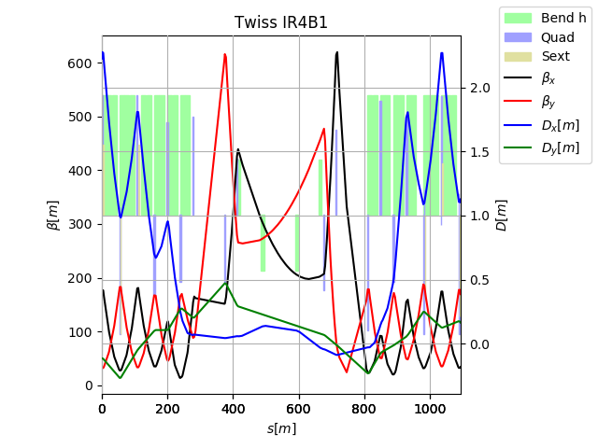
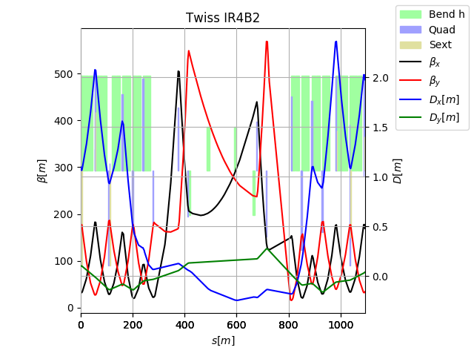
Optics consideration
HL-LHC
Position | DCUM [m] | From IP4 [m] | From beam axis [mm]
Non IP side | 9897.9672 | 99.114 | 135.61
IP side | 9898.5382 | 98.543 | 136.51
HL-LHC and Run2 optics are similar. No optics change foreseen in the dogleg during the cycle.
One can assume:
Β_{x}<~400 m (based on 380m on present optics adding some margin as optics can still evolve)
|D_{x}|<~20 cm (can be smaller but depends on crossing bumps leaking which is hard to design for)

Slide 7
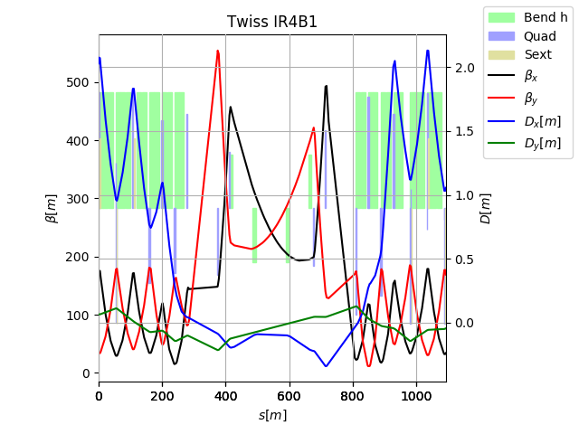
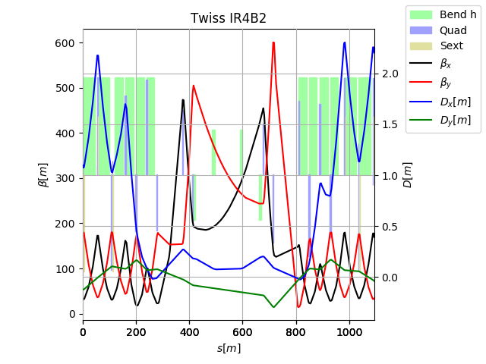
Optics consideration
Run2
Position | DCUM [m] | From IP4 [m] | From beam axis [mm]
Non IP side | 9897.9672 | 99.114 | 135.61
IP side | 9898.5382 | 98.543 | 136.51
HL-LHC and Run2 optics are similar. No optics change foreseen in the dogleg during the cycle.
One can assume:
Β_{x}<~400 m (based on 380m on present optics adding some margin as optics can still evolve)
|D_{x}|<~20 cm (can be smaller but depends on crossing bumps leaking which is hard to design for)

Slide 8
Aperture consideration
Parameters | Injection | Flat top
Energy [GeV] | 450 | 6500
Ref. emittance [µm/γ] | 2.5 | 2.5
Energy Error [%] | 0.0086 | 0.0002
Orbit error [mm] | 2 | 2
Sigma error [%] | 5 | 10
Dispersion Error [%] | 14 | 10
Min protected aperture¹ [σ] | 13 | 20
¹ Based on nominal bottlenecks on present optics, could be reduced to 12.6 σ and 19.4 σ defined in: Updated parameters for HL-LHC aperture calculations for proton beams CERN-ACC-2017-0051.pdf
Results | Injection | Flat top
Betatron component [mm] | 19.71 | 8.36
Dispersion component [mm] | 0.33 | 0.07
Orbit error [mm] | 2.00 | 2.00
Minimum beam stay clear [mm] | 22.04 | 10.42
Mirror position margins² [mm] | 0.80
Potential Operational settings | 22.86 | 11.22
² Includes: alignment tolerances, mechanical tolerances, motor tolerances, interlock tolerances. Enrico proposed 0.5 mm based on 0.3 from survey alignment and 0.5 mm on mechanical structure (see ECR).

Slide 9
Conclusion
Minimum beam stay clear proposed for BSRTM based on the current location and present optics
Operational settings for the mirror to be defined once alignment tolerances, mechanical tolerances, motor tolerances and interlock tolerances will be specified.
Mirror position during the ramp cannot be compute as aperture parameters during the ramp are not specified

