Slide 1
Improving CERN
AV Workflow
13^{nth} December 2010
Thomas Baron, Jacques Fichet,
Tim Smith

Slide 2
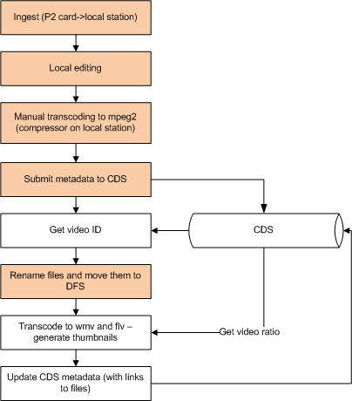
Current Issues
No collaborative editing
  And no asset management
A lot of manual processes
Manual approval process
Several teams involved
  AVC, CDS, OIS
No process monitoring
Lack of archiving of rushes

Slide 3
Proposed Solution
Network file storage for collaborative work on multimedia documents (photos+videos)
  Supported by an asset management system
Automate workflow, incl. flexible approval handling
Transcoding using prof. commercial tools
  Add intro/outro/watermarks
  Add new output formats: podcasts, h264
  Compatible with future 3D rendering needs (CUDA)
Integrate with Mac platform used for AV production
  Final Cut Pro
  Final Cut Server for asset mgmt and workflow mgmt

Slide 4
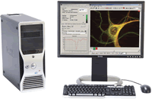
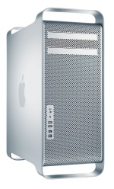
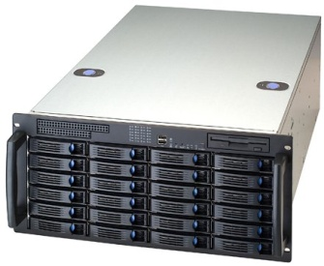

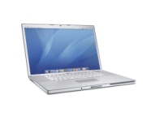
Overall Design
wherever
Web Interface
Previewing
Approving
Final Cut Server
Asset Management
Workflow
Proxying
DFS Servers
Temporary workspace
Final Archiving
10 Gbps
Final Cut Server Client
Managing workflow
Editing
1Gbps
10 Gbps
10 Gbps
Transcoding
Cluster
510 AV Office
Computer Centre

Slide 5
Why Apple Products
Our base editing software Final Cut Pro is used at CERN since 2005
  It is becoming a worldwide de-facto standard
    Studios: Disney, Dreamworks, Universal, Warner Bros, 20th Century Fox, Paramount
    TV stations: TSR, BBC, RSI, SF, TF1, UEFA, CNN, MTV, HBO
  1.8M registered users
    http://www.apple.com/chfr/finalcutstudio/in-action/
Apple products ensure a perfect integration
  The only strong link will be on the workflow management tool
Mac Pros can be reused as workstations later on

Slide 6
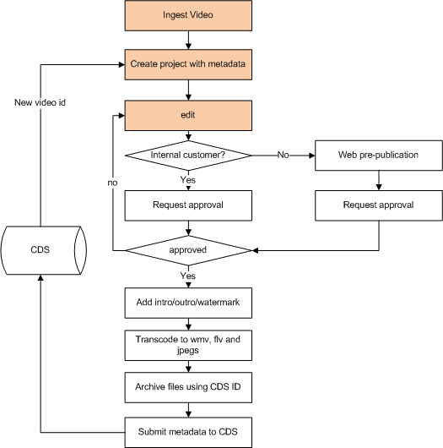
New Workflow

