Slide 1
Interviewing 101
CBI.ATTRACT
27.03.2023
Ole Werner

Slide 2
Thought Experiment
Ask only closed questions (yes/no) to answer the riddle.
A father and son have a car accident and are both badly hurt. They are both taken to separate hospitals. When the boy is taken in for an operation, the surgeon (doctor) says 'I can not do the surgery because this is my son’.
How is this possible?

Slide 3

“The answers you get depend on the questions you ask”
Thomas Kuhn

Slide 4
What is a bias?
A bias is a tendency, inclination, or prejudice toward or against something or someone.
Some biases are positive and helpful—like choosing to only eat foods that are considered healthy or staying away from someone who has knowingly caused harm. But biases are often based on stereotypes, rather than actual knowledge of an individual or circumstance. Whether positive or negative, such cognitive shortcuts can result in prejudgments that lead to rash decisions or discriminatory practices.
Evolutionary adaptive as it helps to save energy (less thinking)
But dangerous when asking questions. (If you ASSUME, you put an ASS in front of U and ME)
Open ended questions are least prone to bias.

Slide 5
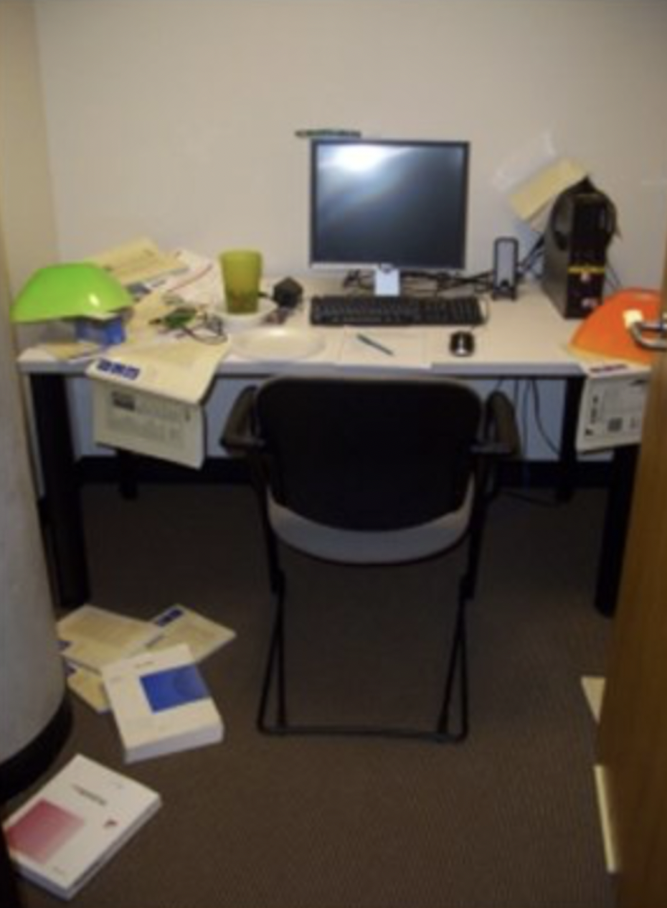
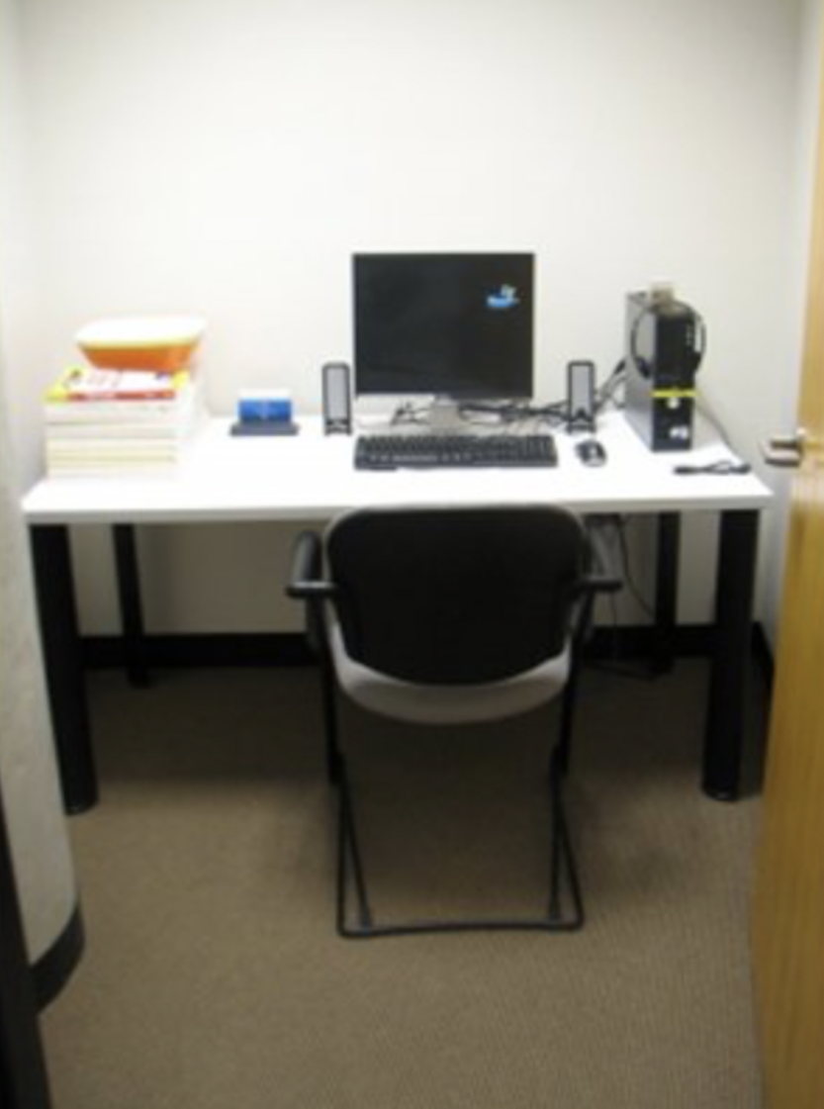
Who of the two people
Is the better worker?
Earns the higher salary?
Knows the best clubs in town?
Has mental problems?
What makes up good work?
What justifies a higher salary?
How do you get to know clubs?
What are mental problems?

Slide 6
Elements of an interview
Contacting potential Interviewees (Pitching the interview)
Prepare a polite and clear message that you can use to ask for a meeting with the stakeholders you have chosen
  Important: If they don’t get it, they won’t reply
Show your interviewee that you are prepared.
  You can do this by mentioning what makes this interviewee’s opinion valuable for your project (e.g. the task they have in their company, their educational background, etc.)
Take as much work away from you interviewee as possible. The easier you make it for your interviewees to participate, the more interviewees will participate.
  Think about when to meet (How many people form your team should be present?), where to meet (zoom/their office?) and think about their motivation (what do your interviewees gain from participating? Could be insight, fresh ideas…)

Slide 7
Preparing the meeting
Prepare the key points and questions you’d like to ask from this specific person
  Start broad :
    What brought you to CERN/to work with …?
  Encourage stories
    Can you tell me about a time when you got first interested with this?
    Try understanding their knowledge and interest in technology: When did you first notice it? How did it develop since then?...
  Include problem hypothesis / pain points and deep needs that technology could solve
    “Do you think … in … could be an application for this technology
  Rephrase questions to reduce bias
    Is this your biggest problem? -> What is taking most of your time on daily bases?
Be prepared to take notes during interview
  You can have one person interviewing and another taking the notes
  You can also ask for a permission to record the conversation for documentation purposes, but this might affect the content of the conversation

Slide 8
During the interview (pitfalls)
Double Barreled Questions
Ex.: ”Do you think that a project to support the local NGO’s should be sponsored by the UN and that it would help the people in the region?”
- What if your interviewee thinks the project would the people help but should not be sponsored by the state? (but by the local government for example?)
Pitfall: Fusing two questions in one // Risk: Missing out on important differentiations, making false conclusions
→ One question at a Time! Try open questions (e.g. what do you think should a project to support local NGOs should focus on in order to be effective? Who do you think should be financing such a project?).

Slide 9
Structure
- Listen actively! (its natural to get nervous, focus on your interviewee and it will be alright! ☺)
- Create space for the other person to answer, tolerate silence
- If you have not understood something, dare to ask again! Here, paraphrases and reflections can help (e.g. “Have I understood correctly, that…” “Am I correct when I say that what you just told me means…?”)
- If you feel there’s an interesting direction to go to expand the conversation to this direction (“Oh, that is interesting, could you perhaps tell me a bit more about…”)
- Try (some of) your questions with somebody outside of your team, thereby you ca know which questions might need rephrasing

Slide 10
Reminder
Introduce yourself and the project you are working with clearly and politely.
Remember, also in research, one person has an opinion, not the truth.
Further connections: You can ask the person to join / keep posted on the project and give you tips on who else to talk to.
Thank them for their time.
Have fun! ☺

Slide 11
Thank you!

