Slide 1
What are we doing here?
CERN as an engine of scientific collaboration;
IdeaSquare as the innovation space at CERN.
CBI.ATTRACT, March 27th , 2023
Ole Werner

Slide 2
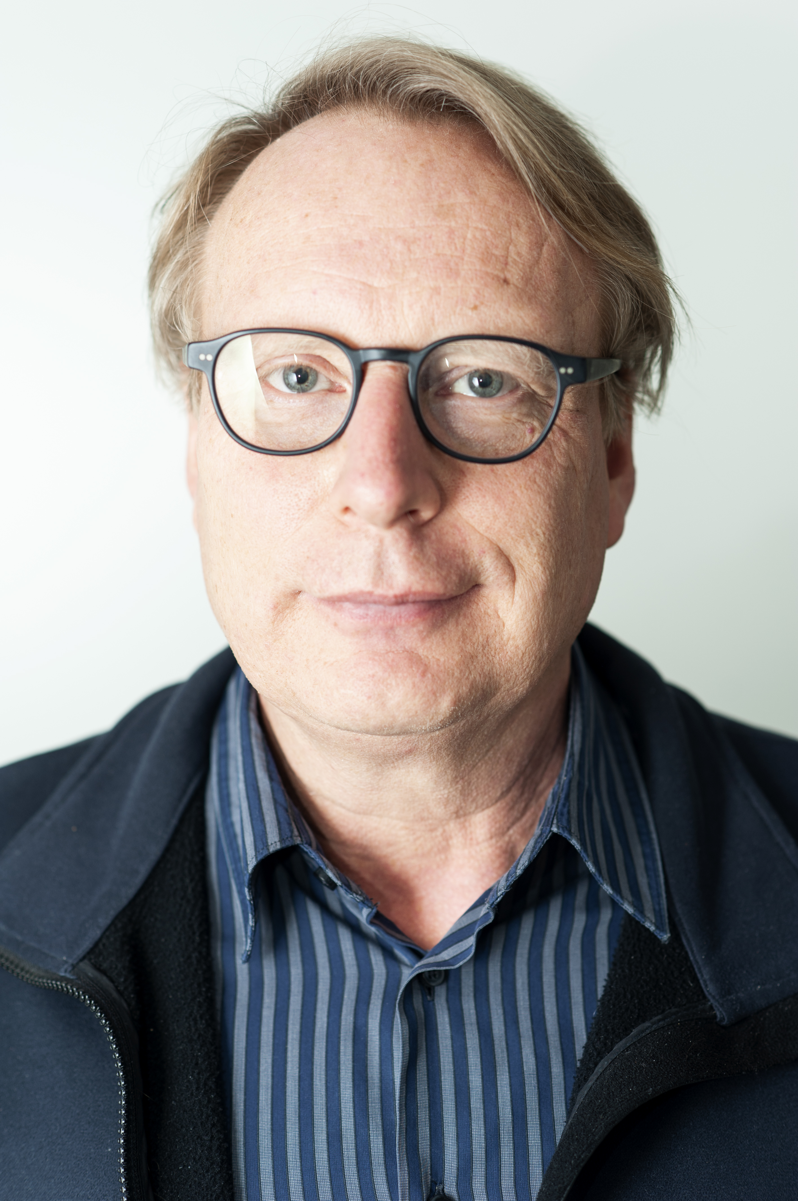
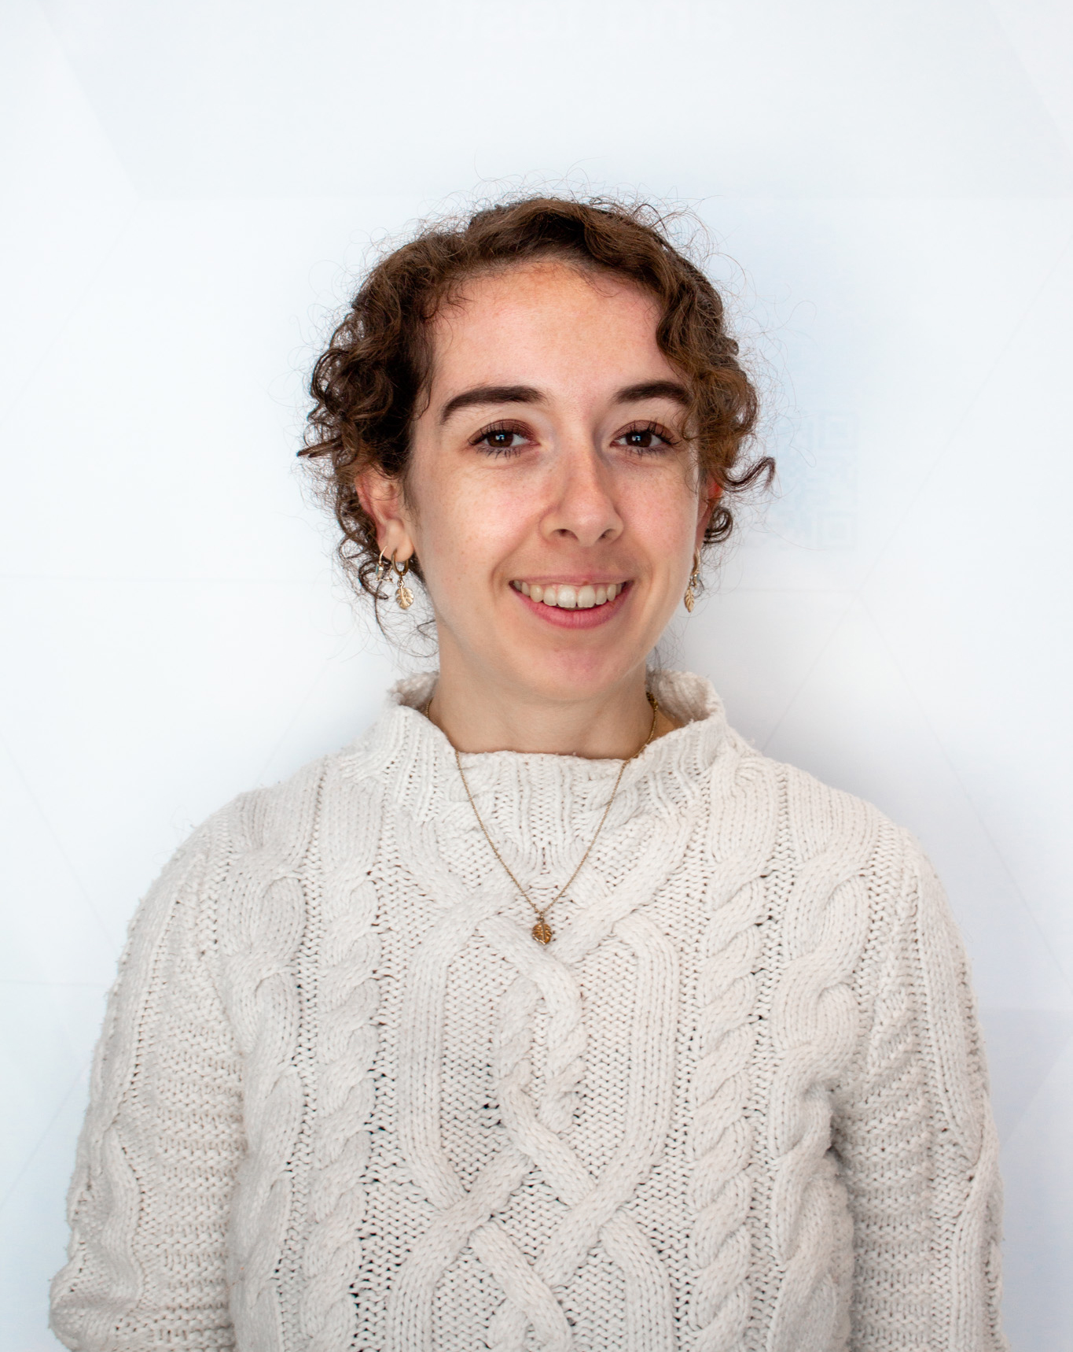
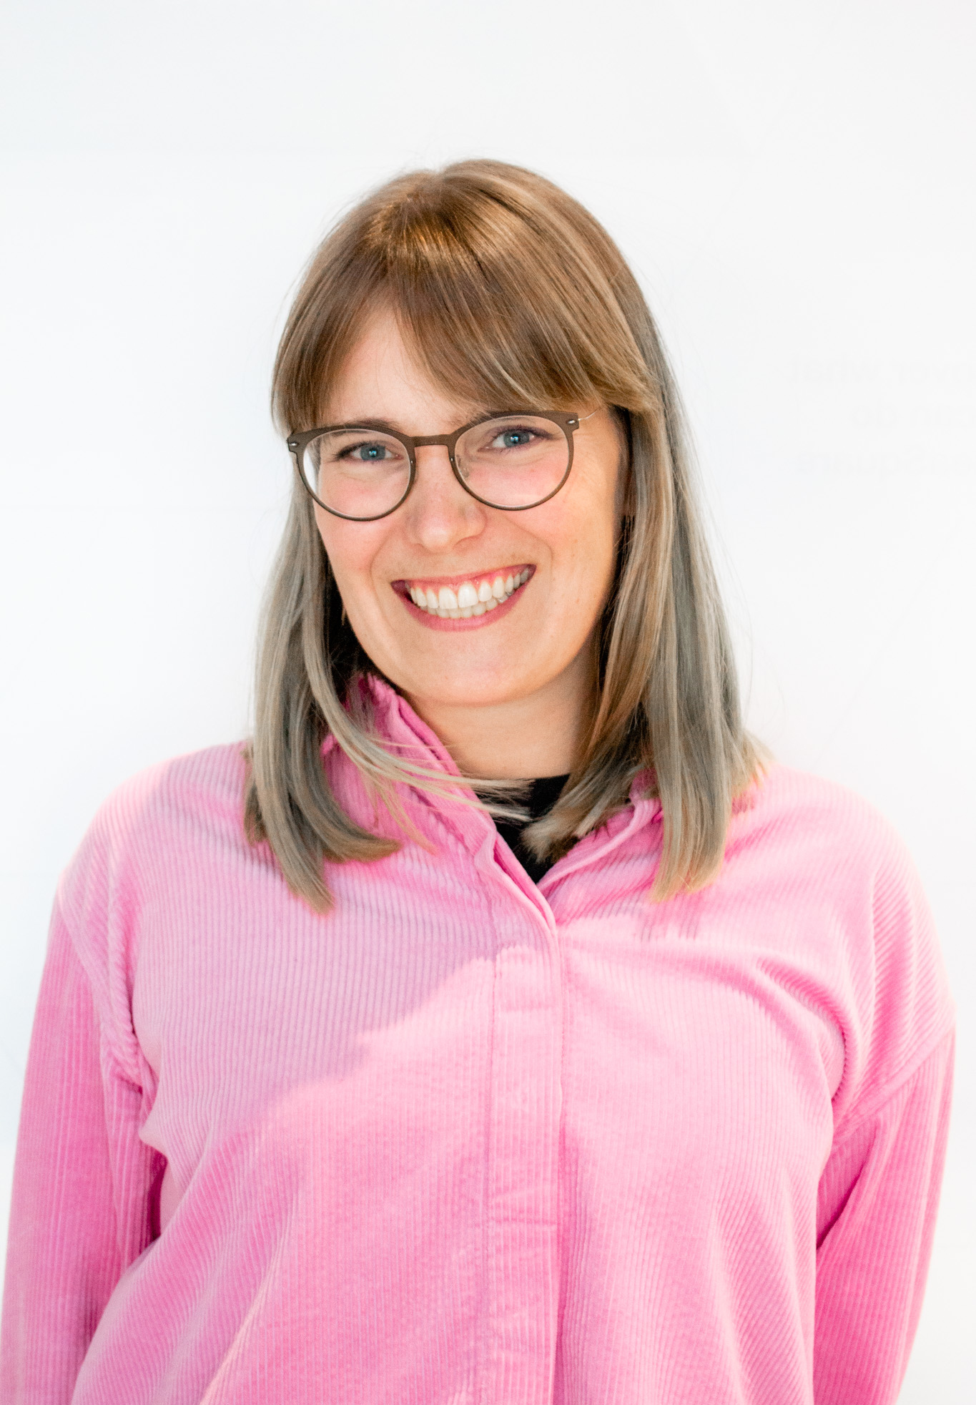
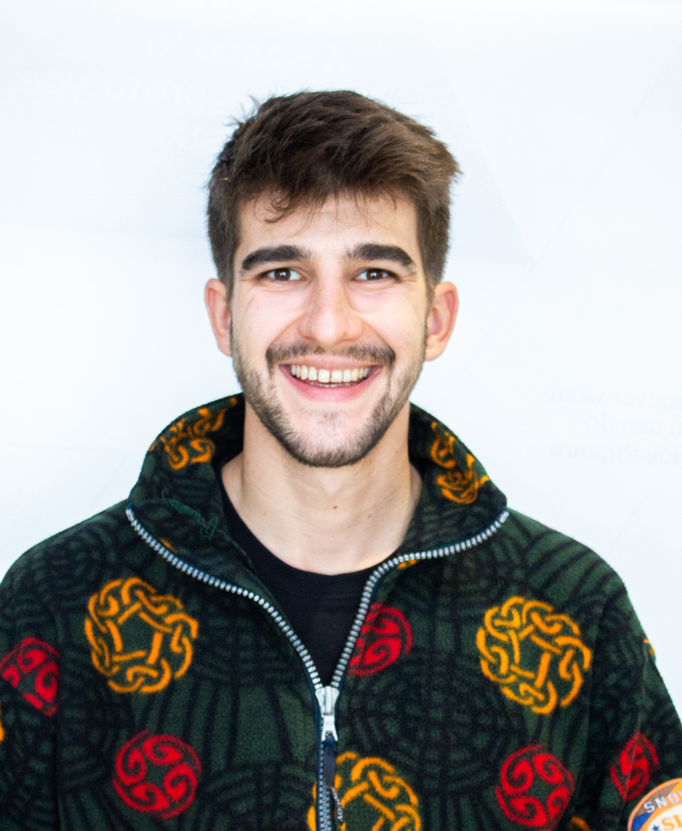
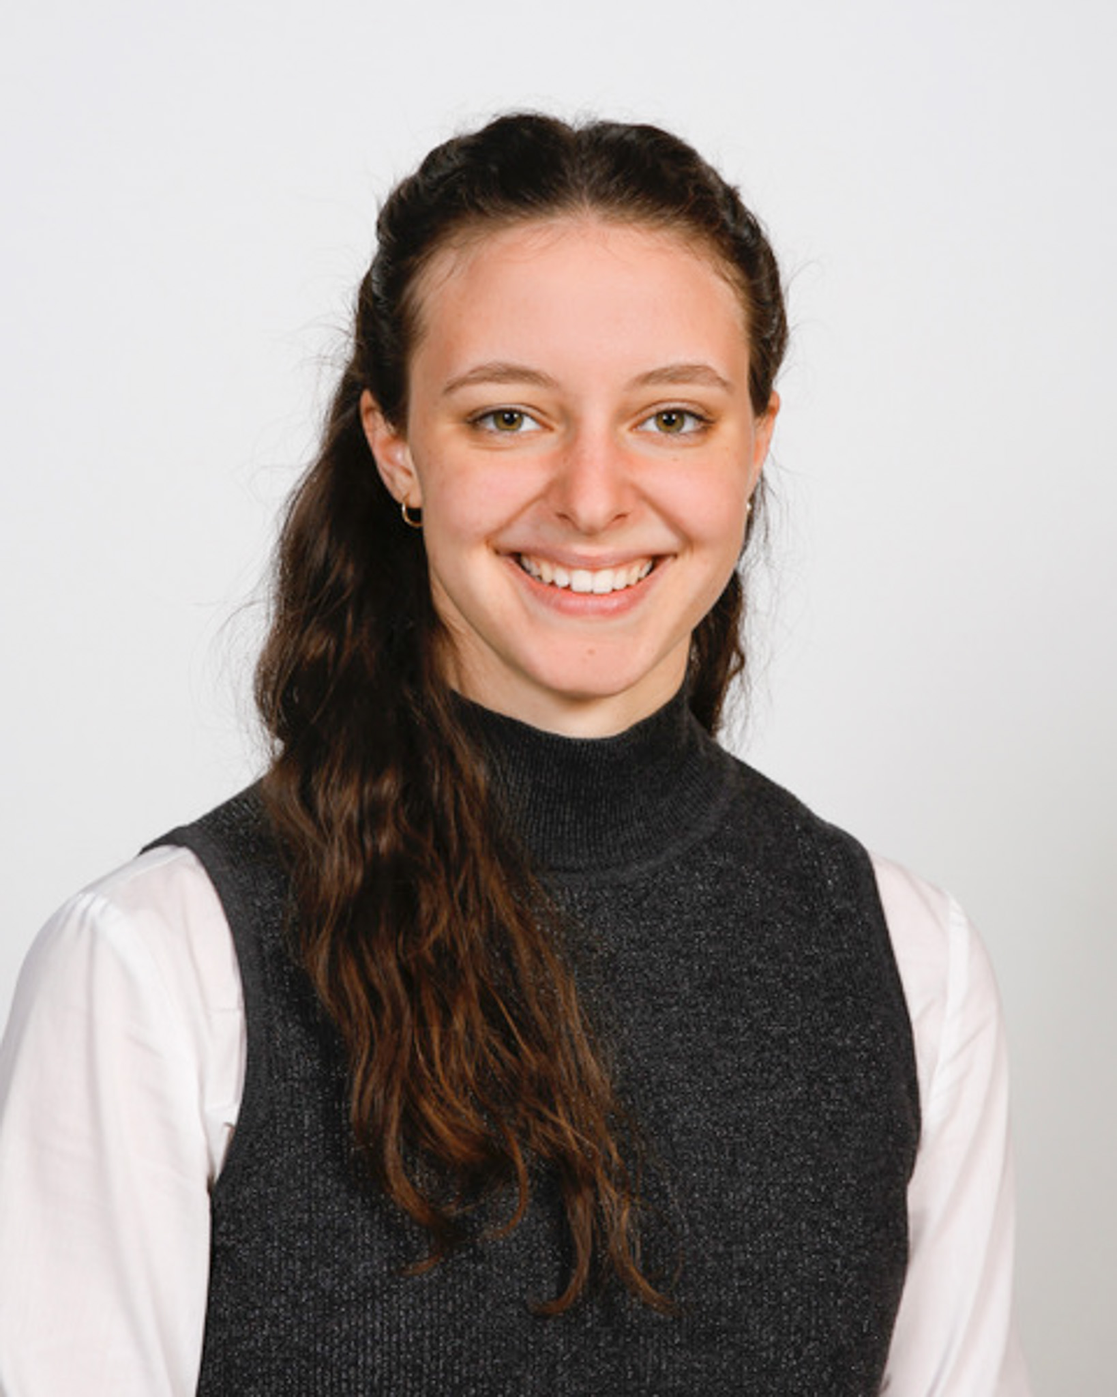
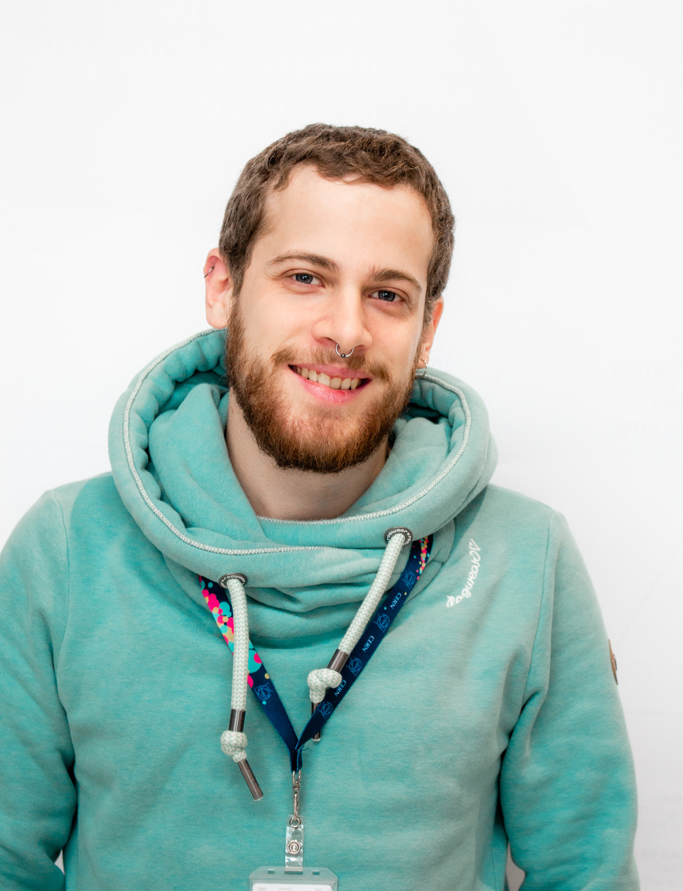
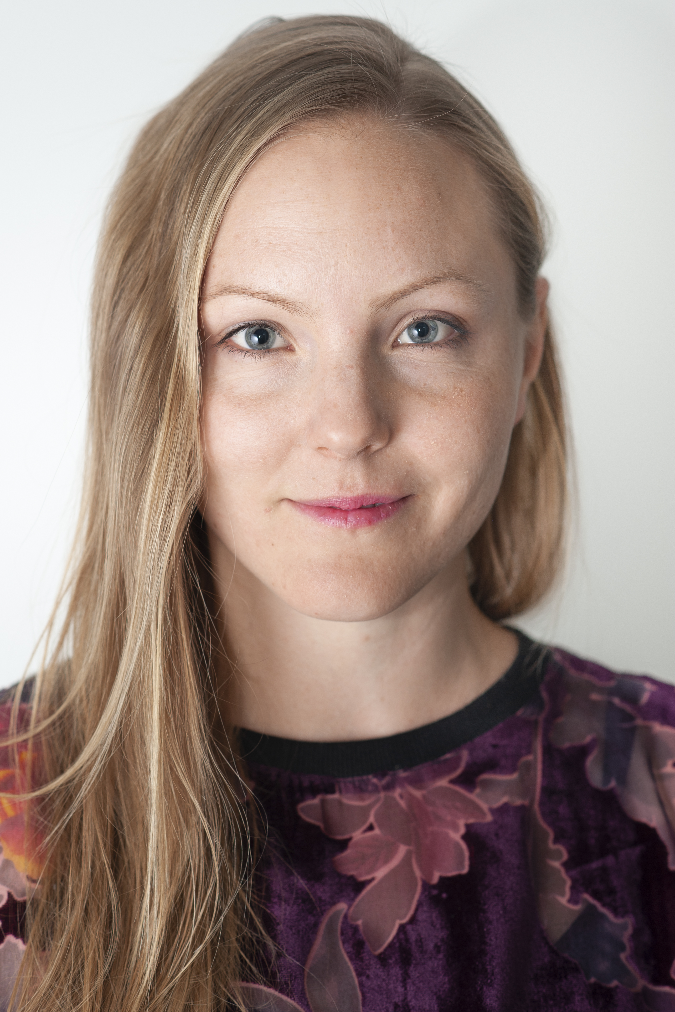
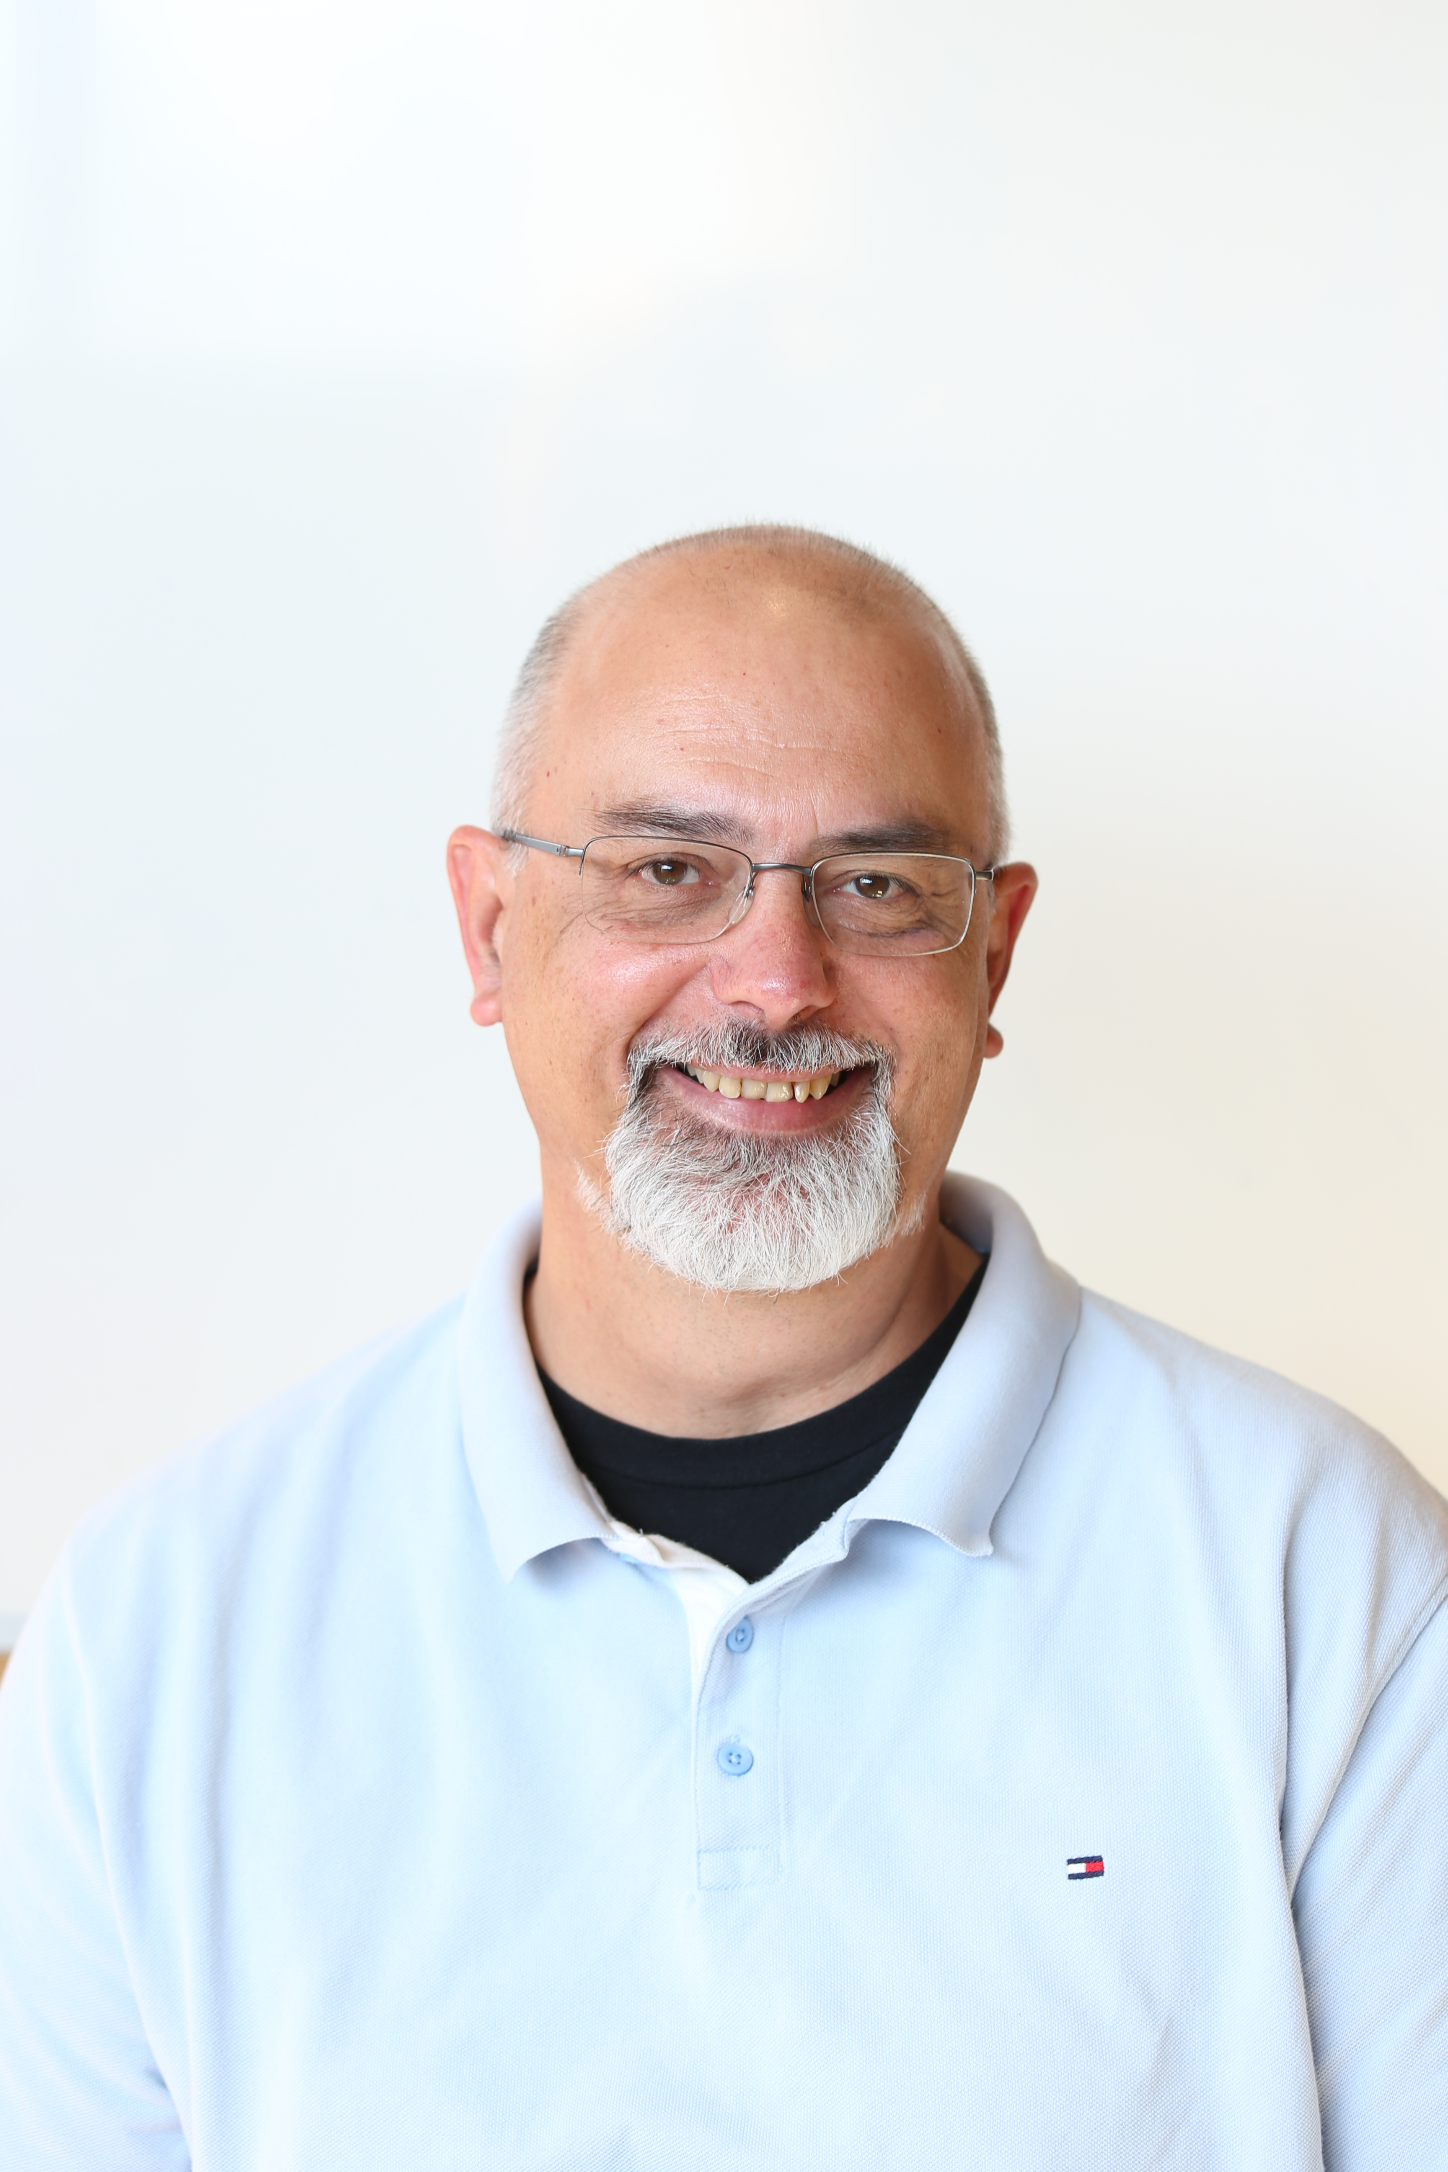
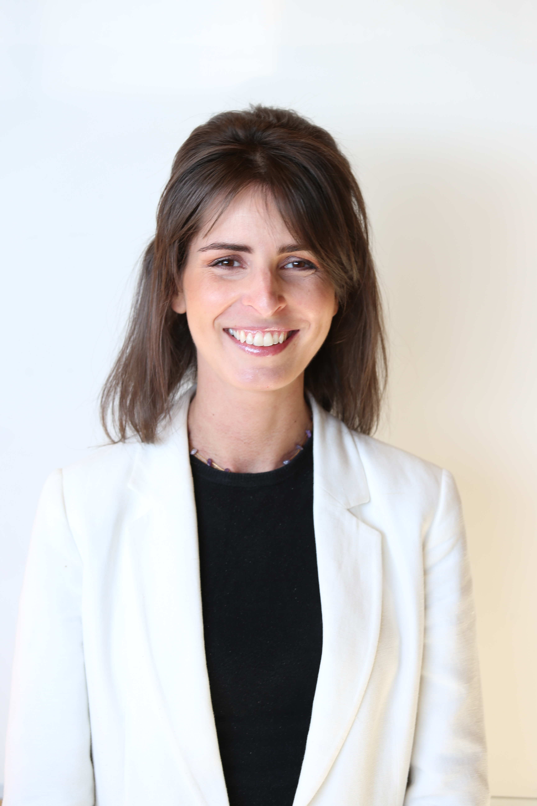
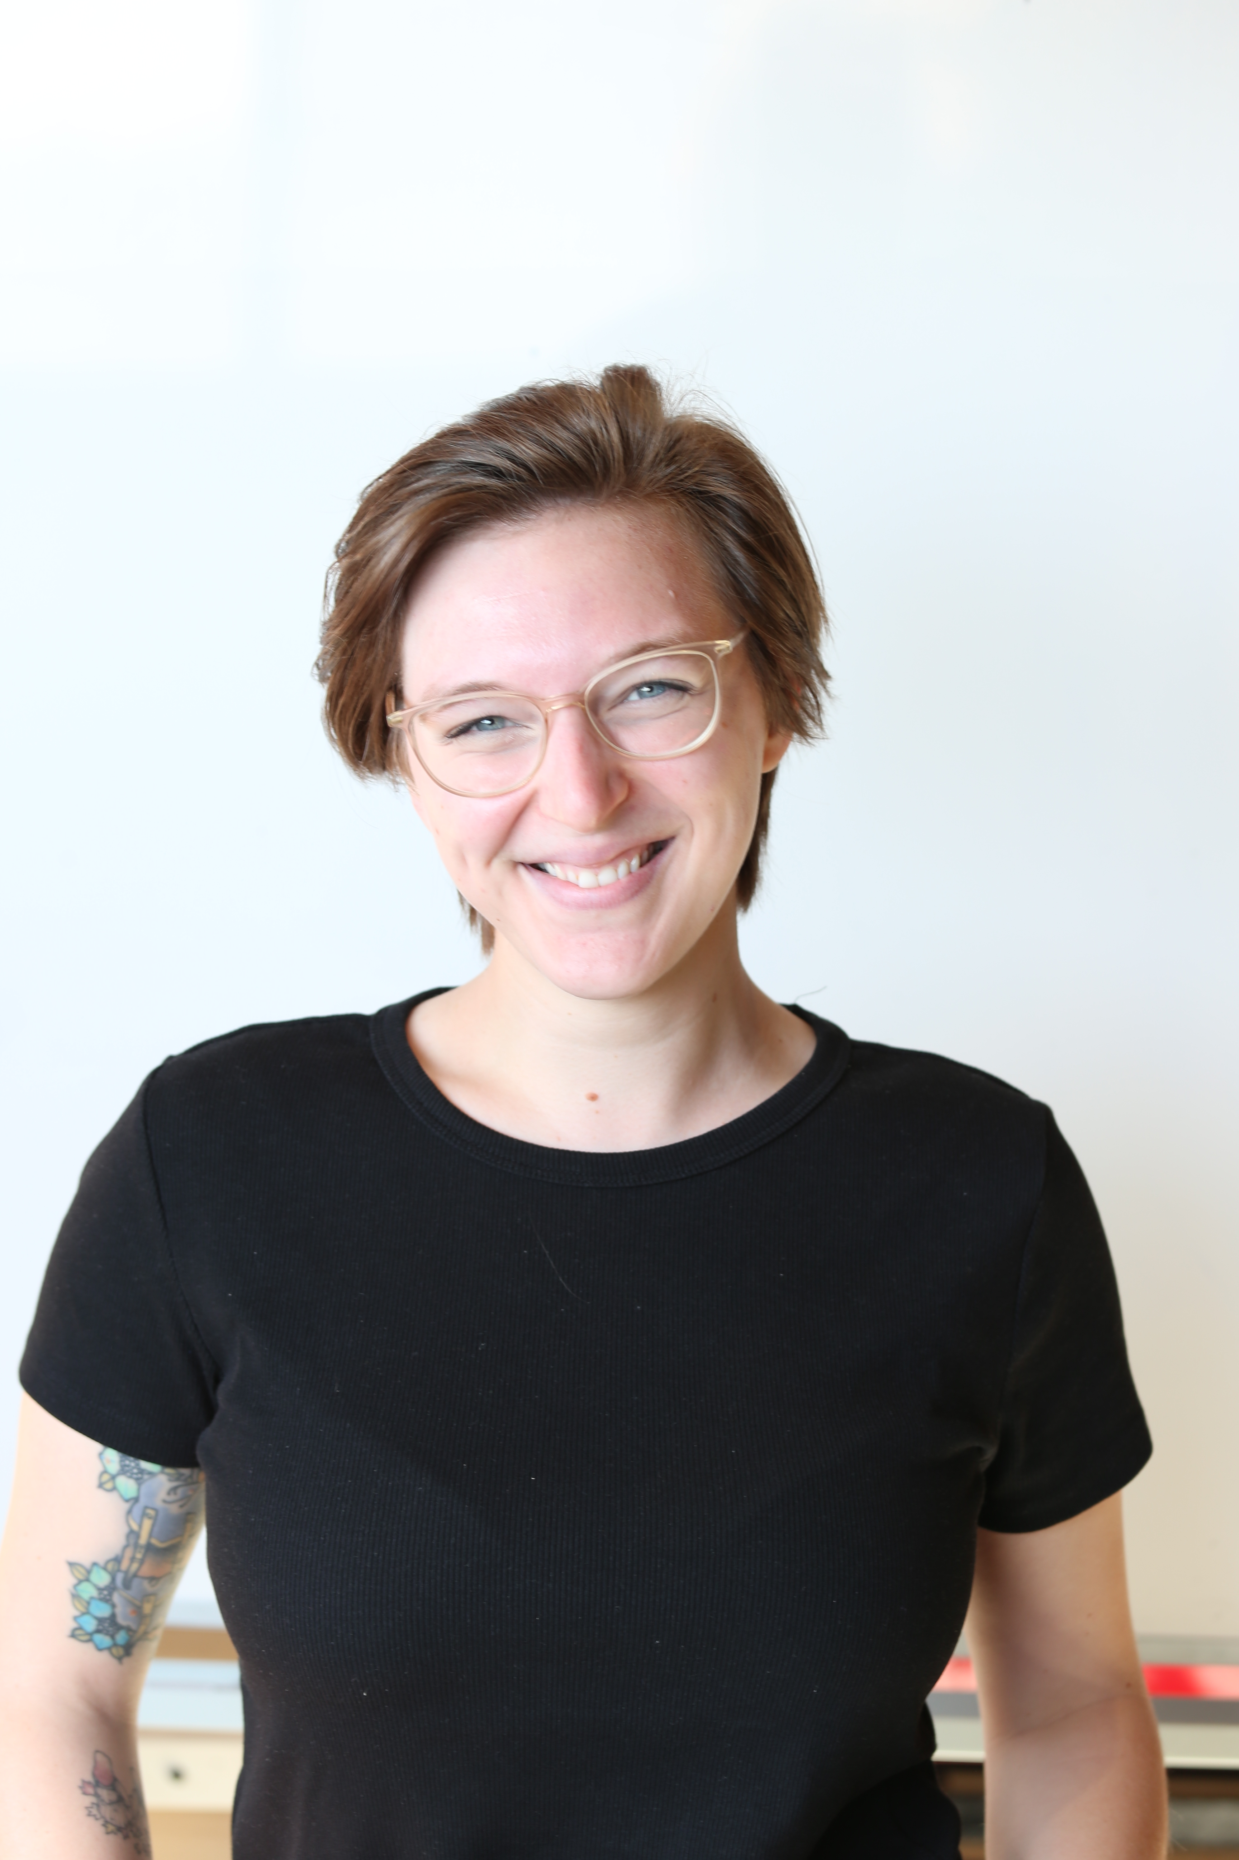
The CREW at IdeaSquare
Alexia Yiannouli
Communications
Laura Wirtavuori
Edu programmes
Ole Werner
Edu Programmes
Dina Zimmermann
Prototyping
Markus Nordberg
Fixing things
Pablo Garcia Tello
The bear from Mowgli
Laëtitia Pedroso
Events
Catarina Batista
Edu programmes
Jimmy Poulaillon
Communications
Tuuli Utriainen
Cosmic collaborator

Slide 3
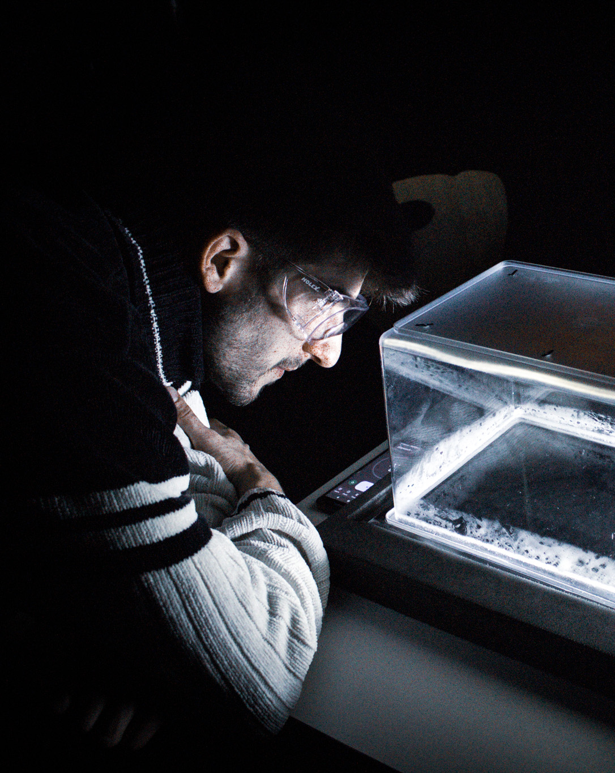
Who am I to talk to you
Ole Werner
Galactic Firefighter at CERN IdeaSquare
BSc Psychology, MSc Behavior Change
Love to excite people, want to understand your minds
Notes:
add slide from catarina

Slide 4
General building safety rules

Slide 5
Safety is first priority.

Slide 6
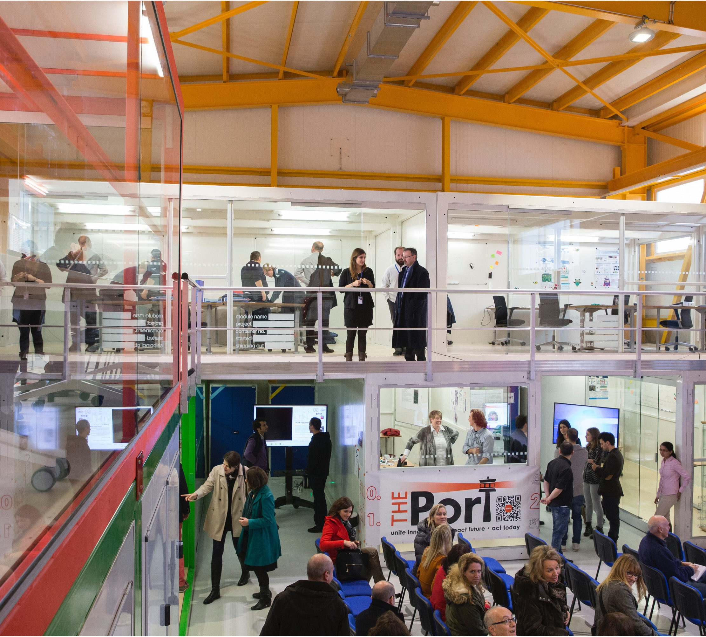
BUILDING SAFETY B3179
In all inside areas of Building 3179 smoking & alcoholic beverages are strictly forbidden.
Working is possible 24/7 with CERN access card, sleeping is prohibited in all CERN buildings. Last person to leave the building is a teacher.
Eating, drinking, coffee breaks are encouraged in the kitchen (and open) area. But not in the Red Bus, please!
Cameras, photos, posting in social media are highly encouraged! :)

Slide 7
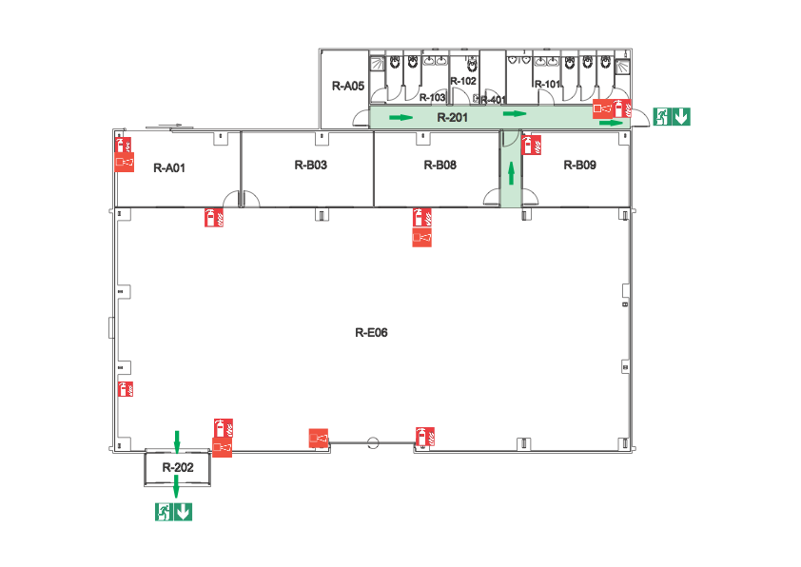
Machineshop
Electroshop
Light Lab
Kitchen
Free to use
1-D01
3D Studio
(2nd floor)
Work under
supervision
Restricted area

Slide 8
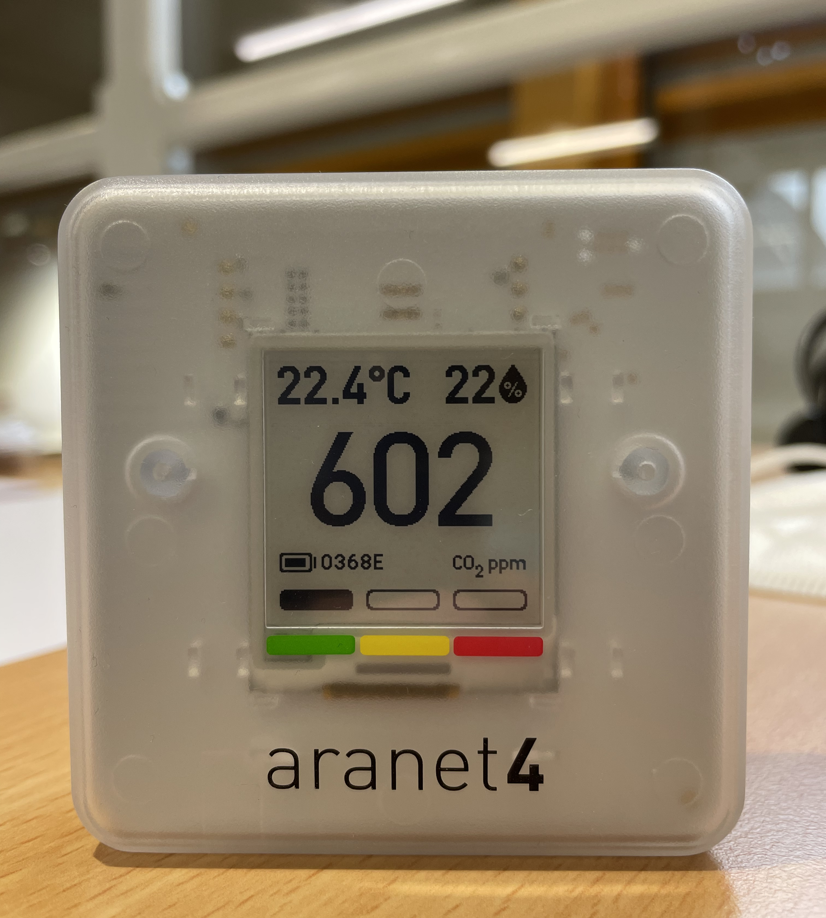
This is a CO₂ monitoring device.
There is one in every room inside ID2.
If the value is over 900ppm:
Leave the room you are in to let it ventilate until the CO₂ concentration goes below 600 ppm. ;
Ask one of the ID2 members to open the main doors to ventilate the whole space.

Slide 9
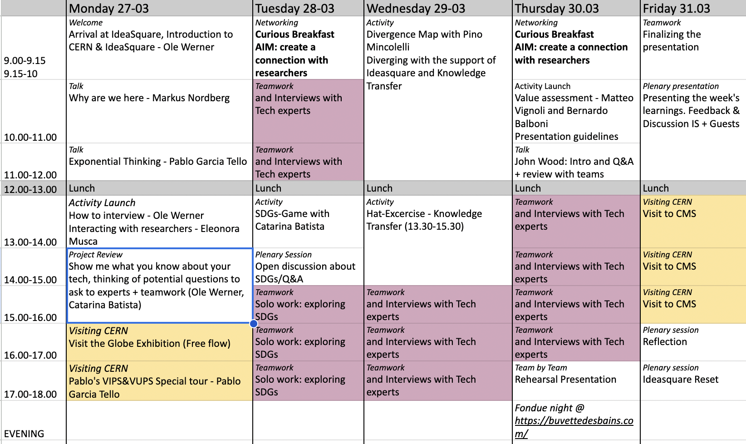


Agenda 4 the Week
Find the updated Indico-Timetable here!
(Real times)

Slide 10
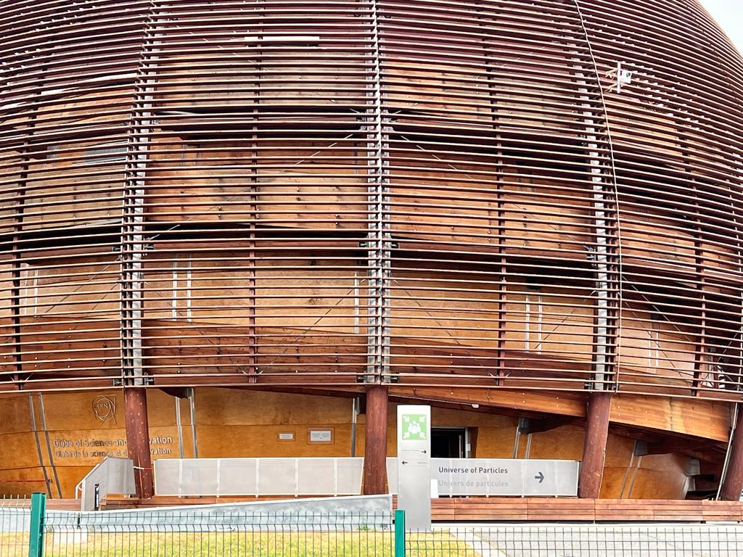

In case of an emergency
While evacuating, always go away from the danger!
Do NOT return to collect your belongings
Wait at the assembly point until counted and released by the TSO/DSO or the Fire Brigade.
Walk quickly and calmly to your building’s designated assembly point or as advised by an Emergency Guide or Fire Brigade personnel
Give to the Fire Brigade all the information they need! +41 22 767 44 44

Slide 11
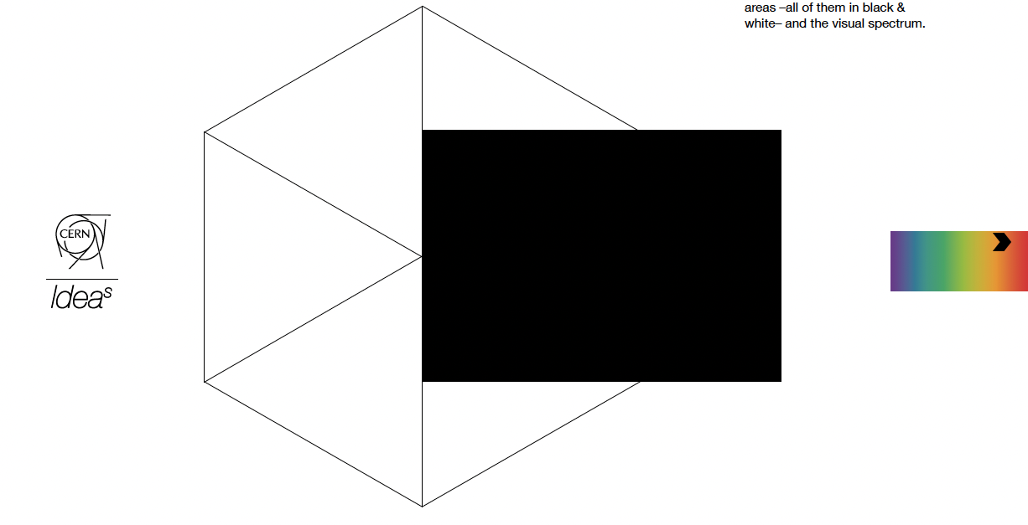
IdeaSquare

Slide 12

Aren’t all CERN labs “innovation spaces” ?
An innovation space is defined as
→ a place dedicated to stimulating the creativity of users,
where innovation projects take advantage of the availability of adapted environments and resources
→ allowing prototyping and creativity
(Lewis, Moultrie, 2005; Moultrie et al., 2007)
The combination of an innovation space & CERN means:
We love to work in teams of mixed expertise
We encourage “dreaming big” & taking the risk to fail
We take on problems that don’t have an answer (….yet)
& We have the best decoration (Red elephant in the room)
Notes:
Short answer: No
Here’s why:
Therefore, IdeaSquare at CERN is a place to play around without having to fear deadly consequences. (different mindset; instead of perfection, we strive for mistakes)

Slide 13
IdeaSquare
The Innovation Space at CERN
IdeaSquare is the innovation space at CERN, that uses collaborative methodologies, access to CERN expertise and cross-connectivity to ideate solutions for the future of humankind.
A place where people have the licence to dream.

Slide 14
Linking science, innovation, and the SDGs

Slide 15
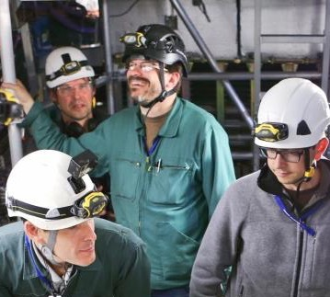
#ATTRACT
Provides funding for developing early-stage ideas and prototypes on detection and imaging
Focuses on innovation with high potential outside research
Engages with MSc-level, cross-disciplinary student activities, seeking for unforeseen entrepreneurial opportunities for the young
Purpose is to create a new innovation ecosystem in Europe
ATTRACT is coordinated by CERN (IdeaSquare)

Slide 16
Connecting curious minds

Slide 17
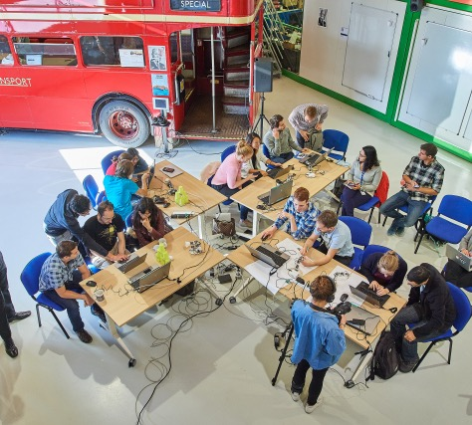
Events, workshops and hackatons
When the building is not in full use, Ideasquare can offer access to its open work areas, rapid prototyping facilities and its meeting rooms for short, deadline driven Challenge Events, such as :
Innovation Events,
Workshops
Hackathons ( an event compressed into a short number of days where participants work towards a concept prototype).
IdeaSquare Open Doors event 2018

Slide 18
Fast forward through prototyping

Slide 19
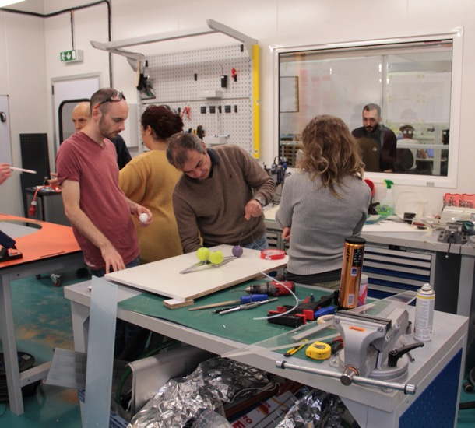
Our Prototyping Facilities
An open space for ideation
An electro shop
A machine shop with a laser cutter
3D printing equipment
CMS Create

Slide 20
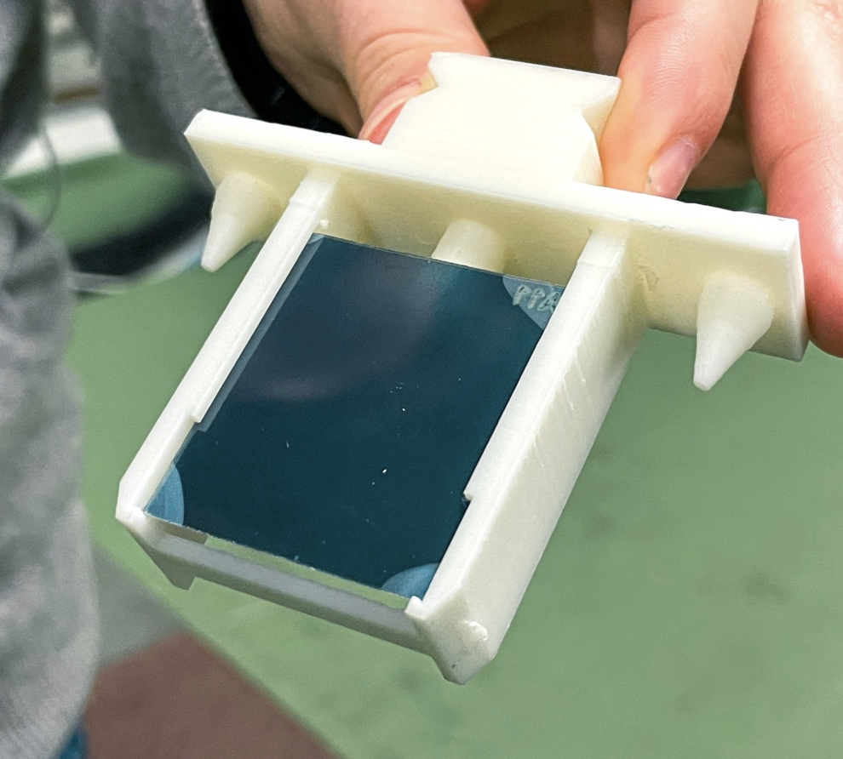
Example: CLEAR
CLEAR is an electron accelerator that operates independently from CERN's main accelerator complex
Prototyping and validation of accelerator components
Researchers are also pursuing two main branches of irradiation tests: radiation hardness of electronic components for space and high-energy physics, and dosimetry for medical applications, in particular cancer therapy.
CLEAR Experiment - https://home.cern/science/accelerators/clear AND https://pkorysko.web.cern.ch/C-Robot.html
Notes:
CLEAR is doing research in medical radiation therapy. Put very simply they research the impact of doing radiation therapy in short, intense bursts, compared to the conventional way of giving small doses of radiation over a longer period of time.
In order to test this they have built a robot which picks up a sample and places it in front of their beam, since they cannot be in the room while the beam is running. The collaboration with IdeaSquare consisted mostly of prototyping parts for the robot. Many different iterations of the sample holders were tested before a final design was chosen. The holders were 3D printed, along with the gripper of the robot. The laser cutter was also used to cut radiation sensitive film, which could not be cut with conventional tools.
VIDEO: https://pkorysko.web.cern.ch/C-Robot.html

Slide 21
Stimulating instrumentation in research

Slide 22
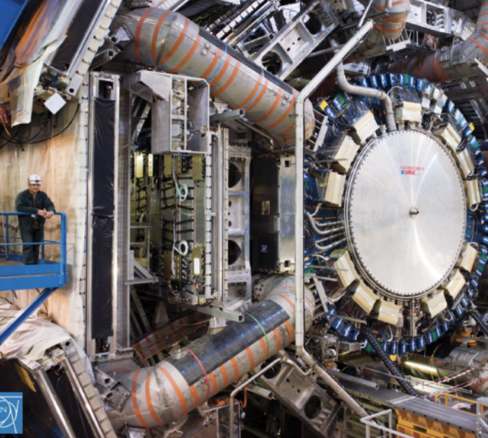
Edusafe
EDUSAFE was a 4-year Marie Curie ITN project that provides training for 10 Early Stage Researchers and 2 Experienced Researchers.
The project focused on research into the use of Virtual Reality (VR) and Augmented Reality (AR) during planned and emergency maintenance in extreme environments (nuclear installations, space, deep sea etc)..
Edusafe: https://edusafe.web.cern.ch/site.php

Slide 23
Training and experimenting with the innovators of the future

Slide 24
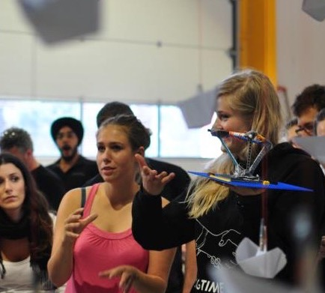
Educational programmes
Ranging from one week to eight months in duration;
Mostly with multidisciplinary teams;
In collaboration with universities around the world;
One proprietary course / methodology: Design the Future
Incorporating sustainable development goals;
Different outputs from conceptual videos to functioning prototypes, but following the same philosophy…
Students prototype to TEDxCERN installation

Slide 25
Why?
We believe that for fundamental change to be made, we need more than traditional innovation methods and mindsets
What we are here to do is to help you imagine a future worth fighting for, and to give you the tools and confidence to start building that future.

Slide 26
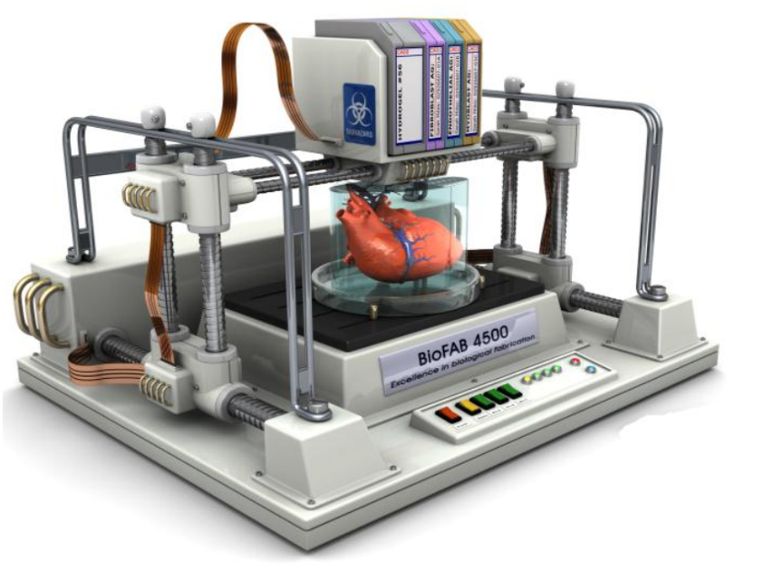
What to expect from your journey?
“It helps us answer the nasty questions.”
Previous students told us, the course helped them to:
not get stuck with specifics in the beginning
moving from incremental to exponential thinking
be aware of uncertainty, and much more motivated to try different pathways if something doesn't work out.
But this is merely the beginning…
Notes:
For example last year a student reached out to us to check if their idea would be feasible to implement, Pablo did the caluclations and we came to the conclusion that they needed to rethink. However, this curious and passionate mindset is what we hope sticks with you.
Fun facts: a comment from a student got Pablo to state that we are not responsible for any PhDs dropping out of their PhD programmes because of this course.

Slide 27
A place where people have the licence to dream!
Notes:
Visual: License to dream card!

