Slide 1
Update on FCC circumference studies and resulting choice of RF frequency
Heiko Damerau, Ivan Karpov, Linhao Zhang
26/04/2022

Slide 2
Outline
Brief review
Results of extended RF harmonic scans
Impact of RF frequency on beam dynamics
Robustness of the selected options
Summary

Slide 3



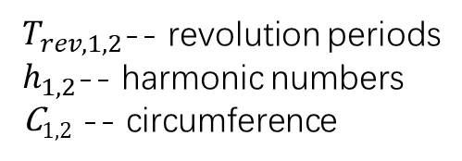
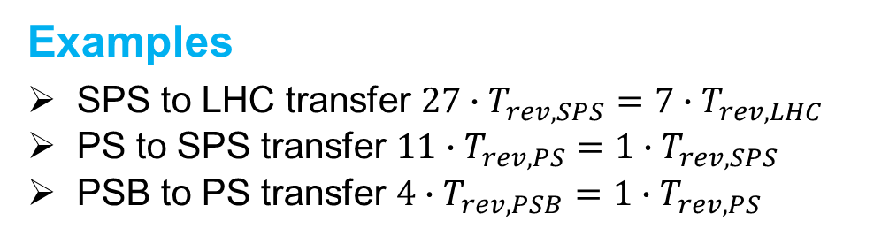
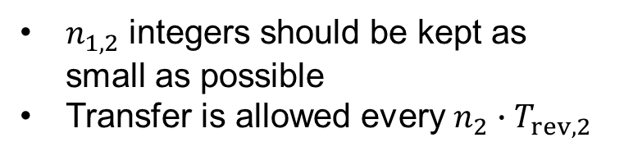
Brief review - Introduction
Synchronization basis
  Basic principle: velocity during transfer is the same.
  $n_{1}T_{rev,1}=n_{2}T_{rev,2}$ or ${f_{rev,1}}/{f_{rev,2}}={n_{1}}/{n_{2}}$
  Assuming $f_{RF,1}=f_{RF,2}$
Synchrotron 2
Synchrotron 1
$$\frac{h_{2}}{h_{1}}=\frac{C_{2}}{C_{1}}=\frac{n_{1}}{n_{2}}$$
$T_{rev,1,2}$-- revolution periods
$h_{1,2}$-- harmonic numbers
C_{1,2} -- circumference
$n_{1,2}$ integers should be kept as small as possible
Transfer is allowed every $n_{2}∙T_{rev,2}$
Examples
SPS to LHC transfer $27∙T_{rev,SPS}=7∙T_{rev,LHC}$
PS to SPS transfer $11∙T_{rev,PS}=1∙T_{rev,SPS}$
PSB to PS transfer $4∙T_{rev,PSB}=1∙T_{rev,PS}$

Slide 4
Brief review – Accelerator parameters
Keep the possibility of SPS & LHC as potential injectors
Proposed FCC circumference: 91172.7 (± 100) m
LHC RF frequency ~ 400.79 MHz was initial baseline option for FCC-hh
  Why is 121888 unfavourable harmonic number?
  • Not dividable by 10； • Not suitable for synchronous transfer
 | Circumference (m) | Harmonic number (400.79 MHz)
FCC | 91172.7 (Intended) | (Corresponds to) 121888
LHC | 2π⋅11⋅100⋅27/7= 26658.7 | 2x3x4x5x11x3x9 = 35640
SPS | 2π⋅11⋅100 = 6911.5 | 2x3x4x5x11x7 = 4620x2
Note that the ratio of harmonic number of LHC and SPS is 27/7 (constant), which comes from the ratio of circumference of LHC and SPS
Note that the factor 11 in the harmonic number of SPS and LHC comes from the ratio of circumference of SPS and PS, which will be not a limit assuming PS replacement as FCC pre-injector

Slide 5
Brief review - Constraints
FCC harmonic number must be dividable by 4 (4 IPs)
h_{FCC} should keep continuous bunch clock
Checked all harmonic ratios to keep n₁ or n₂ as small as possible, so is the wait time for transfer
Previous presentations see:
  Presentation at 148th FCC-ee Optics Design Meeting & 19th FCCIS WP2.2 Meeting (I. Karpov, H. Damerau)
  Presentation at FCC-ee parameters meeting # 08 (H. Damerau, I. Karpov, L.H. Zhang)
  Presentation at FCC-ee parameters meeting # 09 (H. Damerau, I. Karpov, L.H. Zhang)
h_{FCC} = Number of IPs x smth dividable by bunch spacing x ...
Number of RF buckets
4
1 2 3 4 5 6 7 .….. N-1 N
N is related to the max. bunch spacing with a given RF frequency
  For bunch spacing up to 25 ns in 400.79 MHz, N is 10 ( = 25*400.79e-3)
To have more flexible bunch spacings up to the max. bunch spacing, h_{FCC} should be dividable by as many integers from 1 to N as possible.

Slide 6
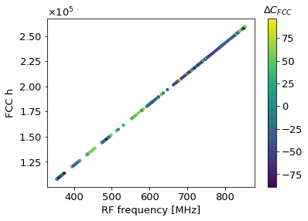
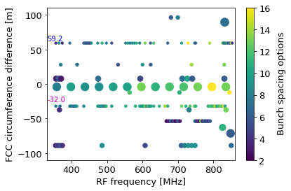
Results of extended RF frequency
Scanned h_{LHC} from 30000 to 76000, f_{RF}: 337 ~ 854 MHz
  scaling law: h_{LHC}=35640 + 27*n, h_{SPS}=2*4620 + 7*n
Requirements:
  h_{FCC} dividable by 4; ΔC_{FCC} < 100 m; largest prime factor < 200 ( ‘arbitrary’ choice)
If the max. bunch spacing is less than 25.5 ns (the max. bucket spacing dividable by h_{FCC} (or ‘N’) is increased to 22 for 854 MHz)
  The max. number of bunch spacing is 16
The point size means the largest prime factor in the factorization of FCC/LHC/SPS harmonic number

Slide 7
Selection of interesting options
RF frequency (MHz) | h_{LHC} | h_{FCC} | C_{FCC} [m] | ΔC_{FCC} [m] | h_{FCC}/h_{LHC} | h_{FCC}/h_{SPS} | Largest prime factor | Bucket spacings | Bunch spacings ≤ 25.5 [ns] | Bunch spacing options
364.35 | 32400 | 110880 | 91231.9 | 59.2 | 154/45 | 66/5 | 11 | [1, 2, 3, 4, 5, 6, 7, 8, 9, 10, 11, 12, 14, 15, 18, 20, 21, 22] | 2.74, 5.49, 8.23, 10.98, 13.72, 16.47, 19.21, 21.96, 24.70 | 9
400.79 | 35640 | 121800 | 91106.2 | -66.50 | 1015/297 | 145/11 | 29 | [1, 2, 3, 5, 6, 7, 10, 14, 15, 21] | 2.5, 5.0,7.5, 12.5, 15, 17.5, 25 | 7
497.34 | 44226 | 151200 | 91140.7 | -32.0 | 400/117 | 1200/91 | 13 | [1, 2, 3, 4, 5, 6, 7, 8, 9, 10, 12,14,15, 18, 20, 21] | [ 2.01 4.02 6.03 8.04 10.05 12.06 14.07 16.09 18.1 20.11, 24.13] | 11
563.54 | 50112 | 171360 | 91160.4 | -12.3 | 595/174 | 765/58 | 29 | [1, 2, 3, 4, 5, 6, 7, 8, 9, 10, 12, 14, 15] | [1.77, 3.55, 5.32, 7.1, 8.87, 10.65, 12.42, 14.2, 15.97, 17.74, 21.29, 24.84] | 12
607.26 | 54000 | 184800 | 91231.9 | 59.2 | 154/45 | 66/5 | 11 | [1, 2, 3, 4, 5, 6, 7, 8, 10, 11, 12, 14, 15, 20, 21, 22] | [1.65, 3.29, 4.94, 6.59, 8.23, 9.88, 11.53, 13.17, 16.47, 18.11, 19.76, 23.05, 24.7] | 13
607.86 | 54054 | 184800 | 91140.7 | -32.0 | 400/117 | 1200/91 | 13 | [1, 2, 3, 4, 5, 6, 7, 8, 10, 11, 12, 14, 15, 20, 21, 22] | [1.65, 3.29, 4.94, 6.58, 8.23, 9.87, 11.52, 13.16, 16.45, 18.1, 19.74, 23.03, 24.68] | 13
728.71 | 64800 | 221760 | 91231.9 | 59.2 | 154/45 | 66/5 | 11 | [1, 2, 3, 4, 5, 6, 7, 8, 9, 10, 11, 12, 14, 15, 16, 18, 20, 21, 22] | [1.37, 2.74, 4.12, 5.49, 6.86, 8.23, 9.61, 10.98, 12.35, 13.72, 15.1, 16.47, 19.21, 20.58, 21.96, 24.7] | 16
805.22 | 71604 | 244800 | 91140.7 | -32.0 | 400/117 | 1200/91 | 13 | [1, 2, 3, 4, 5, 6, 8, 9, 10, 12, 15, 16, 17, 18, 20] | [1.24, 2.48, 3.73, 4.97, 6.21, 7.45, 9.94, 11.18, 12.42, 14.9, 18.63, 19.87, 21.11, 22.35, 24.84] | 15
828.91 | 73710 | 252000 | 91140.7 | -32.0 | 400/117 | 1200/91 | 13 | [1, 2, 3, 4, 5, 6, 7, 8, 9, 10, 12, 14, 15, 18, 20, 21] | [1.21, 2.41, 3.62, 4.83, 6.03, 7.24, 8.44, 9.65, 10.86, 12.06, 14.48, 16.89, 18.1, 21.72, 24.13, 25.33] | 16
Ascending RF frequency
2x3x3x3x3x3x7x13
Complete set of options see spare slides.

Slide 8
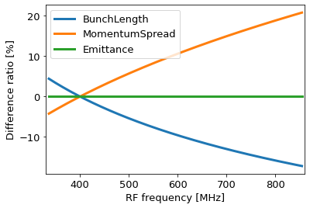
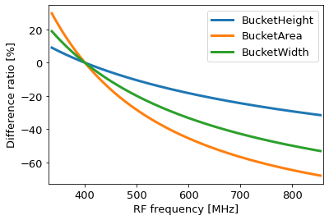
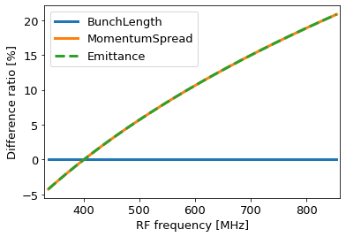
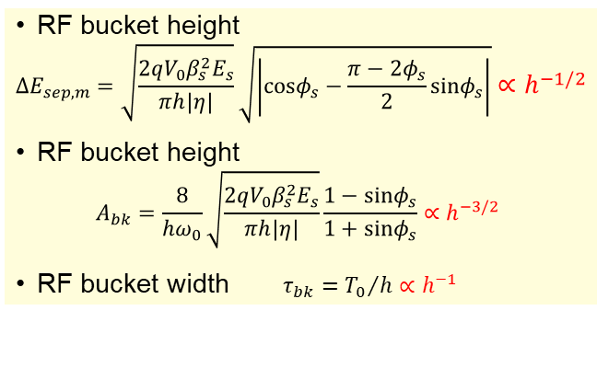
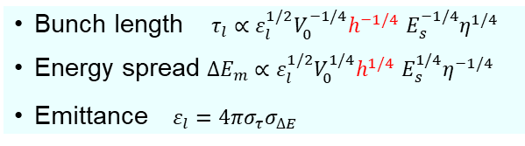
Impact of RF frequency on beam dynamics
RF frequency determines the obtainable bunch spacing and bunch intensity
From RF and beam* point of view:
Bunch length $τ_{l}∝ε_{l}^{1/2}V_{0}^{−1/4}h^{−1/4}$ $E_{s}^{−1/4}η^{1/4}$
Energy spread ${ΔE}_{m}∝ε_{l}^{1/2}V_{0}^{1/4}h^{1/4}$ $E_{s}^{1/4}η^{−1/4}$
Emittance $ε_{l}=4πσ_{τ}σ_{∆E}$
RF bucket height
$${ΔE}_{sep, m}=\sqrt{\frac{2qV_{0}β_{s}^{2}E_{s}}{πh\left|η\right|}}\sqrt{\left|cosφ_{s}−\frac{π−2φ_{s}}{2}sinφ_{s}\right|}∝h^{−1/2}$$
RF bucket height
$$A_{bk}=\frac{8}{{hω}_{0}}\sqrt{\frac{2qV_{0}β_{s}^{2}E_{s}}{πh\left|η\right|}}\frac{1−sinφ_{s}}{1+sinφ_{s}}∝h^{−3/2}$$
RF bucket width $τ_{bk}={T_{0}}/h∝h^{−1}$
Constant longitudinal emittance
Constant bunch length by controlled emittance blow-up
* S.Y. Lee, Accelerator Physics, World Scientific Publishing, 2004

Slide 9
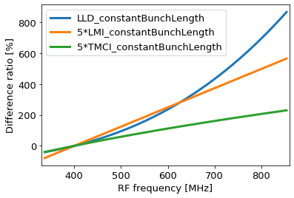
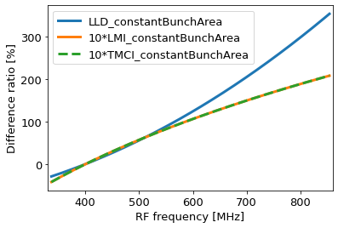
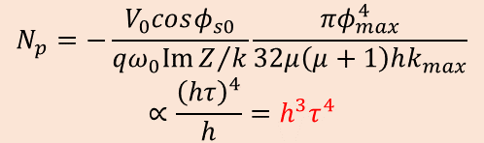
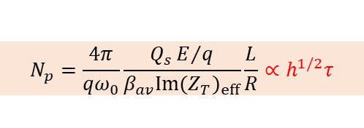

Impact of RF frequency on beam dynamics
From single bunch instability point of view:
  Loss of Landau damping¹:
  Longitudinal microwave instability²:
  Transverse mode coupling instability²
$$N_{p}=−\frac{V_{0}cosφ_{s0}}{qω_{0}ImZ/k}\frac{{πφ}_{max}^{4}}{32μ\left(μ+1\right)hk_{max}}$$
$$∝\frac{{\left(hτ\right)}^{4}}{h}=h^{3}τ^{4}$$
→ N_{p} ∝ h³τ⁴ for a constant bunch length
N_{p} ∝ h² for a constant longitudinal emittance
$$N_{p}=\frac{3π}{qω_{0}}\frac{hV_{0}}{\left|{\left({Z_{L}}/n\right)}_{eff}\right|}{\left(\frac{L}{2πR}\right)}^{3}∝hτ^{3}$$
→ N_{p} ∝ hτ³ for a constant bunch length
N_{p} ∝ h^{1/4} for a constant longitudinal emittance
$$N_{p}=\frac{4π}{qω_{0}}\frac{Q_{s}E/q}{β_{av}Im{(Z_{T})}_{eff}}\frac{L}{R}∝h^{1/2}τ$$
N_{p} ∝ h^{1/2}τ for a constant bunch length
N_{p} ∝ h^{1/4} for a constant longitudinal emittance
⇒ Higher harmonic number seems more beneficial to a higher bunch intensity
¹ Ivan Karpov, Theodoros Argyropoulos, and Elena Shaposhnikova, Phys. Rev. Accel. Beams 24, 011002 (2021)
² Francesco Ruggiero, Single-Beam Collective Effects in the LHC, CERN SL/95-09 (AP)

Slide 10
Sensitivity analysis
How robust are solutions with respect to assumptions?
Figure of MERIT is number of possible bunch spacings up to τ_{spacing,max} (by default 25 ns)
Requires normalization by τ_{spacing,max} ⋅ f_{RF} (= ‘N’ in slide 5)
Fraction of possible bunch spacing options
The options derived by the previous algorithm need to be checked for various maximum bunch spacings, τ_{spacing,max} to demonstrate if the same interesting combinations are always favourable

Slide 11
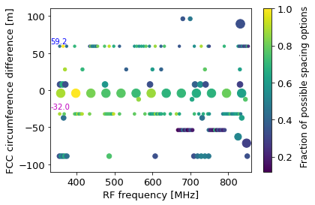
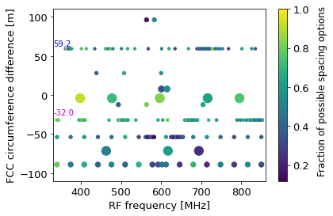
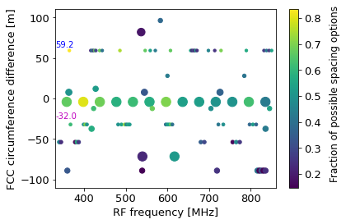
Results for different τ_{spacing,max}
Max. bunch spacing < 25.5 ns
Max. bunch spacing < 30.5 ns
Max. bunch spacing < 50.5 ns
From ‘Fraction of possible bunch spacing options’ point of view, preferable frequency range:
400 ~ 600 MHz

Slide 12
Comparison for different τ_{spacing,max}
RF frequency (MHz) | Bunch spacings ≤ 25.5 [ns] | Percen-tage of possiblespacings | Bunch spacings ≤ 30.5 [ns] | Percen-tage of possible spacings | Bunch spacings ≤ 50.5 [ns] | Percen-tage of possible spacings
364.35 | 2.74, 5.49, 8.23, 10.98, 13.72, 16.47, 19.21, 21.96, 24.70 | 9/9 = 100% | [2.74, 5.49, 8.23, 10.98, 13.72, 16.47, 19.21, 21.96, 24.7, 27.45, 30.19] | 11/11 = 100% | [2.74, 5.49, 8.23, 10.98, 13.72, 16.47, 19.21, 21.96, 24.7, 27.45, 30.19, 32.94, 38.42, 41.17, 49.4] | 15/18 = 83.3%
400.79 | 2.5, 5.0,7.5, 12.5, 15, 17.5, 25 | 7/10 = 70% | 2.5, 5.0,7.5, 12.5, 15, 17.5, 25 | 7/12 = 58.3% | [2.5, 4.99, 7.49, 12.48, 14.97, 17.47, 24.95, 34.93, 37.43] | 9/20 = 45%
497.34 | [ 2.01 4.02 6.03 8.04 10.05 12.06 14.07 16.09 18.1 20.11, 24.13] | 11/12 = 91.7% | [2.01, 4.02, 6.03, 8.04, 10.05, 12.06, 14.07, 16.09, 18.1, 20.11, 24.13, 28.15, 30.16] | 13/15 = 86.7% | [2.01, 4.02, 6.03, 8.04, 10.05, 12.06, 14.07, 16.09, 18.1, 20.11, 24.13, 28.15, 30.16, 36.19, 40.21, 42.22, 48.26, 50.27] | 18/25 = 72%
563.54 | [1.77, 3.55, 5.32, 7.1, 8.87, 10.65, 12.42, 14.2, 15.97, 17.74, 21.29, 24.84] | 12/14 = 85.7% | [1.77, 3.55, 5.32, 7.1, 8.87, 10.65, 12.42, 14.2, 15.97, 17.74, 21.29, 24.84, 26.62, 30.17] | 14/17 = 82.3% | [1.77, 3.55, 5.32, 7.1, 8.87, 10.65, 12.42, 14.2, 15.97, 17.74, 21.29, 24.84, 26.62, 30.17, 31.94, 35.49, 37.26, 42.59, 49.69] | 19/28 = 67.9%
607.26 | [1.65, 3.29, 4.94, 6.59, 8.23, 9.88, 11.53, 13.17, 16.47, 18.11, 19.76, 23.05, 24.7] | 13/15 = 86.7% | [1.65, 3.29, 4.94, 6.59, 8.23, 9.88, 11.53, 13.17, 16.47, 18.11, 19.76, 23.05, 24.7] | 13/18 = 72.2% | [1.65, 3.29, 4.94, 6.59, 8.23, 9.88, 11.53, 13.17, 16.47, 18.11, 19.76, 23.05, 24.7, 32.93, 34.58, 36.23, 39.52, 41.17, 46.11, 49.4] | 20/30 = 66.7%
607.86 | [1.65, 3.29, 4.94, 6.58, 8.23, 9.87, 11.52, 13.16, 16.45, 18.1, 19.74, 23.03, 24.68] | 13/15 = 86.7% | [1.65, 3.29, 4.94, 6.58, 8.23, 9.87, 11.52, 13.16, 16.45, 18.1, 19.74, 23.03, 24.68] | 13/18 = 72.2% | [1.65, 3.29, 4.94, 6.58, 8.23, 9.87, 11.52, 13.16, 16.45, 18.1, 19.74, 23.03, 24.68, 32.9, 34.55, 36.19, 39.48, 41.13, 46.06, 49.35] | 20/30 = 66.7%
728.71 | [1.37, 2.74, 4.12, 5.49, 6.86, 8.23, 9.61, 10.98, 12.35, 13.72, 15.1, 16.47, 19.21, 20.58, 21.96, 24.7] | 16/18 = 88.8% | [1.37, 2.74, 4.12, 5.49, 6.86, 8.23, 9.61, 10.98, 12.35, 13.72, 15.1, 16.47, 19.21, 20.58, 21.96, 24.7, 27.45, 28.82, 30.19] | 19/22 = 86.4% | [1.37, 2.74, 4.12, 5.49, 6.86, 8.23, 9.61, 10.98, 12.35, 13.72, 15.1, 16.47, 19.21, 20.58, 21.96, 24.7, 27.45, 28.82, 30.19, 32.93, 38.42, 41.17, 45.29, 48.03, 49.4] | 25/36 = 69.4%
805.22 | [1.24, 2.48, 3.73, 4.97, 6.21, 7.45, 9.94, 11.18, 12.42, 14.9, 18.63, 19.87, 21.11, 22.35, 24.84] | 15/20 = 75% | [1.24, 2.48, 3.73, 4.97, 6.21, 7.45, 9.94, 11.18, 12.42, 14.9, 18.63, 19.87, 21.11, 22.35, 24.84, 29.81] | 16/24 = 66.7% | [1.24, 2.48, 3.73, 4.97, 6.21, 7.45, 9.94, 11.18, 12.42, 14.9, 18.63, 19.87, 21.11, 22.35, 24.84, 29.81, 31.05, 37.26, 42.22, 44.71, 49.68] | 21/40 = 52.5%
828.91 | [1.21, 2.41, 3.62, 4.83, 6.03, 7.24, 8.44, 9.65, 10.86, 12.06, 14.48, 16.89, 18.1, 21.72, 24.13, 25.33] | 16/21 = 76.2% | [1.21, 2.41, 3.62, 4.83, 6.03, 7.24, 8.44, 9.65, 10.86, 12.06, 14.48, 16.89, 18.1, 21.72, 24.13, 25.33, 28.95, 30.16] | 18/25 = 72% | [1.21, 2.41, 3.62, 4.83, 6.03, 7.24, 8.44, 9.65, 10.86, 12.06, 14.48, 16.89, 18.1, 21.72, 24.13, 25.33, 28.95, 30.16, 33.78, 36.19, 42.22, 43.43, 48.26] | 23/41 = 56.1%

Slide 13
Summary
Extended scan completed from 337 MHz to 854 MHz
  Certain circumferences allow several RF frequency options
  FCC circumference increased by 59.2 m or decreased by 32.0 m offer important flexibility to select RF frequency:
    Many bunch spacing options
    Short wait time for transfer
    Small largest prime factor in harmonic number ratios
From beam dynamics point of view, the RF frequency should be a compromise between bucket size (suggesting lower frequency) and stability (towards higher frequency)
From robustness point of view, the frequency range from 400 to 600 MHz seems most favourable
RF frequency 497.3 MHz particularly interesting
Further selection of RF frequency should also consider technical arguments (size of cavity, achievable gradient, RF power, etc.) and beam dynamics simulations
See spare slides for complete set of options considered

Slide 14
Spare slides

Slide 15
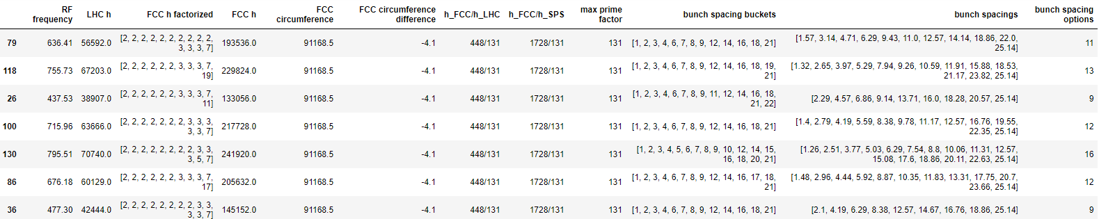
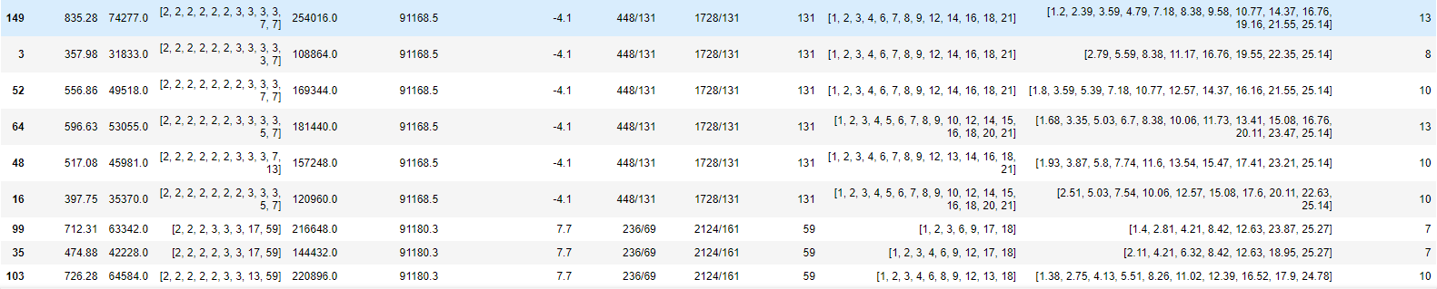
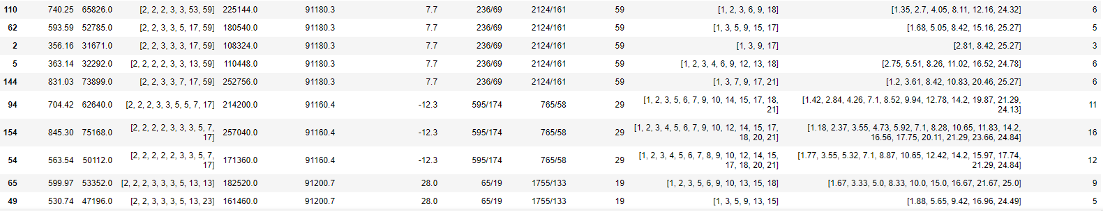
The complete set of options for τ_{spacing,max} ~ 25 ns

Slide 16
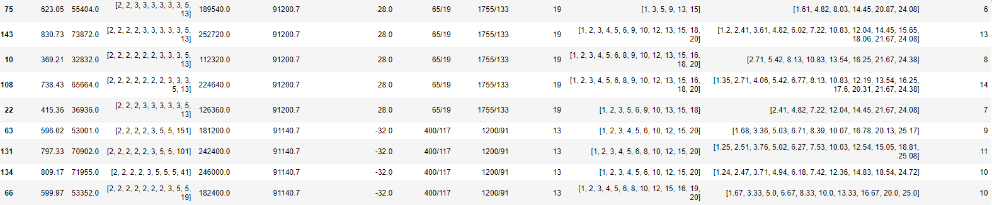
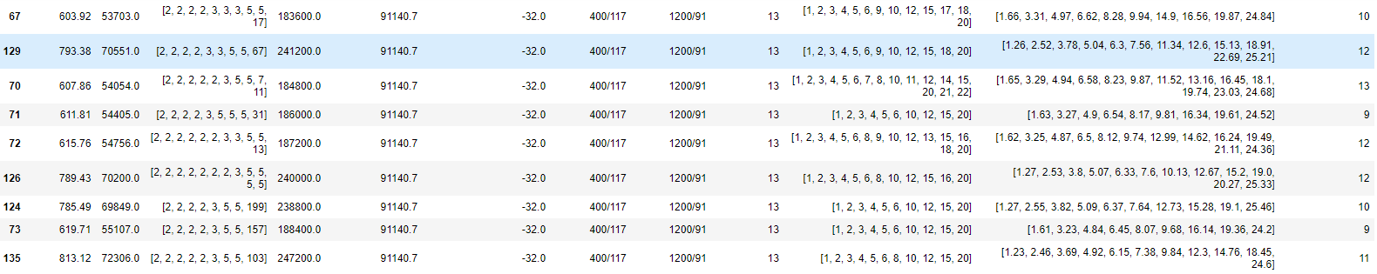
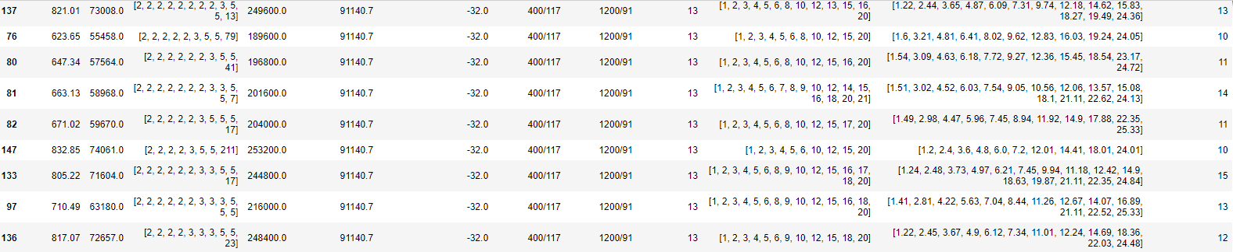

Slide 17
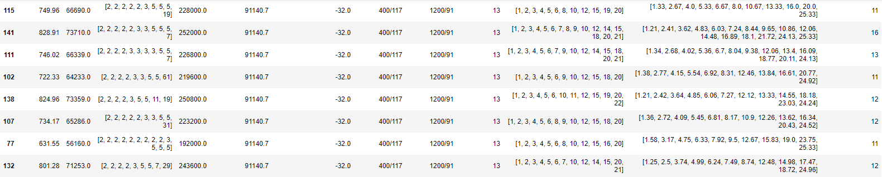
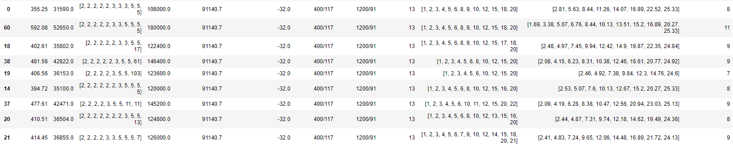
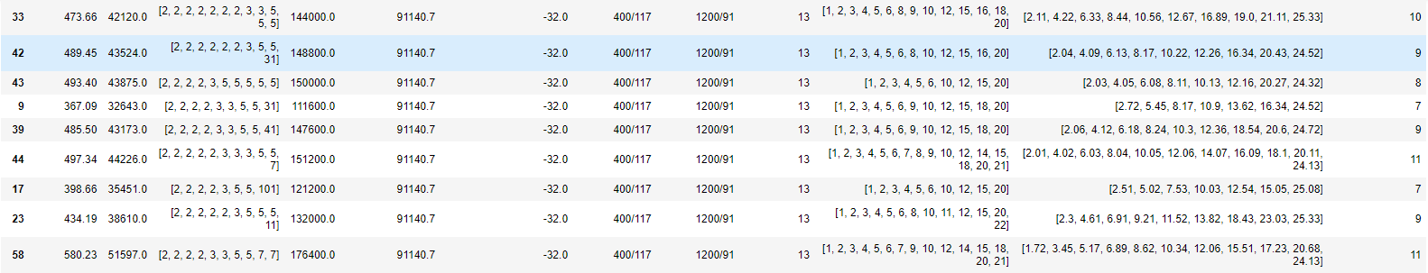

Slide 18
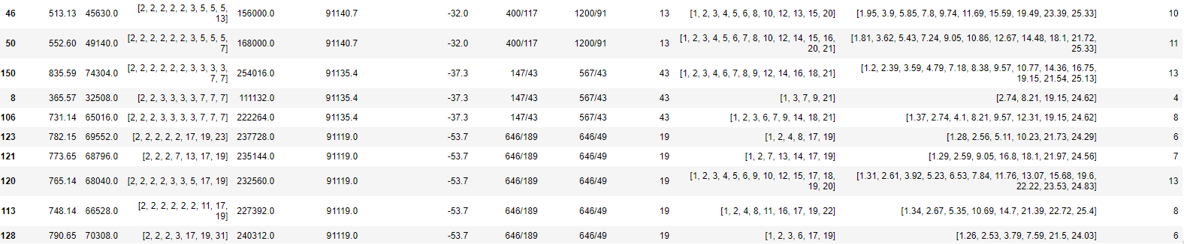
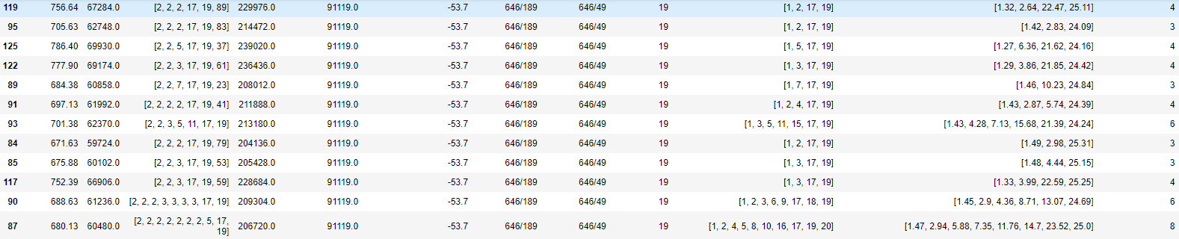
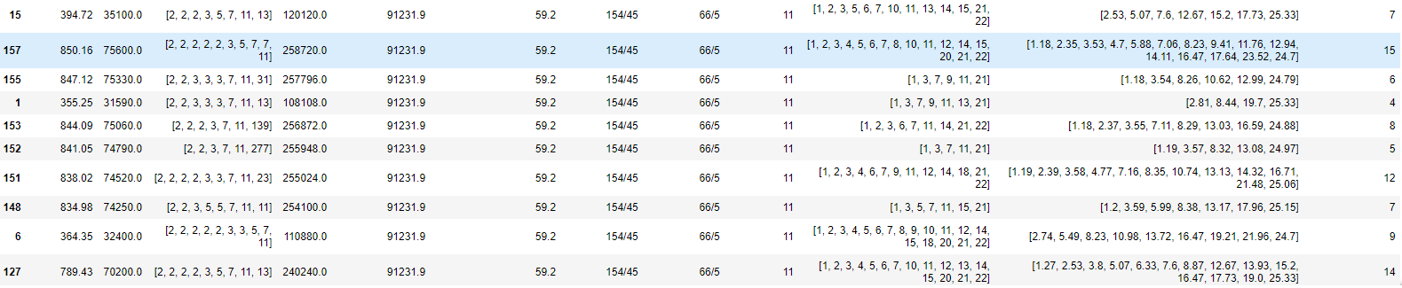

Slide 19
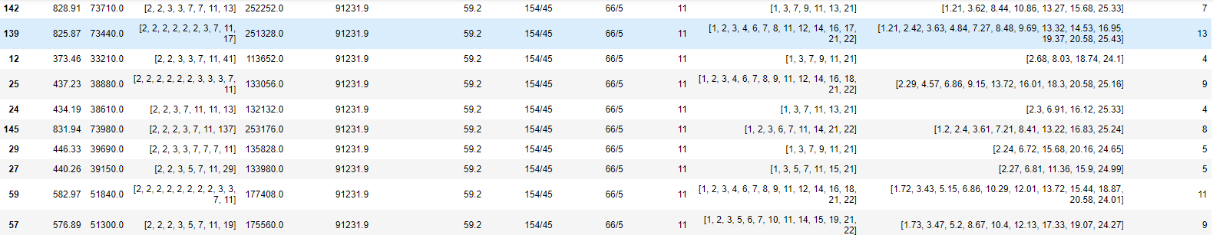
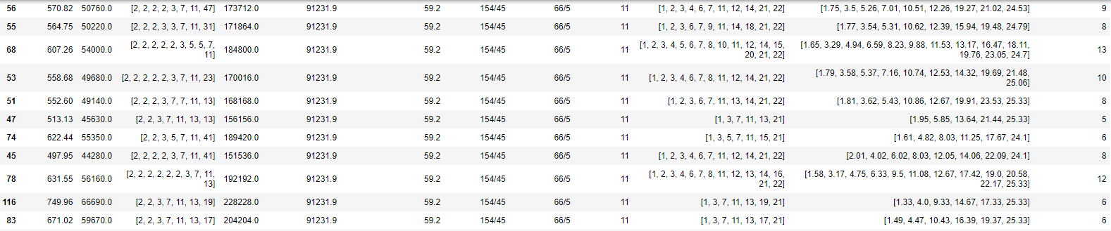
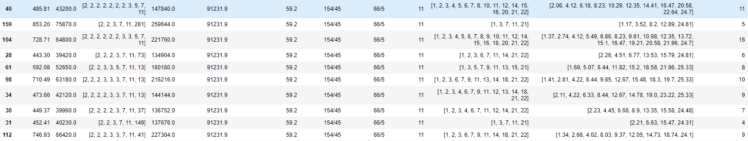

Slide 20
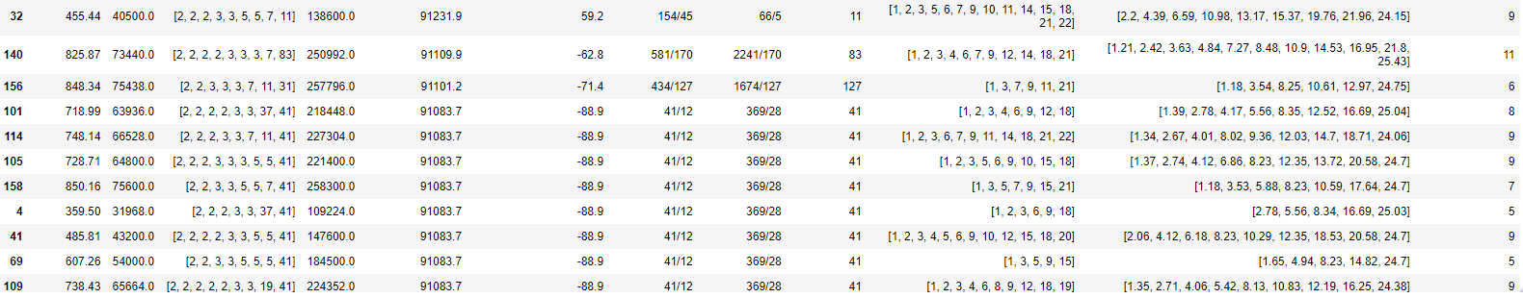
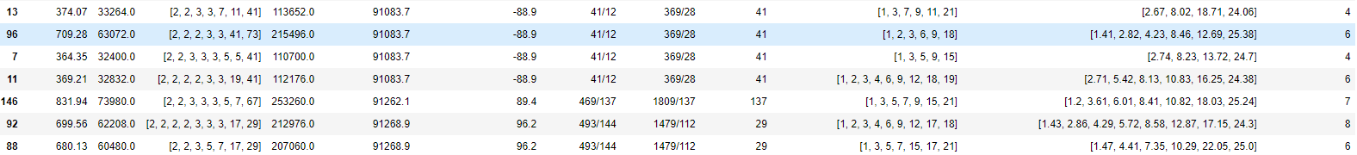

Slide 21
Brief review - Results
 | RF frequency (MHz) | h_{LHC} | h_{FCC} | C_{FCC} [m] | ΔC_{FCC} [m] | h_{FCC}/h_{LHC} | h_{FCC}/h_{SPS} | Largest prime factor | Bucket spacings | Bunch spacings [ns] | Bunch spacing options
PS as FCC-hh pre-injector | 400.79 | 35640 | 121880 = 2³x5x11x277 | 91166 | -6.66 | 277/81 | 277/21 | 277 | 1, 2, 5, 10 | 2.5, 5.0, 12.5, 25 | 4
 | 400.79 | 35640 | 121800 = 2³x3x5²x7x29 | 91106.2 | -66.50 | 1015/297 | 145/11 | 29 | 1, 2, 3, 5, 6, 7, 10 | 2.5, 5.0,7.5, 12.5, 15, 17.5, 25 | 7
 | 390.77 | 30888 | 118800 = 2⁴x3³x5²x11 | 91140.7 | -32.0 | 400/117 | 1200/91 | 13 | 1, 2, 3, 4, 5, 6, 9,10 | 2.56, 5.12, 7.68, 10.24, 12.80, 15.35, 23.03, 25.59 | 8
 | 397.45 | 35343 | 120960 = 2⁷x3³x5x7 | 91238.2 | 65.5 | 640/187 | 17280/1309 | 17 | 1,2,3,4,5, 6, 7, 8, 9,10 | 2.51, 5.03, 7.54, 10.06, 12.57, 15.08, 17.60, 20.11, 22.63, 25.14 | 10
New FCC-hh pre-injector | 397.75 | 35370 | 120960 = 2⁷x3³x5x7 | 91168.5 | -4.2 | 448/131 | 1728/131 | 131 | 1, 2, 3, 4, 5, 6,7, 8, 9, 10 | 2.51, 5.03, 7.54, 10.06, 12.57, 15.08, 17.60, 20.11, 22.63, 25.14 | 10
 | 394.71 | 35100 | 120000 = 2⁶x3x5⁴ | 91140.7 | -32.0 | 400/117 | 1200/91 | 13 | 1,2,3,4, 5,6,8,10 | 2.53, 5.07, 7.60, 10.13, 12.67, 15.20, 20.27, 25.34 | 8
 | 394.71 | 35100 | 120120 = 2³x3x5x7x11x13 | 91231.9 | 59. 2 | 154/45 | 66/5 | 11 | 1, 2, 3, 5, 6, 7, 10 | 2.53, 5.07, 7.60, 12.67, 15.20, 17.73, 25.34 | 7
 | 364.35 | 32400 | 110880 = 2⁵x3²x5x7x11 | 91231.8 | 59.2 | 154/45 | 66/5 | 11 | 1, 2, 3, 4, 5, 6, 7, 8, 9, 10 | 2.74, 5.49, 8.23, 10.98, 13.72, 16.47, 19.21, 21.96, 24.70, 27.45 | 10
 | 388.64 | 34560 | 118080 = 2⁶x3²x5x41 | 91083.7 | -88.9 | 41/12 | 369/28 | 41 | 1, 2, 3, 4, 5, 6, 8, 9,10 | 2.57, 5.15, 7.72, 10.29, 12.87, 15.44, 20.58, 23.16, 25.73 | 9
 | 425.08 | 37800 | 129360 = 2⁴x3x5x7²x11 | 91231.9 | 59.2 | 154/45 | 66/5 | 11 | 1, 2, 3, 4, 5, 6, 7, 10 | 2.35, 4.70, 7.06, 9.41, 11.76, 14.11, 16.47, 23.52 | 8
 | 398.06 | 35397 | 120960 = 2⁷x3³x5x7 | 91099.0 | -73.7 | 4480/1311 | 5760/437 | 23 | 1, 2, 3, 4, 5, 6, 7, 8, 9, 10 | 2.51, 5.02, 7.54, 10.05, 12.56, 15.07, 17.59, 20.10, 22.61, 25.12 | 10
 | 369.21 | 32832 | 112320 = 2⁶x3³x5x13 | 91200.7 | 28.0 | 65/19 | 1755/133 | 19 | 1, 2, 3, 4, 5, 6, 8, 9,10 | 2.71, 5.42, 8.13, 10.83, 13.54, 16.25, 21.67, 24,37, 27.08 | 9
 | 402.61 | 35802 | 122400 = 2⁵x3²x5²x17 | 91140.7 | -32.0 | 400/117 | 1200/91 | 13 | 1, 2, 3, 4, 5, 6, 8, 9, 10 | 2.48, 4.97, 7.45, 9.94, 12.42, 14.90, 19.87, 22.35, 24.84 | 9
RF frequency scanning: 340 ~450 MHz

