Slide 1
EDF R&D
Main Challenges
29/04/2022

Slide 2
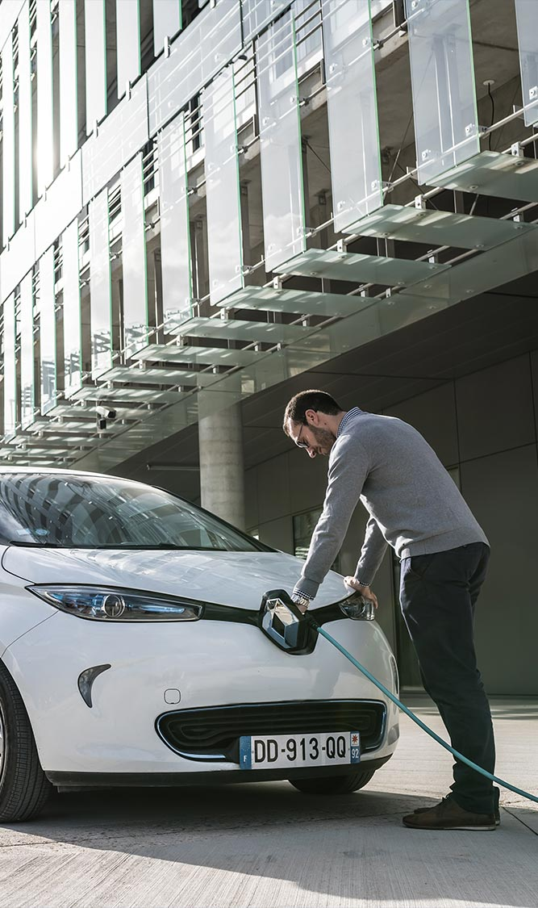
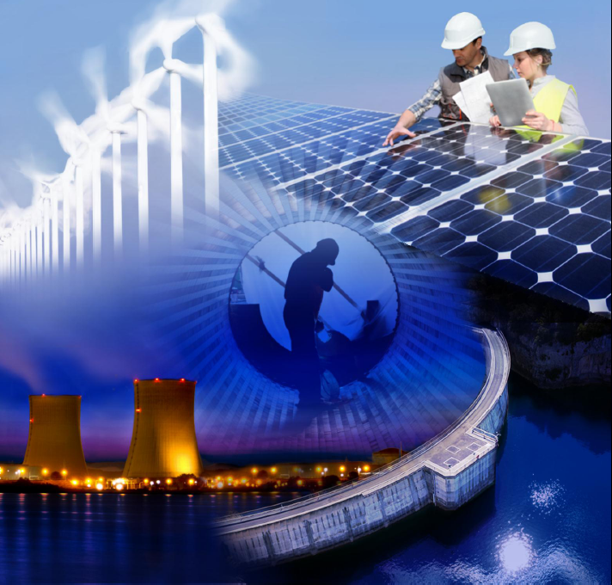

EDF key figures and strategy

Slide 3
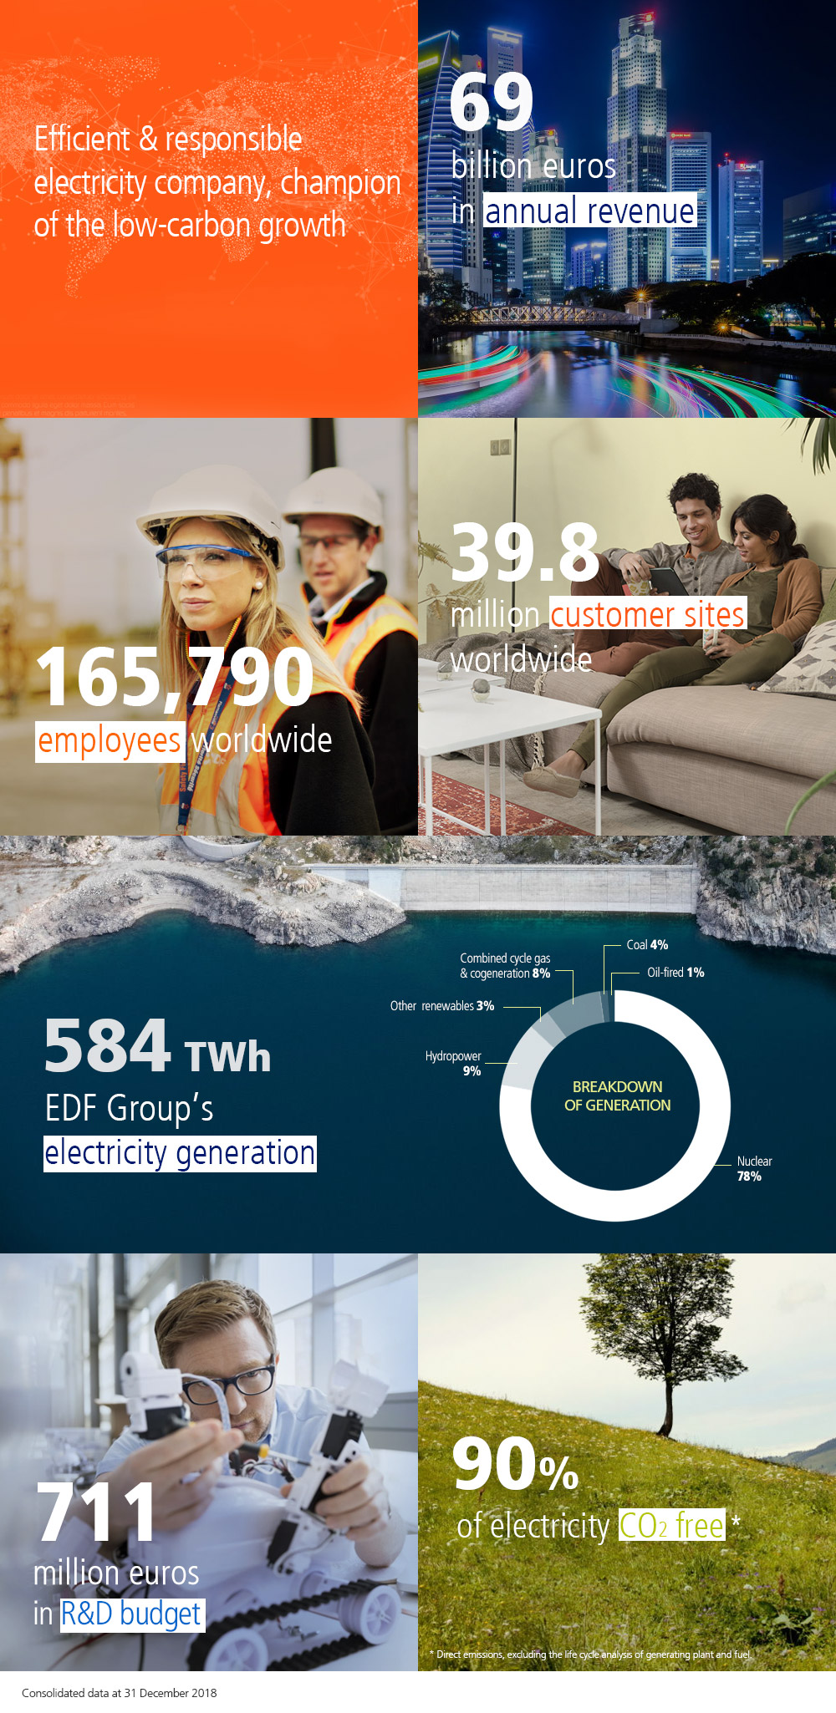
EDF at a glance
WORLD’S No. 1 ELECTRICITY COMPANY
Established in Europe, especially France, the United Kingdom, Italy and Belgium
Diversified low-carbon energy mix based on nuclear power and renewables
LEADER IN LOW-CARBON PRODUCTION
No. 1 producer of nuclear electricity in the world
No. 1 producer of renewables in Europe
No. 3 European operator of energy services
EDF COVERS ALL ELECTRICITY ACTIVITIES
Generation
Transmission and distribution
Supply
Energy services

Slide 4
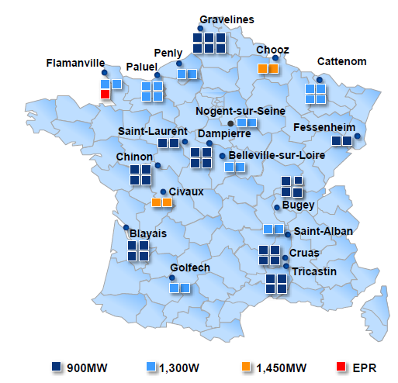
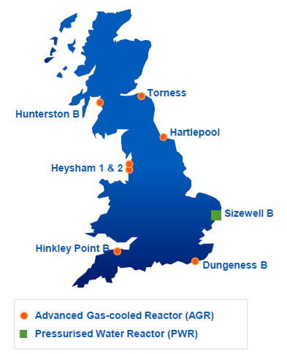
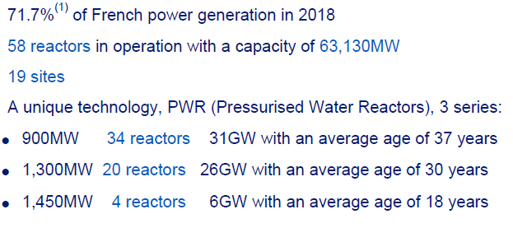
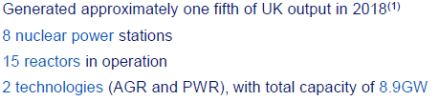
About EDF nuclear fleet
Largest fleet in Europe

Slide 5
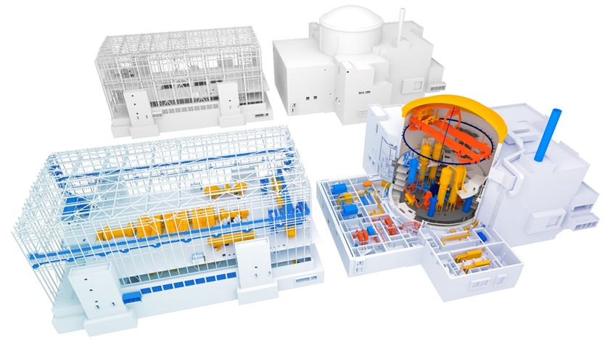
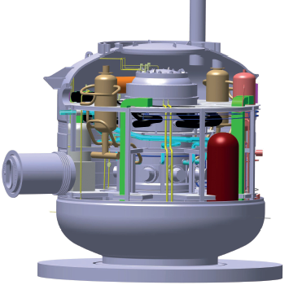
Nuclear by 2050
A turning point in the overall energy policy
President Macron’s announcements for Nuclear in France :
6 new EPRs (« EPR2 » , an optimized version of EPR) + 8 others as an option for studies
SMRs
Operation of existing NPP up to their safe technical end of life
Drivers:
Net zero by 2050
RES are not sufficient enough for a safe, reliable, affordable, and resilient source of energy Nevertheless, they are part of the game, and a strong growth of PV and offshore wind is now on the stage
Gas is expensive and carries strategic issue
Walking on two legs, Nuclear together with RES, is the most safe, reliable, affordable, and resilient solution.
European Taxonomy allows such a solution
Gas is also authorized by the EU taxonomy, but it will have to decrease sharply is CO₂ emission (CCS-CCU) in a near future
CCS : some solutions are mature, but market conditions are not yet there in Europe (CO₂ price, transport & storage infrastructure, regulation, public acceptance) - CCU : solutions still under development, not fully industrial yet

Slide 6
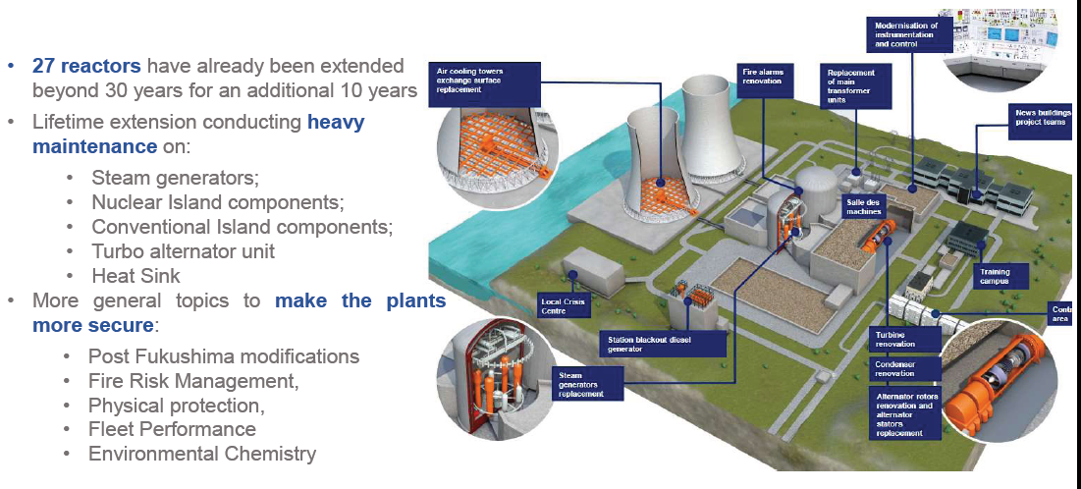
About EDF nuclear fleet
French reactors major overhaul to extend lifetime beyond 40 years

Slide 7
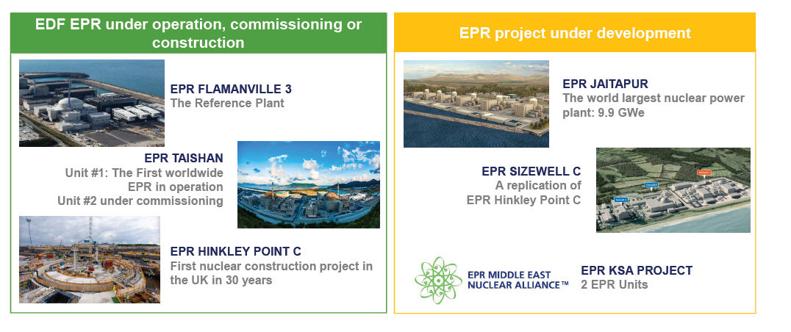
About EDF nuclear fleet
New build projects worldwide

Slide 8
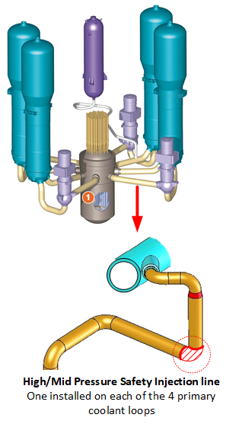
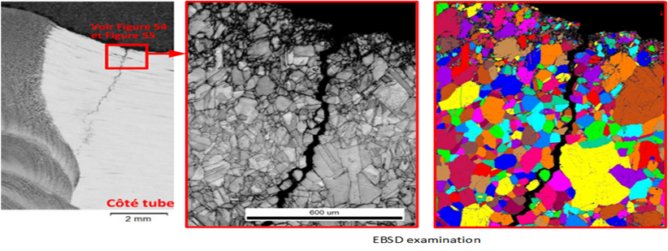
Stress corrosion cracking in French NPP
Detection of stress corrosion indication impacts the availability of the nuclear fleet
On CIVAUX (REP900 MW) Unit 1, PENLY (REP 1300MW) Unit 1, many welded joints have been examined and some flaws detected
Defects' characteristics don't match thermal fatigue criteria: intergranular path of defect
Pronounced strain hardening of surface layer of inner surface
No issue with pipe and elbow materials (chemical composition checked)
No pollutant detected (like chlorides, sulfates, etc.)
Stress Corrosion Crack in strain hardened material confirmed
Pipes have been cut for examinations in laboratory.
Samples from Civaux, Chooz, Penly 1, Flamanville 1, Chinon B3, Fessenheim 2
NPP unavailability will cost about 30 TWh
International feedback confirms :
The existence of this phenomenon, even if rare
Recent feedback in Japan – Kansai – Ohi NPP

Slide 9
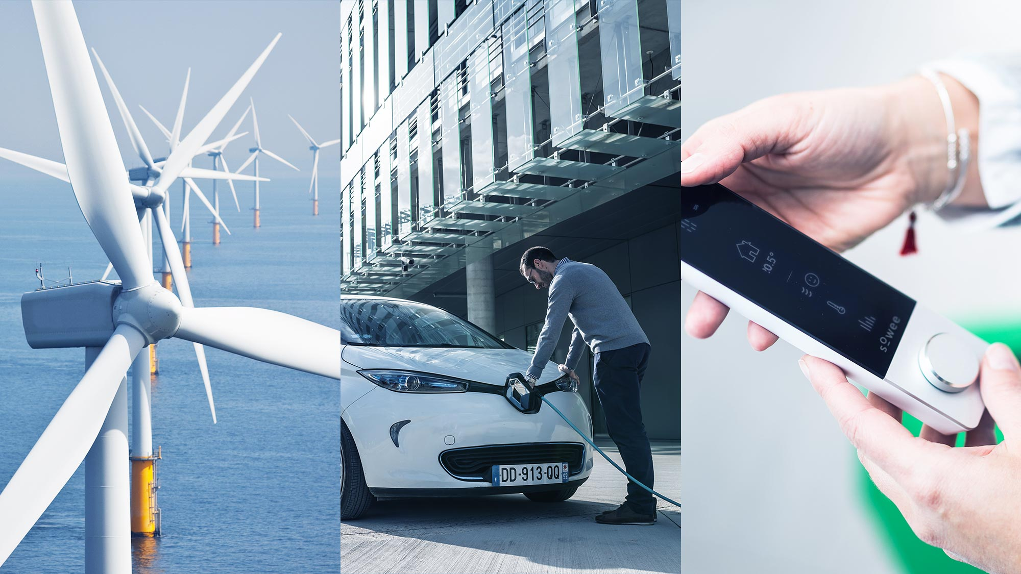

Introducing EDF R&D

Slide 10
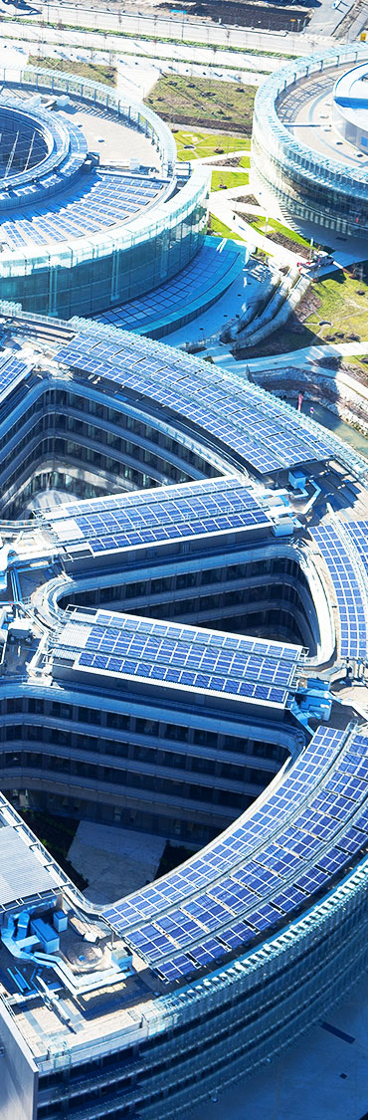
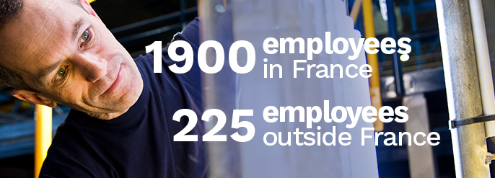



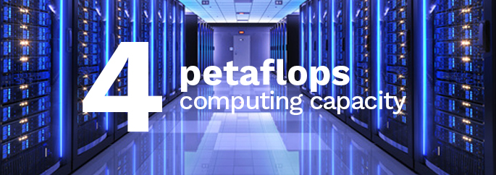

R&D in figures

Slide 11
EDF R&D
THROUGHOUT THE WORLD
With 3 centres in France and 6 abroad, EDF conducts research both nationally and at international level

Slide 12

SCIENTIFIC PLAN: THREE TRANSITIONS
ELECTRICITY TRANSITION
Energy storage for mobility and stationary uses
Electrification as a means of reducing carbon emissions (EV, heating / cooling)
Smart and sustainable cities and territories
Smart grids, digitalization
CLIMATE TRANSITION
An optimized electricity mix combining nuclear and renewables
Competitive renewable energy (solar, wind)
New competitive nuclear reactors including small modular reactors
DIGITAL AND
SOCIAL TRANSITION
Artificial Intelligence
Digital revolution at the service of our engineering and processes
The dynamics of social innovation

Slide 13


























EDF R&D PARTNERSHIPS
AND JOINT LABS
More than 300 partnerships with universities, research institutes and academic partners, and numerous international partnerships in order to meet business needs and find solutions to major research challenges.

Slide 14
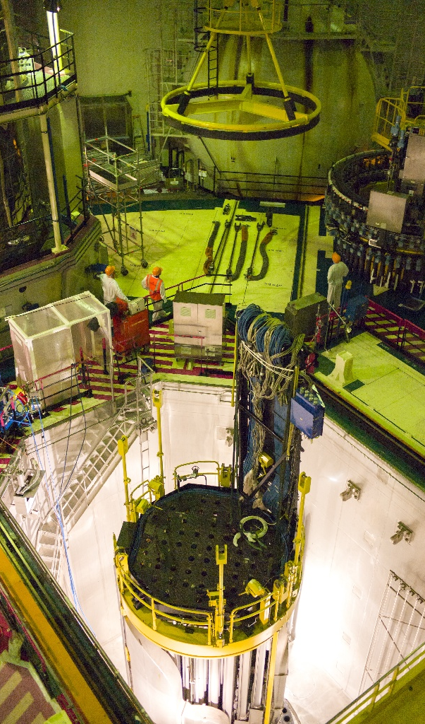
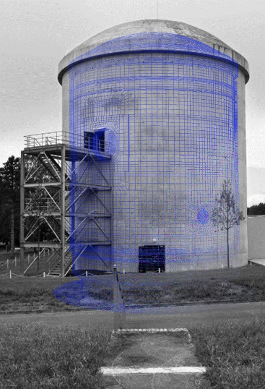
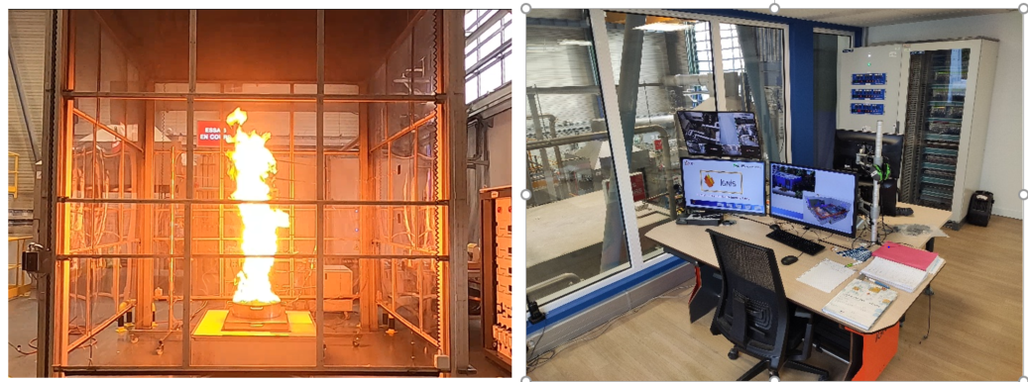
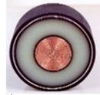
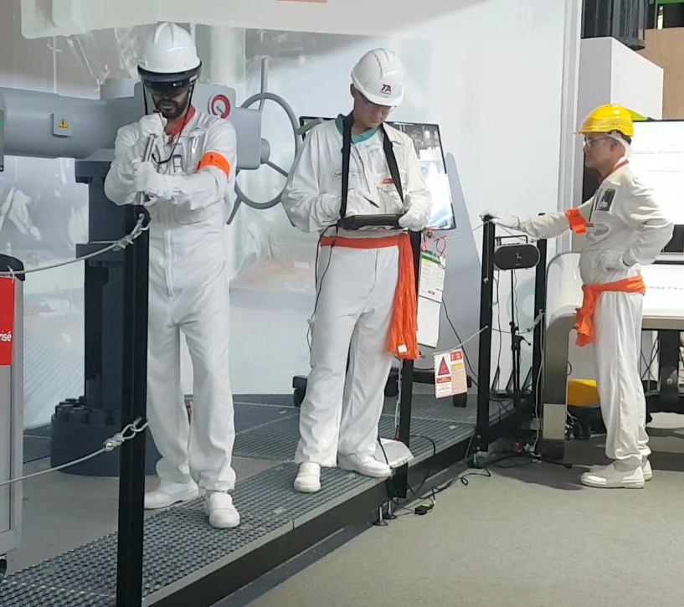
EDF labs and experimental facilities
Civil engineering, hazards, O&M, materials, digital twins
TOP
PRIORITIES
for Nuclear R&D
TOP
PRIORITIES
for Nuclear R&D
7
7
Safety
Performance
Long term operation
Fuel, waste & decommissioning
New reactors designs
Environment
Modeling & simulation
Safety
Extreme hazard and aggressors
Earthquake, flooding, lightning, icing,…
Seismic evaluation to address more stringent requirements
Fire temperature and smoke impact on i&c failure
Cybersecurity

Slide 15
What is AI and Data Science at EDF ?
+ 200 p.
Datascientists
Data analysts
Data engineer and ITarchitects
+ 40 uses cases
Nuclear
Hydro
Thermal
Renewable
HPC Infrastructure
Data Lake and private cloud
Cluster Hadoop
Data Analytics factory
Applications
Technologies
Digital twins for design and operation
Human Machine Collaboration Interfaces
Augmented reality for plant field workers
Predictive maintenance
Production planning and optimization
Drones/robots
Advanced manufacturing
Machine learning
Neural networks
Natural language processing
Graph theory
Multi physics/multi scale
Statistics
Real time computing
Reduction of models

Slide 16
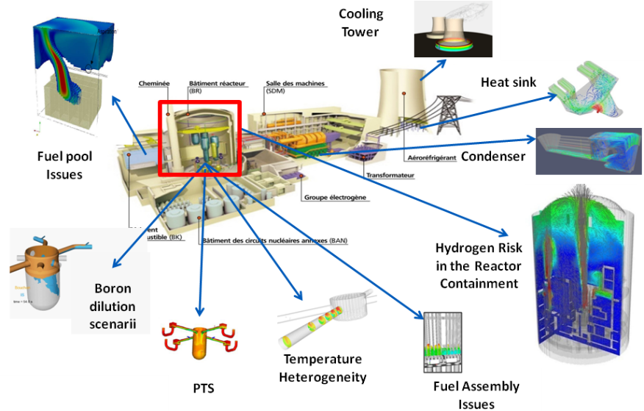



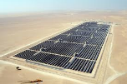







Modeling and Simulation
Thermal-hydraulics, free surface flows, mechanics, electromechanics, neutronics
MAGIC
Atmospheric dispersion
Renewables
Fire safety
SALOME_CFD
Polyphemus
Steam turbines
Services to Cities
THYC
CATHARE
elsA,
Khala

Slide 17
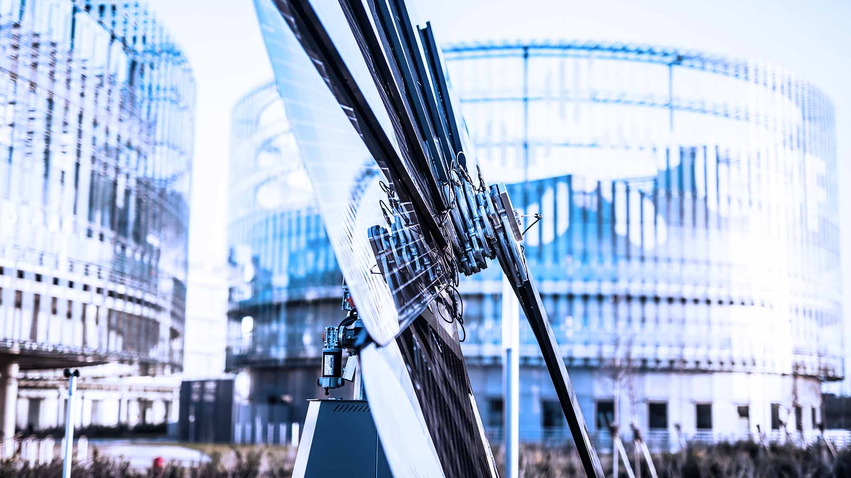
Thank You for Your Attention
Copyright EDF | 2019

