Slide 1

Distributed Fiber Optic Sensors
C. Filipe Ramos cf.ramos@cern.ch
Business Development
CERN Knowledge Transfer

Slide 2

Notes:
Big infrastructures at CERN. And they are dense too.
Example of CMD detector.
Packed to the brim with all sorts of detectors, particle trackers, cables, shielding, etc.
Many restrictions on space, not so much left for monitoring environmental parameters inside these structures.

Slide 3

Notes:
Optical fibre-based sensors are the answer.
OF are small enough to fit anywhere, and can run through hundreds, thousands of metres.
So we can use these fibres as a sensing element for monitoring environmental variables.
Work principle: Optical interrogator connected to the fibre
Sends light and monitors the reflected light

Slide 4
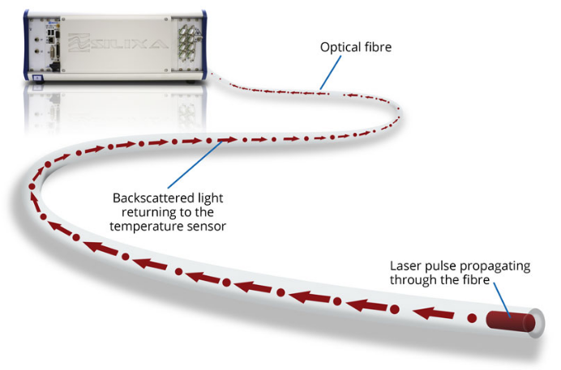
Using fiber optics as sensors:
Main advantages:
Distributed system
Remote monitoring
Robustness
Notes:
Physically modifying the fibre, which then becomes sensitive to specific changes in its surrounding
Thus, the quantity to be measured modulates a parameter of the light in the fiber (intensity, phase, polarization, wavelength or transit time).
This is picked up by the interrogator in the reflected light, and translated into a meaningful value
Advantages: possible distributed measuring system, possible multiplexing, lower cost
Remote sensing with no power needed at remote location
Robustness to other environmental parameters (radiation, magnetic fields)

Slide 5
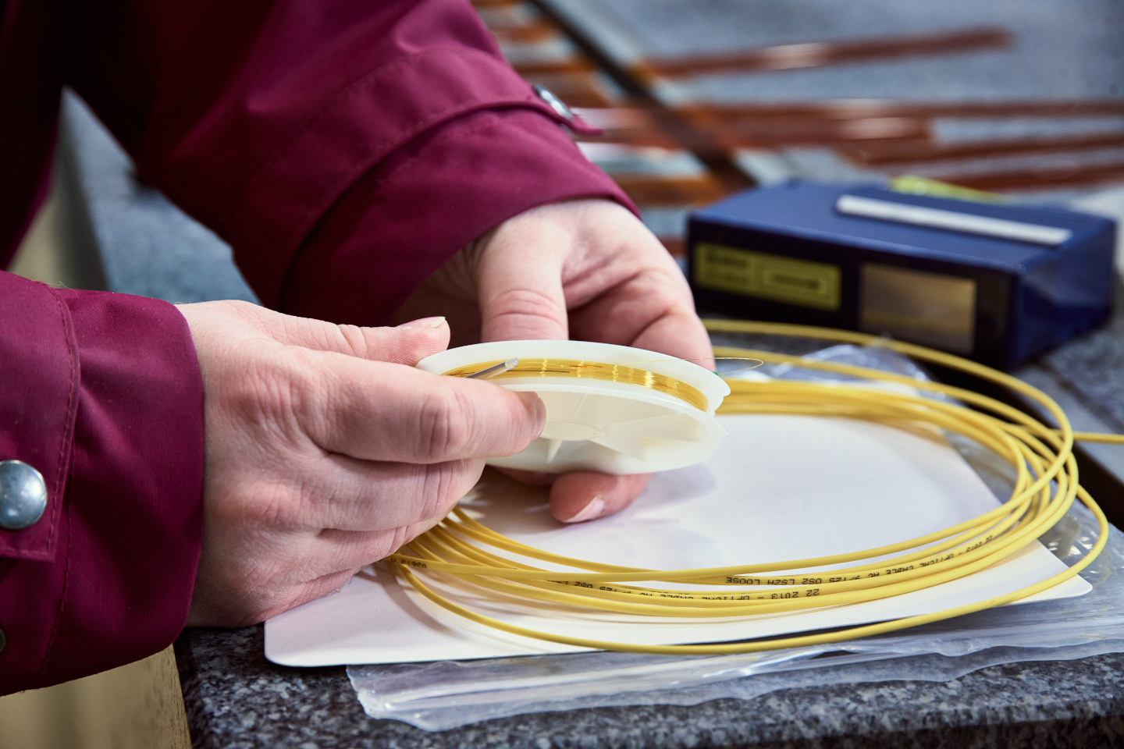
Using fiber optics as sensors:
At CERN are used to monitor:
Radiation dose
Strain
Relative humidity
Temperature

Slide 6
Using fiber optics as sensors:
At CERN are used to monitor:
Radiation dose
Strain
Relative humidity
Temperature
Notes:
High levels of dose
Currently between 100 Gy and 1 Mgy
Price drops tenfold comparing to existent solutions (which go only to ~kGy)
Reusable – Radiation Induced Attenuation is inevitable in radiation environments, saturating the fibre and reducing performance
Photobleaching is possible – shining a specific wavelength to reset the fibre to the initial state
No need for replacement, fibers can be reused without affecting significantly the original calibration

Slide 7
Using fiber optics as sensors:
At CERN are used to monitor:
Radiation dose
Strain
Relative humidity
Temperature
Notes:
Sustains very low temperatures, down to 1.9 K, and very high Magnetic fields
One can monitor the stress applied in the material close to the fiber, thus allowing for Structural health monitoring of structures
Through a distributed system

Slide 8
Using fiber optics as sensors:
At CERN are used to monitor:
Radiation dose
Strain
Relative humidity
Temperature
Notes:
Extensive studies and tests for correct assessment of these parameters, which led to a novel method that does not require modification of fibers.
Not just for environmental monitoring (e.g. near critical components, within detectors), but also structural health monitoring when incorporated within the material, as it can detect faults and cracks.
Cement curing trial – initial proof of concept for monitoring the curing process and also to remain as structural monitor.

Slide 9
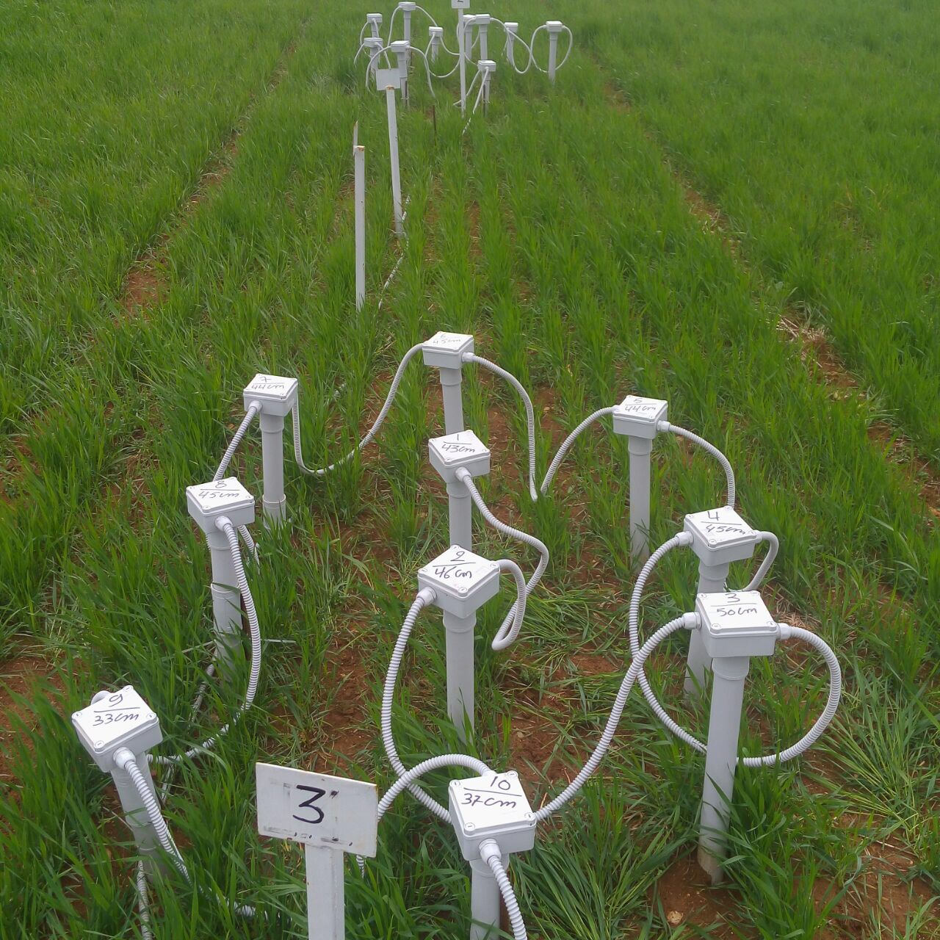
Notes:
Example of distributed environmental monitoring/application
The expertise in RH-sensing optic fibres was introduced in a sustainable agriculture project, which allowed for precise measuring of water content in soil, together with insight on soil constituents

Slide 10
Questions?
C. Filipe Ramos cf.ramos@cern.ch
Business Development
CERN Knowledge Transfer

