Slide 2
HFM Organisation meeting

Slide 3
Outline
Organisational structure (reminder)
Meetings
EDMS Structure
BC Structure
WP implementation plan

Slide 4
Organisational structure
The proposed organizational structure comprises the following bodies:
      HFM Steering Board
      Collaboration Board
      HFM Advisory Committee
      HFM Management and Coordination Board
      Project Office
      Technical and Scientific Committee
      Structure of R&D Line Fora with Work Package breakdown

Slide 5
HFM Project Collaboration Structure

Slide 6
Meetings (1)
HFM | Mandate of the meeting | Frequency | Participants
HFM Steering Board (HFM SB) | The HFM SB oversees the execution of the HFM Project and makes high-level strategic decisions. The HFM SB reports to LDG. | Twice a year | Up to 10 people: The CERN ATS Director as the ex-officio member; The CERN TE Department Head; Two expert members nominated by the ATS Director; The Chair of the HFM Collaboration Board; Up to two further members from among the participating institutes, appointed by the HFM Collaboration Board, to ensure appropriate technical and geographical diversity; The HFM Project Leader (without voting rights).
Collaboration Board (HFM CB) | The HFM CB mandate is to discuss the strategy and the scope of participation to the HFM Programme. | Twice a year | The Collaboration Board is composed as follows: One representative per institution that, having signed the HFM MoU , contributes to the HFM R&D Programme. Their participation is approved by the HFM Collaboration Board; A representative of CERN as one of the participants in the HFM R&D Programme. The HFM R&D project leader
HFM Advisory Committee | The HFM Scientific Advisory Committee closely follows and reviews the scope and progress of HFM programme, giving scientific and technical advice to the HFM Steering Board, HFM | Once a year | The Scientific Advisory Committee consists of up to 6 international experts who are not directly involved in the HFM Programme and have renowned expertise in one or more scientific and technical domains relevant to the HFM Programme

Slide 7
HFM Project Work Packages and RD Line Fora

Slide 8
Meetings (2)
HFM | Mandate of the meeting | Frequency | Participants
Technical and scientific committee (HFM TSC) | The HFM Technical and Scientific Committee as the executive body for the technical and scientific matters oversees the follow-up of implementation of the technical work comprised within the scope of each RD Line and Work Package. | Quarterly per RD line Plenary meetings if required | Chaired by the HFM Deputy Project Leader (or PL) and includes: the CERN RD Lines Coordinators, the Work Package Leaders CERN Liaisons as well as other key players in the execution of the HFM R&D Programme
Management and coordination board (HFM MCB) | The HFM MCB is the executive body of the HFM R&D Programme The HFM MCB is responsible for the implementation of the work plan established within the scope of the HFM Programme. The HFM MCB is also responsible for setting up and overseeing all bilateral collaboration agreements with the collaborating institutions. The HFM MCB makes strategic and key technical decisions and allocates appropriate resources in the field of bilateral liabilities with all external entities. | The frequency of meetings will be according to the needs, typically quarterly. | Chaired by the HFM Project Leader, and includes the RD Line coordinators according to the agenda,
Project office | The Project Office manages all administrative and coordination aspects of the HFM R&D Programme, including preparation and running of meetings, administrative follow-up of collaboration agreements, budget and planning follow-up, reporting, documentation, and archiving. | Every two weeks | Caired by the PO leader and includes: the HFM PL the DPO the TE DPO and DDPO The HFM admin. Assistant The FAP link person
Thematic RD Line Fora | The RD Line Fora are thematically focused and topically complementary, so that the structure allows the efficient exchange of information facilitating advancement in each individual domain, whilst ensuring harmonisation, synergies, and oversight of each R&D domain. | The frequency will be as required by the WPs, typically once a month. | The RD Line Fora are led by coordinators appointed by the HFM PL.

Slide 9
Meetings (3)
The meetings will be created in Indico. The Indico categories will follow the HFM organizational structure
The minutes will be uploaded in EDMS
RD Line coordinators and WP Leaders will organise their technical meetings. WP Leaders will report the progress at the TSC meetings (current status, potential issues and actions, deviation with respect to the agreed implementation plan, detailed plan for the next three month)

Slide 10
HFM EDMS structure (1)
A structure has been defined HFM | Project CERN-0000212426
This structure follows the HFM project organization
  RD0: mainly for the project office
  RD1…6: for the RD coordinators and WP coordinators
  The structure within each WP needs to be defined in collaboration with the respective WP Leader, while keeping standardisation

Slide 11
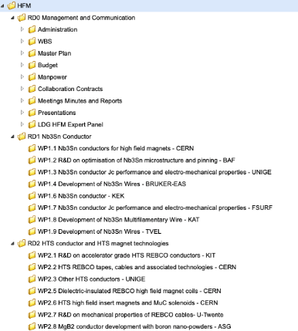
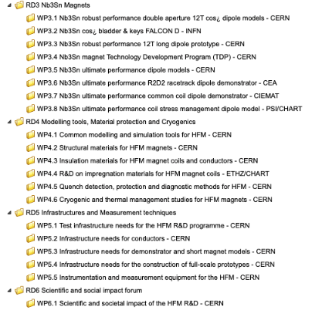
HFM EDMS Structure (2)
The HFM EDMS structure is the following
RD0
RD3
RD1
RD4
RD5
RD2
RD6

Slide 12
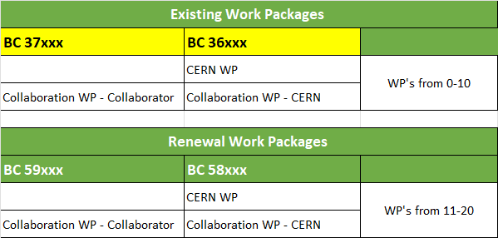
HFM BC Structure
A dedicated meeting will be organised upon completion of the BC creation (currently under way)
Example of a CERN WP
Example of a Collaboration Agreement WP

Slide 13
WP implementation plan
CERN work packages: a template (divided in 3 sections) is proposed to summarise the main tasks, the milestones and the timeline with budget (M + P) profile
Cross-work-package tasks are of importance and need to be defined by WP Leaders
Collaboration work packages: the collaboration agreements are the relevant documents. In case of deviations to the original contracts, amendments need to be prepared and approved by the HFM PL

Slide 14
Template for the CERN WP implementation plan (1)
1
2

Slide 15
Template for the CERN WP implementation plan (2)
3

