Slide 1
Drag chain trials for cluster F
WP6a internal meeting 2022
Marcin Curylo
HL-LHC WP6A – 22/04/2022

Slide 2
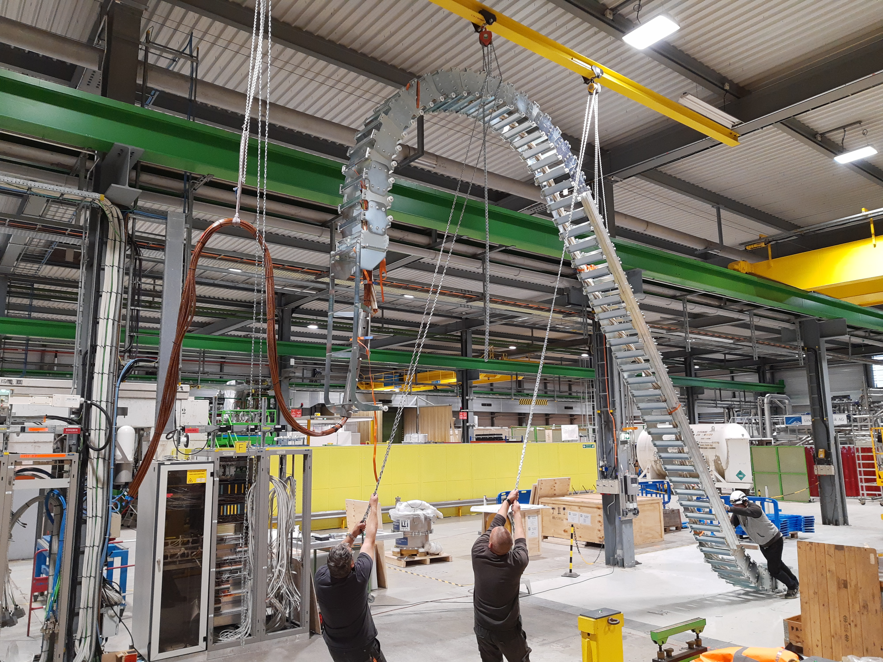



3 hoists (1 for cable, 2 lifting points for drag chain, )
Representation of
6 m NbTi cable
(~ Φ72 mm)

Slide 3
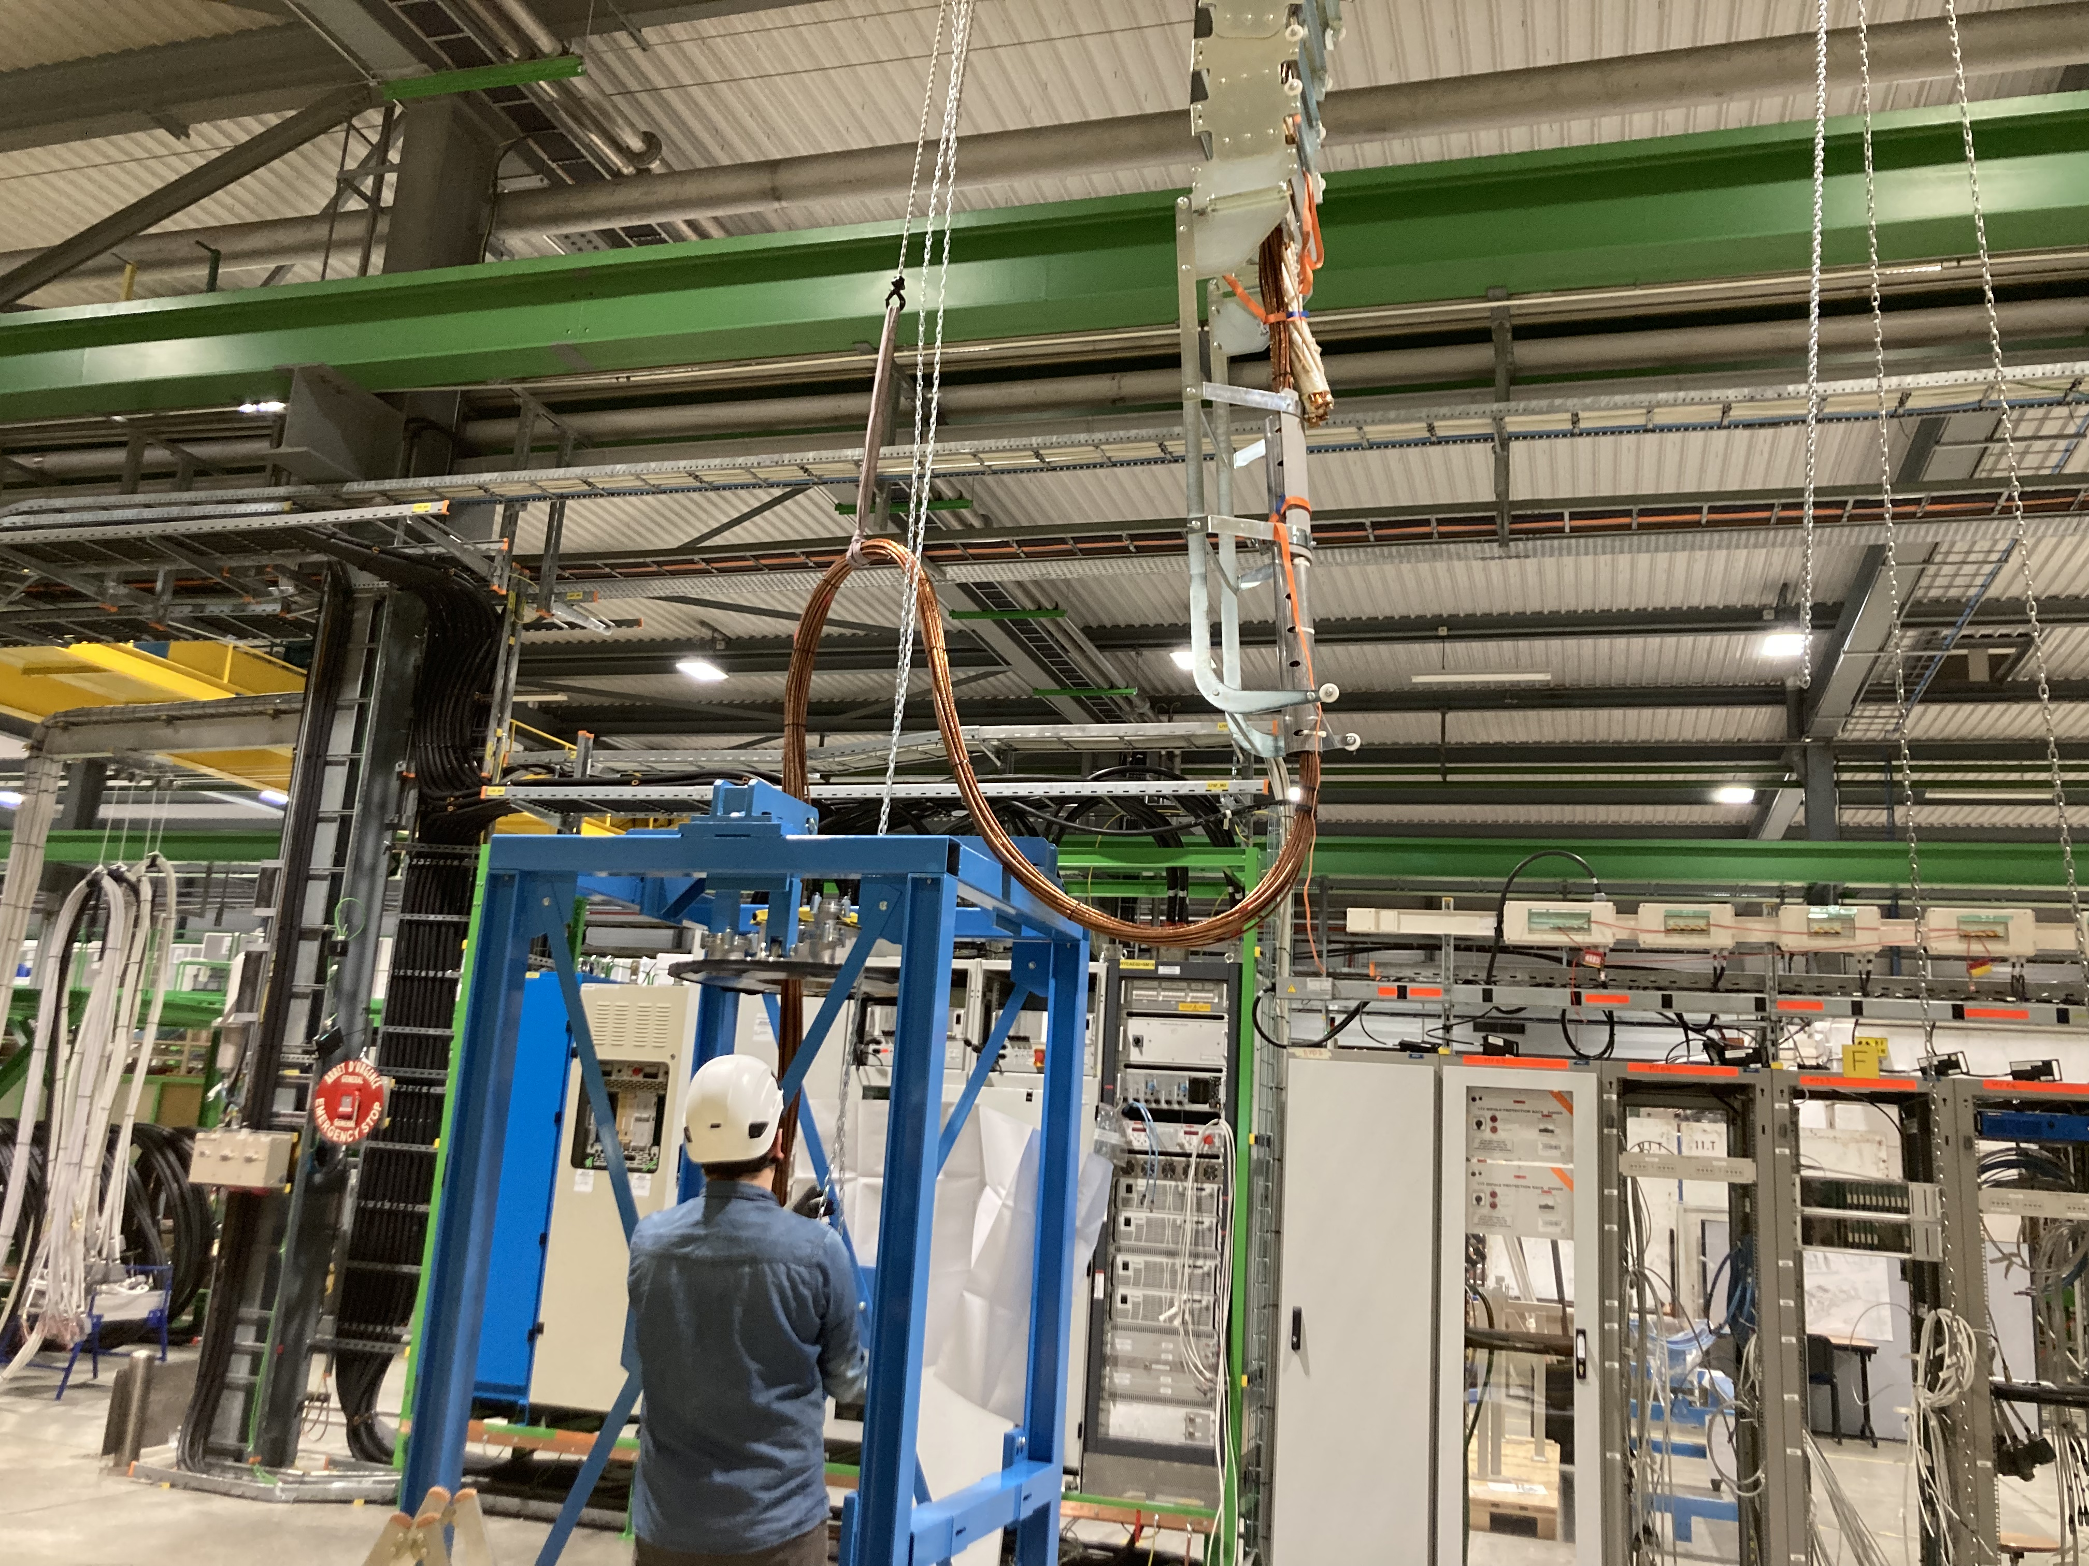
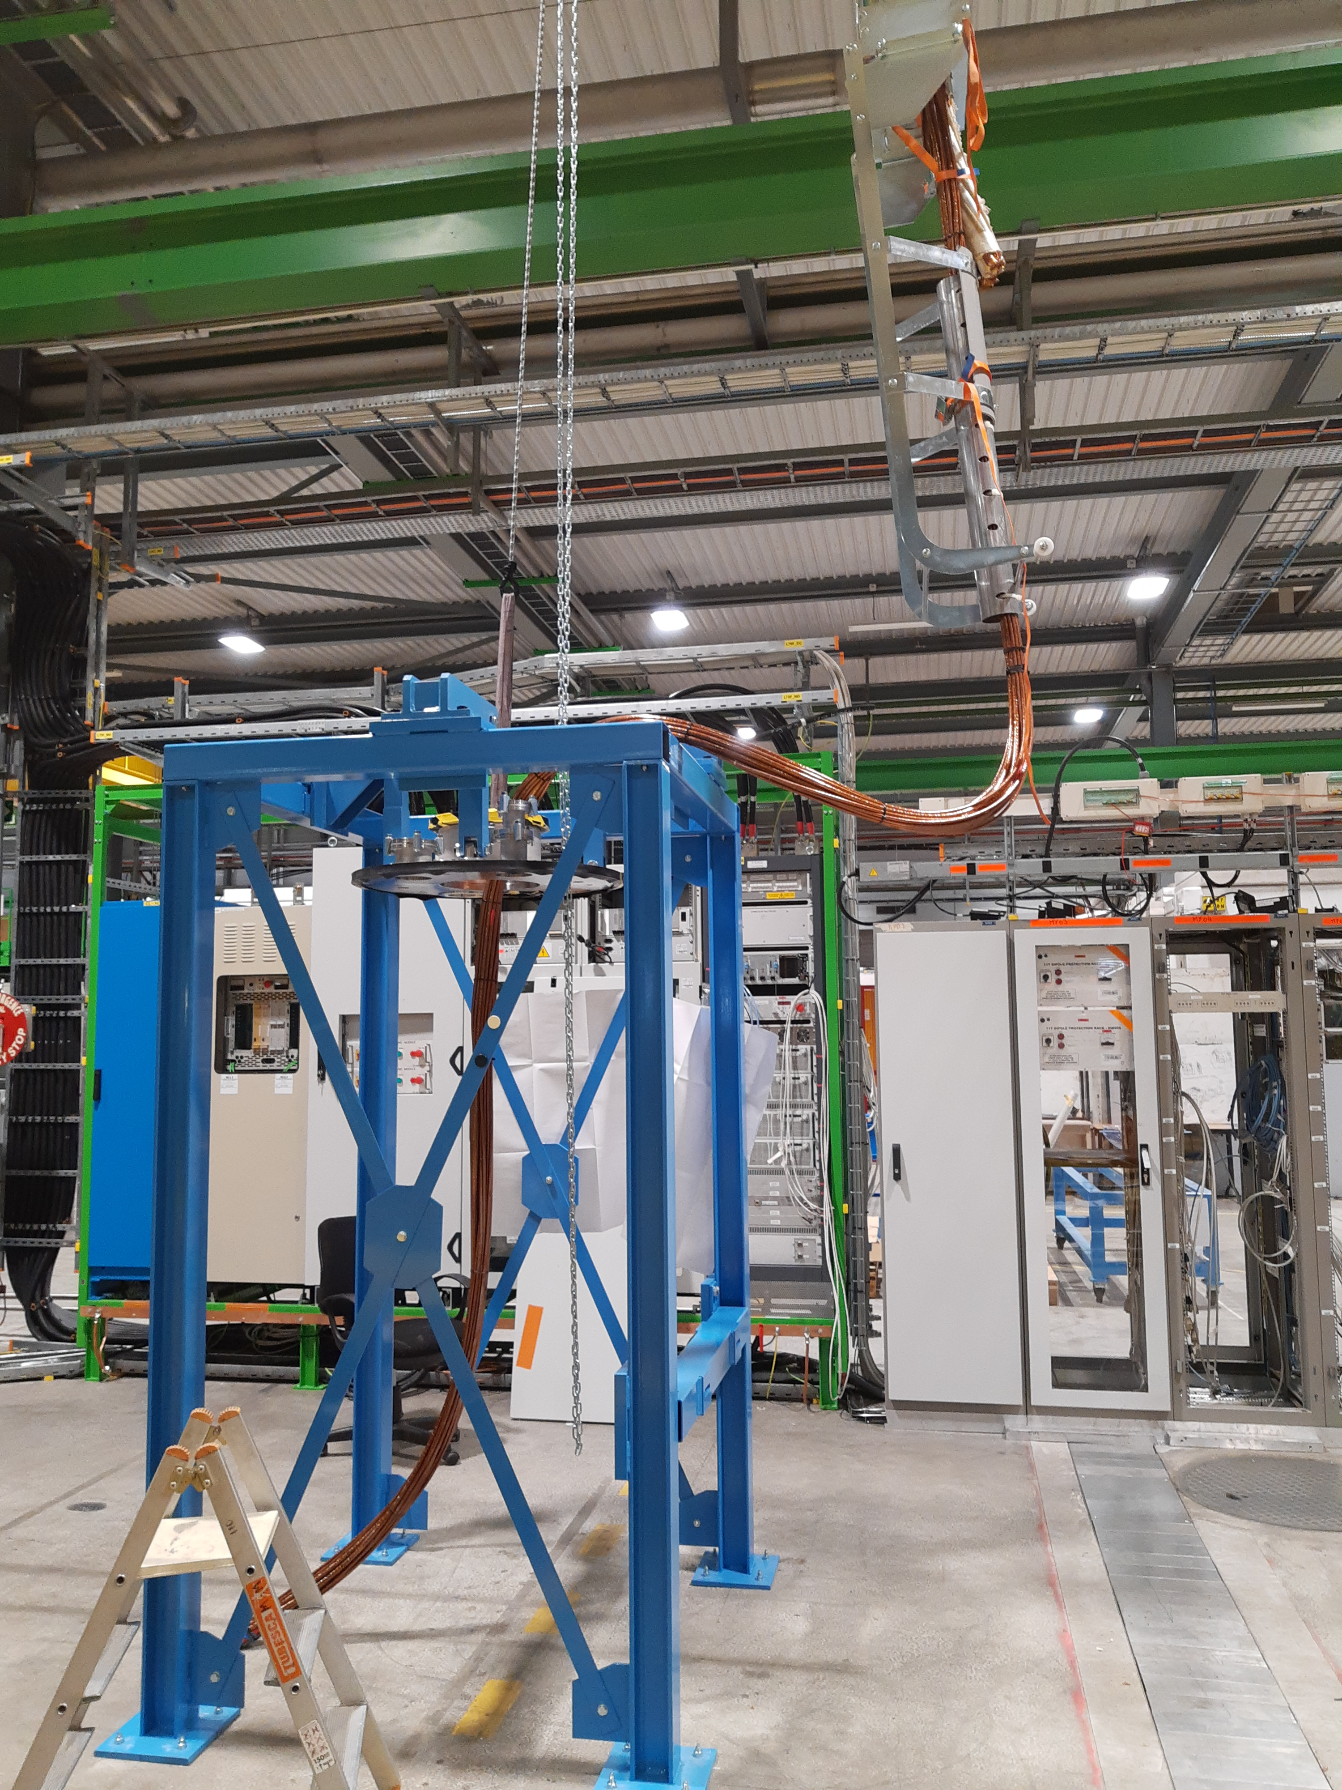
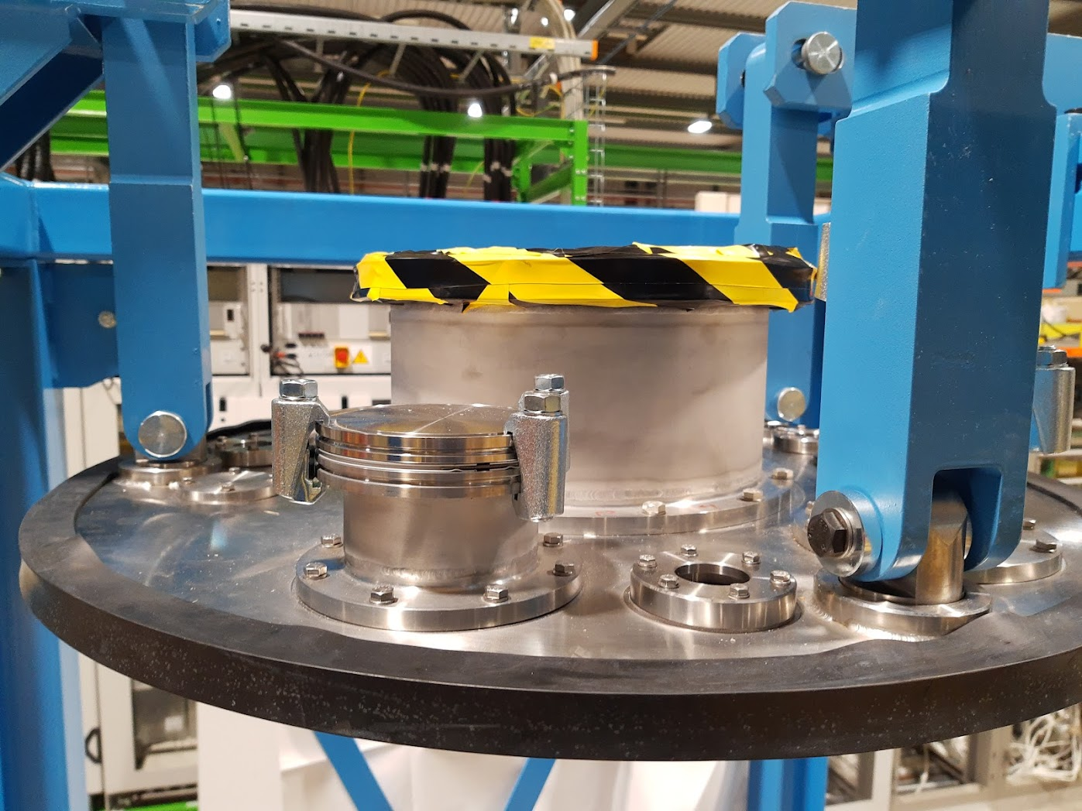
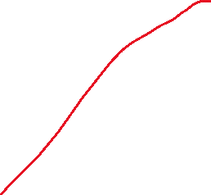
Interface top flange DFX

Slide 4
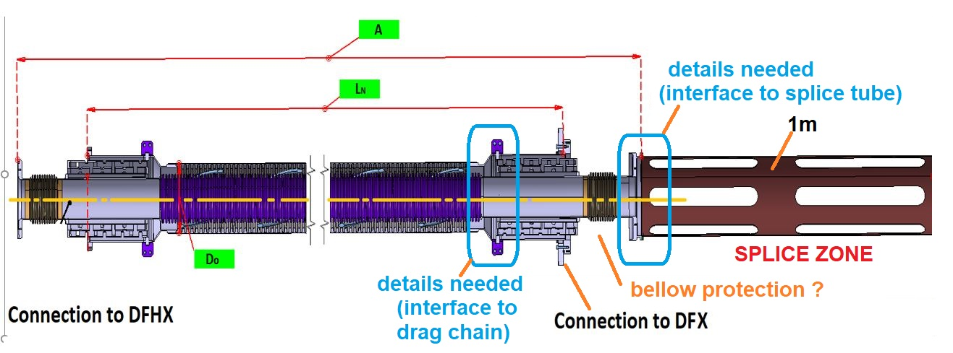

Slide 5
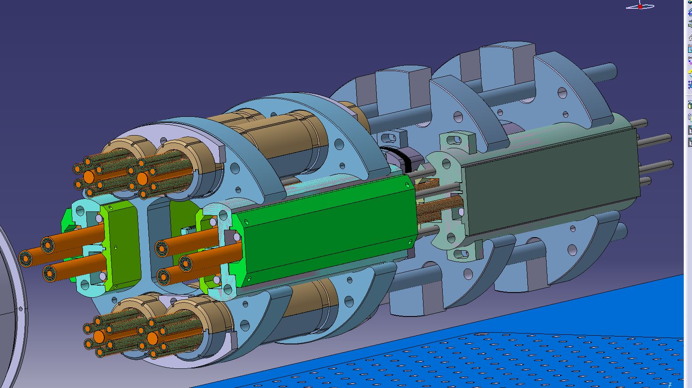


Slide 6
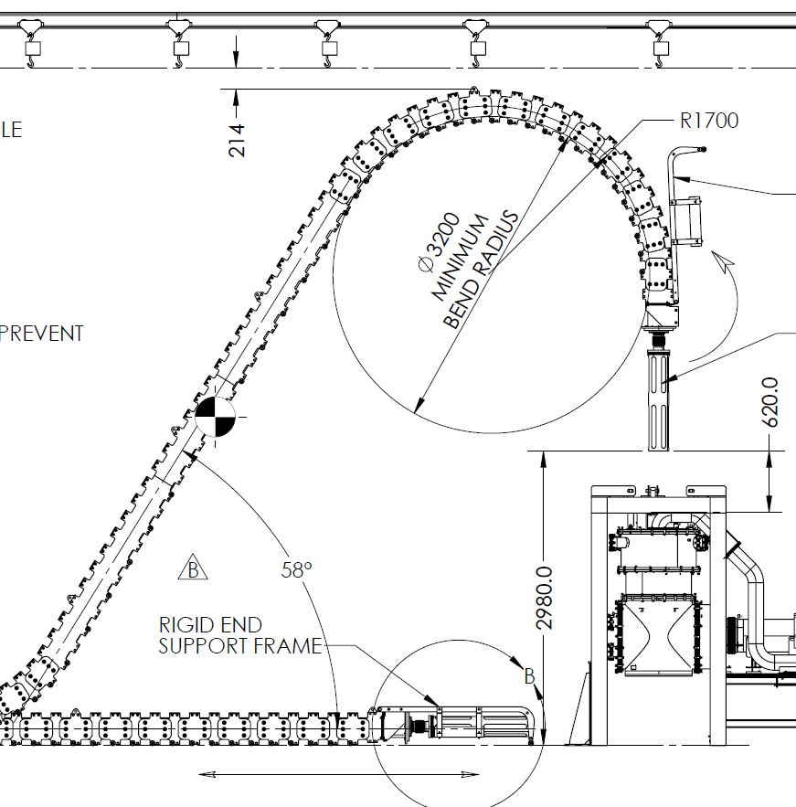


Removal or new part

Slide 7
Future steps:
- Drag chain termination modification (Erik ? )
- Interface between DSH cryostat and drag chain (to clarify)
Connection tube for splice + reinforcement for bellows (Robin, Yann ?)
Additional tools to keep bending radius of NbTi cable
( min. bend. Radius Φ 300 mm ? )

