Slide 1
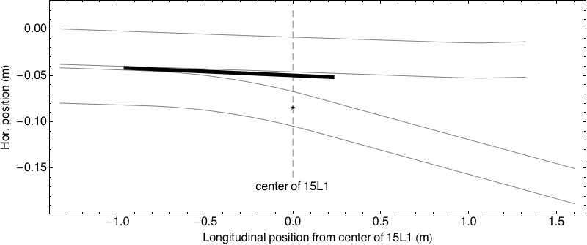
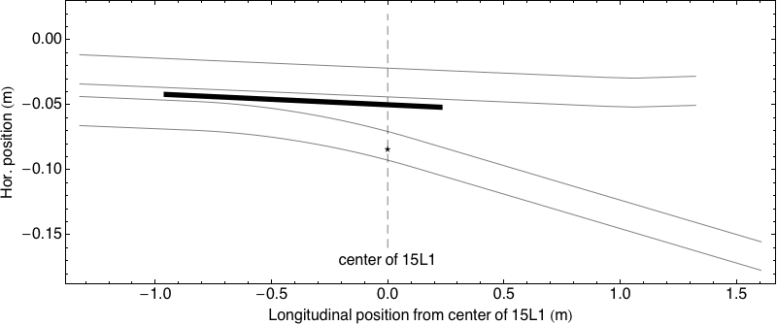
PPM Modulation of the PSB to PS Transfer Energy
A cost effective PSB Upgrade Option
BTP upgrade for PPM operation
  Moderate cost, operational flexibility
  Bright LHC beams delivered to PS with 2 GeV
  Other beams transferred to PS with 1.4 GeV
Ejection and recombination of LHC beams at 2 GeV possible with present kickers (savings)
Transparent for other beams in the Booster
  No issues with bunch splitting of high intensity beams at 2 GeV (short flat-top and slow synchrotron motion)
  No impact on radiation issues at PS injection
Solution for PS injection of high intensity beams at 2 GeV not yet found
Issues related to rms current of PSB power supply mitigated
Possible impact of PSB 2 GeV upgrade on magnet life-time mitigated
circulating beam (with bump)
septum
ejected beam
Booster ejection of high intensity beams
at 1.4 GeV (present situation)
Booster ejection of LHC beams at 2 GeV
With existing kickers
- smaller kicks sufficient for small beams
- stronger ejection bumpers required
- recombination similar

