Slide 1
Status of ELQA equipment
and related software
Reference document (EDMS 788197):
  Recall of ELQA tests and terminology
Status of the hardware
Status of the software
Long shutdown activities:
  ELQA campaigns
  R2E & Collimators in P3

Slide 2
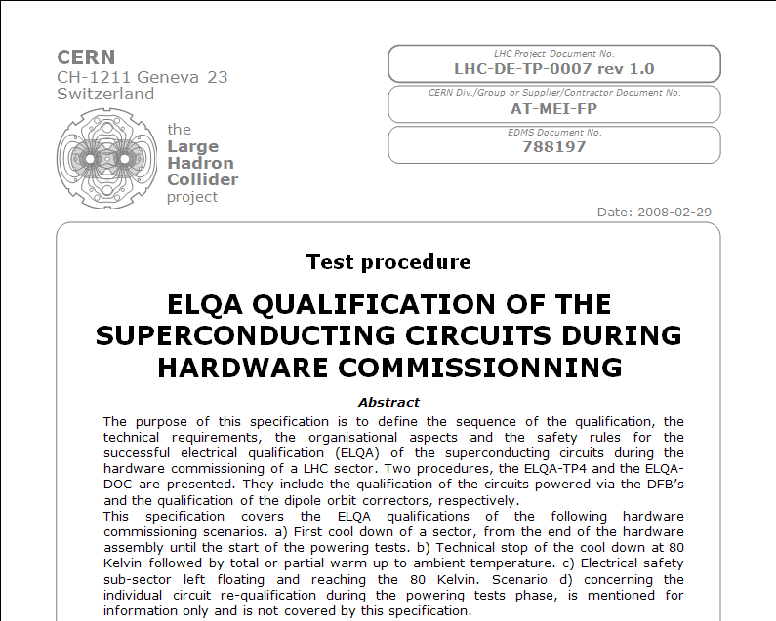
This document is being revised:
  To add MIC tests
  To revise voltage levels for HVQ
  To refine the cryogenic conditions for each tests
  To add new scenarios (ex. partial warm up of a sector)

Slide 3
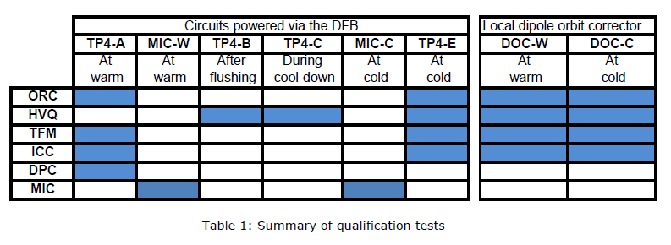
ELQA standard tests during HWC
Needs for diagnostic in case:
During ORC, we find an open circuit at warm or open/resistive circuit at cold?
During HVQ, we find a frank short/breakdown at warm at cold?
During MIC, we found a broken voltage taps or a defective quench heater (open or too resistive) at warm, at cold?

Slide 4
Standard scenario
Metallic debris found in dipole’s diode pot after flushing! Is it the end of the story?
See Mateusz presentation for details
HV monitoring RB, RQD, RQF & Spools... We are studying the possibility to measure more circuits
Should we need a special scenario before the long shutdown?

Slide 5
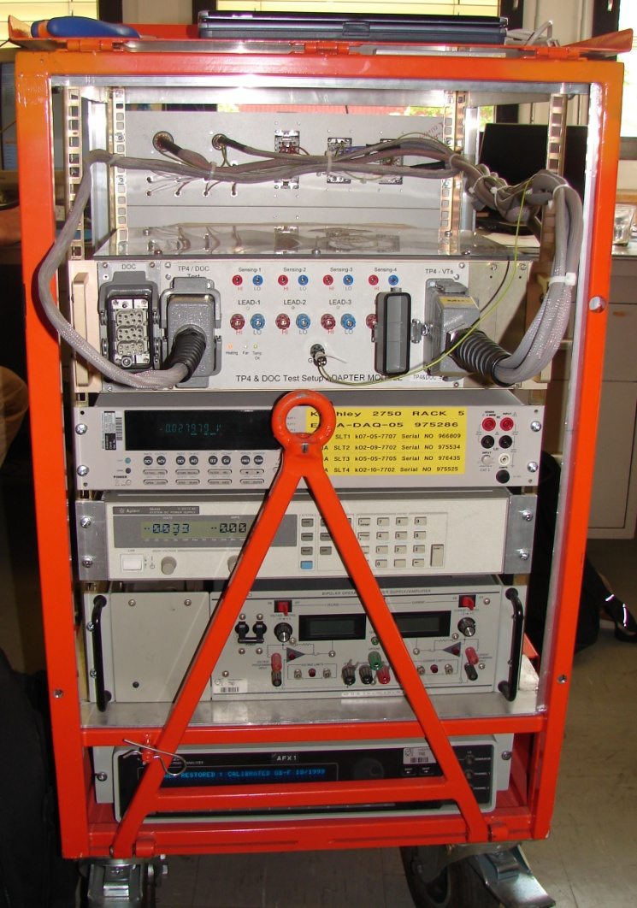
Hardware (1/3):
TP4 systems
We have 4 such mobile systems designed
to do all TP4, DOC and MIC tests
Limitation: Max. 8 teams if 2 shifts a day!
Critical: The Matrix box is “home made” (= black box) built by the Polish collaboration (3 PCBs inside), No spare parts!
We should build 2 more TP4 in order to have:
An improved version of this matrix box
  To have spare parts
  Easier logistics (transport = risk of damaging our racks)
Work is on stand-by:
We are waiting for the renewal of the Polish collaboration agreement!

Slide 6
Hardware (2/3):
TP4 systems
Rest is off the shelf equipment but is ageing: Keithley 2750/E (x9)
HP power supply (x4)
Kepco Amplifier (x4)
We are buying 6 x “GP-102” Frequency Response Analyser from Powertek UK to replace our Solartron SI-1253 for TFM measurements => New possibilities.

Slide 7
Hardware (3/3)
Laptops: The older ones will need to be replaced.
HVQ « Long live crate » used for TP4, DOC, MIC, HVQN, PAQ and Monitoring (20 crates): Not a issue!
Racks that were used during the assembly phase:
  AIV1, AIV2: 2 systems available: Too few?
    We could use our TP4 systems (would need new software)
Hardware for diagnostic:
  Time Domain Reflectometer, Megger TDR2000/2
  Digital Low Resistance Ohmmeter, Megger DLRO 10
  2 NI-PXIs: Presently used for IRSM measurements on IPQs (Multipurpose)
  We want to buy 2 oscilloscopes

Slide 8
Software
Migration to Win 7 should not be a problem
Upgrade of all our applications to the latest version of LabVIEW (LabVIEW 2010) should not be a problem for TP4, DOC, MIC, CHVQ applications
Older applications like AIV, PAQ, HVQN (more than 5 years old) needs to be rewritten
The Matrix box in TP4 systems is strongly interdependent with all our applications
  A modification of the matrix box will imply re-witting all applications
  => Polish collaboration
ELQA Oracle DB up to date (needs to be maintained)
  All data from previous campaigns are available from our web site
  Needs to develop new tools for data extraction

Slide 9
Activities during next long shutdown
Rework of 13kA Splices :
  At places where TE/MSC will replace a magnet:
  We will need to redo AIV1, AIV2 and PAQ tests in close collaboration with TE/MSC group as during assembly phase.
  At places where only 13 kA inter-connexions will be redone (spools & Line N not touched):
  We need “only” to check the electrical insulation before closing the hydraulic connections (manchette).
  Full ELQA campaigns (at warm & at cold) before LHC restarts.
R2E:
Since this year, we are responsible for the current leads heating system:
Relocation of 3 racks (UJ14, UJ16, UJ56) => Order of non standard cable (thermo-couple),
re-commissioning the racks after relocation
Collimators in P3:
Displacement of DFBAE and DFBAF: All the equipment behind the current leads (transformers) including the PE crate will be moved to put a cryogenic extension link to the QRL => Cabling and re-commissioning

Slide 10
Thank you for your attention

