Slide 1
LHC Electrical/Instrumentation Drawings
Overview of development
S.Pemberton
Why do we need new drawings?
Objectives of the project
Implementation
Where are we now
Next steps

Slide 2
Why do we need new drawings?
The current electrical drawings available for the LHC only provide an overview of DFB/magnet locations and their respective powering configuration.
There is a need for more detailed drawings of all the electrical circuits, including elements such as:
Voltage Taps
Quench Heaters
IFS Interface Boxes
Presently, information on magnet design and their electrical configuration exists in many different forms of documentation. One of the biggest challenges of this project is to find and then integrate this information.
There are a lack of drawings in which splice information is clearly represented.
We currently do not have drawings that can be easily used for diagnostic purposes ‘in the field’.

Slide 3
Objectives
To create a comprehensive set of drawings for the LHC that incorporate detailed representations of magnet internals and instrumentation from the cold mass to the IFS box/PE.
The drawings should be as close to the ‘as built’ layout of the machine as possible.
To include all available splice information.
To create these drawings in a format that can be easily used by technicians for fault finding and thus provide points of reference during campaigns such as ELQA testing.
The drawings should reflect non-conformities.
Circulate these drawings for review and comments at various stages of their development to ensure they are legible and useful for a variety of users.
To have a complete set of drawings available to all departments before the next shutdown.

Slide 4
Implementation
AutoCAD is being used for the drawing construction. AutoCAD offers a system of design whereby different aspects (layers) of the drawing can be removed or added; hence, the user can easily tailor the drawing to their particular needs.
A selection of preexisting drawings containing various specialist aspects of the machine are used; to pull together layout, powering and splice information. These provide the platform on which the new drawings will be developed.
Through numerous discussions we now feel we have a balance whereby the level of detail does not compromise the legibility.
We have recently recruited a technician, Kevin Pereira, who has previous experience in AutoCAD, this will allow different aspects of design and production to run in parallel.

Slide 5
Where are we now?
I am currently responsible for the data gathering and design of the drawings. I will be overseeing and reviewing the production strategy as it evolves.
We have detailed drawings of two complete cells (C10L2 & C5R2)
These drawings are nearing graphical completion; however, we still have development to do around elements such as:
Naming Conventions (polarity and turned magnets)
Scaling
QPS
DFB Current Lead Layout
We are currently working on the layout and detail of the inner triplet right of
Point 2.

Slide 6
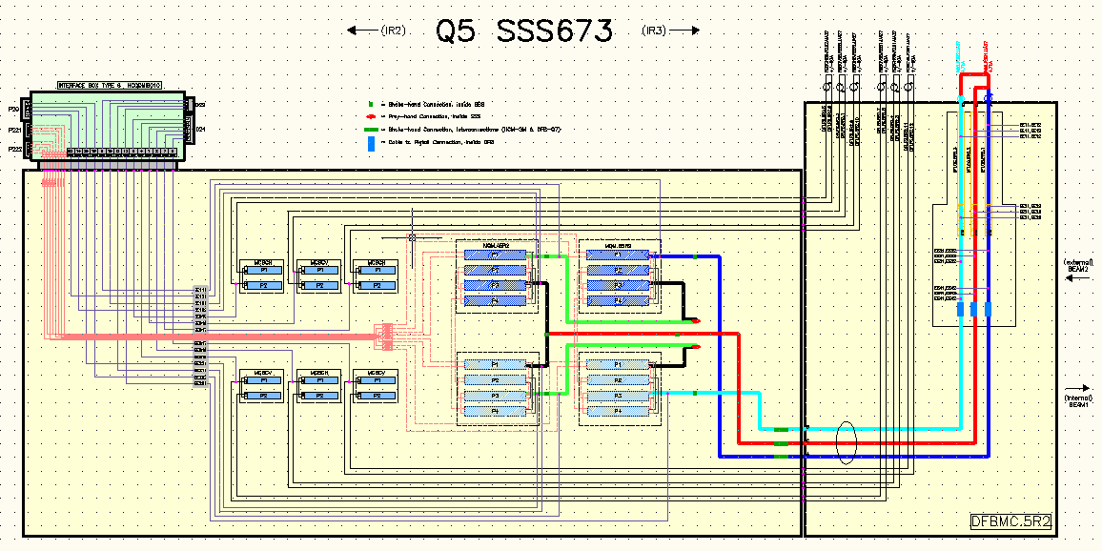
C5R2

Slide 7
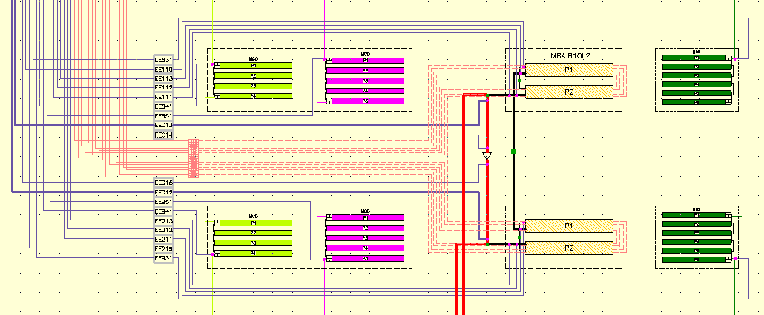
MBA Magnet Internals

Slide 8
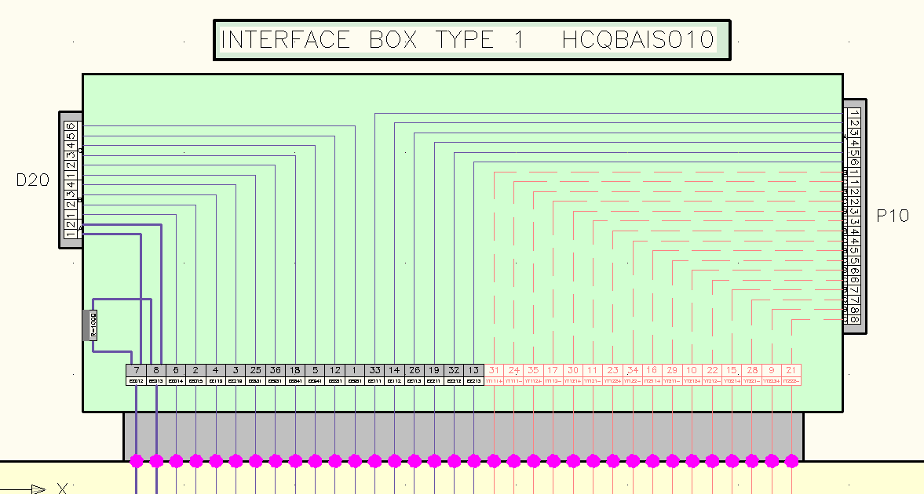
IFS Box for Main Dipole

Slide 9
Our next steps……….
Bring Kevin up to speed with the design, layout and production of the drawings.
Produce a regular arc cell drawing; this can then be duplicated rapidly while other aspects of design run in parallel.
Disseminate completed drawings for final comments and cross checking, this will ensure they are in-line with the collective needs of various groups.
As the process is still in its infancy we need to perform a review of our working methods at the beginning of the new year to try and optimise the process, we should then be able to forecast a realistic date for completion of all drawings (A current rough estimate would be 12-18 months for 2 people). N.B: At this point, I believe that the work can be completed within our section but this will be reviewed as the process matures.
Decide on the final method/format of distribution.

Slide 10
Thank you for your attention.
Any Questions?

